Slide 1
Notable Examples of Nativism
Colonial Times – Catholics
  Most Brits were Protestant and disliked Catholics
1840-1860 – Irish
  Disliked by “Natives” because they took jobs for very low wages
18o0-1940s – Chinese
  Disliked by “Natives” because they took jobs for very low wages
1920-30s – Eastern Europeans/Jews
  Seen as Communists/Anarchists, Took jobs for low wages
  STRICT anti immigration laws passed
  Leads to increase in ILLEGAL Immigration
1950s-Present Day – Mexicans
  High number of illegal immigrants
  Often denied citizenship requests

Slide 2
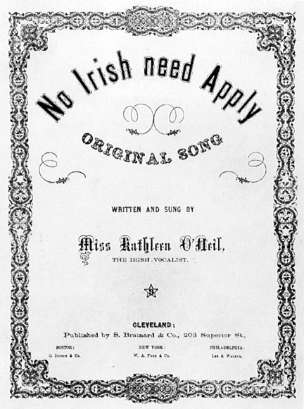
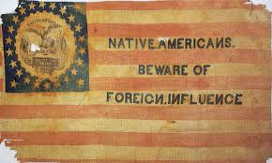
Anti Irish

Slide 3
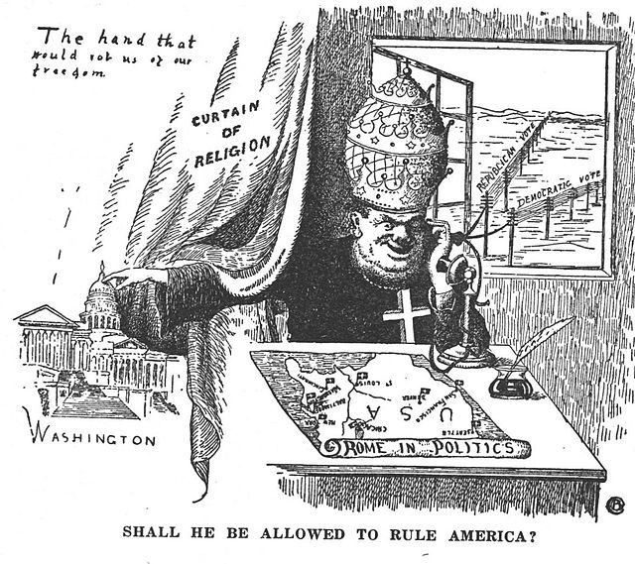
Anti Catholic

Slide 4
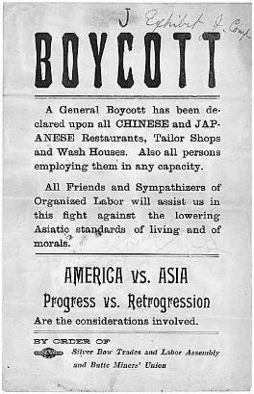
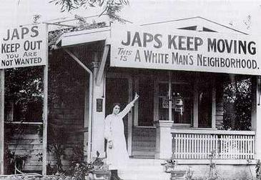
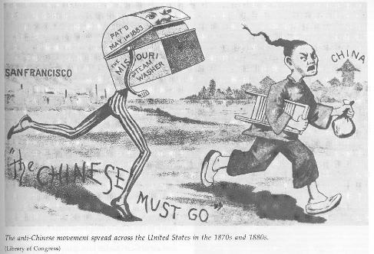
Anti Asian

Slide 5
American Colonies & Society
Citizenship & Government

Slide 6
Where Did the colonists who settled in the American colonies come from?
Mostly from England
Others from: Scotland, Ireland, Wales, Germany, Africa (slaves), Sweden
Some of the colonies were not founded by English people
  The Dutch started the colony of New York (was New Amsterdam)
  Sweden helped found what became Delaware and New Jersey

Slide 7
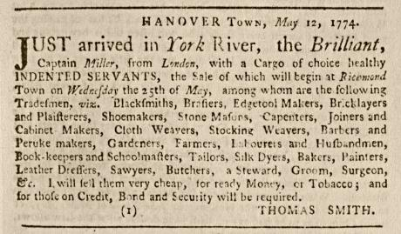
Economic Opportunity
People came to America for many reason but the main reason was to earn a living
  America offered land for farming and other jobs too
Those too poor to pay for their trip to America came as indentured servants
  Colonists in America agreed to pay the costs of bringing the servants to the colonies and promised to provide food and shelter in return for work
  The servants worked from 4 to 7 years, until their debt was paid
  Then the workers were free to make better lives for themselves

Slide 8
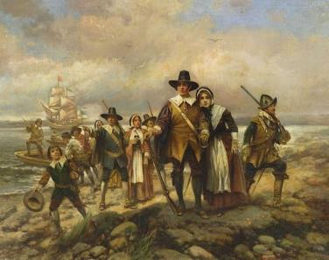
Religious Freedom
Other people came to the colonies for religious freedom
Around this time, there was great religious unrest in Europe, especially in England
Some groups were persecuted because of their religious beliefs
The Puritans founded Massachusetts for this reason
  Puritans: they wanted to reform, or “purify,” the church in England
  They also called themselves pilgrims-a person who travels to a holy place
  Pilgrims founded Plymouth colony in 1620

Slide 9
Religious Freedom
  The Massachusetts Bay Colony, nearby, was founded by another group of Puritans, who were religious dissenters-opposes the official or commonly held views
  The Puritans left England because they wanted to worship God in their own way
    They did not allow other people this curtesy
    They forced people to leave their colony if they did not wish to worship as the Puritans did

Slide 10
Religious Freedom
Some colonists who were forced to leave Massachusetts started
the colonies of Rhode Island and Connecticut
Rhode Island became known for the freedoms its colonists enjoyed
Connecticut developed America’s first written constitution in 1639
  Called the Fundamental Orders of Connecticut
  Said that the colonists would elect an assembly of representatives from each town to pass laws
  Colonists also elected their governor and judges

Slide 11
Colonial Life
By 1733, England had 13 colonies along the Atlantic Coast of North America
The features of its geography influenced each colonists economy
These factors also shaped how people lived
Over time, 3 economic regions developed and had its own way of life

Slide 12
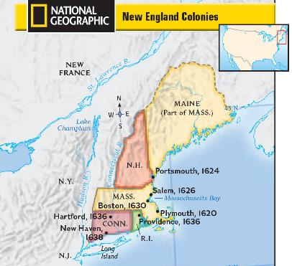
The New England Colonies
Includes: Massachusetts Bay, New Hampshire Connecticut, and Rhode Island
Most people lived in towns
Had a cold climate and rocky soil which made large-scale farming difficult
Farms were small and located near towns
Many colonists were Puritans whose religion stressed the values of thrift and hard work
Many worked as shopkeepers, shipbuilders, fishermen, trappers, hunters, and traders

Slide 13
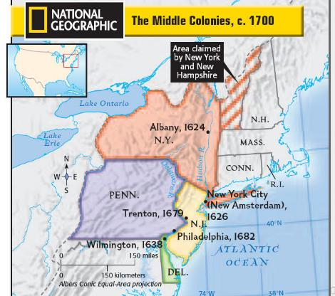
The Middle Colonies
Includes: New York, Pennsylvania, New Jersey and Delaware
Climate and soil were better for agriculture
Farmers grew wheat and other cash crops
  Cash crops were grown in large quantities to be sold rather than to feed the farmer’s family
  The cash crops were often traded overseas which lead to busy port cities like New York & Philadelphia
  Many of the port businesses were owned by hardworking colonists from Germany, Holland, and other European countries
Region was rich in natural resources
  Businesses such as sawmills, mines, and ironworks grew in this region

Slide 14
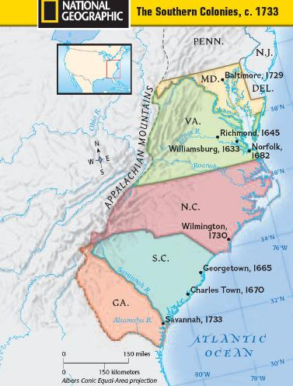
The Southern colonies
Include: Maryland, Virginia, North Carolina, South Carolina and Georgia
Large-scale agriculture was successful due to the warm climate, long growing season and rich soil
Tobacco became the main cash crop, along with rice
Large plantations developed, at first attended to by indentured servants, but eventually taken over by enslaved Africans
Few large towns and little industry developed

Slide 15
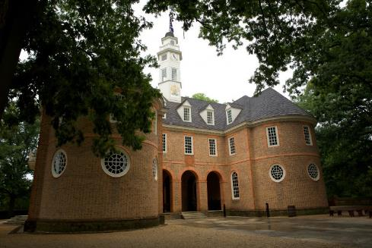
Colonial Government
Most colonists were loyal to England and valued their rights as English subjects
Because of the distance and difficulty in communication, colonists began to depend on their own governments for leadership and began to see themselves as Americans rather than English subjects
House of Burgesses, the first representative assembly in the colonies; had little power; marked the beginning of self-government in colonial America

Slide 16
Governing in the Colonies
The English government paid little attention to the colonies when they were first founded due to political unrest in England
English leaders believed that the main purpose of the colonies was to benefit England
In the 1650s, Parliament began passing laws to regulate the colonies’ trade
  These laws were hard to enforce
  Colonial traders were mostly able to ignore England trade laws

Slide 17
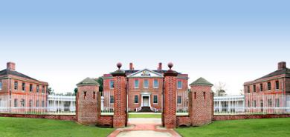
Governing the Colonies
Most colonies eventually had a governor who had been appointed by the king
The royal governor took orders from the English king and Parliament and enforced England’s laws in his colony
Local laws were usually passed by the colony’s elected assembly
William Tryon, was a Royal Governor of North Carolina from 1765-1771
”Tryon’s Palace” in New Bern, NC our first state capital

Slide 18
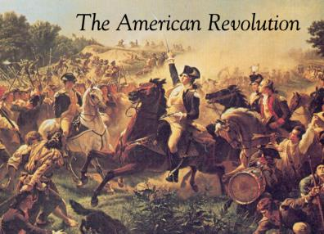
A Time of Change
As time passed, the colonists’ elected assemblies grew strong
Assemblies and governors sometimes fought for control of the colonies
The assemblies had the power to tax and to decide how the money would be spent
They used these powers to weaken the royal governors
By the mid 1700s, the colonies had become used to governing themselves
Many colonists felt that their governor put British interest ahead of their own and began to resent the fact that they had fewer rights than people living in Great Britain

Slide 19
Journal Entry #2 9/5/18
6-8 SENTENCES
What problems could result from a society that lacks Geographic Awareness? (knowing where places are located)

