Slide 1
North Carolina as a State

Slide 2
Timeline
Use the following link to complete the timeline in and tape it in your journal:
https://www.sosnc.gov/divisions/publications/kids_page_history
Here are some links about the new country North Carolina became a part of:
Liberty’s Kids - a new Country
https://www.youtube.com/watch?v=Ceb1wkSamG4&feature=youtu.be
Preamble to the US Constitution
https://youtu.be/30OyU4O80i4

Slide 3


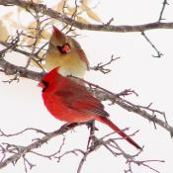
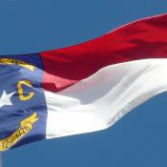

State Symbols
Official symbols represent the cultural heritage & natural treasures of each state or the entire USA. States are also recognized by icons & emblems such as state flags & seals, and every city & town has unique places: landmarks & historic buildings; national, state, & local parks; & markers. http://www.statesymbolsusa.org/states/united-states/north-carolina
Read this list of state symbols. In your journal, choose three state symbols you are most interested in, and write why you chose each one. Write what you were able to learn about the symbol you chose, and be sure to include examples from the text.
https://www.sosnc.gov/divisions/publications/kids_page_symbols

Slide 4
Important Buildings in North Carolina
North Carolina State Capitol
http://www.visitraleigh.com/listings/North-Carolina-State-Capitol/60239/?maxshow=10
http://nchistoricsites.org/capitol/
North Carolina State Legislative Building
http://www.visitraleigh.com/listings/North-Carolina-State-Legislative-Building/60002/?maxshow=10
http://www.ncleg.net/
North Carolina Executive Mansion
http://www.visitraleigh.com/listings/North-Carolina-Executive-Mansion/58146/?maxshow=10
http://www.nchistoricsites.org/capitol/exec/exectour.htm
North Carolina Justice Building
http://www.nccourts.org/Courts/Appellate/Supreme/JBuilding.asp
http://www.nccourts.org/Citizens/PGallery/PGallery.asp
Use the links to fill out the page in your journal. If you finish, read about each of the buildings. Here is a list of a few more to look up!
http://www.visitraleigh.com/things-to-do/history/government-buildings/
http://www.visitraleigh.com/listings/North-Carolina-State-Capitol/60239/?maxshow=10

Slide 5
The Constitution
https://www.brainpop.com/socialstudies/ushistory/usconstitution/
The United States of America has a Constitution.
https://www.usconstitution.net/const.pdf
https://www.usconstitution.net/constkidsK.html
North Carolina has it’s own constitution.
http://www.ncleg.net/Legislation/constitution/ncconstitution.html
Use the above links to answers these two questions in your Social Studies Journal:
What is a Constitution?
What is the difference between the United States Constitution and the North Carolina Constitution?

Slide 6
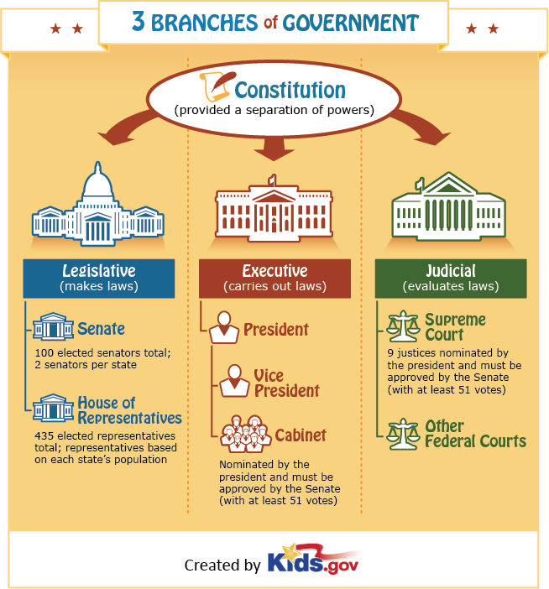
The Constitution
The United States Constitution gives us three branches of government.
Check out this flocabulary video about it.
https://www.youtube.com/watch?v=m8RwahIjIDI

Slide 7
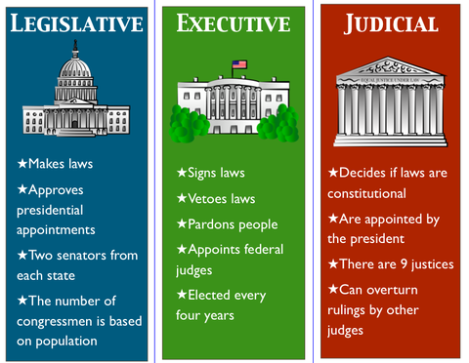
The Constitution
The North Carolina Constitution also gives us three branches of government, but for the state instead of the country.
Use the links below to find out who is in each branch.
https://www.sosnc.gov/divisions/publications/kids_page_government
https://www.nc.gov/government/NC-GOVERNMENT
Fill out the information in your journal.

Slide 8
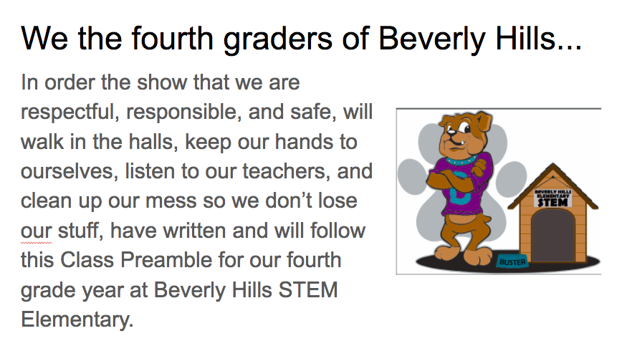
Preamble
Just like the US Constitution has a preamble, the North Carolina Constitution has a preamble.
http://www.ncleg.net/Legislation/constitution/ncconstitution.html
Here is a preamble made by a 4th grade class at BHE!

Slide 9
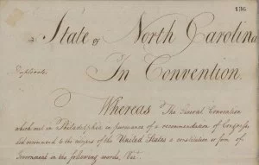
Revisions
A revision is when something is edited or changed.
The Constitution of North Carolina has been through two major revisions. It was first written in 1776, right after the declaration of independance. In 1868 changes were made after the Civil War. Then in 1971 there was another major revision.

Slide 10
Revisions
Take a close look at an old 4th grade preamble and propose a revision you think could be made for next year. Write it in the next page of your journal and be ready to share at the end of class.

Slide 11

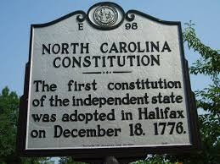

Rights and Responsibilities
Go through the prezi below and do the activity at the end, make a T chart in your journal.
https://prezi.com/1gmdi0ive7fb/copy-of-rights-and-responsibilities-of-nc-citizens/

