Slide 1
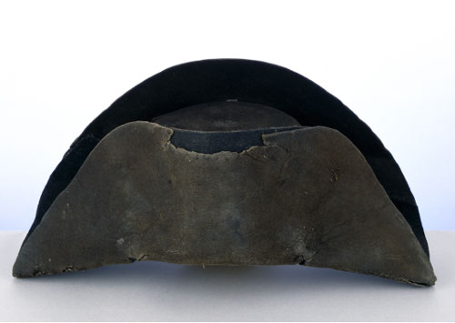
Napoleon I
(1804-1814)

Slide 2
Napoleon's
Early
Career

Slide 3
Napoleon’s Background
Birthplace: Corsica, Italy
Dates: 1769-1821
Family Class: lesser nobility
Education: French schools, military
Acceptance: 1785 Commission – Artillary Officer
Height: 5’6” - Just Mrs. P’s size!

Slide 4
Napoleon’s Rise to Power
Earlier military career →
  Toulon:1793 → he recovered the port from Great Britain.
  Paris: 1795 → saved the Directory by putting down the Royalist rebellion

Slide 5
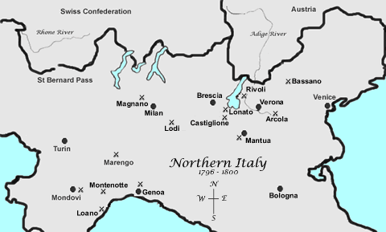
Napoleon’s Rise to Power
Earlier military career → the Italian Campaigns:
  1796-1797 → he conquered most of northern
  Italy for France, and had
  developed a taste for governing.
  In northern Italy, he moved to suppress religious orders, end serfdom, and limit age-old noble privilege.

Slide 6
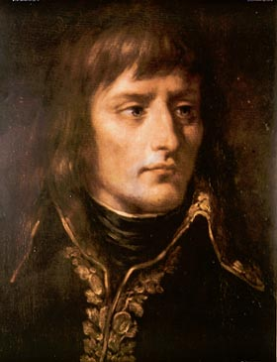
Napoleon’s Rise to Power
Earlier military career → the Austrian Campaigns:
  October 1797 → he took Austria out of war with the Treaty of Campo Formeo

Slide 7
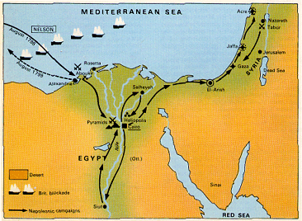
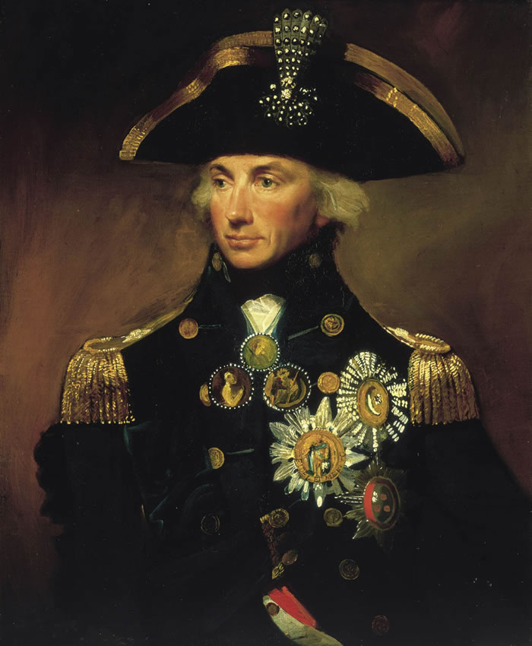
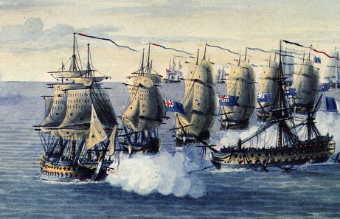
Napoleon’s Rise to Power
Earlier military career → the Egyptian Campaign:
  1798 → he was defeated by a British navy under Admiral Horatio Nelson, who destroyed the French fleet at the Battle of the Nile.
  Abandoning his troops in Egypt, Napoleon returned to France and received a hero’s welcome!

Slide 8
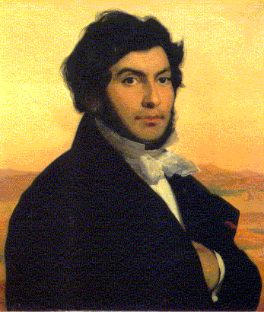
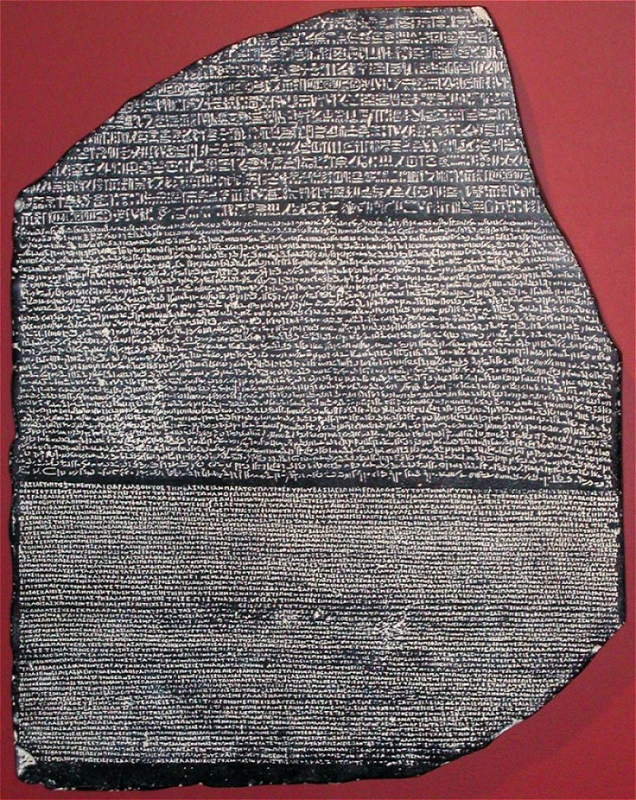
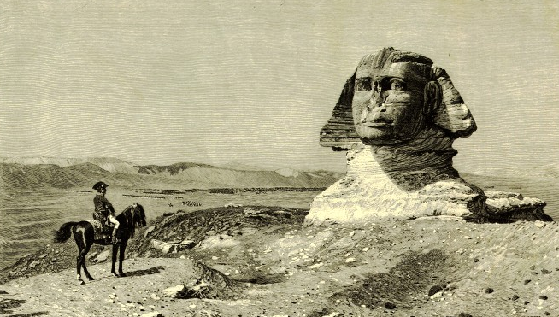
The Rosetta Stone
Jean Francois Champollion

Slide 9
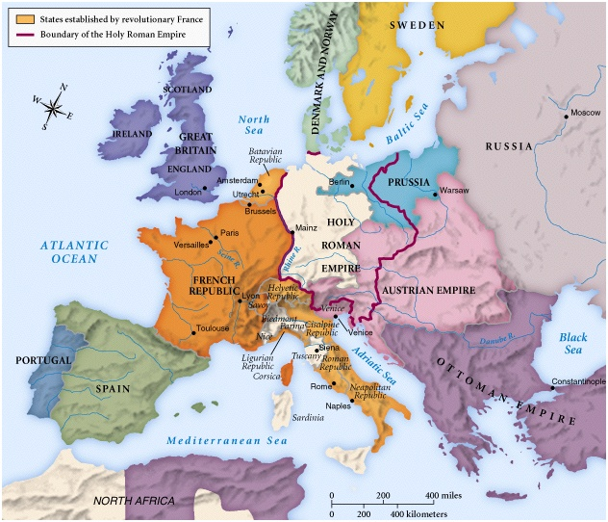
Europe in 1800

Slide 10
1799-1804
Directory – Consulate – Dictatorship – Empire!

Slide 11
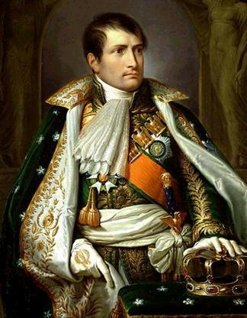

Napoleon as “First Consul”
With the government in disarray, Napoleon launched a successful coup d’ etat on November 9, 1799.
He proclaimed himself “First Consul” [Julius Caesar’s title] and did away with the elected Assembly [appointing a Senate instead].
  In 1802, he made himself sole “Consul for Life.”
  Two years later he proclaimed himself “Emperor.”

Slide 12
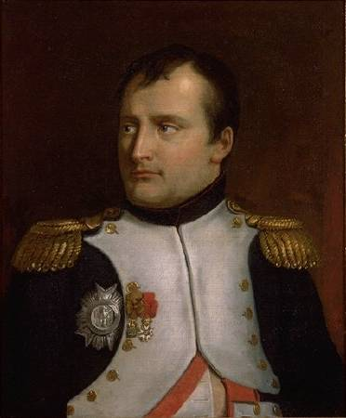
The Government of the Consulate
Council of State
  Proposed the laws.
  Served as a Cabinet & the
  highest court.
Tribunate
  Debated laws, but did not
  vote on them.
Legislature
  Voted on laws, but did not discuss or debate them.
Senate
  Had the right to review and veto legislation.

Slide 13
The Consulate Reforms
Established a meritocracy
  Required a civil service exam
  Promotion based on merit
Created a effective bureaucracy
Streamlined taxation system
Started a central bank of France

Slide 14
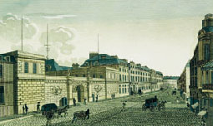
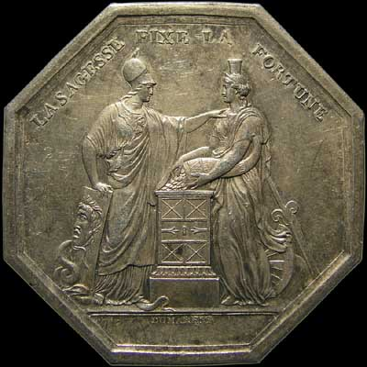
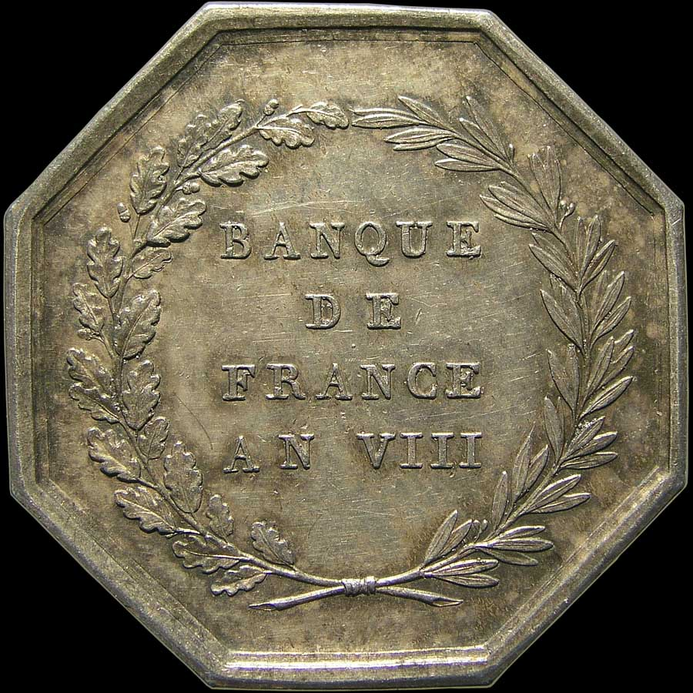
Napoleon Established the
Banque de France, 1800

Slide 15
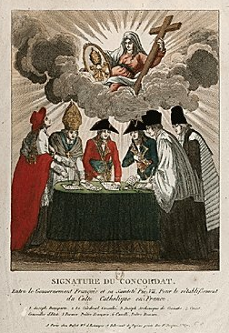
Concordat of 1801
Napoleon wanted to heal the divisions within the Catholic Church that had developed after the confiscation of Church property and the Civil Constitution of the Clergy.
But, Napoleon’s clear intent was to use the clergy to prop up his regime.

Slide 16
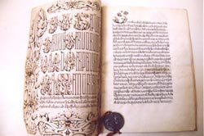
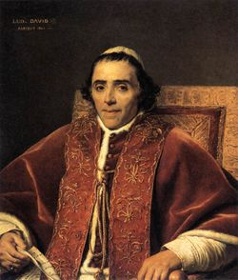
Concordat of 1801
Catholicism was declared the religion of the majority of Frenchmen.
Papal acceptance of church lands lost
during the Revolution.
Bishops subservient to the regime.
Eventually, Pope Pius VII renounced
the Concordat, and Napoleon had him
brought to France and placed under
house arrest.

Slide 17
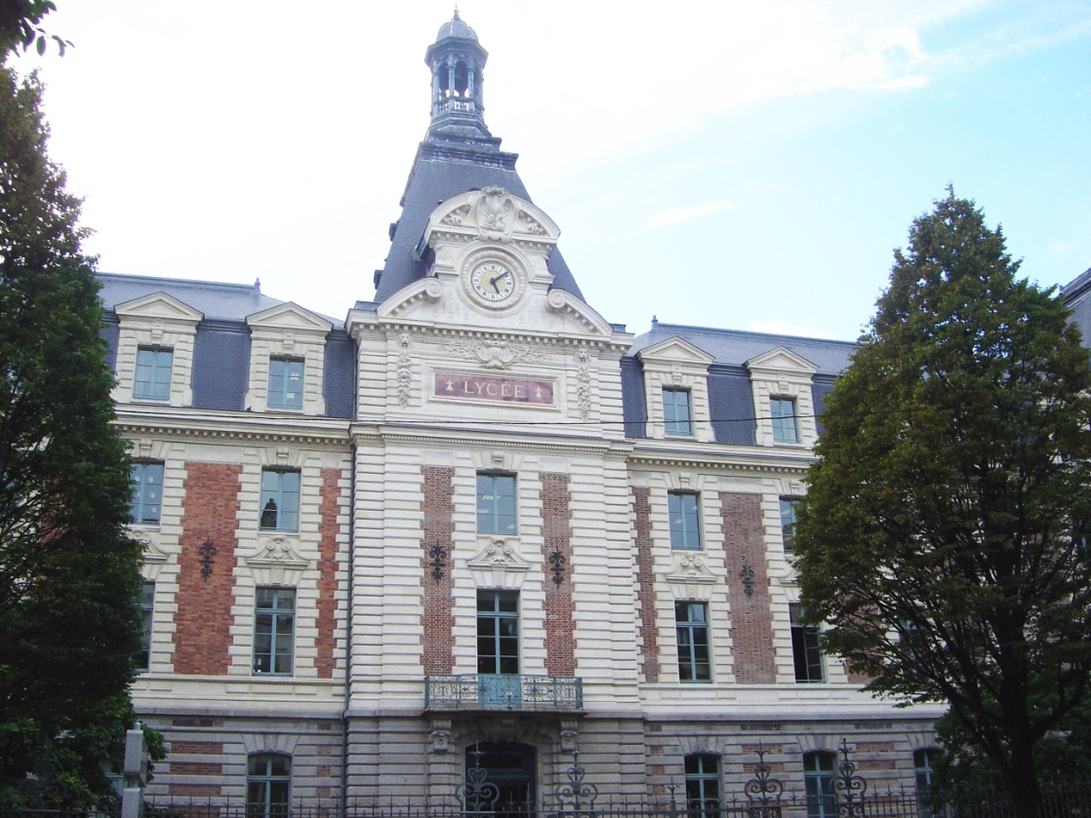
Lycee System of Education
Established by Napoleon in 1801 as an educational reform.
Lycées initially enrolled the nation’s most talented students [they had to pay tuition, although there was some financial help available for poorer student].
Lycées trained the nation’s future bureaucrats.

Slide 18
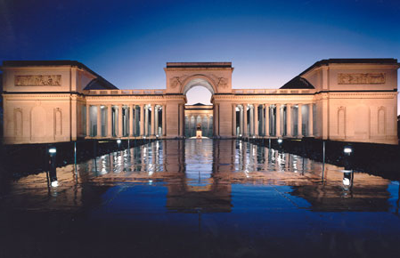
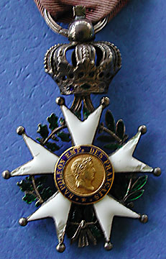
Legion of Honor, 1802
Palace of the Legion of Honor, Paris

Slide 19
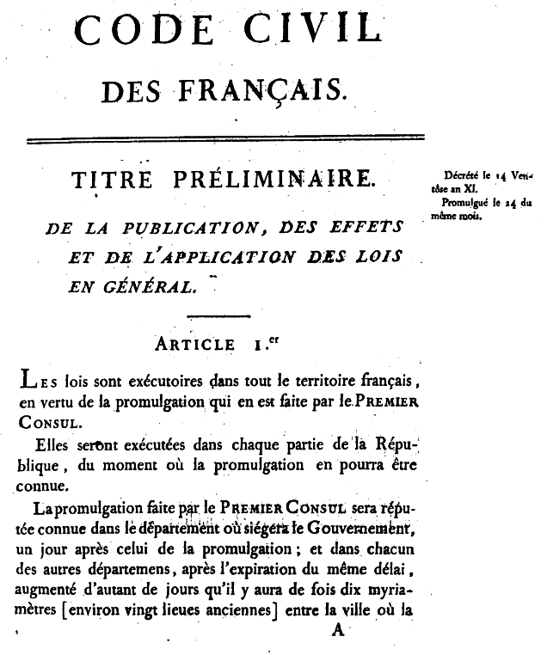

Code Napoleon, 1804
It divides civil law into:
  Personal status.
  Property.
  The acquisition of property.
Its purpose was to reform the French legal code to reflect the principles of the Fr. Revolution.
Create one law code for France.

Slide 20
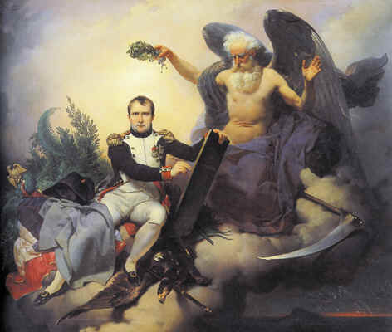
Napoleon and His Code

Slide 21
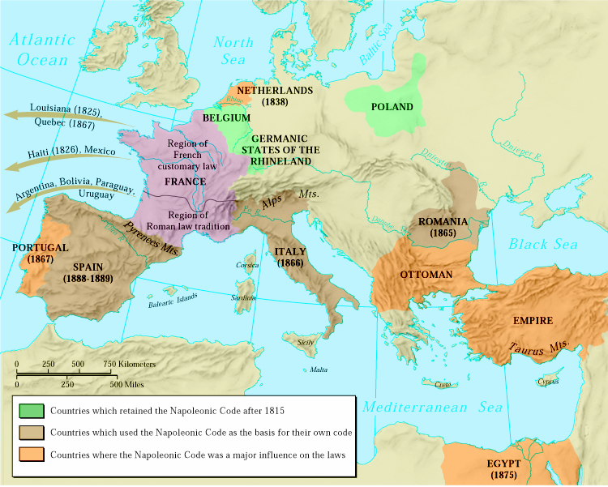
The Influence of the Napoleonic Code
Wherever it was implemented [in the conquered territories], the Code Napoleon swept away feudal property relations.

Slide 22
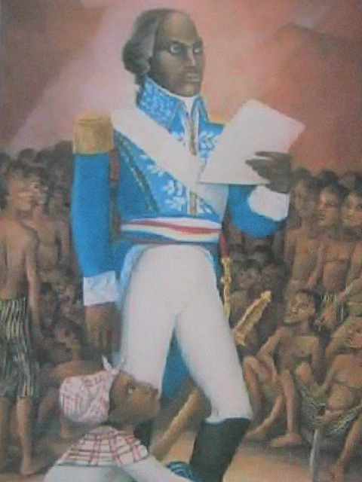
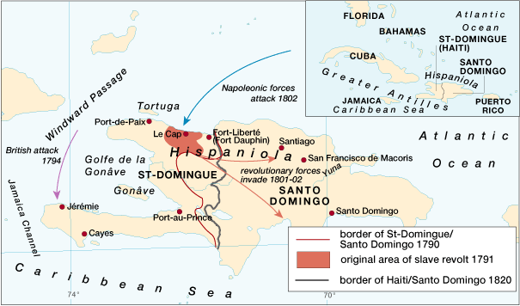
Haitian Independence, 1792-1804
Toussaint L’Ouverture

Slide 23
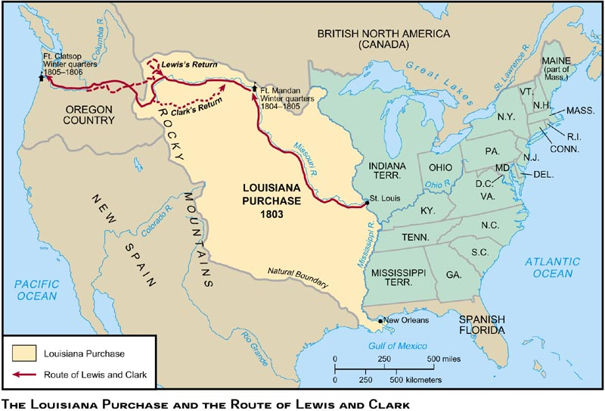
Louisiana Purchase, 1803
$15,000,000

Slide 24
Emperor
Napoleon I

Slide 25
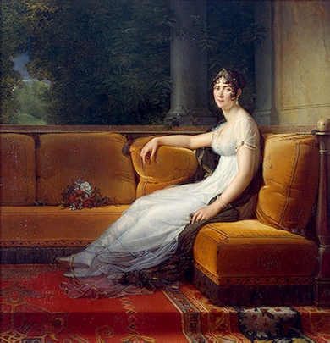
The Empress Josephine

Slide 26
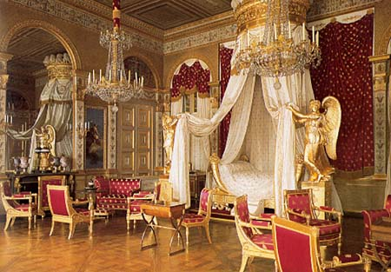
Josephine’s Bedroom

Slide 27
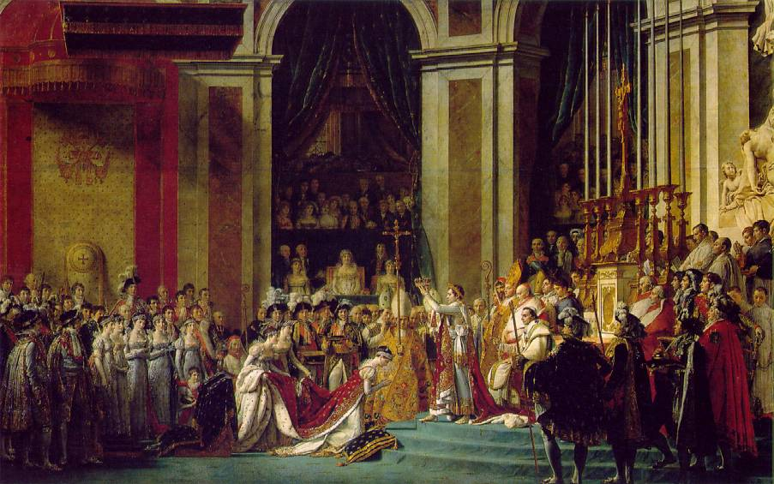
“Consecration of the Emperor Napoleon & the Empress Josephine,” 1806 by David
December 2, 1804

Slide 28
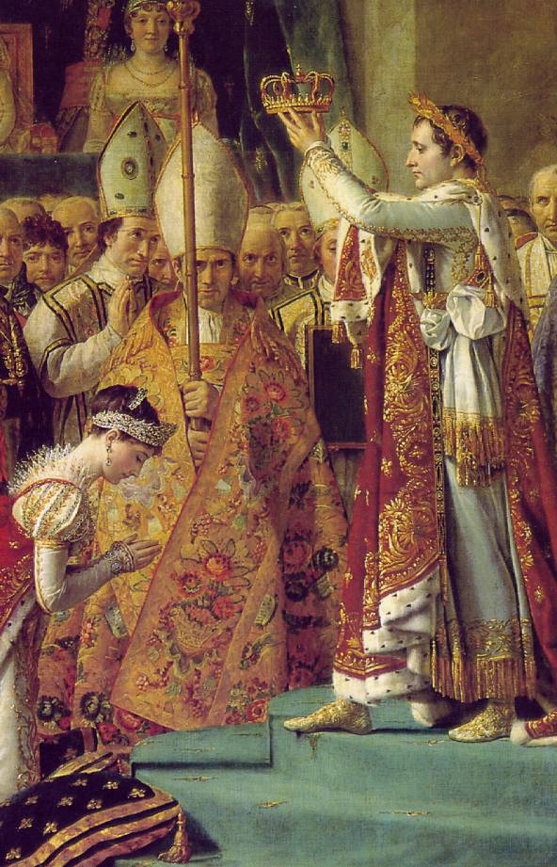
“Consecration
of the Emperor Napoleon & the Empress Josephine,”
1806
by David

Slide 29
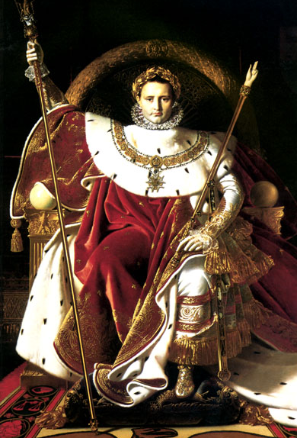
“Napoleon on His Imperial Throne”
1806
By Jean Auguste
Dominique Ingres

Slide 30
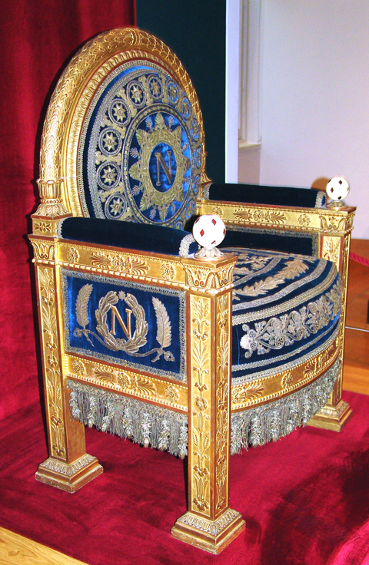
Napoleon’s Throne

Slide 31
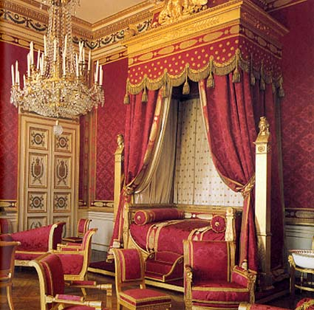
Napoleon’s Bed Chamber

Slide 32
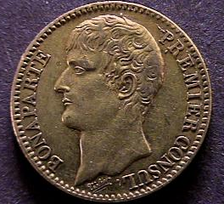
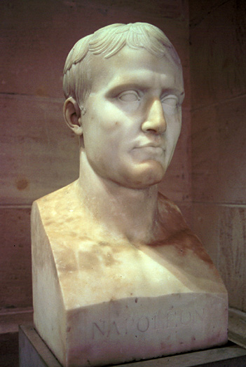
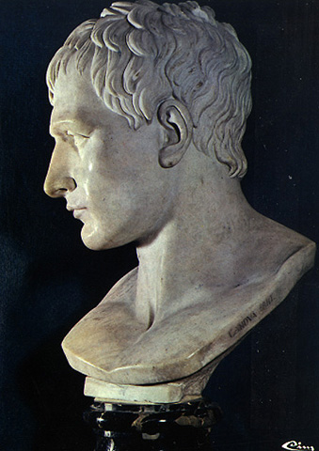
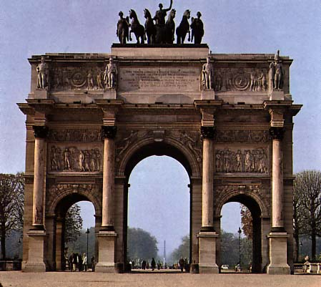
The Imperial Image

Slide 33
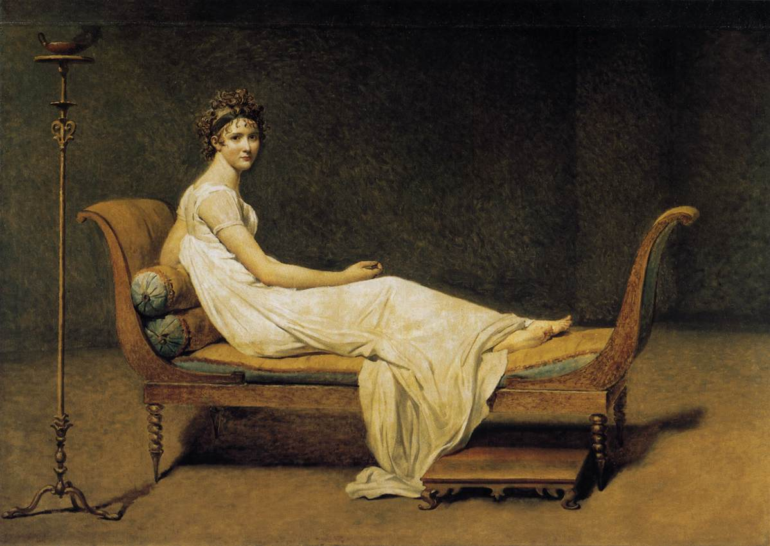
The “Empire” Style
Madame Recamier by David, 1808

Slide 34
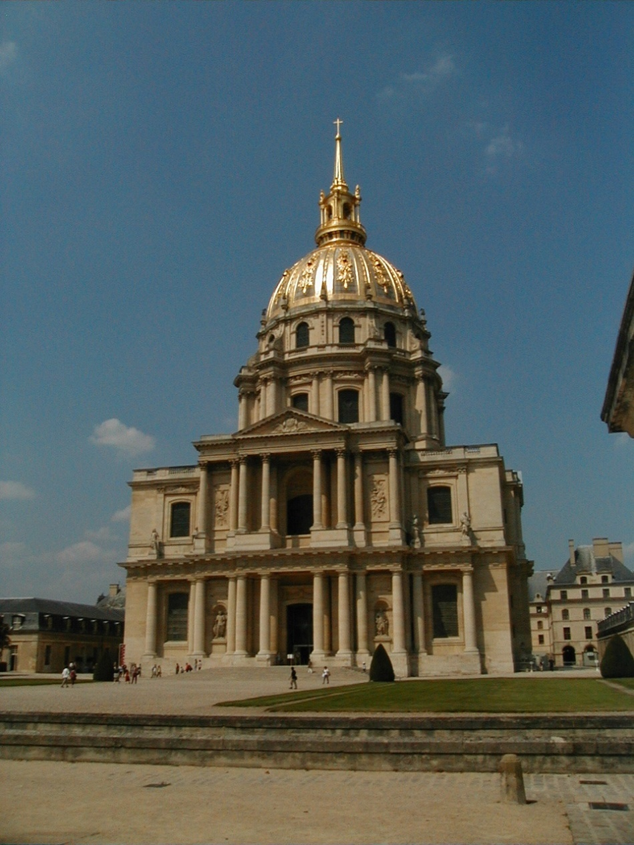
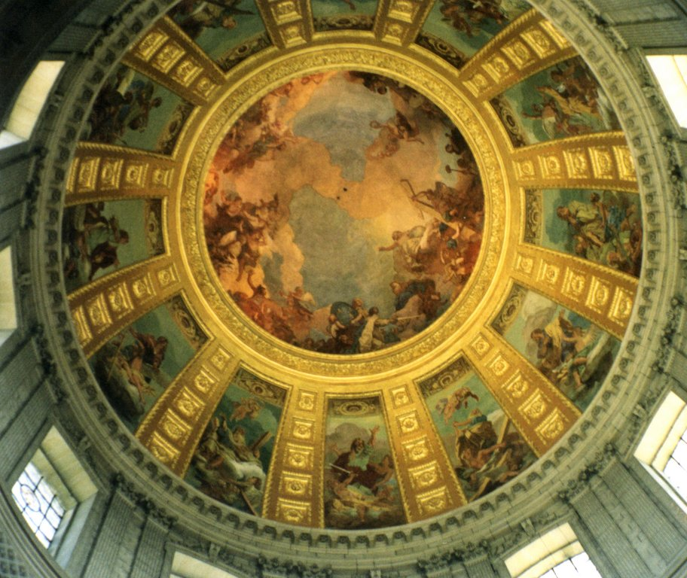
Neo-Classical Architecture
Napoleon’s Tomb

Slide 35
Napoleonic Wars
Glory of the Grand Armee

Slide 36
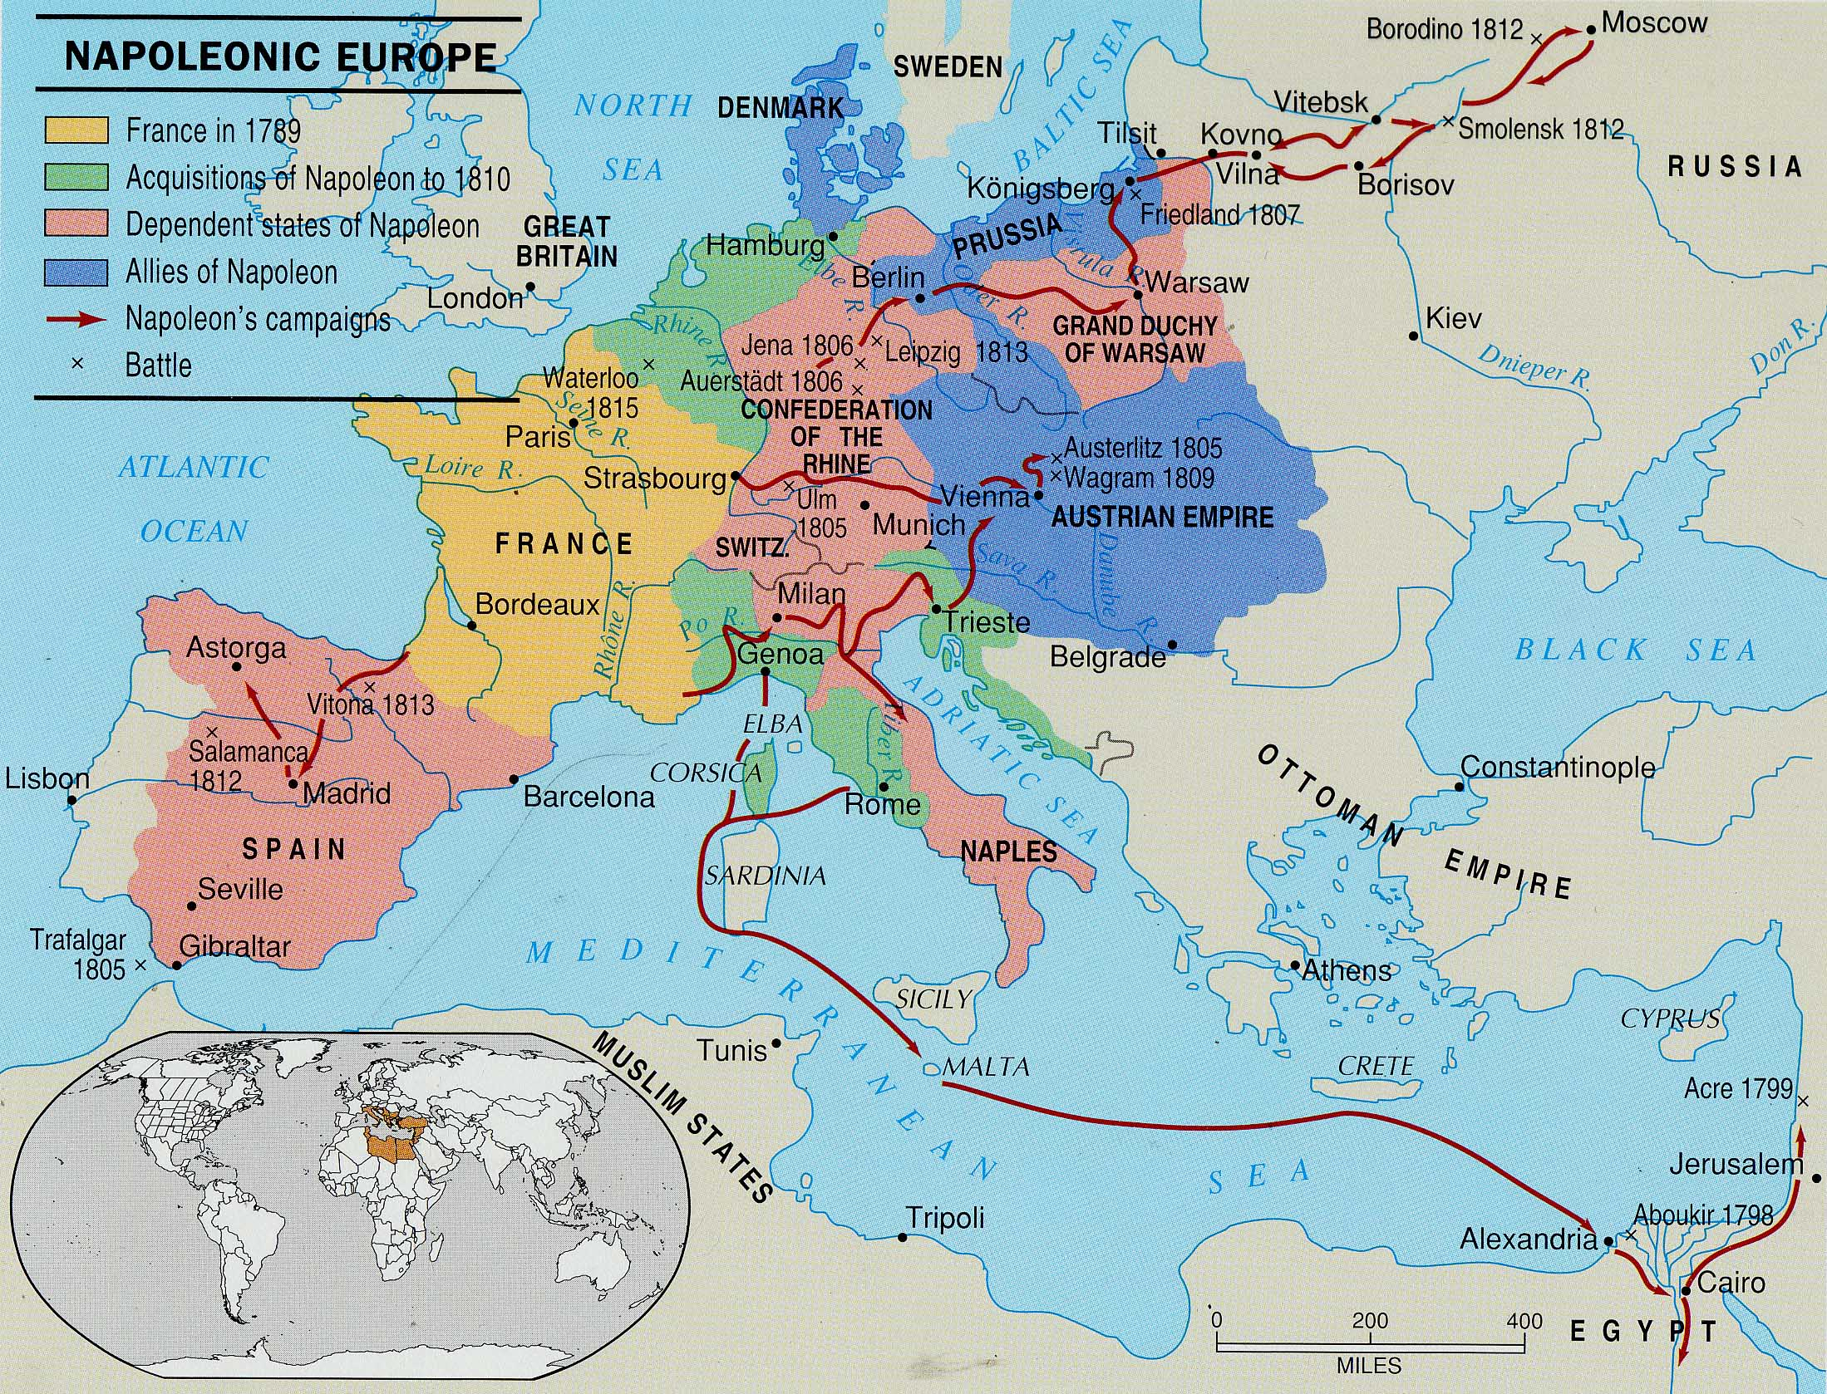
Napoleonic Europe

Slide 37
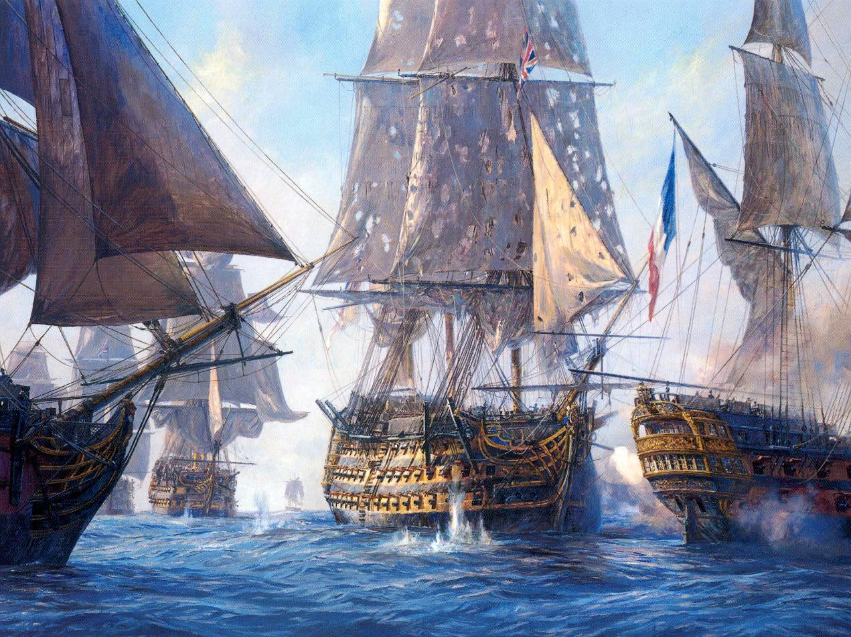
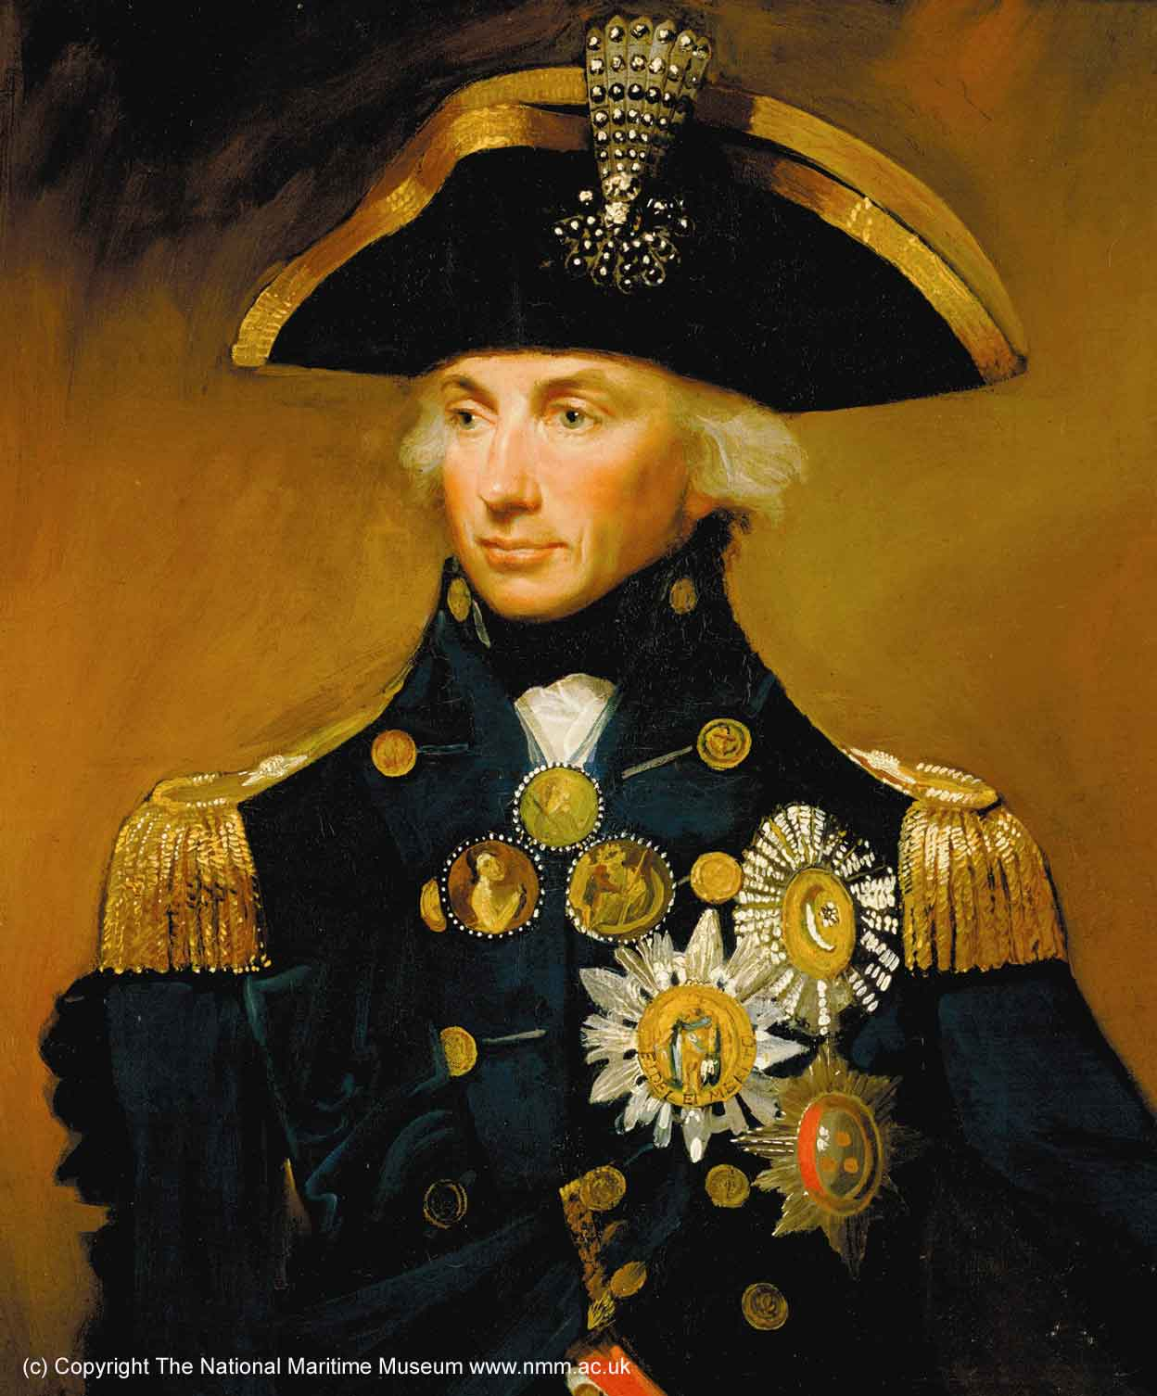
Napoleon’s Major Military Campaigns
Sea
Power
1805:
France →
← Britain
Trafalgar (Lord Nelson: Fr. Navy lost!)

Slide 38
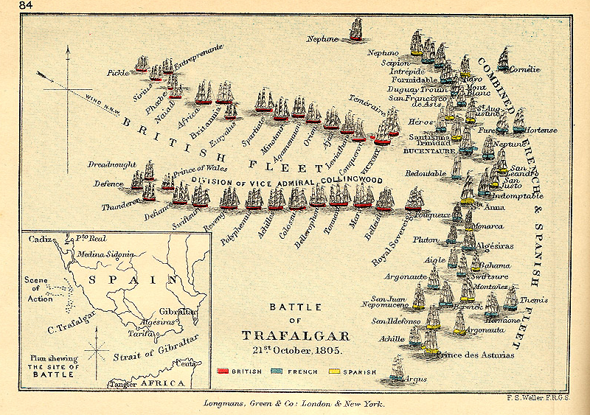
Battle of Trafalgar

Slide 39
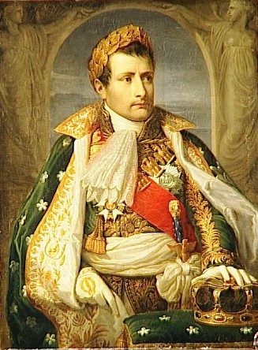
Napoleon’s Major Military Campaigns
-Danube
-Italy
1805:
France →
← Britain
Austria
Russia
(3rd Coalition)
ULM: France defeated Austria.
AUSTERLITZ: France defeated
Austria & Russia.
Crowned “King of Italy” on May 6, 1805

Slide 40
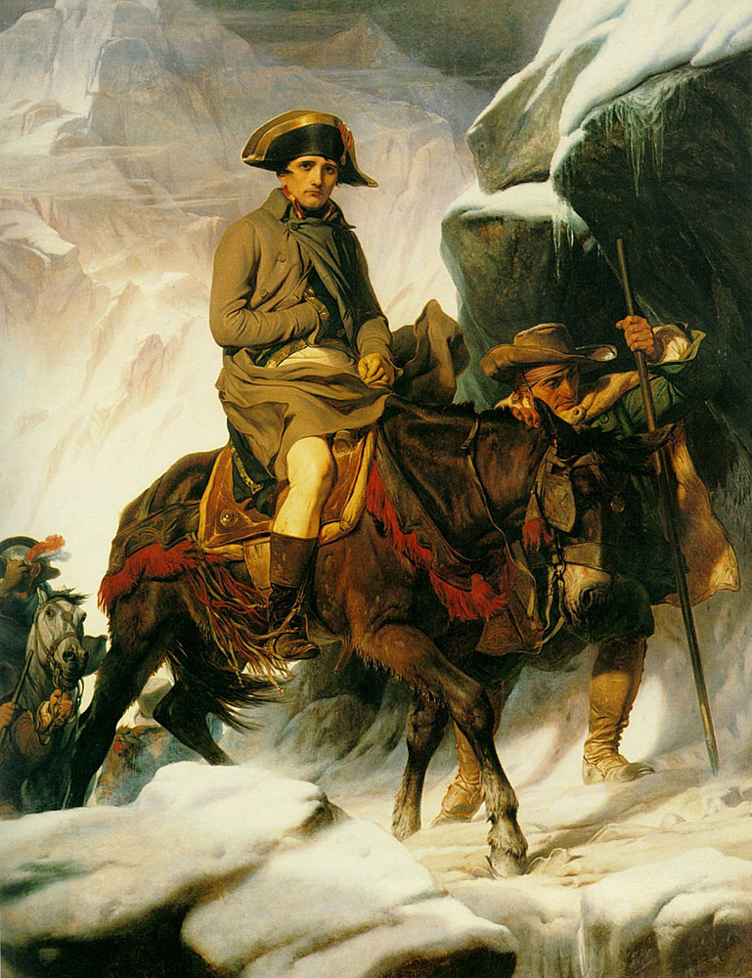
“Crossing the Alps,”
1805
Paul Delaroche

Slide 41
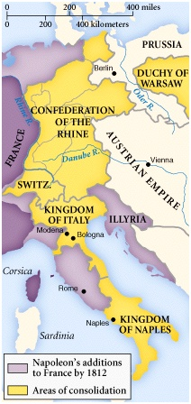
Napoleon’s Major Military Campaigns
Confed.
of the
Rhine
1806:
France →
← Prussia
JENA: French Troops in Berlin!
BERLIN DECREES
(“Continental System”)
4th Coalition created

Slide 42
Napoleon’s Major Military Campaigns
Poland
1806:
France →
← Russia
Grand Duchy of Warsaw
FRIEDLAND: France defeated Russian troops
: France occupied Konigsberg,
capital of East Prussia!

Slide 43
Napoleon’s Major Military Campaigns
Directions: With your partner, research the battles and treaties of the Napoleonic Era. Complete the given chart and report your findings to the class.

Slide 44
Napoleon’s Problems Begin!
Constant warfare wears down his supporters.
His war unleashes nationalism across Europe, especially in Germany and Spain.
The Continental System

Slide 45
The Continental System
Designed to punish & isolate Britain and promote Napoleon’s mastery over Europe.
Berlin Decrees (1806)
  British ships were not allowed in European ports.
“Order in Council” (1806)
  Britain proclaimed any ship stopping in Britain would be seized when it entered the Continent.
Milan Decree (1807)
  Napoleon proclaimed any ship stopping in Britain would be seized when it entered the Continent.
These edicts eventually led to the United States declaring war on Britain → WAR OF 1812.

Slide 46
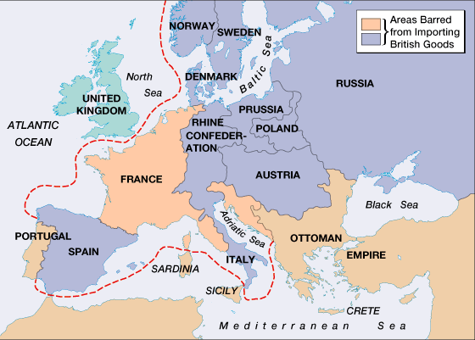
The Continental System

Slide 47
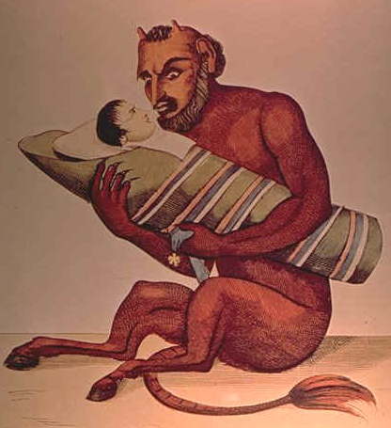
British Cartoon
Result:
Continental System backfires
England makes MORE money

Slide 48
Josephine’s Divorce Statement (1807)

Slide 49
Josephine’s Divorce Statement (1807)
With the permission of our august and dear husband, I must declare that, having no hope of bearing children who would fulfill the needs of his policies and the interests of France, I am pleased to offer him the greatest proof of attachment and devotion ever offered on this earth.

Slide 50
Napoleon’s Divorce Statement (1807)
Far from ever finding cause for complaint, I can to the contrary only congratulate myself on the devotion and tenderness of my beloved wife. She has adorned thirteen years of my life; the memory will always remain engraved on my heart.

Slide 51

Marie Louise
(of Austria)
married Napoleon on
March 12, 1810
in Vienna

Slide 52

Marie Louise
(of Austria)
with
Napoleon’s Son
(Napoleon Francis Joseph Charles: 1811-1832)

Slide 53
Peninsular Campaign: 1807-1810
Continental
System
1806:
France →
← Spain
Portugal
Portugal did not comply with the Continental System.
France wanted Spain’s support to invade Portugal.
Spain refused, so Napoleon invaded Spain as well!

Slide 54

“The Spanish Ulcer”
Napoleon tricked the Spanish king and prince to come to France, where he imprisoned them.
He proclaimed his brother, Joseph, to be the new king of Spain.
He stationed over 100,000 Fr troops in Madrid.
On May 2, 1808 [Dos de Mayo] the Spanish rose up in rebellion.
Fr troops fired on the crowd in Madrid the next day [Tres de Mayo].

Slide 55

“Third of May, 1808” by Goya (1810)

Slide 56

“The Spanish Ulcer”
Napoleon now poured 500,00
troops into Spain over the next
few years.
But, the Fr generals still had
trouble subduing the Spanish
population.
The British viewed this uprising
as an opportunity to weaken
Napoleon.
  They moved an army into
  Portugal to protect that country
  and to aid the Spanish guerillas.
After 5 long years of savage fighting, Fr troops were finally pushed back across the Pyrennes Mountains out of Spain.
The Surrender of Madrid
May, 1809
by Goya

Slide 57

“Napoleon in His
Study”
1812
by David

Slide 58

Napoleon’s Empire in 1810

Slide 59

Napoleon’s Family Rules!
Jerome Bonaparte → King of Westphalia.
Joseph Bonaparte → King of Spain
Louise Bonaparte → King of Holland
Pauline Bonaparte → Princess of Italy
Napoléon Francis Joseph
Charles (son)→ King of
Rome
Elisa Bonaparte → Grand
Duchess of Tuscany
Caroline Bonaparte → Queen
of Naples

Slide 60

Napoleon’s Family & Friends/Allies

Slide 61

The “Big Blunder” -- Russia
The retreat from Spain came
on the heels of Napoleon’s
disastrous Russian Campaign
(1812-1813).
In July, 1812 Napoleon led his
Grand Armee of 614,000 men
eastward across central Europe
and into Russia.
  The Russians avoided a direct
  confrontation with Napoleon.
  They retreated to Moscow, drawing the French into the interior of Russia [hoping that it’s size and the weather would act as “support” for the Russian cause].
  The Russian nobles abandoned their estates and burned their crops to the ground, leaving the French to operate far from their supply bases in territory stripped of food.

Slide 62

Napoleon’s Troops at the Gates of Moscow
September 14, 1812 → Napoleon reached Moscow, but the city had largely been abandoned.
The Russians had set fire to the city.

Slide 63

Moscow Is On Fire!

Slide 64

Russian General Kutuzov
The Russian army defeated the French at Borodino.

Slide 65

Napoleon’s Retreat
from Moscow (Early 1813)
100,000 French troops retreat—40,000 survive!

Slide 66


The 6th Coalition
Napoléon’s
Defeat
1813-1814:
France →
← Britain, Russia.
Spain, Portugal,
Prussia, Austria,
Sweden, smaller
German states

Slide 67

Battle of Dresden (Aug., 26-27, 1813)
Coalition → Russians, Prussians, Austrians.
Napoléon’s forces regrouped with Polish reinforcements.
100,000 coalition
casualties;
30,000 French
casualties.
French victory.

Slide 68


Napoleon’s Defeat at Leipzig
(October 16-17, 1813)
“Battle of the Nations” Memorial

Slide 69
Napoleon Abdicates!
Allied forces occupied Paris on March 31, 1814.
Napoléon abdicated on April 6 in favor of his son, but the Allies insisted on unconditional surrender.
Napoléon abdicated again on April 11.
Treaty of Fontainbleau → exiles Napoléon to Elba with an annual income of 2,000,000 francs.
The royalists took control and restored
Louis XVIII to the throne.

Slide 70

Napoleon’s Abdication

Slide 71


Napoleon in Exile on Elba

Slide 72

Louis XVIII (r. 1814-1824)

Slide 73
The
"Hundred Days"
(March 20 - June 22, `1815)

Slide 74
“The War of the 7th Coalition”
Napoleon’s
“100 Days”
1815:
France →
← Britain, Russia.
Prussia, Austria,
Sweden, smaller
German states
Napoléon escaped Elba and landed in France on March 1, 1815 → the beginning of his 100 Days.
Marie Louise & his son were in the hands of the Austrians.

Slide 75



Napoleon’s Defeat at Waterloo
(June 18, 1815)
Duke
of
Wellington
Prussian
General
Blücher

Slide 76


Napoleon
on His Way
to His
Final Exile on
St. Helena

Slide 77

Napoleon’s Residence on St. Helena

Slide 78

Napoleon’s Tomb

Slide 79

Hitler Visits Napoleon’s Tomb
June 28, 1940

Slide 80
Congress of Vienna
Re-establishes how Europe was BEFORE Napoleon’s wars
Considered one of the GREATEST treaties ever!
  Restores Dutch kingdom
  Ends colonial rivalry with England (South Africa, Malta, Trinidad & Tobago)
  Austria gets Tuscany, Milan, & Venice
  Ends the Polish Question: Czar Alexander gets Warsaw; Prussia gets 2/5 of Saxony
  700 million Francs paid to Coalition for Napoleon’s return.
Not another major war until 1914!

Slide 81
What is Napoleon’s Legacy?

Slide 82
Ms, Susan M. Pojer
Horace Greeley HS Chappaqua, NY

