Slide 1
My plate

Slide 2
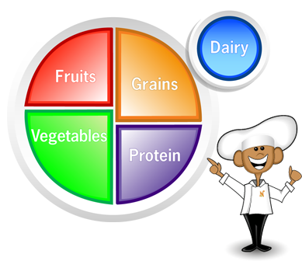
GRAINS
FRUITS
VEGETABLES
PROTEIN
DAIRY

Slide 3
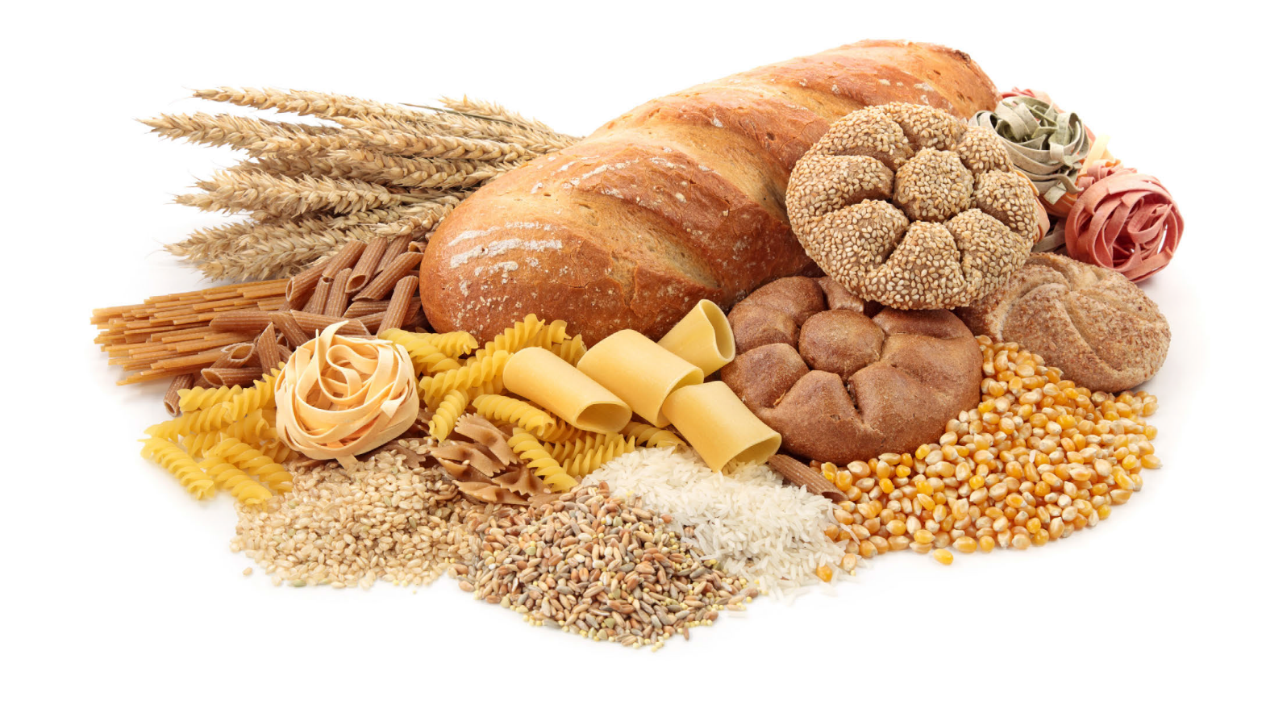
GRAINS
Comes from a small plant seed that is good source of carbohydrates
2 sub-groups: refined and whole grains
Need about 3-8 ounces daily
Some Examples:
  Brown Rice
  Oatmeal
  Popcorn
  Whole Grain
  Barley
  Cornmeal
  Rye
  Whole Wheat Bread
  Whole wheat pasta

Slide 4
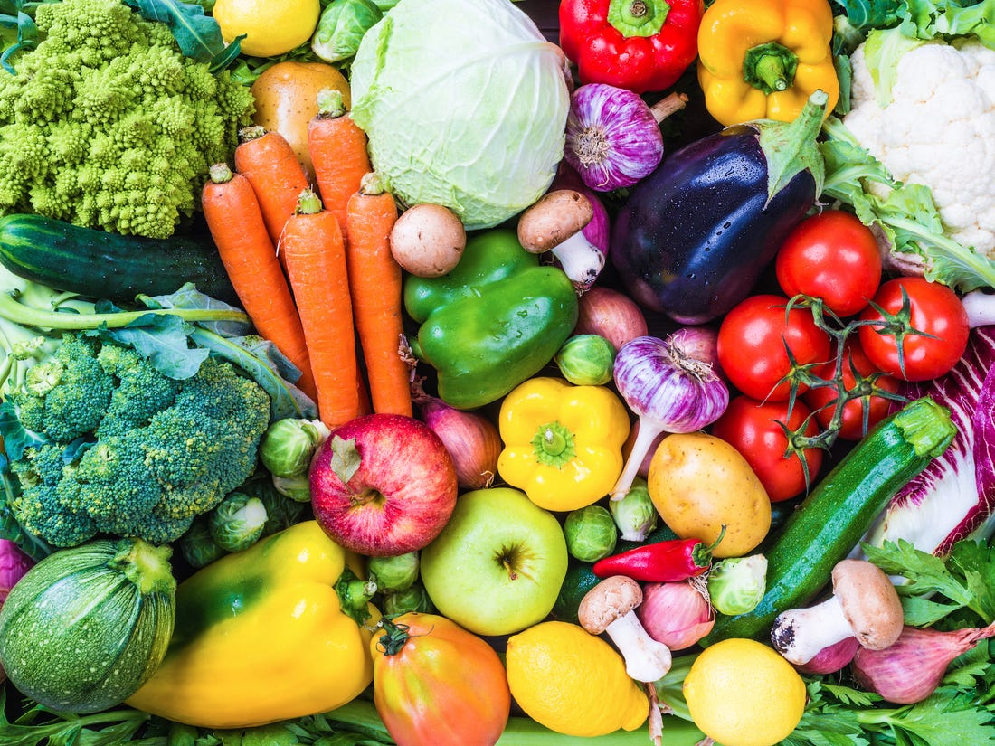
Vegetables
The edible part of a plant
Includes raw, cooked, fresh, frozen, canned, juiced or dried
5 sub groups: Dark-green vegetables, starchy vegetables, red and orange vegetables, beans and peas, and other
Need: 1-3 cups daily
Some Examples:
  Onions
  Carrots
  Lettuce
  Bell Peppers
  Cabbage
  Kale
  Green Beans

Slide 5
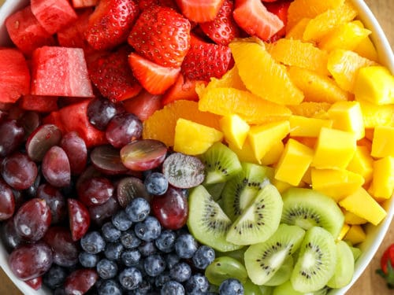
Fruit
A seed baring structure from a flowering tree or plant
Can be juiced, canned, fresh, frozen, or dried
Need: 1-2 cups
Some Examples:
  Apples
  Oranges
  Grapes
  Pineapple
  Mango
  Kiwi
  Berries

Slide 6
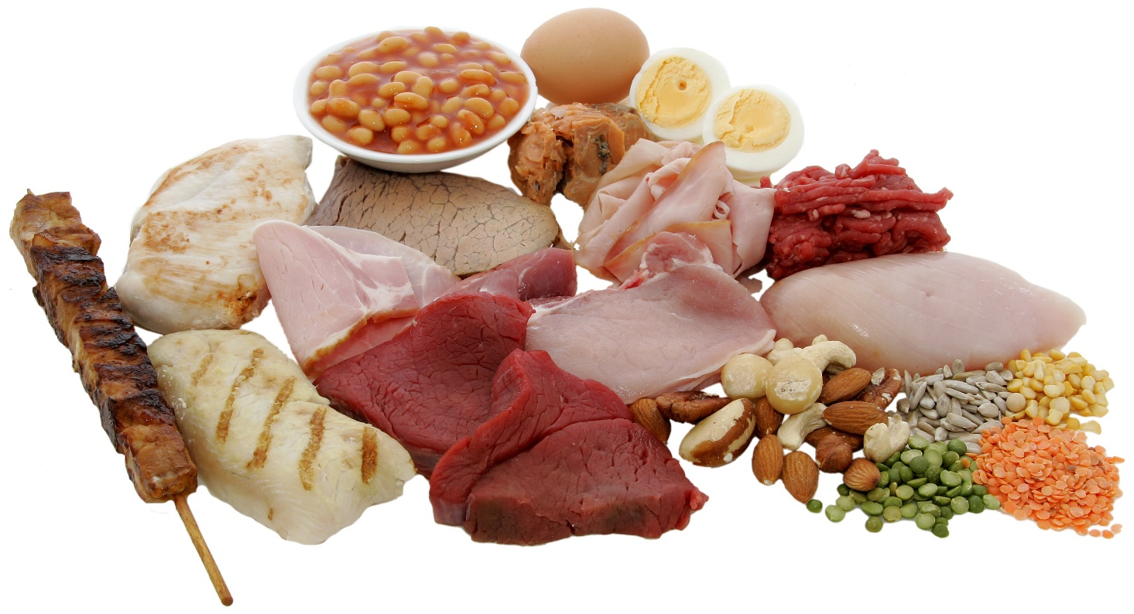
Protein
Helps build muscle and repairs muscle in the body
Need about 2-6.5 ounces depending of physical activity level
Some examples:
  Chicken
  Red meat
  Pork
  Fish
  Shellfish
  Eggs
  Soy products
  Nuts
  Legumes (beans, lentils)

Slide 7
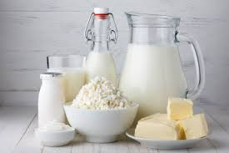
Dairy
Products made by the milk of mammals
Need 2-3 cups daily
Some examples:
  Yogurt
  Milk
  Cheese
  Cottage Cheese
  Sour cream
  Fortified soy milk

