Slide 1
Mindfulness
Training your brain for learning and living

Slide 2
Goals for Learning
Students will identify how their brain functions effect behavior.
Students will identify the difference between mindful and unmindful thoughts and actions.
Students will learn an exercise that combines listening and breathing to calm and focus their minds.

Slide 3
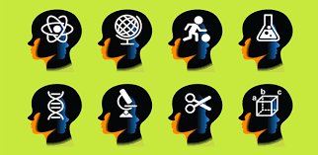
How do people learn different skills?
Think about...
- learning to play an instrument
- learning to play a sport
- learning to read

Slide 4
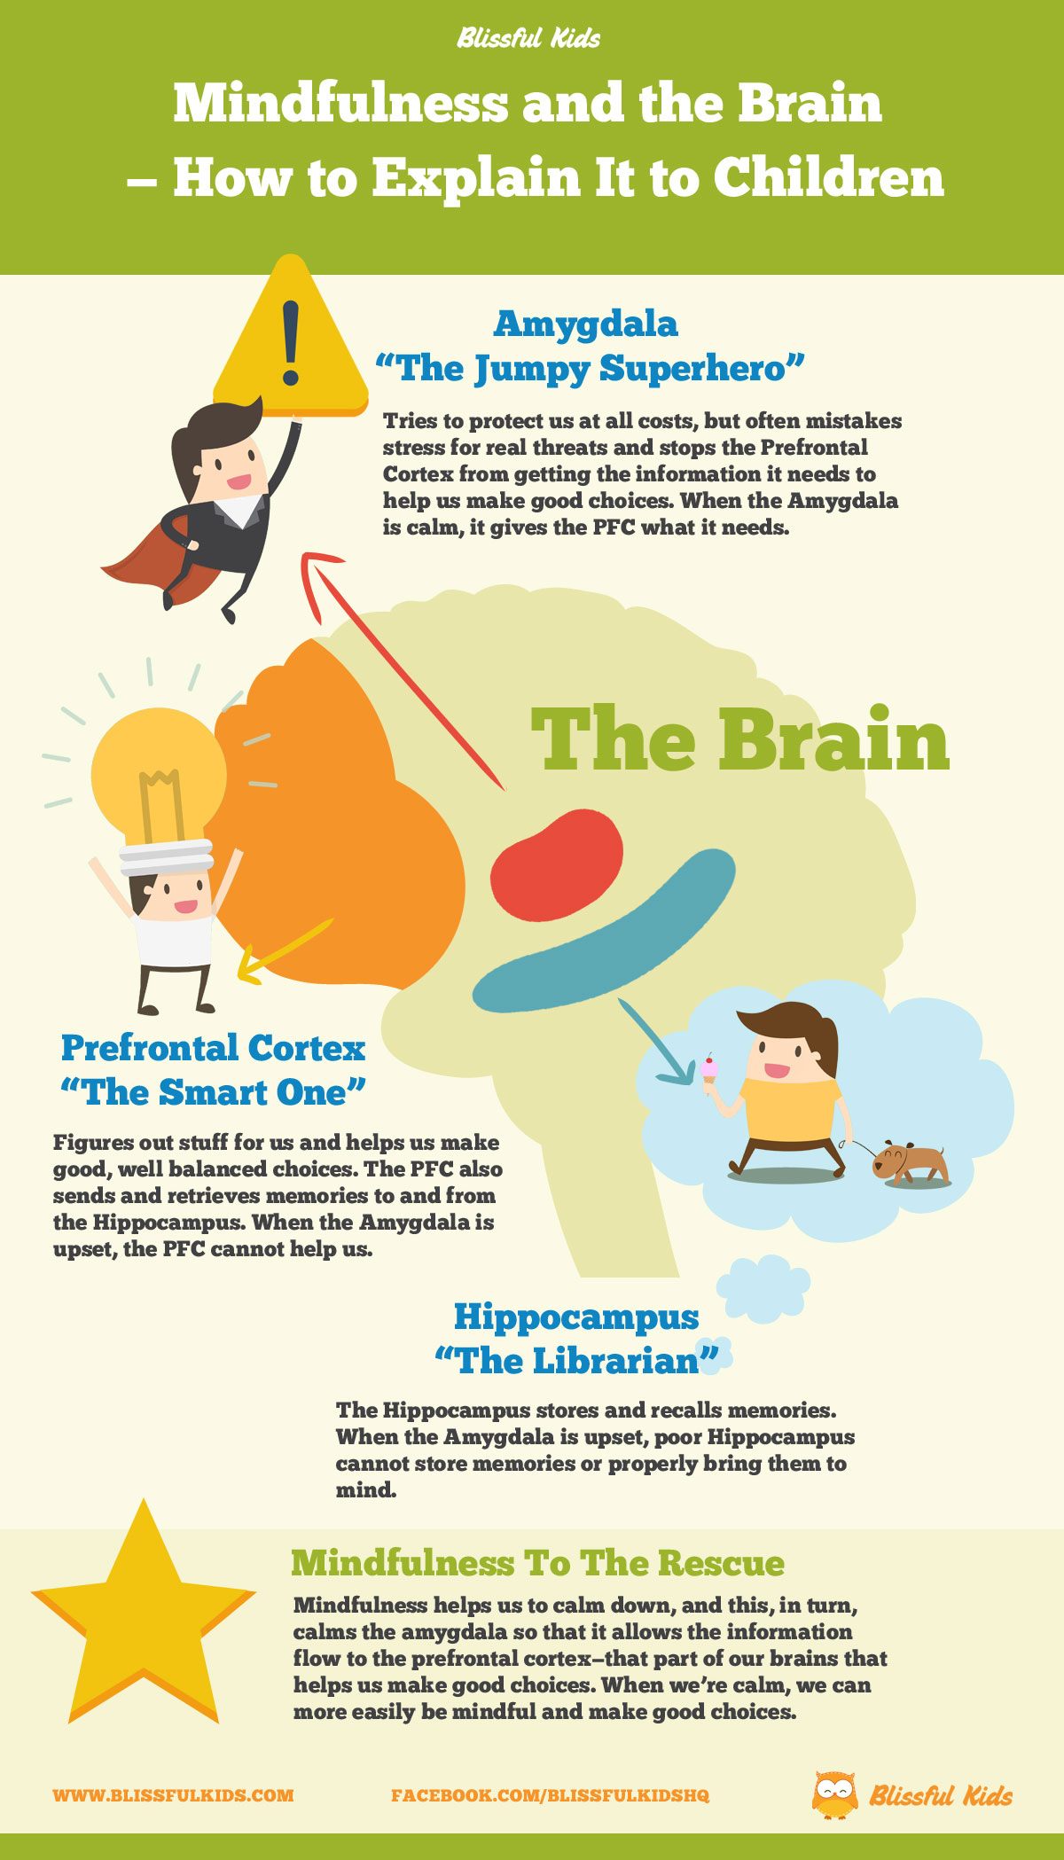

Slide 5
Mindful Awareness
The amygdala determines emotional responses by classifying incoming sights, sounds, smells, and movement as either potentially dangerous or enjoyable. Enjoyable input moves on the PFC, dangerous input is blocked and sparks an immediate reaction- fight, freeze or flight.
The amygdala can trigger reactive behavior that is unwanted or unwarranted. This is cause unmindful behavior.
When we process information before responding, this is called mindful behavior. This gives the PFC time to analyze, interpret, and prioritize information.

Slide 6
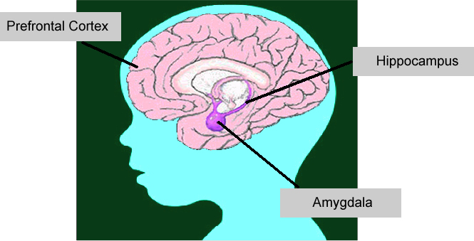
Getting to know your brain
Parts of your brain operate like a team:
PC= Quarterback (helps you pay attention and make good choices)
Amygdala= Blockers (alerts you to danger and keeps you safe- sometimes blockers move to fast and cause a penalty)
Hippocampus= Coach (keeps the playbook and remembers important information for later use)

Slide 7
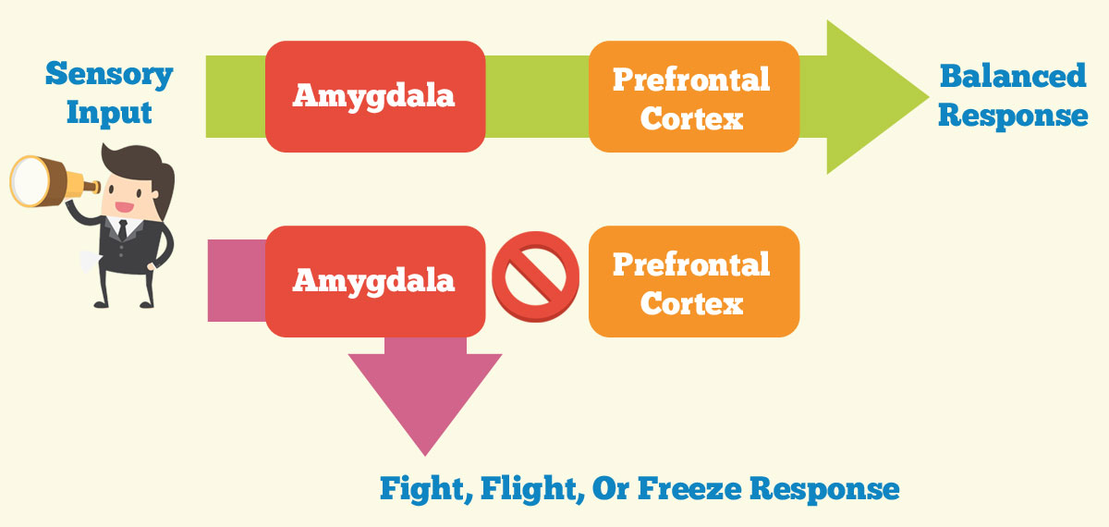
Mindful Awareness

Slide 8
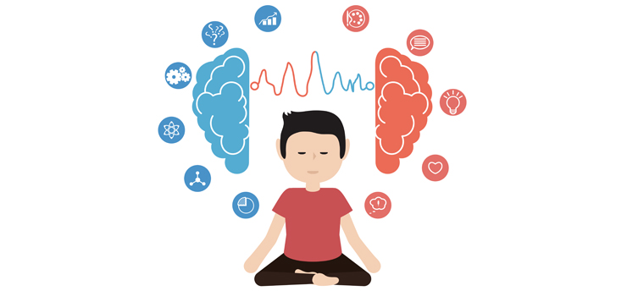
Mindful or unmindful?

Slide 9
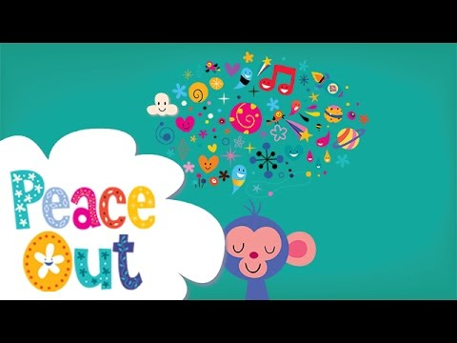
Mindfulness Strategies
Breathing
Grounding
Sensory Focus

Slide 10
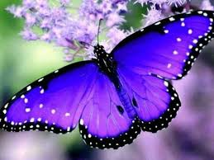
Sensory Meditation
Butterfly Meditation

