Slide 1
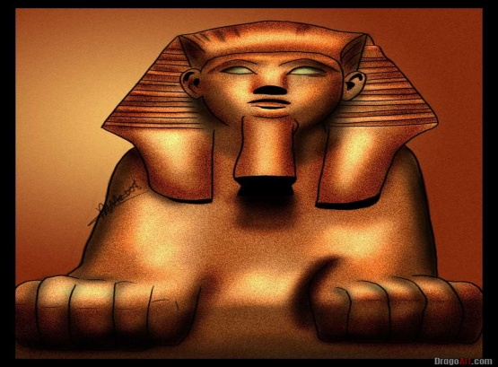
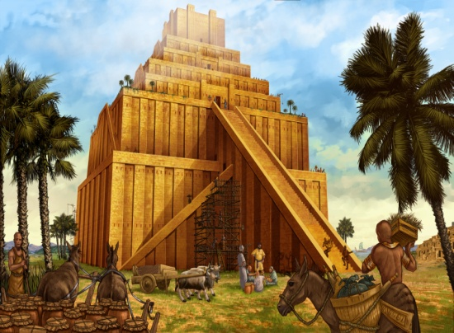
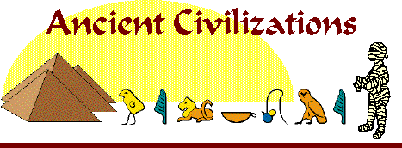

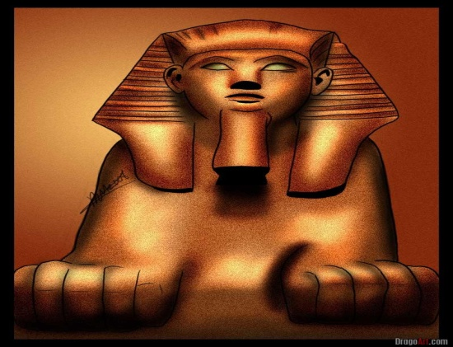
Mesopotamia, India, China, Egypt

Slide 2
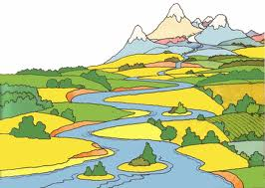
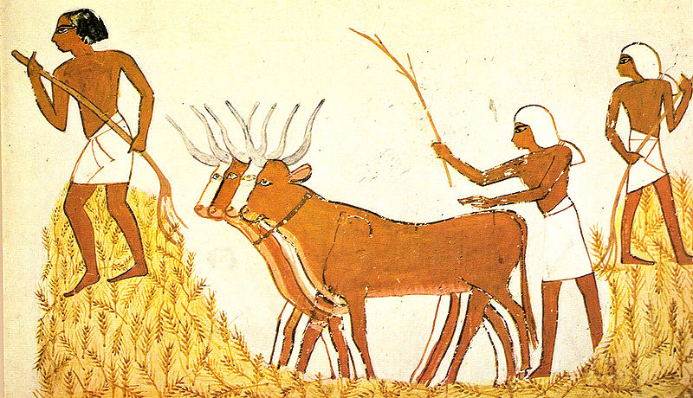
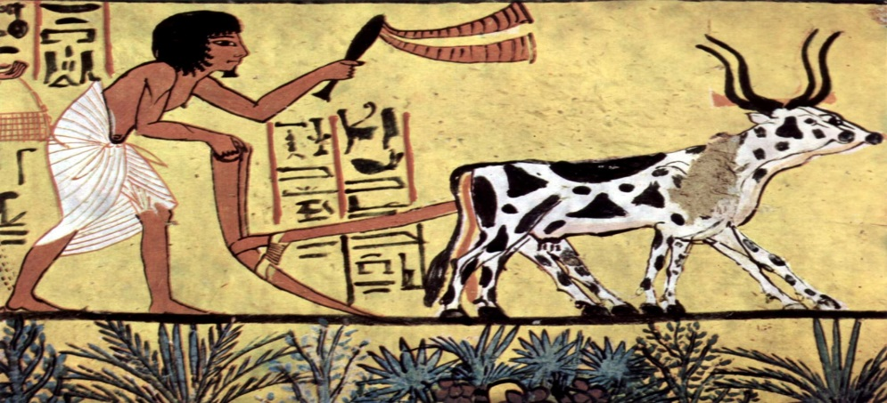
People migrated to where the food was located. This made them hunters and gatherers.
They also tended to gather near fresh water and places with usable natural resources.
After the Ice Age was over and the Earth warmed, the planet became more green.
The weather change made humans adapt from hunters and gatherers to an agricultural (farming) society.

Slide 3
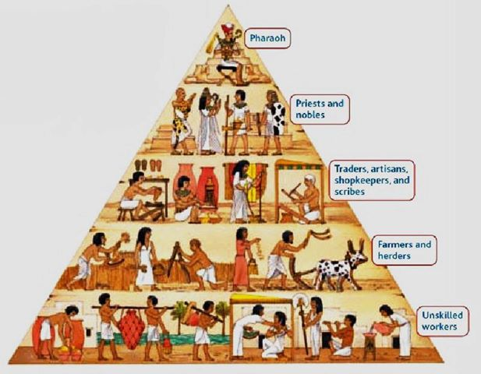
The more food means:
1. More people
2. Less need for
everyone to farm – therefore people could focus on what they were good at. This is called specializtaion of Labor.
3. Focus on building a
stable society.

Slide 4
Ancient
Civilizations

Slide 5
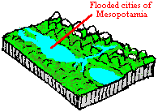
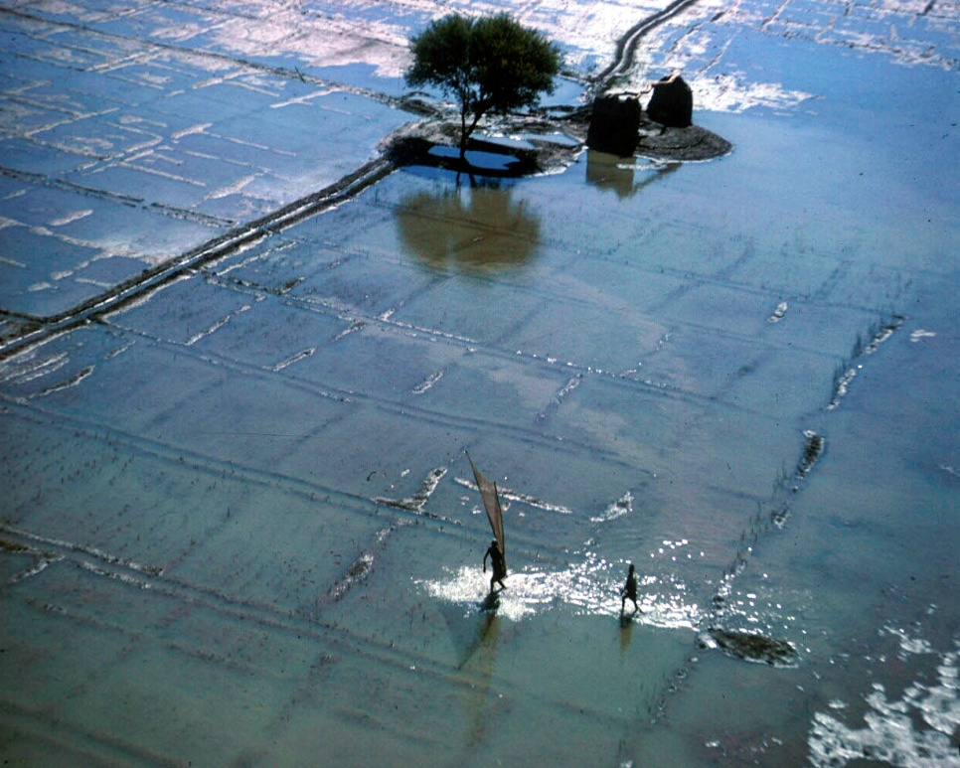
Most of the Ancient Civilizations that thrived were along major world rivers.
The rivers flooded and silt was left on the land.
Rivers also provided irrigation.
Mesopotamia is the land between the Tigris and Euphrates Rivers.
The Indus River is in India.
The Chinese River Valley is found along the Yellow River.
The Nile River is the foundation for the Egyptian civilization.

Slide 6
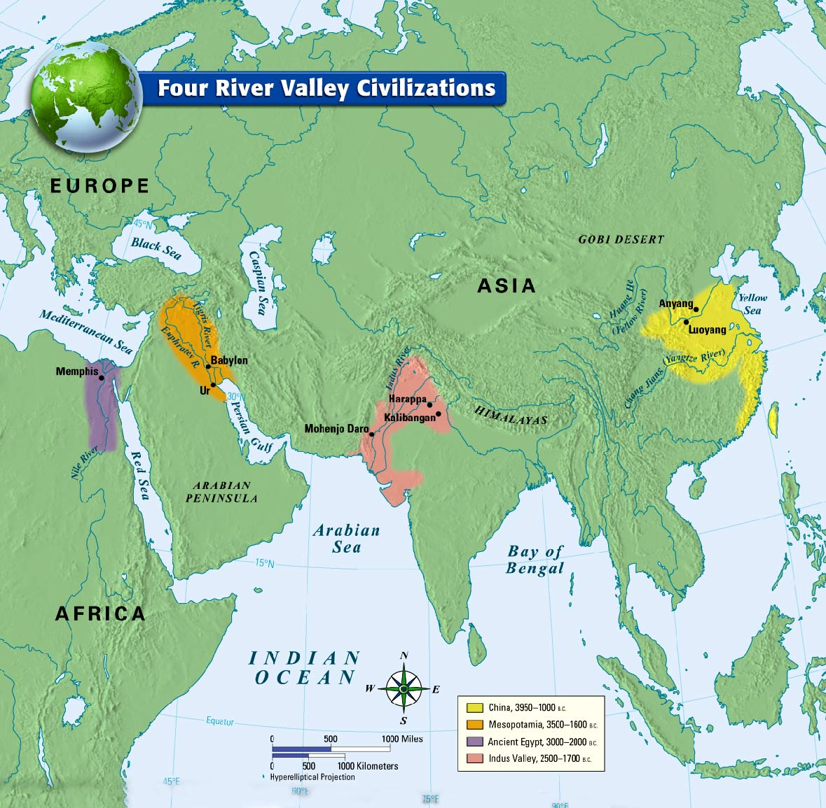

Slide 7
Mesopotamia
“The Land Between the Rivers”
People began to settle and farm the land between the Tigris and Euphrates Rivers.
Because of its curved shape, it was called the “Fertile Crescent.”
May be the oldest civilization at over 6,000 years old.
Many consider Mesopotamia the “cradle” of civilization.
The Tigris and Euphrates Rivers flooded and left a thick bed of mud called silt, perfect for farming.

Slide 8
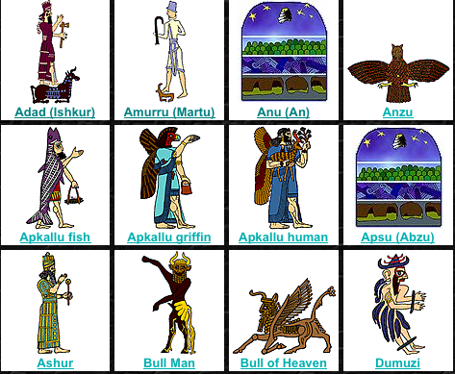
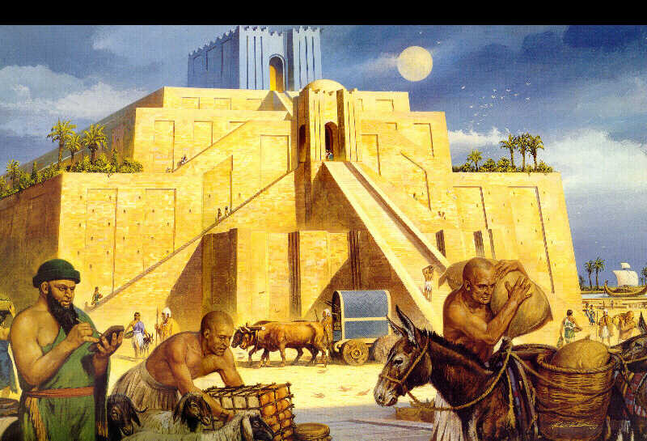
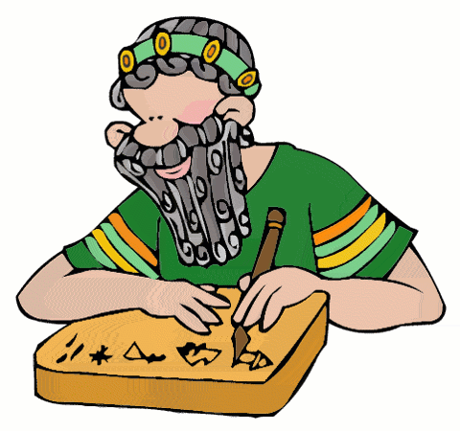
Cities were typically led by a series of rulers from the same family, a dynasty.
Priests led the polytheistic culture.
At the heart of the city was usually a ziggurat; both city hall and temple.
Sumerians helped build the ideas of math:
60 seconds in minute;
360 degrees of a circle.
They also helped develop arches, columns, and of course the wheel.
They also created a system of
writing called cuneiform.

Slide 9
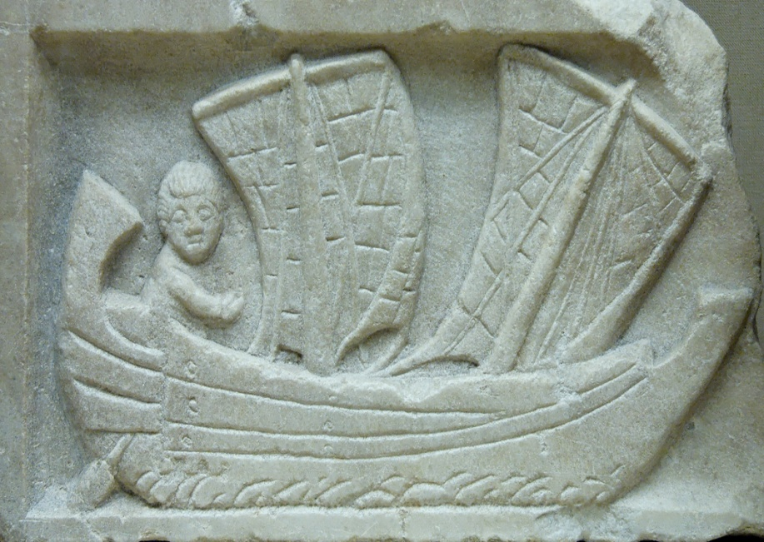

Mesopotamia
Sumerians were very talented. Many focused on trade and building, not just farming.
Artisans were those who were skilled at their profession.
Many traders brought new ideas across the known world, creating cultural diffusion.

Slide 10
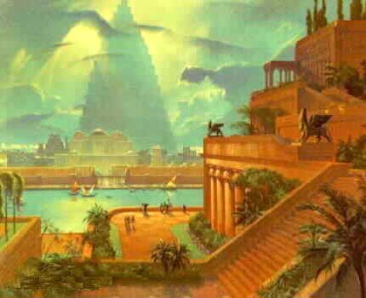
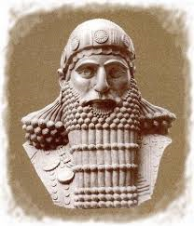
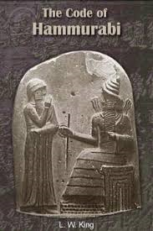
Babylon became the capital, and Hammurabi was their strong leader.
He developed a strict code of laws, The Code of Hammurabi. Copies were placed all over the empire.
Most of the nearly 282 laws written on the pillar pertain to property rights of landowners, slavemasters, merchants, and builders.
Ex. Law #196:
"If a man destroy the eye of another man, they shall destroy his eye. If one break a man's bone, they shall break his bone. If one destroy the eye of a freeman or break the bone of a freeman he shall pay one gold mina. If one destroy the eye of a man's slave or break a bone of a man's slave he shall pay one-half his price."

