Slide 1
Matter
Vocabulary Terms

Slide 2
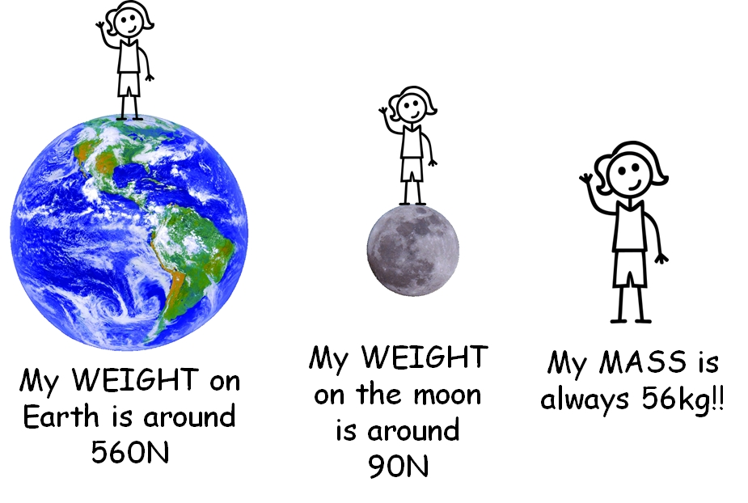
Mass
The amount of matter in an object.

Slide 3
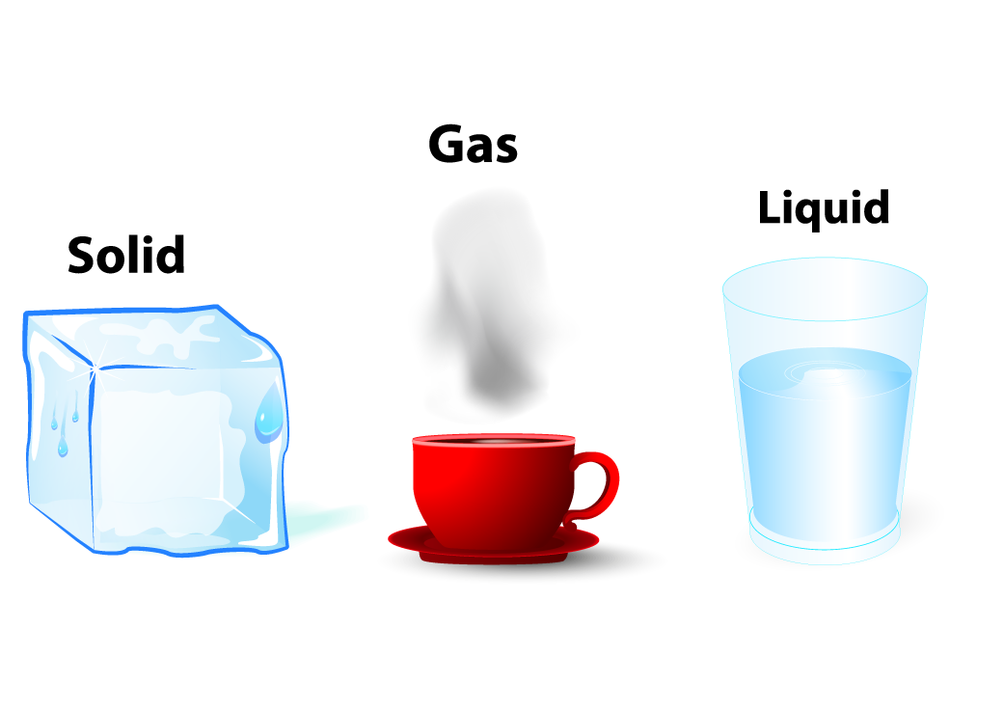
Matter
Anything that has mass and takes up space.

Slide 4
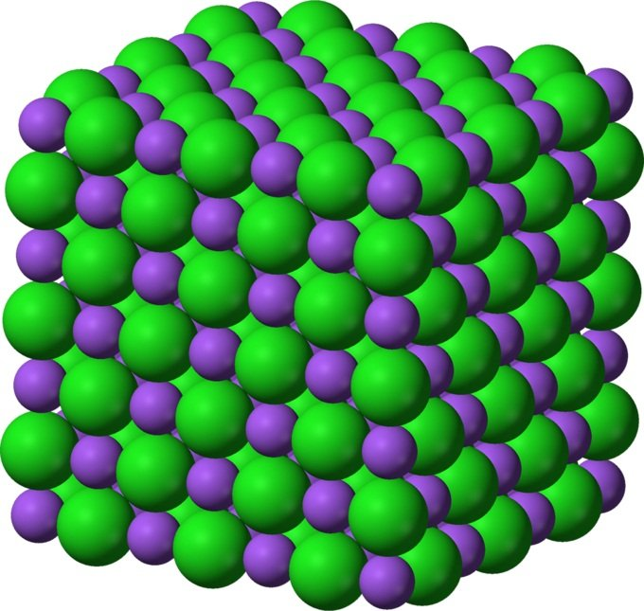
Solid
A state of matter that has a definite shape and volume.

Slide 5
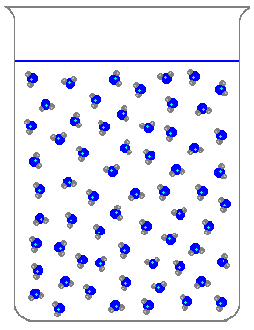
Liquid
A state of matter with definite volume, but no definite shape (can take the shape of its container).

Slide 6
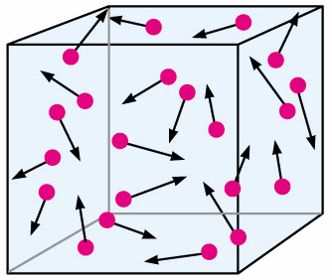
Gas
Particles of matter that move very fast. They spread out with a lot of empty space.

Slide 7
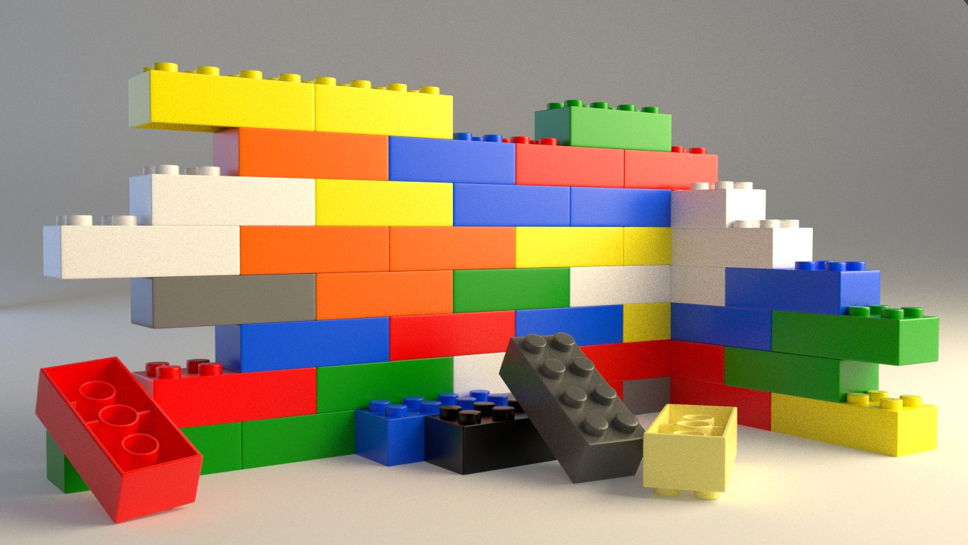
Law of Conservation of Matter
The mass of an object or a collection of objects never changes, now matter how the parts are rearranged. The sum of the parts are equal to the total sum.

Slide 8
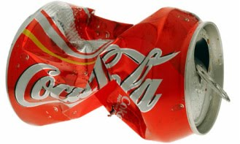
Physical Changes
A change that does not make a new substance.

Slide 9
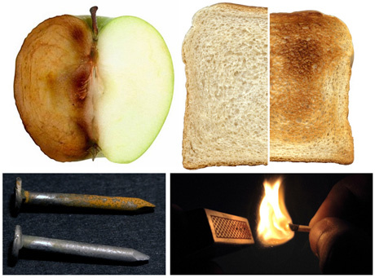
Chemical Change
Matter reacts with other matter to form a new substance or material.

Slide 10
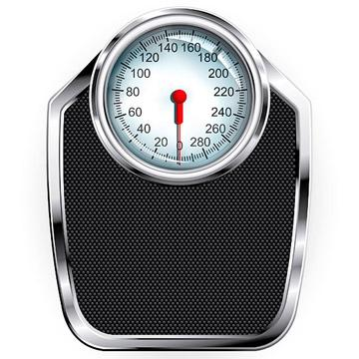
Weight
The pull of gravity on an object.

Slide 11
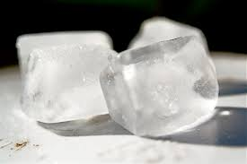
Freezing Point
When a substance changes phase from liquid to solid.

Slide 12
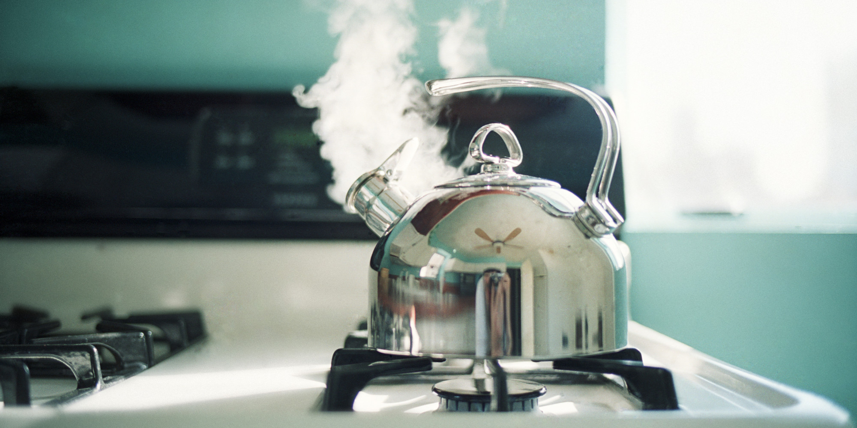
Boiling Point
When a substance changes phase from liquid to gas.

Slide 13
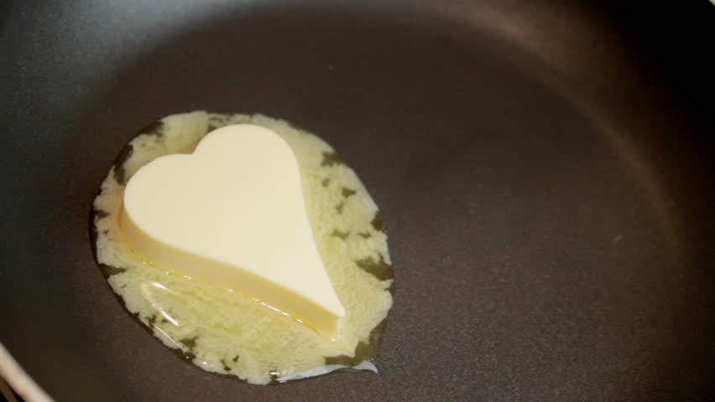
Melting Point
When a substance changes phase from solid to a liquid.

Slide 14
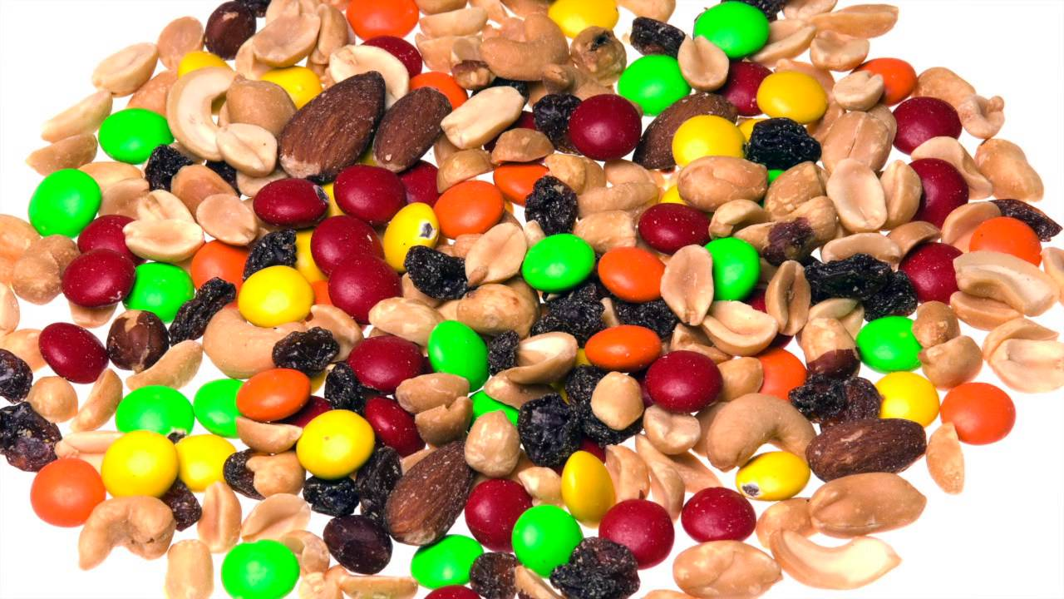
Mixture
A physical combination of substances that remain the same.

