Slide 1
MODERN HISTORY
DANCE

Slide 2
MODERN DANCE
Modern dance emerged in the US started in the early 1900’s as a contrast and a challenge to the rigorously structured world of ballet, it was not readily accepted as an art form. It is uniquely American, although a similar movement evolved in Germany. Modern dance was interested in the communication of emotional experiences- through basic movement, through uninhibited movement- not through the academic tradition of ballet masters. It is however, a popular art form of today.

Slide 3
Differences between ballet and modern dance
Ballet
  Looks to European aristocracy for its traditions
  Very structured and movement vocabulary is similar all around the world.
  Focus on arms and legs and strives tot defy gravity.
  Examples of steps seen in ballet: positions of the feet and arms, plies, tendus, pirouettes, everything is done in turn out and dancers often dance in pointe shoes.
  Tends to be about ‘make believe’ situations such as fairy tales.
  Ballet companies tend to perform choreography by many different people and are named after their location (i.e. Boston Ballet)
Modern
  Looks within the individual for inspiration
  Modern dance movement vocabulary varies depending on which choreographer’s style you are studying.
  Focus on torso and often gives into gravity.
  Examples of steps seen in modern: contract/release, fall/recovery, swings, ballet type exercises done in parallel and turnout, laterals, use of breath, X on floor, use of floor, incorporates improvisational activities and dancers often dance barefeet
  Modern dance may deal with social concerns and ideas of the time and focuses on individuality and improvisation
  Modern companies often perform mainly work of the director, after whom the company is named after, however, some companies such as Alvin Ailey American Dance Theatre bring in a wide variety of choreographers.

Slide 4
Pioneers of Modern Dance
In the early 1900’s, modern dance was spearheaded by Isadora Duncan, Loie Fuller, Ruth St. Denis, and Ted Shawn
These artists all began performing in the popular theatres of the day, but were drawn to making more serious work.
Some emphasized self expression while others focused on creative use of lights, costumes, décor, and fusing other cultural dances.

Slide 5
Isadora Duncan
-The most famous of these was Isadora Duncan who had a huge impact on dances and society.
-Born in CA and was as an early feminist; believed marriage was too restrictive thought dance should be inspired by nature, and also looked to ancient greece for inspiration.
-Thought dance was an expression of the spirit.
-Felt ballet was artificial.
-She helped discover and define improvisation and used a lot of pedestrian movement.
-Aesthetic dance- appealed to senses and feelings. She believed dance is the expression of pure emotion.
-Barefoot and loose clothing such as tunics (no corsets or tight restrictive clothes).
-Believed all movement came from the solar plexus- pit of the stomach, center of body.
-Had a dramatic personal life.
-Better dancer than teacher- never really had her own technique.
-Known for most self-expression.

Slide 6
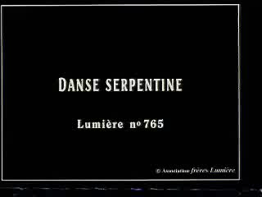
LOIE FULLER
1900’s, one of the three Precursors of Modern Dance along with Isadora Duncan and Ruth St. Denis.
Famous for dancing with scarves and sticks while changing forms into flowers and butterflies.
Invented her own multi-lighting design which contributed to color gels of today.
http://www.youtube.com/watch?v=fIrnFrDXjlk

Slide 7
Ruth St. Denis
(1879-1968) was inspired by the Orient and incorporated a variety of cultural dances in her pieces. Ted Shawn was her dance partner and her husband and together the created a famous school in Los Angeles called Denishawn. Hundreds of dancers trained at Denishawn and learned a variety of dance styles much like dance studios in America today.

Slide 8
The founders
Just as the pioneers revolted against ballet & vaudeville, the Founders rebelled against the pioneers in the 1920’s and 30’s.
Some of them studied at Denishawn and found the dance too commercial.
They wanted to establish the freedom and independence of modern dance.
They called in “modern dance” to distinguished it from expressionist dance and ballet.
The dance was severe rather than pretty and emphasized integrity over commercial success.

Slide 9
Martha Graham
(1894-1991)
Martha studied at Denishawn in 1916-1923.
Founded her own should in NY in 1927.
Created a technique based on contraction and release.
Style stressed angularity & extreme muscle tension to show passion.
Known for creativity works with psychological themes, social issues of the time, heritage and exploring inner emotions.
http://www.youtube.com/watch?v=xgf3xgbKYko

Slide 10
Doris Humphrey
(1895-1958)
Went to Denishawn in 1915; left in 1928 to create her won company.
Like Graham, felt Denishawn technique was artifical; wanted a more serious dance form.
Created a technique based on fall and recovery.
Wrote the first book on choreography; The Art of Making Dance in 1959.

Slide 11
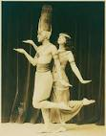
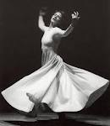
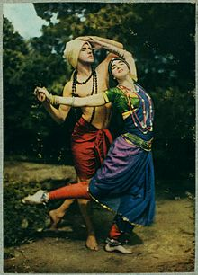




Slide 12
The post-war generation
After WWII, in the late 1940’s, modern dance came into its own. Dancers were less concerned with rebelling and more interested in building on current trends. Modern dance became established in higher education, and became more accepting of ballet. African American artists began to be recognized more.

Slide 13

POST MODERN DANCE MID 1900’s
Katherine Dunham and Pearl Primus: 2 black women who both held doctorates in anthropology, had undertaken African and Caribbean to wildly enthusiastic audiences of every color.
http://www.youtube.com/watch?v=dKWQODJA4yE
http://www.youtube.com/watch?v=HLNFijDYaX0

Slide 14
Alvin Ailey
(1931-1989)
Well known African-American dancer and choreographer.
Started dancing when he was 22 years old.
Studied under a wide variety of dancers such as Martha Graham and Lester Horton.
Known for using a wide variety of dance styles and appealing to the masses.
Used his ‘blood memories’ from growing up in the south to create dances. His dances told a story.
Created Alvin Ailey Dance Theatre.
He wanted to create opportunities for African Americans to perform concert dance.
His style blends elements of modern, ballet, jazz and African and stresses African-American themes.
Despite his death in 1989, his company and school are still going strong and his work is known around the world.
He choreographed over 70 dances and his signature work, Revelations is based on spirituals and the African American experiences.

Slide 15
Alwin Nikolais
(1910-1993)
His dances were abstract and weren’t focused on telling a story. He played with lighting and visuals to create illusions.
PILOBOLUS
A modern performance company founded in 1971, that creates inventive, athletic, witty, collaborative performance works on stage and screen using the human body as a medium for expression.

Slide 16
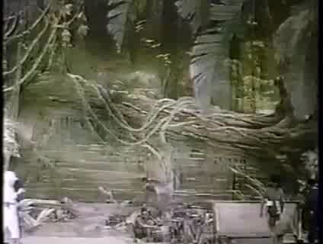
Josephine Baker was famous for her Banana Dance.
Mark Morris choreographed the comedic version of The Nutcracker titled The Hard Nut.
Merce Cunningham Leader of American Avant-garde
Twyla Tharp choreographed Hair and Moving Out.
http://www.youtube.com/watch?v=ZmnIZrg_1iQ
http://www.youtube.com/watch?v=AfxsFTDWWnw
http://www.youtube.com/watch?v=wmw5eGh888Y
http://www.youtube.com/watch?v=gWJzSP7irwM
http://www.youtube.com/watch?v=drFs3cWP1uw
http://www.youtube.com/watch?v=RC7Qh0Jy6YQ
http://www.youtube.com/watch?v=Jf6_A-wZiKk

Slide 17
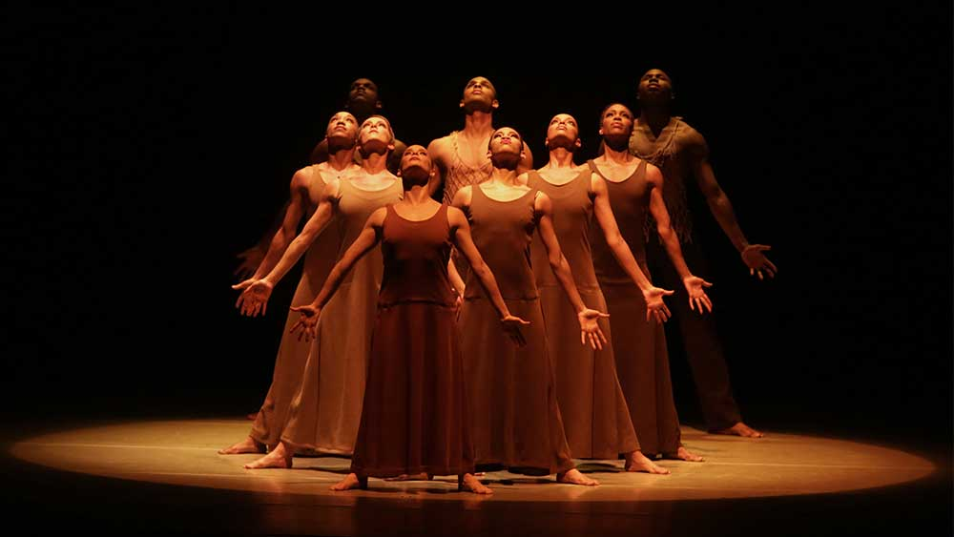
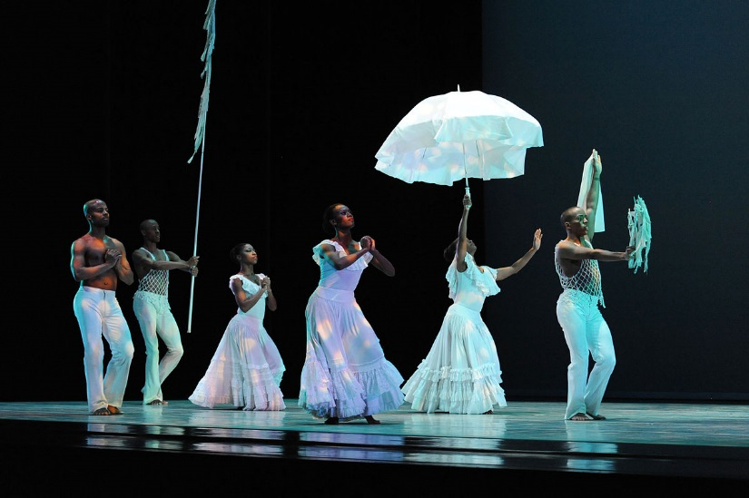
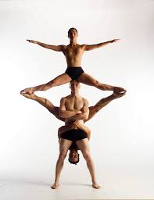
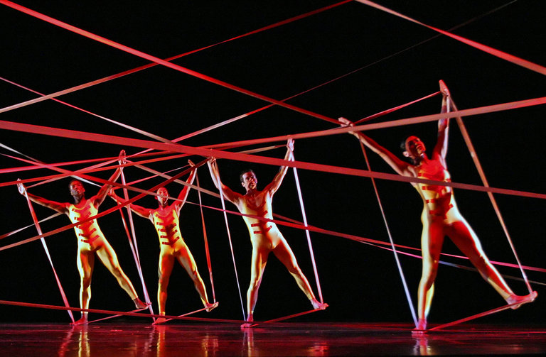

Slide 18
Judson Dance Theatre or Judson Group: A company that allowed dancers to perform pedestrian style movement. There were no dues, no rules, and or organization.

Slide 19
Modern dance since the 1980’s
Modern dance today offers a broad range of approaches, some narrative, some structural, some mainly athletic.
Technical skills of varied types are back in demand.
New kinds of dance include aerial dance integrated dance (wheelchairs), and various hybrids of modern & ballet, modern & hiphop, and other combinations.
Skill emphasizes individual expression.

Slide 20
BIBLIOGRAPHY
Anderson, Janet. World Of Dance: MODERN DANCE. 2004. Chelsea House Productions.
http://www.youtube.com/watch?v=YNZ4WCFJGPc
Pearl Primus:
http://www.youtube.com/watch?v=dKWQODJA4yE
Josephine Baker- Banana Dance:
http://www.youtube.com/watch?v=wmw5eGh888Y
Martha graham:
http://www.youtube.com/watch?v=xgf3xgbKYko
Alwin Nikolais:
http://www.youtube.com/watch?v=ZmnIZrg_1iQ
http://www.youtube.com/watch?v=AfxsFTDWWnw
Katherine Dunham- Stormy Weather:
http://www.youtube.com/watch?v=HLNFijDYaX0
Twyla Tharp:
http://www.youtube.com/watch?v=RC7Qh0Jy6YQ
http://www.youtube.com/watch?v=Jf6_A-wZiKk
Mark Morris:
http://www.youtube.com/watch?v=drFs3cWP1uw
Alvin Ailey:
http://www.youtube.com/watch?v=gWJzSP7irwM

