Slide 1
MLA
8th Edition

Slide 2
What is MLA?
Modern Language Association (MLA) is way to organize and format writing
Most often used in the Humanities discipline:
  - Language - Art
  - Literature - Theatre
  - History - Religion
MLA Regulates:
  Document format
  In-text citations
  Works-cited list

Slide 3
MLA General Format
An MLA Style paper should:
  Be typed on white 8.5“ x 11“ paper
  Double-space everything
  Use 12 pt. Times New Roman (or similar) font
  Leave only one space after punctuation
  Set all margins to 1 inch on all sides
  Indent the first line of paragraphs one half-inch using the “Tab” key

Slide 4
MLA General Format
An MLA Style paper should:
Have a header with page numbers located in the upper right-hand corner
Use italics for titles and quotation marks for sources within titles (e.g., chapters within books)

Slide 5
Formatting the First Page
The first page of an MLA Style paper will:
Have no title page
Double space everything
List your name, your instructor's name, the course, and date in the upper left-hand corner
Center the paper title (use standard caps but no underlining, italics, quote marks, or bold typeface)
Create a header in the upper right corner at half inch from the top and one inch from the right of the page (list your last name and page number here)

Slide 6
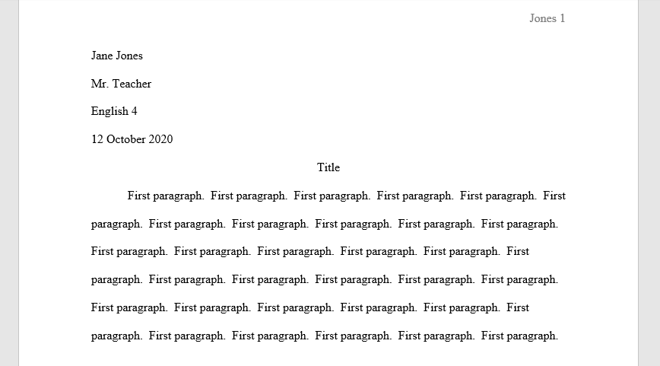
Sample First Page

Slide 7
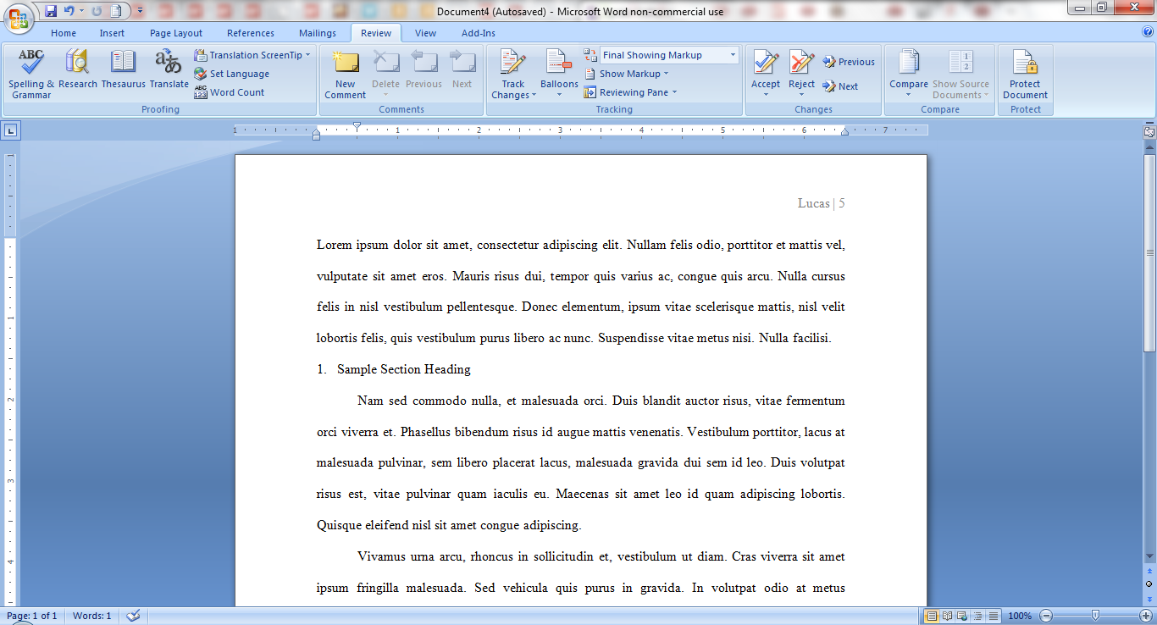
Formatting Section Headings
Section Headings are generally optional but should be consistent in grammar and formatting.
  Improve readability
  Are usually numbered

Slide 8
Consulting Core Elements
When figuring out how to cite your source, consult the list of core elements. MLA suggests including each of these in a Works Cited entry. In a citation, the elements should be listed in the following order:
Author
Title of source
Title of container
Other contributors
Version
Number
Publisher
Publication date
Location

Slide 9
Consulting Core Elements
https://owl.purdue.edu/owl/research_and_citation/mla_style/mla_formatting_and_style_guide/mla_formatting_and_style_guide.html

Slide 10
In-text
Citation

Slide 11
In-text Citation
An in-text citation is a brief reference using parenthetical citations in your text to indicate the source you are directly referring.
  Any source you provide in-text must match what is provided on the Work Cited page (at the end of the paper)
  It will be the author’s last name (or abbreviated title if no author) with a page number, enclosed in parentheses

Slide 12
In-text Citation: The Basics
https://owl.purdue.edu/owl/research_and_citation/mla_style/mla_formatting_and_style_guide/mla_in_text_citations_the_basics.html

Slide 13
In-text Citation: Quotations
https://owl.purdue.edu/owl/research_and_citation/mla_style/mla_formatting_and_style_guide/mla_formatting_quotations.html

Slide 14
Works
Cited

Slide 15
Works Cited Page
A Works Cited page is a list of the resources referenced in the body of the paper
All in-text citations should be listed and match what is on the Works Cited page

Slide 16
Works Cited Page
Works Cited page begins on a separate page at the end of your paper.
It should have the same one-inch margins and last name, with a page number header as the rest of your paper
Label the page Works Cited (do not italicize the words Works Cited or put them in quotation marks) and center the words Works Cited at the top of the page.
Citations begin flush left
Double space all citations, but do not skip spaces between entries.
Indent the second and subsequent lines of citations by 0.5 inches to create a hanging indent.

Slide 17
Works Cited: Basics
When listing page numbers in citation, if only one page of a print source is used, mark it with the abbreviation “p.” before the page number (e.g., p.157).
When referring to multiple pages, mark it with the abbreviation “pp.” before the page number (e.g., pp.157-68).
Omit the first set of repeated digits when referencing multiple pages (e.g. pages 157-168 would be pp.157-68, and pages 225-250 would be pp. 225-50).

Slide 18
Works Cited: Basics
Capitalize each word in the titles of articles, books, etc.
Do not capitalize articles (a, and, the), prepositions, or conjunctions unless one is the first word of the title or subtitle: Gone with the Wind, The Art of War, There Is Nothing Left to Lose.
Use italics (instead of underlining) for titles of larger works (books, magazines)
Use quotation marks for titles of shorter works (poems, articles)

Slide 19
Works Cited: Basics
Known Author:
  Entries are listed alphabetically by author’s last name. Author names are written with the last name first, and then first name, followed by middle name or middle initial if provided
    Jones, Robert.
    Smith, Timothy J.
    Rowe, Susan Ford.
No Known Author:
  Alphabetize by title

Slide 20
Works Cited: Books
https://owl.purdue.edu/owl/research_and_citation/mla_style/mla_formatting_and_style_guide/mla_works_cited_page_books.html

Slide 21
Works Cited: Periodicals
https://owl.purdue.edu/owl/research_and_citation/mla_style/mla_formatting_and_style_guide/mla_works_cited_periodicals.html

Slide 22
Works Cited: Electronic Sources
https://owl.purdue.edu/owl/research_and_citation/mla_style/mla_formatting_and_style_guide/mla_works_cited_electronic_sources.html

Slide 23
Works Cited: Common Sources
https://owl.purdue.edu/owl/research_and_citation/mla_style/mla_formatting_and_style_guide/mla_works_cited_other_common_sources.html

Slide 24
Works Cited: FAQs
https://owl.purdue.edu/owl/research_and_citation/mla_style/mla_formatting_and_style_guide/mla_faqs.html

Slide 25
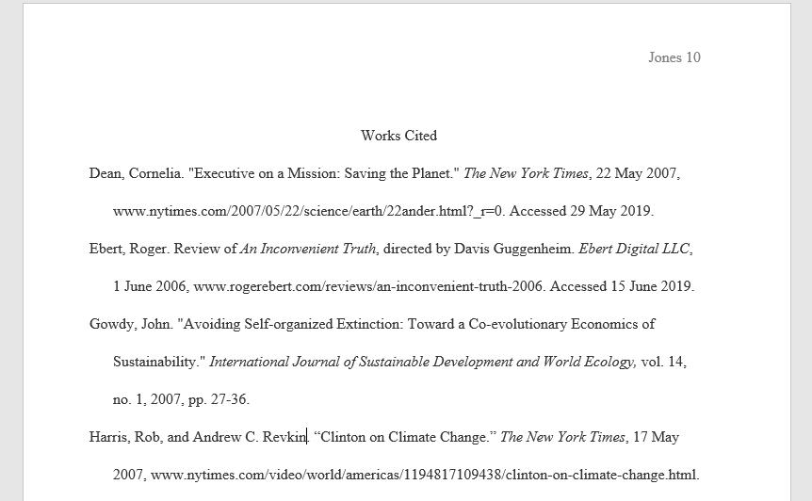
Works Cited: Sample

Slide 26
SAMPLE MLA PAPER
https://owl.purdue.edu/owl/research_and_citation/mla_style/mla_formatting_and_style_guide/mla_sample_paper.html

Slide 27
Works Cited
“Ashford University.” Ashford University, 28 July 2014, www.ashford.edu/blog/online-learning/mla-versus-apa-format. Accessed 7 Apr. 2020.
"MLA Formatting and Style Guide." The Purdue OWL, Purdue U Writing Lab.
https://owl.purdue.edu/owl/research_and_citation/mla_style/mla_formatting_and_style_guide/mla_general_format.html Accessed 7 Apr. 2020.

