Slide 1
Living Organisms
Unit 2 – 5th Grade Science

Slide 2
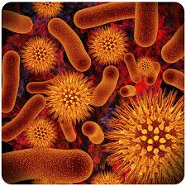
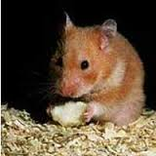
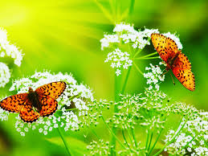
Setting up your journal
Title Page
  “Living Organisms” should be written on the page and you should include illustrations

Slide 3
Table of Contents
  Page 3 – Essential Questions
  Pages 4 – 7 - Vocabulary
Essential Questions
  How is structure and function related in living things?
  How are the systems of the human body interconnected for survival?
  In what ways are organisms able to maintain life?

Slide 4
Vocabulary
cell – the basic unit of structure and function for all living things
unicellular- living thing made of only one cell
multicellular- living thing made of more than one cell- like the human body
cytoplasm- jelly like fluid has many chemicals that help the cell stay alive
organelle- means "little organ" structures inside the cell that carry out different functions.
nucleus- cell's command center. controls cell actions, contains the DNA
cell membrane- holds the parts of the cell together, provides a barrier between the cell and its surroundings

Slide 5
Cells
A cell is the smallest living part of an organism
Some living organisms are made up of only one cell. That single cell is the organism's entire body. Bacteria are an example of a single cell organism.
Organisms that are made up of more than one cell are called multi-cellular organisms. People, animals, and plants have multi-cells.
The size and shape of a cell depends on its function. Example: red blood cells are small and disc shaped (so that they can easily fit through the smallest blood vessels)
Cells work together to perform basic life processes that keep organisms alive (release energy from food, get rid of body wastes, make new cells for growth and repair)
Brainpop – Cells
Brain Pop - Cell Structure

Slide 6
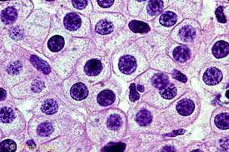
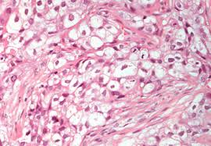
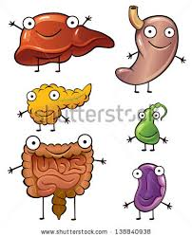
Cells form tissue →
← Tissues form organs
Organs form organ systems →

Slide 7
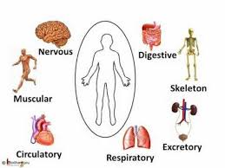
Organ Systems

Slide 8
Tissues, Organs, and Systems
Tissue: a group of the same kind of cells that work together doing the same job
  Tissue example: Muscle cells group in bundles to make up muscle tissues.
  4 kinds of tissues in humans: muscle, nervous, connective, and epithelial
Organ: a structure made of different tissues that work together to complete a main job in the body
  The heart, eyes, ears, stomach, and skin are all organs
  Each organ performs a major function that keeps the animal alive (ex: the heart pumps blood throughout the animal’s body)
System: a group of organs that work together to carry out a life process
  Blood cells, blood vessels, and the heart work together to move materials through the body. The mouth, stomach, intestines, and other organs work together to digest food.

Slide 9
Cell Transport
Cells use several methods of moving substances across the plasma membrane.
Sometimes they must get these substances and other times they release them.
Methods are classified on whether or not they need energy.

Slide 10
Cell Transport - continued
Active transport- Movement of materials through a cell membrane using energy.
Cell Energy PUSHES the carrier proteins through channels in the cell membrane.
Like traveling upstream against the current. You must use energy to paddle the canoe.
Brain Pop - Active Transport
Passive transport- Movement of materials through a cell membrane without the use of energy. Traveling downstream in a canoe you don’t need to use a paddle.
Brain Pop - Passive Transport

Slide 11
Skeletal Vocabulary
skeletal system: is made of bones and cartilage.
cartilage: is a strong tissue that is more flexible than bone
joint: two or more bones meet; different kinds

Slide 12
Skeletal System
Performs five important functions:
1. supports your body and gives it its shape
2. protects your internal organs. For example, your skull protects your brain.
3. allows you to move when muscles pull on bones
4. stores substances such as calcium
5. makes red blood cells that carry oxygen and white blood cells that fight germs.

Slide 13
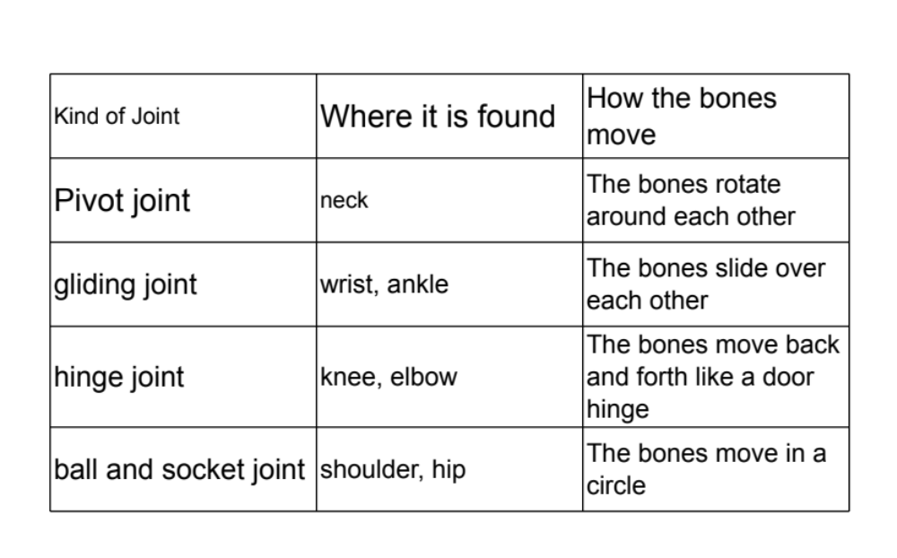
Joints

Slide 14
Brain Pop video – Skeletons
Brain Pop video – Joints
You will draw an illustration of a human bone. You will use the text book to help you :o)

Slide 15
Owl Pellets
Owls hunt during the night and their diet consists of small animals and rodents.
They eat their prey whole, but the whole prey is not digestible.
Their digestive tract breaks down the food, and the undigested portions of their meal, such as bones and fur, are compacted into a pellet that the owl coughs up and out through its mouth.
As you dissect your owl pellet, be careful not to break any bones.
You will use the chart to identify the bones you have found and record the names of them along with illustrations in your journal.

Slide 16
Muscular Vocabulary
muscular system- the system that allows for movement. It consists of both voluntary and involuntary muscles.
involuntary muscle- a muscle that contracts without conscious control (happen without you thinking about it). ex: heart, organs in your digestive track
voluntary muscle- a muscle that is under conscious control (you need to think about it for it to happen). ex: arms and legs

Slide 17
Muscular System
Performs 4 important functions:
  Moves your body parts
  Moves food through your Digestive System
  Pumps blood through your Circulatory System
  Makes you breathe
The muscles that make your body move are attached to bones. When one of these muscles contracts, or gets shorter, it pulls on the bone it’s connected to and the bone moves. A muscle has a bulging middle and narrow ends called tendons. The tendons attach the muscle to a bone.
Many skeletal muscles work in pairs. When one muscle in the pair contracts (or shortens), the other muscle relaxes.

Slide 18
3 kinds of muscles in the body
  Skeletal muscles – move bones and are controlled by you. Example: when you kick a soccer ball, skeletal muscles pull on the bones in your lower leg.
  Cardiac muscles – make your heart beat and pump blood through your body; your heart beats automatically without you thinking about it (you cannot control your heart muscles).
  Smooth muscles – found in many of your organs (like the stomach); let your breathe, cough, and sneeze. They work automatically, but you can control some of them. For example, you can cough on purpose if you want to.
Brain Pop video - Muscles

Slide 19
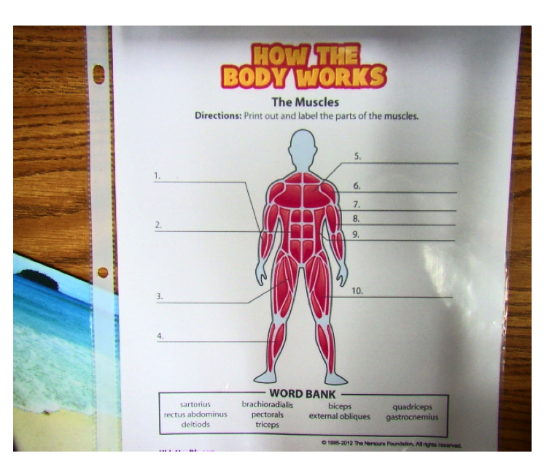
pectorals
brachioradialis
deltiods
triceps
rectus abdominus
external obliques
sartorius
quadriceps
gastrocnemius

Slide 20
Nervous System Vocabulary
Central nervous system: controls all of your body’s activities. The other systems would not function without the nervous system.
Brain: the control center of your body; gets information from senses, controls how to respond to the information, and allows you to think and store memories
Spinal cord: long bundle of nerves that runs from your brain down your back and is protected by the backbone. Messages to and from your brain travel through the spinal cord.
Nerves: made of nerve cells that transmit messages. They carry messages from all parts of your body to your spinal cord and brain and then back again.
Peripheral nervous system: the part of the nervous system outside of the brain and spinal cord that is made of nerves

Slide 21
Nervous System
Main structures: brain, spinal cord, sensory organs, nerves
Our nervous system is important because without it our bodies wouldn't receive and process signals that allow us to see, smell, taste, touch, hear, move, think, remember, feel, etc.
Nervous system is divided into two parts: the central nervous system (which contains the brain and spinal cord) and the peripheral nervous system
The basic building blocks of the nervous system are nerve cells called neurons, which are responsible for transmitting information throughout the entire body.
Brain Pop - The Nervous System

Slide 22
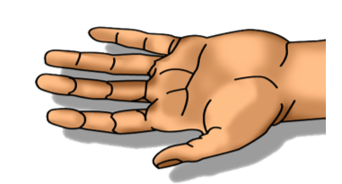
Example of a Neuron
Brain Pop - Neurons
Dendrites >>>>>>>
Receives messages from other neurons
Axon
<<<<<<<<<<<
Receives messages from the cell body and sends them to another neuron
^Soma/cell body^
Controls whether the message is sent

Slide 23
The Brain
Your brain is made of three main parts and each part has different functions
The cerebrum controls body movements that you decide to make. It also controls learning, thinking, memory, and imaginations. The cerebrum is the part of your brain that receives information from your sense organs.
The cerebellum coordinates the movement of your muscles. It also helps you keep your balance
The brain stem controls your breathing, heartbeat, and movements inside your digestive system. This part of the brain functions automatically, even when you are sleeping.
Brain Pop - the Brain

Slide 24
Respiratory System Vocabulary
respiratory system- takes in oxygen and gets rid of waste gases (like carbon dioxide).
inhale- breathe in
exhale- breathe out
diaphragm- domed shaped muscle under your lungs/ribcage that helps you breathe

Slide 25
Organs in the Respiratory System
Mouth and Nose- air enters your body through these and exits the same way
Trachea- Air travels through this organ toward your lungs. Waste travels back up this tube to be removed when you exhale.
Bronchi- the trachea branches into 2 tubes called bronchi. One tube leads to each lung.
Lungs- When you inhale, your lungs take in air and pass through to the red blood cells. When you exhale, the waste comes back through your lungs and back out of your body.

Slide 26
Respiratory System
When you inhale, you take air into your lungs. Your body’s cells need oxygen to release energy from the nutrients in food.
In your lungs, the oxygen passes into tiny blood vessels. Red blood cells pick up the oxygen and carry it to cells through your body.
As your cells use oxygen they produce 2 wastes- carbon dioxide and water. These wastes leave the cells and enter your blood. Your blood carries the 2 wastes back to your lungs where the water changes to water vapor. As your exhale, the 2 wastes leave your body.
Brain Pop - Respiratory System

Slide 27
Review Questions
1. The nervous system is made up of these three parts:
  A. brain, spinal cord, and nerves
  B. nerves, arteries, and veins
  C. brain, heart, and spinal cord
  D. nerves, heart, and lungs
2. Which part of the body is the control center for the nervous system?
  A. spinal cord
  B. brain
  C. heart
  D. stomach

Slide 28
3. The brain can do which of the following?
  A. think and learn
  B. receive information
  C. trigger movement
  D. all of the above
4. All of the following are functions of the nervous system EXCEPT _____________________
  A. senses changes.
  B. analyzes changes.
  C. stores calcium.
  D. responses to changes.
5. The major parts of the respiratory system include the nose/mouth, trachea, the lungs, and the ______________.
  A. liver
  B. diaphragm
  C. esophagus
  D. pancreas

Slide 29
6. When you breathe in air, you bring oxygen into your lungs and blow out:
  A. hydrogen
  B. carbon monoxide
  C. oxygen
  D. carbon dioxide
7. What is the name of the tiny air sacs located in your lungs?
  A. Bronchioles
  B. Ravioli
  C. Alveoli
  D. Bronx
8. What is the main function of the respiratory system?
  A. to break food down
  B. supply the blood with oxygen
  C. circulate the blood

Slide 30
Try this…
Stand in place and put your hand over your heart. You should be able to feel in beating.
Now, do jumping jacks for 2 minutes. Stop and put your hand over your heart again.
  What do you notice?
Your heart pumps blood rhythmically throughout your circulatory system. When you exercise, your heart beats faster. When you rest, your heart beats slower.

Slide 31
Circulatory System Vocabulary
circulatory system- moves blood throughout your body
Heart – the muscle that pumps blood through your blood vessels to all parts of your body
arteries- blood vessels that carry blood away from the heart
capillaries- the narrowest blood vessels that allow gases and nutrients to pass from blood cells - they connect arteries to veins
veins- carry blood back to the heart.

Slide 32
plasma- the liquid part of your blood
red blood cells- carry oxygen to all parts of the body
white blood cells- fight germs that cause disease
platelets- plug holes in injured blood vessels

Slide 33
Circulatory System Notes
Food and oxygen are carried by your blood through your circulatory system to every cell in your body. Blood moves nutrients throughout your body, fights infection, and helps control your body temperature.
Your body relies on your circulatory system to deliver essential nutrients and oxygen to your organs, tissues, and cells.
There are 4 main parts of the Circulatory System:
  The heart, arteries, veins, and capillaries
  Together, these parts of the circulatory system transport oxygen, nutrients, and wastes through the body.
Brain Pop - The Circulatory System

Slide 34
What’s In Your…
digested food
red blood cells
white blood cells
BLOOD
oxygen
waste
carbon dioxide
platelets
plasma

Slide 35
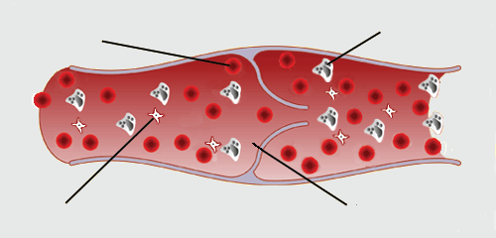
Blood has 4 major parts-
red blood cell
white blood cell
platelets
plasma
Brain Pop - Blood

Slide 36
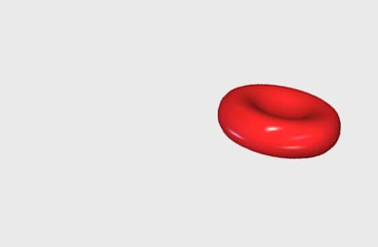
Red Blood Cells
contain hemoglobin, a molecule specially designed to hold oxygen and carry it to cells that need it.
can change shape to an amazing extent, without breaking, as it squeezes single file through the capillaries.

Slide 37
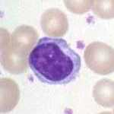
White Blood Cells
    White Blood Cells help fight infection- when you are ill, white blood cells come to the rescue.

Slide 38
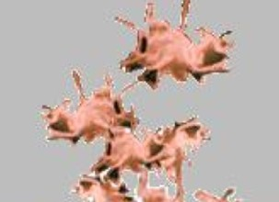
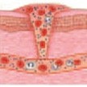
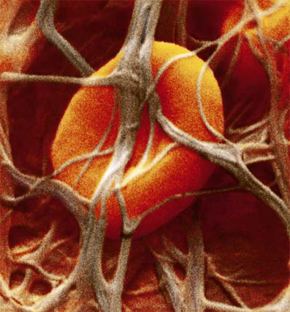
Platelets
Platelets are bits of cell broken off larger cells.
    Platelets help the blood clot and stop bleeding from wounds. They clump together as soon as you get a cut. The clot then hardens to make a scab and seals the cut.

Slide 39
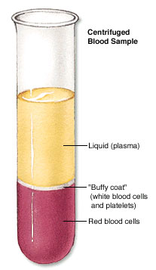
Plasma
A centrifuge is a machine
used to separate liquids of
different densities.
Plasma is a yellowish liquid that carries the cells and the platelets, which help blood clot.
Plasma also contains useful things like:
carbon dioxide
glucose (sugar)
proteins
minerals
vitamins

Slide 40
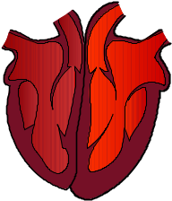
Our circulatory system is a double circulatory system.
This means it has two parts parts.
Lungs
the left side of the system
deals with oxygenated blood.
the right side of the system
deals with deoxygenated blood.
Body cells

Slide 41
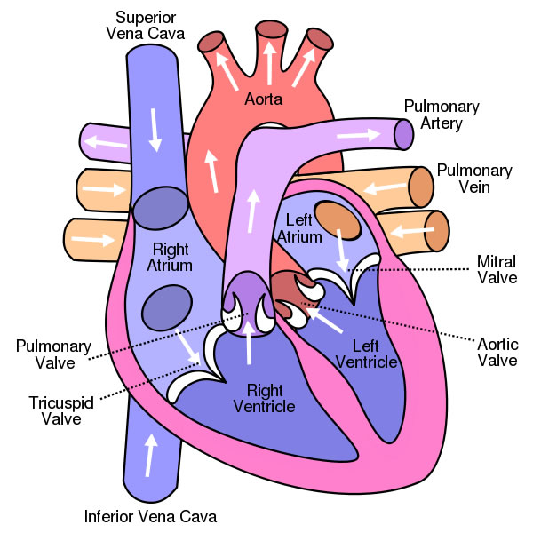
Brain Pop - the Heart

Slide 42
Digestive System Vocabulary
digestive system- breaks food down into nutrients
nutrient- is a substance that an organism needs in order to survive and grow
villi- little fingerlike structures along the walls of the small intestines
chyme- cream like liquid that is mixed with food in the stomach

Slide 43
The Digestive System
The purpose of the Digestive System is to convert food particles into simpler molecules that can be absorbed into the bloodstream and used by the body
The Digestive System breaks food down into smaller parts that our body needs for energy, growth, and repair.
Did You Know??
Digestion begins as soon as you begin to chew your food!

Slide 44
As you chew your food, food is broken down into smaller parts. Glands in your mouth produce saliva. Saliva breaks down some of the carbohydrates. Chewing and saliva break down starchy foods (breads, pasta, potatoes, etc) into sugars for the body.
From the mouth, food travels down the esophagus, the long tube that leads to the stomach.
Your stomach has acid that breaks down the swallowed food.

Slide 45
When food leaves your stomach and goes to your small intestine, it is mixed with a thick liquid. As food moves through the small intestine, nutrients are absorbed and passed into the blood.
Whatever is not absorbed by the small intestine goes to the large intestine, where water and vitamins are absorbed.
The remaining waste leaves your body when you use the restroom.

Slide 46
Additional Organs
Pancreas – produces the hormone insulin that regulates blood sugar levels. It also helps neutralize stomach acid
Liver – produces bile, which breaks down fats in foods
Gallbladder – pouch-like organ that stores bile for future use
The Big Idea!
  Your body needs nutrients from food for energy and proper cell function.
Brain Pop - The Digestive System

