Slide 1
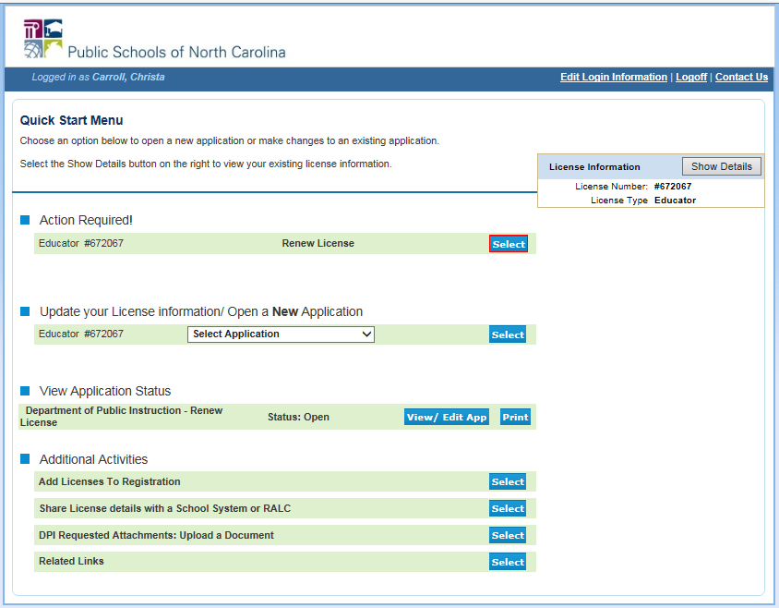
What the Individual Educator Will See for Renewals

Slide 2
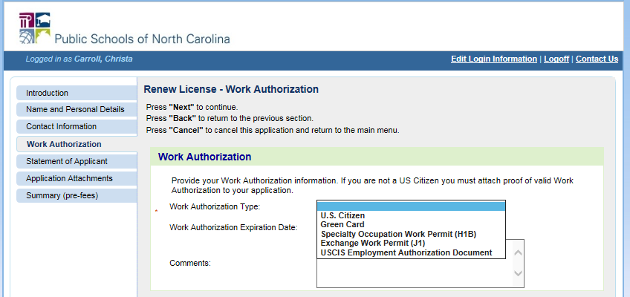
Individual Educator – Work Authorization
If the first time accessing the online system is with an automated process the educator will be required to answer the work authorization questions.
If U.S. Citizen is selected, please DO NOT ENTER A DATE IN WORK AUTHORIZATION EXPIRATION DATE.
If non-U.S. Citizen then the work authorization expiration date does need to be entered and documentation of work authorization will need to be attached under the Application Attachments tab.

Slide 3
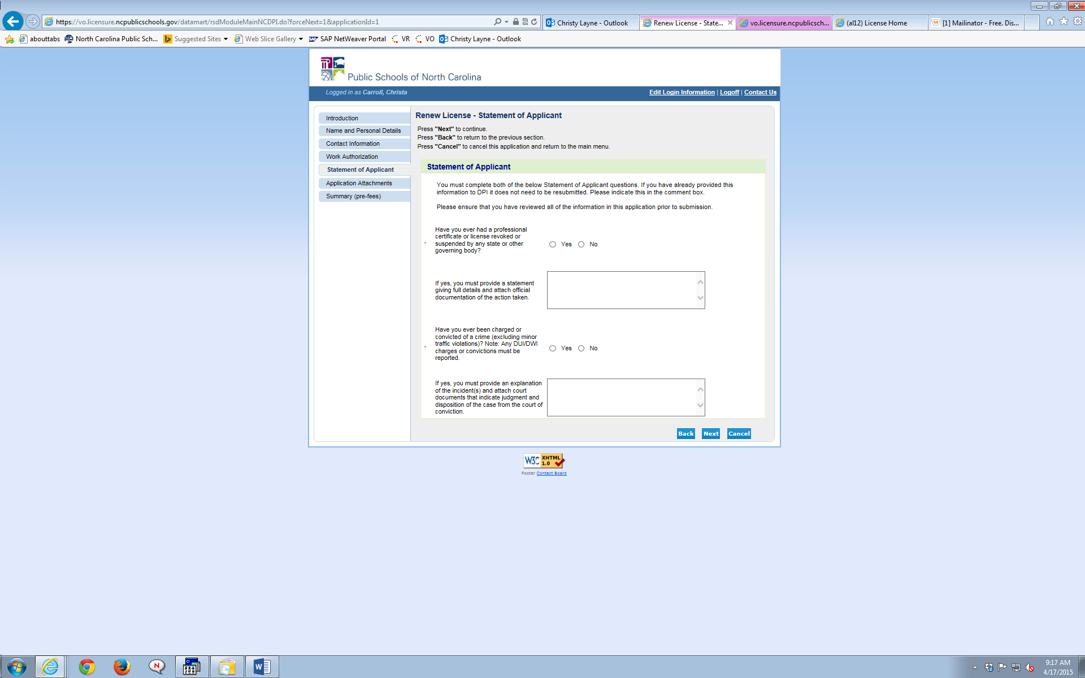
Individual Educator – Criminal
Conviction / Statement of Applicant
If “Yes” to either question, please provide an explanation in the box provided and upload any supporting documents on the next tab.

Slide 4
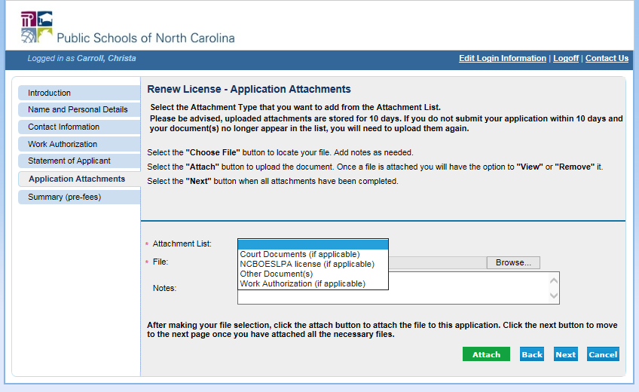
Individual Educator – Attachments with Statement of Applicant or Non U.S. Citizen Work Authorization
Attachments will need to be uploaded if “Yes” is answered for either of the Statement of Applicant questions, or if work authorization documents exist other than U.S. Citizenship.

Slide 5
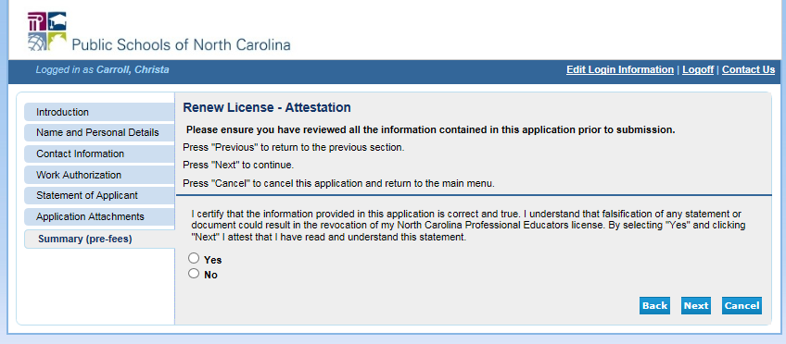
Individual Educator – Attestation
There is a $35 fee to renew the license.

