Slide 1
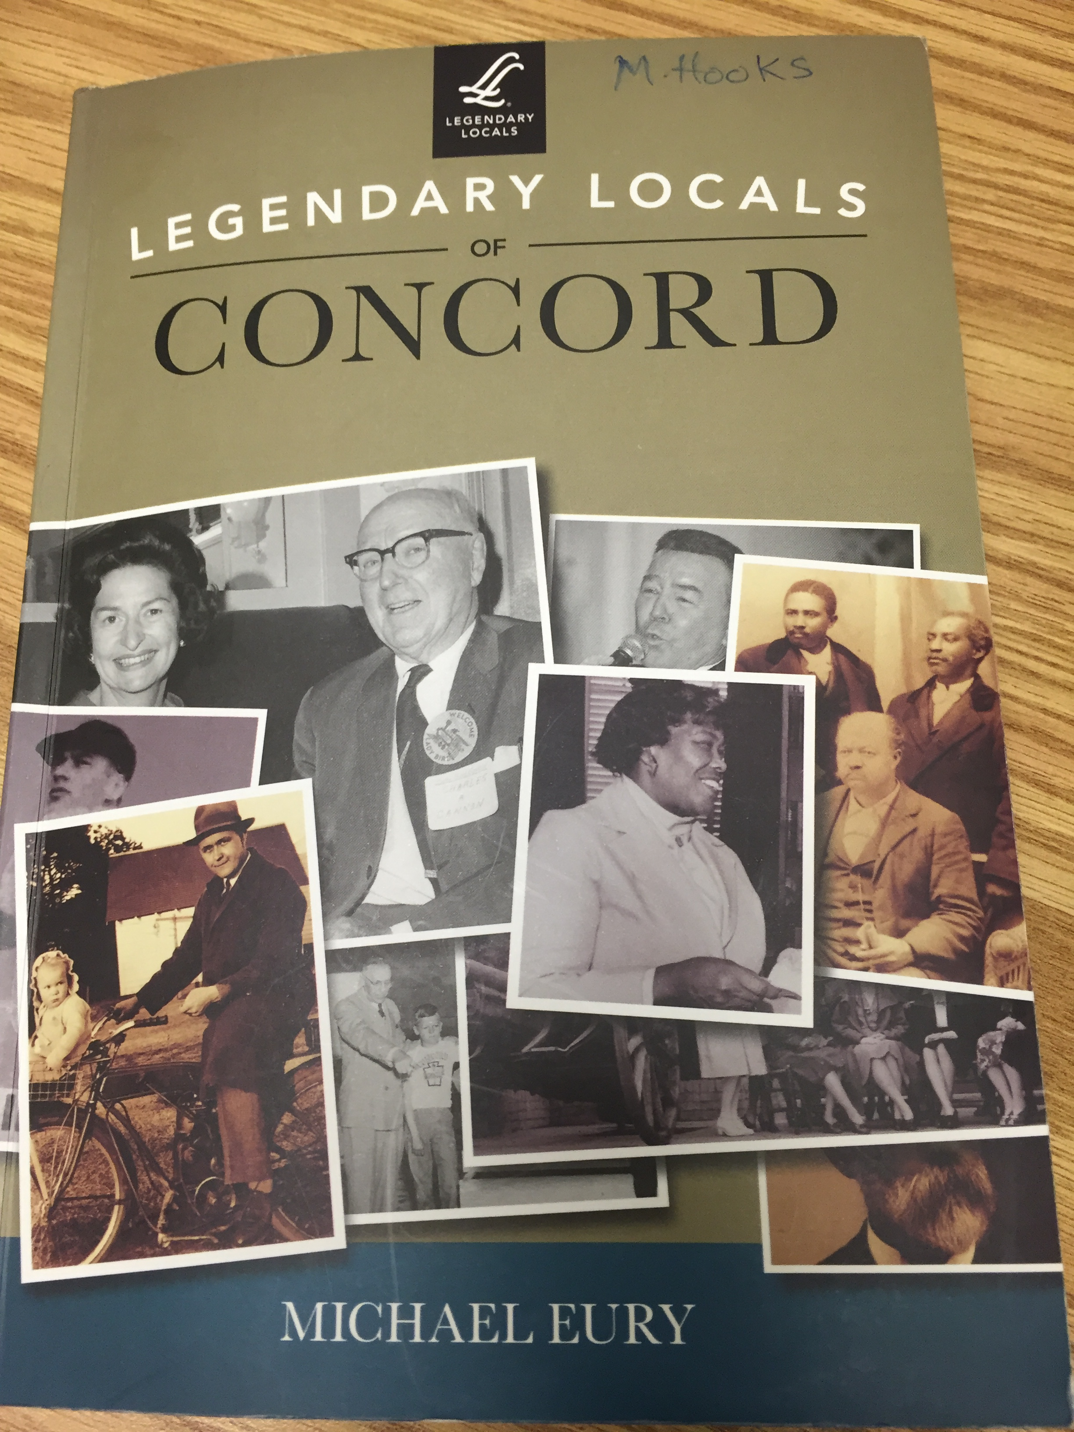

Slide 2
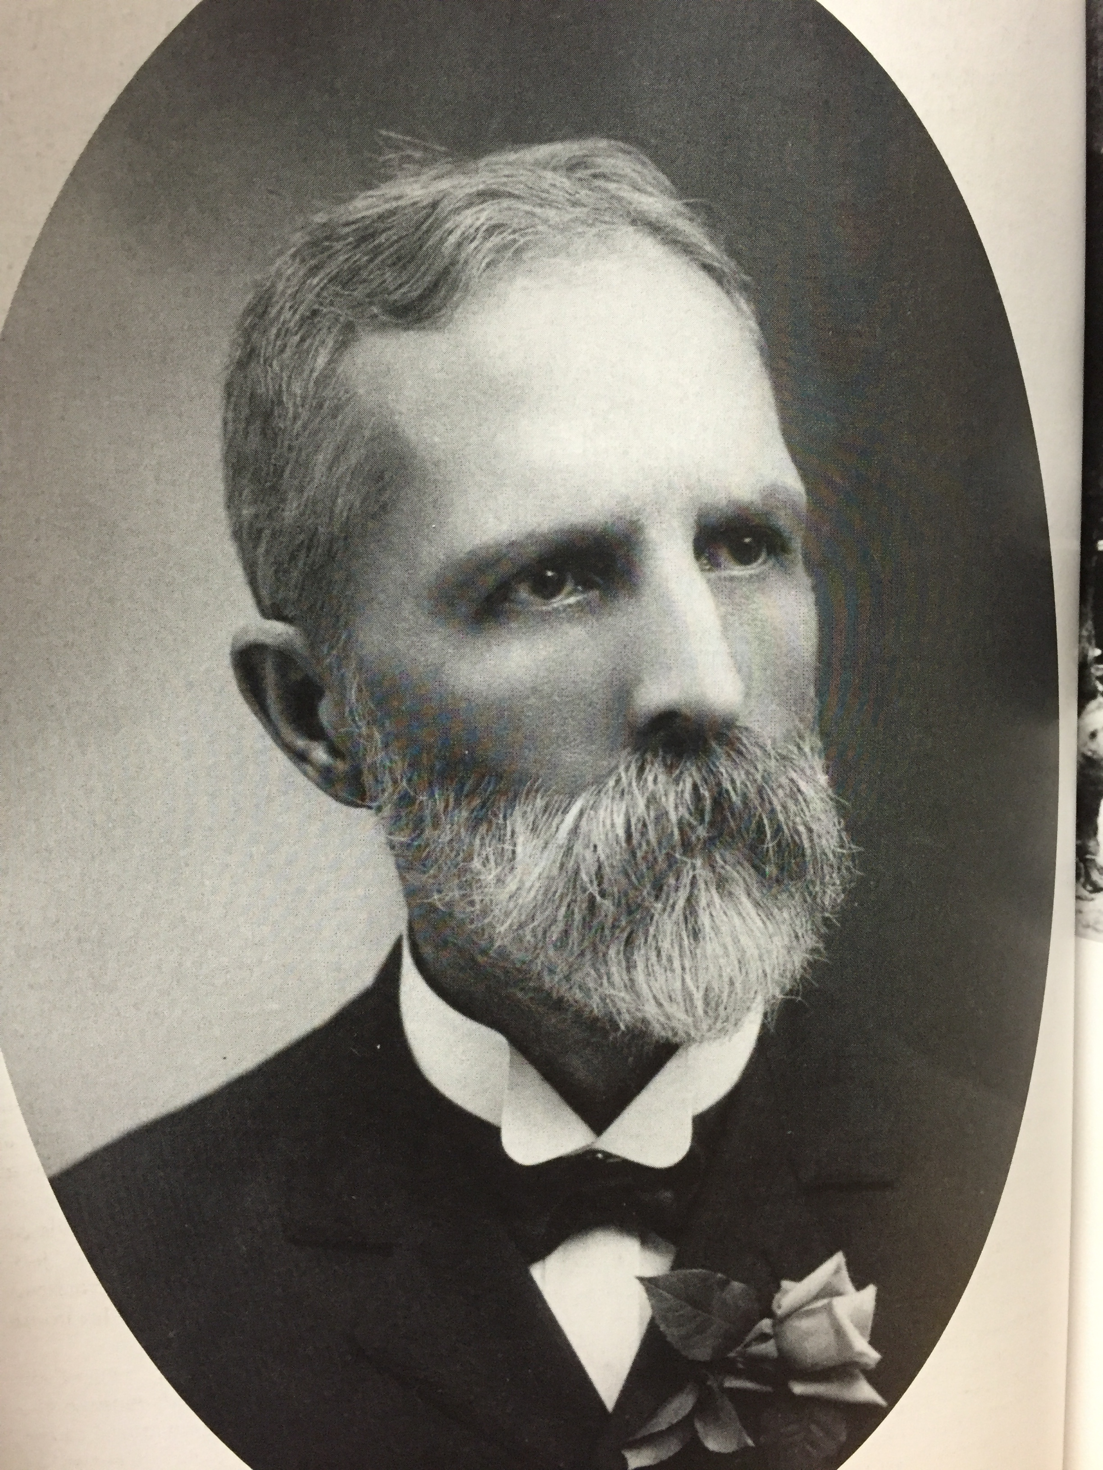
Daniel Branson Coltrane
He opened the Concord National Bank in 1888.
When he was young he lived in a log cabin in Randolph County.
He was a soldier in the Confederate Army.
He moved to Concord in the 1880s.
He started Concord’s public schools and Coltrane-Webb was named after him.
He was the Concord National Bank President until he died in 1937.

Slide 3
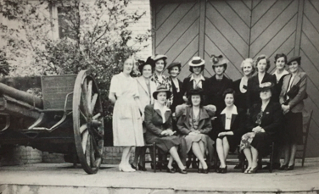
Ruth Coltrane Cannon
She married Charles A. Cannon in 1912.
She is the daughter of Daniel Branson Coltrane.
She helped open Memorial Hall, Concord’s history museum in 1939.
She was very involved in history and restoring historical homes.
She donated to have the first N.C. governor’s mansion, called Tryon Palace, in New Bern fixed in 1959.
There is an award named in her honor called the Ruth Coltrane Cannon Award given to people for preserving history.

Slide 4
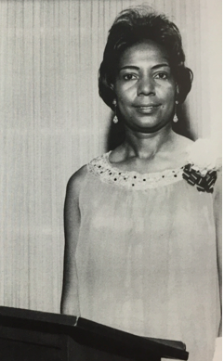
Mildred Florence Stevenson Harvey
She became the first African American banker in 1962.
She attended Barber-Scotia College.
She worked as a bank teller and manager for 30 years.
She was a lifelong member of Price Memorial A.M.E. Zion Church.

Slide 5
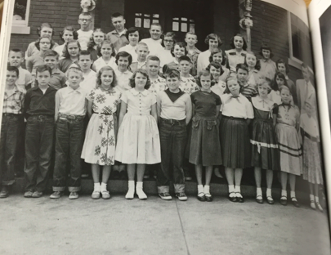
Joseph N. Fries
He moved to Concord in the 1950s and was a 6th grade teacher.
He was the first principal of Beverly Hills Elementary in 1954.
He was the superintendent of Cabarrus County Schools from 1977-1988.
After he retired, a middle school was named after him, J.N. Fries Middle School.
He died in 2013.

Slide 6
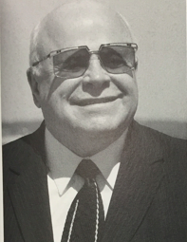
Bruton Smith
He worked with short-track races when he was a teenager.
In 1959 he built the Charlotte Motor Speedway.
He improved the speedway by adding condos, a dirt track, and a drag strip.
The Charlotte Motor Speedway attracts famous visitors and has brought millions of dollars to Concord businesses like hotels and restaurants.
A road was named after him called Bruton Smith Boulevard.

Slide 7
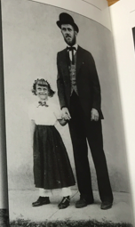
John Reed
He moved to Concord from Germany.
In 1799 his son Conrad found a 17 pound stone in Little Meadow Creek.
The family used the stone as a doorstop for three years.
The rock was gold and started the gold rush in our area.
His farm, near Midland, is now called Reed Gold Mine and is a historical place to visit.

Slide 8
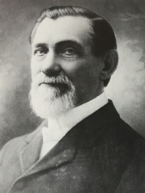
John Odell
He was a captain in the Confederate Army and a teacher.
In 1877 he bought the Concord Steam Cotton Factory.
The factory had been closed for four years.
The factory was renamed Odell Mills.
The areas around the factory grew with houses and churches.
His mansion is located in downtown Concord.
The factory was destroyed by a fire in 1908.

Slide 9
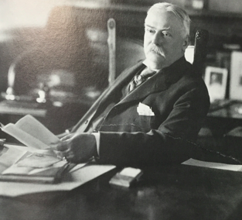
James W. Cannon
He worked as a store clerk for his brother as a teenager.
He was a cotton buyer and many businesses wanted to buy his “Cannon Cloth.”
He opened his first textile plant in 1880 called the Cabarrus Cotton Mill.
His business grew and he opened many other textile plants like Gibson Mills, Franklin Mills, and Tuscarora Mills.
His textile plants made Cannon Towels not just yarn or cloth.
In 1905 he bought 600 acres and built a village which is the city of Kannapolis today.
Cannon Mills Plant No. 1 was in the center of the city with small mill houses around it for workers to rent.
He donated to the community and helped to start the YMCA.

Slide 10
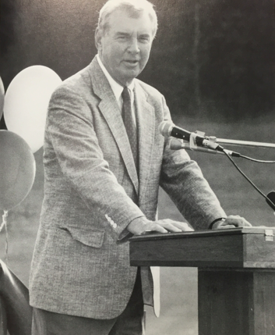
George W. Liles Senior
He was a surgeon and spent almost all of his 88 years caring for others.
He was a doctor during World War II.
He retired in 1993 and started the Community Free Clinic.
He was also mayor of Concord.
When he was mayor, he developed the Concord Regional Airport and Concord Mills Mall.
A road is named after him, George W. Liles Boulevard.

Slide 11
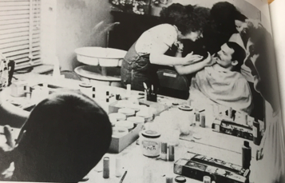
Mary Boger
She was born in 1920 and moved to Concord as a teenager.
She graduated from Concord High School in 1936.
She married Charles E. Boger Jr.
She was a writer for the Concord Tribune and a drama and speech teacher.
In 1973 she helped preserve Cabarrus County’s 1876 courthouse.
The courthouse became the Old Courthouse Theatre.
An award is named after her, the Mary Snead Boger Lifetime Achievement Award for the theater’s actors and volunteers.
She died in 2011 at the age of 90.

Slide 12
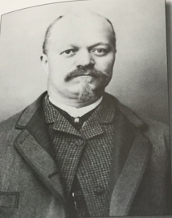
Warren C. Coleman
He was born in 1849.
He was a slave on a farm as a child.
He made shoes for soldiers during the Civil War.
He became one of the richest African American businessmen in North Carolina by 1890.
He owned a general store and barbershop in downtown Concord.
He opened the Coleman Manufacturing Company in 1901 and hired African American workers.
He died in 1904.
A road is named after him, Warren C. Coleman Boulevard.

Slide 13
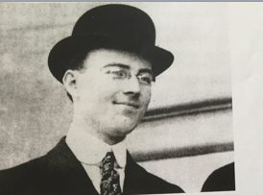
Charles A. Cannon
He was the youngest son of James W. Cannon who owned the Cannon Mills.
He was born in 1892 in Concord.
He became vice president of Cannon Mills in 1916.
He became president of Cannon Mills and worked there until 1962.
He hired 25,000 workers who made 300,000 towels a day.
He donated to the community and started the Cabarrus Memorial Hospital.
He died in 1971.

Slide 14
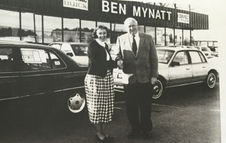
Ben Mynatt
He was a car salesman from Tennessee.
He bought a Concord Chevrolet dealership in 1976.
He was involved in the community with the Boys and Girls Club and the Salvation Army.
He donated over $1 million to charity.
He won the Citizen of the Year Award in 2000.
He died in 2001.

Slide 15
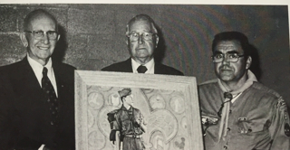
Frank Liske
He was chairman of the Cabarrus County Democratic party.
He was very involved in the community through Boy Scouts and the Boys Club.
He volunteered for the Boys Club’s annual Pancake Day.
He spent more than 20 years working with troubled youth at the Stonewall Jackson Training School.
Concord’s 238 acre park is named after him, Frank Liske Park.

