Slide 1


Creating a budget

Slide 2
Chapter Overview
Lesson 1: Creating a Budget
Lesson 2: Savings and Bank Accounts
Lesson 3: Real-Life Issues in Buying and Selling

Slide 3

Components of a Financial Plan
Finance - the management of money
Personal Finance - how you manage your money
Photo courtesy of Shutterstock

Slide 4

Advantages of a Personal Financial Plan
Make good financial decisions
Evaluate the opinions of financial advisers
Photo courtesy of Shutterstock

Slide 5

Creating a Personal Financial Plan
Managing your budget
Managing your liquidity
Financing Large Purchases
Protecting Your Assets
Investing for the Future
Investing in Your Retirement
Photo courtesy of Shutterstock

Slide 6

Managing Your Budget
Budget
  Detailed summary of expected expenses and income
Income
  Money coming in on a regular basis
Expenses
  Money going out for needs and wants
GOAL: Income > Expenses
Photo courtesy of Shutterstock

Slide 7

Managing Your Liquidity
Liquidity
  Access to funds to cover a short-term cash need
  Money needed to cover unexpected expenses
Photo courtesy of Shutterstock

Slide 8
Financing Your Large Purchases
Financing
  Obtaining or providing money for a specific purpose
  Generally comes in the form of loans
Interest
  Charge on borrowed money
Compound Interest
  Interest on accumulated unpaid interest

Slide 9
Protecting Your Assets
Asset
  Something of value that you own
  Tangible assets are physical items
  Assets may be protected with insurance
Insurance
  An agreement between two parties
  Premium or monthly fee

Slide 10

Investing for the Future
Investment
  Something you own that you expect to increase in value over time
Examples of investments:
  Stocks
  Bonds
  Mutual Funds
Photo courtesy of Shutterstock

Slide 11

Investing in Your Retirement
Retirement
  Period of life during which you no longer work full time
People typically retire once they qualify for Social Security
Military members may retire after 20 years of service
Start planning for retirement now
Photo courtesy of Shutterstock

Slide 12

Steps for Developing a Personal Financial Plan
Establish your financial goals:
  How important is money to you?
  What do you need money for?
  Be realistic
  Timing is important:
    Short-term
    Intermediate-term
    Long-term
Photo courtesy of Shutterstock

Slide 13

Steps for Developing a Personal Financial Plan (cont)
Your Current Financial Position
  Present financial position impacts future decisions
Identify and Evaluate Alternative ways to Achieve Goals
  Savings Account
  Investments/Stocks
Photo courtesy of Shutterstock

Slide 14

Steps to Creating a Personal
Financial Plan (cont)
Select the best plan
  Should be a plan you can stick with
Evaluate your plan
  Review it regularly to see how you’re doing
Revise your plan
  Note where it’s worked and not worked
Photo courtesy of Shutterstock

Slide 15
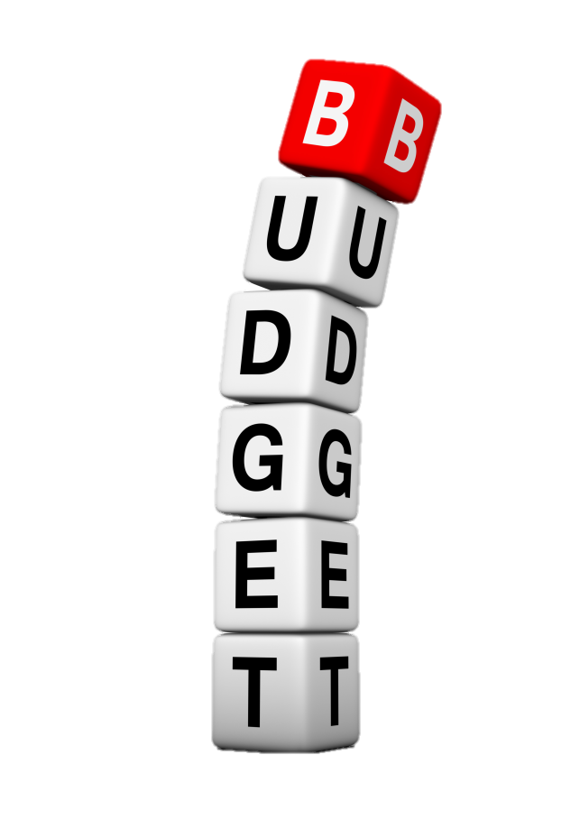
The Elements of a Budget
Income – money you receive regularly
  Salary / Wages
  Savings
  Investments
Expense – money you spend
  Clothing
  Entertainment
  Food
  Car
Chapter 1, Lesson 1
Graphic courtesy of Shutterstock

Slide 16
Summary
The Components of a Personal Financial Plan
The Steps to Creating and Developing a Personal Financial Plan
The Elements of a Budget

