Slide 1


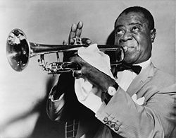

Welcome to World Social Studies
1450 – present
Ms. Sharon Koch (cook)
“What a Wonderful World”
Louis “Satchmo” Armstrong (1901 – 1971)
Jazz Trumpeter from New Orleans

Slide 2
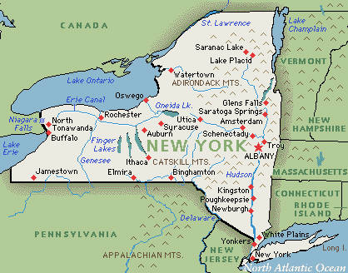
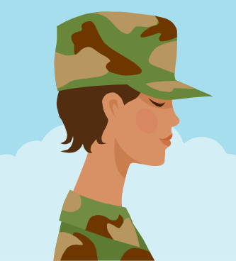

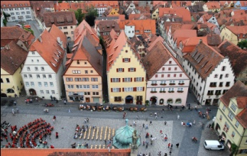
This is my 29th year teaching!
I’m from Buffalo, NY.
I served six years in the US Army
and lived in Newark, NJ, Seattle, Washington, and
Kitzengen, Germany.
I started teaching in Watertown in Upstate NY.

Slide 3

I moved to Cabarrus County in 1999 for the
New Millennium and taught at
Central Cabarrus High School.

Slide 4




I have taught 11th grade, 10th grade, 8th grade, and 6th grade… ELA, science, SS, SAT prep…
I taught 7th grade ELA and SS at JN Fries for 10 years.

Slide 5
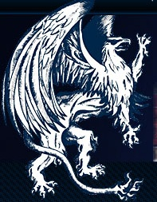


This year is my ninth and
wonderful
year at CC Griffin!
I have an Associates degree in Liberal Arts, Bachelors degrees in English Literature, Technical Writing, and Middle School Education, and a minor in political science.
I also have a Masters degree
in High School ELA.

Slide 6
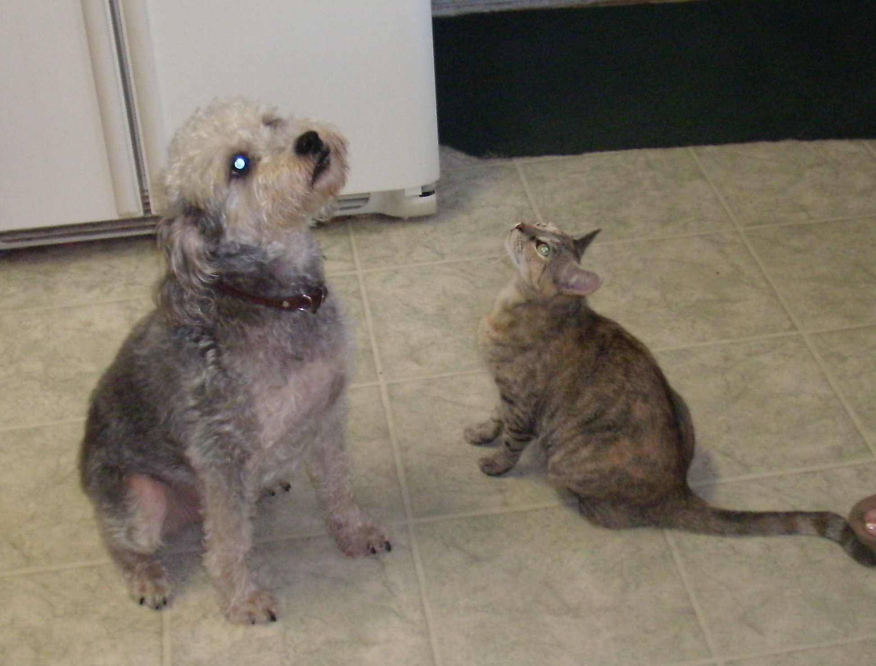
I have a dog, Noble, and a cat, Tumbleweed.

Slide 7
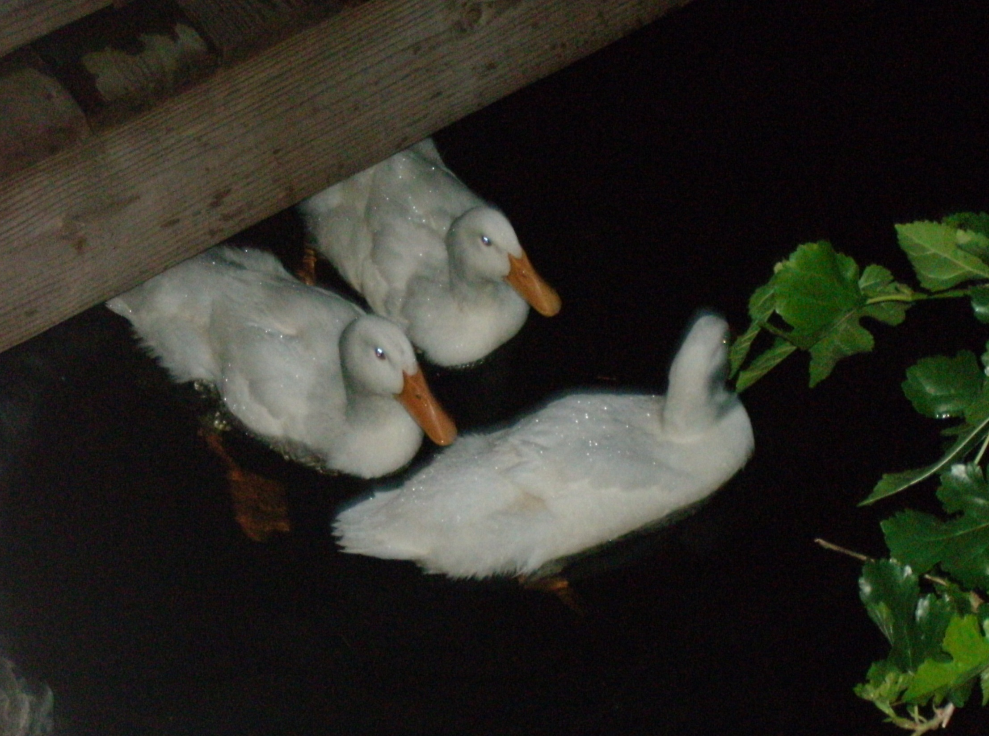
I have ducks and frogs who live in my yard.

Slide 8
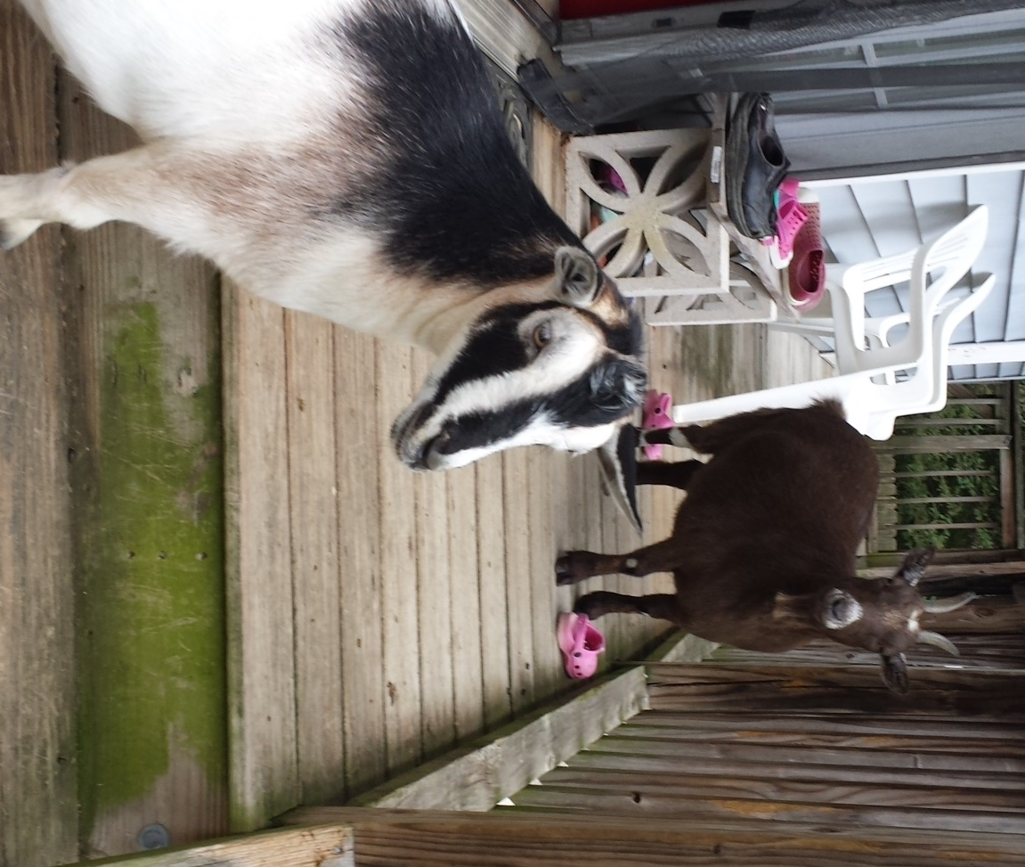
These are my two biggest babies,
Melanie and Ashley Goat!

Slide 9
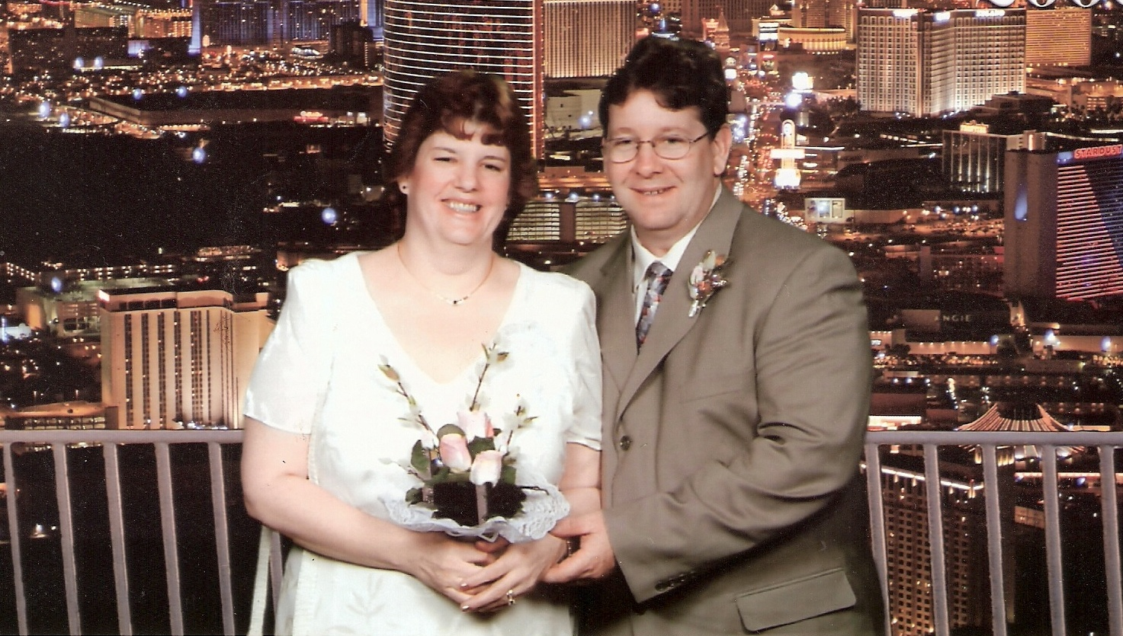
My husband, Mike, and I have been married for fifteen years!
Between us we have many children, step-children, foster children, daughters-in-law, sons-in-law, fiancés, and loved ones we call family and friends!

Slide 10
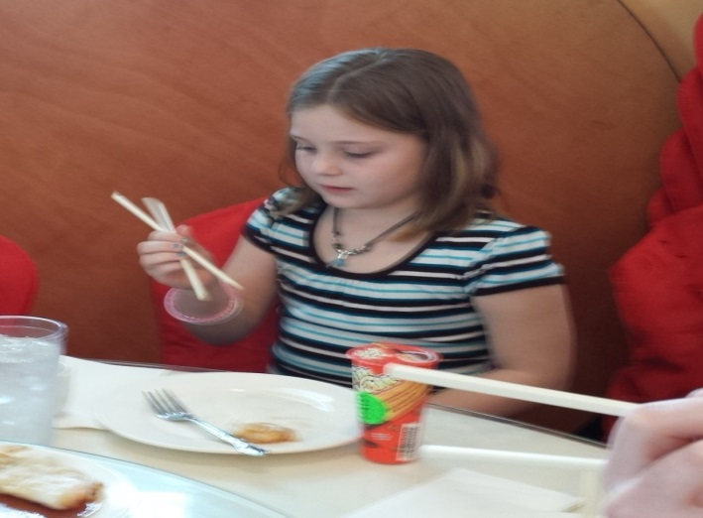
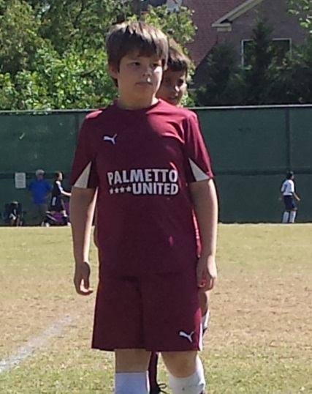
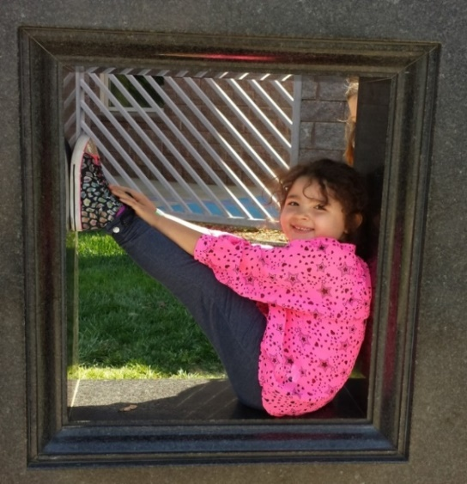
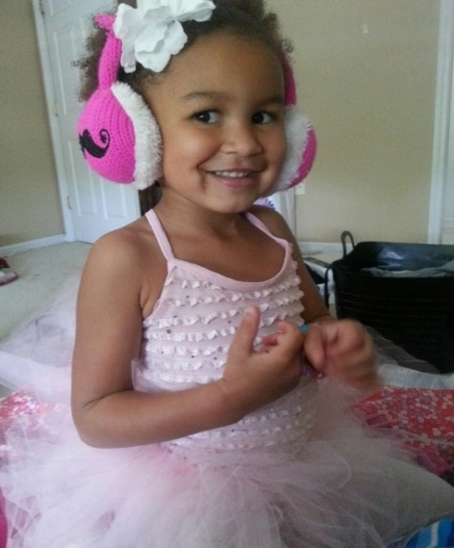
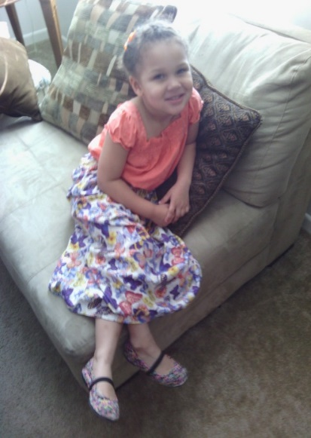
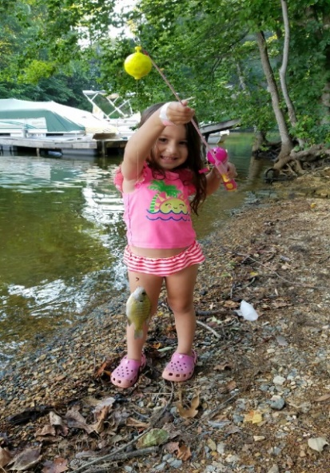
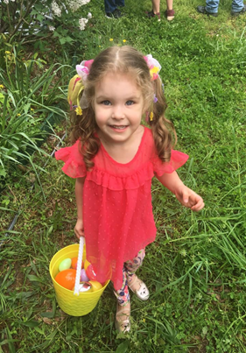
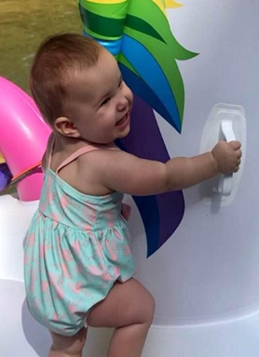
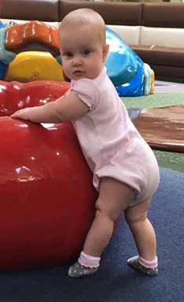
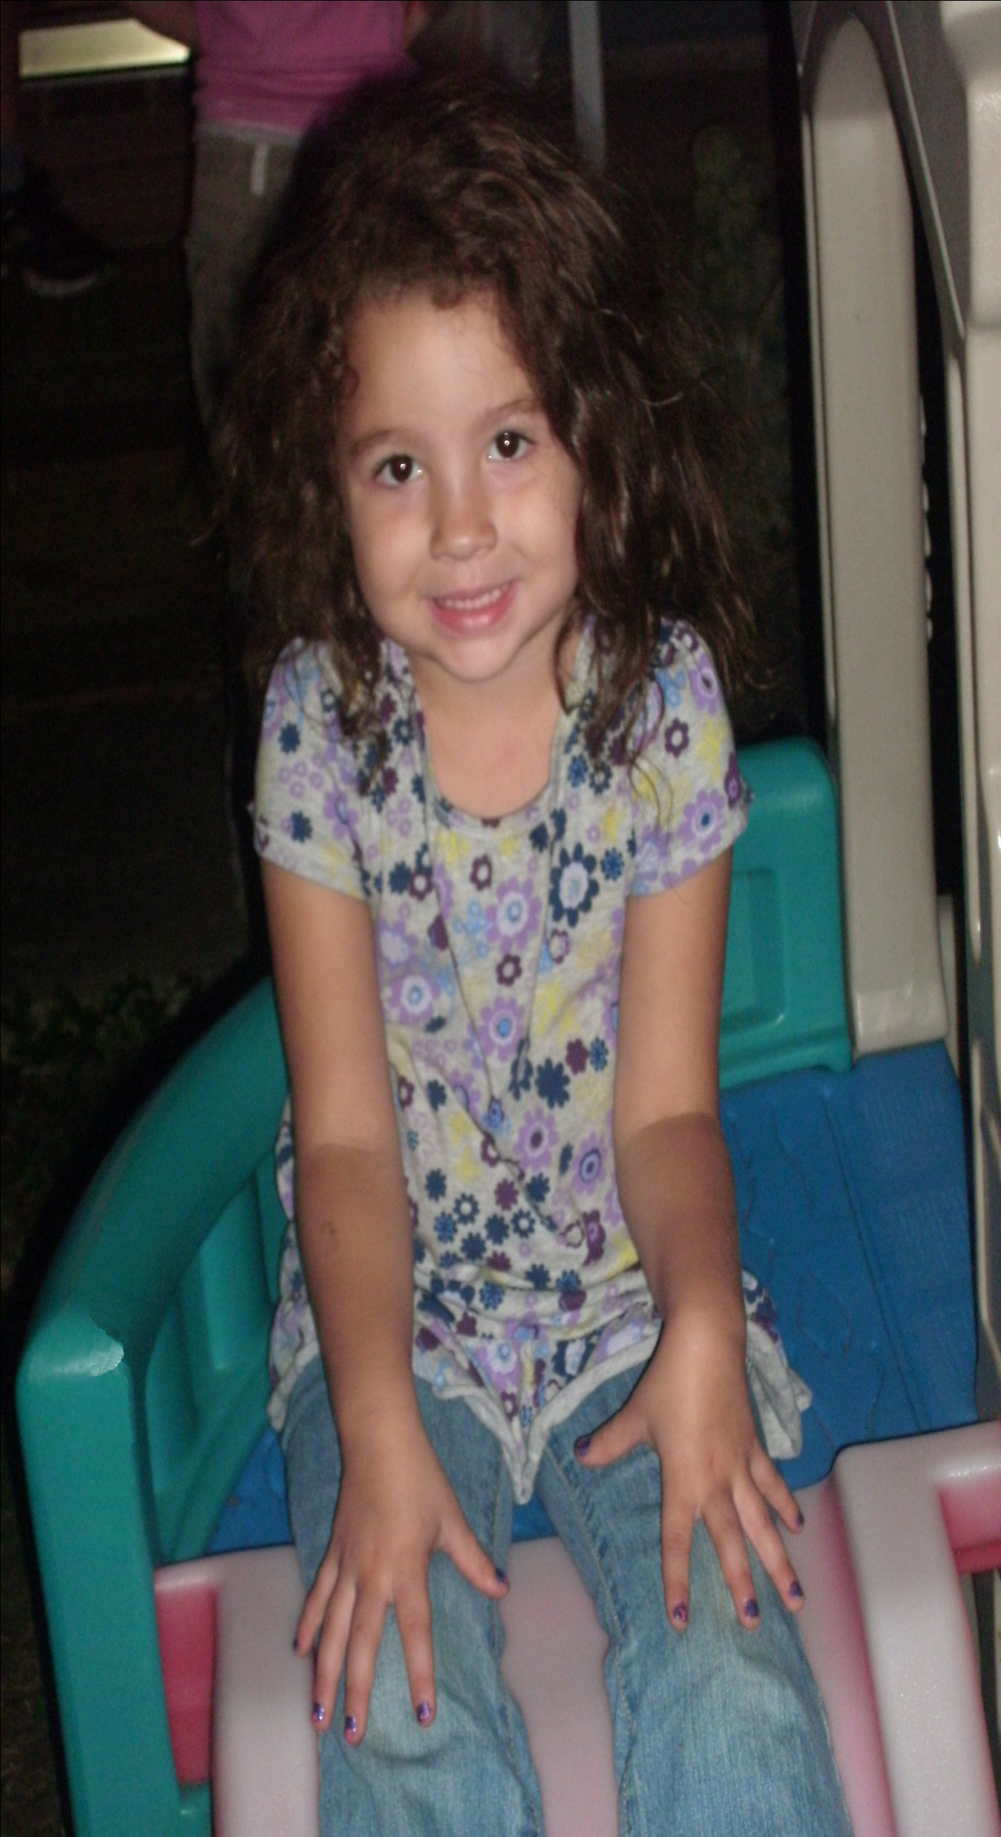
We have nine grandchildren!
Jaela, 10
Kristy, 14 7/8
Michael, 14 3/4
Chloe, 12
Camai, 9
Addy, 7 1/2
Brenna, 3 ½
Millie, 11
months
Abby, 10
months

Slide 11

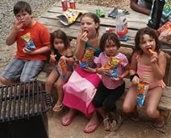
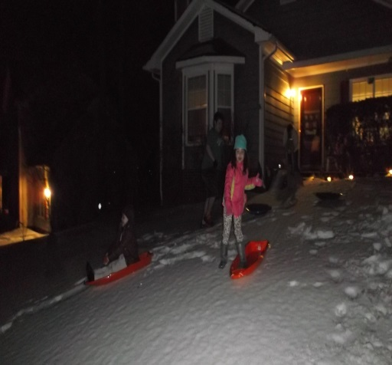

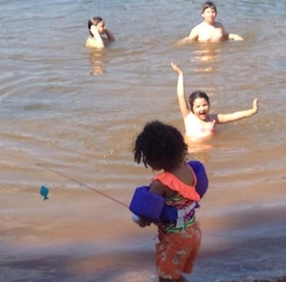
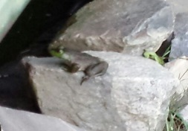

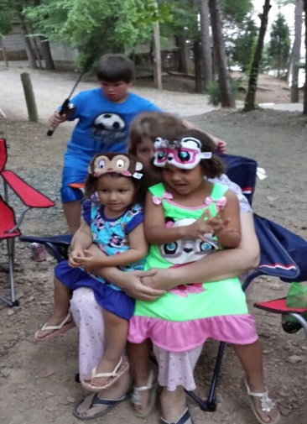

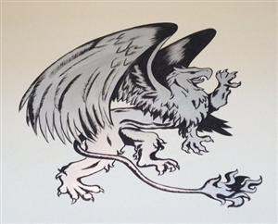
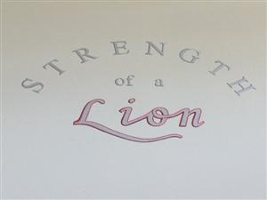
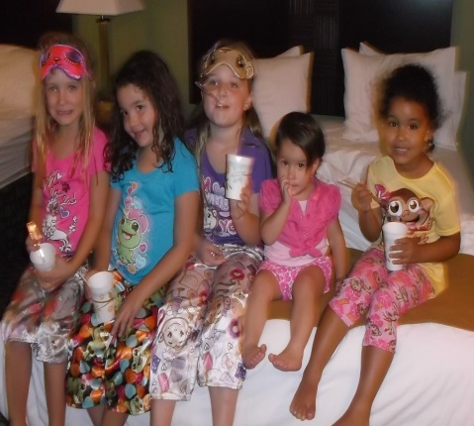
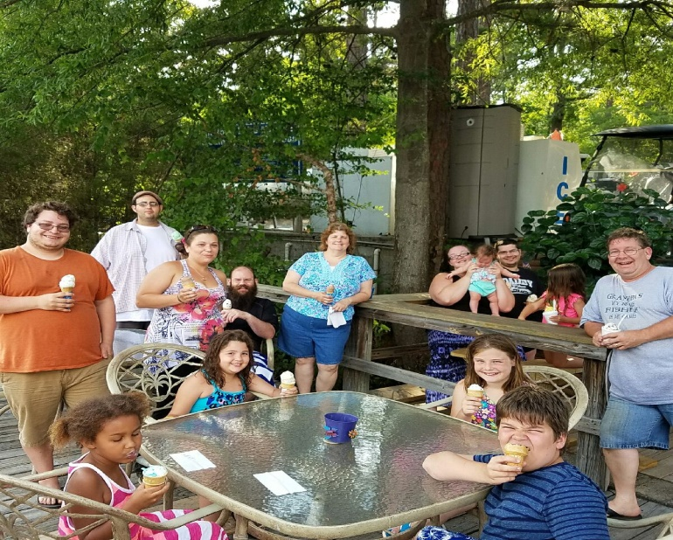
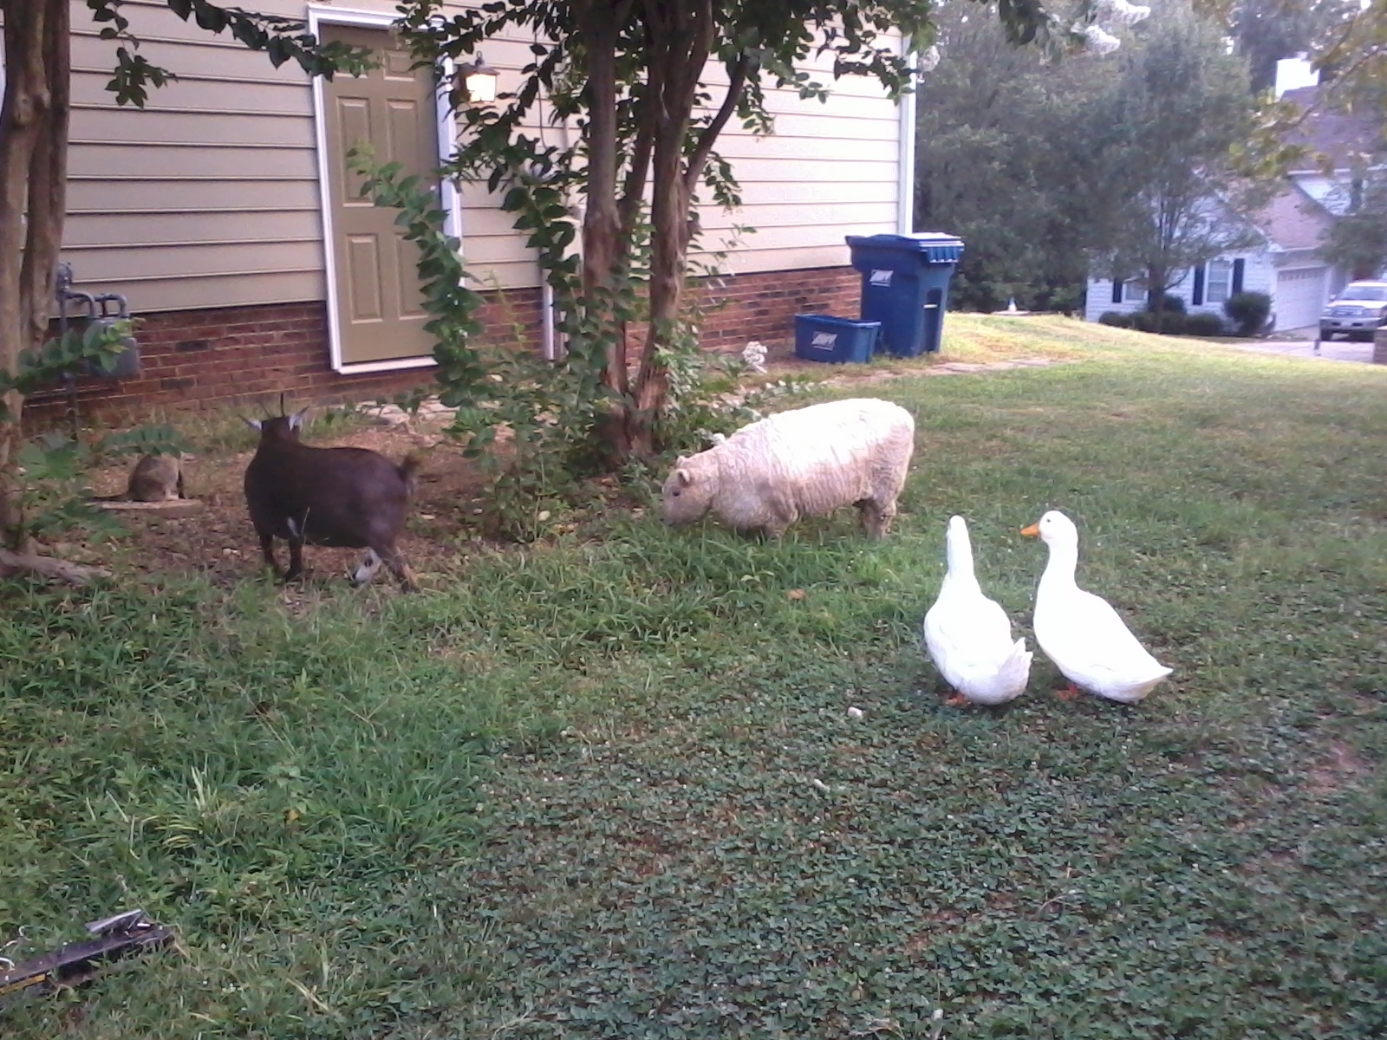
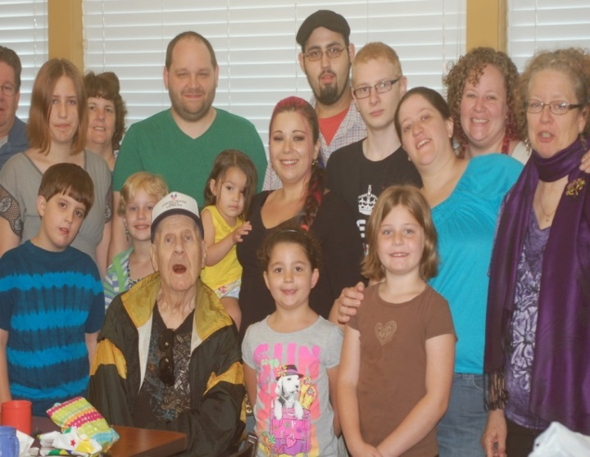


What a wonderful world!

Slide 12
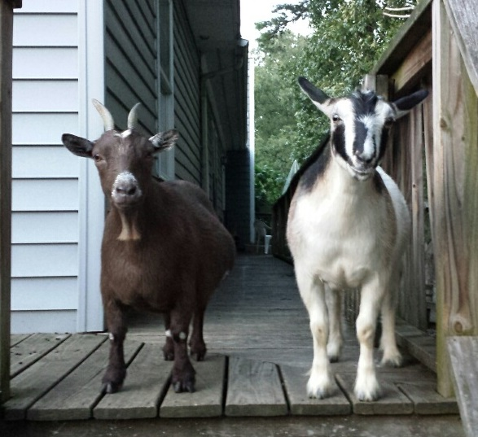
I hope you feel like you know me a little better, and I can’t wait to get to know you!
Together we’ll be BRAVE!!

Slide 13
Oh Ya!

