Slide 1
The Presidency of
John Adams

Slide 2
Washington’s Impact on Adam’s……

Slide 3
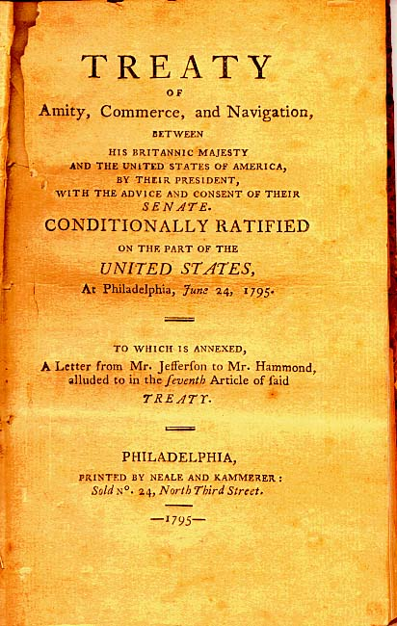
Jay’s Treaty (1795)
The U.S. agreed not to seek damages from Britain for the ships and goods they had seized; in return, Britain agreed to grant the U.S. “most favored nation” status and to allow American merchants free trade with British colonies in the Caribbean to offset Americans’ lost trade with France
President Washington convinced Congress to approve Jay’s Treaty, even though its terms were not popular with the pro-French Democratic-Republicans

Slide 4
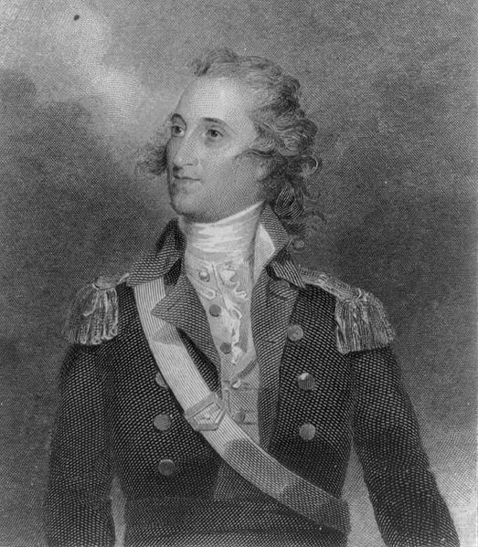
Pinckney’s Treaty (1796)
Spain, worried by the possible alliance between the U.S. and Britain represented by Jay’s Treaty, negotiated with U.S. diplomat Thomas Pinckney to allow the U.S. free navigation of the Mississippi River and the port of New Orleans
The treaty also settled the dispute over the location of the northern border of Spanish Florida, creating a fixed border between the U.S. and Spanish held territories
Unlike Jay’s Treaty, Pinckney’s treaty was universally popular with Americans for ending any threat of war with Spain

Slide 5
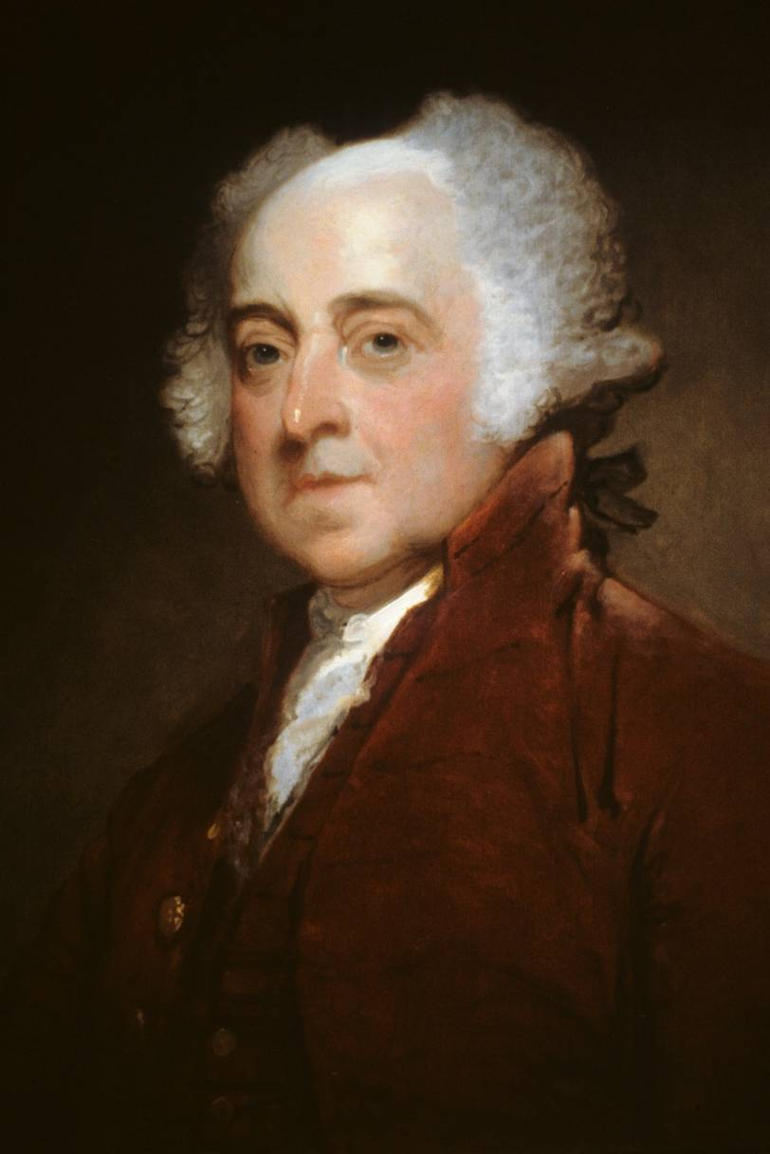
President John Adams
Served: 1797 – 1801
Member of the Federalist Party; had served as Washington’s Vice-President
Adams beat out Thomas Jefferson in America’s first contested presidential election in 1796 by only 3 electoral votes, but would later lose to Jefferson in the 1800 presidential election

Slide 6
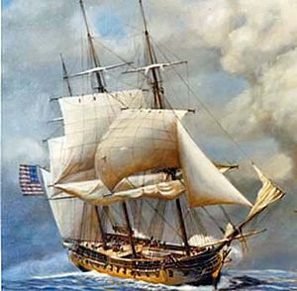
Consequences of Jay’s Treaty
France retaliated against the U.S. for signing Jay’s Treaty by beginning to seize U.S. ships bound for English ports
These attacks caused many members of the Federalist Party (which supported the wealthy merchants who owned most of the ships and cargos being attacked) to call for a declaration of war against France
This also deepened the division between the pro-British Federalists and pro-French Democratic-Republicans

Slide 7
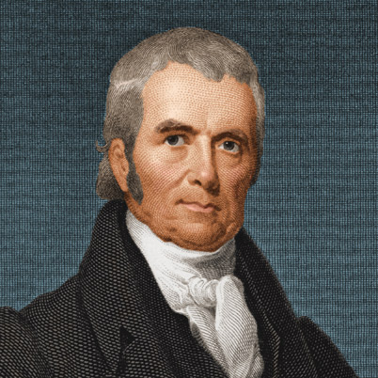
The “XYZ” Affair (1797)
Adams was reluctant to get involved in a war, so he sent John Marshall and two other diplomats to attempt to negotiate with the French
The U.S. delegation was asked by three French agents (whom Adams would only name as X, Y, and Z to Congress) to pay a $250,000 bribe and to promise $12 million in loans to the French government just to even meet with French officials
The American delegation refused and angrily returned home
American newspapers quickly picked up the story and attacked France in editorials and cartoons

Slide 8
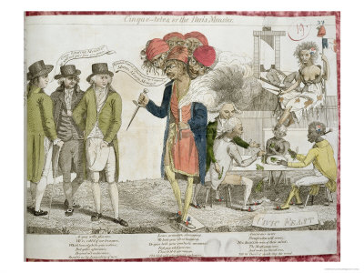
“Millions for defense, but not one cent for tribute!”

Slide 9

The Quasi-War (1798)
France’s actions led to increased calls for war from angry Americans
In June 1798, Congress suspended trade with France and ordered the U.S. Navy to begin attacking French ships
The U.S. and France were in an undeclared state of war, at least at sea

Slide 10
Political Divisions lead to Partisan Legislation……

Slide 11
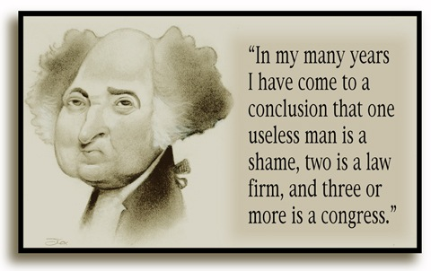
Political Divisions Continue
Democratic-Republicans were highly critical in the press of the Adams administration’s handling of foreign affairs
Federalists took advantage of public support for Adams’ stand against France to pass laws aimed at weakening the Democratic-Republican Party

Slide 12
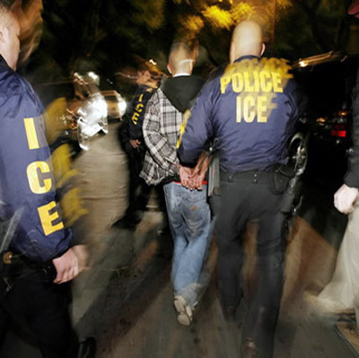
The Alien Acts (1798)
The Federalist-controlled Congress passed three bills aimed at “aliens”:
Required immigrants to wait 14 years before they could become citizens
Authorized the President to order the deportation, without trial, of any alien considered “dangerous”
The Alien Acts were clearly targeting recent French and Irish immigrants, who tended to be anti-British and to vote Democratic-Republican

Slide 13
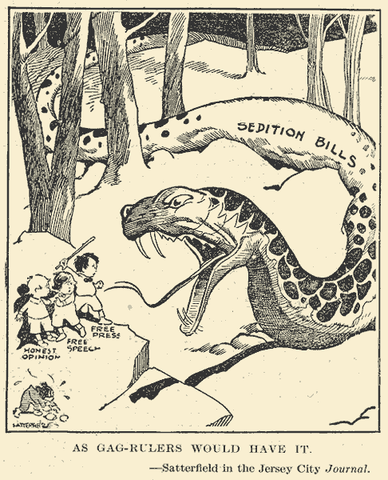
The Sedition Act (1798)
The Federalists also passed the Sedition Act, which limited free speech by making it illegal to publish "false, scandalous, and malicious writing" against the government or its officials
Was used to silence Democratic-Republican critics, including newspaper editors and politicians

Slide 14
What is the purpose of the Alien and Sedition Acts?

Slide 15
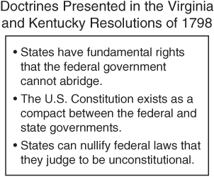
The Virginia and Kentucky Resolutions
In response to the Alien and Sedition Acts, in 1798 the legislatures of Kentucky and Virginia passed resolutions arguing that any state can refuse to enforce federal laws they believe to be unconstitutional – they can, in effect, “nullify” the law (the Doctrine of Nullification)
These resolutions were anonymously written by none other than the two most vocal of the Democratic-Republicans, James Madison and Thomas Jefferson

Slide 16
Can you think of a modern example of Nullification?

Slide 17
End Part 1

Slide 18
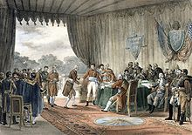
The Convention of 1800
By the fall of 1798, France asked to reopen negotiations with the U.S.
In September 1800, the two nations agreed to the terms of the Convention of 1800
The U.S. agreed to give up any claims against France for damages to US shipping
France agreed to release the U.S. from the terms of the Treaty of 1778
Thus, the Quasi-War ended

Slide 19
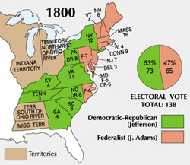
The Election of 1800
The Alien & Sedition Acts, coupled with an increase in taxes, had made Adams unpopular
The Democratic-Republicans won the election, but due to a quirk in the Electoral College, it was a tie between their intended president, Thomas Jefferson, and their intended vice-president, Aaron Burr
In the event of no candidate holding a majority of the electoral votes, the House of Representatives has to decide which candidate will win

Slide 20
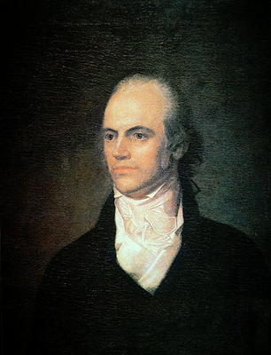
Jefferson or Burr?
  Federalists controlled the House of Representatives, and so they would have to choose between Jefferson and Burr
  Alexander Hamilton chose Jefferson over Burr, despite being of the opposite political party, he deemed Jefferson the more qualified candidate.

Slide 21
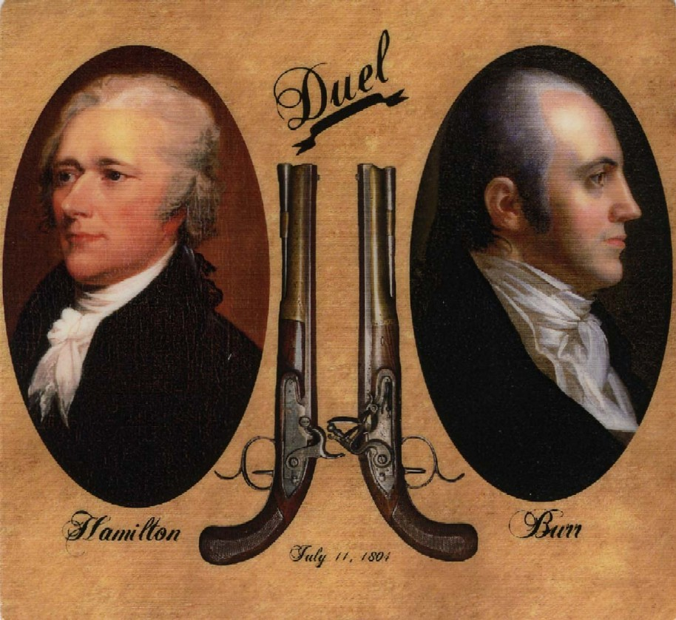
Burr-Hamilton Duel
July 1804
Vice-President Burr challenged Hamilton to a duel in which Burr shot and killed Hamilton
Burr was charged with murder, but acquitted and finished his term as VP

Slide 22
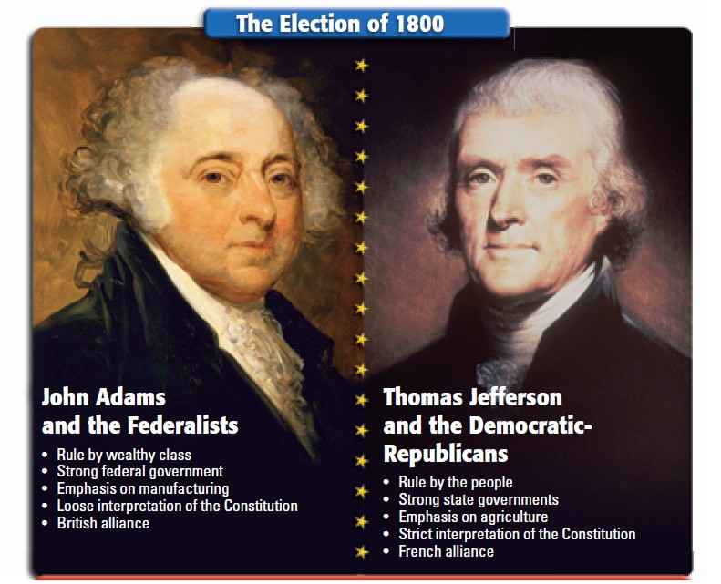
The Peaceful Revolution
The Federalists controlled the Presidency, Congress, the Federal Courts, and the military in 1800, and could have refused to recognize the results of the election – instead, they honored the election’s results and upheld the Constitution
This first transition of power from one political party (the Federalists) to another (the Democratic-Republicans) is sometimes called “The Peaceful Revolution”

Slide 23
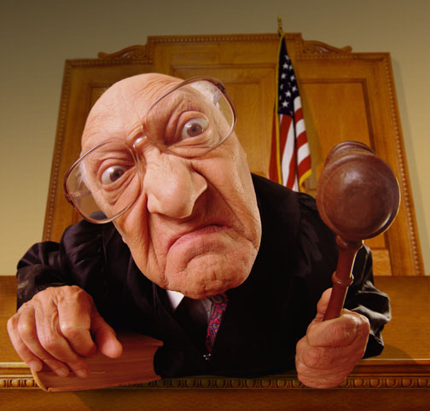
The Midnight Judges
Just before the transition of power, however, Congress passed the Judiciary Act of 1801, creating 16 new federal judgeships
The day before leaving office, Adams signed letters appointing Federalists to fill these new life-long positions
  Purpose was to keep Federalists in power even during Jefferson’s presidency

Slide 24
Society during the Adam’s administration

Slide 25
“We hold these truths to be self-evident, that all men are created equal …”

Slide 26
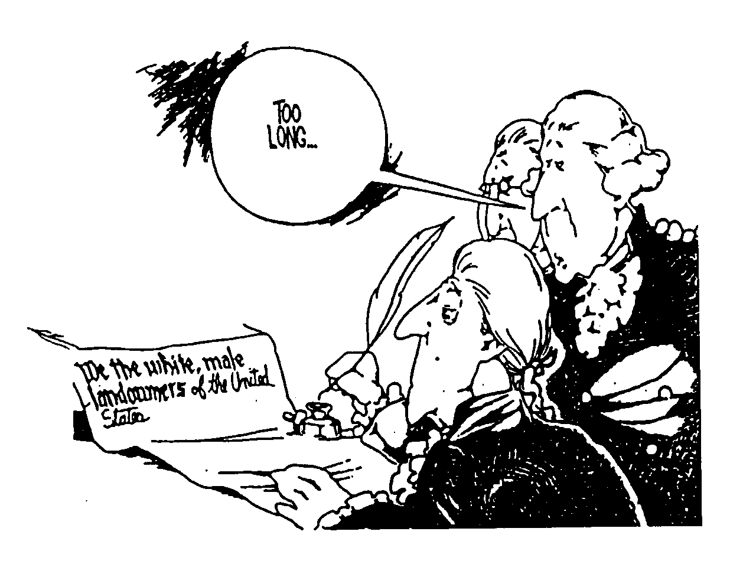
All men created equal?
Originally, only WHITE, PROPERTY OWNING MEN were allowed to vote in the US!

Slide 27
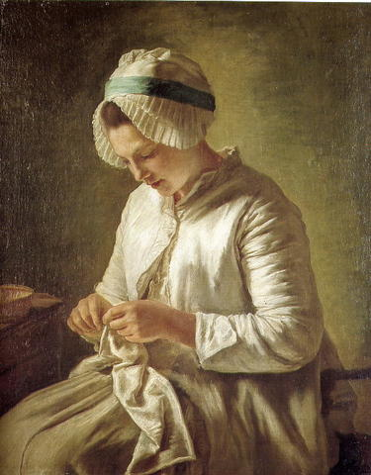
The Role of Women
Primary roles of American women were to be wives, mothers, and homemakers
Some poor, single women worked outside the home as servants
Women had few property rights, could not vote
Republican Motherhood: Without public schools, mothers became the primary means of producing well educated citizens

Slide 28
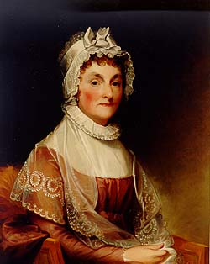
Abigail Adams
Wife of President John Adams
Pushed for women’s rights to education, to own property, and to have a voice in politics
"...remember the ladies … Do not put such unlimited power into the hands of the Husbands … all Men would be tyrants if they could … [we] will not hold ourselves bound by any Laws in which we have no voice, or Representation.”

Slide 29
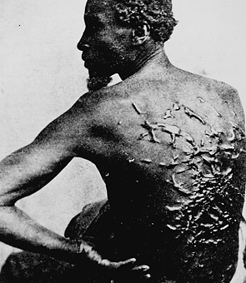
Slavery: a “necessary evil”
The 3/5ths Compromise in the Constitution only counted slaves as 3/5 of a person for representation and taxation purposes, but did not make them citizens or give them any legal rights (including the right to vote)
Some free black men in the North did enjoy citizenship and voting privileges, based on state laws
By 1800, there were close to 1 million slaves in US, equaling about 1/6th of the population

Slide 30
Technology impacts slavery!!!!

Slide 31
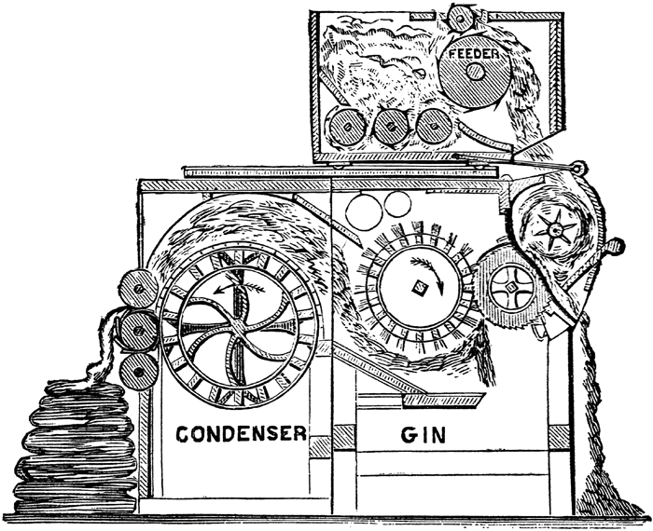
Eli Whitney’s Cotton Gin
Patented in 1794
A machine that separated cotton fibers from the hard to remove seeds
The gin made cotton farming much more profitable by freeing up workers to pick cotton instead of to clean it, and led to the rise of “King Cotton”, the South’s economic dependency on the cotton trade
Growth in the cotton trade led to the continuation and growth in slavery

Slide 32
What does it mean to be an Abolitionist?

Slide 33
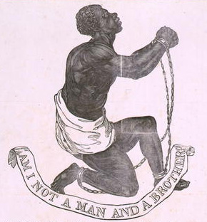
Beginnings of the Abolitionist movement
Many people, however, opposed slavery as a moral wrong; even some slave owners like George Washington and Thomas Jefferson worried about the consequences of keeping slaves
Most northern states had passed laws ending slavery there by the early 1800s

Slide 34
John Adam’s Presidency Dialogue/Script
In groups of 2-3, create a dialogue/script for a skit about an event from John Adam’s Presidency! Include relevant characters, information and conversation.
Options: XYZ Affair, Quasi-War, Alien & Sedition Acts, Virginia & Kentucky Resolutions, Convention of 1800, Election of 1800, Burr-Hamilton Duel, The Midnight Judges.
Requirements: Must be at least 20 lines/exchanges long. Must be appropriate. Any group who performs the skit will receive 5 points of extra credit on U3 Quiz. All groups must turn in a written dialogue for a grade.

Slide 35
Please Find a Partner (You may work independently if you wish)
You are members of the US senate in the 1790’s
Your job in today’s session is to create policies/legislation which will improve the lives of different groups of Americans.
Create at least two policies (EACH) to improve the conditions of Women, Native Americans, African Americans and the Poor.
Must have at least 2 ideas for each group
Be as detailed as possible
(In other words, create laws/acts that will increase freedom/opportunity for these groups)

