Slide 1
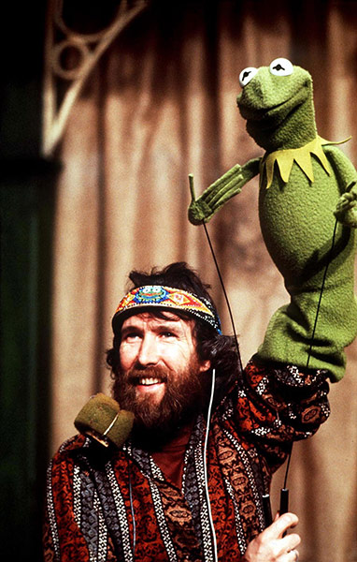
Jim Henson
What kind of art is he well known for?
Where was he born, what college did he go to?
When did Jim first start creating puppets?
What family member encouraged Jim’s creative passions?
What television show that Jim created is still on the air?
How did he become interested in making puppets?
What was Jim's first professional job?
Henson is honored twice on the Hollywood walk of fame, how?
When did The Muppet Show first air on television?
What two television shows did Jim win Emmy Awards for?

Slide 2
      What are three tributes Jim received post-humously?
      Why do you think his work means so much to other people?
Why is Jim’s work an important addition to American Popular Culture?
What famous musician played the role of Goblin King in one of Jim’s most popular films?
Tell me something you can relate to/find interesting about Jim or his work.
What was the first Kermit the Frog made out of?
What medium does he use (what kind of materials does he sure to create his puppets?)
Did anything special happen at Jim’s Funeral?
      Create a new slide and post an image of one of his pieces. Explain to me why you like it.

