Slide 1
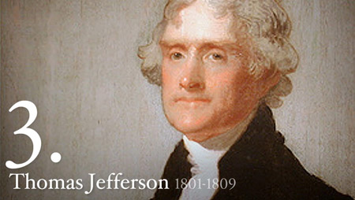
Jeffersonian Era
1800-1815

Slide 2
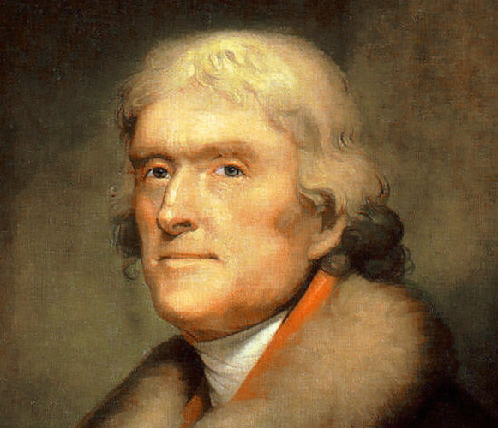
Jeffersonian Democracy
“Peoples President”
Appoints Republicans to “Whitehouse”
Devious Politician
Hopes to shrink Fed Govt.

Slide 3
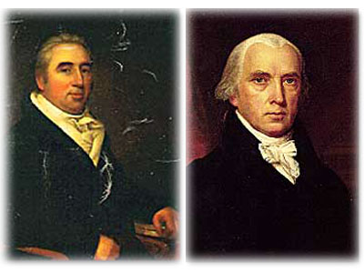
Jeffersonian Era – Politics
Judicial Branch
  Only Branch not controlled by Republicans
  Marbury v. Madison
    “Midnight Appointments”
      not delivered by Madison
    Marbury Sues
    S.C. ruling = Constitution did not give Congress power to increase # of justices
    Establishes Power of S.C. = Judicial Review

Slide 4
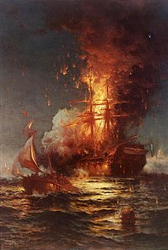
Jeffersonian Era - Politics
Money
  Abolished internal taxes
  Cuts National Debt in half
    Virtually eliminates Nat Bank.
  Reduced Armed Forces
    Army - 4000 to 2500
    Navy - 22 to 7
    Effect – Ship Impressments increase
  Embargo of 1807
    Goal: stop ships from being attacked
    Effect: Devastates the economy

Slide 5
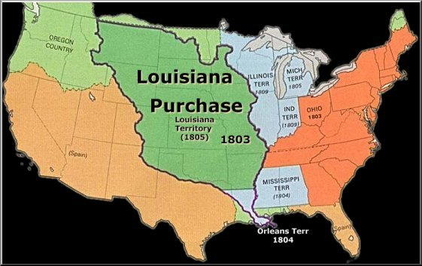
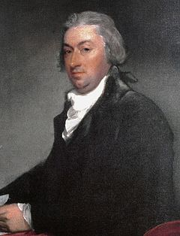
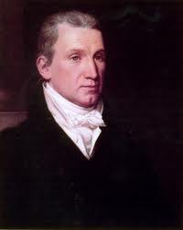
Jeffersonian Era - Politics
Louisiana Purchase
Why?
  Napoleon hopes to regain empire in Amer.
  Regains Terr. from Spain
  New Orleans ignores Pinckney's Treaty
  Many Westerners call for war
  Jefferson Forced to prevent war
  Sends R Livingston and Monroe to buy New Orleans

Slide 6
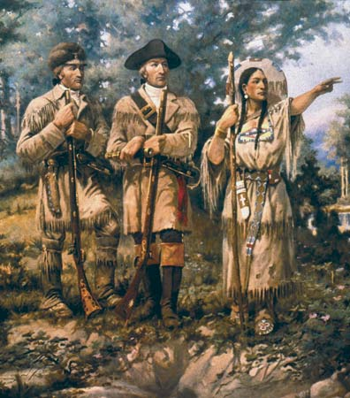
Jeffersonian Era – Politics
Purchase
  When Americans get to France..
    Napoleonic Wars about to begin
    Yellow Fever
    Napoleon just needs money
    No longer concerned with U.S.
  U.S. buys for $15 million
    Boundaries not clearly defined
Effects
  Lewis and Clark – NW
  Zebulon M Pike – Great Plains
  Expansion West

Slide 7
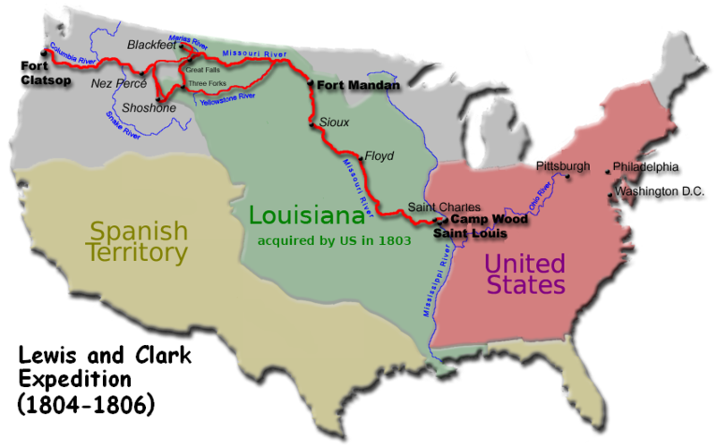

Slide 8
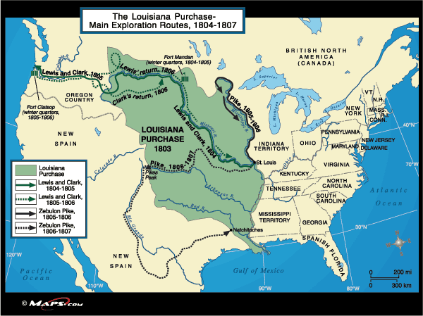

Slide 9
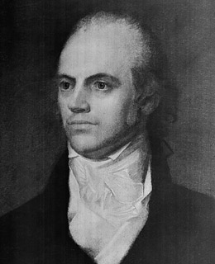
Jeffersonian Era - Politics
Federalist Fallout
  Federalist worried about N.E. losing power
    Why?
  Many consider secession
    “Essex Junto”
  Hamilton refuses to support this idea
  Feds look to his enemy
    Aaron Burr

Slide 10
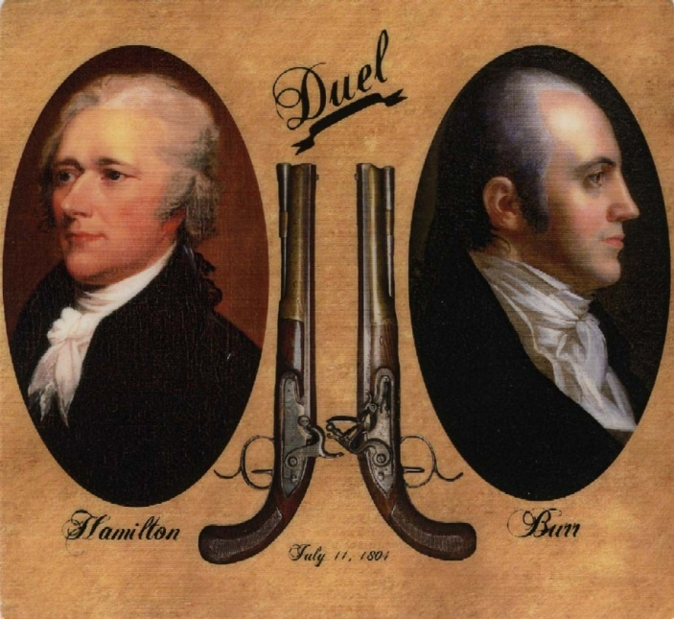
Jeffersonian Era - Politics
Aaron Burr – 1803-1804
  Rumors swirling..
    Wants to lead N.E. secession
    Wants to attack Mexico and annex for U.S.
  Hamilton calls out Burr
    “Despicable Character”
  Duel
    Burr murders Hamilton
  Later accused of launching attack on New Orleans
    Arrest ordered by Jefferson
    Acquitted but reputation ruined

Slide 11
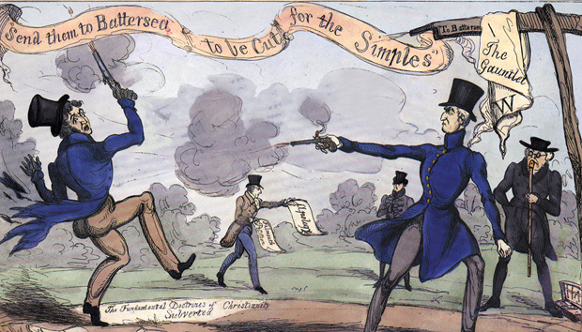
Aaron Burr challenges Alexander Hamilton to a duel after the Election. Burr kills Hamilton in a duel in 1804.

Slide 12
Economic Changes

Slide 13
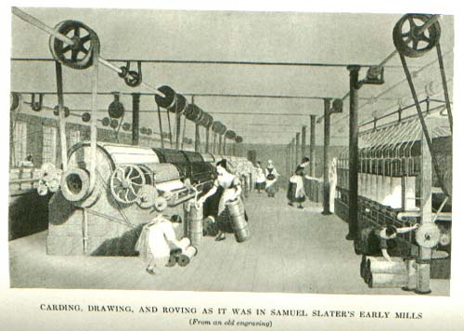
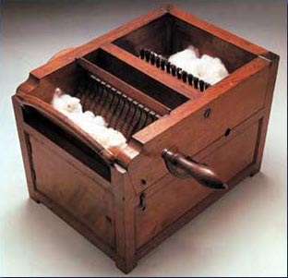
Jeffersonian Era – Economics
Inventions/Innovations
  Adopted from Europe
  Samuel Slater
    Spinning Mill - 1791
  Eli Whitney
    Cotton Gin -1794
    Interchangeable Parts
  Effects
    Spread of Slavery (Short Staple Cotton)
    Textiles in North

Slide 14
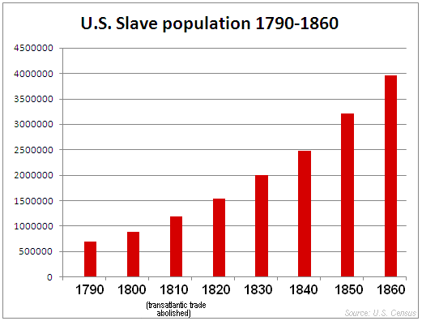

Slide 15
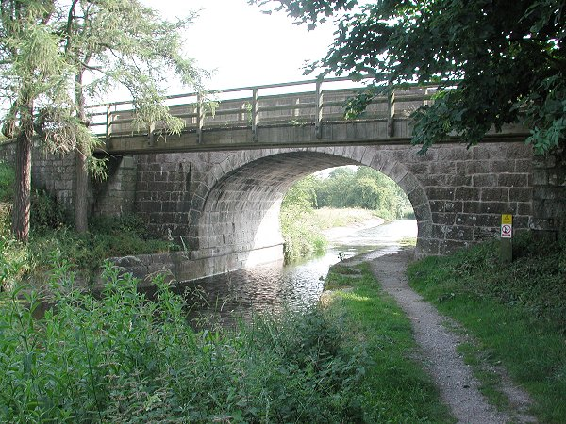
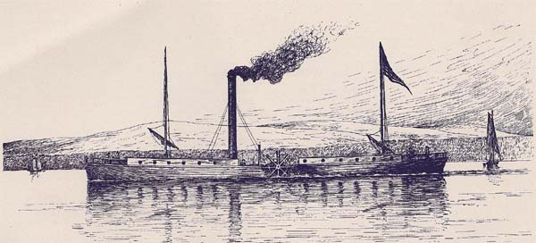
Transportation
Transportation
  Turnpikes - 1790
    Mostly in North
  Steamboats–1807
    Robert Fulton
    Clermont

Slide 16
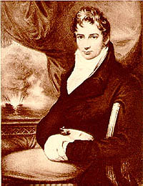
Robert Fulton
& the Steamboat
1807: The Clermont

Slide 17
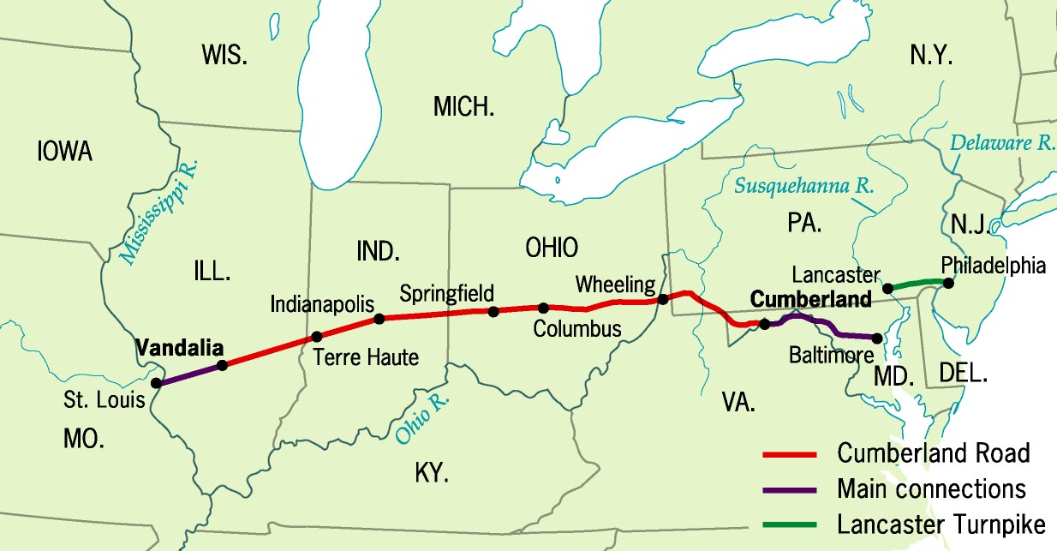
Cumberland (National Road), 1811

Slide 18
Jeffersonian Era
Social Changes

Slide 19
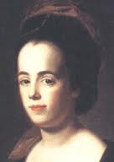
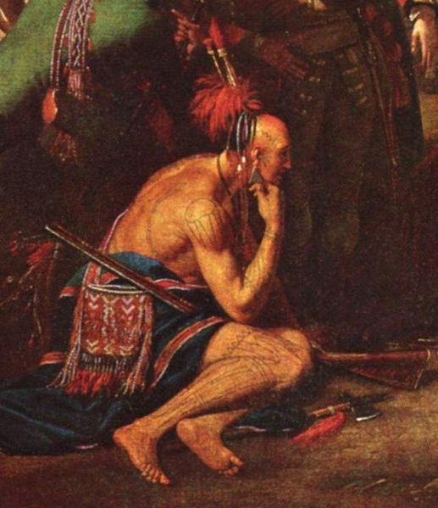
1800 America - Education
Few Public Schools
Women
    First allowed in public schools (rare)
    “Republican Motherhood”
    Judith Sargent Murray
Native Americans
    “Noble Savages”
    Assimilation
Higher Education
    9 colleges (1776) – 22 (1800) (1%)

Slide 20
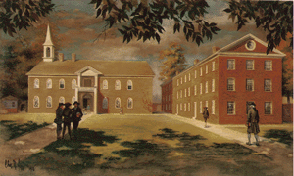
1800 America - Medicine
University of Pennsylvania
  Founded by Ben Franklin
  First College to offer Medical School
Most physicians reject modernization
Study of anatomy frowned upon

Slide 21
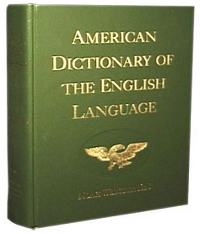
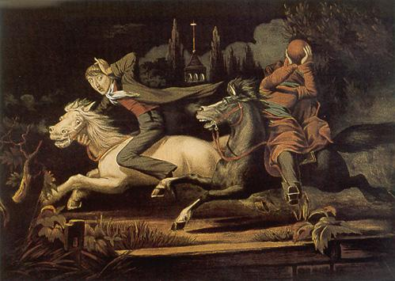
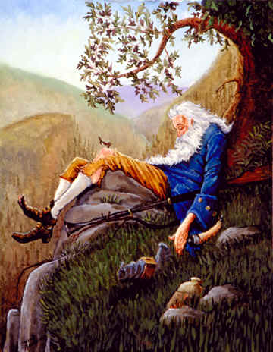
1800s American – National Identity
Hope for “Rising Glory in America”
Noah Webster - 1828
  Dictionary
  Encourages “American” literacy
Washington Irving – 1820s
  The legend of Sleepy Hollow & Rip Van Winkle
  “ American” Folk Tales

Slide 22
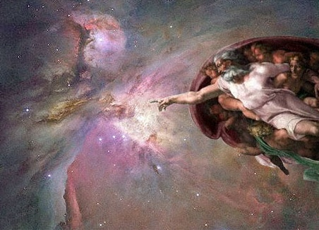
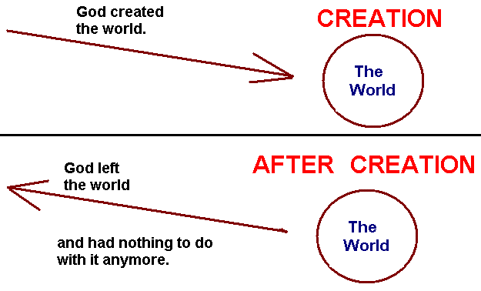
1800 America - Religion
Deism
  Mixture of science and religion
  Franklin and Jefferson
  God as “Watchmaker”

Slide 23
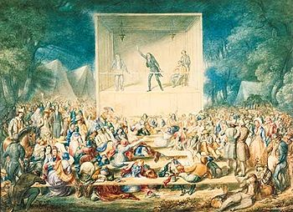
1800 America - Religion
Second Great Awakening - 1820
  Rejection of Predestination
  Focus on Good Works
  Revivals/Evangelism
  Reject Skepticism
    Presbyterian – West
    Methodist – Nationwide
    Baptist – South
Effects
  Sparks Reform movement of mid1800s
  Women - More involved
  African Americans - Beginnings of abolition movement
  Natives - Some turn away from customs
“Camp Meeting”

Slide 24
