Slide 1
Japan
By: Coach Sheets

Slide 2
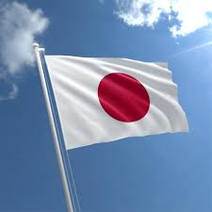
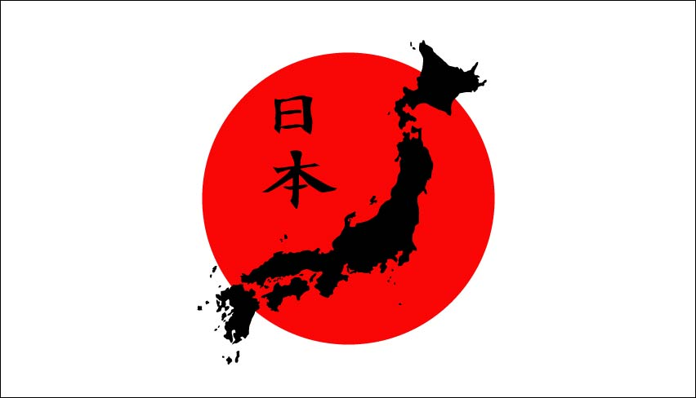
Introduction
Japanese enjoy one of the longest life spans in the world, in part because a traditional diet is comprised of fresh, unprocessed foods.
In addition to eating healthfully, the Japanese also have different attitude toward food than many Americans.
In Okinawa, for instance, residents practice ‘ hara hachi bu’ or eight parts of 10. They stop eating when they are 80 percent full.

Slide 3
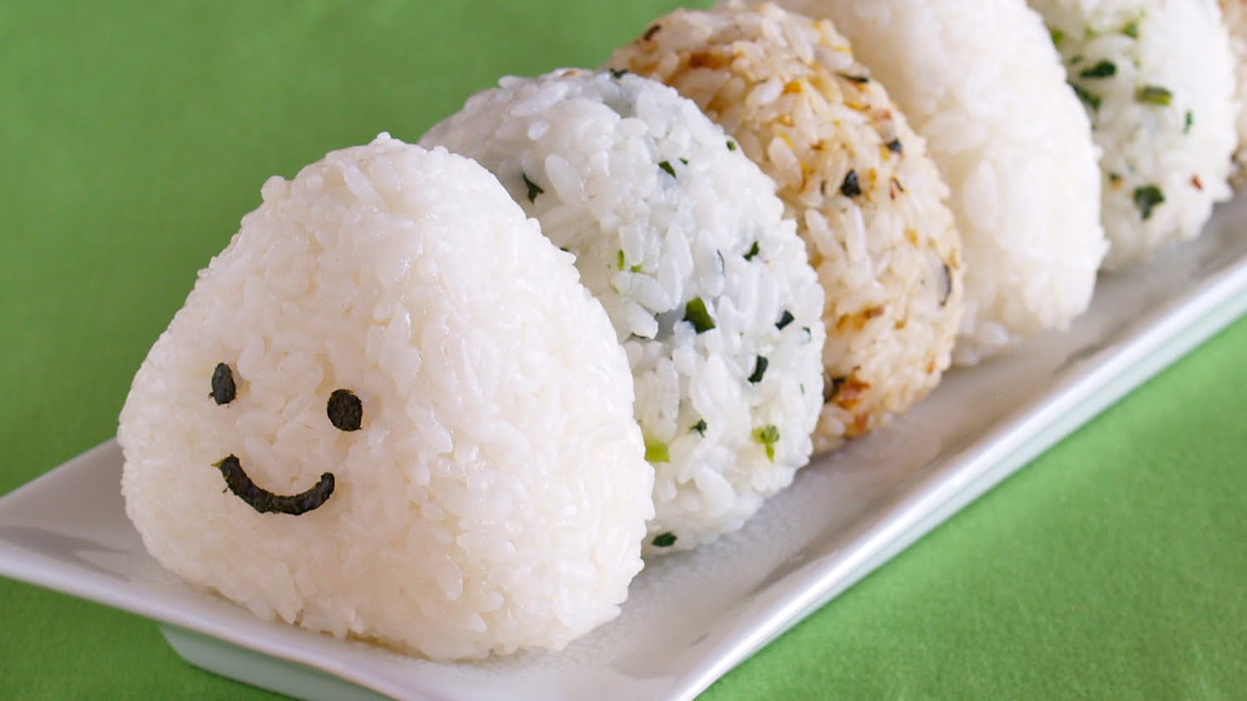
Intro Cont’d
Gohan at every Meal
The Japanese use the same word, ‘Gohan’ meaning cooked rice and meal. Prefixes are attached to gohan to form words for breakfast, lunch and dinner (asogohan, hirugohan and bangohan)
In other words, a meal without rice is not a meal at all.

Slide 4
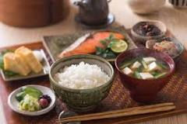
Breakfast
It consists of foods that make up a complete meal that one could conceivably enjoy at lunch or dinner. Typically, a traditional Japanese breakfast consists of steamed rice, miso soup, a protein such as grilled fish and various side dishes.

Slide 5
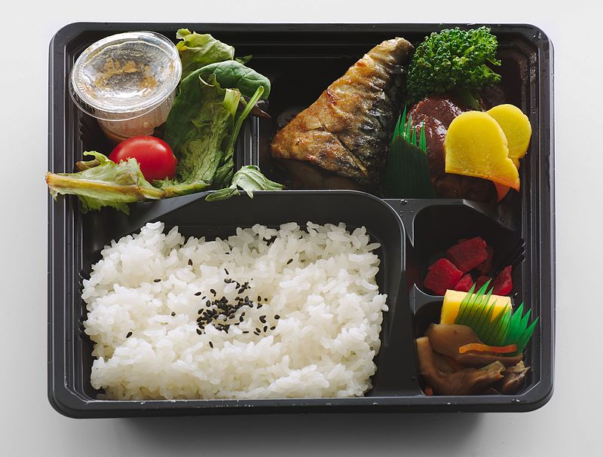
Lunch
Bento (弁当 bentō?)^{[ -} Is a single-portioned takeout or home-packed meal common in Japanese cuisine. A traditional bento holds rice, fish or meat, with pickled or cooked vegetables, usually in a box-shape container

Slide 6
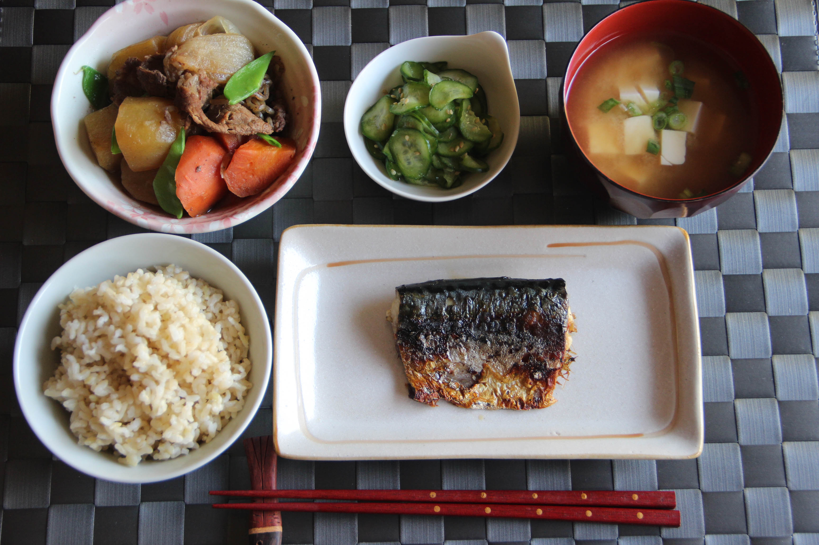
Dinner
Japanese dinner here with Saba Shioyaki (Grilled Mackerel) as a main dish, Nikujaga (Meat and Potato Stew) and Sunomono (Cucumber Salad) as side dishes. Miso Soup and Genmai (Brown Rice) are also served with other dishes, of course

Slide 7
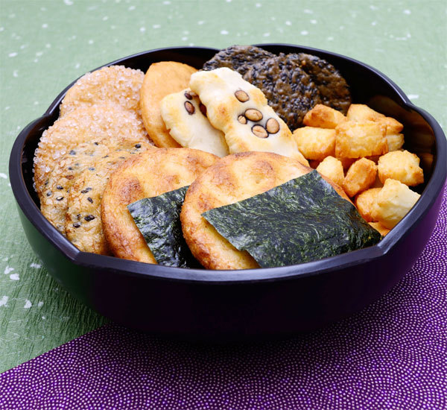
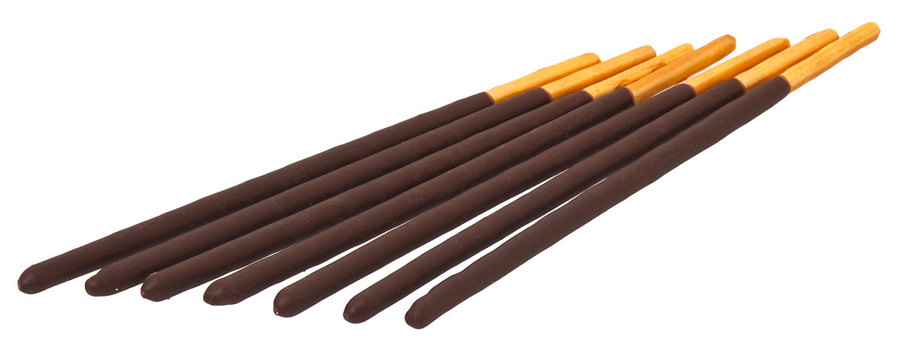
Snacks and Dessert
Senbei
Pocky
Senbei is a type Japanese rice cracker often served with green tea. They are savory but sometimes sweet. Normally, when they are cooked they are brushed with a flavoring sauce, often made of soy sauce
Pocky is a crispy cookie biscuit stick coated in chocolate cream. Although the original flavor was chocolate, many new flavors have been added such as strawberry and almond. In Japan, Pocky is very popular among teenagers

Slide 8
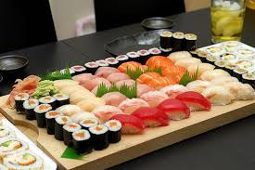
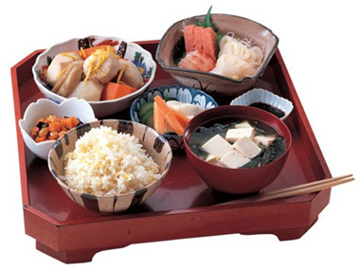
Conclusion
In conclusion, the Japanese traditional diet is much more healthy than what we typically have here in the Southeastern part of the United States.
While most of our meals are centered around fatty meats, their meals are focused on rice and leaner meats.
Just these simple differences leads to a healthier life and longer life span.

