Slide 1
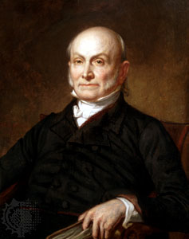
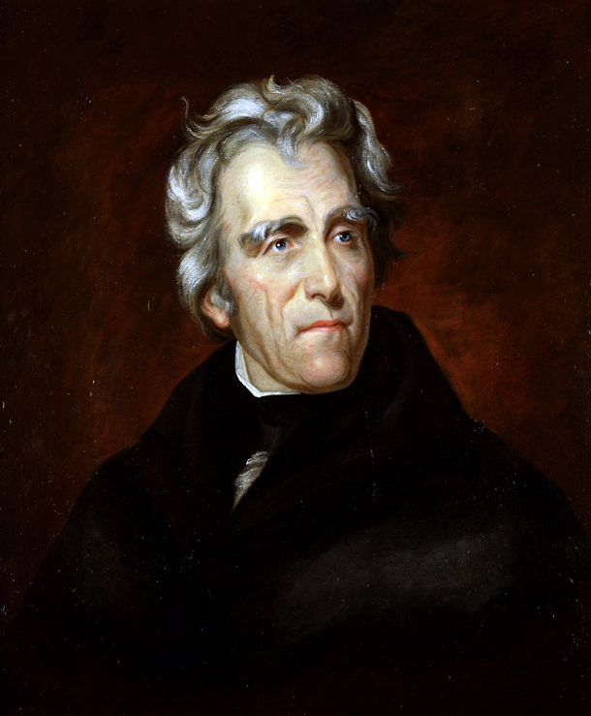
Jacksonian America

Slide 2
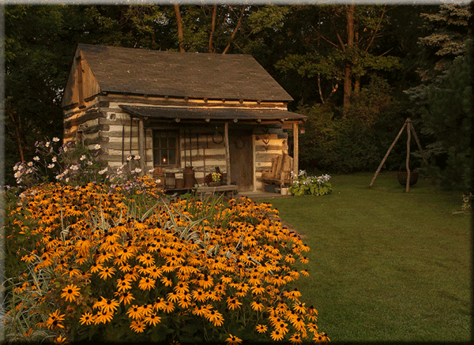
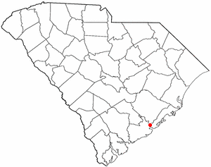
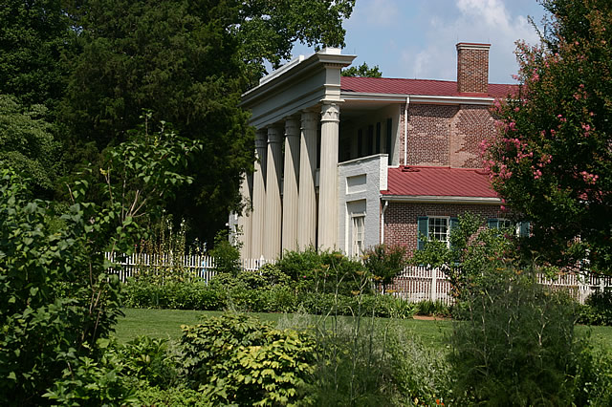
Jackson: ‘Man of the People’
Born in a small
Log Cabin in SC
Jackson downplayed the fact that he was a wealthy landowner in Tennessee with over 100 slaves at the Hermitage.
War of 1812 hero of the Battle of New Orleans
First president since George Washington without a college education

Slide 3

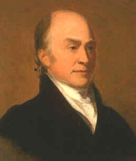
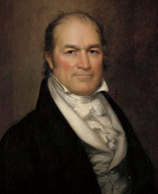
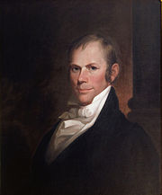
Election of 1824
Andrew Jackson
William Crawford
*All Considered “Republicans”
John Quincy Adams
Henry Clay

Slide 4
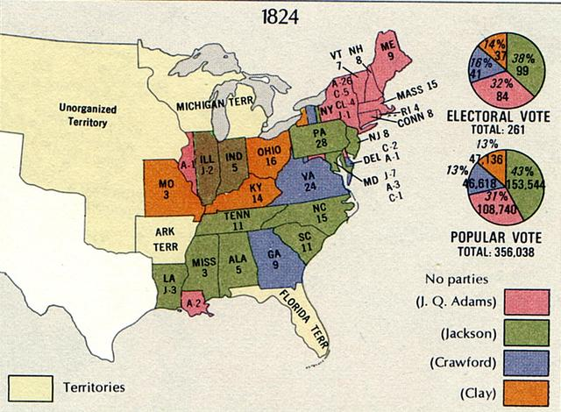

Slide 5
Results of Election
Jackson wins popular vote
No one wins Majority of Electoral College
12th Amendment states that House will Choose
← Henry Clay is Speaker
Clay sways congress towards J Q Adams
In turn, JQA appoints Clay as Secretary of State
“Corrupt Bargain”
Shows need for 2 party system

Slide 6
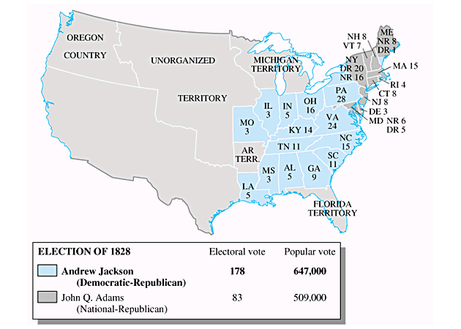
Election of 1828
Jackson vs. John Q Adams

Slide 7

John Quincy Adams
Divisive politics kept JQA from achieving much during his administration
1st President that was the son of a President

Slide 8
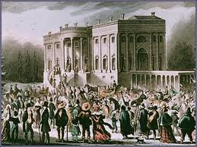
Age of the “Common Man”?
New Voters
  Property ownership no longer required to vote in many states
Return of Two Party System
  Seen as necessary (Checks/Balances)

Slide 9
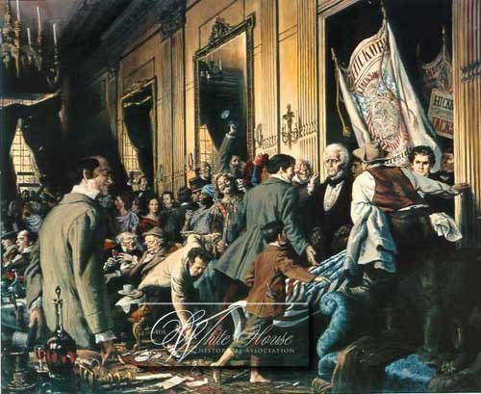

Slide 10
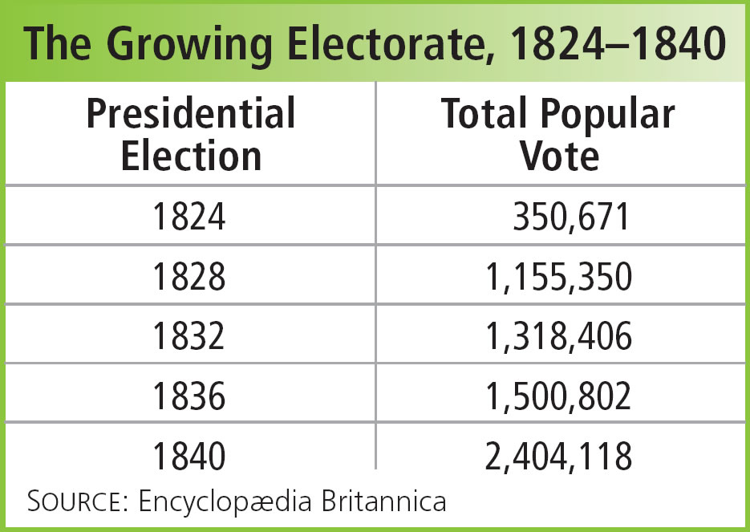
“JACKSONIAN DEMOCRACY”
24% White Males
48% White Males
80% White Males

Slide 11
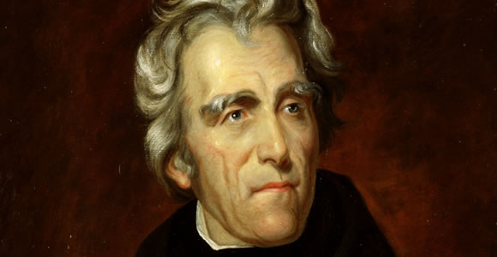
Essential Question:
Champion of
the
“Common Man”?
“King”
Andrew?
OR

Slide 12
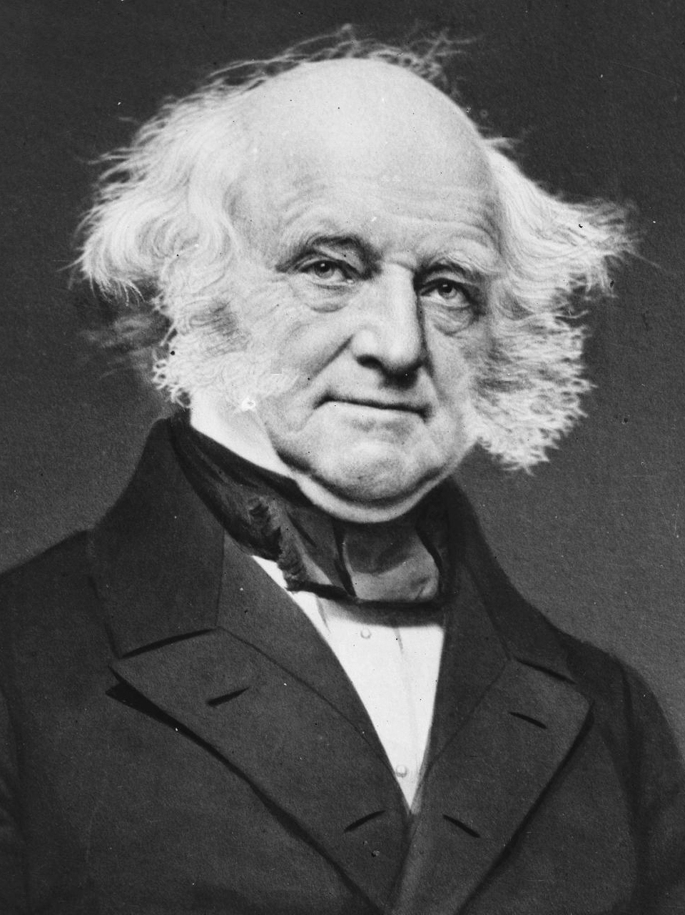
Spoils System – AKA Patronage
1/5th of White House employees
replaced
Spoils System - Act of giving Govt jobs in return for political support/favors
Jackson believes govt positions belong to the “Common Man”
  Not Aristocrats (The rich elite)
Jackson’s “kitchen cabinet”-
  friends and supporters of Jackson
  Replace John Quincy Adams’ appointees.
  Van Buren = Secretary of State →

Slide 13
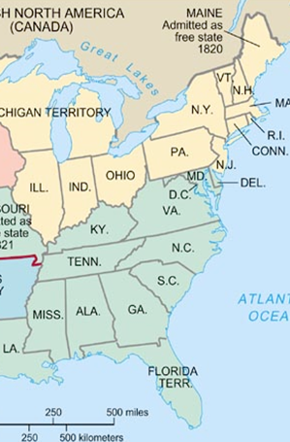
The Nullification Crisis
Tariff of 1828:
  South blames Tariffs for economic failures
  The tariff forced southerners to buy more expensive goods from the North
  Nicknamed the “Tariff of Abominations”

Slide 14
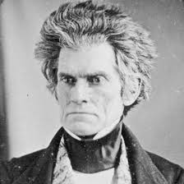
The Nullification Crisis
Nullification
  South Carolina believes this law is Unconstitutional
  Idea brought back by John C. Calhoun (Jacksons VP)
    Remember the VA and Kentucky Resolutions?
South Carolina Doesn’t have to take this abuse!

Slide 15
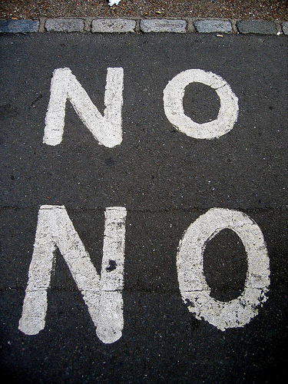
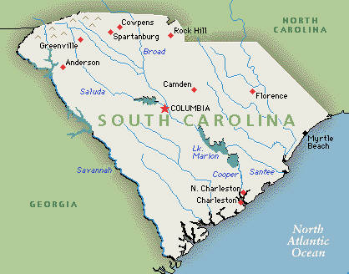
The Nullification Crisis
1828: Vice President John C. Calhoun secretly writes the South Carolina Exposition and Protest
He says that South Carolina should NULLIFY this tax
He says that South Carolina will SECEDE from the United States and become it’s own country if they are forced to follow this tax

Slide 16
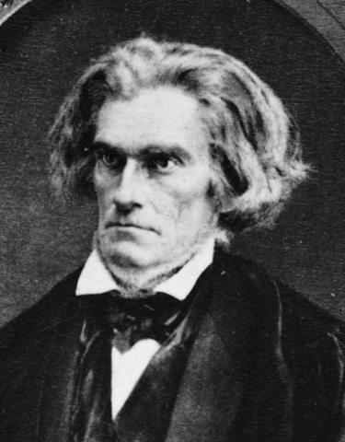
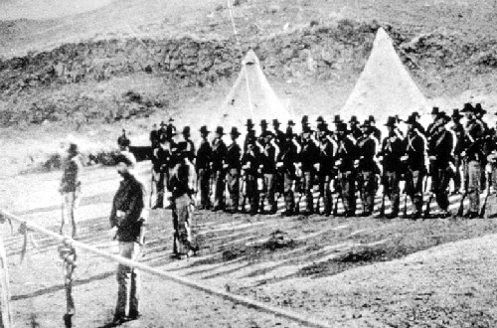
The Nullification Crisis
1832: John Calhoun resigns from being Vice President
South Carolina decides to NULLIFY the tariffs
Jackson says this is treason and passes The Force Bill passed
Jackson sends the army to South Carolina to force them to follow the tax
“Ill hang that treasonous Calhoun”
- Andrew Jackson

Slide 17
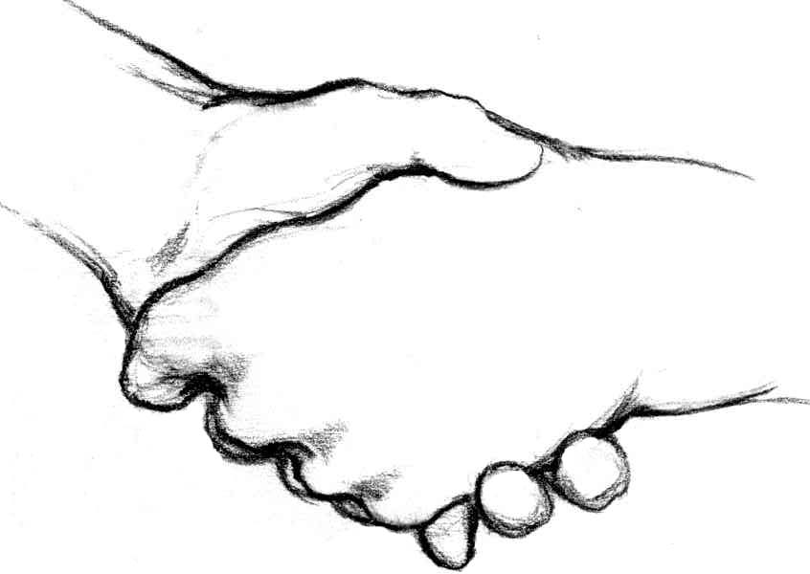
The Nullification Crisis
1833 – “Compromise Tariff”
Proposed by Henry Clay
Gradually reduces tariffs over the next decade
Is the Nullification a success?

Slide 18
Film Clip
The Nullification Crisis

Slide 19
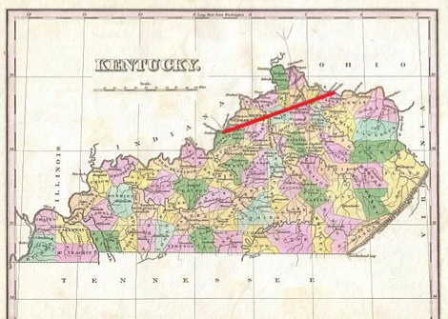

Veto of the Maysville Road
Congress approved funding for road within Kentucky
Jackson said this was unconstitutional
  Not INTERstate trade
Vetoes the project
One of 12 vetoes

Slide 20
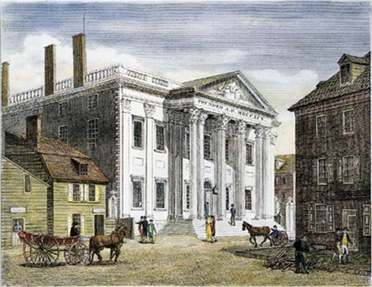
The Bank War
The Bank
Good for the economy
  Regulates Money flow
  Makes money on loans that can be used for internal improvemetns
Want Congress to make a new National Bank
Jackson
A National Bank is a bad idea
  Believes only helps the rich and has too much power
1832: vetoes the re-chartering of the National Bank

Slide 21
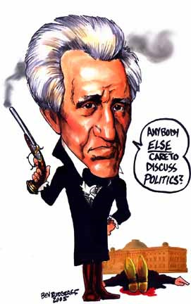
The End of the Bank War
“The Bank, Mr. Van Buren, is trying to kill me. But I will kill it.”
Pet Banks:
  Government money now given to these banks instead
What happened to the bank?
  Completely gone by 1841
  Why could this be bad?

Slide 22
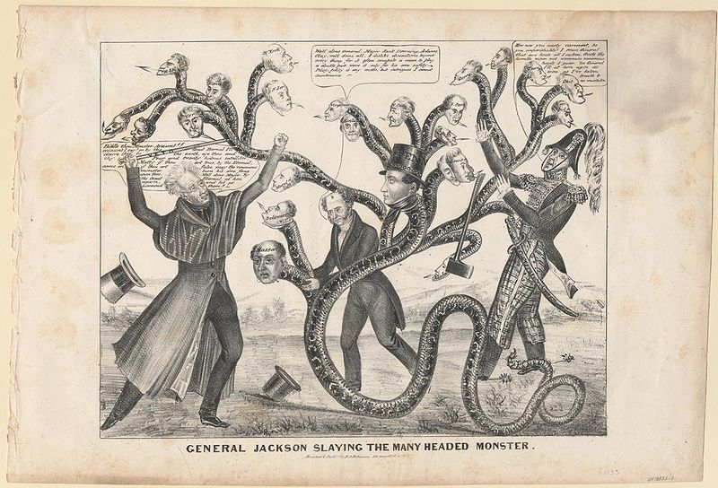
Jackson Killing the “Monster”

Slide 23
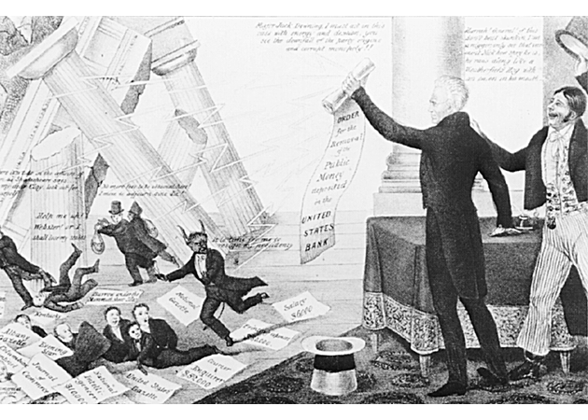
The Downfall of “Mother Bank”

Slide 24
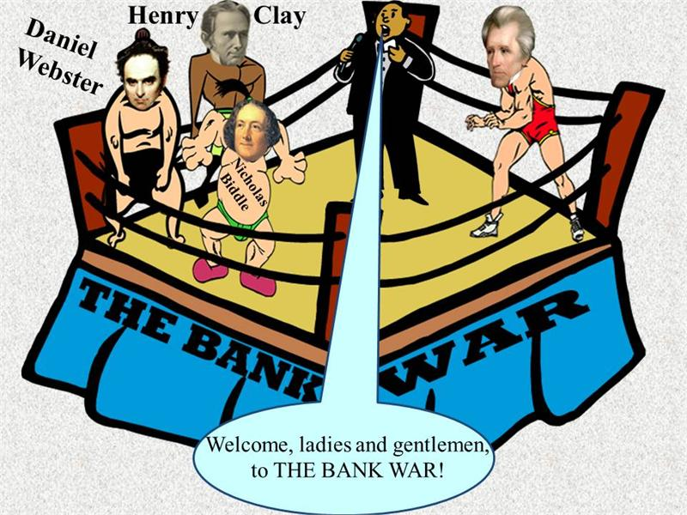

Slide 25
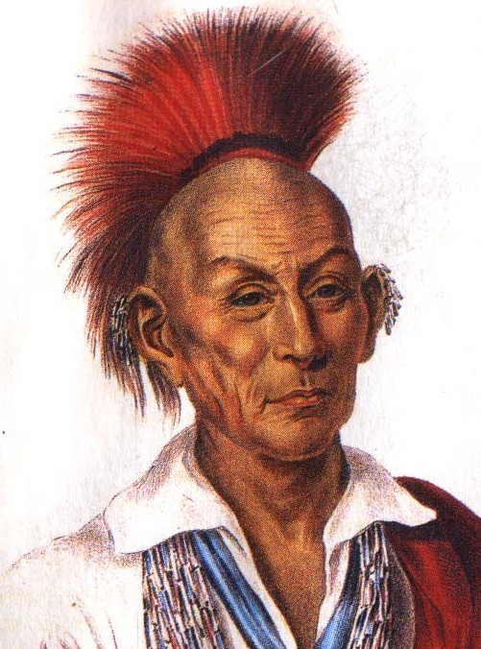
Indian Removal Act - 1830
Allows states to force natives to move west of the Mississippi
Why?
  Settlers want more land
  Natives Continued to resist
    Leads to Violence
  The government is forced to respond with troops

Slide 26
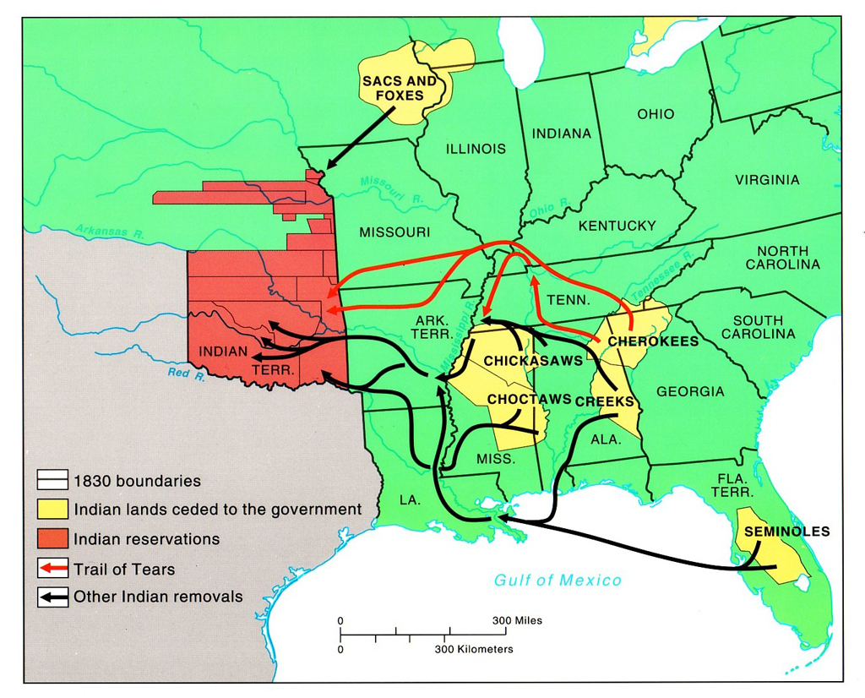
Indian Removal Act
Who?
  All tribes East of the Mississippi
  “5 Civilized Tribes”
    Cherokee
    Choctaw
    Chickasaw
    Creek
    Seminole
Refusal
  Cherokee look to Supreme Court
  Small group of Seminoles refuse

Slide 28
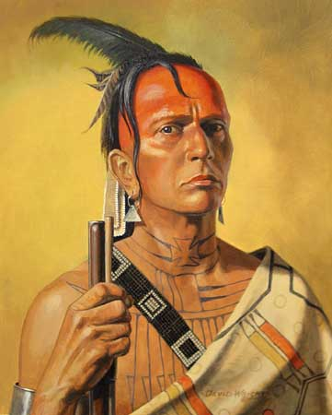
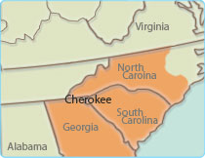
Worcester v. Georgia (1832)
Question
  Does Georgia have control over native lands?
  A.k.a. can GA kick out the Cherokee?
Ruling
  No they do not!
  Essentially declare I.R.A Unconstitutional
Jackson’s Response
  “John Marshall has made his decision, now lets see him enforce it!”

Slide 29
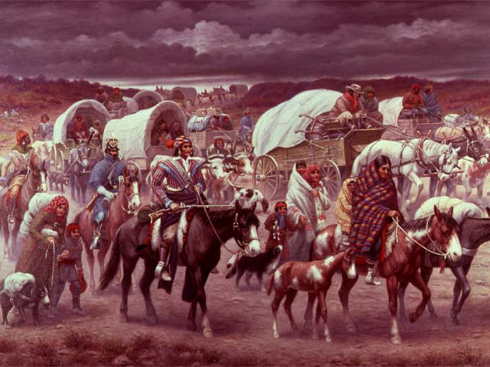
Trail of Tears
1838
  Forced remaining tribes to reservations in Oklahoma
  25% die during trip

Slide 30
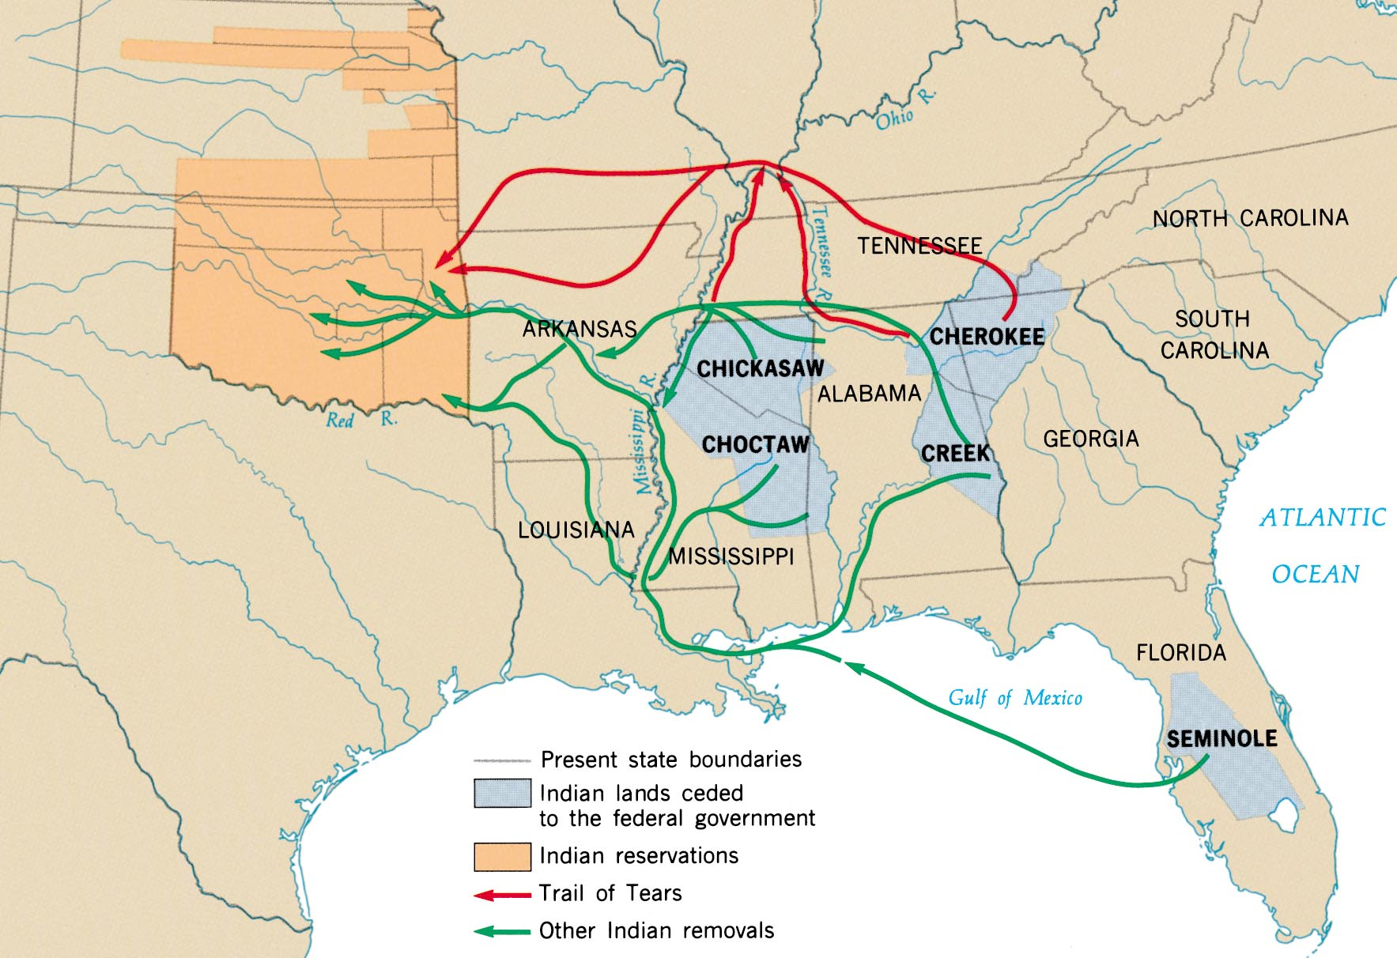
Indian Removal

Slide 31
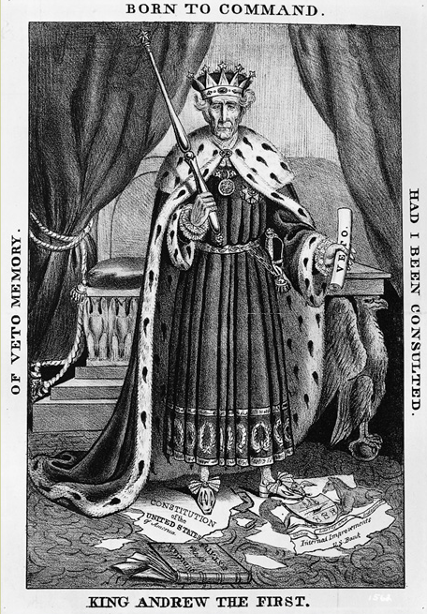
An 1832 Cartoon:
“King
Andrew”?

Slide 32

"After 8 years as president, I have only two regrets. That I have not shot Henry Clay or hanged John C. Calhoun."
—Andrew Jackson

Slide 33
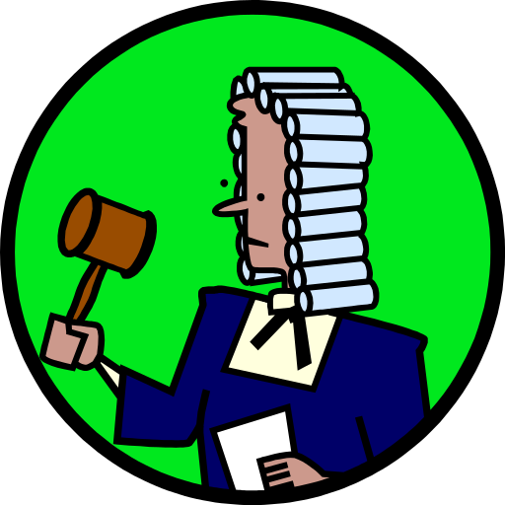
The Whig Party is formed
Beliefs
Anti Andrew Jackson
Pro Strong federal government
Pro American System:
  national bank
  protective tariffs
  build canals and roads to improve the country

Slide 34
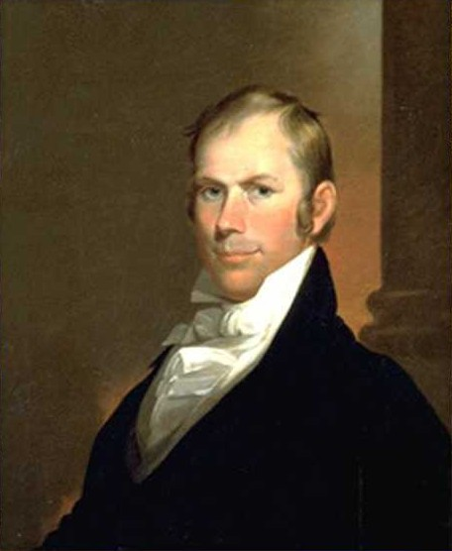
Whig Party
Led by Henry Clay and Daniel Webster (Even Calhoun) & made up of people who dislike Jackson
Could not agree on one candidate, so had 3 Whig candidates run against Jackson.

Slide 35
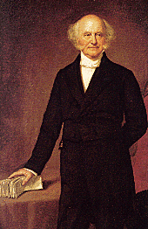
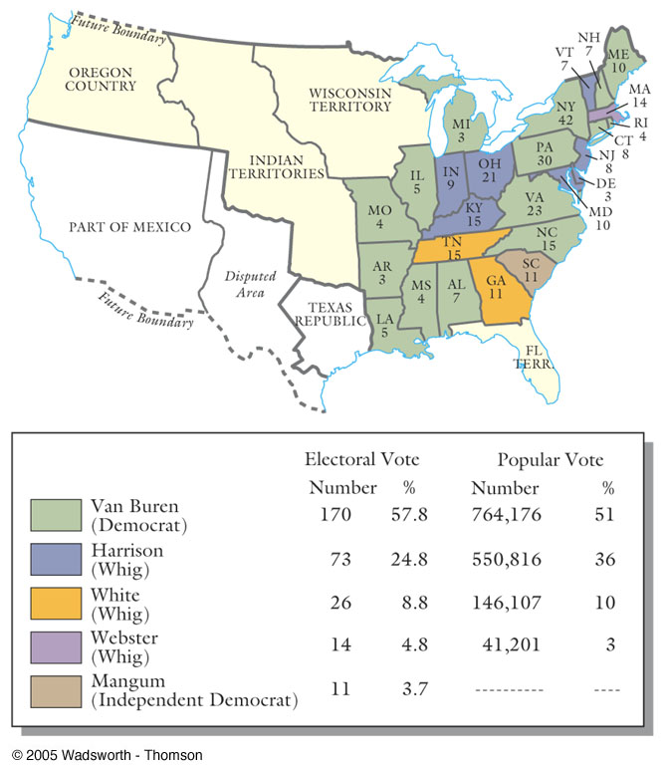
The 1836 Election Results
Martin Van Buren
“Old Kinderhook”
[O. K.]

Slide 36
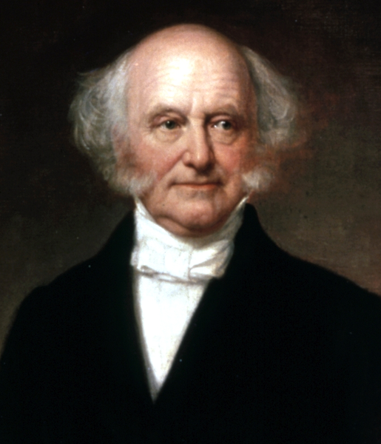
Panic of 1837
Pet Banks printed too much money
  It becomes worthless
Jackson announces that only money backed by Specie Circular (gold & silver) was now acceptable.
People rushed to the banks to trade paper currency for gold and silver-
  Banks closed
  Leads to Depression
  1/3 of the population unemployed
Van Buren gets the Blame
Rush on the banks to trade paper for gold but banks did not have enough
  + Banks forced to close
  + Businesses went bankrupt
  = PANIC OF 1837
Van Buren blamed for crisis

Slide 37
In Summary…. Was Jackson a good or bad president?
Cons
Disobeys the Supreme Court
  Worcester vs. Georgia decision
Forces removal of Natives
  Indian Removal Act / Trail of Tears
Unintentionally caused the Panic of 1837
Pros
Common man has more say over who is President
Creates Democratic Party
Believes in keeping the country united no matter what

Slide 38
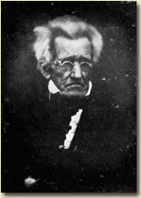
Photo of Andrew Jackson in 1844
(one year before his death)
1767 - 1845

Slide 39
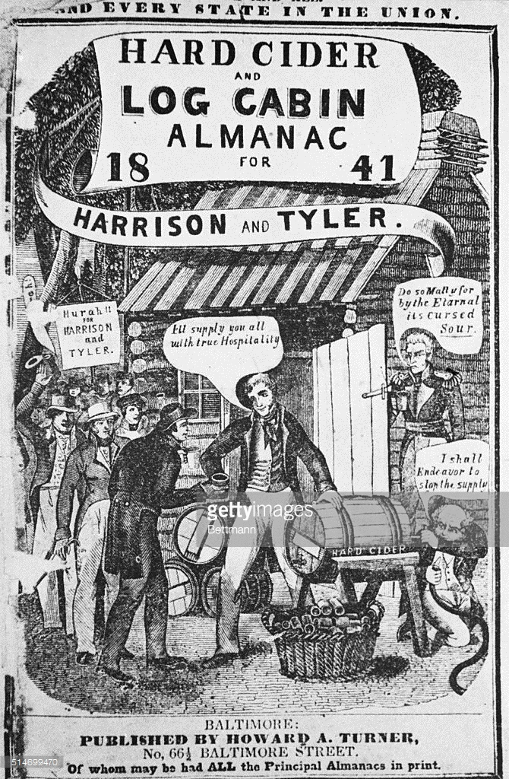
Tippecanoe and Tyler Too!!
Tip and Ty
What's the cause of this commotion, motion, motion,
Our country through?
It is the ball a-rolling on
For Tippecanoe and Tyler too.
For Tippecanoe and Tyler too.
And with them we'll beat little Van, Van, Van,
Van is a used up man.
And with them we'll beat little Van.

Slide 40
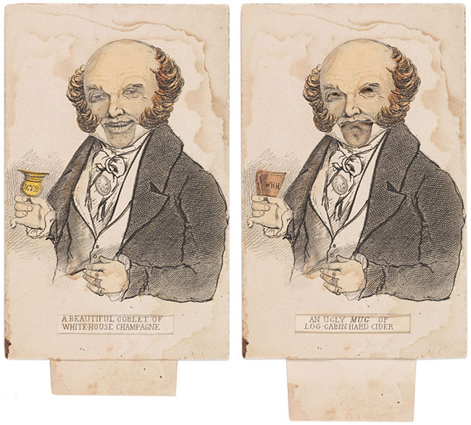

Slide 41
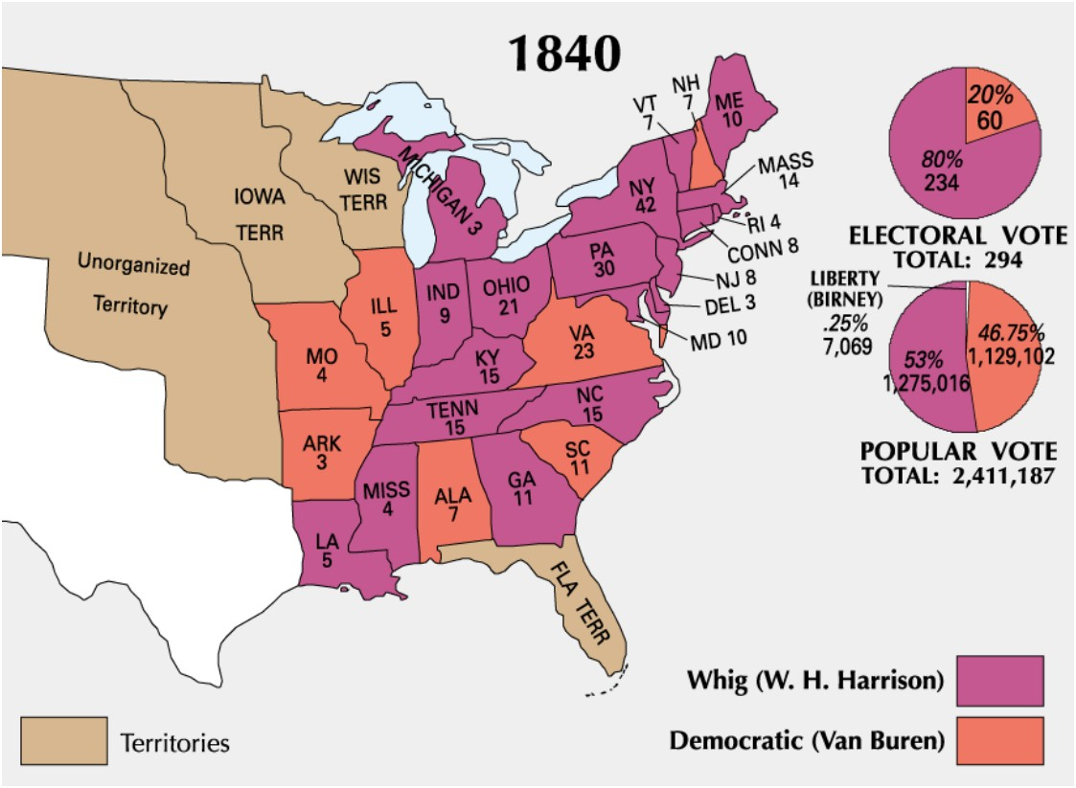
Election of 1840

Slide 42
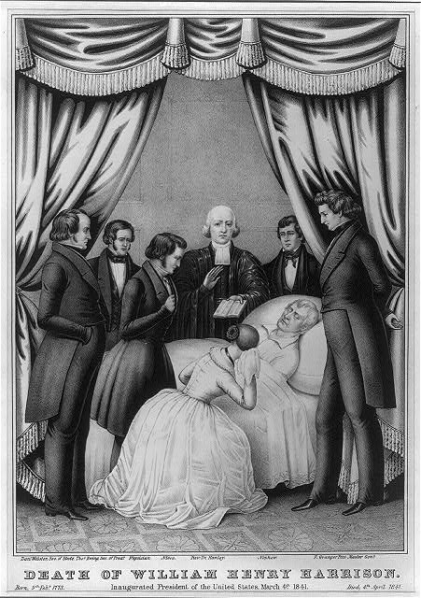
Death of Harrison

Slide 43
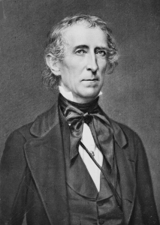
“His Accidency”
“A President without a party”
Attempted to impeach 3 times
Most of Cabinet stepped down
John Tyler

