Slide 1
Istation and online logins
Beverly Hills Elementary logins 2019-2020

Slide 2
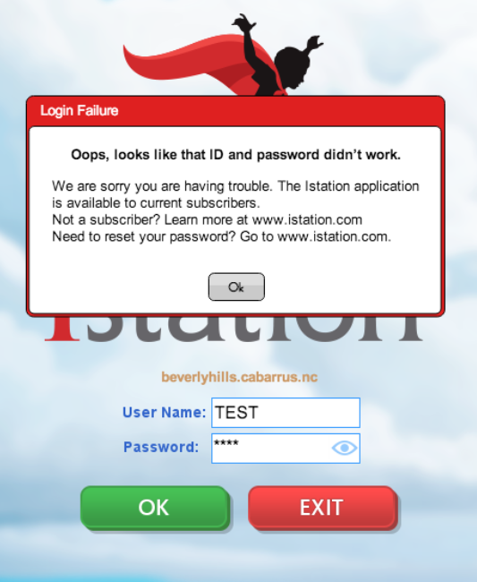
How to load Istation at home:
Hello Parents! Having heard some questions about loading Istation, here are some directions for loading and using the program at home. Istation in particular is an app that needs to be downloaded and installed in order to use it. If you are getting a msg that says “ID and password didn’t work” follow these steps to install it on your device and login with Clever.

Slide 3

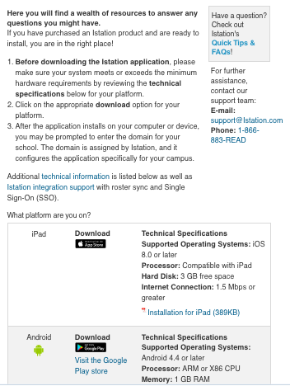
How to load Istation at home:
Install Istation by going to www.istation.com/Support.
Follow the instructions to install Istation on your home device. (You can choose between iPad, Chromebook, Tablet, Mac, or PC.)
Log in to Istation using Clever on the Beverly Hills Elementary School website.
You will only need to download Istation one time. After that continue to use Clever to log in and load the app.

Slide 4
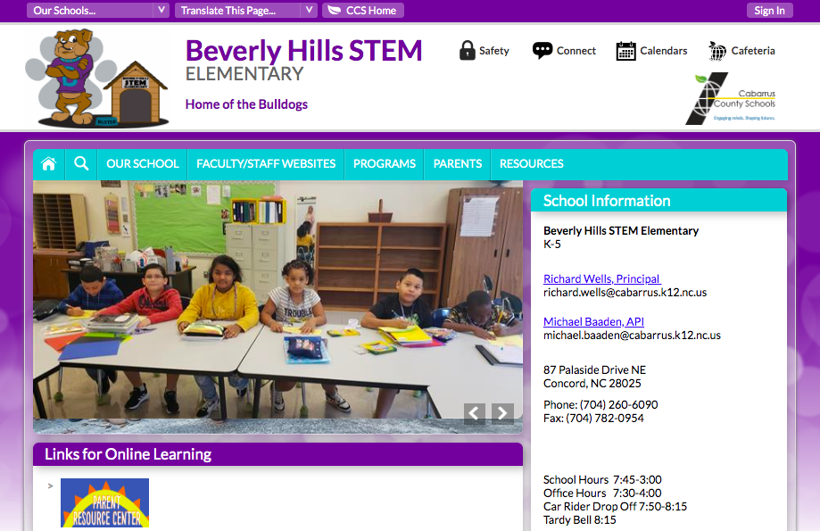

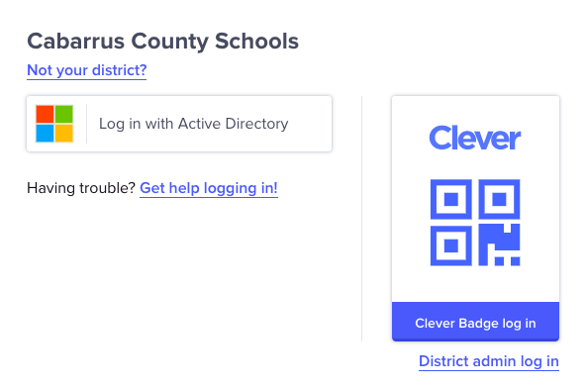
How to login to Clever:
IGo to the Beverly Hills Webpage https://www.cabarrus.k12.nc.us/Domain/10
Click on the BLUE C for Clever.
Grades 2-5 will click on “Log in with active directory.” They will enter their username & password.
Grades K-1 can click on the QR code reader and scan their badge.

Slide 5
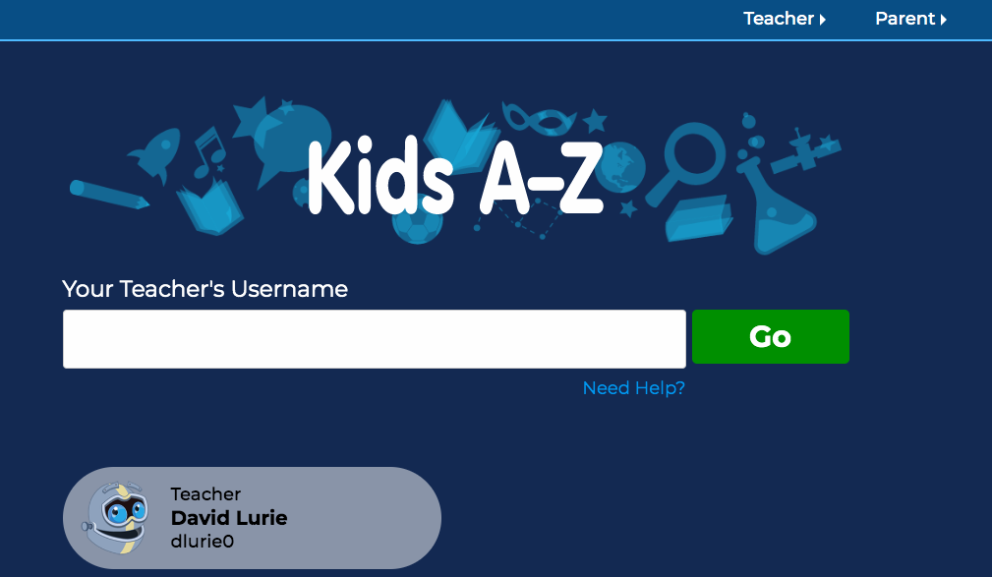
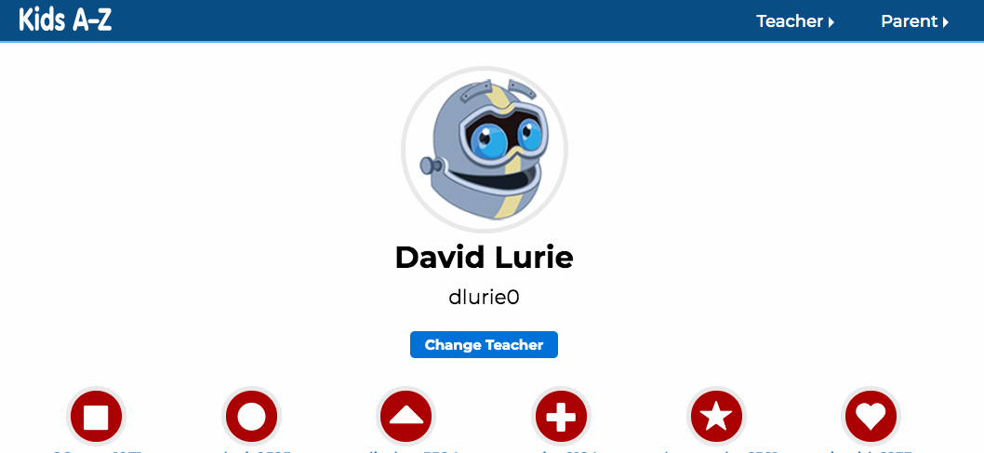
How to login Raz Kids:
IGo to the Beverly Hills Webpage https://www.cabarrus.k12.nc.us/Domain/10
Click on Raz Kids in the student links
Enter your teacher’s user name.
Select your profile and enter the Raz Kids password.

Slide 6
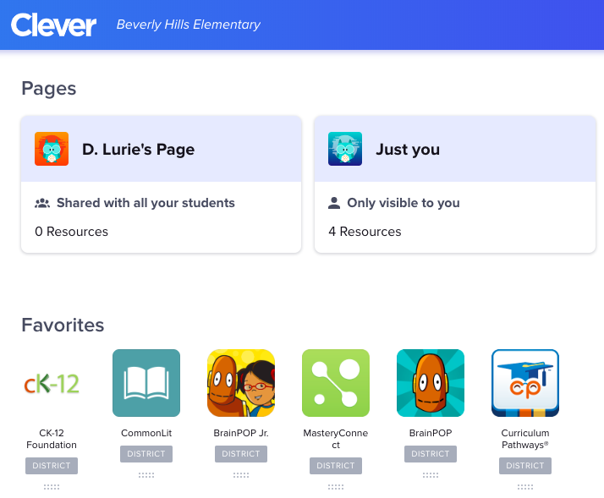
How to login to BrainPOP:
IGo to the Beverly Hills Webpage https://www.cabarrus.k12.nc.us/Domain/10
Login to Clever
Select BrainPOP or BrainPOP Jr.
There may be multiple buttons for BrainPOP and BrainPOP Jr. If one does not work, try another.

