Slide 1
ISLAM:
Submission
to the
Will of Allah

Slide 2
The
Judeo-Christian
Foundations
of Islam

Slide 3
Islam→An Abrahamic Religion
Muslims are strict monotheists.
They believe in the Judeo-
Christian God, which they call
Allah.
Muslims believe that the Torah
and the Bible, like the Qur’an,
is the word of God.
Peoples of the Book

Slide 4
Abraham’s Genealogy
HAGAR
ABRAHAM
SARAH
Ishmael
Isaac
12 Arabian Tribes
Jacob
Esau
12 Tribes of Israel

Slide 5
The Prophetic Tradition
Adam
Noah
Abraham
Moses
Jesus
Muhammad

Slide 6
The Qur'an:
God's Last
Revelation
-
Islam’s Sacred Book

Slide 7
The Origins of the Qur’an
Muhammad received his first
revelation from the angel
Gabriel in the Cave of Hira in 610.
622 → Hijrah → Muhammed
flees Mecca for Medina.
* The beginning of the
Muslim calendar (1 A.H.)
Muhammad’s revelations were
compiled into the Qur’an after
his death.

Slide 8
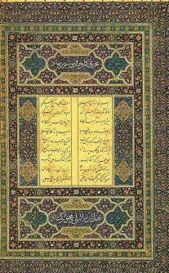
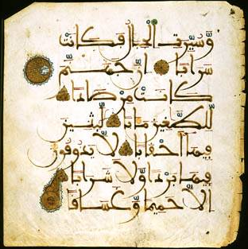
The Qur’an
Muslims believe it contains the
word of God.
114 suras (chapters).
In the name of Allah,
the compassionate,
the merciful.
Written
in Arabic.

Slide 9
The
Five Pillars
of
Islam

Slide 10

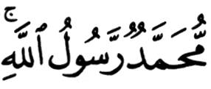
1. The Shahaadatayn
The testimony.
The declaration of faith:
There is no god worthy of
worship except God, and
Muhammad is His
Messenger [or Prophet].
1

Slide 11
2. The Salaah
The mandatory prayers
performed 5 times a day:
* dawn
* noon
* late afternoon
* sunset
* before going to bed
Wash before praying.
Face Mecca and use a prayer rug.
2

Slide 12
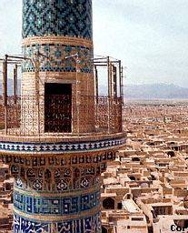
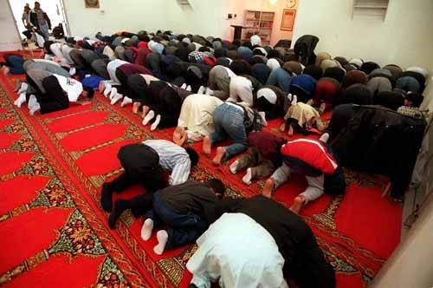
2. The Salaah
The call to prayer by the
muezzin in the minaret.
Pray in the mosque on Friday.
2

Slide 13
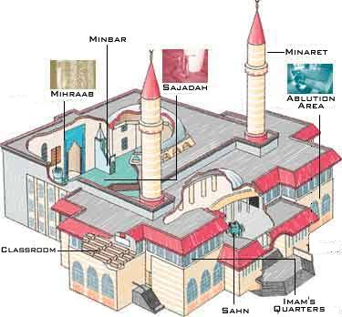
The Mosque
The Muslim place of worship.

Slide 14
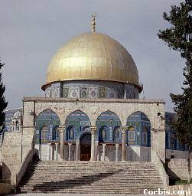
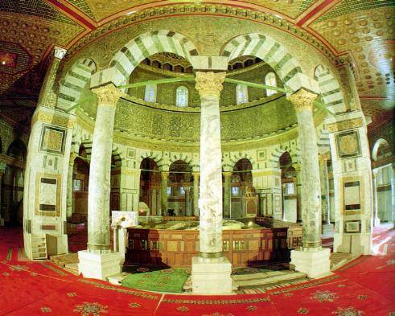
The Dome of the Rock Mosque in Jerusalem
Mount Moriah Rock
where Muhammad ascended into heaven.

Slide 15
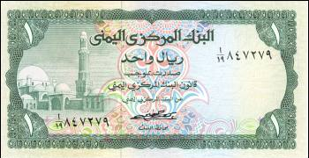
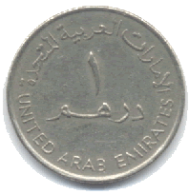
3. The Zakaah
Alms-giving (charitable
donations).
Muslims believe that all things
belong to God.
Zakaah means both “purification”and “growth.”
About 2.5% of your income.
3

Slide 16
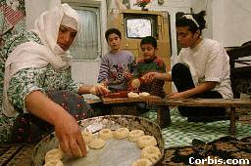
4. The Siyaam
Fasting during the holy month
of Ramadan.
Considered a method of self-
purification.
No eating or drinking from
sunrise to sunset during
Ramadan.
4

Slide 17
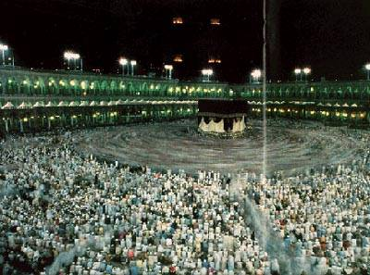
5. The Hajj
The pilgrimage to Mecca.
Must be done at least once in a
Muslim’s lifetime.
2-3 million Muslims make the
pilgrimage
every
year.
5

Slide 18
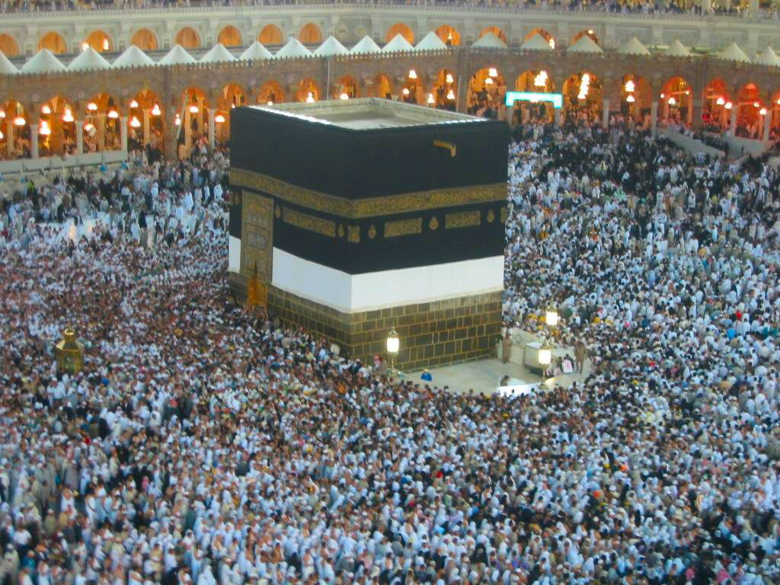
Ka’ba
Building in Mecca (Saudi Arabia) – most sacred site in Islam

Slide 19
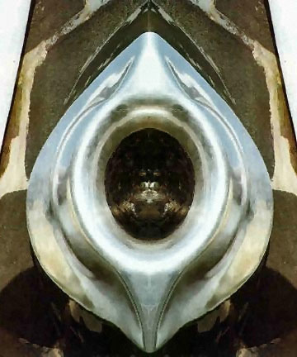
The Black Stone
Located in the eastern cornerstone of the Ka’ba
Tradition dates is back to Adam and Eve
Believed to be white (at first) – turned black absorbing sins

Slide 20
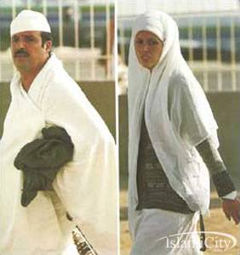
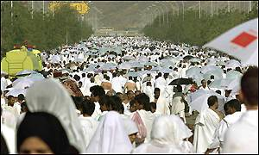
5. The Hajj
Those who complete the
pilgrimage can add the title
hajji to their name.
5

Slide 21
Other Islamic Religious Practices
Up to four wives allowed at once.
No alcohol or pork.
No gambling.
Shariah → set of practical laws to regulate daily living.
Three holiest cities in Islam:
* Mecca, Medina, Jerusalem.

Slide 22
The Dar al-Islam
The World
of Islam
1
2
3
4
5

Slide 23
Essential Question:
Why was Islam able to spread so quickly and convert so many to the new religion?

Slide 24
Essential Question:
Why was Islam able to spread so quickly and convert so many to the new religion?

Slide 25
The Spread of Islam
Easy to learn and practice.
No priesthood.
Teaches equality.
Non-Muslims, who were “Peoples of
the Book,” were allowed religious
freedom, but paid additional taxes.
Easily “portable” → nomads & trade
routes.
Jihad (“Holy War”) against pagans
and other non-believers (“infidels”).

Slide 26
Divisions of Islam
Sunni – believed the caliph (successor to Muhammad? Should be chosen by Muslim leaders
Shi’a – believed the caliph should be descendents of Muhammad only

Slide 27
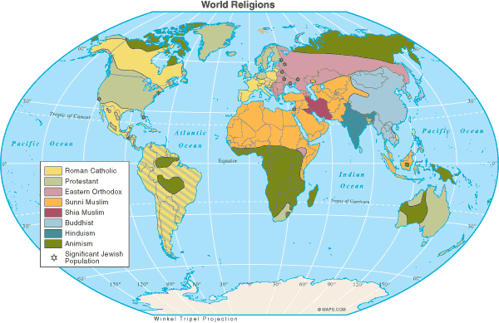
Muslims in the World
Today

Slide 28
Countries with the Largest Muslim Population
1. | Indonesia | 183,000,000 | 6. | Iran | 62,000,000
2. | Pakistan | 134,000,000 | 7. | Egypt | 59,000,000
3. | India | 121,000,000 | 8. | Nigeria | 53,000,000
4. | Bangladesh | 114,000,000 | 9. | Algeria | 31,000,000
5. | Turkey | 66,000,000 | 10. | Morocco | 29,000,000
* Arabs make up only 20% of the total Muslim population of the world.

Slide 29
Islam
in
America

Slide 30
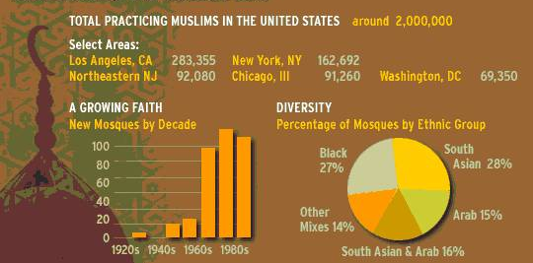
Muslims in America
http://www.people-press.org/2011/08/30/a-portrait-of-muslim-americans/

Slide 31
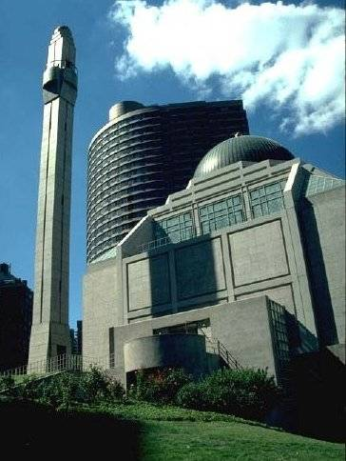
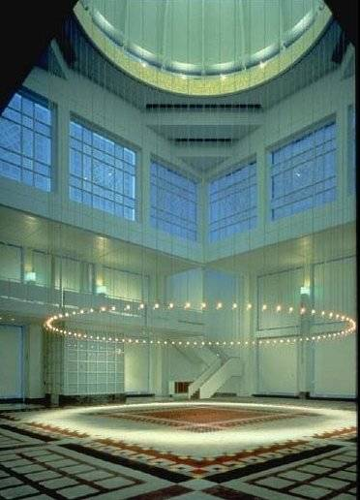
Muslim Culture in NYC
The Islamic Center, New York City

Slide 32
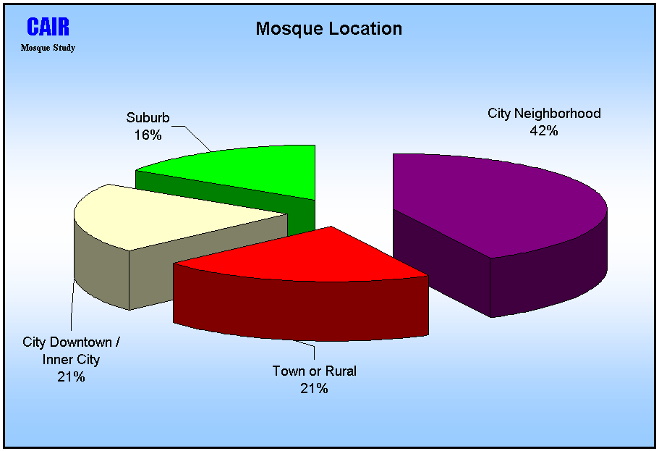

Slide 33
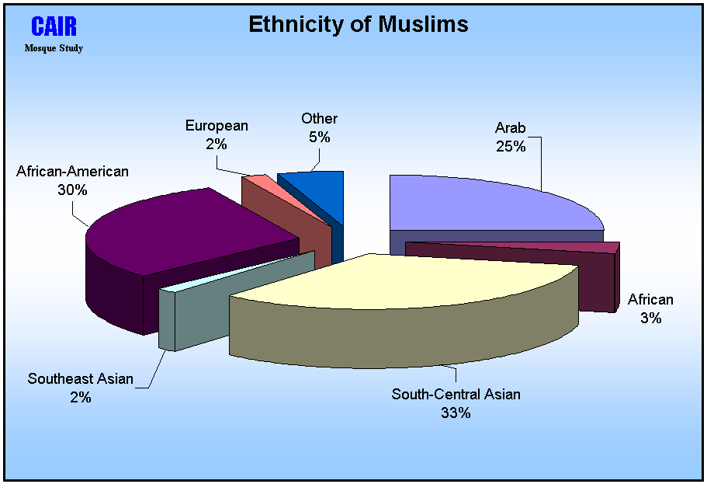

Slide 34
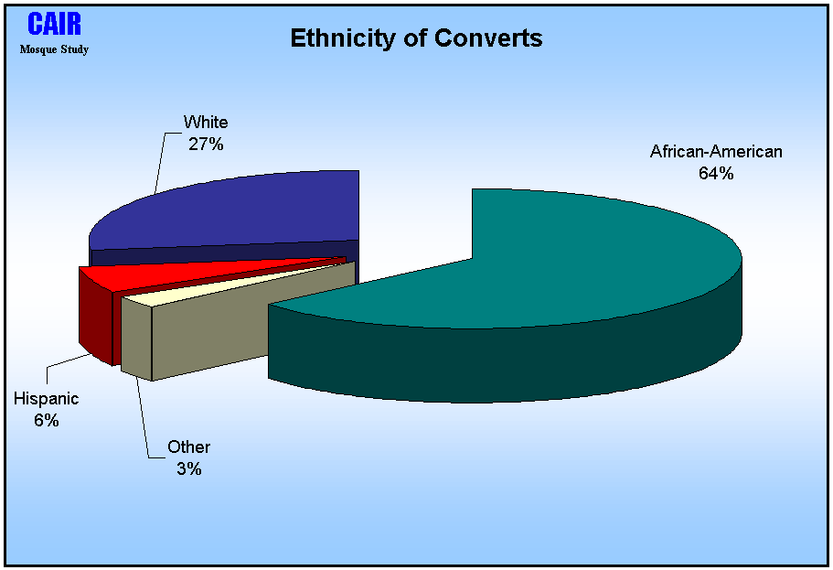

Slide 35
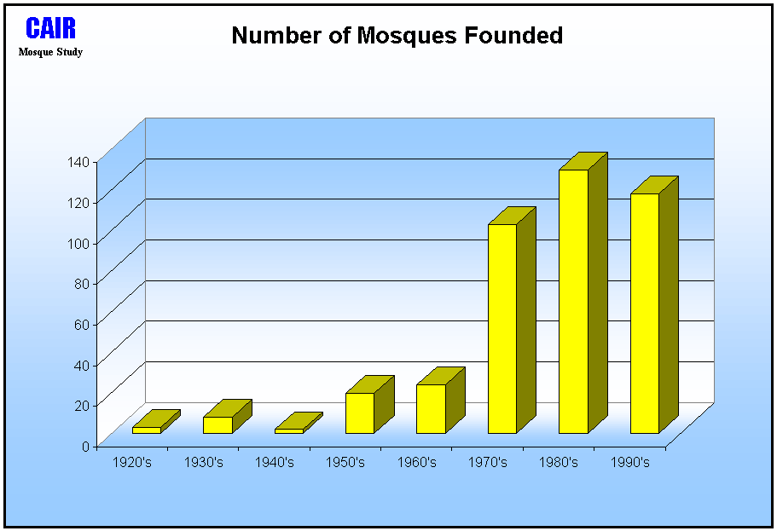

Slide 36
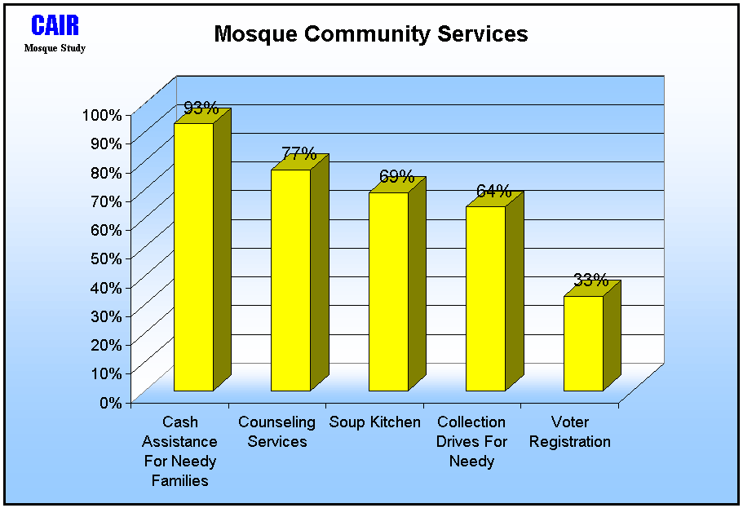

Slide 37
Islam
in
America
After
September 11?

Slide 38
Resources
McDougal-Littell - World History: Patterns of Interaction
Glencoe - World History
Ms. Susan M. Pojer
Horace Greeley HS Chappaqua, NY

