Slide 1
Writing an
Introduction
and a
Conclusion

Slide 2
Introductions:
Introductions should hook the reader. The reader should read the first line and want to keep reading to learn more about the topic or, in this case, your opinion.
Now, you need to think…How will I create a great introductions

Slide 3
Ways to Hook Your Reader
Three ways I like to start an introduction is to ….
Ask a question about the topic
  Have your heard…?
  Did you know (realize)…?
State a startling (surprising) fact
A small powerful statement that hints at the topic

Slide 4
Introductions don’t just have to hook the reader. Introductions also tell the reader a little about what the topic or, in this case, your opinion.
An introduction must include:
Your claim
The 2 reasons to support your claim.

Slide 5
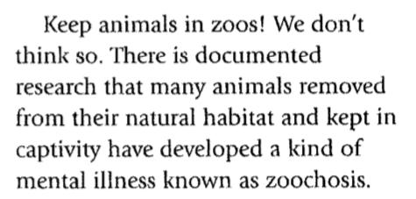
Example of Good A Introduction
From the article “Zoochois”
Hints at topic
A little bit of authors’ claim
The reasons the authors use to support their claim.

Slide 6
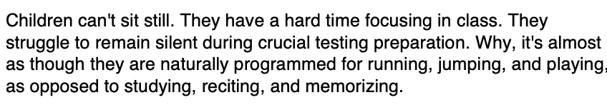
Example of Good A Introduction
From the article “Death of Recess in America” by David A. Tomar
Startling statement
The reasons the authors use to support their claim.
Author’s claim

Slide 7
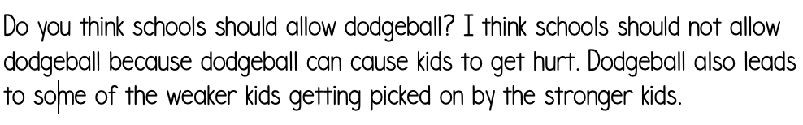
Example of Good A Introduction
From the article “Dodge Dodgeball” by Anonymous 5th Grader
Asked a question
Author’s claim
The reasons the authors use to support their claim.

Slide 8
NOW ITS YOUR TURN
THINK about how you will hook your reader
INDCLUDE YOUR CLAIM…I believe…
State the reasons that support your claim

Slide 9
Write Your introduction on your Google
Classroom Document (found in clever under Mrs. Shakespeare’s Page)
Remember: Introductions need to be the first paragraph of your paper. When you are ready to start writing, place the cursor before the first word of the first paragraph you have written.

Slide 10
Conclusions:
A Conclusion sums up the evidence in your text and restates your claim. But…a good opinion paper leaves the reader with something to think about.

Slide 11
Ways to Conclude
Must Haves
May Haves
Summary of your evidence that supports your reason using the GIST strategy.
Restate your claim… I believe…
The life lesson you have learned
Statement that makes your reader think
A Call to Action

Slide 12

Example of a Good Conclusion
From the article “Why Choose an Exotic Pet, Anyway?” by Dr. Laurie Hess
A call to action
Summary of evidence…
GIST
Restates claim

Slide 13
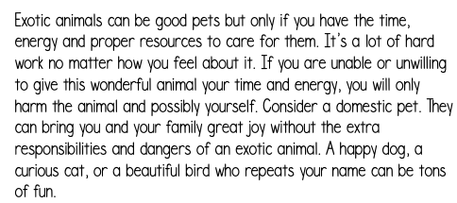
Example of a Good Conclusion
Excerpt from Everyday Health ““Enjoying Exotic Animals as Pets”
Repeats counter claim but discredits it
Claim
Summary of evidence…
GIST
Something for the reader to think about

Slide 14
NOW GIVE IT A TRY!
SUmmarize the reasons that support your claim…Use GIST
INDCLUDE YOUR CLAIM…I believe…
THINK about which “May Haves” you will use

Slide 15
Write Your Conclusion on your Google
Classroom Document (found in clever under Mrs. Shakespeare’s Page)
Remember: Conclusions need to be the last paragraph of your paper. When you are ready to start writing, place the cursor at the last word you have written on the page. Click return/enter to start your conclusion.
You will receive 2 DOJOs for on Task when you complete the introduction & conclusion.

