Slide 1
Introduction to Musculoskeletal Anatomy
IB SEHS

Slide 2
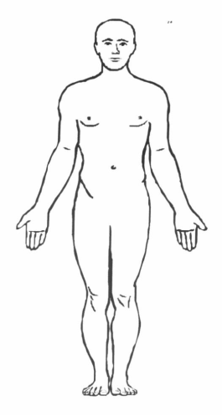
Starter
The anatomical starting position:
1. One person on the group should lie on the floor in the anatomical starting position
Draw around the person lying on the floor with a marker
Label the outline with following terms:
-head -trunk -arm
-neck -forearm -hand
-trunk -thigh -leg
-foot

Slide 3
Learning Objectives
Everyone should
Apply anatomical terminology to the location of various body parts
Most will:
State the different functions of the skeletal system

Slide 4
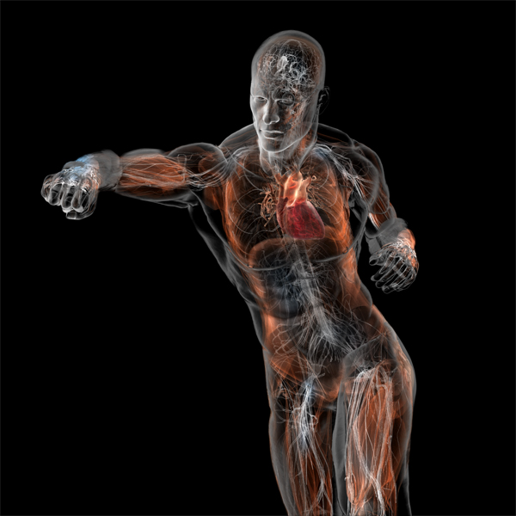
The Musculoskeletal system
Skeletal system:
Bones
Joints
Muscular system
Muscles
Muscles cross joints and pull on bones causing movement of joints
To understand how bones and muscles are involved in sporting actions we need to know the location and structure of specific muscles and bones and the way they work together.

Slide 5

Anatomical starting position
head
neck
trunk
arm
forearm
hand
thigh
leg
Now copy this into your workbook!
foot

Slide 6
Pairs activity
Look at your anatomical starting position diagram.
In turns, try and describe the location of a body part
Try and do this by relating its position to another body part
e.g. your neck is below your head
What kind of words did you use to help you do this?
Prepositions?

Slide 7
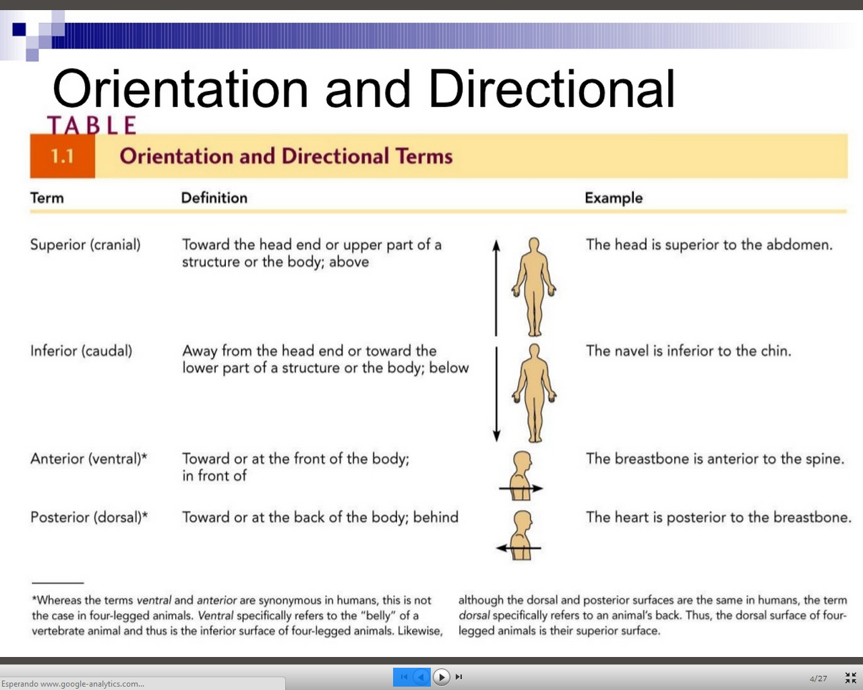
Now copy this into your workbook!

Slide 8
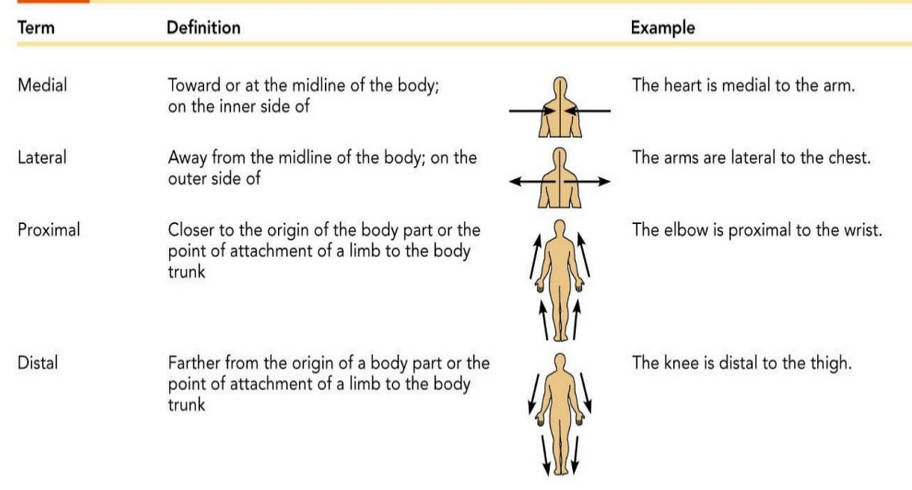
Internal | Located inside or further away from the surface | The heart is internal to the ribcage
External | Located on or near the surface | The male reproductive system is external to the body
Now copy this into your workbook!

Slide 9
The Skeleton
There are five functions of the Skeleton
1
Shape / Support
2
Storage
3
Protection
4
Movement
5
Blood cell production

Slide 10
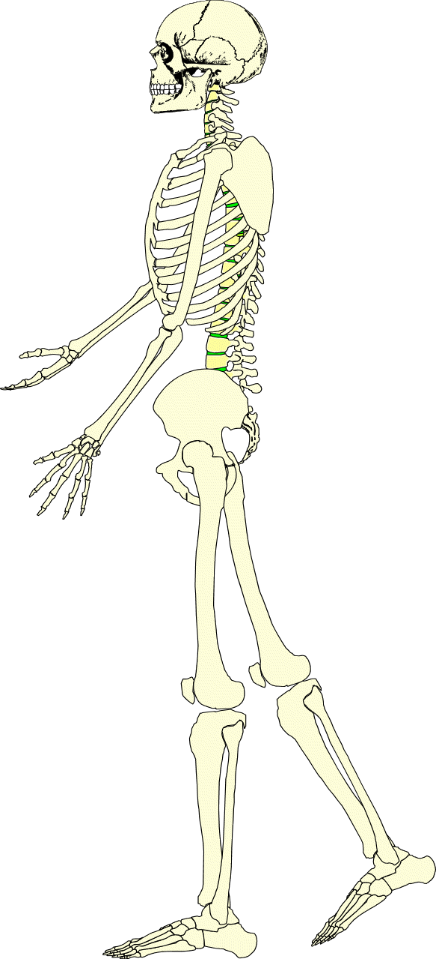
Functions of the Skeleton
Protection of vital organs
The skeleton protects the most important internal organs from injury.
Attachment point for muscles
-bones connected by ligaments
-muscles run from one bone to another
-connected to bones via tendons
-muscle/tendon contraction causes joint movement
Now copy this into your workbook!
Storage
-mineral homeostasis
bones act as reservoirs storing vital minerals such as calcium and phosphorus
-used for muscle contraction and nerve activity
-energy storage
-lipids stored inside yellow bone marrow
-located inside long bones
Blood Cell Production (haemopoeisis)
-RBCs, WBCs and platelets produced in red bone marrow
-found in plat bones (e.g. ribs) and the end of long bones (e.g. femur)
Shape / Support
-skeleton serves as the structural framework for the body
-each part bears the weight of all the structures above it
-bones get bigger as you move down the body
₋

Slide 11
Time to mark off Learning Outcomes
Everyone should:
Apply anatomical terminology to the location of bones.
Most will:
State the different functions of the skeletal system

Slide 12
STARTER: GROUP ACTIVITY
Using the list of bones in the box below, use the ‘post-it’ labels to mark the bone location on a member of your team
Skull/cranium | Pelvis | Femur
Ribs | Ulna | Tibia
Vertebral column | Sternum | Fibula
Clavicle | Radius | Patella
Scapula | Humerus

Slide 13
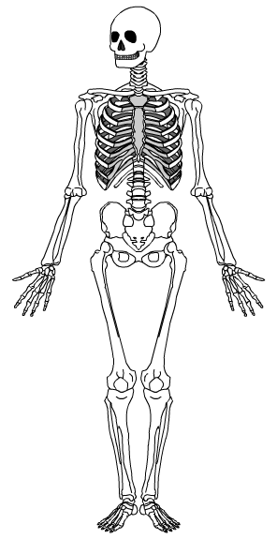
Naming bones
Cranium (skull)
Clavicle (collar bone)
Sternum (breast bone)
Ribs
Humerus
Pelvis
Radius
Ulna
Patella (knee cap)
Femur
Tibia
Fibula
Notes:
Encourage students to learn both the common name and scientific name of each bone.

Slide 14
Learning Outcomes
Everyone should:
Identify the axial skeleton
Apply anatomical terminology to the location of bones.
Most will:
Describe the functions of the axial skeleton
Distinguish between the vertebrae and intervetebral discs

Slide 15
The skeletal system
Made up of
-bones -cartilage
-ligaments -joints
Skeleton
forms the framework of the body
Comprised of 206 bones grouped into two main parts
1. The axial skeleton (80 bones)
2. The appendicular skeleton (126 bones)

Slide 16
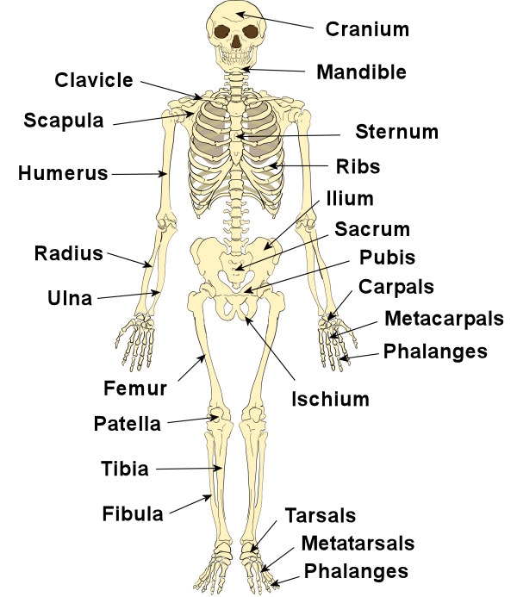
Pelvic girdle
Now label the skeleton in your workbook

Slide 17
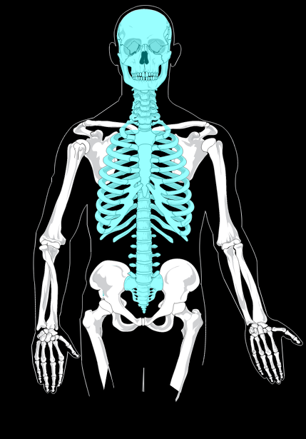
The Axial Skeleton
Forms the main core of the skeletal system and is more rigid than the appendicular skeleton.
Comprising of:
  Vertabral column (spine)
  Cranium (skull)
  Thoracic (rib cage)
  Sternum (breast bone)
Now color in the axial skeleton in your workbook

Slide 18
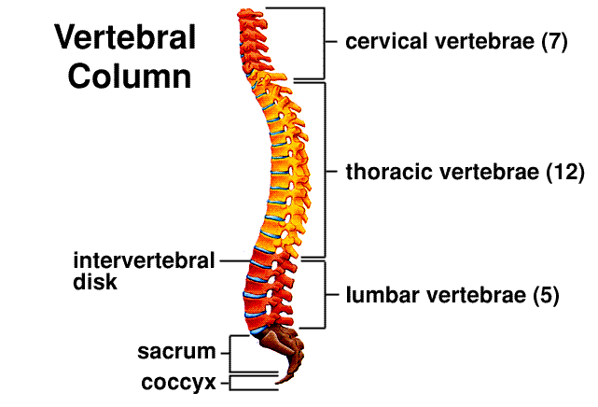
Functions of the vertebral column
supports the head
encloses and protects the spinal cord
Transmits weight from the body to the leg
Provide attachment points for the ribs and muscles of the back
-smallest
-greatest range of movement
Now label and annotate the vertebral column in your workbook
Don’t forget to answer the question too!
-less mobile as ribs attached to each side of the vertebra restricting movement
-biggest and strongest
-major role in weight-bearing
-absorb high compression loads
transmit weight from body to pelvis and legs
Notes:
2

Slide 19
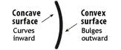
Individual activity
Can you describe the shape of the spine using the words listed below?
anterior
concave
convex
The cervical and lumbar curves are ________ _________
The thoracic and sacral/coccgyeal curves are ________ ________
The curves increase the strength of the vertebral column and help maintain upright balance.

Slide 20
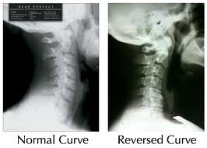
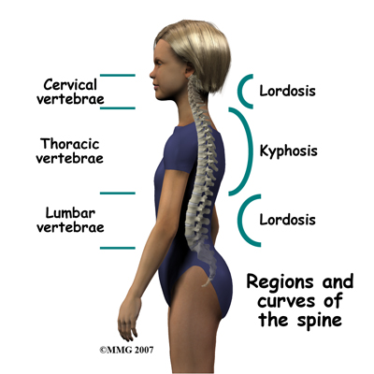
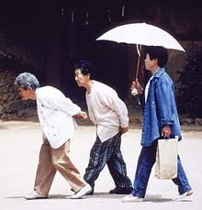
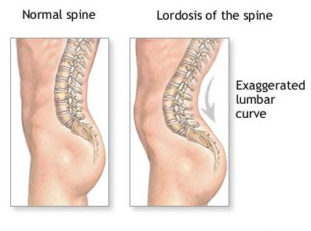
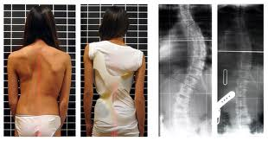
Cervical lordosis
Normal spine
Kyphosis
Lumbar lordosis
Scoliosis – lateral deviation

Slide 21
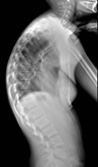
GROUP ACTIVITY
Can you identify spinal disorder in the x-ray below?

Slide 22
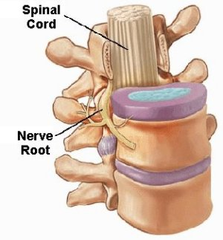
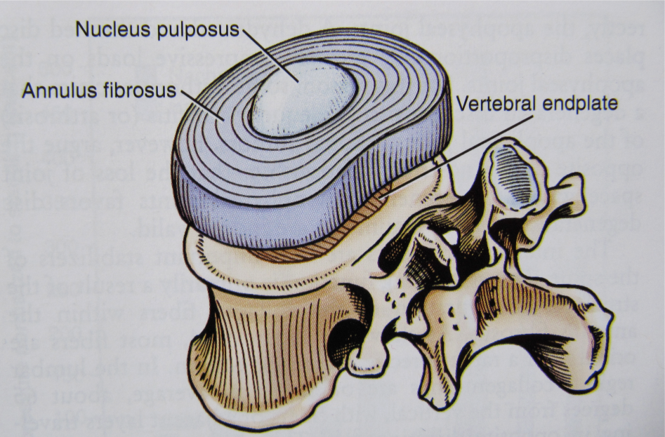
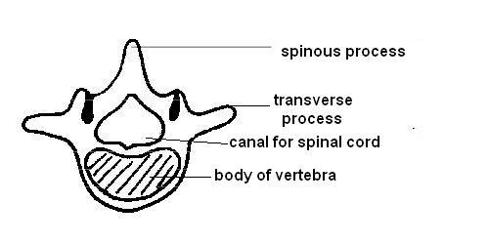
Vertebrae
To innervate – supply organ or body part with nerves
Soft, gel-like and elastic
Tough fibrocartilage
The intervertebral discs make the vertebral column more flexible .
They also flatten and bulge out to the sides when they are compressed making them important shock absorbers
(vertebral foramen)

Slide 23
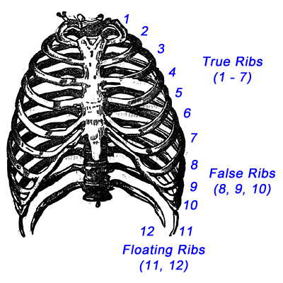
Sternum and ribs (thoracic cage)

Slide 24

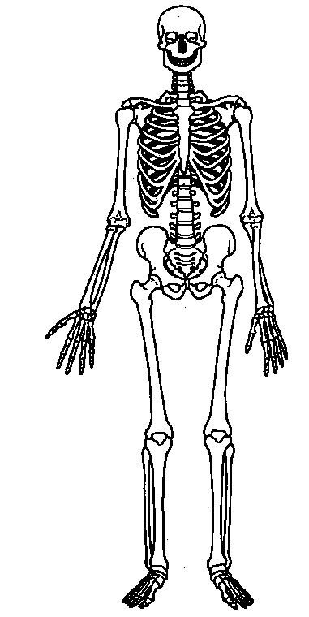
Plenary – Group Activity
Now what can you label on the skeleton?
DO not use your notes!
Try and include as much as we have covered in the lesson as possible

Slide 25
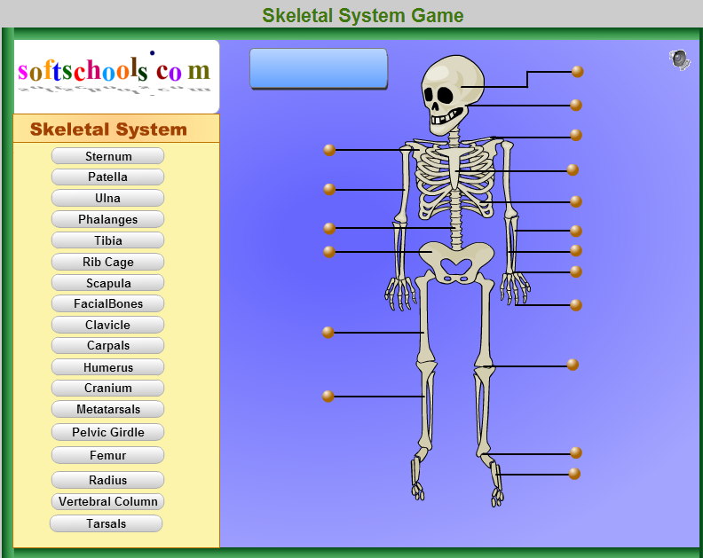
STARTER – Name the bone!

Slide 26
Learning Outcomes
Everyone should:
Identify the appendicular skeleton
State the four types of bone.
Most
Distinguish anatomically between the axial and
appendicular skeleton
Draw and annotate the structure of a long bone.

Slide 27
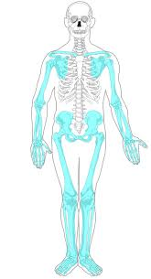
The Appendicular Skeleton
Comprises of the pectoral girdle & the pelvic girdle
PAIRS ACTIVITY
Can you list all the bones in the appendicular skeleton?
Now color in the appendicular skeleton in your workbook

Slide 28
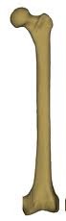
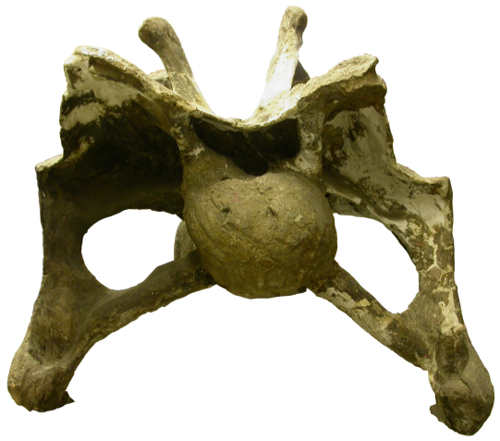
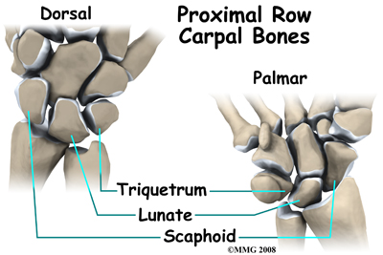
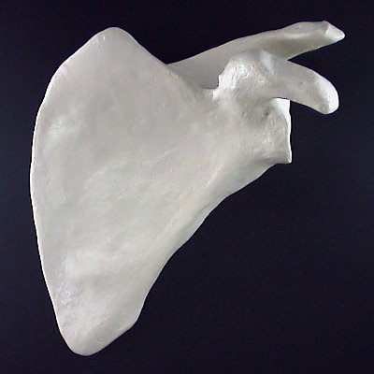
GROUP ACTIVITY-Match the picture with the name
Flat bone
Short bone
Irregular bone
Long bone
To articulate– form a joint

Slide 29
Introduction to bone biology
What is the scientific name for a bone cell?
Why does bone need a blood supply?
What gives bone its flexibility and strength?

Slide 30
INDIVIDUAL TASK:
Anatomy of a long bone colouring
Read the page fully and carefully
Highlight the functions of the different parts of the bones as you read through for the first time
Read through the page a second time
This time, follow the colouring instructions in the reading
Finally, annotate your coloured diagram with the sections underlined from the text

Slide 31
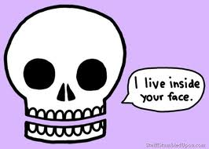
BONE LAB
In pairs:
Carry out the bone structure lab in your workbooks
Carry out the bone strength lab in your workbook
Make sure you write a good, IB standard conclusion for the bone strength lab before the end of the lesson.

Slide 32
STARTER – Bone is a dynamic tissue
What does dynamic mean in this context?
How do our bones change over time?
Why does this happen?

Slide 33
Bone as a dynamic tissue
Read the Case Study in your workbook
In pairs, discuss possible answers to the questions in your workbook
Individually answer the questions in your workbook. Use full, meaningful sentences.

Slide 34
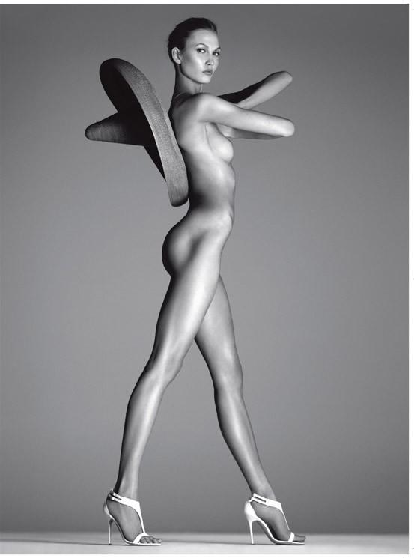
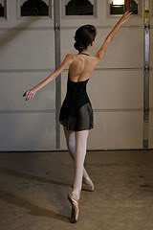
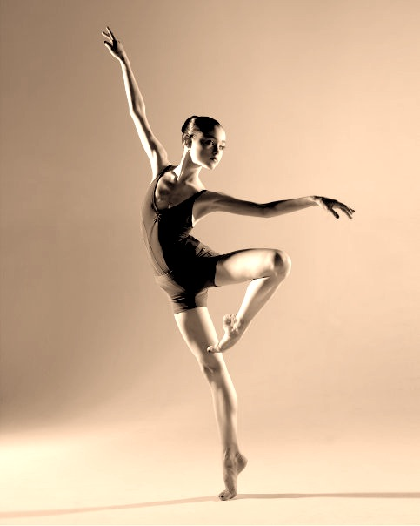
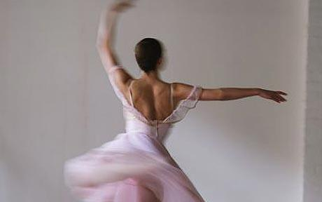
ToK in SEHS - Ballet
GROUP ACTIVITY – What words come to mind when you see these pictures?

Slide 35
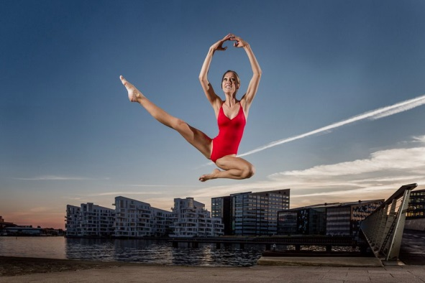
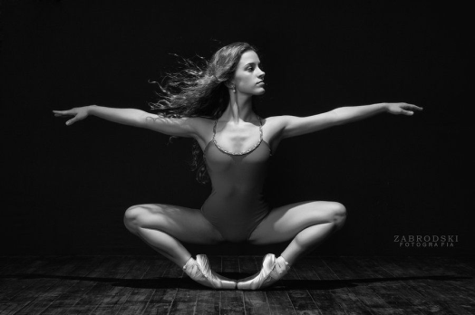
Buckhardt et al. 2011. “The effects of nutrition, puberty and dancing on bone density in adolescent ballet dancers.” Journal of Dance Medicine and Science. Vol 15 (2), Pp. 51-60.
16 years old – 60 asians and 67 caucasians – all females
Normal BMI in only 42.5% of dancers
15.7% had a more or less severe degree of thinness
Food intake below recommendation except animal proteins which was more than double the recommended amount
Individual Activity:
Read the BBC article in your workbook.
Group discussion:
Why is there a history of eating disorders within the ballet world?
How could you change the mindset of the dancers and the public in order to promote healthier eating?

