Slide 1

Interest Meeting
Track
This Photo by Unknown Author is licensed under CC BY-NC-ND

Slide 2
This will be available on my Website
If you can’t remember all this information, it will be on my website titled Interest Meeting on the left hand side
We will start on Thursday September 9, 2021 (it is not mandatory that you come, preseason is OPTIONAL) if you choose to participate in Indoor or Outdoor Season it is mandatory that you attend all practices

Slide 3
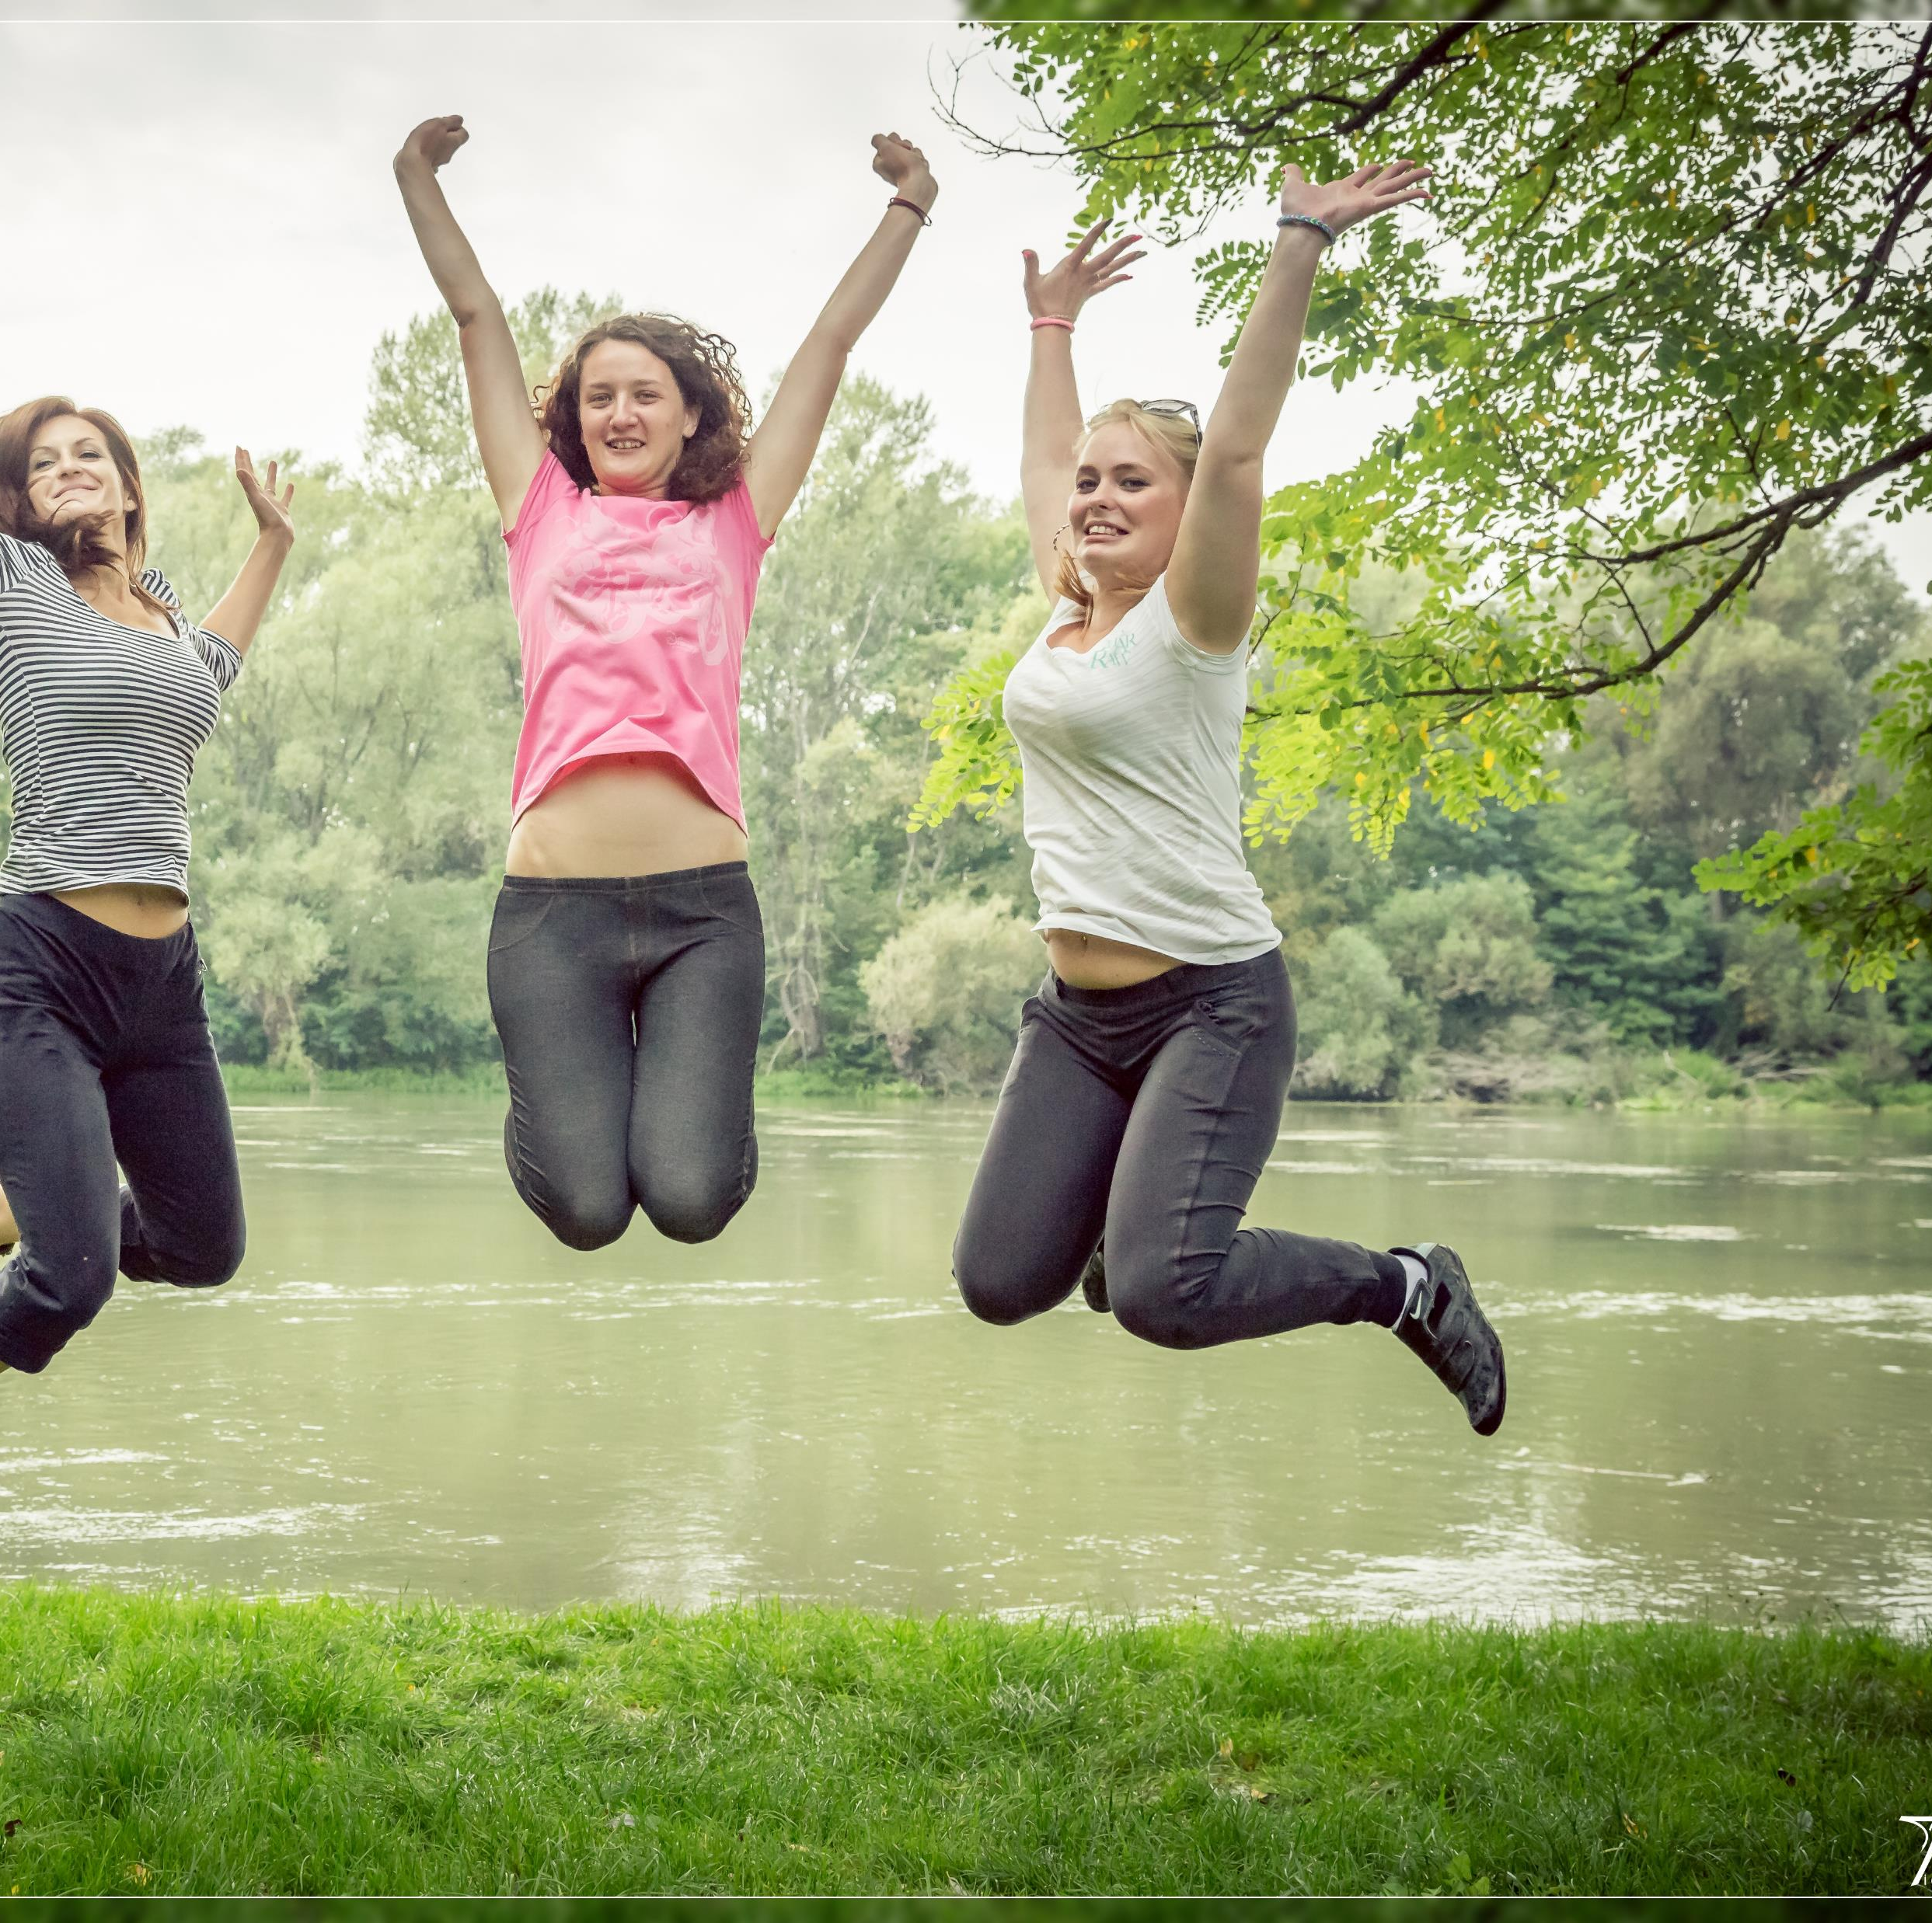
Make Sure You Visit the Athletics Webpage for Anything Regarding Athletics
This is great if you have questions about
Registering for sports ( you do not have to do if you play another sport prior to track season)
Physicals-You need to email the athletic trainer to get a form or visit your local doctor
Yellow Cards—Must see the Physical Trainer
Tryouts
Coach Information
Webpage for Athletics

Slide 4
Who to Contact if Have Additional Questions
Coaches:
Coach Wilson (aka Coach Jup) Jupiter.Wilson@Cabarrus.k12.nc.us
Coach Williams Alycia.Williams@cabarrus.k12.nc.us
Coach Shephard (aka Coach Shep) darren.shepherd@cabarrus.k12.nc.us
Athletic Trainer: Shatt Vang Shatt.Vang@cabarrus.k12.nc.us

Slide 5
Sign Up for Remind
Send a text to 81010 and text @hrhswo (for girls)
Or join with this link
https://www.remind.com/join/hrhswo
Send a text to 81010 and text @hrhsmen (for boys)
Or join with this link
https://www.remind.com/join/hrhsmen
You and your parents need to sign up so everyone is in the know

Slide 6
Preseason Training (This is NOT mandatory)
We will start at 2:30 and meet by the gym
We will start roughly at 2:40 Practice will be an hour and is subject to go over (no more than 15 minutes)
You must wear a mask while we are indoors
We will only do 2 days a week- Monday and Wednesday (that may change) I will let you know ahead of time

Slide 7
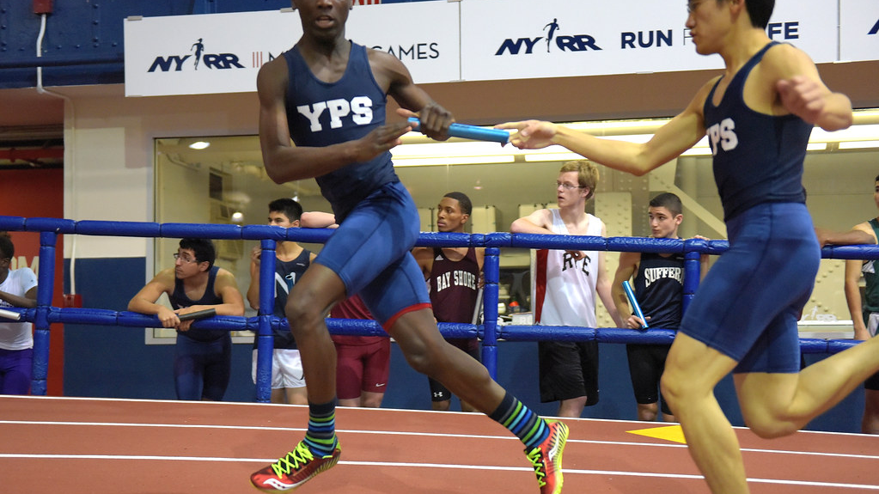
Indoor Training will Start Nov 1
We will move up to 3 days
Looking at Monday, Wed & Thursday
You will need to have your registration, physicals and yellow cards done prior to that!
This Photo by Unknown Author is licensed under CC BY

Slide 8
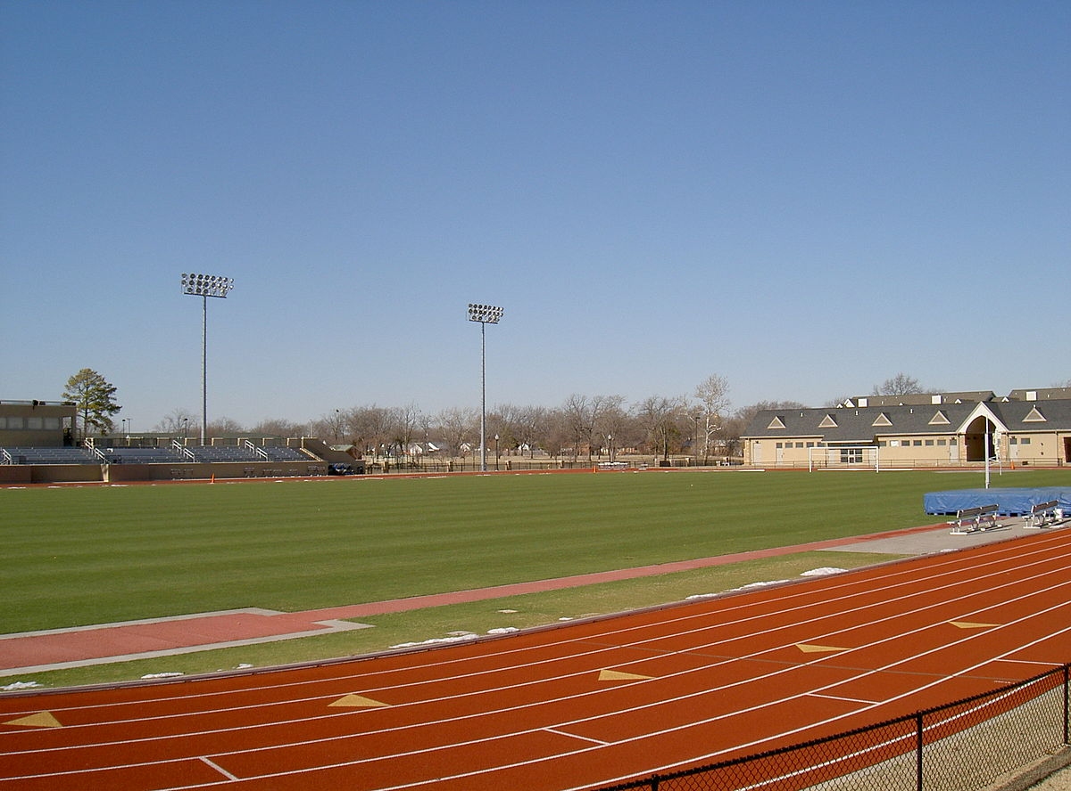
Outdoor Training Will start Feb 14.
This will be four-day training (no training on Fridays)
It is mandatory to be there daily (or discuss your schedule with one of the coaches)
You will be expected to compete at local/state meets
This Photo by Unknown Author is licensed under CC BY-SA

Slide 9
Dress Code
NO CROCS/SLIDES when practice is starting only after you finish your cool down
NO short shorts (if any parts of the body that are supposed to be covered are not, leave it at home)
No clothes that have inappropriate wording/graphics
Remember if you can’t represent our school in a positive manner with what you are wearing DO NOT WEAR IT

