Slide 1
Warm Up
The Industrial Revolution changed the way people did work in the 18th and 19th Centuries, making hard, manual easier and definitely more time-efficient.
What do you think changes the way we do work today?
If you did not pick up a new unit schedule and unit vocab on FRIDAY, please do so NOW!

Slide 2
Industrialization
Flocabulary Video – Industrial Revolution

Slide 3
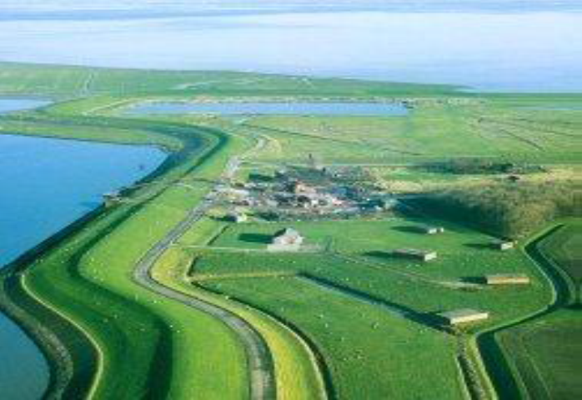
Causes
Agrarian Revolution
Dutch built dikes to protect farmland from the sea and use animal fertilizer to improve soil
British discover ways to produce more food and invent seed drill
BETTER FOOD PRODUCTION

Slide 4
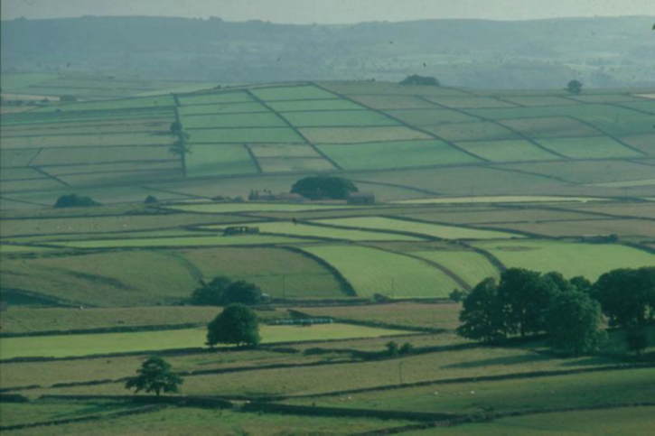
Causes
Enclosure Movement
  Larger farms replaced smaller ones
  Approved by Parliament in Britain
  More profits→ fewer people needed to farm

Slide 5
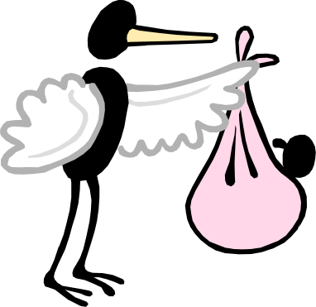
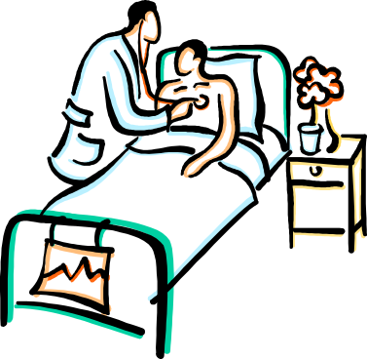
Causes
Population Growth
  More food
  More babies
  Improved medical care
  More people
During the 1700s, Europe’s population increases from 120 million to 190 million.

Slide 6


Causes
Energy Revolution
  Water wheels power new machines
  Coal used to fuel steam engines
  This results in faster production of goods.

Slide 7
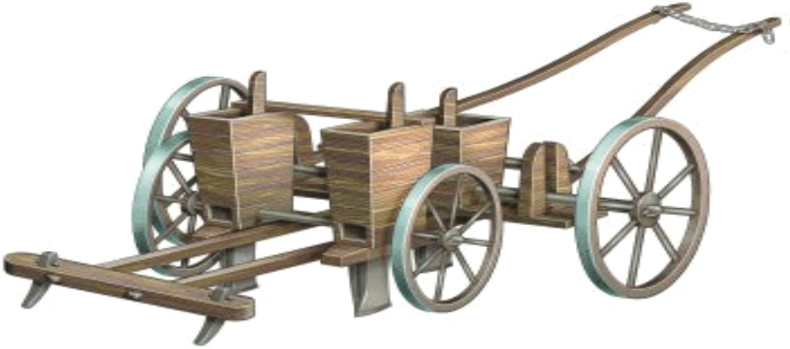
Causes
Inventions! Click here to see the History’s take on the origins of the Industrial Revolution.
“Developments in Agriculture and Industry”

Slide 8
Causes
New inventions that made industrialization easier
  1. Thomas Newcomen—developed steam engines to pump water out of mines
  2. James Watt—improved Newcomen’s invention to make it more efficient. This would lead to machinery, locomotives, and steamships driven by steam power.
  3. John Kay—flying shuttle increased speed of weaving
  4. James Hargreaves—spinning jenny produced thread faster to keep up with weavers needs
  5. Richard Arkwright—water frame used waterpower for spinning rather than man power
  6. Eli Whitney – cotton gin and interchangeable parts

Slide 9
What do you think would be the TWO most important inventions? Why?
Answer on your guided notes sheet in the “Causes” column.

Slide 10
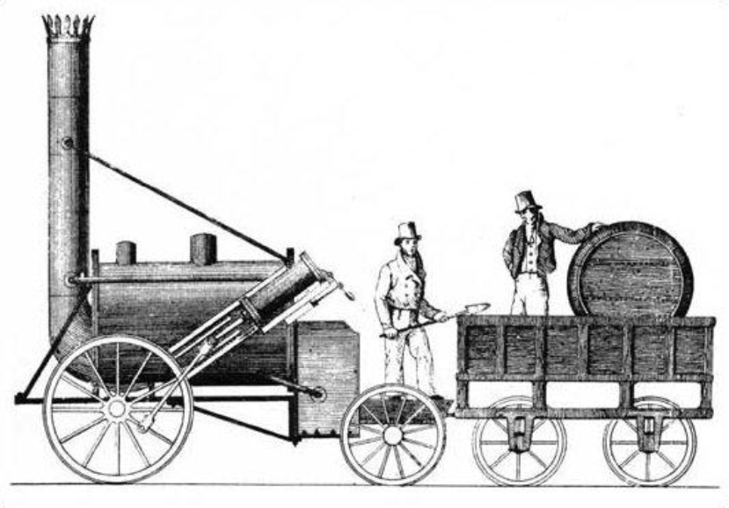
Causes
Transportation changes
  More private roads and canals were being built due to need for faster transportation.
  Railroad-George Stephenson

Slide 11
Questions for Thought
How does industrialization change the way labor is performed?
Do you think industrialization hurt certain groups? If yes, explain who and why. If no, explain how everyone benefitted.
Why did population growth allow for industrialization?
Which of the causes we discussed was most influential in industrialization? Why?

Slide 12
Document Analysis
Read the provided document and answer the following questions.
What does the document tell you about effects of industrialization? What effects are positive? What effects are negative?

Slide 13
Effects
Changes in Social Class
  Upper Class
    People gained new-found wealth from industrialization (industrial business families)
  Middle Class
    Divided into upper and lower middle class
    Upper Middle Class-government employees, doctors, lawyers, managers of factories
    Lower Middle Class-Factory overseers; skilled workers (toolmakers, printers)
  Lower Class
    Laborers; poor working and living conditions

Slide 14
Effects
Labor Unions
  Developed by working class as a response to poor working conditions
  Represents people who have the same job/skill
  Collective Bargaining-negotiate with their employers for better conditions
  Strikes-take place when demands are not met
  Development of labor unions eventually leads to reform laws to be made by government (laws regarding hours, breaks, vacation times, general working conditions)

Slide 15
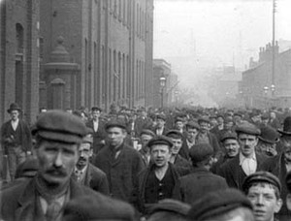
Effects
Environment
  Cities became over populated
  Sewage issues
  Pollution

Slide 16
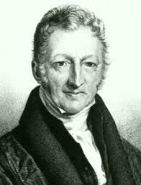
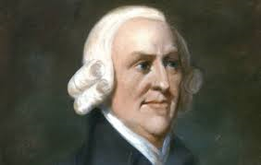
Effects
New Economic Ideas
Malthus
  Poverty is unavoidable
Smith
  Laissez Faire
  Capitalism

Slide 17
Effects
Karl Marx - Socialism
    Communist Manifesto
    No social classes
    Complete socialism where means of production are owned by the people; no private property; everything is shared equally
New Governmental Ideas
  Socialism-factors of production are owned by the public, and operate for the welfare of all
    Government should plan the economy
    Government control would end poverty and promote equality

Slide 18
New Technologies?
Invention breeds more invention!
Read pages762 – 767. What new technologies are created as both industry and technology advanced throughout the 19th century? Identify AT LEAST 7!

Slide 19
Industrialization Spreads
Log in to CANVAS and find the Industrialization Spreads in the Assignments tab of our class page.
Use your book or the link provided to complete the document. You might want to save this as a GOOGLE DOC or to your school ONE DRIVE!
Upload your completed work to CANVAS.

Slide 20
Questions for Thought
  Why is industrialization considered to by “revolutionary”?
  What do you think society would be like if we never industrialized?
  Which political and economic theories are still present in today’s world. Explain and provide examples.

