Slide 1
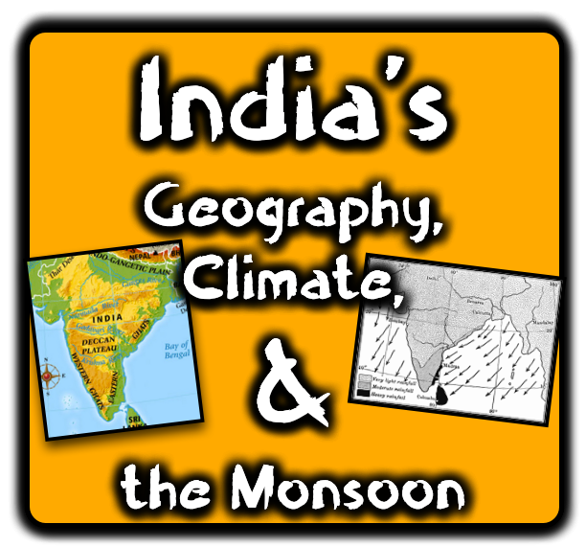

Slide 2
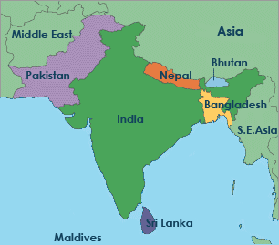
India: A subcontinent or a peninsula?
A subcontinent is a smaller piece of land that is part of a larger continent, yet has some differences that earn a separate designation.
While physically connected, subcontinents usually have a different geography, culture, and even rest on a different tectonic plate than the main continent. India’s culture is uniquely their own, they experience a climate unlike most of Asia, and this massive land mass rests solely on its own Indian plate.

Slide 3
India: A subcontinent or a peninsula?
However, many refer to India as a peninsula. This is a piece of land that is surrounded by water on three sides. The Bay of Bengal sits on India’s east, the Arabian Sea to its west, and the Indian Ocean to its south. Is India a peninsula or a subcontinent? While it depends mainly on who you talk to, but India is actually both!

Slide 4
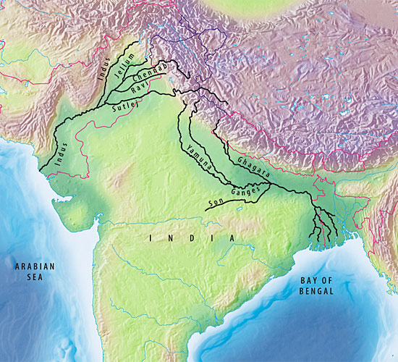
India’s Rivers
Indo-Gangetic Plain
India's rivers are crucial to daily life; they provide fresh drinking water as well as water for farmers to grow crops. Through technological advancements, water now provides electricity for the 1.1 billion Indians who inhabit the region.
Two of India’s greatest rivers are the Ganges and the Indus. The source of both rivers rests high up in the Himalaya Mountains. Here, glaciers and snow melt to provide the flow of water for India’s rivers. As the water rushes down the mountainside, it fans out into a wide plain known as the Indo-Gangetic Plain.
Indus River
Ganges River
Due to the flooding and silt left behind, soil is very rich here. This has led to the area being very densely populated.

Slide 5
Indus River
WESTERN India
Starts in Himalayas
Empties in Arabian Sea
Ganges River
EASTERN India
Starts in Himalayas
Empties in Bay of Bengal

Slide 6
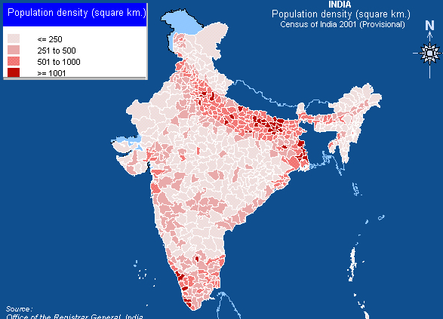
Do you notice the heavily concentrated areas of people in India’s northern and north-eastern sections?
This is a result of the favorable conditions in the Indo-Gangetic Plain!

Slide 7
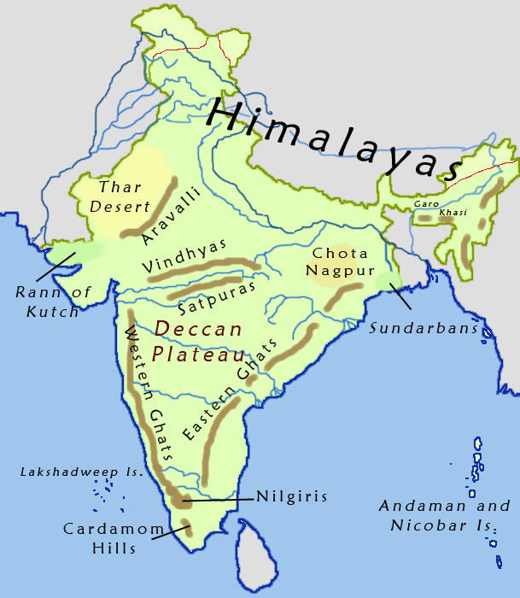
The Deccan Plateau
Notice the Deccan Plateau in central India!
The Deccan Plateau is located in central India and covers approximately 43% of its landmass. Like all plateaus, this
area is flat and has a higher elevation than the surrounding areas. The plateau is generally a very dry region, however seasonal rains allow for farmers to grow grains, beans, cotton, and a variety of medicinal plants and herbs. Today, farmers use around 60% of the plateau to grow crops, and the remaining 40% is used for animal grazing.

Slide 8
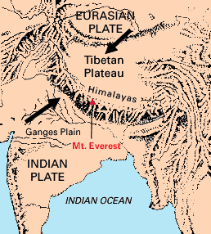
India’s Mountains
Mountains are formed by tectonic plates pushing themselves together. This is called a convergent plate boundary, and when this happens there is nowhere for the land to go but up. The Himalayas are an example of a mountain range created this way.
The word “Himalaya” translates to mean “home of snow” since its tallest peaks have snow year-round.
Do you see how the Indian and Eurasian Plates are pushing against each other? This action is what causes mountains to form – and when you already have mountains, it makes them higher!

Slide 9
India’s Mountains
Its tallest peak is the highest mountain in the world; it is known as Mount Everest and is over 29,000 feet tall.
Due to the continued force exerted at the convergent plate boundary, Everest continues to grow taller by 5 centimeters per year.
Do you see how the Indian and Eurasian Plates are pushing against each other? This action is what causes mountains to form – and when you already have mountains, it makes them higher!

Slide 10
The Ghats are another set of India’s mountains. The Eastern and Western Ghats border the Deccan Plateau on each side.
The Ghats are very fertile. The monsoons bring plenty of rainfall (next section), while India’s great rivers also drain through the Ghats.
India’s southern border has mountains on both sides: the Western and Eastern Ghats!

Slide 11
India’s southern border has mountains on both sides: the Western and Eastern Ghats!
Wildlife in both ranges is very diverse; many medicinal plants habitat the area and elephants, leopards, and tigers all dot the landscape.

Slide 12
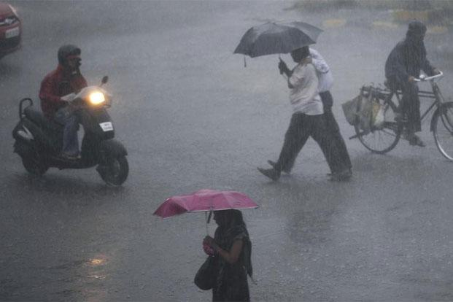
The Monsoon
Monsoons are strong, violent wind storms that change directions based on the season. These have a dramatic impact on India’s climate as they bring rainfall to different parts of the subcontinent based on the time of year. While Indian farmers rely on the seasonal monsoon to bring rainfall, it is important to know that a monsoon only refers to the changing of the wind pattern.
People often associate monsoons with severe rain storms, like the one above. However, a monsoon only refers to violent wind that changes direction with the season. There are dry monsoons too!

Slide 13
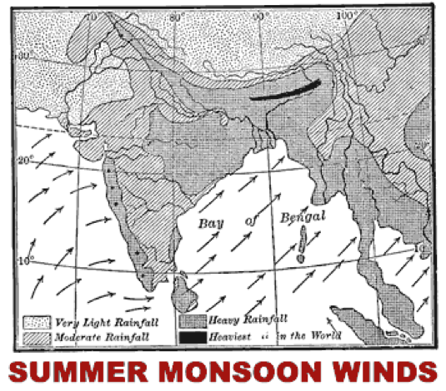
India’s Summer Monsoons
In the summer, air current travels across India from the southwest. The current brings moisture from the Indian Ocean and drops it over India, causing heavy rainfall at times. Because of this, the summer monsoon is the often known as the “wet monsoon” in India.
The summer monsoon brings heavy rainfall to India between April and October. As the winter months come to an end, the weather pattern begins to shift. Air from the southwest begins to blow toward the northeast. As the air blows across the Indian Ocean, it picks up moisture; once it reaches the Indian subcontinent, torrential rainfall begins across the land as the air cannot hold anymore moisture.
Watch the effects of a monsoon in Pakistan!

Slide 14
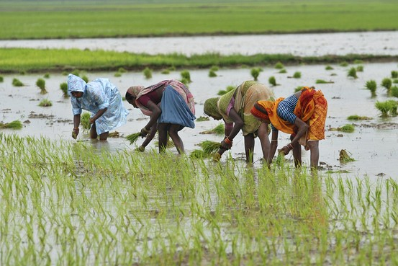
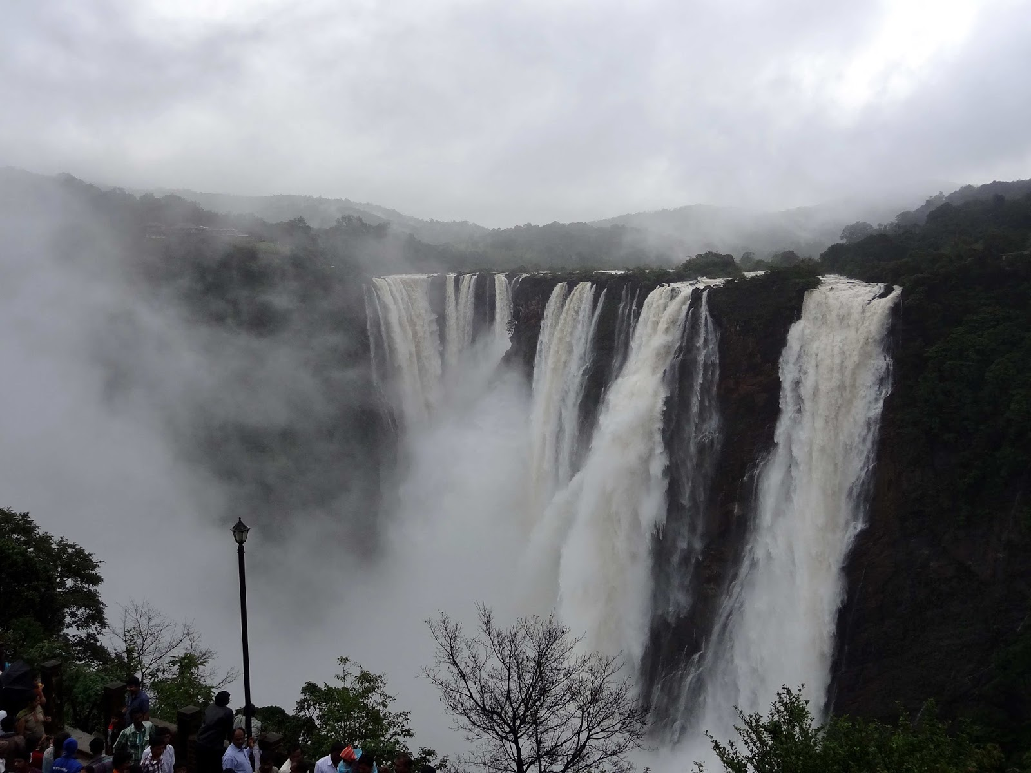
India’s Summer Monsoons
The summer monsoon brings much-needed rainfall for crops!
Farmers love the summer monsoon since it brings the much-needed rainfall to grow their crops. Dairy farmers rely on the monsoon to keep their cows healthy and well-fed. Since a great deal of electricity is produced by hydroelectric power plants (water-powered), businesses, government officials, and schools also rely on the summer monsoon.
The water power provided by the monsoon gives millions of Indians access to electricity!

Slide 15
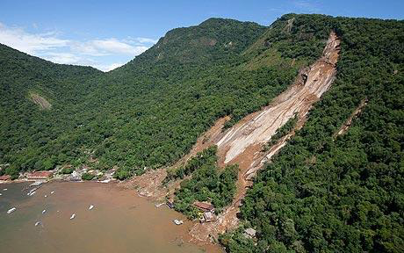
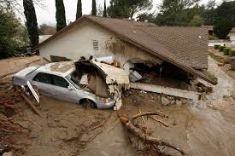
India’s Summer Monsoons
The summer monsoon can be just as destructive as it is beneficial. Streets flood, mudslides can bury villages, and people are often killed.
Torrential rain create mudslides that can swallow up entire villages!

Slide 16
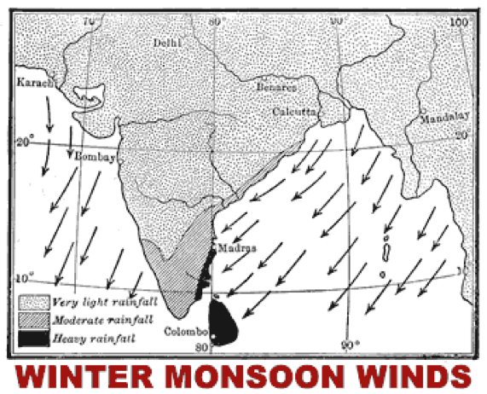
India’s Winter Monsoons
In the winter, air current reverses and travels across India from the northeast. Most of the water vapor falls in the massive Himalayan Mountains, which then brings dry air into India. Because of this, the winter monsoon is the “dry monsoon” in India.
Once summer season passes and autumn arrives, the summer monsoon is replaced with the winter monsoon. The winter monsoon arrives in October and lasts until April. The wind pattern shifts almost in a complete reversal; the wind now blows from the northeast to the southwest. The winter monsoon is much less powerful than the summer, mainly because the Himalaya Mountains block the wind and moisture from reaching India.

Slide 17
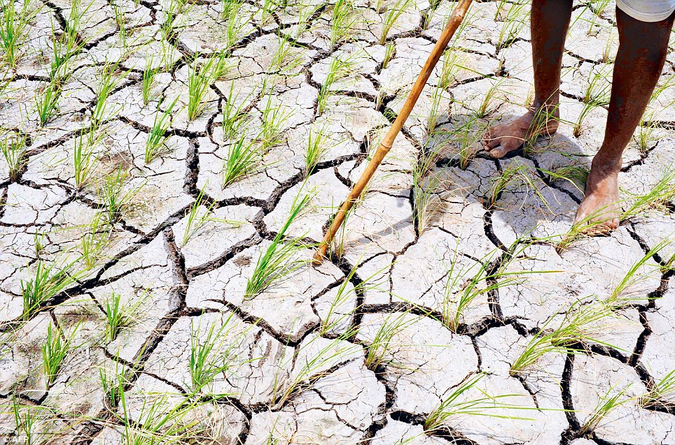
India’s Winter Monsoons
Due to this, it is common for India to experience droughts during this time of year.
Throughout most of India’s north and west, vegetation dies off and the soil begins to crack (like a desert). However, the east coast does receive average rainfall during the winter monsoon. Why? The air is able to pick up moisture in the Bay of Bengal that is then dropped onto India’s Eastern Ghats. This makes the Eastern Ghats one of the few fertile places in India during the Winter Monsoon.
Notice the cracked earth that is created from the heavy, dry winds.
Watch how monsoons work!

Slide 18
