Slide 1
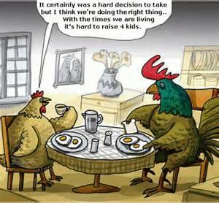

Slide 2
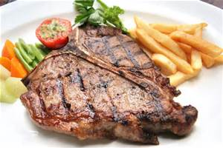
Incomplete or Complete?
Complete
Saturated or Unsaturated?
Saturated

Slide 3
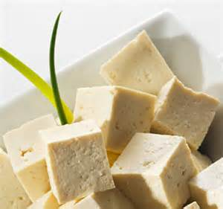
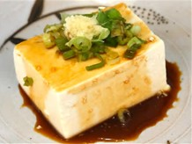
Complete or Incomplete?
Complete!

Slide 4
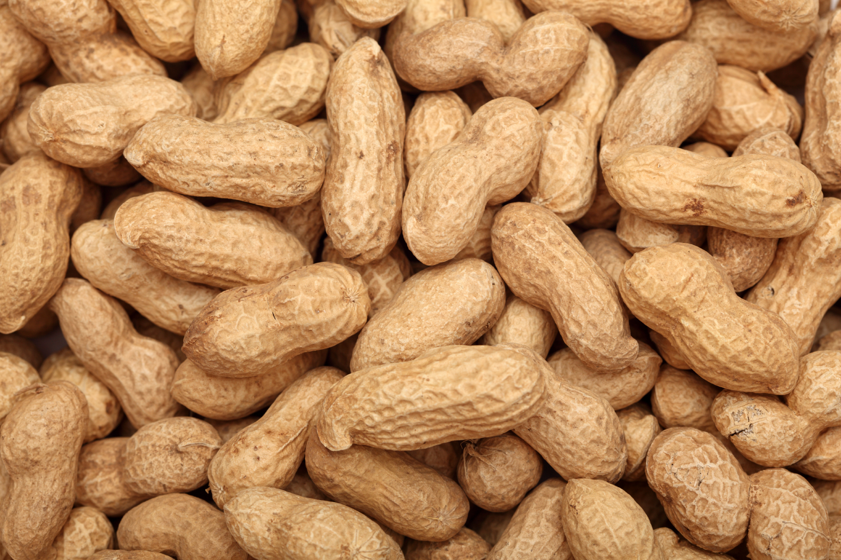
Incomplete or Complete?
Incomplete
Saturated or Unsaturated?
Unsaturated

Slide 5
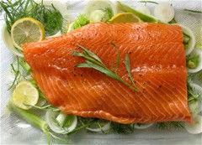
Incomplete or Complete?
Complete
Saturated or Unsaturated?
Unsaturated

Slide 6
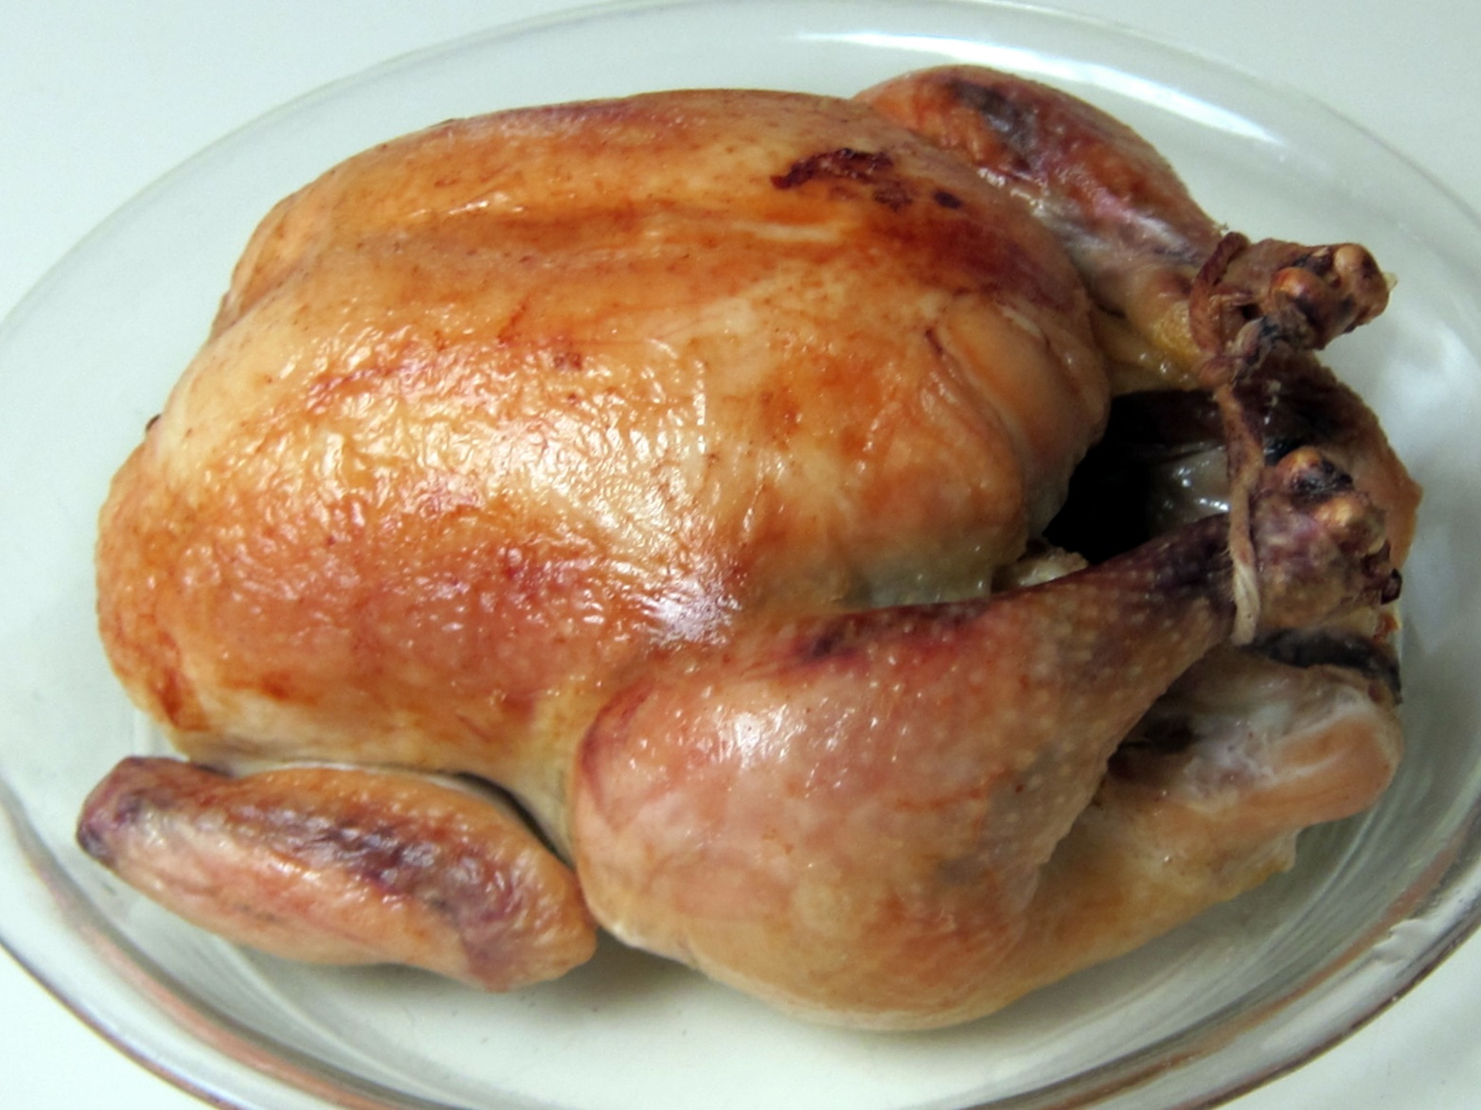
Incomplete or Complete?
Complete
Saturated or Unsaturated?
Saturated

Slide 7
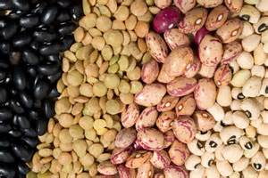
Incomplete or Complete?
Incomplete

Slide 8
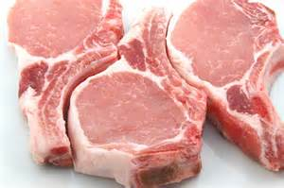
Saturated or Unsaturated?
Saturated
Incomplete or Complete?
Complete

Slide 9
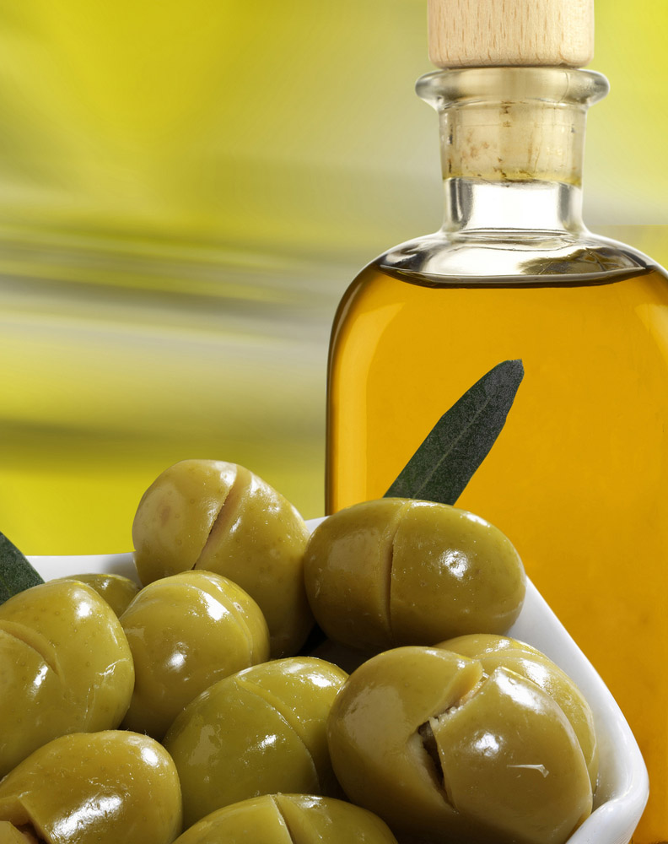
Saturated or Unsaturated?
Unsaturated

Slide 10
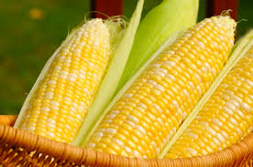
Saturated or Unsaturated?
Unsaturated

Slide 11
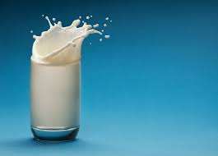
Incomplete or Complete?
Complete
Saturated or Unsaturated?
Saturated

Slide 12
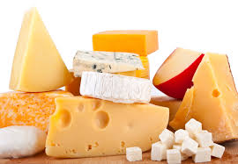
Incomplete or Complete?
Complete
Saturated or Unsaturated?
Saturated

