Slide 1

Humanitarian Society Club

Slide 2
Meeting Agenda:
Welcome! Complete form/attendance
Welcome (Ms. Delp and Alicia)
Open Question (Alicia)
Meet our Board! (Officer board)
Personal hours opportunity (donation)
Plans
Follow us!
Some pictures of HumSo in action!
Open Discussion until meeting adjournment

Slide 3
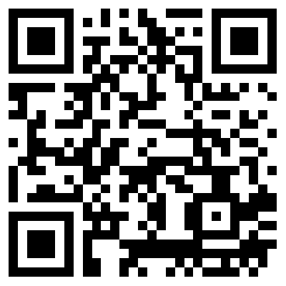
GOOGLE FORM TO SIGN IN
Please fill out this form while we talk so we could know more information about you!
QR Code:
Link:
https://goo.gl/forms/dlfUM2UJkGXR2At42

Slide 4


Slide 5
What is your idea of the word “Humanitarian?”
Do you consider yourself a humanitarian? Reflect
What will you do to demonstrate the traits that a good humanitarian possesses on a day-to-day basis?
Think, then share your thoughts to everyone for a brief discussion

Slide 6





Humanitarian;
(adj.) concerned with or seeking to promote human welfare.
(noun) a person who seeks to promote human welfare; a philanthropist.

Slide 7
Our Mission Statement:
We seek to establish an open environment which positively impacts our school and community through the encouragement of new ideas, engaging opportunities, connecting with others through selfless acts, promoting the importance of human welfare and kindheartedly practicing ‘Service Above Self’

Slide 8
Goals/ Upcoming Events/ Plans
There are many opportunities that are open for this club to be involved in. These include providing aid and cooking meals at local food banks/soup kitchens, participating in hunger/donation drives, volunteering at a 5k for autism or multiple sclerosis or at Special Olympics, volunteering with Girl Scouts with cookie distribution and Boy scouts with Pumpkin sorting, volunteering with the Amazing Grace Advocacy and being peers to children who suffer from mental disorders, writing bookworm letters to children encouraging them to read more through Promising Pages, etc. These few examples show just a hint of what this club can offer. I want to give a nice prom to the elderly with the club this school year, which would require a lot of early planning. We require everyone to participate in at least TWO volunteer activities this 2016-17 year in order to be an official member of this club!!!

Slide 9
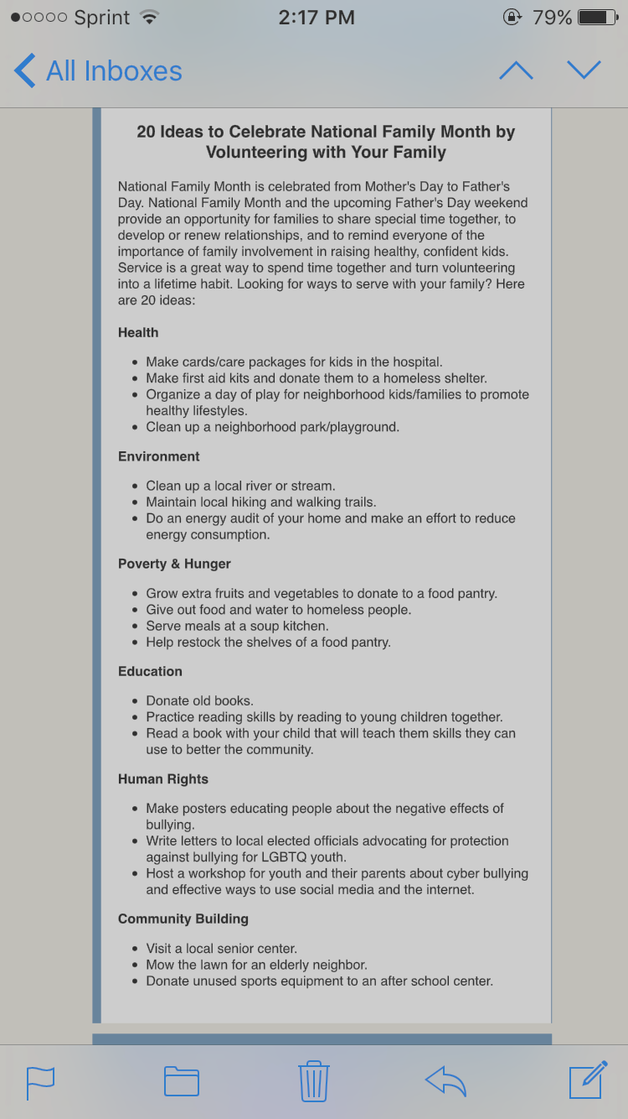

Slide 10
As a civic focused organization, The Humanitarian Club strives to:
Develop leadership skills of our members through dedicated service activities both at our school and in the larger Charlotte community
Increase awareness of social issues; focused outreach activity; engage our school community in discussions aimed at solving real issues
Support school events
Civic activities supporting efforts of local charities and the underserved population in the Charlotte community
Uphold an inclusive atmosphere

Slide 11
2016-2017 Officers
Founder/President: Alicia Powell
Vice President: Jillian Platt
Human Resource Officer: Grace Anthony & Lia Esposito
Secretary: Iyanna Wallace and Eve Munroe
Food Bank Leader: Tiana Gonzalez
Advisor: Ms. Delp (Room 2305)

Slide 12
Positions Explained
President- plans and coordinates majority of activities; makes a monthly/yearly plan; sets goals for the club; attends majority, if not all volunteer events; sets meeting dates; coordinates with club and officers; primarily organizes all emails and had the right to deny any person(s) of membership at personal discretion
Vice-President - fulfills the duties of the President or aids when the President is absent; performs duties assigned by the President and assists with meetings and ongoing activities
Example: Running an event with President (Must be organized, extremely committed and involved in club entirely)
Human Resource Officer – makes sure opportunities are organized and communicates them with members through social media (Twitter and announcements), helps organize interesting school based events/opportunities, helps relay information to members
Example: Making sure members are engaged and understand specific activities, brings new and interesting opportunities for members to enjoy (Idea go to person... must be creative and open to new opportunists! Personable/social)
Secretary- takes meeting minutes; maintains attendance records; keeps class activity calendar/webpage up to date with Ms. Delp; responsible for maintaining records and details that are important for the smooth operation of the Humanitarian Society Club; be neat, organized and efficient
Example: Updating the webpage regularly, along with announcements (Must be organized and good with keeping track of meetings; able to attend meetings regularly and and publicizes activities through flyers around school.)

Slide 13
Committee Descriptions
*Food Bank (Tiana): Aiding with local homeless shelters as well as food banks and providing meals for the hungry.
Example: Angels and Sparrows soup kitchen volunteering, making meals for substance abuse men, women and children, etc.
*Donation Drive (Alicia and Jillian): Organize drives to give back to local people in need.
Examples: Canned good drive (For Hunger Drive next year!*), food drive, book drive, etc.
*School Event (Lia): Getting involved around Cox Mill and lower level schools on a spirited level in uplifting ways.
Example: Helping with concessions, helping with elementary or middle school in multiple events, etc.
*Public Relations (Everyone): Spreading the word about the club and becoming active around the community.
Example: Scrapbooking and social media usage involving twitter, making posters, etc.

Slide 14
Tiana Gonzalez
My position is the Food Bank Leader. This year I plan to better the club by not only achieving drives for hunger, but to help people understand why it is important and to allow others to recognize the issue at hand with helping in our community. Being a leader in this club means guiding others to excel in assisting those who need it the most.
Someone once said “the boy cried because he did not have shoes, until he met someone without feet”. This quote has always been significant to me because there will always be someone who needs help whether it is saving a life or just being there for comfort. Humanitarian club and the participating members can make a difference.
Food Bank Leader
Senior

Slide 15
Eve Munroe
I first joined the Humanitarian Society club as a way to get involved in the community and found that it was a great way to meet new people and give back to those in need. I have done many different kinds of volunteer work, from feeding the needy to helping disabled children, and hope to do much more in the upcoming school year. I hope to give as many hours to the needy as I can and to help make the community around me a better place for everyone.
Co-Secretary
Junior

Slide 16
Iyanna Wallace
Reasons I joined:
To serve my community by giving back through selfless acts
Offer my services to those in need regardless of their situation
Make a difference and better someone’s life
What I hope to contribute:
Bringing new and engaging volunteer opportunities everyone can take part in.
Dedication to the cause
Co-Secretary
Senior

Slide 17



Grace Anthony
I will:
Help Humanitarian Society succeed by informing others of our activities
Recruit new members
Actively search for volunteer signups, contact those who need volunteers and set up signup links if necessary
Make posters/flyers and use social media as a part of the Public Relations Committee
Create shirts and other merchandise to proudly represent our club
Human Resource Officer
I want to contribute time, effort, and ideas to help improve the school and our community overall
I hope to get other students involved in Humanitarian Society and effectively work together to overcome obstacles
I joined Humanitarian Society because I wanted to improve our community and make a difference
I feel that volunteering is something that is important to make a positive impact in our area
Humanitarian Society provides me opportunities to volunteer and has allowed me to meet new people and work harder
I believe that if I become Human Resource Officer, I will be able to get others participate in the community

Slide 18
Lia Esposito
Reasons I decided to be apart of Humanitarian Society
-To continue my mission of servicing my community
-To meet people who wanted to give back to their community
-To impact and better the community I live in
Human Resource Officer
Junior

Slide 19


Read, Lead, Succeed
Description:
This year Humanitarian Society is creating a new program called “Read Lead Succeed”. As a volunteer, you would read and tutor kids at Cox Mill Elementary School. The frequency is to be determined but it is flexible to busy schedules. This is a great opportunity to help your immediate community and to give young kids a great role model.
Outreach program for High School students to read to and encourage Elementary students in order to help them form a love for reading and learning

Slide 20
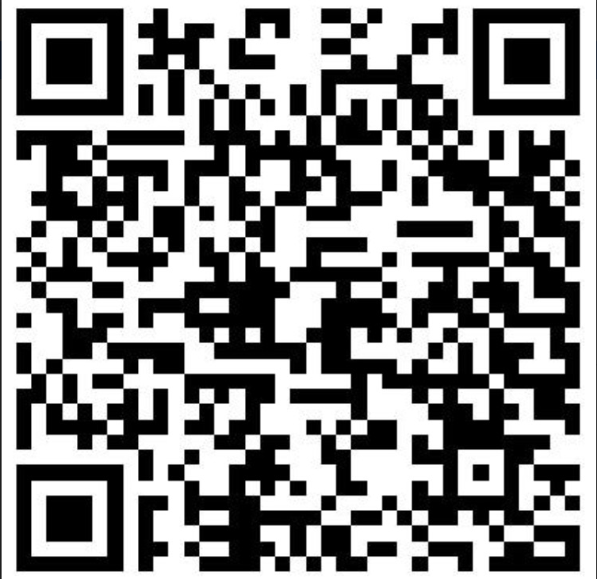
If you are interested...
Any Questions?
Lia Esposito
704-654-9126
lia@wiredsage.com
http://docs.google.com/forms/d/e/1FAIpQLSeKCneXY5sHC1Ava8M0RetnckD_Qh5GREvHd
OR Go to Sign Up Genius and type in ‘Find a Sign Up’ and enter the email: alicia.powell99@yahoo.com
(Read, Lead, Succeed)

Slide 21
Jillian Platt
I first joined this club, because I loved what I was doing in Beta and wanted more opportunities for myself and others to help our community. Throughout my years in highschool I have done countless hours of volunteer work that has impacted my life in so many ways. Some of my favorite events have been Tiger World, Girl Scouts, and Special Olympics. I hope to attend as much events as possible and help to find events for us to participate in. I want to motivate people not just in our club but around the school to join us in some events.
Vice President
Senior

Slide 22
Alicia Powell
I founded the Humanitarian Society club last year to really connect with my peers, as well as my community, in helpful ways. I personally get so much joy of volunteering and it makes me feel great to be able to be apart of something bigger than me. Donating my time to people who are less fortunate than me is something that I’ve always enjoyed, and I’ve valued helping others since as long as I can remember.
As President, I plan to provide helpful and beneficial service activities to my club, and organize events to the best of my ability. I will encourage my peers to get active with our shared school and community. I am humbled by this position, and I am a great resouce if you need help with finding ways to volunteer. Last year, my favorite activity was volunteering with the Amazing Grace Advocy and participating in Special Olympics, because I felt that I truly connected with children who have mental disorders, and that makes me love what I do. If I get this $500 Disney grant, I especially look forward to providing a Prom for Nursing Home residents!
President/ Founder
Senior

Slide 23


SOCIAL MEDIA
-Twitter:
@CMHShumanitary
-Sign Up Genius:
Click ‘Find a Sign Up’ and type in the email:
alicia.powell99@yahoo.com
We communicate via EMAIL (above) and our meeting schedule is on our club website

Slide 24
Kiara Lawson (Personal Hour Opportunity)
Operation Heal
Gather clothes and shoes for orphans in Kenya to combat fungal meningitis
Need hours:
  Earn 10 minutes per box turned in
  Earn 10 minutes per shoe pair
  Earn 20 minutes per clothing set

Slide 25
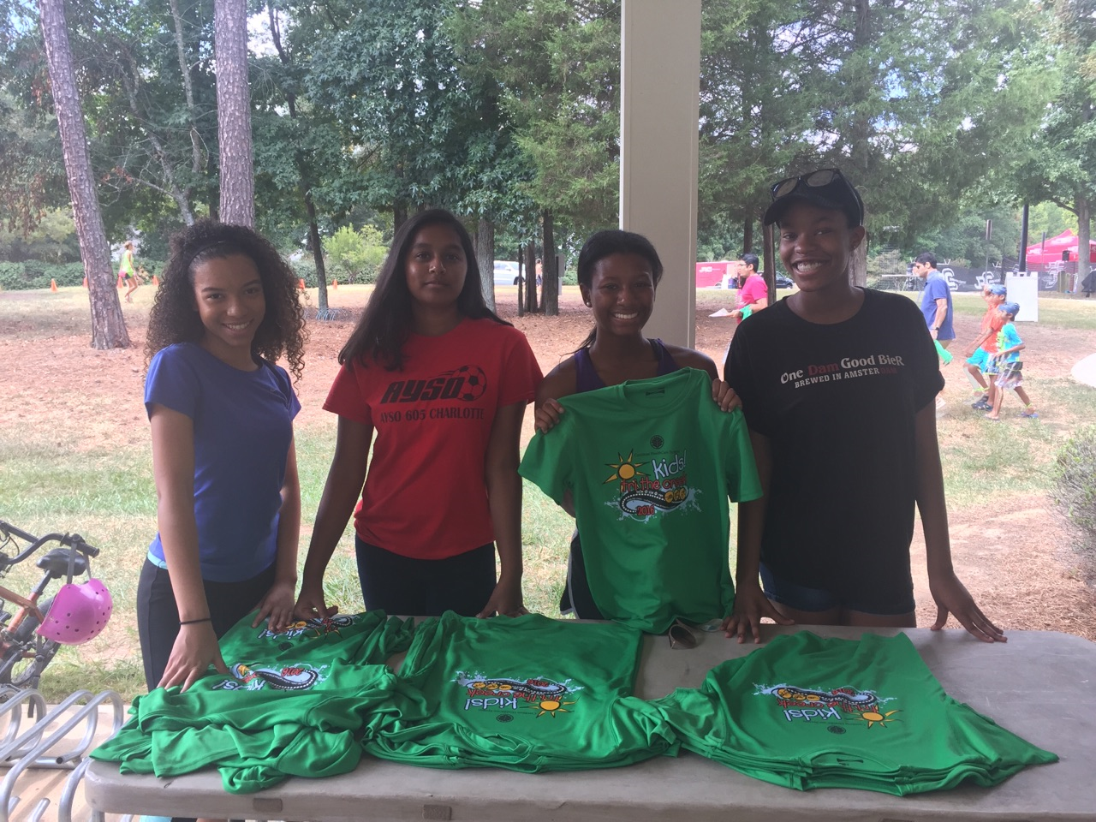
2016-2017
Kids “Tri The Creek” Event

Slide 26
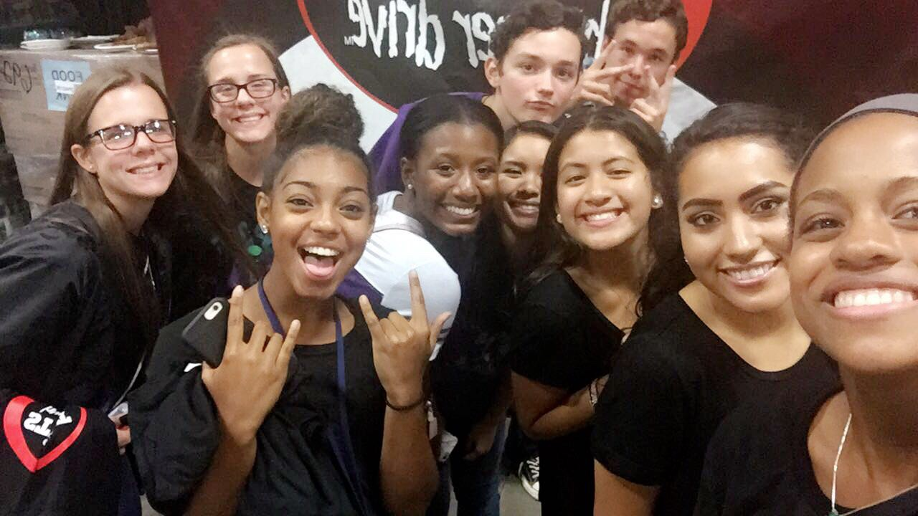
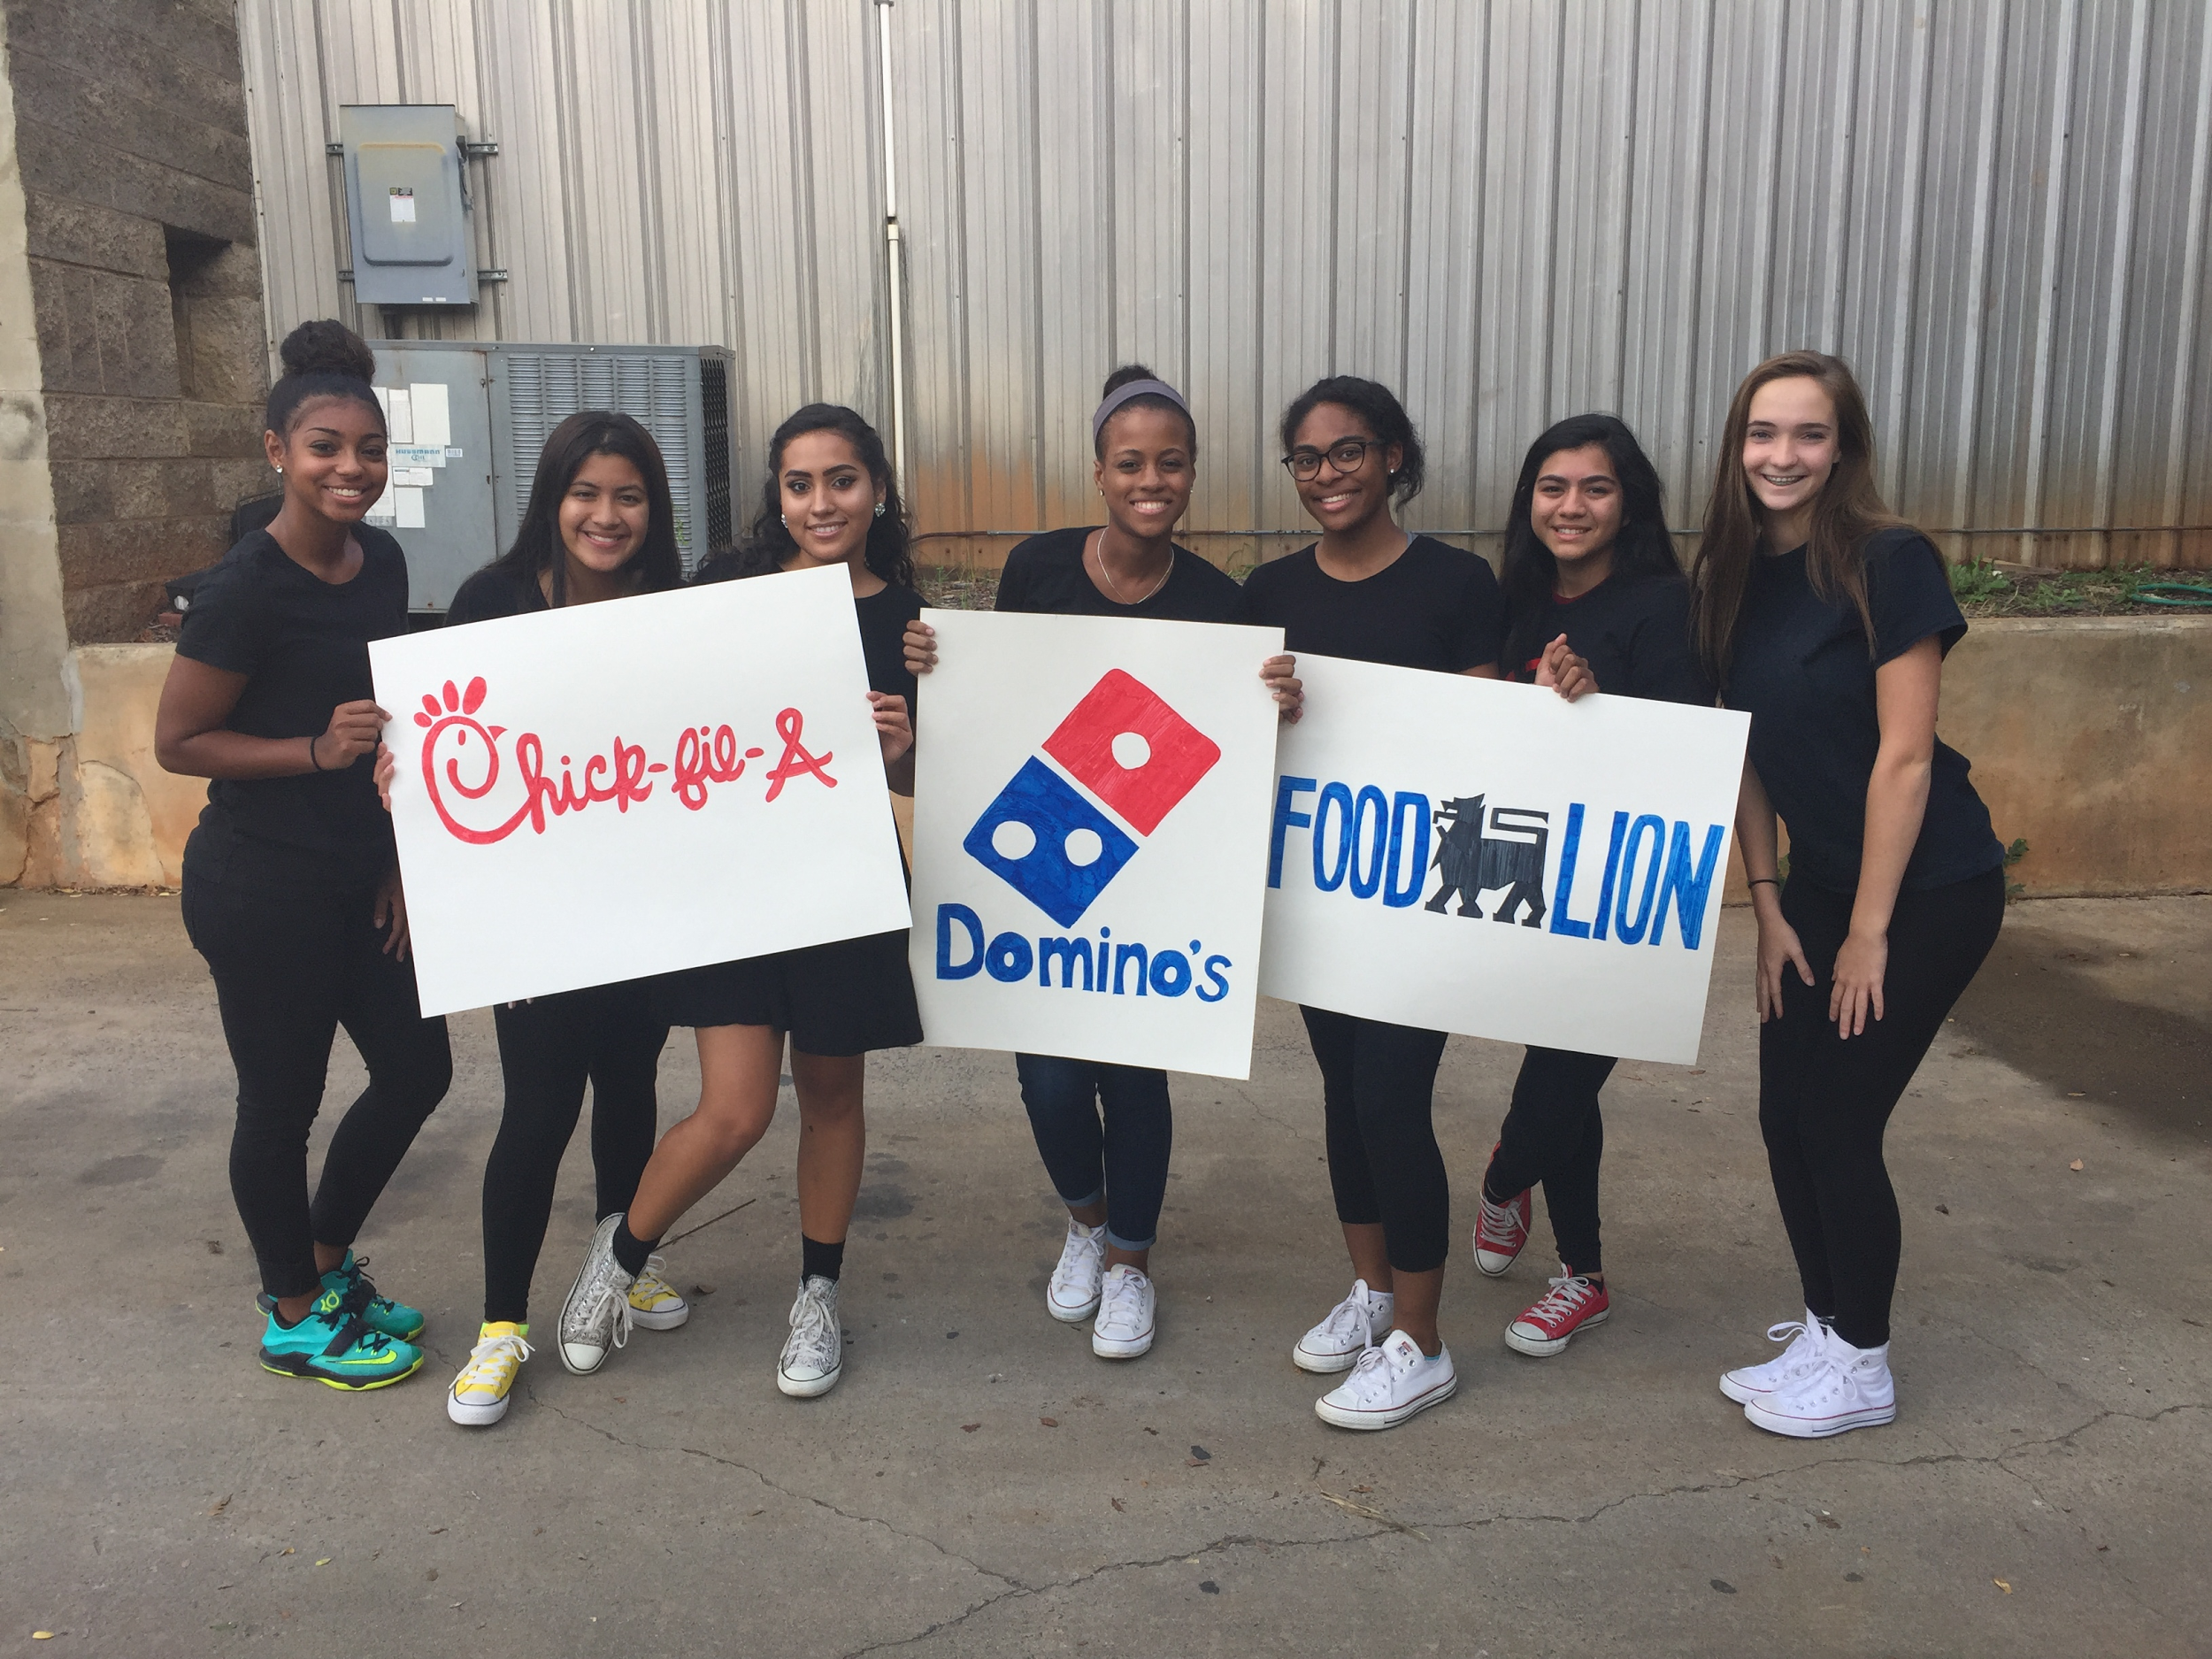
Hunger Drive Kick-off

Slide 27
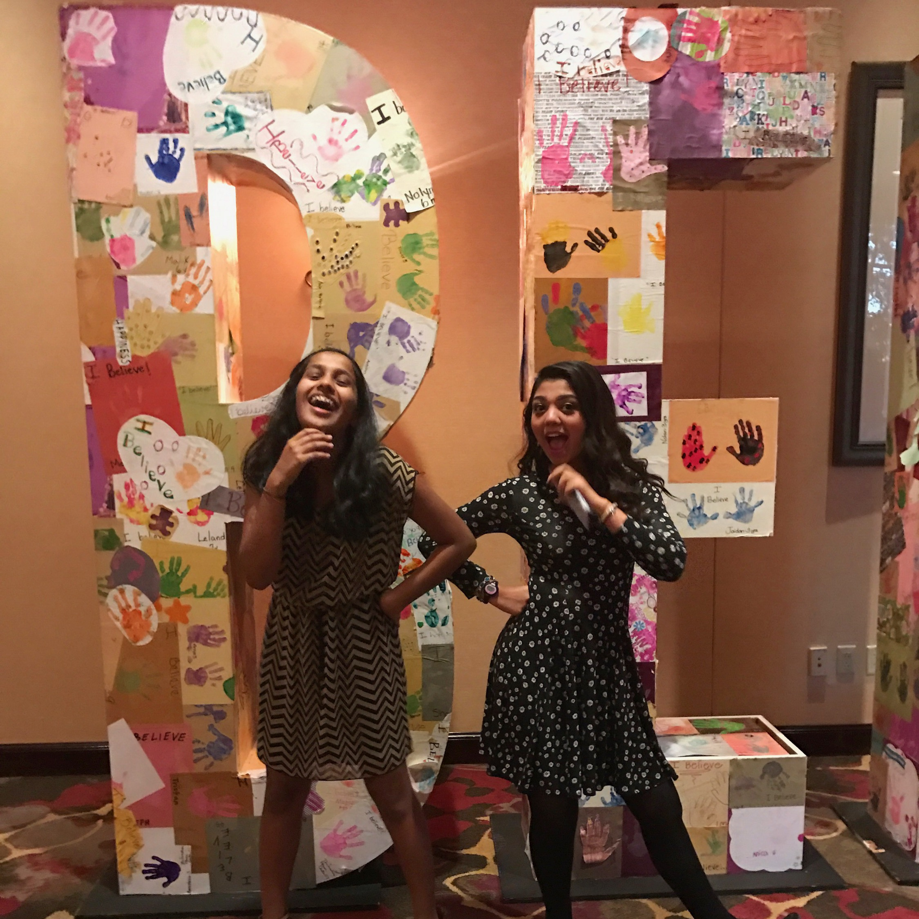
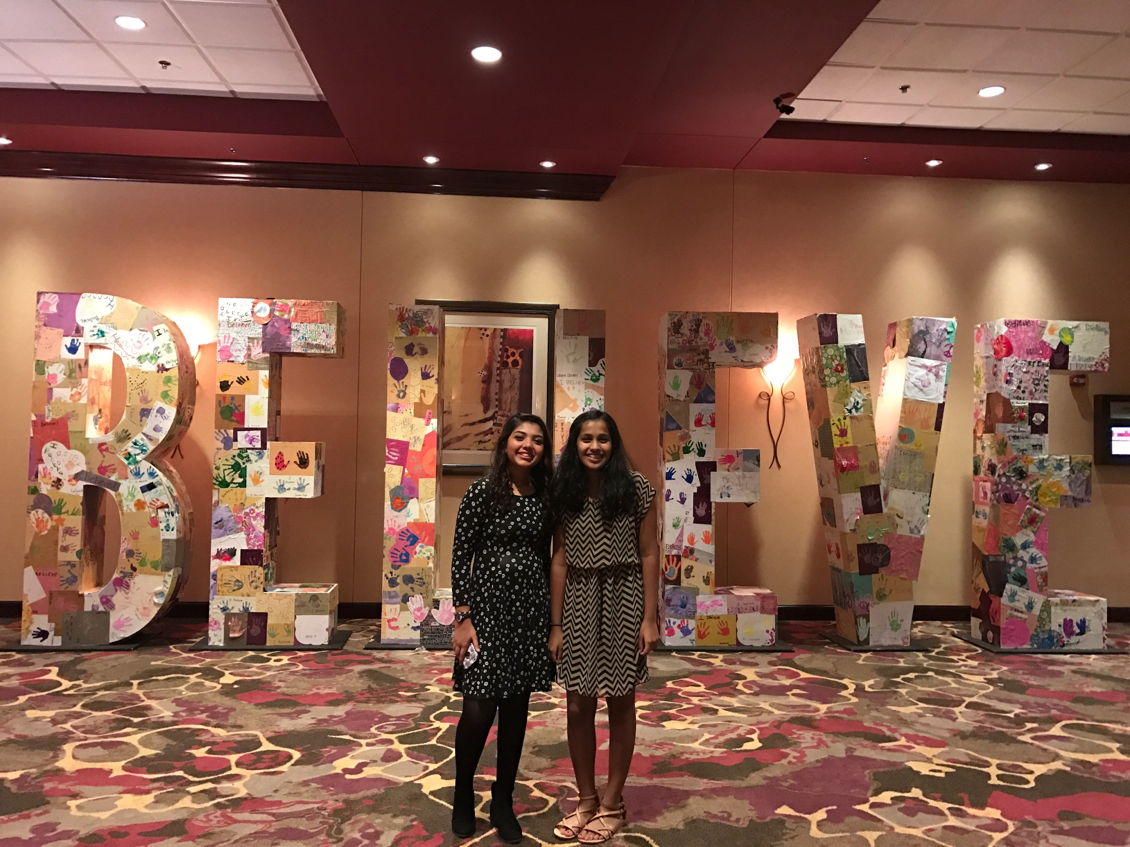
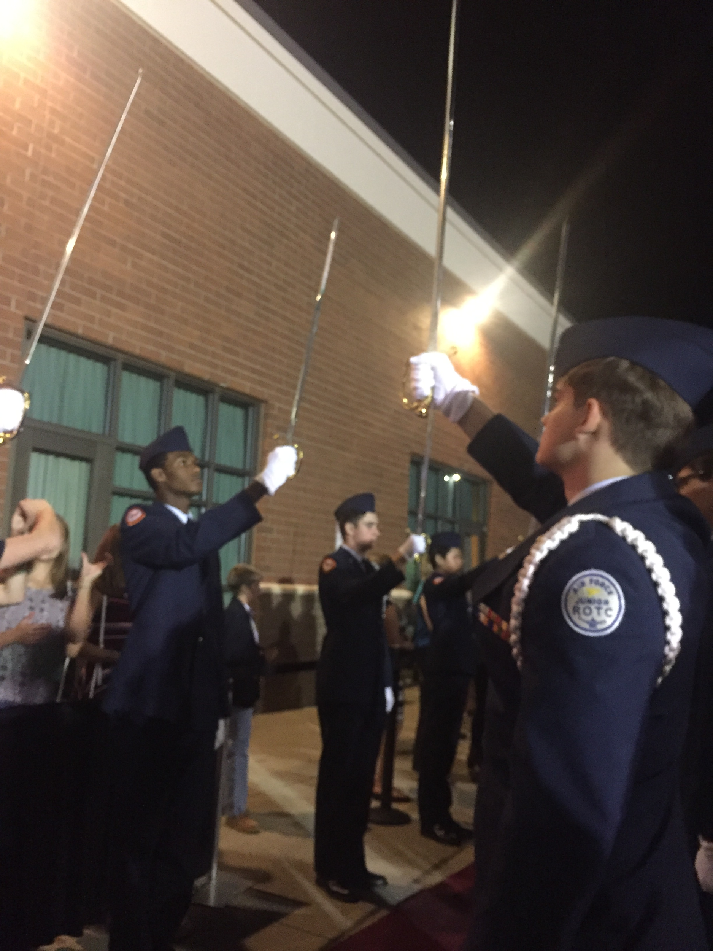
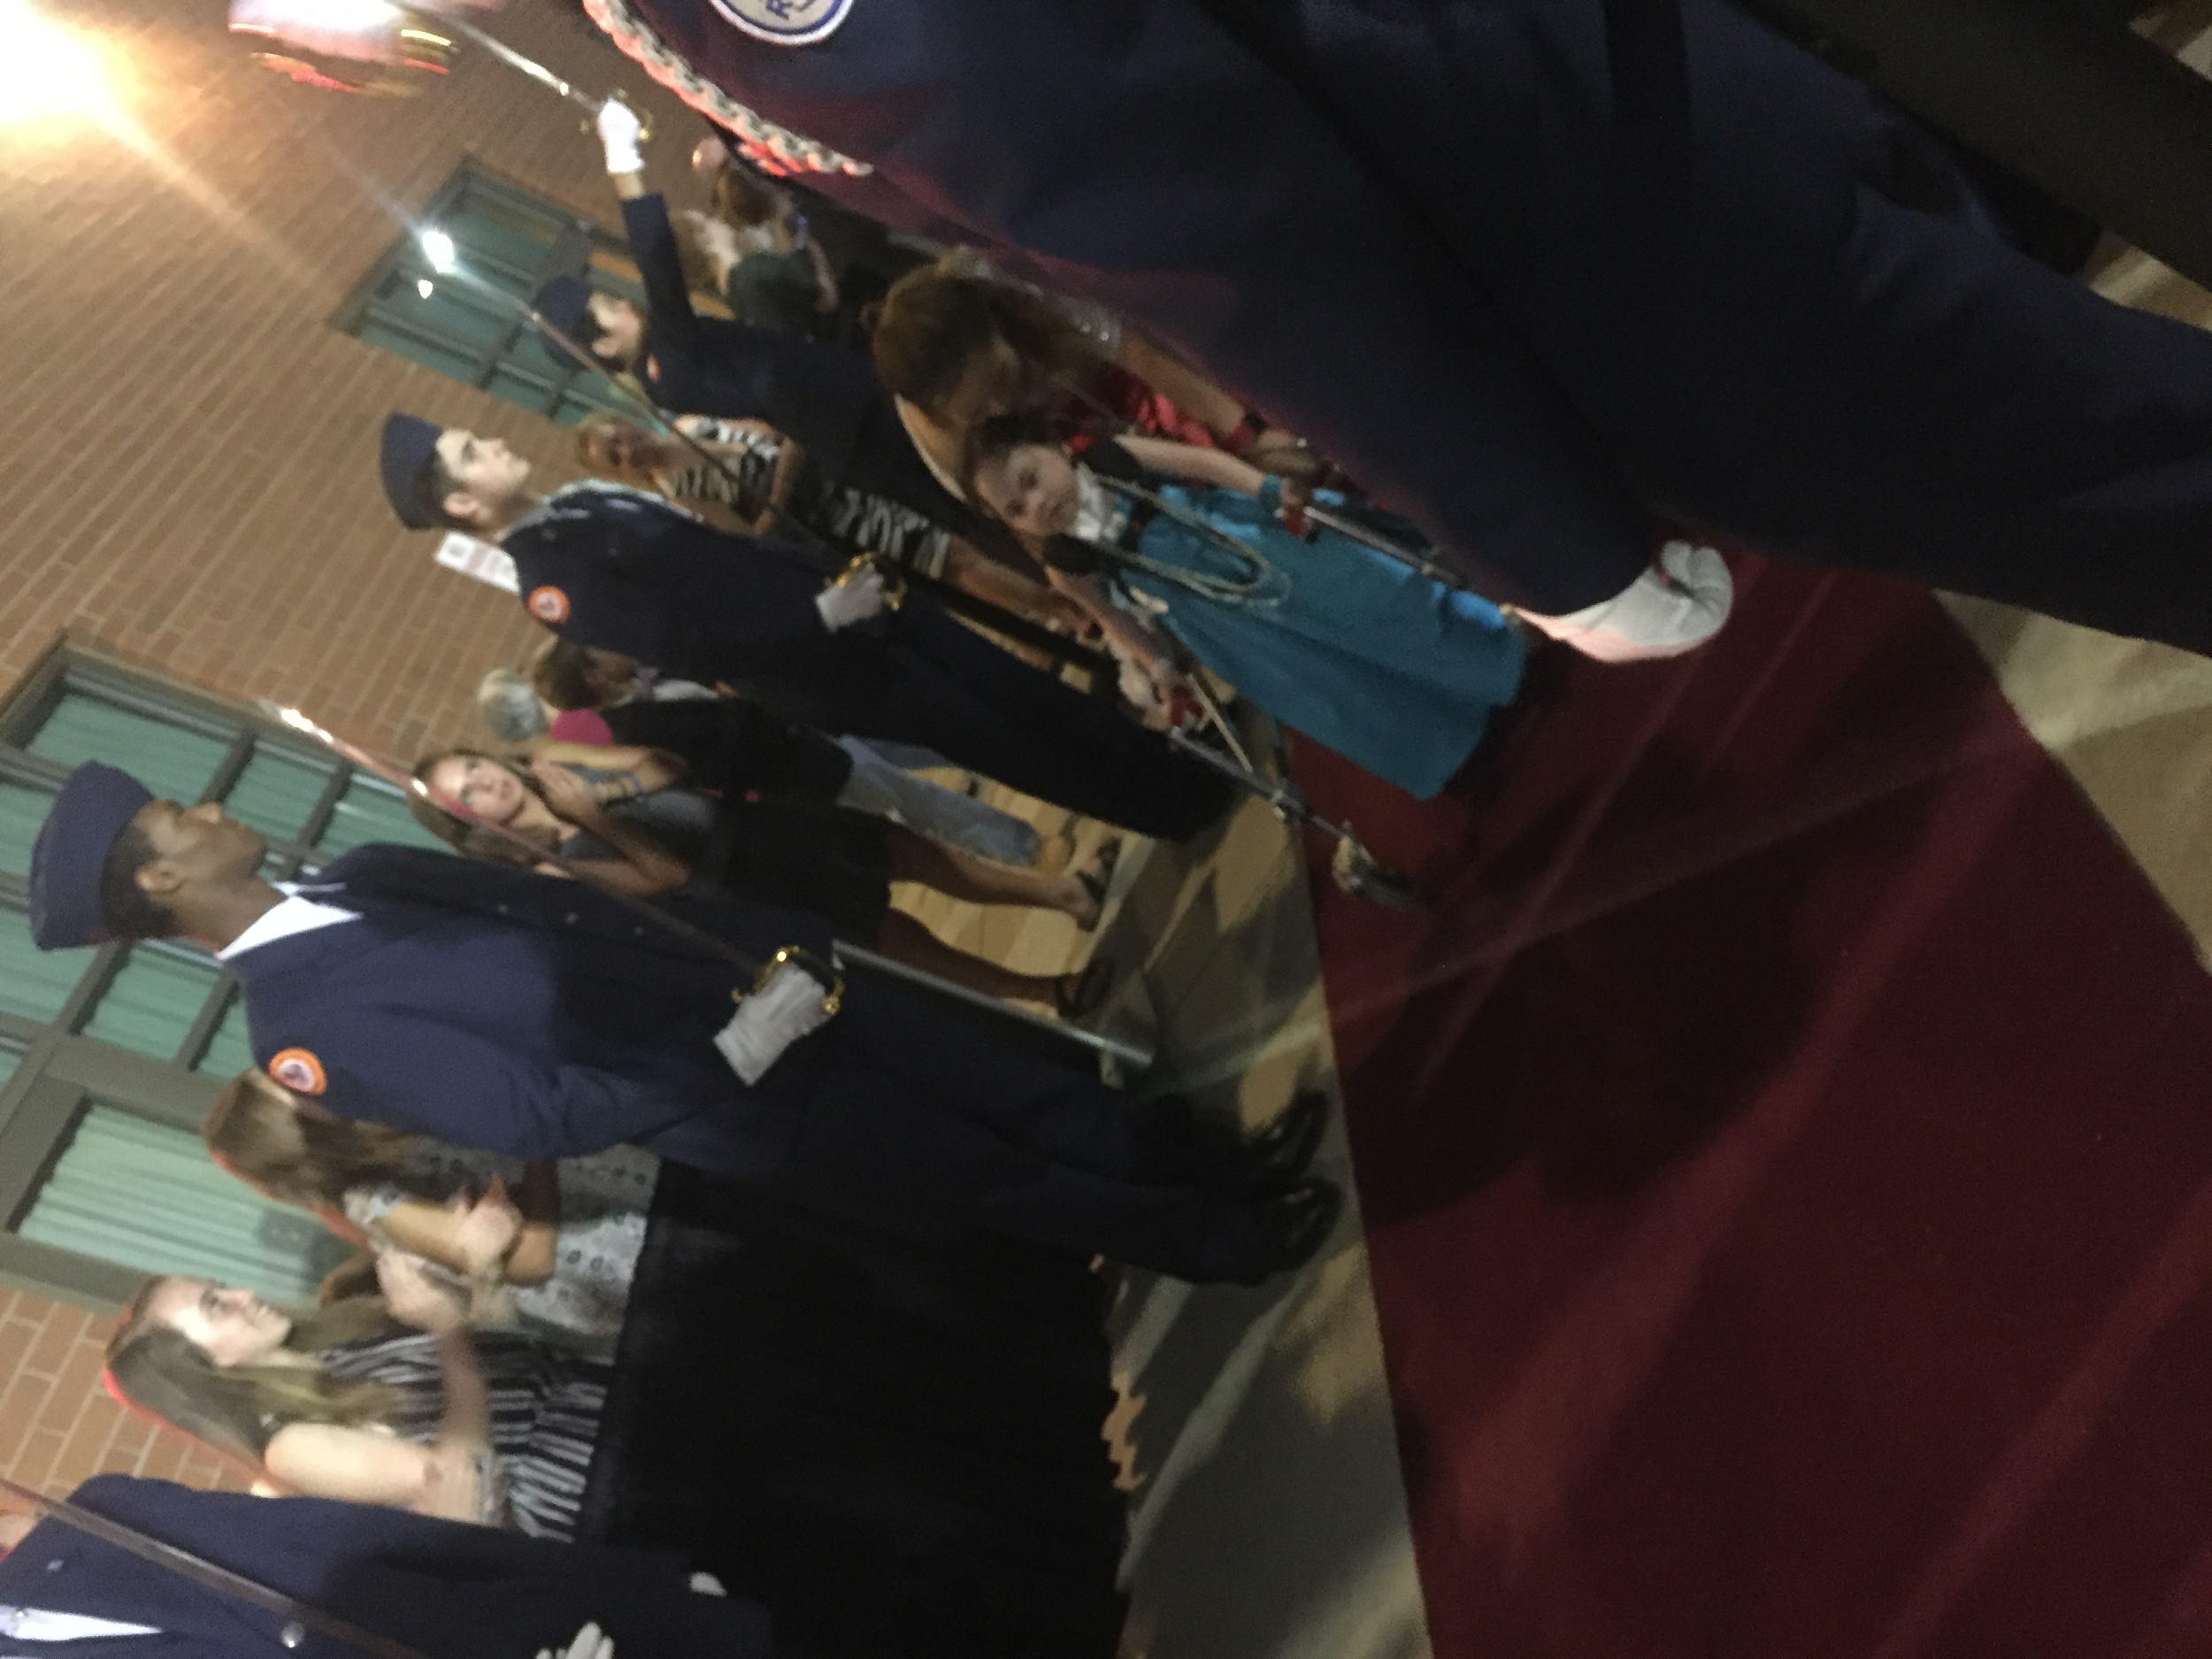
NASCAR Hall of Fame Prom for Children supporting children who suffer from mental illness (Nandika Komirsetti and Shaista Sayeed)

Slide 28
Let’s discuss...
Humso T-Shirts?
Event suggestions? (Fall fest,
Donation suggestions?
Do we want shirts this year?
goals?
Improvements?
Other Suggestions?

Slide 29
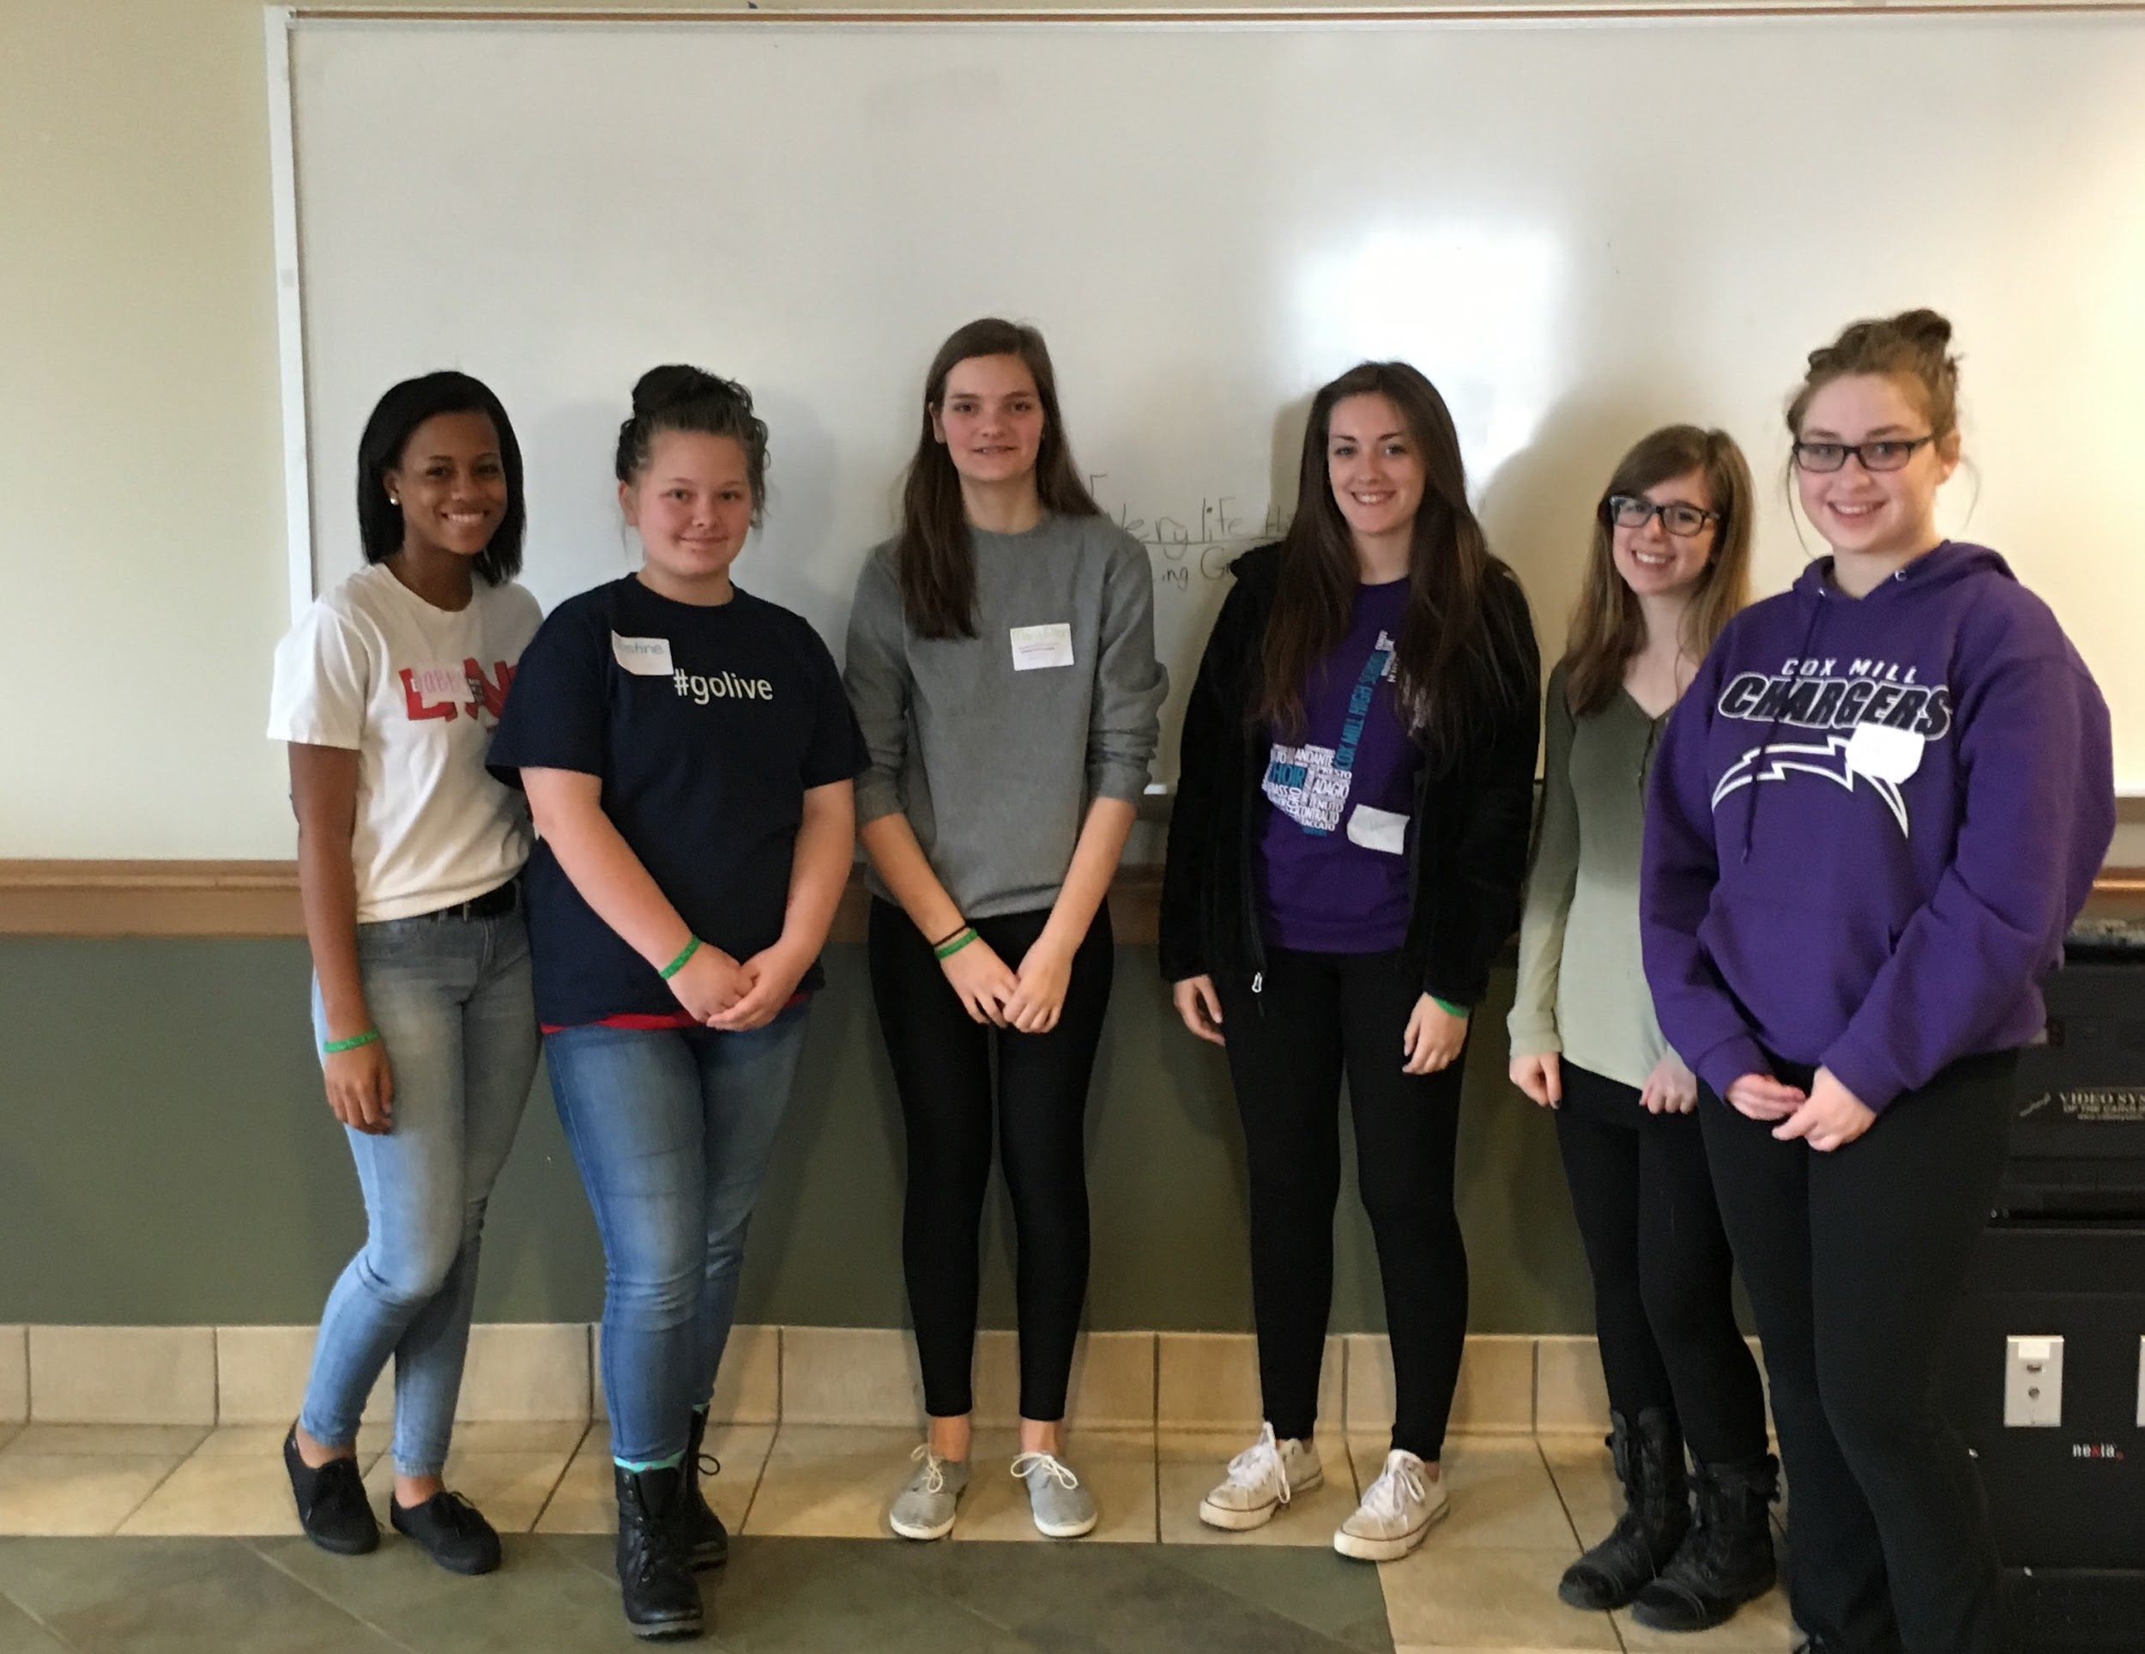
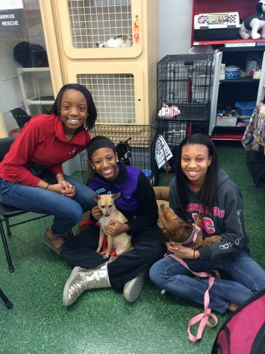
2015-2016 Club Launch
Volunteering with the Amazing Grace organization at a card making event with the children
Petco volunteering

Slide 30
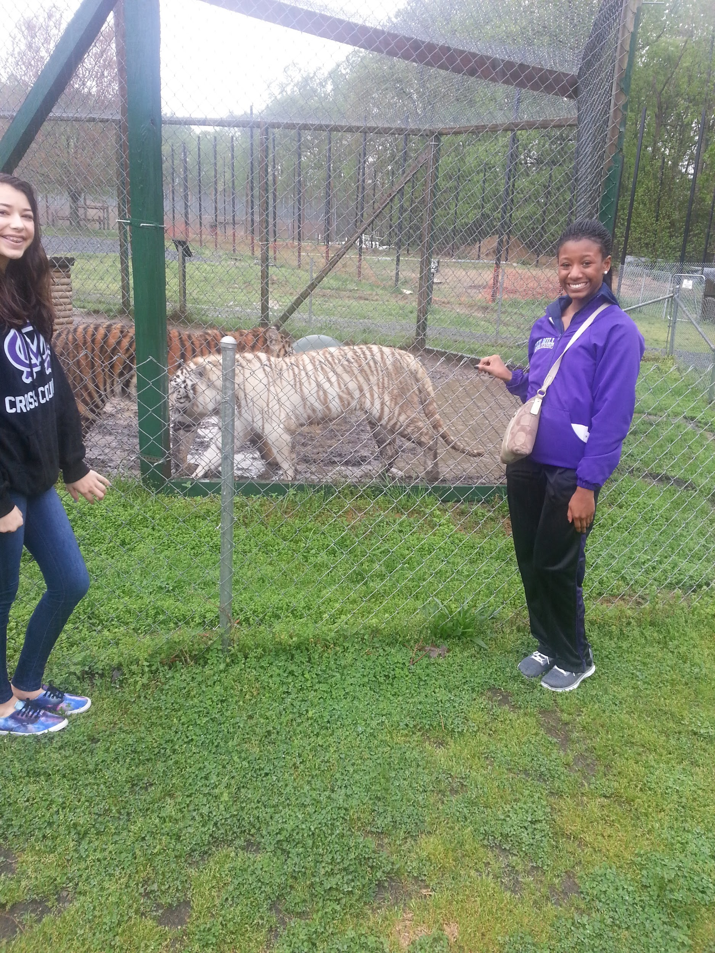
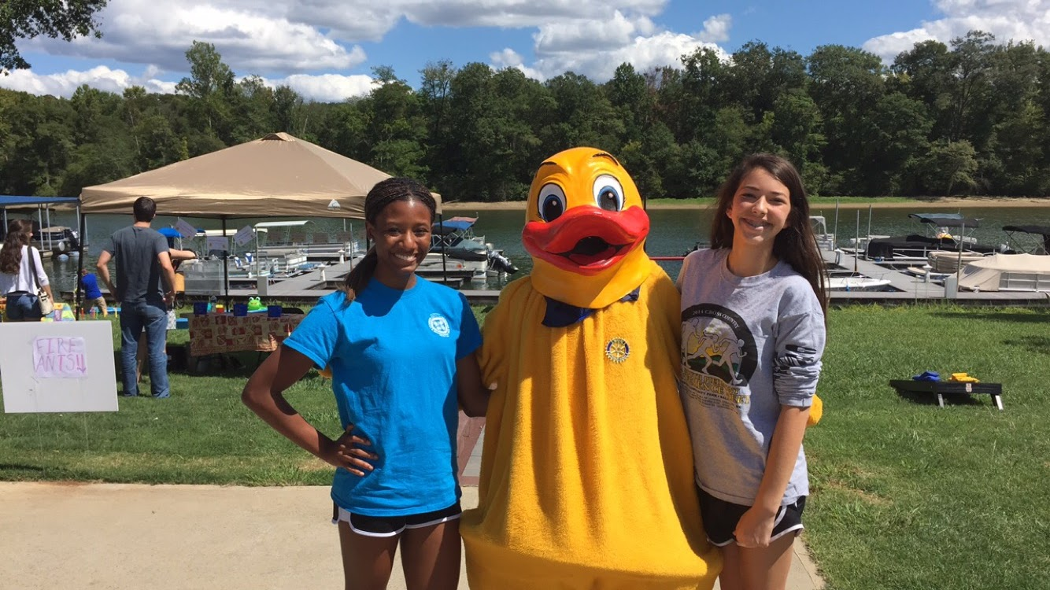
Volunteering at a Duck Race with Rotary
Volunteering at Tiger World

Slide 31
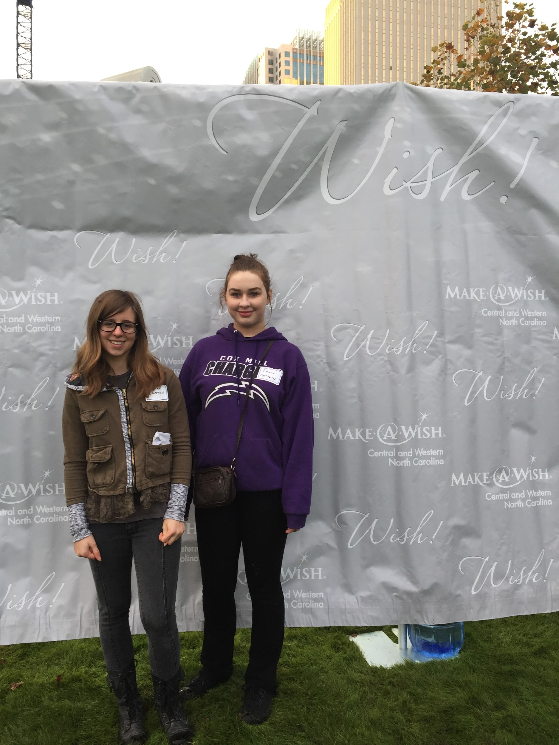
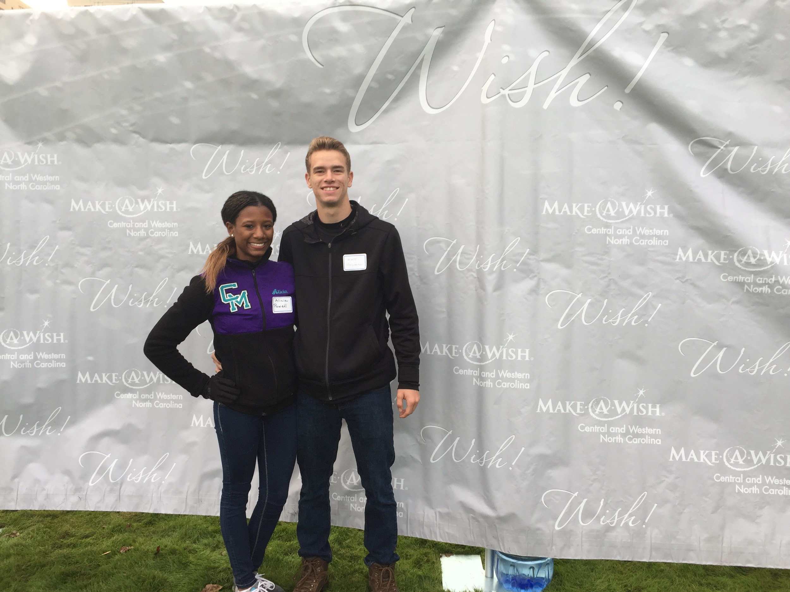
Volunteering with the Make-a-wish foundation for their Wish Walk

Slide 32
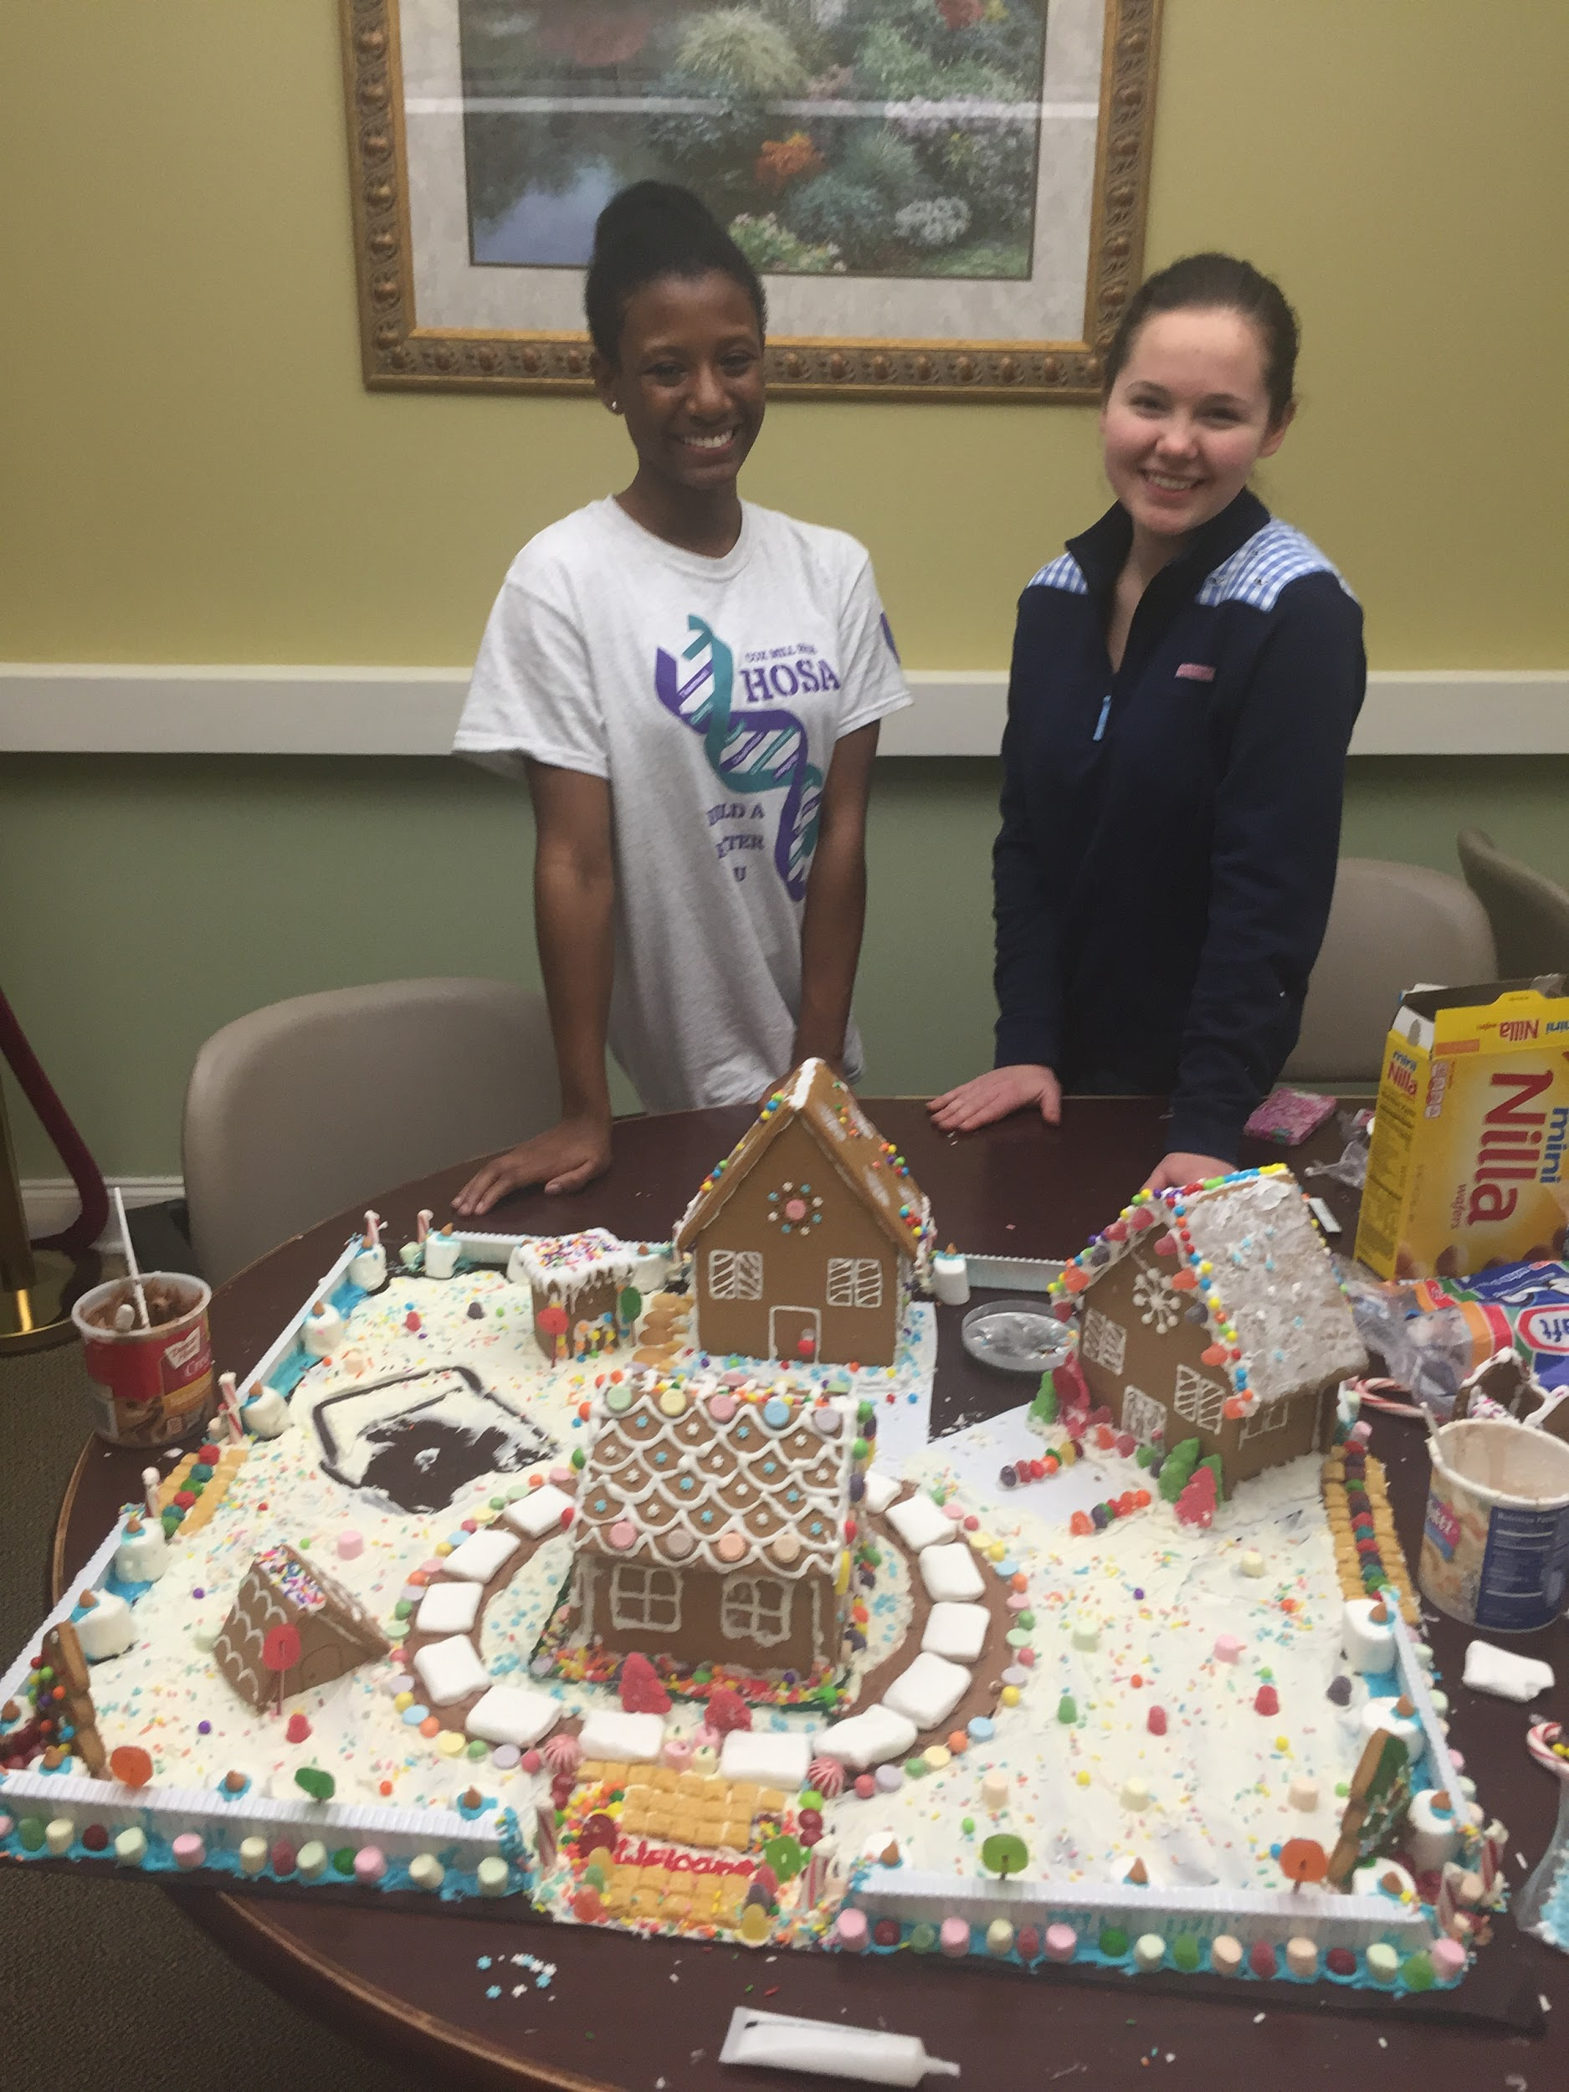
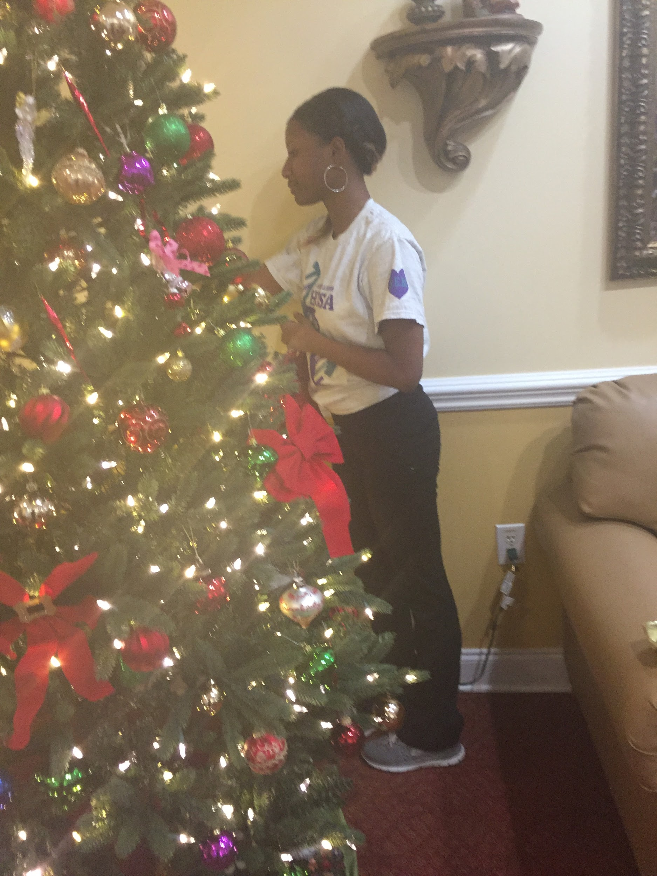
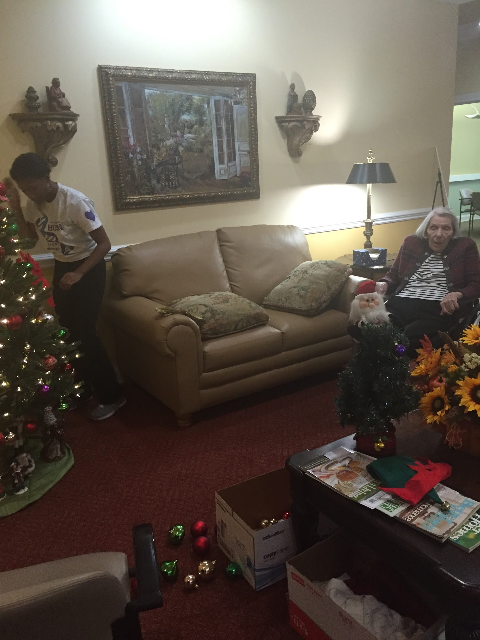
Nursing Home Volunteering

Slide 33
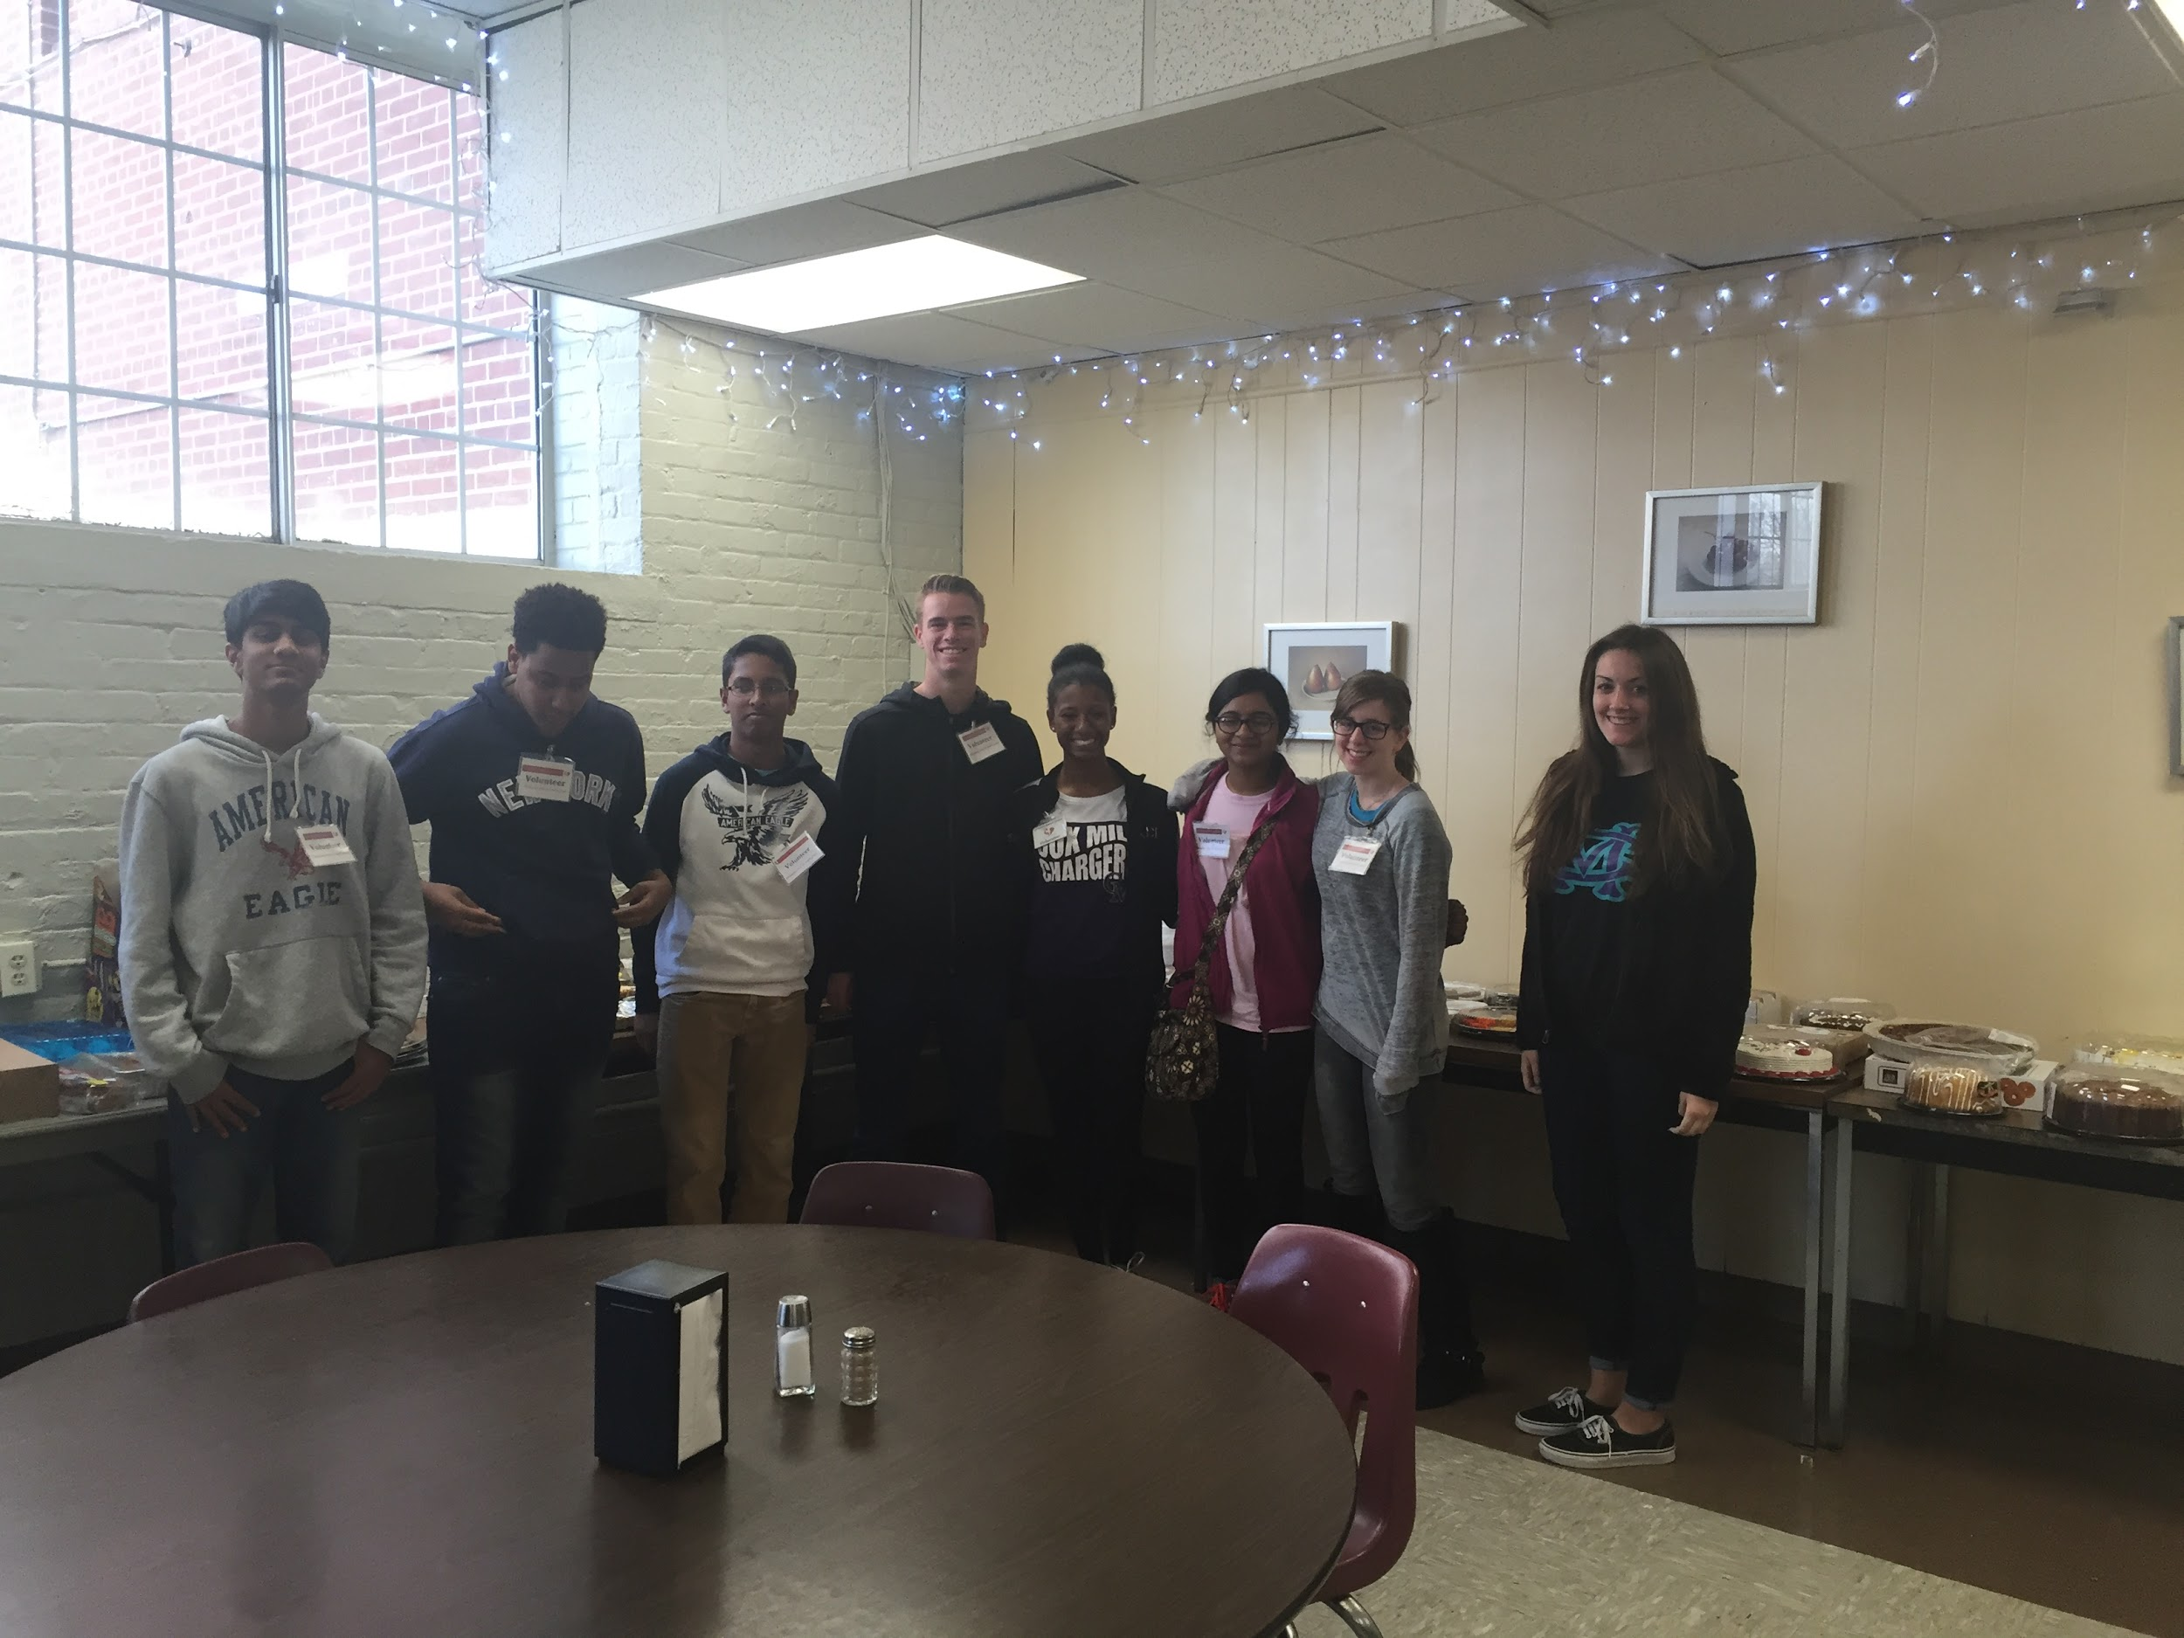
Volunteering at the Charlotte Rescue Mission “Serve and Clean” with men who are recovering from substance abuse (We helped provide meals to these men, and we got to personally speak with quite a few and hear their stories)

Slide 34
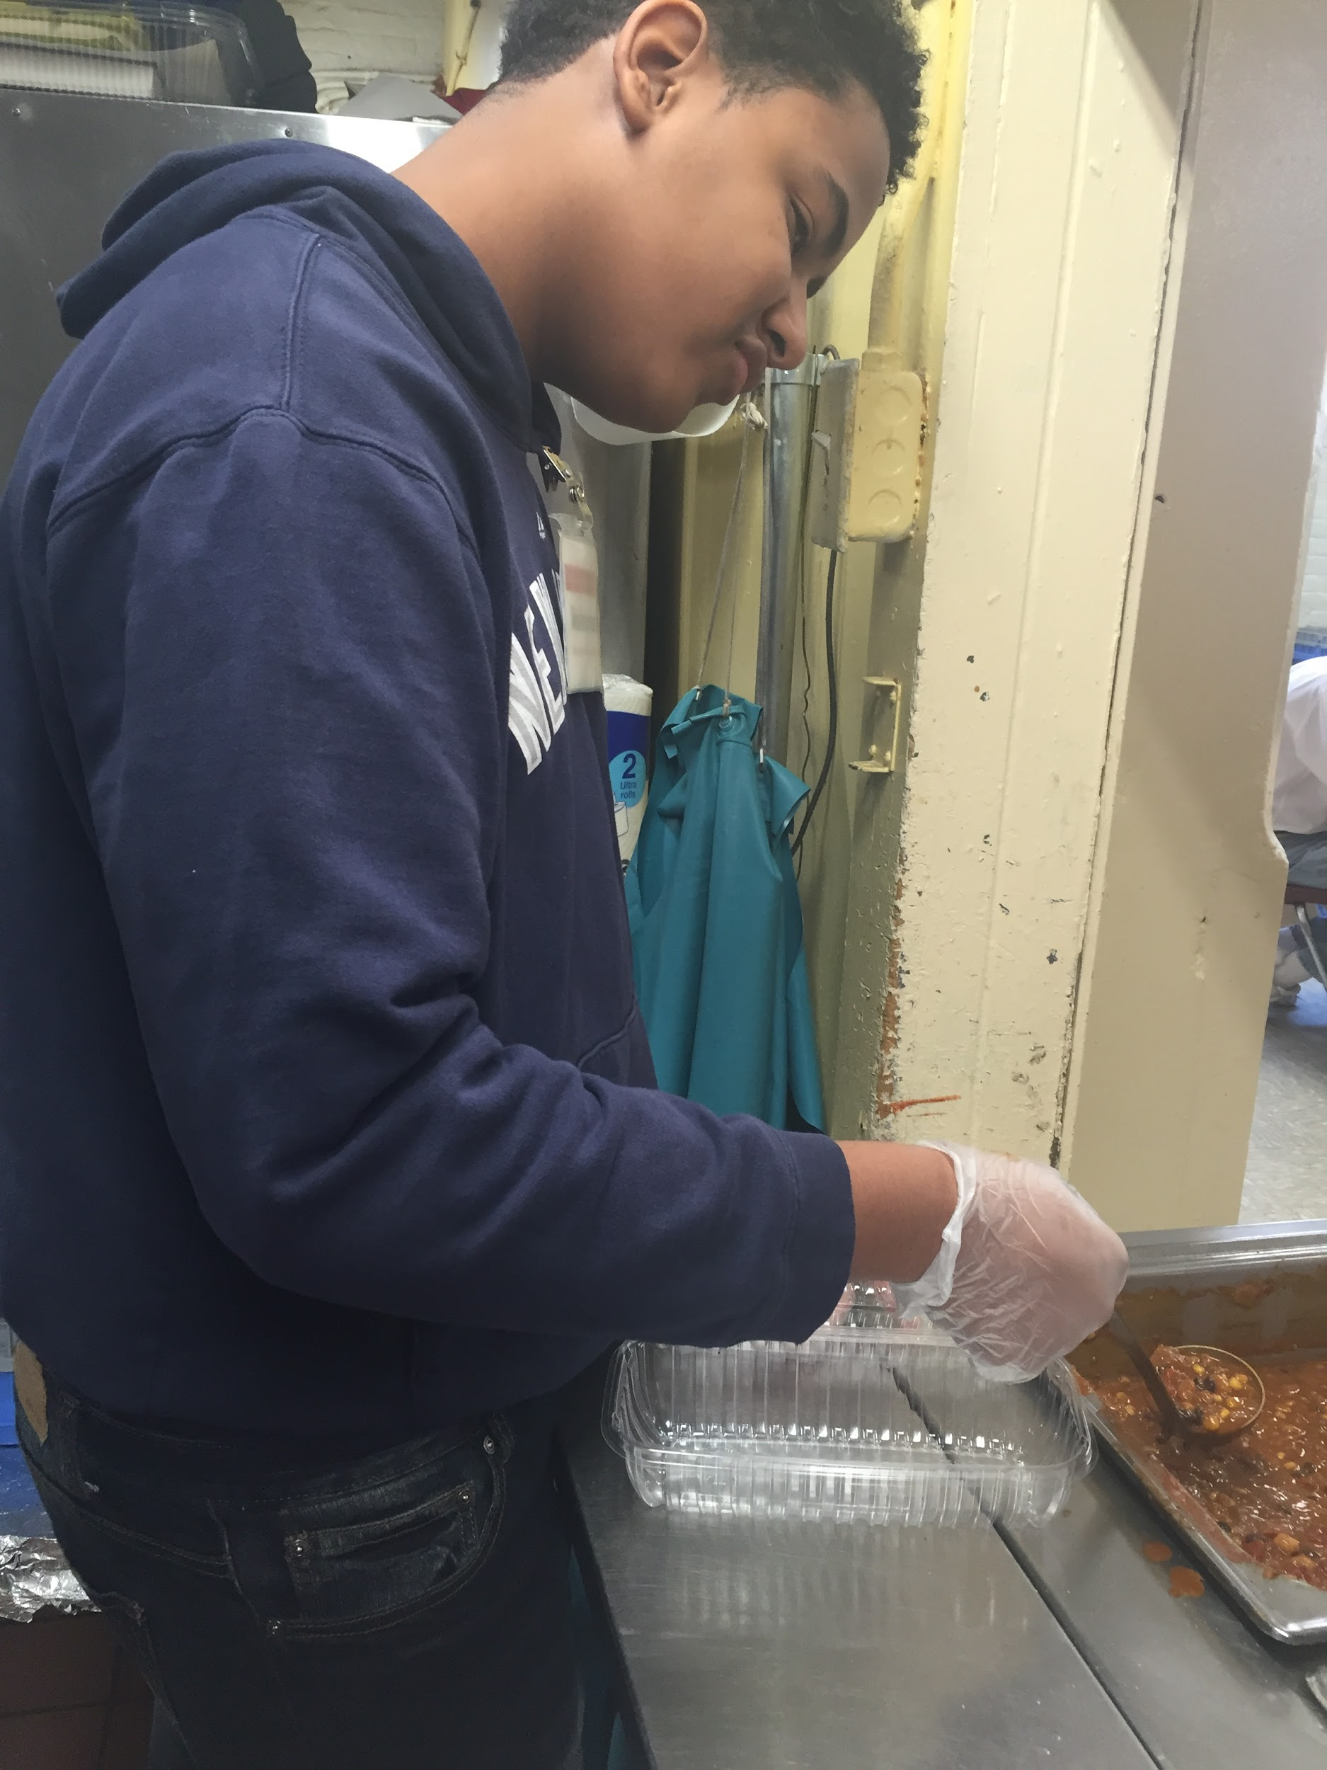
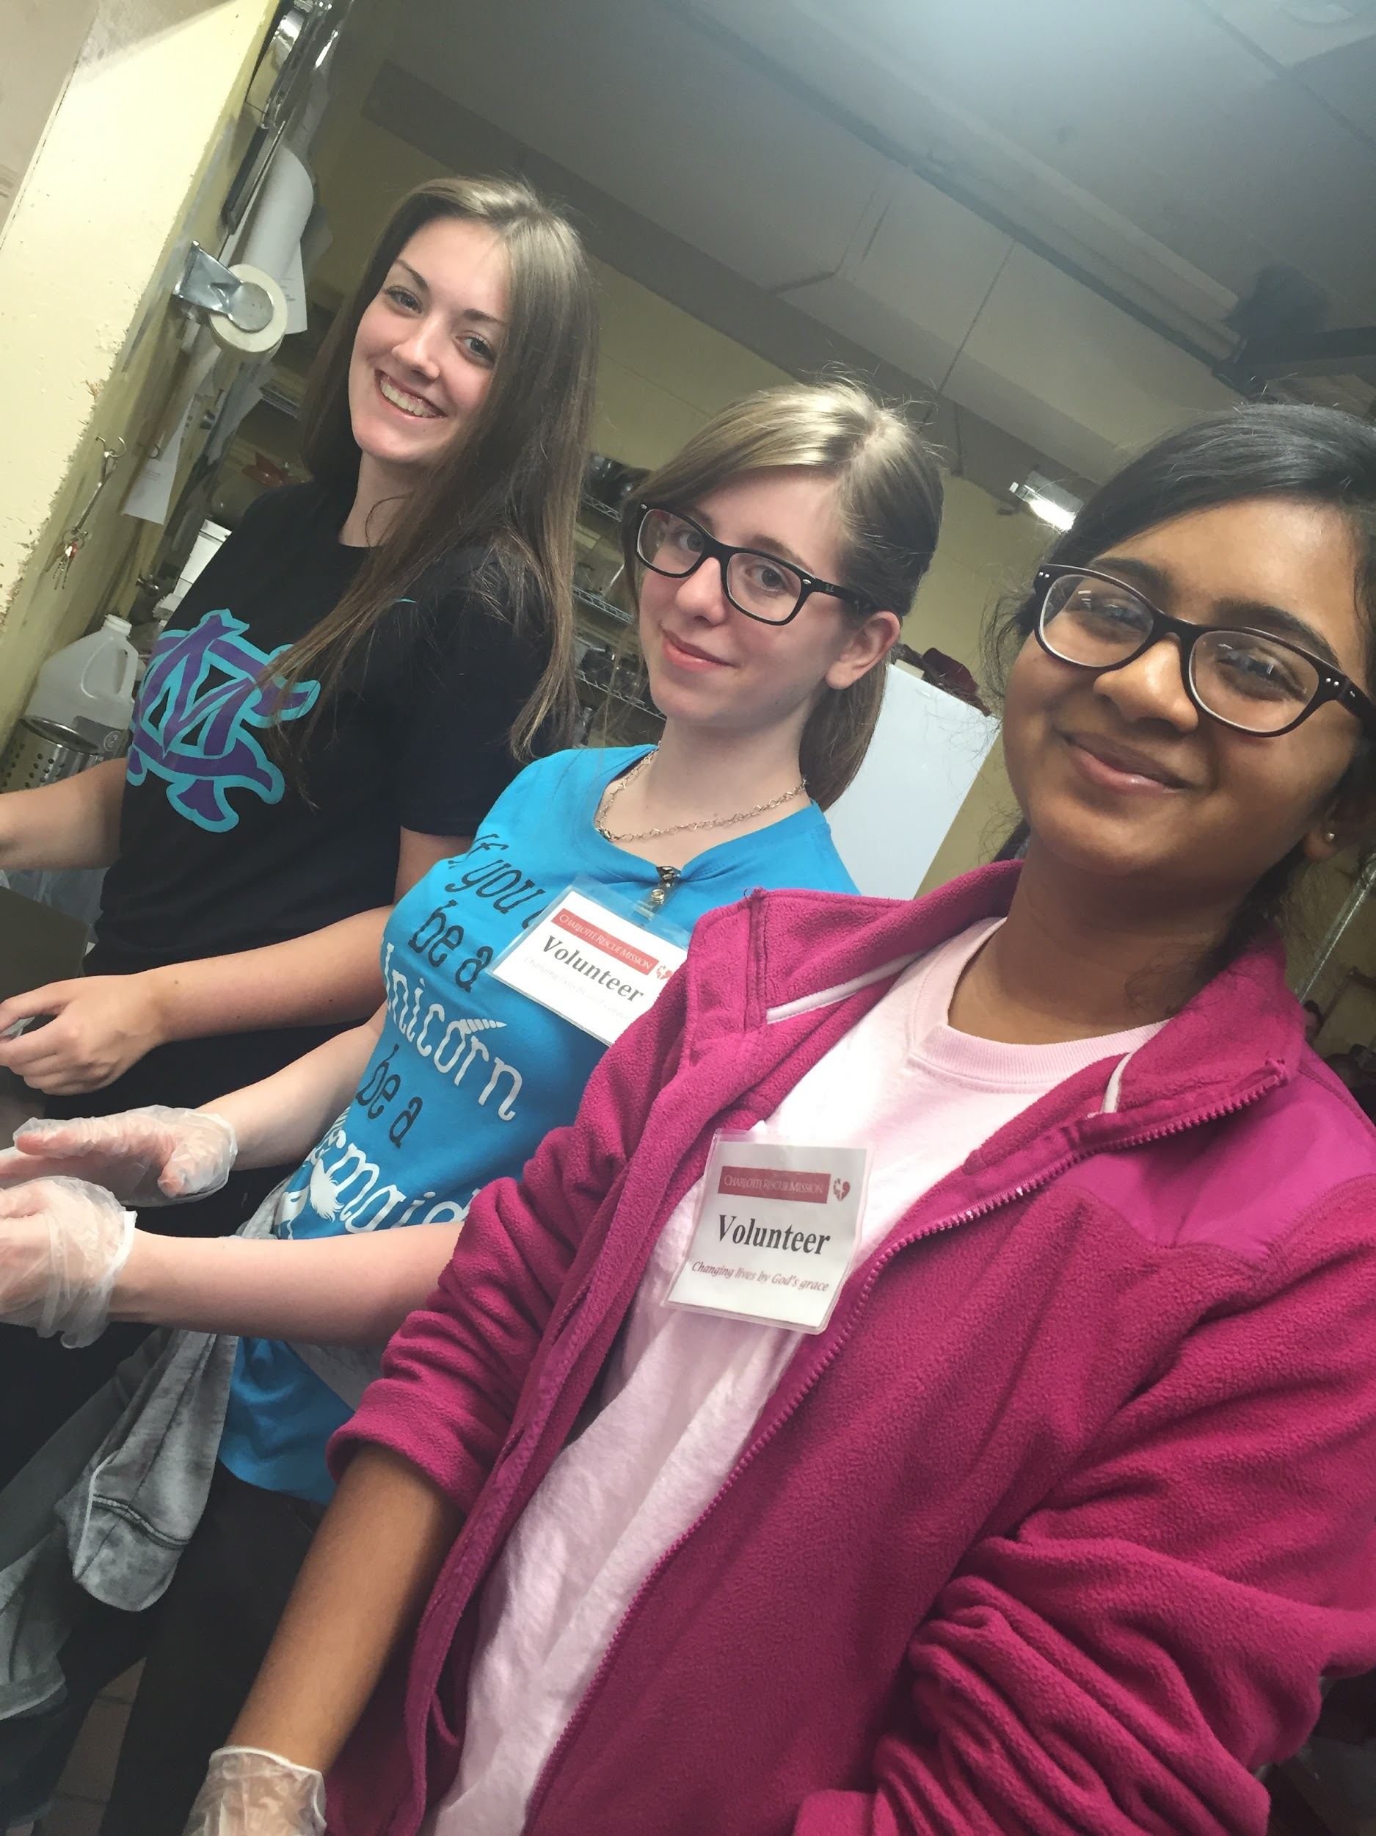
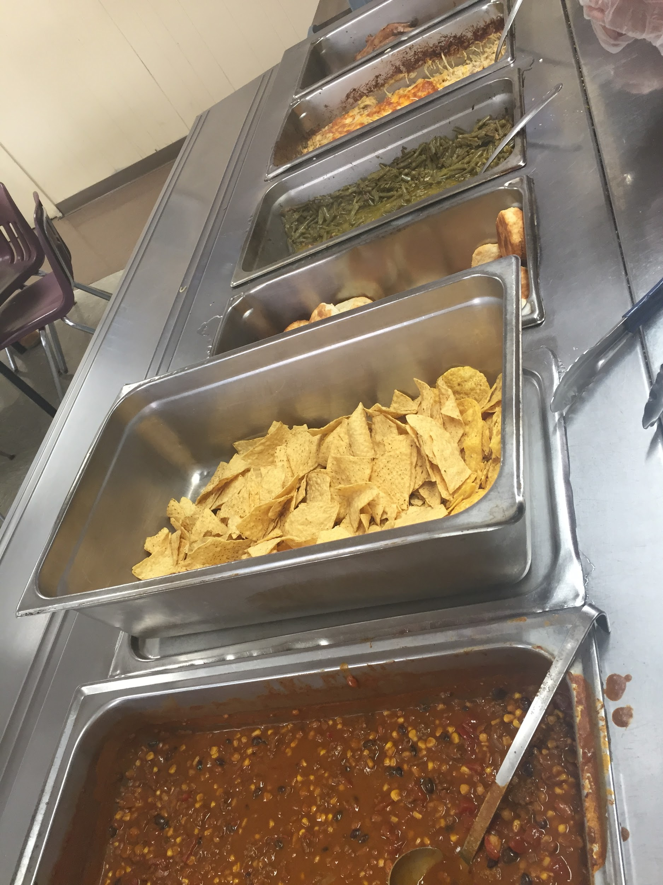

Slide 35
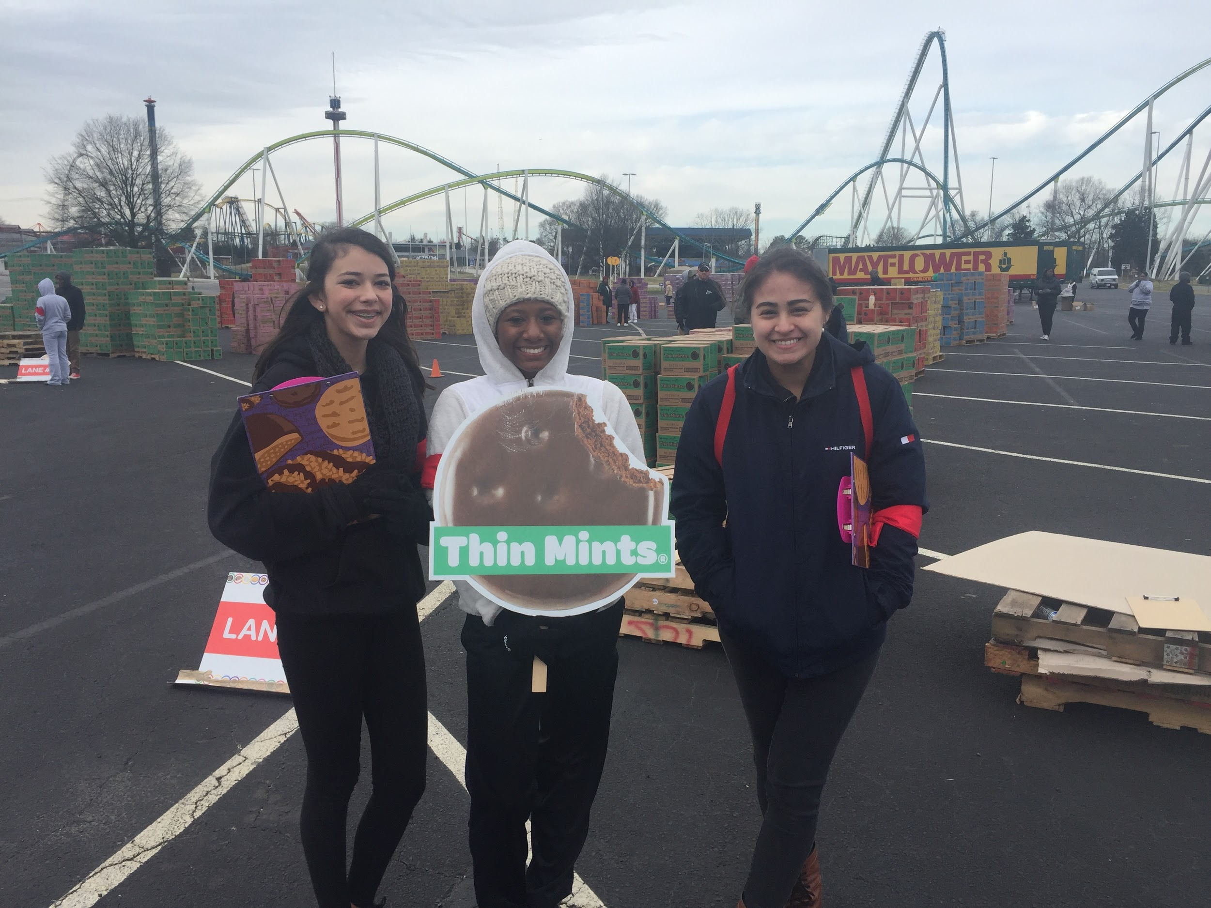
Volunteering with the Girl Scouts organization for aid with cookie distribution

Slide 36
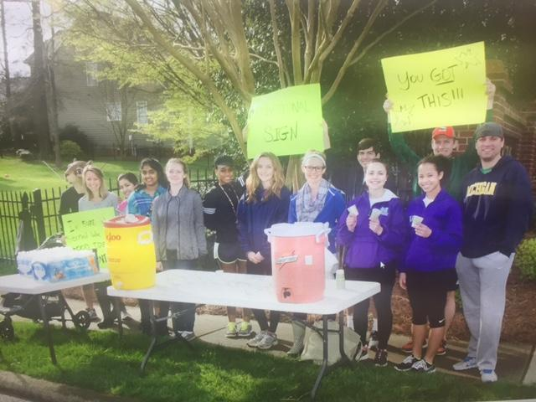
Highland Creek 5k Run the Creek Event!

Slide 37
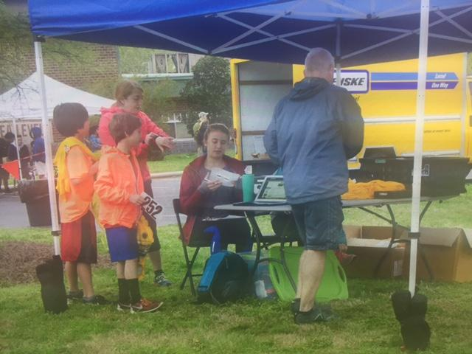
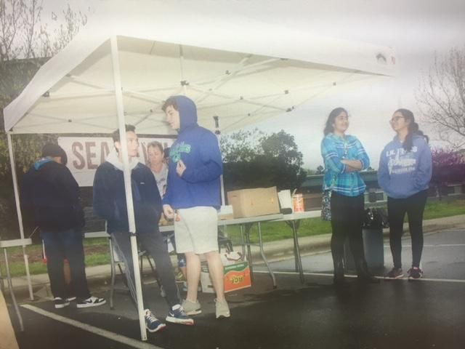

Slide 38
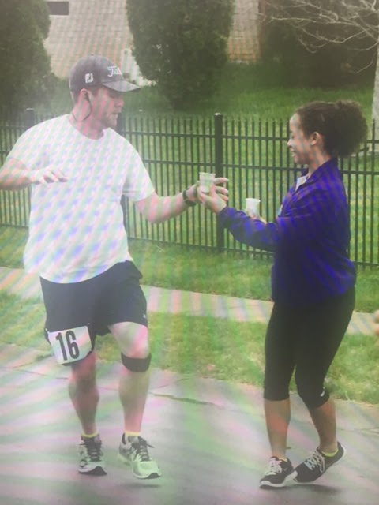
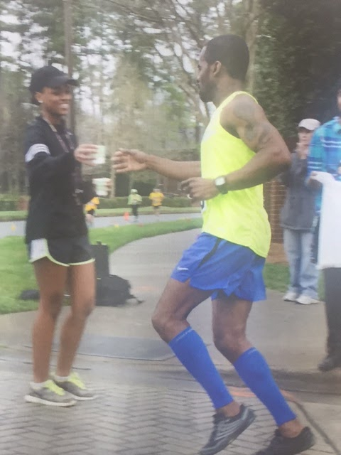

Slide 39
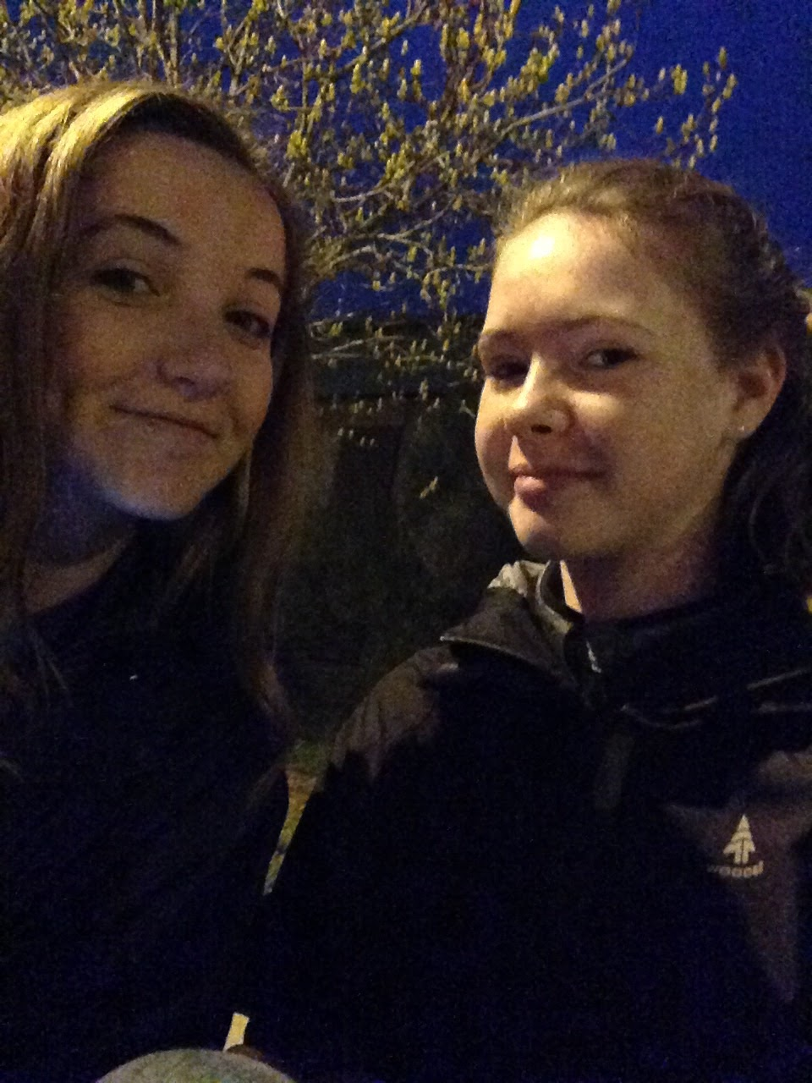
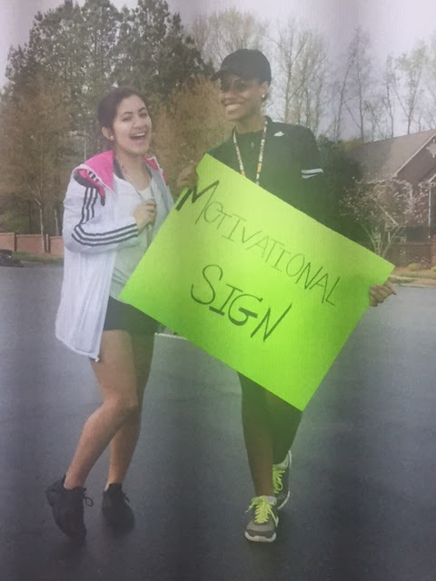
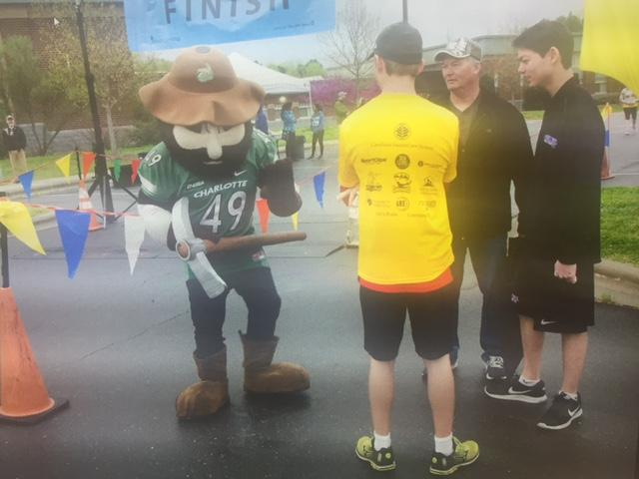
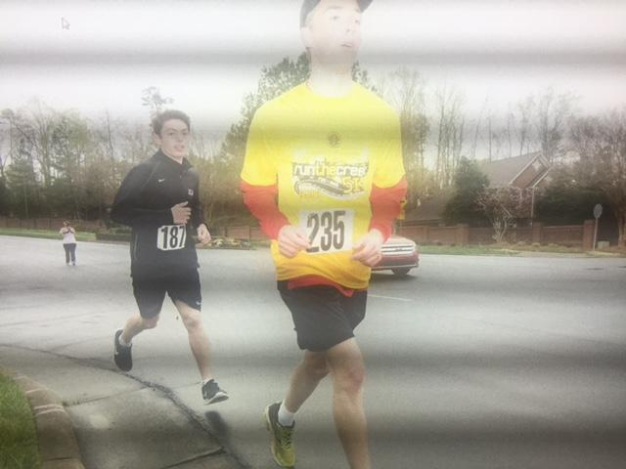

Slide 40
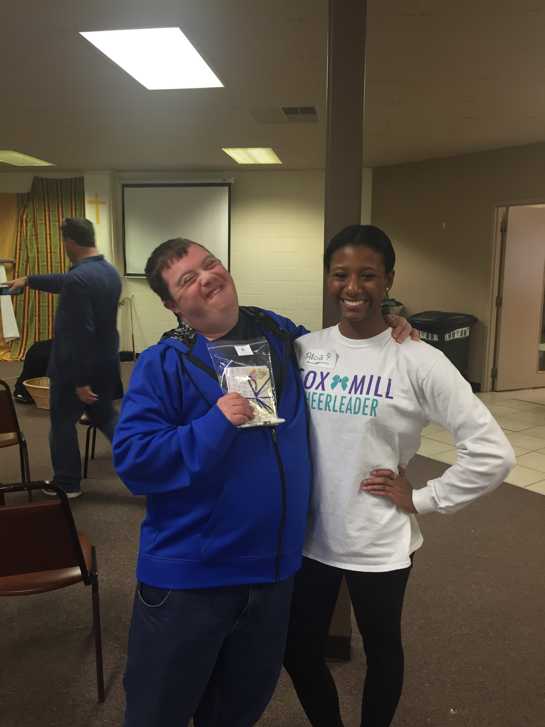
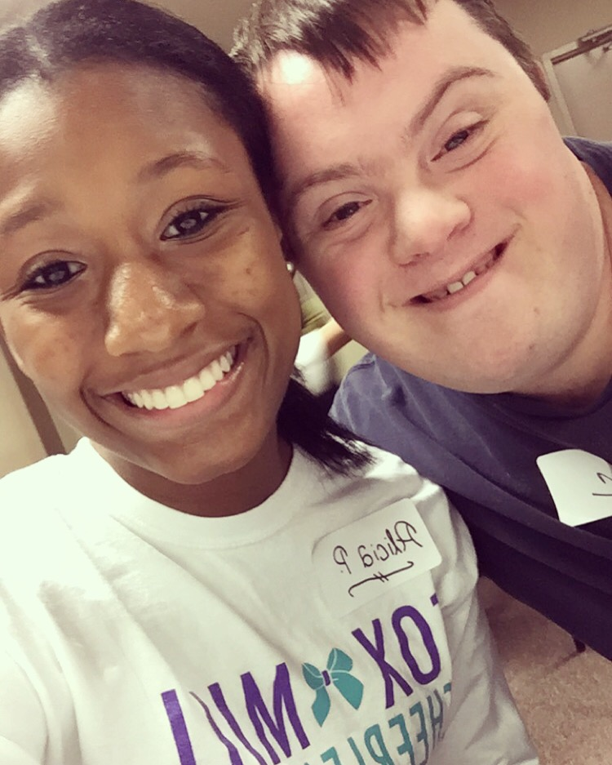
Volunteering at the Amazing Grace Card Making Event with Eric and other children suffering from mental disorders

Slide 41
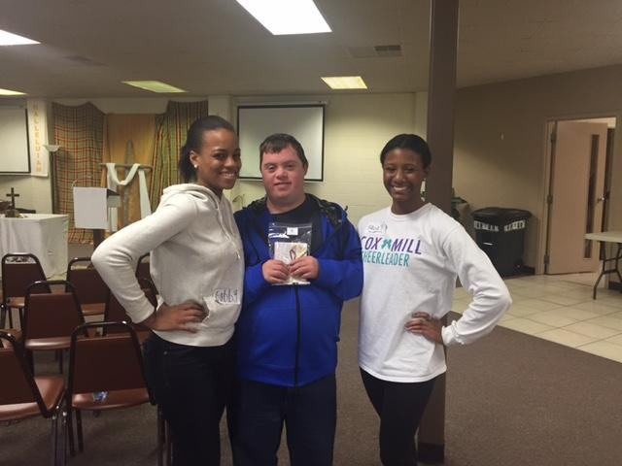

Slide 42
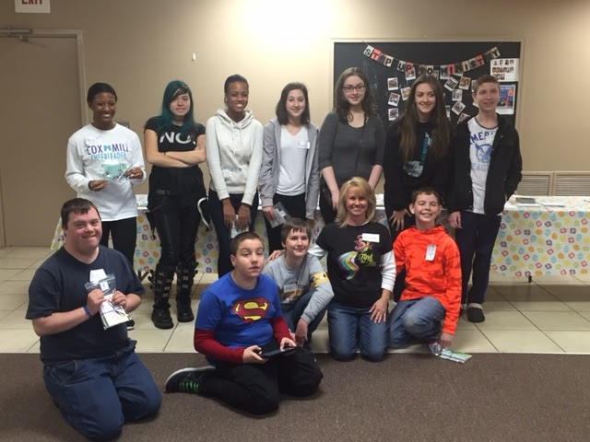
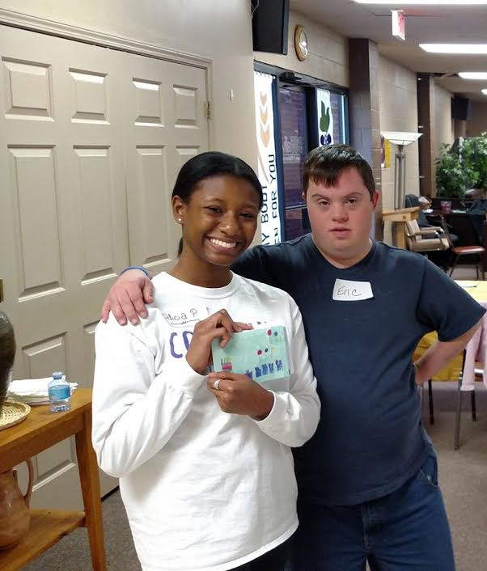

Slide 43
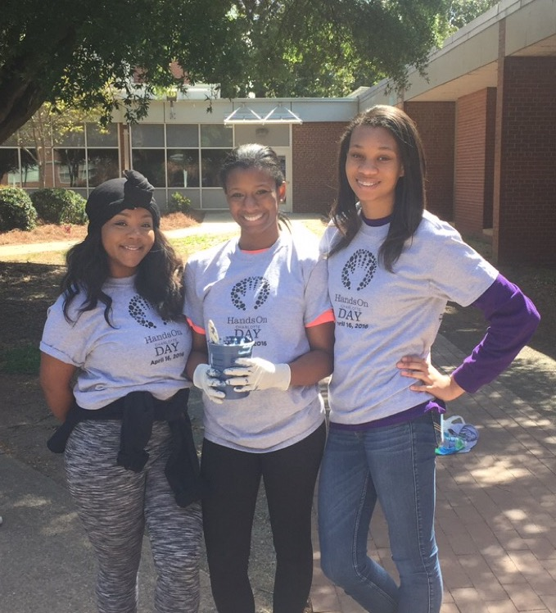
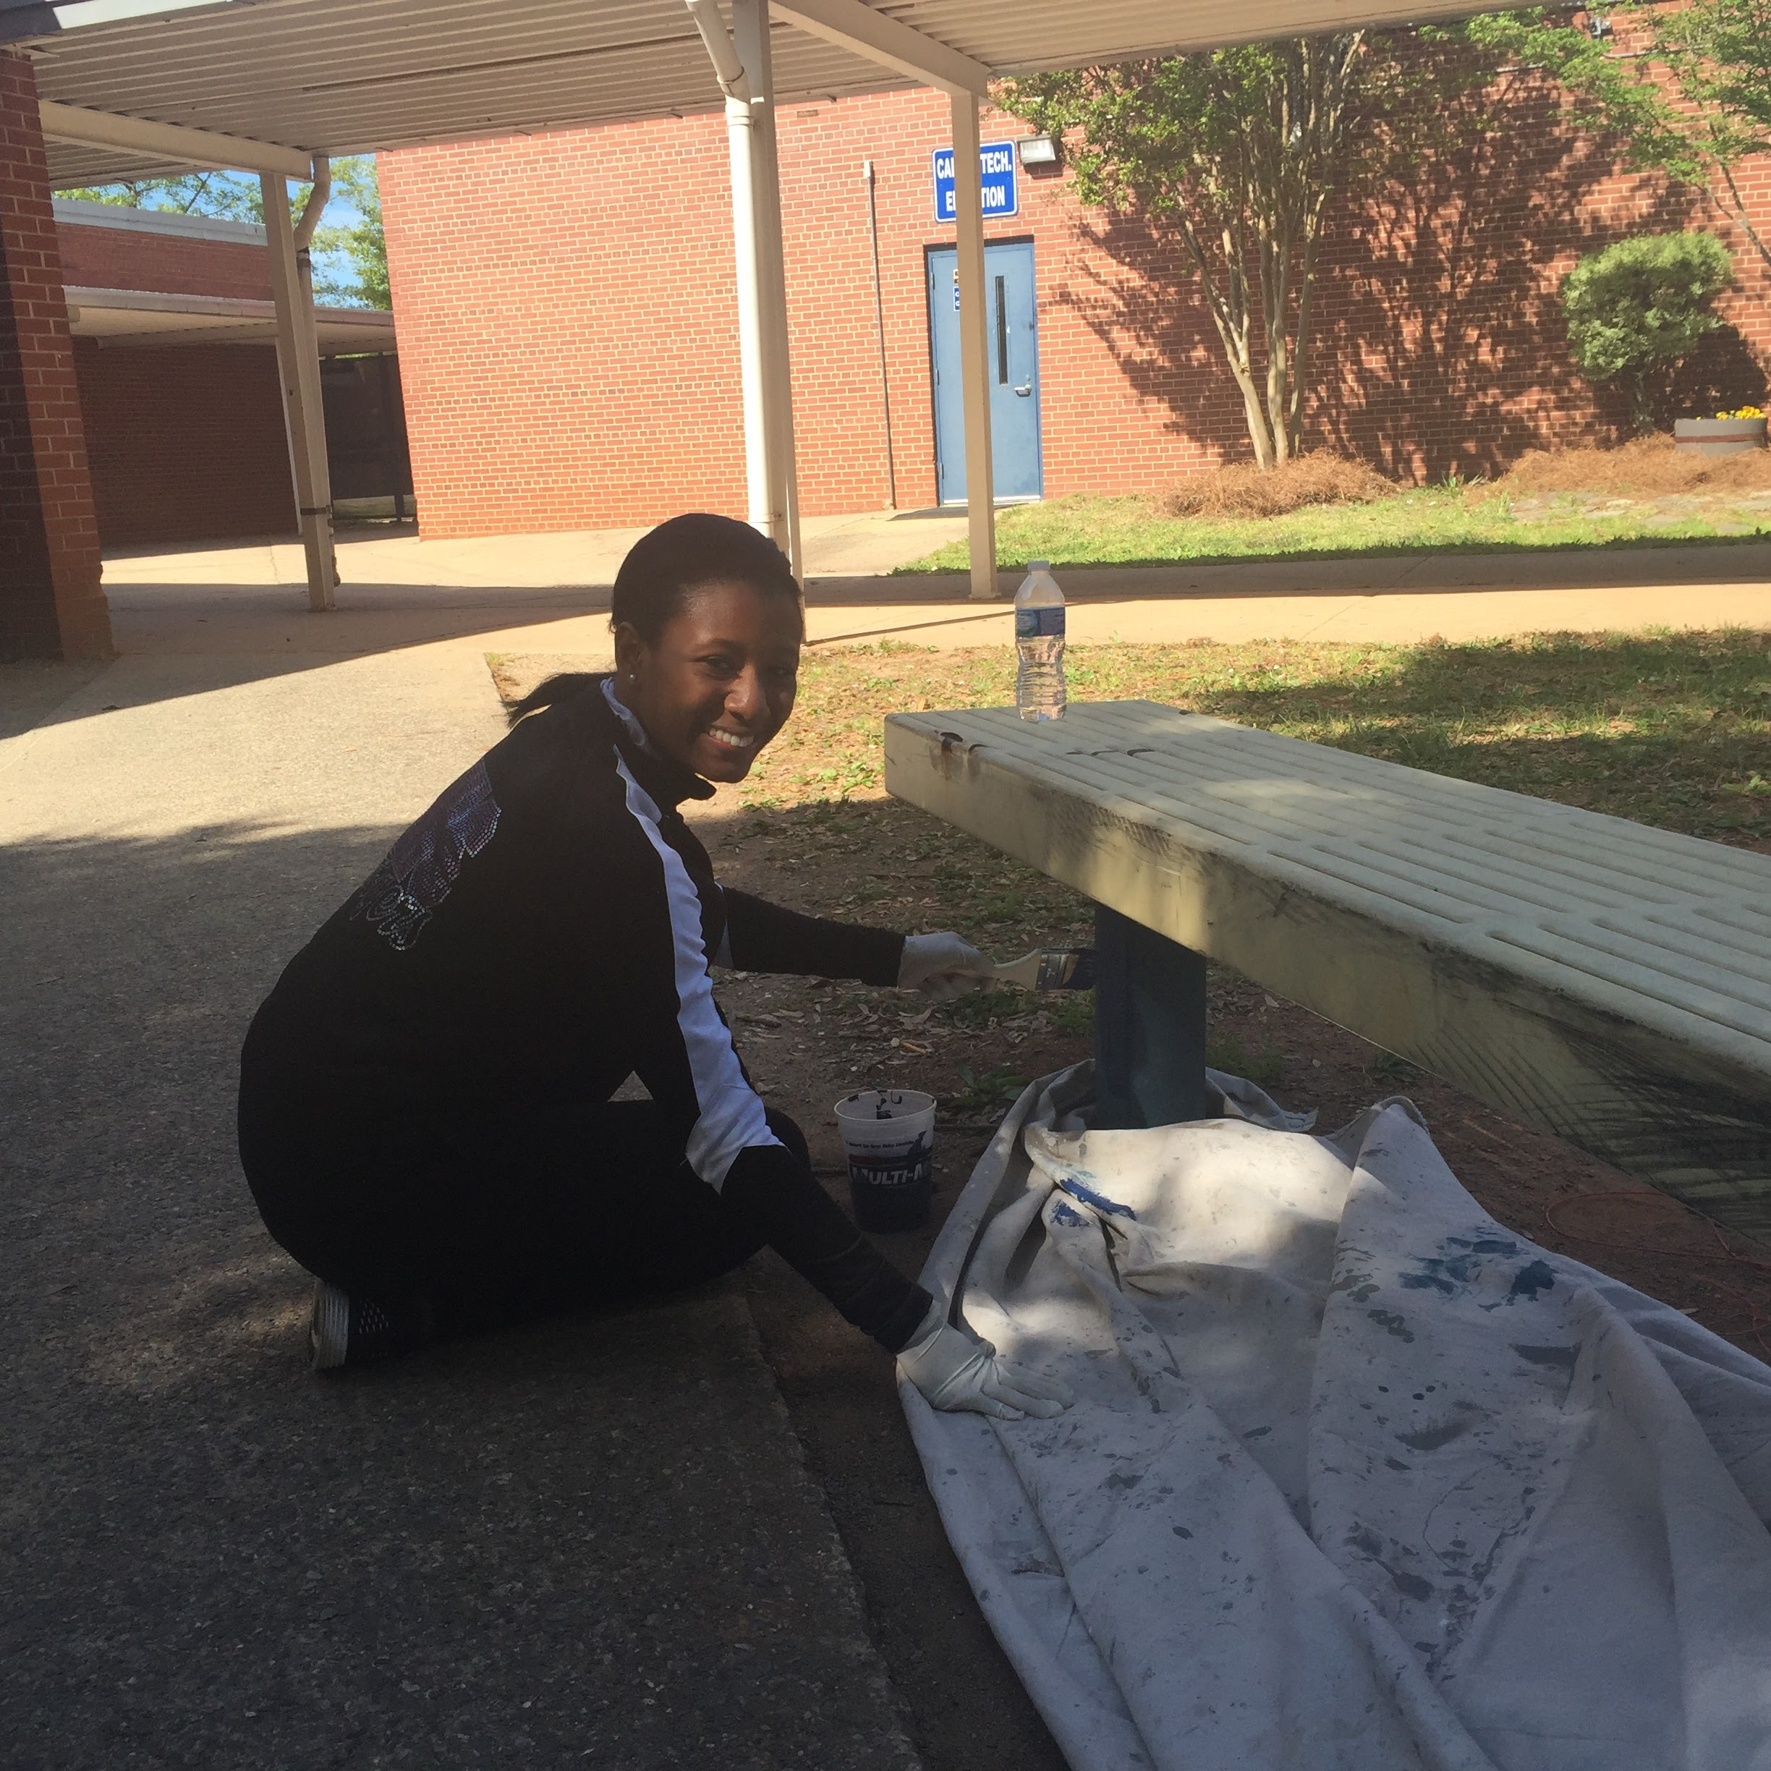
Volunteering with Hands on Charlotte at a clean up service event

Slide 44
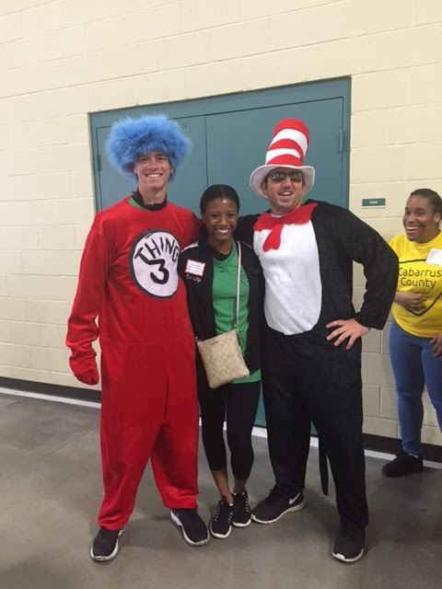
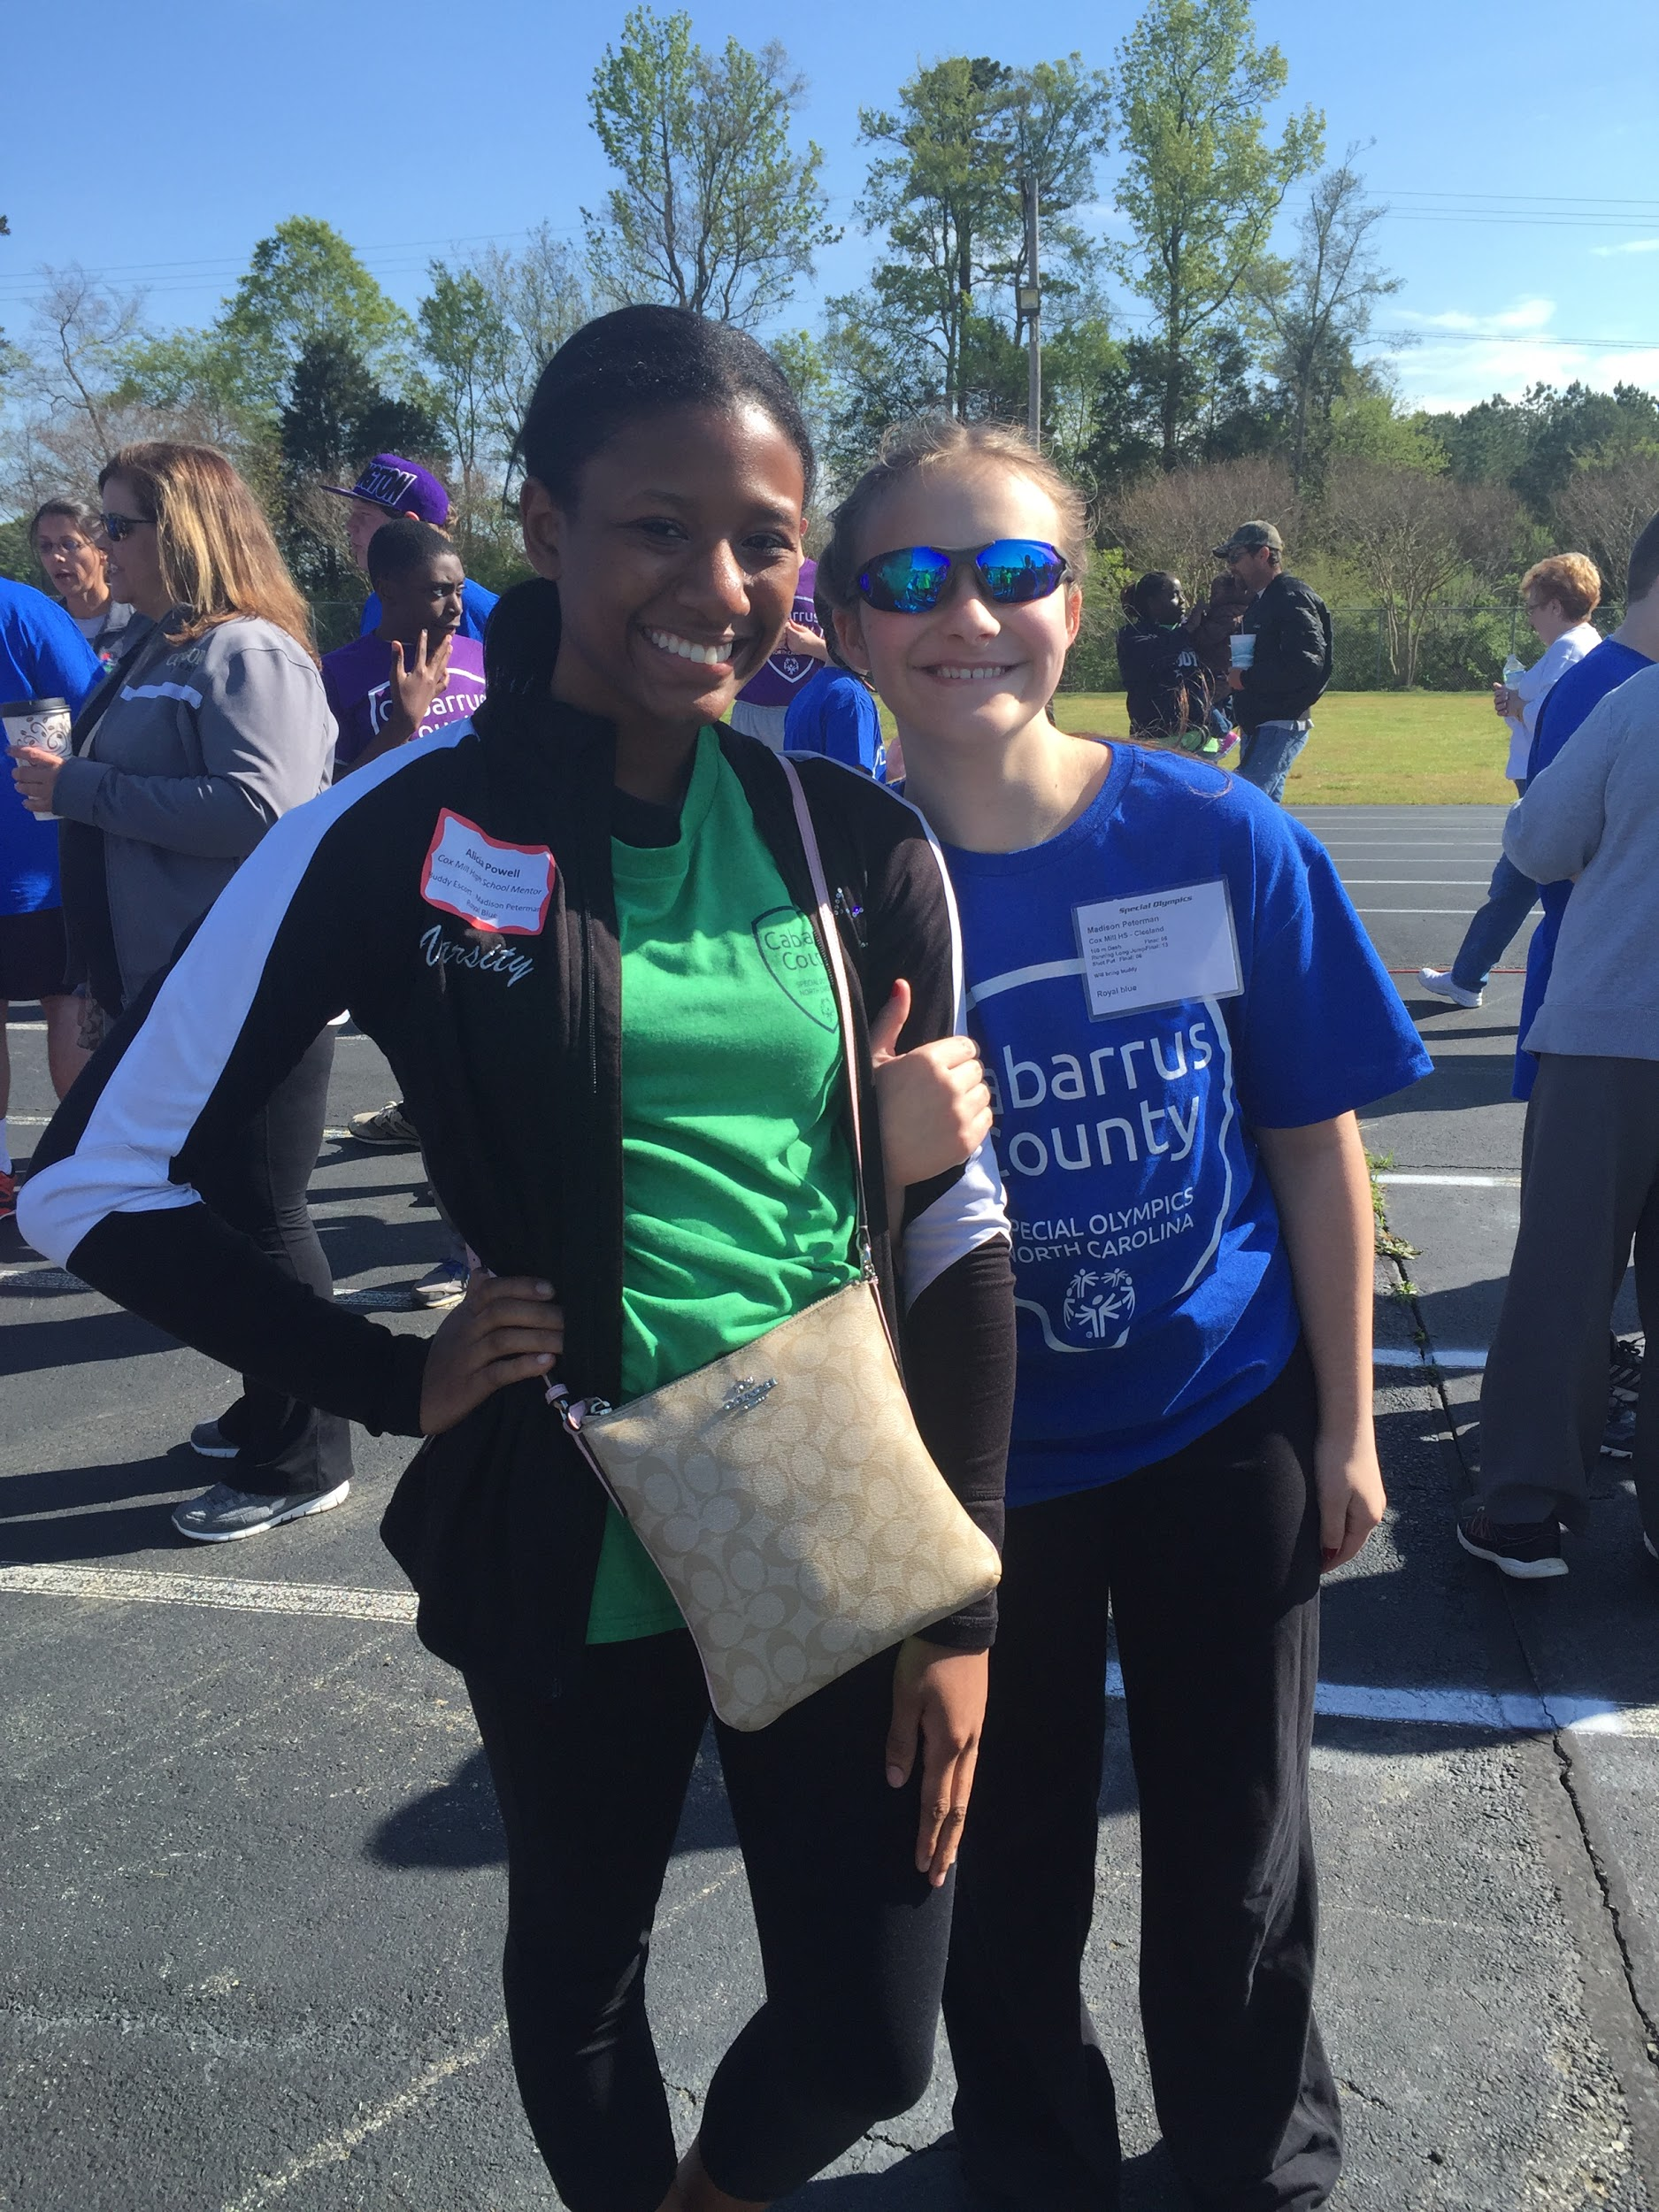
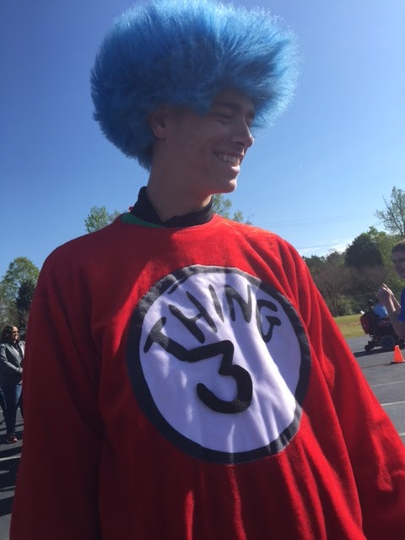
Special Olympics with Cox Mill’s students with mental disabilities

Slide 45
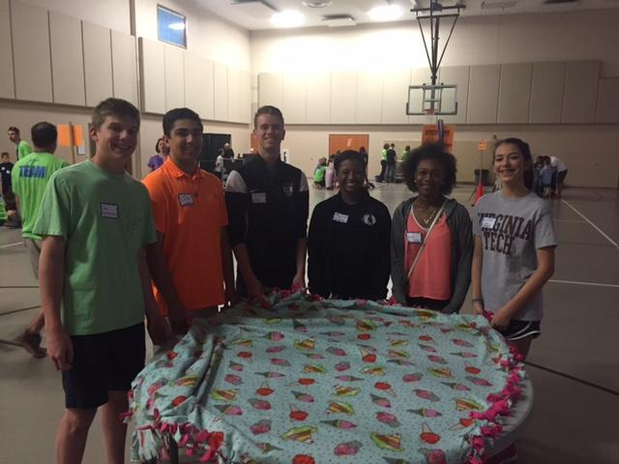
Volunteering at the Connect Church for the Jeff Gordon Children's Hospital patients - making new-sew blankets (I Love My City Event)

Slide 46
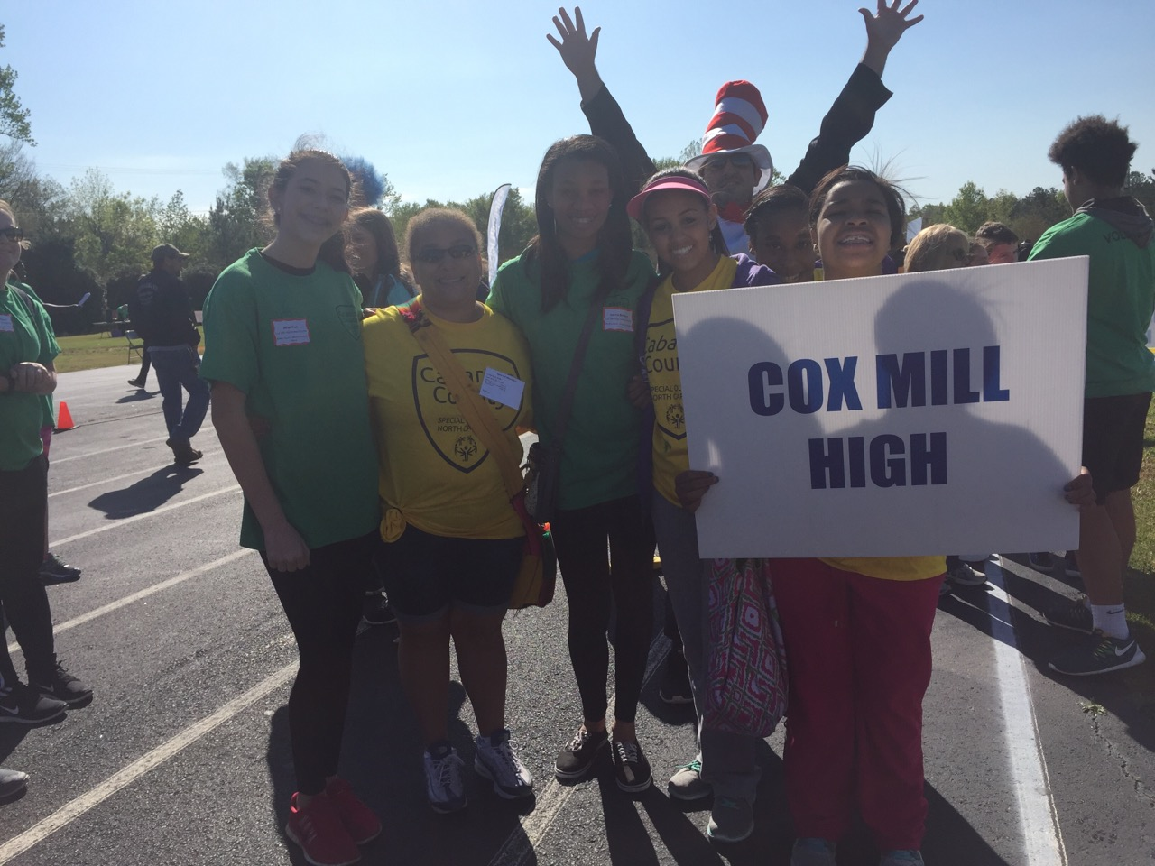

Slide 47
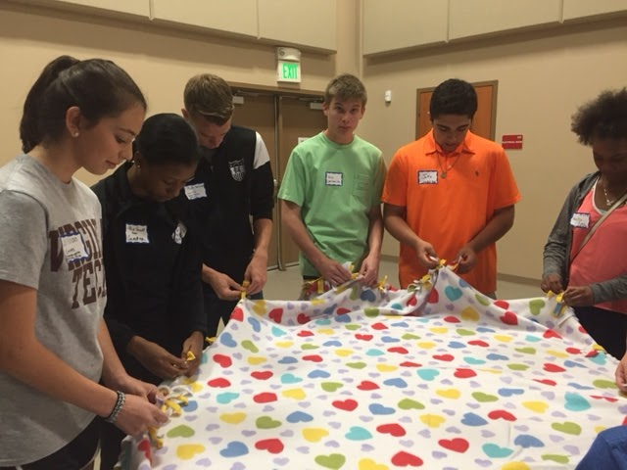
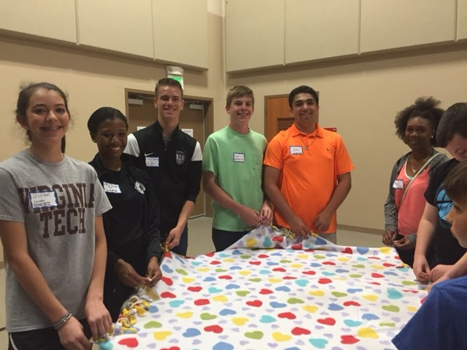

Slide 48
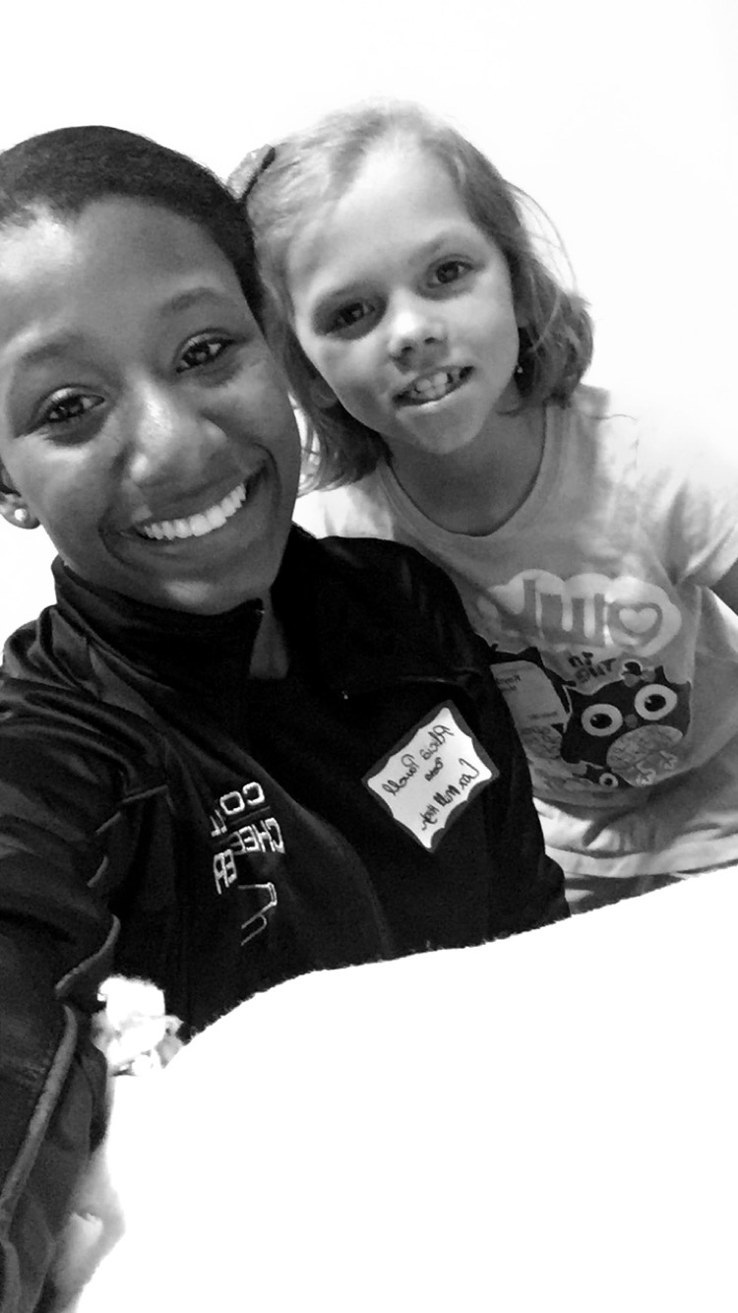
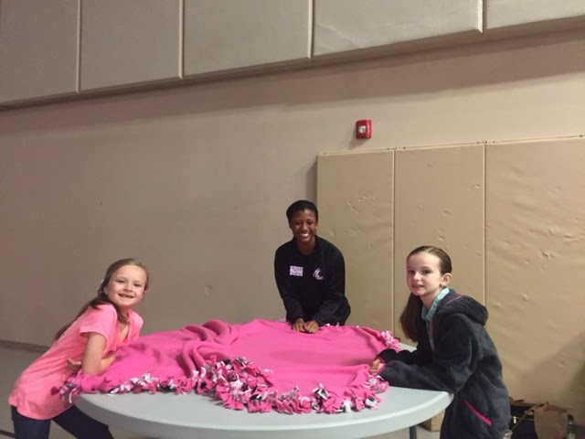

Slide 49
Thank you!

