Slide 1


Human Services Leaders
Notes:
Throughout the history of the Human Service field there are some prime players that influenced human services. From the early days to current days their influence continues to impact people helping people in many ways.

Slide 2
Contributors to the human service field
Anna Y. Reed
Eli Weaver
Ellen Richards
Doris Calloway
James Lind
James Cattell
E.G. Williamson
Carl Pfeiffer
Jane Addams
Notes:
These contributors are diverse in many ways but all had one goal. To aid their fellow human beings in a positive way. We will explore each of their major impacts within the field. (read each name out).

Slide 3
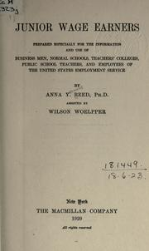
Anna Y. Reed
Author of Junior Wage Earners book. Written in 1920.
Proponent of children’s education and vocational guidance in learning to better employment potential.
Also outspoken in the area of Prison Reform and the need to link prison placement with rehabilitation.
Notes:
Junior Wage Earners book focused on business, the link between industry and schools in employment in the United States. She also collaborated with our next person, Eli Weaver, on idea of career planning.

Slide 4

Eli weaver
Organized teacher guidance committees in every high school in New York.
These committees were designed to help students discover their skills for the most appropriate employment.
Worked with Anna Y. Reed to judge a person’s employability for specific jobs.
Notes:
After reading slide, share that currently most schools have a CDC, Career Development Coordinator, as a result of Weaver’s theories.

Slide 5

Ellen Richards
The founder of the Home Economics, currently known as Family and Consumer Sciences.
First women in history to earn a degree in Chemistry.
First person to link the worlds of science and chemistry to nutrition.
Notes:
Read slide, then share: President Obama recognized Ellen during his Women’s History Month proclamation in March of 2009 as one of four women who worked to save the planet for her work on the need for clean air.

Slide 6

Doris Calloway
American nutritionist from the University of Berkeley, Ca.
Ran the “Penthouse Project”.
Developed the standards of nutrition and worked with NASA to create “space food”. Ever heard of Tang Breakfast Drink?
Notes:
Read slide, share that the Penthouse Project was a study of nutrition on women of different socioeconomic status from those living in the Penthouse to the poor house. Allow reply to Tang question.

Slide 7

James Lind
Scottish physician that fought to improve the hygiene and nutrition of early naval sailors.
Wrote Treatise of the Scurvy about treating the nutritionally related disease of Scurvy.
Introduced the use of citrus fruits, specifically oranges, as a way to protect men at sea from developing Scurvy.
Notes:
Read slide. Ask if anyone has taken Foods class and if so ask what they remember about scurvy. Say: We still teach about the link between citrus fruits and scurvy in our current Foods II classes.

Slide 8
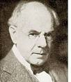
James Cattell
American psychologist that developed what was known as “mental tests”. Those test are known as intelligence measurement tests that are used today.
Believed that inherited as well as environmental influences have an affect on a person’s mental capabilities.
Notes:
Read slide, after that share: In our current Parenting and Child Development course we still discuss heredity and environmental influences and the effect they have on children.

Slide 9

E.G. Williamson
Thought of as one of the Fathers of Counseling.
Expanded counseling beyond its vocational orientation into other areas.
Lead to career opportunities in different types of counseling that we now have today. For example, who is your School Counselor?
Notes:
Read slide, let students answer counselor question. Remind them that they should know who theirs is and how they can help them.

Slide 10
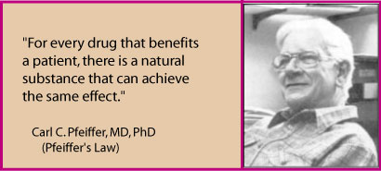
Carl Pfeiffer
American doctor who linked the use of nutrition and biochemistry in aiding mental disorders and disturbances such as those experienced by schizophrenic patients.
Believed that trace minerals and biochemistry play a part in mental stability. This became known as Pfeiffer’s Law.
http://www.whale.to/b/pfeiffer_h.html
Notes:
Read slide. Share: Developed idea that nutrition is a major key to balancing the wellness of not only the body but of mind.
And in Foods II there is study into the affects on minerals and vitamins on our health and that Pfeiffer’s logic helped to establish those links between health and nutrition.

Slide 11
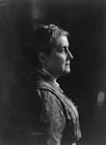
Jane addams
1st American women awarded a Noble Prize for her work involving women and children.
Opened the Hull House.
Is recognized as the founding mother of Social Work as we know it.
Her work in aiding women and children in the areas of health, community and world peace continues today.
Notes:
Read slide. Explain Hull House as a support home for women that was a major influence in aiding women’s rights and suffrage.

Slide 12
Careers
On the back of your graphic organizer, list some of the careers that were influenced by the contributors you have learned about in this PowerPoint.
Photos from www.google.com and www.wikipedia.com
Notes:
Do a Turn and Talk Activity: to share the careers the students have added to their organizer with each other.

