Slide 1
Success in a virtual classroom
Preparing to be an online learner

Slide 2

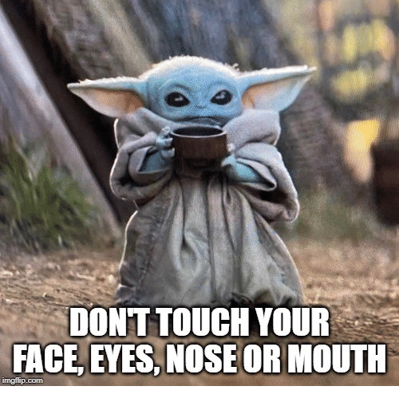
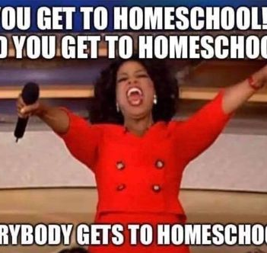


Unchartered waters

Slide 3
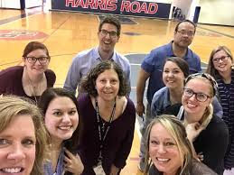
We miss you, so let’s connect
Google classroom
Canvas
Interactive lessons
Big blue button
Virtual classrooms
Microsoft teams
Recorded lessons from your teachers
Live lessons with your teachers

Slide 4

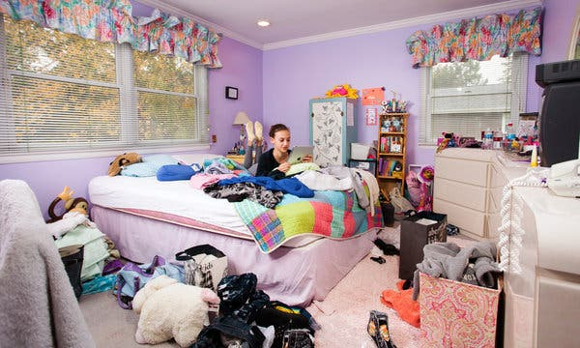
Step 1 establish a place for learning
Do
Don’t

Slide 5
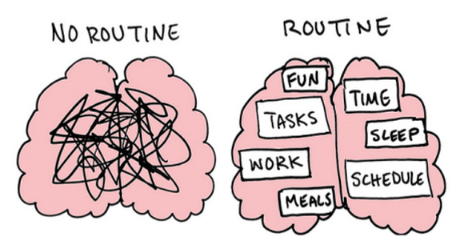
Step 2 Set a Routine

Slide 6


Step 3 Take breaks
Do
Don’t

Slide 7


Step 4 school dress code when live
Do
Don’t

Slide 8
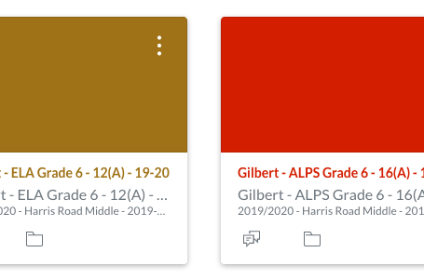
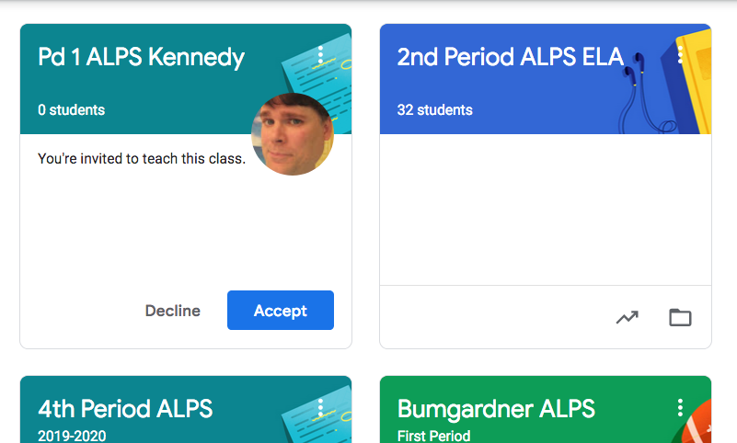
Step 5 Daily Class Checks

Slide 9

Step 6 Use teacher office hours
Teachers are available to respond to emails and/or set up small group support

Slide 10

Step 7 if you need help, ask
Virtual makes it hard for us to know if you are struggling. If you need extra help, just ask!

Slide 11

Step 8 communication must be course related

Slide 12
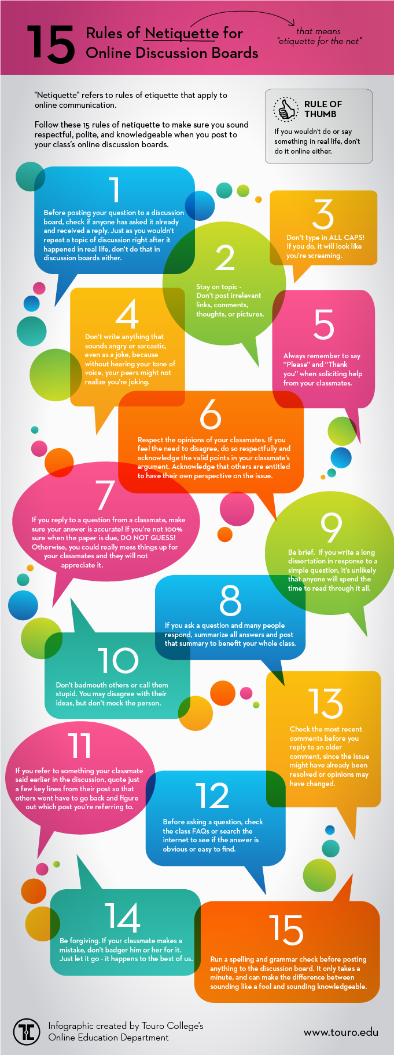
Virtual etiquette
Use chat feature to ask questions
No sidebar conversations during instruction
Mute your mic if receiving live instruction and if the background is noisy
Regular, active participation is required
Communicate in a positive and courteous manner
Student code of conduct applies

