Slide 1
How to Find a Theme
Spring 2012
English I

Slide 2
How to Find a Theme
Find the subject of the story. Connect the subject to the theme (from word to sentence). Remember that the theme makes some revelation about the subject of the story.
  Example: Subject of the story is LOVE.
  Theme might be: “Love is likely to develop when we least expect it.”

Slide 3
(continued)
Think about whether the main character changes in the story or makes a realization. Often a writer expresses the theme through what a character learns.
Think about how the conflict is resolved in the story. It can be a clue to the theme.
Think about the title of the piece. Does it point to a special meaning or a theme?

Slide 4
(continued)
Test your first idea of what the theme is by checking to see if it can apply to the WHOLE story, not just parts of it.
Remember that there are many ways to state a theme. Also, remember that there may be more than one theme in a piece.

Slide 5
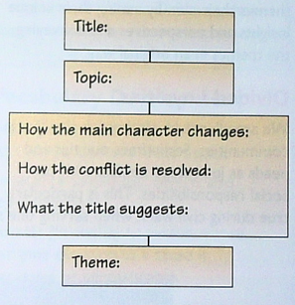
Graphic Organizer… for Determining Theme

Slide 6
Now It’s Your Turn!

