Slide 1
Turf grass Management
Essential Standard 6.00: Understand turf

Slide 2
Turf Grass Regions
The US has six regions or zones based on:
  Climate
  Temperature
  Available Moisture
  Length of growing season
North Carolina has three of the regions/zones
  Mountains and Western Piedmont- Zone 1
  Central and Eastern Piedmont- Zone 2
  Extreme Southeastern Coast- Zone 3

Slide 3
Turf Characteristics
Cool Season grasses
  Grow best in the spring and fall 65-75 degrees
  Stay green in the winter
  Best established in the fall
Warm season grasses
  Grow best in the summer 80-95 degrees
  Go dormant (turn brown) in the winter
  Best established in the spring

Slide 4
Turf Characteristics
Leaf color
  Light to dark green
  Light green
  Medium green
  Medium to dark green
Leaf texture
  Fine- thin needle textured blades
  Medium- medium textured blades
  Coarse- thick, wide textured blades

Slide 5
Turf Characteristics
Growth habit- how new shoots are produced:
  Rhizome- underground stem that grows horizontally
  Stolon- above ground stem that grows horizontally
  Stolon and rhizome- above and underground stems that grow horizontally
  Bunch- blades grow in small cluster or tufts from the soil

Slide 6
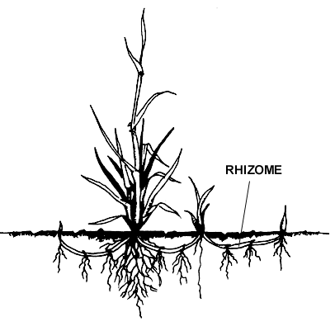
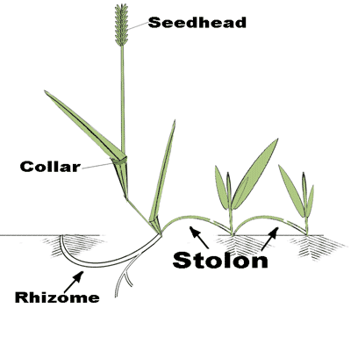
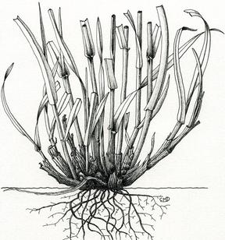
Growth Habits
Bunch

Slide 7
Turf Characteristics
Wear- how the grass stands up to foot traffic
  Excellent
  Very good
  Good
  Fair
  Poor
  Very Poor

Slide 8
Grasses for Lawns

Slide 9
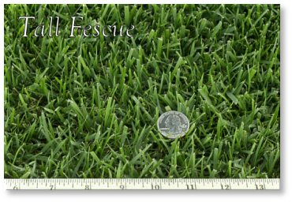
Tall Fescue
Region- 1,2,3
Season- cool
Color- Medium Green
Texture- medium to coarse
Habit- Bunch
Wear- very good
Location- sun, part shade

Slide 10
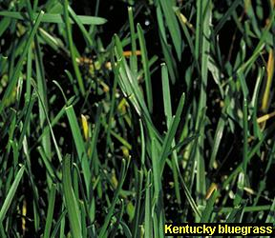
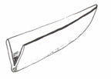
Kentucky Bluegrass
Region- 1, 2
Season- Cool
Color- medium to dark green
Texture- fine to medium
Habit- rhizome
Wear- very good
Location- sun

Slide 11
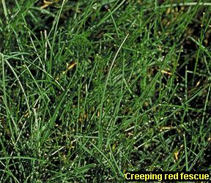
Red Fescue (fine fescue)
Region- 1, 2 (some counties)
Season- Cool
Color- Medium green
Texture- fine
Habit- Rhizome
Wear- fair
Location- shade

Slide 12
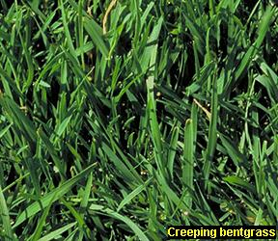
Creeping Bentgrass
Region- 3
Season- Cool
Color- bluish green
Texture- fine
Habit- Stolon
Wear- Poor
Location- Sun
*Special Treatment- Creeping bent requires fans on the golf course greens and frequent watering to keep the seed beds continually moist and cool.

Slide 13
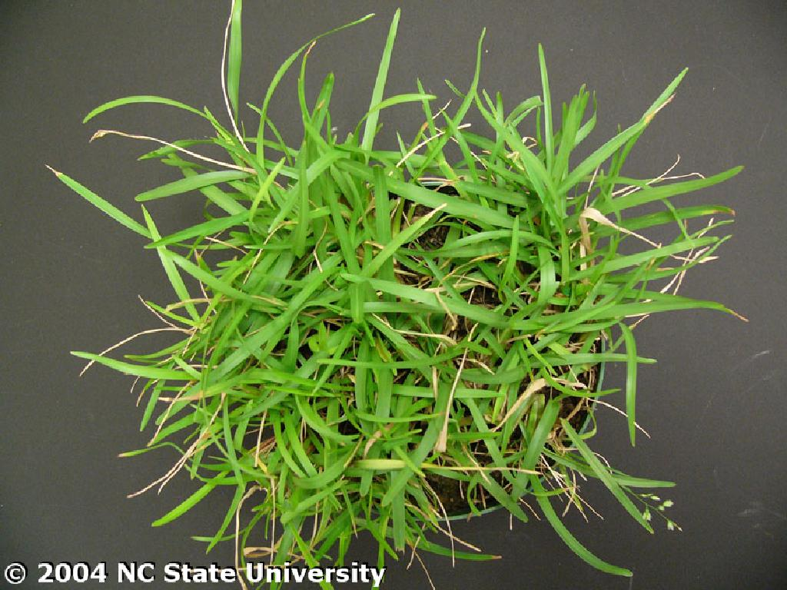
Centipede
Region- 2, 3
Season- Warm
Color- light to dark green
Texture- Medium
Habit- Stolon
Wear- Poor
Location- Sun

Slide 14
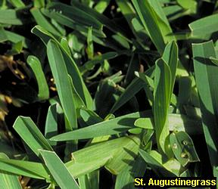
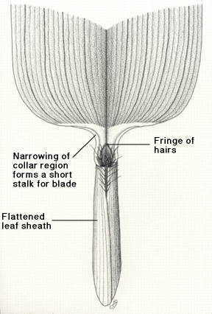
St. Augustine
Region- 2, 3
Season- Warm
Color- Light to dark green
Texture- fine
Habit- Stolon and rhizome
Wear- Excellent
Location- sun

Slide 15
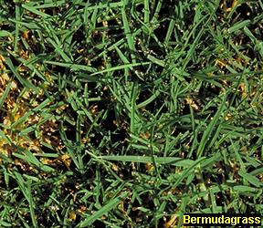
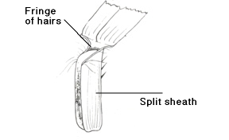
Bermuda
Region- 2, 3
Season- warm
Color- Light to dark green
Texture- Fine
Habit- Stolon and rhizome
Wear- excellent
Location- Sun

Slide 16
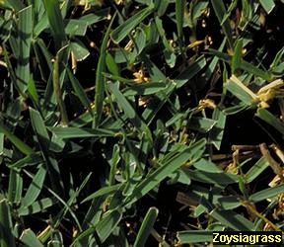
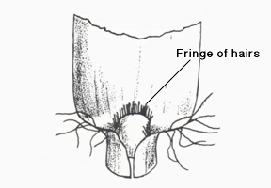
Zoysia
Region- 2,3
Season- Warm
Color- Light to dark green
Texture- Fine
Habit- Stolon and Rhizome
Wear- Good
Location- Sun, part shade

Slide 17
Grasses not used alone for lawns

Slide 18
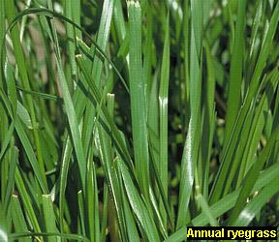
Annual Rye
Over seeding fields and some lawns, never used alone
Region-2
Season- Cool
Color- Light green
Texture- Medium
Habit- Bunch
Wear- Good
Location- Sun

Slide 19
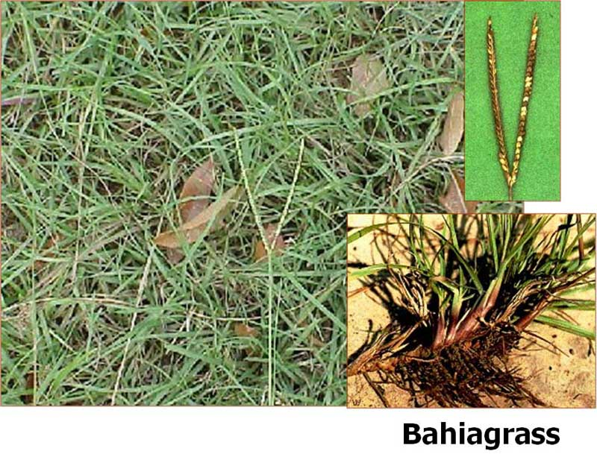
Bahia
Not recommended for lawns, most commonly used for highway grass
Region- 2, 3
Season- Warm
Color- Medium to dark
Texture- coarse
Habit- Rhizome
Wear- Good
Location- Sun

Slide 20
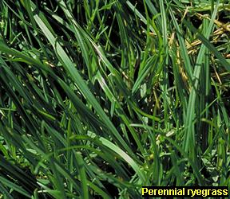
Perennial Rye
Seeded with Kentucky Bluegrass, never alone
Region- 1
Season- Cool
Color- Medium green
Texture- Fine
Habit- Bunch
Wear- Very good
Location- Sun

Slide 21
Principles of Turf grass planting

Slide 22
Turf Grass Site Preparation
Remove trash and debris
Control weeds with herbicide. Spray post-emergence broadleaf herbicides 4-6 weeks before seeding or sodding
Grade avoiding steep slopes, low areas, and poorly drained areas (no more than 15% for mowing safety)
Protect existing trees and bed areas with silt fencing, edged borders or mulch
Incorporate a 2-3% slope away from home or structure

Slide 23
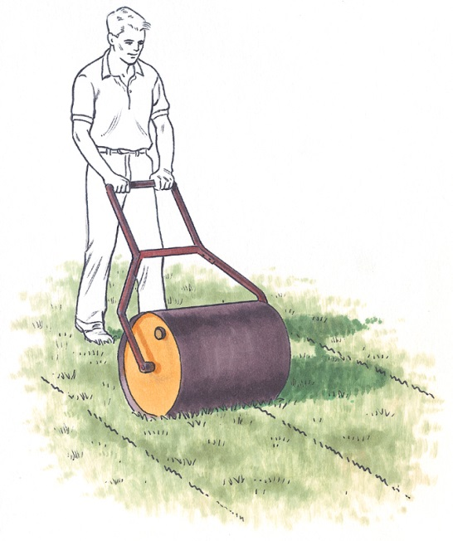
Turf Grass Site Preparation
Soil Preparation
  Till soil to a depth of 2-3”
  Add 4-5” of top soil
  Run a soil test
  Incorporate lime and fertilizer based on soil sample results
  Finish grade
  Roll area with lawn roller
  Water
  Seed or install sod

Slide 24
Methods of Establishing Lawns
Seeding
  Most common and least expensive way to start a lawn
  Seed is sown by hand or with a mechanical device such as a rotary or drop type spreader
  Apply half the seed in one direction and the other half at a 90 degree angle to the first pass
  Roll the soil lightly to ensure good seed to soil contact

Slide 25
Methods of Establishing Lawns
Seeding (cont.)
  Lightly cover the seed with peat moss or weed free straw
  Water to stabilize the seed and peat moss or weed free straw
  Seeding for cool season grasses
    Sept.1st – 15th Piedmont region
    Sept. 15th– Oct. 15th Coastal region
    Aug. 15th – Sept. 1st Mountain Region
    Emergency seeding: Mid Feb. to early March

Slide 26
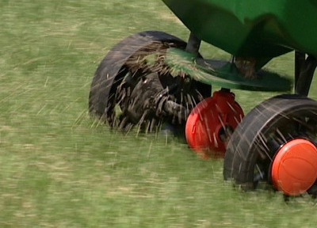
Methods of Establishing Lawns
  Seeding (cont.)
    Seeding for warm season grasses March 1st – July 1st
    Purchase quality seed. Read the label

Slide 27
Methods of Establishing Lawns
Sodding
  Using established turf (grass and roots) that is cut in thin layers and removed from growing area in strips
  It is moved to the new lawn, rolled out and fitted together
  Start the sodding process from a straight edge to ensure uniformity
  Butt strips together and stagger rows in a brick pattern

Slide 28
Methods of Establishing Lawns
Sodding (cont.)
  The new lawn soil should be moist before laying the sod
  Water after installing new sod
  Install the sod within 24 hours to prevent roots from drying out
  Unroll sod if it cannot be laid within 48 hours
  Sodding provides an instant lawn (fastest method of establishment)

Slide 29
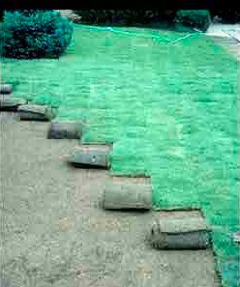
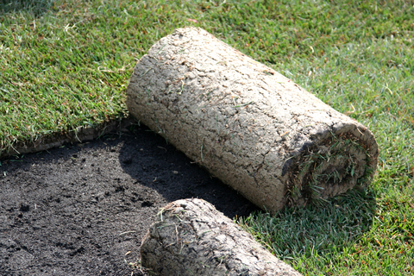
Methods of Establishing Lawns
Sodding (cont.)
  Sodding for cool season grasses- anytime during the cooler times of the growing season
  Sodding for warm season grasses- April- July 1st

Slide 30
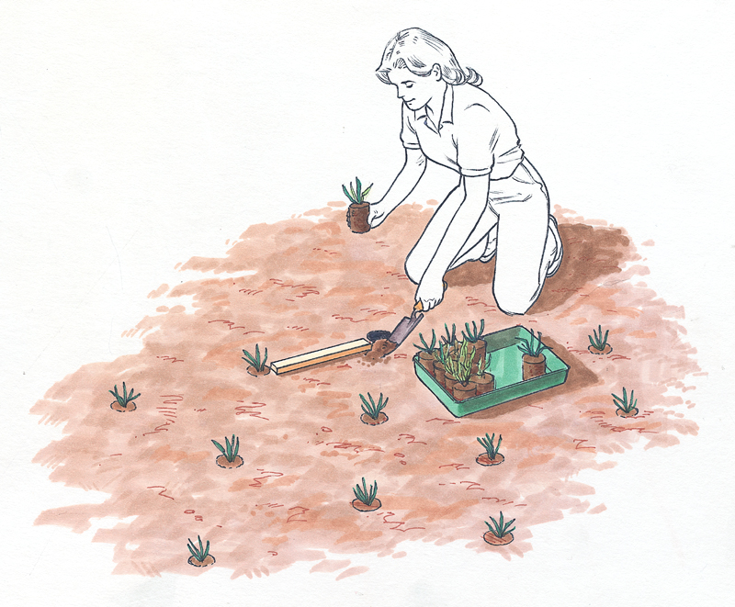
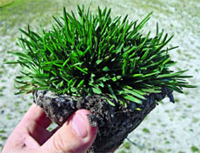
Methods of Establishing Lawns
Plugging
  Uses small plugs or blocks of sod to plant in holes about 6-12” apart
  Very time consuming method of planting
  Common method used for many warm season grasses that are poor seed producers
  Water
  Plugging for warm season grasses April- July 1st

Slide 31
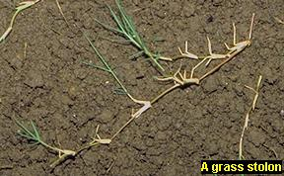
Methods of Establishing Lawns
Sprigging
  Uses plant runners, cuttings or sprigs (cut stems)
  Sprigs are rolled or pressed into the top ½ to 1” of soil
  Water
  Sprigging is usually used on larger areas such as golf courses
  Sprigging for warm season grasses March 1st- July

Slide 32
Care for newly established Lawns
Irrigating
  Keep the top 1.5” of soil moist by watering 2 to 3 times a day for the first 7-21 days
  Water early in the morning to reduce the risk of disease and water loss
  Water established lawns 2-3 times a week ½” each watering
  Should be moist 6-8”
  to encourage good
  root development

Slide 33
Care for newly established Lawns
Mowing
  Mow when grass is 50% higher than the desired height
  Mow to the suggest height for the type of grass you have planted
  Mow when the grass is dry with a sharp, clean blade

Slide 34
Care for newly established Lawns
Grass | Mowing height
Tall fescue | 2.5- 3.5 inches
Kentucky bluegrass | 1.5-2.5 inches
Red fescue | 1.5-2.5 inches
Creeping Bentgrass | .125-.5 inch
Centipede | 1-1.5 inches
St. Augustine | 2.5-4 inches
Bahia | 2-4 inches
Bermuda | .75-2 inches
Zoysia | .75-2 inches

Slide 35
Care for newly established Lawns
Fertilizing
  Apply fertilizer with a rotary or drop type spreader
  Apply half the fertilizer in one direction and the other half at a 90 degree angle to the first pass
  For seeded lawns, fertilizer 6-8 weeks after seed emerges
  For sodded, plugged, or sprigged, lawns fertilize every 3-4 weeks throughout growing season

Slide 36
Care for newly established Lawns
Pest Control
  Weeds
    Common in newly seeded lawns
    Proper mowing will eliminate most weeds
    Follow directions on a selective herbicide if weeds are an issue

Slide 37
Care for newly established Lawns
Pest Control
  Insects
    Check newly established lawns on a regular basis for insect issues
    Identify and treat as needed

Slide 38
Care for newly established Lawns
Pest control
  Diseases
    Do not overwater newly established lawns as this can cause diseases
    Hot summer weather can also cause disease issues
    Identify and treat as needed

Slide 39
Grass seed Terminology
Viable- the ability to germinate
Inert ingredients- stems and/or other plant products that is not viable
Weed seed- any seed not defined as a component in “other crop”
Noxious weed- invasive, hard to control weed seed

