Slide 1
Conducting a Business Meeting
Objective:
Understand parliamentary procedure

Slide 2
Conducting A Business Meeting

Slide 3
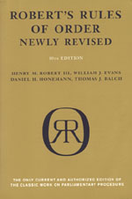
What is Parliamentary Procedure?
Parliamentary procedure is a systematic way of organizing meetings.
Parliamentary procedure is governed by Robert’s Rules of Order.

Slide 4
Parliamentary Law
Robert’s Rule of Order
  Rules for conducting a meeting
  Assures that all sides are treated fairly and that everyone has the opportunity to discuss and vote

Slide 5
Parliamentary Law
Main Objective:
  Focus on one item at a time
  Extend courtesy to everyone
  Observe the rule of the majority
  Ensure the rights of the minority

Slide 6
Methods of Voting
Voice
Rising
Secret Ballot
Roll Call

Slide 7
Voting
Simple majority
  one vote more than 50% of the votes cast
Two-thirds majority
  2/3 of the members must be for the motion
  usually used when the rights of the members are limited

Slide 8
Voting
Quorum
  number of members required to conduct business

Slide 9
Gavel
Symbol of authority
Meaning of the taps
  1 tap means to be seated
  2 taps means the meeting is called to order
  3 taps means that members should stand
  Series of taps
    “be quite and orderly”

Slide 10
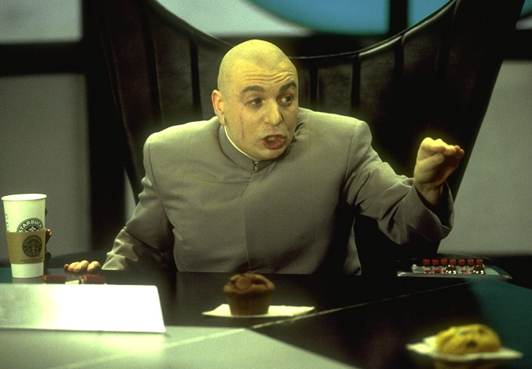
Presiding Officer
Chapter FFA President
Must be fair and impartial
Must relinquish the chair when the president desires to discuss business

Slide 11
Motions

Slide 12
Table of Motions
Highest
Privileged
Incidental
Subsidiary
Unclassified
Lowest

Slide 13
Main Motion
Used to get group approval for a new project or some other course of action
Wording: “I move” NOT “I make a motion”

Slide 14

Main Motion
Requires second
Debatable
Amendable
Majority vote required
Can be reconsidered

Slide 15
Amendments
Used to change a main motion
3 ways to amend: addition, substitution, striking out
Wording: “I move to amend the motion”

Slide 16

Amendments
Requires second
Debatable
Amendable
Majority vote required
Can be reconsidered

Slide 17
Adjourn
Used to end a meeting
Wording: “I move to adjourn”

Slide 18

Adjourn
Cannot be debated
Cannot be amended
Cannot be reconsidered
Requires second
Requires majority vote

Slide 19
Appeal
Changes a decision made by the chair
Wording: “I appeal the decision of the chair”

Slide 20

Appeal
Requires a second
Debatable
Can be reconsidered
Not amendable
Majority vote required

Slide 21
Point of Order
Used when one believes a parliamentary error has been made
Wording: “I rise to a point of order”

Slide 22

Point of order
Not debatable
Amendable
Does not require second
Cannot be reconsidered
No vote required

Slide 23
Division of the House
Calls for a counted vote
Wording: “I call for a division of the house.”

Slide 24

Division of the House
Not debatable
Amendable
Does not require second
Cannot be reconsidered
No vote required

Slide 25
Lay on the table
To postpone a motion to the next meeting
Motion must be taken from the table at the next meeting to be discussed
Wording: “I move to lay this motion on the table”

Slide 26

Lay on the table
Requires second
Not debatable
Not amendable
Cannot be reconsidered
Majority vote

Slide 27
Previous question
Used to stop debate and vote
Wording: “I move to previous question”

Slide 28

Previous question
Second required
Not debatable
Not amendable
Can be reconsidered before vote
2/3 vote required

Slide 29
Refer to committee
Used to gain more information on a motion before voting
Wording: “I move to refer this motion to a committee to report at our next meeting.”

Slide 30

Refer to committee
Second required
Debatable
Amendable
Can be reconsidered
Majority vote

Slide 31
Suspend the Rules
Allows Members to do something it needs to do that it cannot do with out suspending the rules.
Wording: “ I move to suspend the rule ______”

Slide 32
Suspend the Rules
Requires a second
Requires 2/3 majority vote
Cannot be debated
Cannot be amended
Can be reconsidered

Slide 33
Extend or Limit Debate
Allows members to limit or extend debate to a specified time frame. .
Wording: “I move to extend/limit debate by ___________________”

Slide 34
Extend or Limit Debate
Requires a second
Requires a 2/3 majority vote
Cannot be debated
Can be amended
Can be reconsidered

