Slide 1
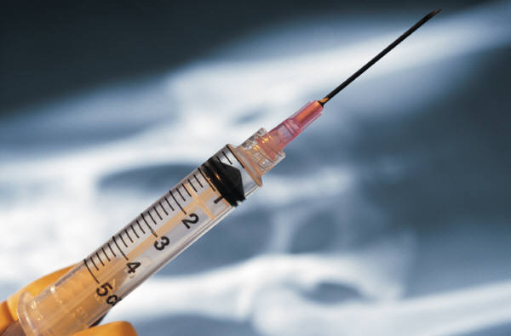
Heroin

Slide 2
What is Heroin?
Heroin is a narcotic that is highly addictive; It is processed from morphine, a naturally occurring substance extracted from the seedpod of the Asian poppy plant.
The most abused and most rapidly acting of the opiates.
Usually seen as a white or brown powder or as a black sticky substance. The differences in color are due to impurities left from the manufacturing process or the presence of additives.
Pure heroin, which is a white powder with a bitter taste, is rarely sold on the streets.
Sometimes cut with other substances such as sugar, powdered milk, cornstarch, or even poisons like strychnine.

Slide 3
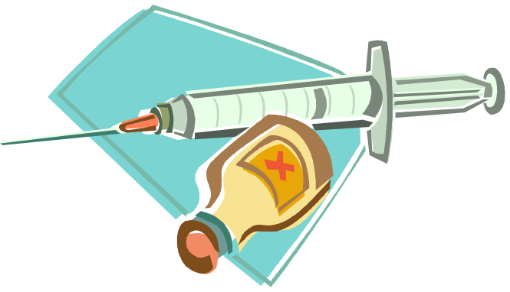
Street Names
H
Smack
Junk
Horse
China white
Black tar
Brown
skag

Slide 4
Methods of Use…
In the past heroin was mostly injected but in recent years it has been made in forms that can be smoked or snorted.
The user feels the effect of heroin within seconds of taking it. Heroin is converted into morphine when it enters the brain, which disrupts normal brain activity and creates intense feelings of pleasure.

Slide 5

Short Term Effects
Euphoria
Warm flushing of the skin
Dry mouth
Heavy extremities
Decreased mental ability
Insensitivity to pain
Vomiting
Lowered breathing
Lowered heart rate
DEATH

Slide 6
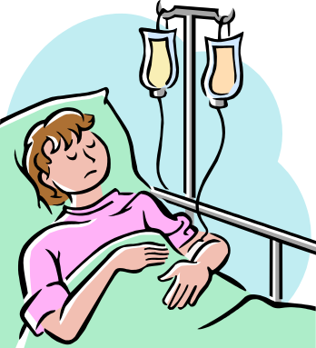
Long Term Effects
Addiction
High degree of tolerance
Brain damage
Arthritis
Liver disease
Infection of the heart lining
HIV/AIDS or hepatitis
Abscesses of the skin (at injection sites)
DEATH

Slide 7

Withdrawal
Heroin causes severe physical and psychological symptoms 6 to 8 hours after the last dosage. Painful withdrawal gets worse as time passes.
Symptoms Include:
  Runny nose muscle and bone pain
  Emotional distress and restlessness
  Diarrhea
  Vomiting
  Hot flashes and heavy sweating
  Cold flashes with goose bumps
  Insomnia
  An overwhelming need for more heroin

Slide 8
Heroin Facts
In 1999, there was an estimated 104,000 new heroin users. Among these new users, 87,000 were between the ages of 12 and 25.
About 80,000 people are newly addicted to heroin yearly. 14 % of all drug-related emergency room visits involve heroin.
20 % of alcohol and drug-related suicides are heroine users.
Heroine is responsible for nearly 40% of deaths caused solely by a single drug.

