Slide 1
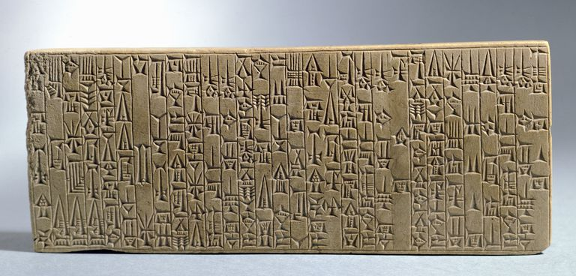

Slide 2
directions
Get into groups of 3 or 5 (Odd!)
You and your group are going to hear some cases and must administer a ruling.
You may chose ANY punishment, result, or just dismiss the case. You are the judge.

Slide 3
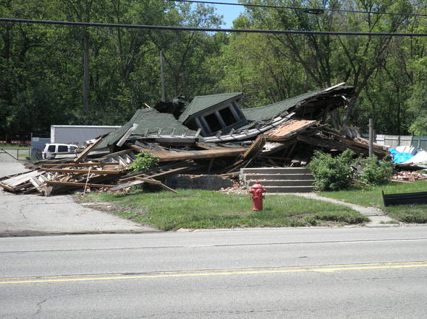
Case #1
A carpenter has built a house for a man who has just moved to town. A month after he sells the house, the roof collapses and the owner is killed.
Has there been any wrongdoing in this case? Is a punishment necessary?

Slide 4

Hammurabi says…
“If a builder builds a house for a man and does not make its construction sound, and the house which he has built collapses and causes the death of the owner of the house, the builder shall be put to death.”

Slide 5

Case #2
A man has borrowed money from a creditor and cannot pay him back.
Has there been any wrongdoing in this case? Is a punishment necessary?

Slide 6

Hammurabi says…
“If a man be in debt and is unable to pay his creditors, he shall sell his wife, son, or daughter, or bind them over to service. For three years they shall work in the houses of their purchaser or master; in the fourth year they shall be given their freedom.”

Slide 7

Case #3
A wife has been neglecting her duties of cleaning the house and has been trash talking her husband.
Has there been any wrongdoing in this case? Is a punishment necessary?

Slide 8

Hammurabi says…
“If the woman has not been careful but has gadded about neglecting her house and belittling her husband, they shall throw that woman into the river.”

Slide 9

Case #4
While arguing about household chores, a teenager slaps his father in the face.
Has there been any wrongdoing in this case? Is a punishment necessary?

Slide 10

Hammurabi says…
“If a son strike his father, his hands shall be cut off.”

Slide 11
Examples of inequality
“If a man has destroyed the eye of a man of the gentleman class, they shall destroy his eye…If he has destroyed the eye of a commoner…he shall pay one mina of silver. If he has destroyed the eye of a gentleman’s slave…he shall pay half the slave’s price.”

Slide 12
Examples of inequality
“If a man knock out the teeth of his equal, his teeth shall be knocked out.”
Committing the same crime against a member of a lower class was punished with only a fine.

Slide 13
Examples of inequality
If a man killed a pregnant “maid-servant,” he was punished with a monetary fine, but if he killed a “free-born” pregnant woman, his own daughter would be killed as retribution.

Slide 14
Examples of inequality
Men were allowed to have extramarital relationships with maid-servants and slaves, but unfaithful women were to be bound and tossed into the Euphrates along with their lovers.

Slide 15
Examples of inequality
Distinguished punishments for each social-class.
Most laws pertained to property rights of landowners, slave masters, merchants, and builders.
Members of the upper-class often received harsher punishments than commoners (Expected to know better).
Women had some rights (Still a patriarchal society).

Slide 16
Assignment
Artistically represent your chosen law on a sheet of white paper.
On the back, answer the following questions:
  In your opinion, were Hammurabi’s punishments fair or were they too harsh? Use specific laws as references.
  Comparing HC with American laws, which is more demanding? What does this say about our values today?

Slide 17
