Slide 1
Warm Up- Analyze the document you were handed on your way in! ☺
Historical Context | What is happening in the time and place of the document? Consider: years, change, events, dispute, or political, cultural, and economic setting.
Intended Audience | Who is the document written to? Consider: politicians, editors, competitors, government officials, public, self, family, friend
Purpose of Author | Why is the author writing the document? What is the motivation? Signal words: intends, contends, prove, reasons, objective, proposes, enlightens, argues, response, persuade, dissuade, defend, criticize
Point of View of Author | What is the point of view of the author? Signal words: support, negate, advocate, agree, disagree, suggest, implies, asserts, illustrates.
Other Context | How does this document explain or support a key concept or a historical argument? Signal words: Exemplifies, connects, demonstrates, supports, accentuates, highlights, clarifies, provides evidence for. Give an example of similar theme in a different place/time period

Slide 2
Period 1: 1491-1607

Slide 3
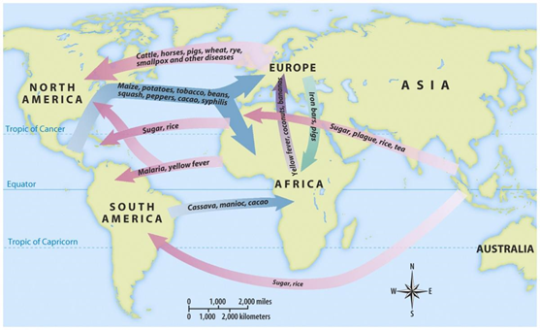
Historical Context
Intended Audience
Purpose of Author
Point of View of Author
Other Context

Slide 4
“’The discovery of America,’ the Scottish writer Adam Smith announced…was one of the “two greatest and most important events recorded in the history of mankind.”…It is not surprising that looking back nearly three centuries after the initial voyage of Christopher Columbus in 1492, Smith focused primarily on the economic results of the conquest and colonization of North and South America. The influx of goods from the New World, he insisted, greatly increased the “enjoyments” of the people of Europe and the market for European goods. Nonetheless, Smith did not fail to note the price paid by the indigenous population of the New World… ‘Benefits’ for some, Smith observed, went hand in hand with the ‘dreadful misfortunes’ for others…”
- Eric Foner, Voices of Freedom: A Documentary History Vol. I, 2014
Historical Context
Intended Audience
Purpose of Author
Point of View of Author
Other Context

Slide 5
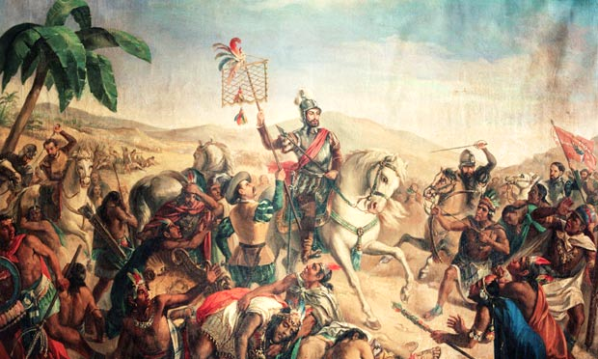
Historical Context
Intended Audience
Purpose of Author
Point of View of Author
Other Context
Source: Aztecs under attack: Hernan Cortez. Retrieved from http://www.theguardian.com

Slide 6
"Concerning the treatment of Native American workers:
When they were allowed to go home, they often found it deserted and had no other recourse than to go out into the woods to find food and to die. When they fell ill, which was very frequently because they are a delicate people unaccustomed to such work, the Spaniards did not believe them and pitilessly called them lazy dogs, and kicked and beat them; and when illness was apparent they sent them home as useless, giving them some cassava for the twenty-to eighty­ league journey. They would go then, falling into the first stream and dying there in desperation; others would hold on longer, but very few ever made it home. I sometimes came upon dead bodies on my way, and upon others who were gasping and moaning in their death agony, repeating 'Hungry, hungry."'
-Bartolome de Las Casas, priest and social reformer, In Defense of the Indian, c. 1550
Historical Context
Intended Audience
Purpose of Author
Point of View of Author
Other Context

Slide 7
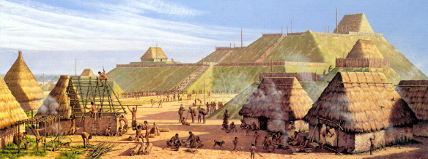
Cahokia Mounds, upper Mississippi Valley, mid-15th century.
Historical Context
Intended Audience
Purpose of Author
Point of View of Author
Other Context

Slide 8
"To oppose those hordes of northern tribes, singly and alone, would prove certain destruction. We can make no progress in that way. We unite ourselves into one common band of brothers. We must have but one voice. Many voices makes confusion. We must have one fire, one pipe and one war club. This will give us strength. If our warriors are united they can defeat the enemy and drive them from our land; If we do this, we are safe . . . . And you of the different nations of the south, and you of the west, may place yourselves under our protection, and we will protect you. We earnestly desire the alliance and friendship of you all . . . ."
-Chief Elias Johnson, Legends, Traditions, and Laws of the Iroquois, or Six
Nations, and History of the Tuscarora Indians, 1881
Historical Context
Intended Audience
Purpose of Author
Point of View of Author
Other Context

Slide 9
When it became clear that there was no gold left, the Indians were taken as slave labor on huge estates, known later as encomiendas. They were worked at a ferocious pace, and died by the thousands. By the year 1511, there were perhaps fifty thousand Indians left. By 1550, there were five hundred. A report of the year 1650 shows none of the original Arawaks or their descendants left on the island.
Howard Zinn “Columbus, the Indians, and Human Progress,”
A People’s History of the United States, 1980
Historical Context
Intended Audience
Purpose of Author
Point of View of Author
Other Context

Slide 10
Period 2: 1607-1754

Slide 11
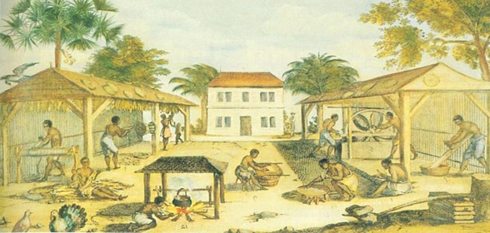
Virginia Tobacco Plantation 1670
Historical Context
Intended Audience
Purpose of Author
Point of View of Author
Other Context

Slide 12
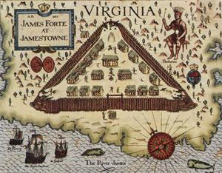
Historical Context
Intended Audience
Purpose of Author
Point of View of Author
Other Context

Slide 13
“Objection 5: But what warrant have we to take that land, which is and has been of long time possessed of others, the sons of Adam?
“Answer: That which is common to all is proper to none. This savage people rule over many lands without title or property; for they enclose no ground, neither have they cattle to maintain it, but remove their dwellings as they have occasion, or as they can prevail against their neighbors. And why may not Christians have liberty to go and dwell amongst them in their waste lands and woods….Secondly, there is more than enough for them and us. Thirdly, God has consumed the natives with a miraculous plague, whereby the greater part of the country is left void of inhabitants. Fourthly, we shall come in with good leave of the natives.”
John Winthrop, General Considerations for the Plantation in New England with an Answer to Several Objections…, 1629
Historical Context
Intended Audience
Purpose of Author
Point of View of Author
Other Context

Slide 14
“The spring is now approaching, it pleased God the mortality began to cease amongst them, and the sick lame recovered… Afterwards they…began to plan their corn, in which service Squanto stood them in great stead, showing them both…how to set it, and after how to dress and tend it…”
~William Bradford, Puritan Governor of Plymouth Colony, A History of Plymouth Plantation
Historical Context
Intended Audience
Purpose of Author
Point of View of Author
Other Context

Slide 15
“…Whereas the enforcing of the conscience in matters of religion has frequently fallen out to be of dangerous consequence in those commonwealths where it has been practiced, and for the more quiet and peaceable government of this Province, and the better to preserve mutual love and amity among the inhabitants thereof. Be it therefore enacted that no person or persons whatever in the Province…professing to believe in Jesus Christ, shall from henceforth be any ways troubled, molested, or discountenanced for or in respect of his or her religion nor in the free exercise thereof within the Province…nor in any way compelled to the belief or exercise of any other religion against his or her consent, so [long] as they not be unfaithful to the Lord Proprietary, or molest or conspire against the civil government established in this Province under him…”
Maryland Act Concerning Religion, 1644
William Hand Browne, ed., Archives of Maryland (Baltimore: Maryland Historical Society, 1883)
Historical Context
Intended Audience
Purpose of Author
Point of View of Author
Other Context

Slide 16
October 1670-ACT XII. What time Indians to serve.
[This law created an additional distinction between African Americans and Native Americans. It was an attempt to make lifetime servitude the normal condition for all Africans imported into Virginia. The legislators repealed this statute in November 1682.]
WHEREAS some dispute have arisen whither Indians taken in war by any other nation, and by that nation that taketh them sold to the English, are servants for life or term of years, It is resolved and enacted that all servants not being Christians imported into this colony by shipping shall be slaves for their lives; but what shall come by land shall serve, if boys or girls, until thirty years of age, if men or women twelve years and no longer.
-The House of Burgesses on Slavery 1670
Historical Context
Intended Audience
Purpose of Author
Point of View of Author
Other Context

Slide 17
“Loving and kind father and mother:
“…this is to let you understand that I your Child am in a most heavy case by reason of the nature of this Country [which] is such that it causeth much sickness.…And when we are sick there is nothing to comfort us; for since I came out of the ship, I never ate anything but peas, and loblollie (that is water gruel)….There is indeed some fowl, but we are not allowed to go, and get it, but must work hard both early and late for a mess of water gruel, and a mouthful of bread, and beef.…[I]f you did know as much as I, when people cry out day, and night—Oh that they… would not care to lose any limb to be in England again….And I have nothing to comfort me…I have nothing at all—no, not a shirt to my back but two rags, nor no clothes but one poor suit….My cloak is stolen by one of my own fellows, and to his dying hour [he] would not tell me what he did with it; but some of my fellows saw him buy butter and beef from a ship, which my cloak, [no] doubt, paid for….And he [Mr. Jackson] much marveled that you would send a servant to the Company; he saith that I had been better knocked on the head. And indeed so I find it now, to my great grief and misery; and saith if you love me you will redeem me suddenly, and for which I do entreat and beg. And if you cannot get the merchants to redeem me for some little money, then for God’s sake get a gathering or entreat some good folks to lay out some little sum of money in meal and cheese and butter and beef.”
Letter from Richard Frethorne, indentured servant, to his parents in England, 1623
Historical Context
Intended Audience
Purpose of Author
Point of View of Author
Other Context

Slide 18
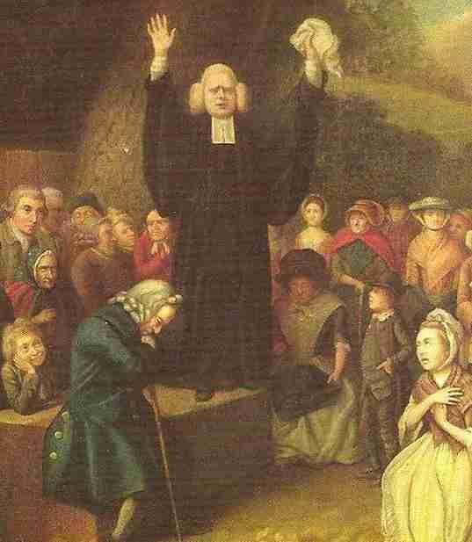
John Collet, George Whitefield Preaching¸18th Century
Historical Context
Intended Audience
Purpose of Author
Point of View of Author
Other Context

Slide 19
“We have no way of knowing how many of the colonists were devoted Calvinists, for no one took a census of beliefs. Yet common sense instructs us that religion (or the church) attracts not only a committed core, but also others who, like “horse-shed” Christians, limit their commitment…New England…had its “dark corners of the land,” the places or the groups of people that were less affected by religion and less likely to want clergy. The fishermen of Gloucester, Massachusetts, made life difficult for Richard Blinman, who arrived as a town minister in 1642. And, as told by Cotton Mather, a minister in some unnamed coastal village urged on his audience a more active practice of religion, lest otherwise they “contradict the main end of planting this wilderness!” Thereupon, a local resident cried out: “Sir, you think you are preaching to the people at the Bay; our main end was to catch fish.”
David D. Hall, Worlds of Wonder, Days of Judgment, 1989
David D. Hall, Worlds of Wonder, Days of Judgment: Popular Religious Beliefs in Early New England (New York: Alfred A. Knopf, 1989)
Historical Context
Intended Audience
Purpose of Author
Point of View of Author
Other Context

Slide 20
“In the name of God, Amen. We . . . the loyal Subjects of our dread sovereign Lord King James . . . Having undertaken for the glory of God, and advancement of the Christian Faith, and honor of our King and Country, a Voyage to plant the first Colony in the Northern parts of Virginia; do by these presents solemnly and mutually, in the presence of God and one another, covenant, and combine ourselves together into a civil body politick, for our better ordering and preservation and furtherance of the ends aforesaid . . . do enact . . . such just and equal Laws, Ordinances, acts, constitutions, and offices from time to time, as shall be thought most meet and convenient for the general good of the Colony; unto which we promise all due submission and obedience.”
The Mayflower Compact, 1620
Historical Context
Intended Audience
Purpose of Author
Point of View of Author
Other Context

Slide 21
“One answer, given by the leaders of the colony, is that the settlers included too many ne’er-do-wells and too many gentlemen who “never did know what a dayes work was.” Hard work had to wait until harder men were sent. Another answer may be that the Jamestown settlers were debilitated by hunger and disease….[or], [o]nce land was distributed to individuals and men were allowed to work for themselves, they gained the familiar incentives of private enterprise….These explanations are surely all valid….[b]ut they do not reach to a dimension of the problems that contemporaries would have overlooked….[t]hey do not tell us what ideas and attitudes about work, carried from England, would have led English settlers to expect so little of themselves in a situation that demanded so much.”
--Edmund S. Morgan, The Labor Problem at Jamestown, 1607-18 (1971).
Historical Context
Intended Audience
Purpose of Author
Point of View of Author
Other Context

Slide 22
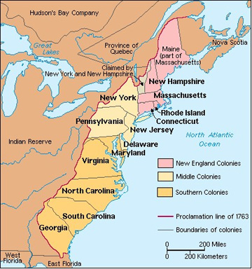
Historical Context
Intended Audience
Purpose of Author
Point of View of Author
Other Context

Slide 23
“Colonial America also had regional differences among culture or historical reason for establishment as a colony. The Southern colonies were established as economic ventures and were seeking natural resources to provide material wealth to the mother country and themselves. In contrast, the early New England colonists were primarily religious reformers and separatists. They were seeking a new way of life to glorify God and for the greater good of their spiritual life. The Middle colonies welcomed people from various and diverse lifestyles. The social-political structure included all three varieties: villages, cities, and small farms.”
History and News Media, 2013
Historical Context
Intended Audience
Purpose of Author
Point of View of Author
Other Context

Slide 24
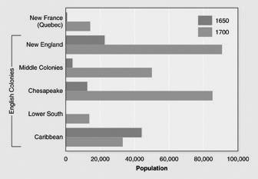
Historical Context
Intended Audience
Purpose of Author
Point of View of Author
Other Context

Slide 25
We cannot in our hearts find one single spot of rebellion or treason or that we have in any manner aimed at subverting the settled government. . . . All people in all places where we have yet been can attest our civil, quiet, peaceable behavior far different from that of rebellion. . . Let us trace . . . the men in authority and favor to whose hands the dispensation of the country's wealth has been committed. Let us observe the sudden rise of their estates . . . compared with the quality in which they first entered this country…Now let us compare these things together and see what sponges have sucked up the public treasure and whether it has not been privately contrived away by unworthy favorites and juggling parasites whose tottering fortunes have been repaired and supported at the public charge.
Nathaniel Bacon's "Manifesto," 1676
Historical Context
Intended Audience
Purpose of Author
Point of View of Author
Other Context

Slide 26
“And it is further enacted by the authority aforesaid, that…no sugars, tobacco, cotton-wool, indigo, ginger, fustic or other dying wood, of growth, production, or manufacture of any English plantations in America, Asia, or Africa, shall be shipped, carried conveyed or transported, from any of the said English plantations to any land, island, territory, dominion, port or place whatsoever, other than to such other English plantations as do belong to his Majesty…under the penalty of the forfeiture of said goods, or the full value thereof, and also the ship, with all her guns, tackle, apparel, ammunition and furniture.”
-The Navigation Act of 1660
Historical Context
Intended Audience
Purpose of Author
Point of View of Author
Other Context

Slide 27
“The Puritan leaders could withstand this rising tide of democracy only by such support as the government would give them—which became increasingly less after the new charter of 1692 took away from the saints all power to select their own governors and divorced the state and church—or else by the sheer force of their personalities. As early as the 1660s and ’70s we can see them beginning to shift their attention from mere exposition of the creed to greater and greater insistence upon committing power only to men of wisdom and knowledge….By the beginning of the eighteenth century the task of buttressing the classified society, maintaining the rule of the well-trained and the culturally superior both in church and society seems to have become the predominate concern of the clergy. Sermon after sermon reveals that in their eyes the cause of learning and the cause of a hierarchical, differentiated social order were one and the same.”
Perry Miller and Thomas H. Johnson, The Puritans, 1938
Perry Miller and Thomas H Johnson, eds. The Puritans (New York: American Book Company, 1938)
Historical Context
Intended Audience
Purpose of Author
Point of View of Author
Other Context

Slide 28
. . . Nor do these unhappy beings, after they become the property of the Europeans (from whom, as a more civilized people, more humanity might naturally be expected), find their situation in the least amended. Their treatment is no less rigorous. The men, on being brought aboard the ship, are immediately fastened together, two and two, by handcuffs on their wrists and by irons rivetted on their legs. They are then sent down between the decks and placed in an apartment partitioned off for that purpose. The women also are placed in a separate apartment between decks, but without being ironed. An adjoining room on the same deck is appointed for the boys. Thus they are all placed in different apartments.
-Alexander Falconbridge, An Account of the Slave Trade on the Coast of Africa, 1788
Historical Context
Intended Audience
Purpose of Author
Point of View of Author
Other Context

Slide 29
We shall find that the God of Israel is among us, when ten of us shall be able to resist a thousand of our enemies; when He shall make us a praise and glory that men shall say of succeeding plantations, "may the Lord make it like that of New England." For we must consider that we shall be as a city upon a hill. The eyes of all people are upon us. So that if we shall deal falsely with our God in this work we have undertaken, and so cause Him to withdraw His present help from us, we shall be made a story and a by-word through the world. We shall open the mouths of enemies to speak evil of the ways of God, and all professors for God's sake.
-John Winthrop, (1630) “A Model of Christian Charity” Sermon
Historical Context
Intended Audience
Purpose of Author
Point of View of Author
Other Context

Slide 30
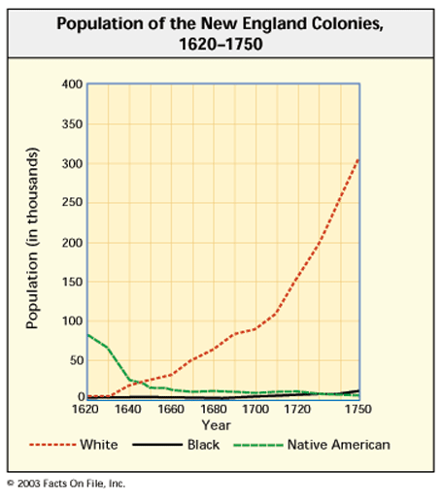
Historical Context
Intended Audience
Purpose of Author
Point of View of Author
Other Context

Slide 31
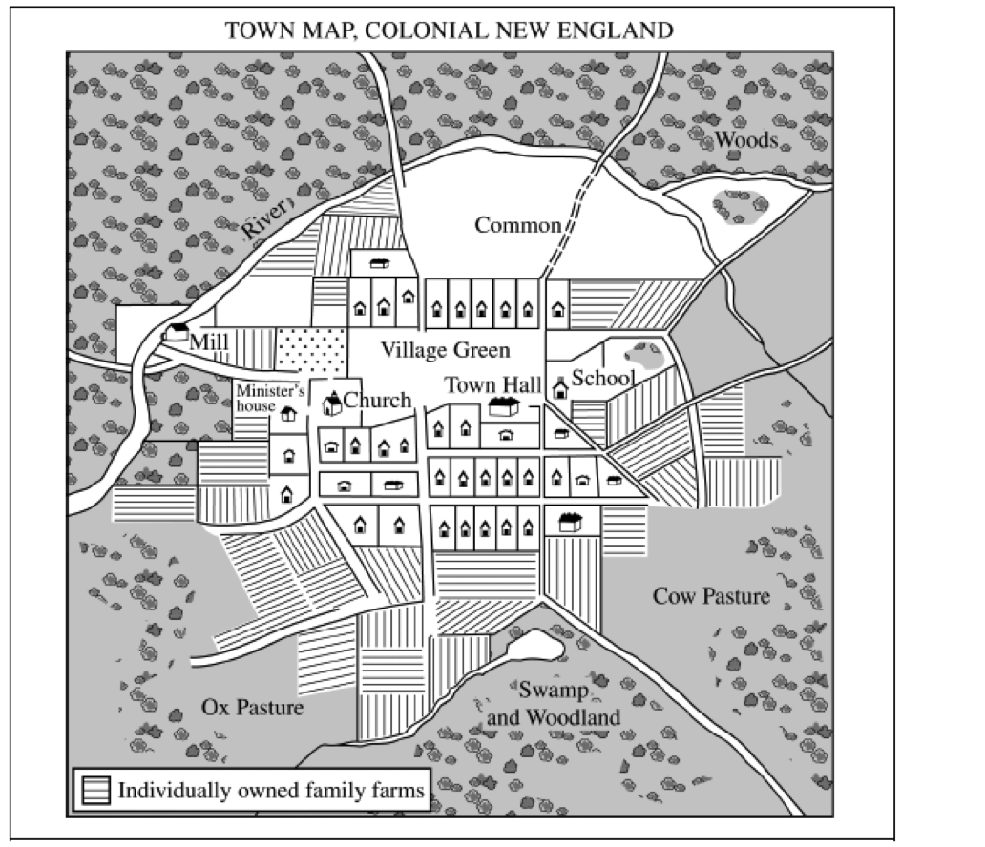
Historical Context
Intended Audience
Purpose of Author
Point of View of Author
Other Context

Slide 32
"In 1739 arrived among us from Ireland the Reverend Mr. [George] Whitefield, who had made himself remarkable there as an itinerant preacher. He was at first permitted to preach in some of our churches; but the clergy, taking a dislike to him, soon refused him their pulpits, and he was obliged to preach in the field. The multitudes of all sects and denominations that attended his sermons were enormous.... It was wonderful to see the change soon made in the manners of our inhabitants. From being thoughtless or indifferent about religion, it seemed as if all the world were growing religious, so that one could not walk through; the town in an evening without hearing psalms sung in different families of every street."
Benjamin Franklin, The Autobiography of Benjamin Franklin
Historical Context
Intended Audience
Purpose of Author
Point of View of Author
Other Context

Slide 33
A brief and plain scheme how the English colonies in the North parts of America,--viz., Boston, Connecticut, Rhode Island, New York, New Jerseys, Pennsylvania, Maryland, Virginia, and Carolina,--may be made more useful to the crown and one another's peace and safety with an universal concurrence.
That the several colonies before mentioned do meet once a year, and oftener if need be during the war, and at least once in two years in times of peace, by their stated and appointed deputies, to debate and resolve of such measures as are most advisable for their better understanding and the public tranquility and safety.
-William Penn, 1697
Historical Context
Intended Audience
Purpose of Author
Point of View of Author
Other Context

Slide 34
Period 3: 1754-1800

Slide 35
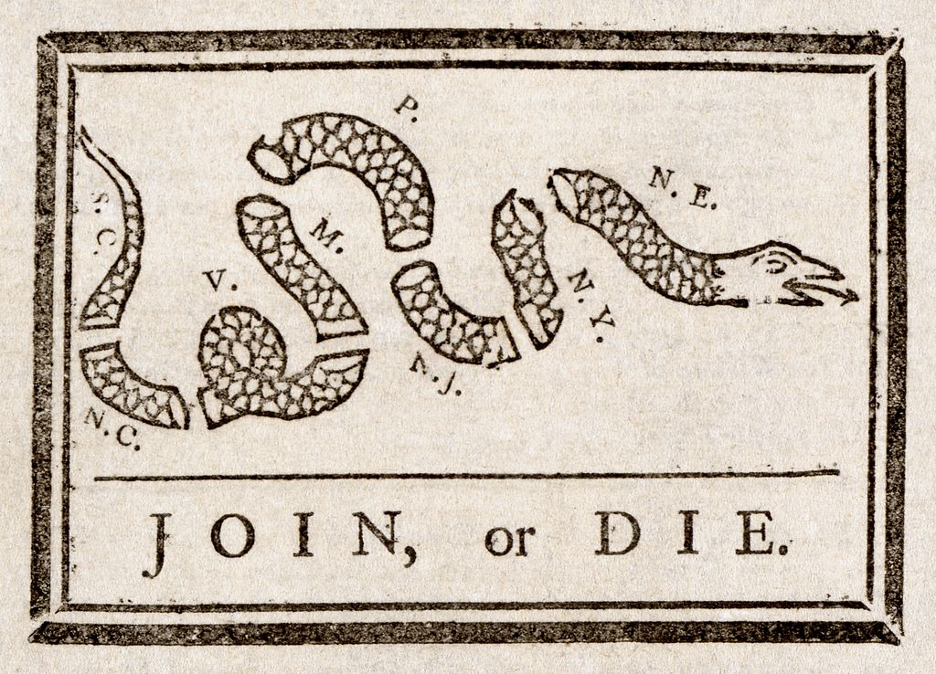
Historical Context
Intended Audience
Purpose of Author
Point of View of Author
Other Context

Slide 36
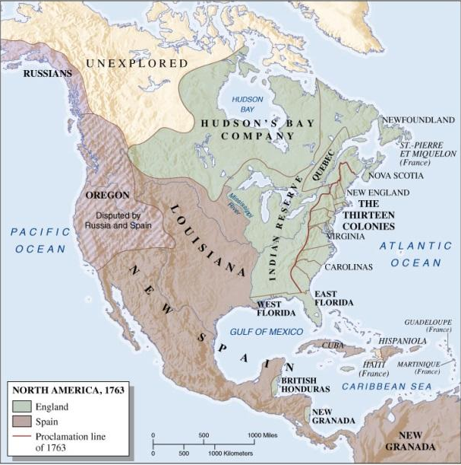
1763
Historical Context
Intended Audience
Purpose of Author
Point of View of Author
Other Context

Slide 37
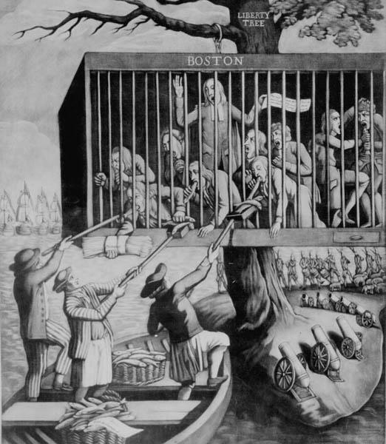
“Bostonians in Distress,” 1774
Historical Context
Intended Audience
Purpose of Author
Point of View of Author
Other Context

Slide 38
Art. 1. No person, demeaning himself in a peaceable and orderly manner, shall ever be molested on account of his mode of worship or religious sentiments, in the said territory.
Art. 6. There shall be neither slavery nor involuntary servitude in the said territory, otherwise than in the punishment of crimes whereof the party shall have been duly convicted: Provided, always, That any person escaping into the same, from whom labor or service is lawfully claimed in any one of the original States, such fugitive may be lawfully reclaimed and conveyed to the person claiming his or her labor or service as aforesaid.
- Northwest Ordinance (1787)
Historical Context
Intended Audience
Purpose of Author
Point of View of Author
Other Context

Slide 39
“It is proposed that humble application be made for an act of Parliament of Great Britain, by virtue of which one general government may be formed in America, including all the said colonies, within and under which government each colony may retain its present constitution, except in the particulars wherein a change may be directed by the said act as hereafter follows….That they make such laws as they judge necessary for regulating all Indian trade….That they raise and pay soldiers, and build forts for the defence of any of the Colonies, and equip vessels of force to guard the coasts and protect the trade on the oceans, lakes, or great rivers; but shall not impress men in any Colony, without the consent of the Legislature. That for these purposes they have power to make laws and lay and leavy such general duties, imposts, or taxes as to them shall appear most equal and just…and such as may be collected with the least inconvenience to the people…”
Albany Plan of Union, 1754
Historical Context
Intended Audience
Purpose of Author
Point of View of Author
Other Context

Slide 40
Therefore, to prevent a calamity which, of all others, is the most to be dreaded- slavery, and its terrible concomitants- we, the subscribers, being influenced from a regard to liberty, and disposed to use all lawful endeavors in our power, to defeat the pernicious project, and to transmit to our posterity, those blessings of freedom which our ancestors have handed down to us; and to contribute to the support of the common liberties of America, which are in danger to be subverted, do, for those important purposes, agree to associate together, under the name and style of the sons of New York, and engage our honor to, and with each other faithfully observe and perform the following resolutions, viz.
1st. Resolved, That whoever shall aid, or abet, or in any manner assist, in the introduction of tea, from any place whatsoever, into this colony, while it is subject, by a British act of parliament, to the payment of a duty, for the purpose of raising a revenue in America, he shall be deemed an enemy to the liberties of America.
-Resolves of the New York Sons of Liberty” adopted on December 15, 1773
Historical Context
Intended Audience
Purpose of Author
Point of View of Author
Other Context

Slide 41
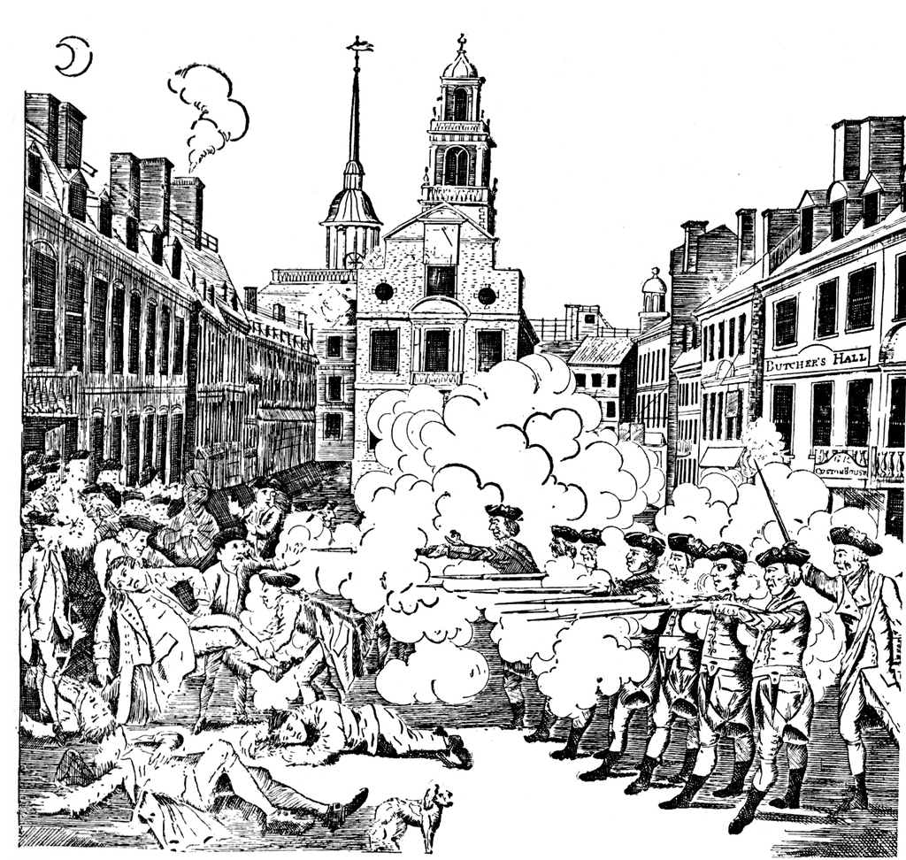
March 5,1770
Historical Context
Intended Audience
Purpose of Author
Point of View of Author
Other Context

Slide 42
“The members of this Congress, sincerely devoted, with the warmest Sentiments of Affection and Duty to his Majesty’s Person and Government…esteem it our indispensable Duty, to make the following Declarations of our humble opinion, respecting the most essential rights and liberties of the Colonists, and of the Grievances under which they labor, by Reason of several late Acts of Parliament….”
“2. That his Majesty’s Liege subjects in these Colonies, are entitled to all the inherent Rights and Liberties of his Natural born Subjects, within the Kingdom of Great Britain.”
“4. That the people of these Colonies are not, and from their local Circumstances cannot be, Represented in the House of Commons in Great-Britain.”
“5. That the only Representatives of the People of these Colonies, are Chosen therein by themselves, and that no taxes…can be…imposed on them, but by their respective Legislature.”
“Lastly, That it is the indispensible Duty of these Colonies…to endeavor by a loyal and dutiful Address to his Majesty, and humble Applications to both Houses of Parliament, to procure the Repeal of the Act for granting and applying certain Stamp Duties…”
“Declarations” of the Stamp Act Congress, signed in New York City, 1765
Historical Context
Intended Audience
Purpose of Author
Point of View of Author
Other Context

Slide 43
... And I do hereby further declare all indented Servants, Negroes, or others, (appertaining to Rebels,) free that are able and willing to bear Arms, they joining His MAJESTY'S Troops as soon as may be, foe the more speedily reducing this Colony to a proper Sense of their Duty, to His MAJESTY'S Crown and Dignity. I do further order, and require, all His MAJESTY'S Liege Subjects, to retain their Quitrents, or any other Taxes due or that may become due, in their own Custody, till such a Time as Peace may be again restored to this at present most unhappy Country, or demanded of them for their former salutary Purposes, by Officers properly authorised to receive the same.
-Dunmore Proclamation (NOVEMBER 7, 1775)
Historical Context
Intended Audience
Purpose of Author
Point of View of Author
Other Context

Slide 44
[W]e have prostrated ourselves before the throne, and have implored its interposition to arrest the tyrannical hands of the ministry and Parliament. Our petitions have been slighted; our remonstrances have produced additional violence and insult; our supplications have been disregarded;... If we wish to be free — if we mean to preserve inviolate those inestimable privileges for which we have been so long contending — if we mean not basely to abandon the noble struggle in which we have been so long engaged, and which we have pledged ourselves never to abandon until the glorious object of our contest shall be obtained — we must fight!
-Patrick Henry’s speech at St. John’s Church in Richmond, Virginia on March 23, 1775
Historical Context
Intended Audience
Purpose of Author
Point of View of Author
Other Context

Slide 45
SECONDARY SOURCE -- Alien and Sedition Acts (1798)
In 1799, several defendants were indicted in Massachusetts for violating the Sedition Act by the erection of a “liberty pole.” The pole had an inscription attached: “No Stamp Act; no Sedition, no Alien-Bill; no Land Tax; Downfall to the Tyrants of America; Peace and Retirement to the President.” A wealthy and well-connected defendant charged only with assisting in the erection of the pole pled guilty and received a small fine plus six hours imprisonment.
- Free Speech, “The People’s Darling Privilege”, Struggles for Freedom of
Expression in American History, Michael Kent Curtis, 2000
Historical Context
Intended Audience
Purpose of Author
Point of View of Author
Other Context

Slide 46
“Govern America as you govern an English town which happens not to be represented in Parliament [?] Are gentlemen really serious when they propose this? Is there a single trait of Resemblance between those few towns, and a great and growing people spread over a vast quarter of the globe, separated from us by a mighty ocean? … The eternal barriers of nature forbid that the colonies should be blended or coalesce into the mass … of this kingdom. We have nothing therefore for it, but to let them carry across the ocean into the woods and deserts of America the images of the British constitution.”
Edmund Burke, “Notes for Speech in Parliament, 3 February 1766”
Historical Context
Intended Audience
Purpose of Author
Point of View of Author
Other Context

Slide 47
“The nearer any government approaches to a republic the less business there is for a king. It is somewhat difficult to find a proper name for the government of England. Sir William Meredith calls it a republic; but in its present state it is unworthy of the name, because the corrupt influence of the crown, by having all the places in its disposal, hath so effectually swallowed up the power, and eaten out the virtue of the house of commons (the republican part in the constitution) that the government of England is nearly as monarchical as that of France or Spain. Men fall out with names without understanding them. For it is the republican and not the monarchical part of the constitution of England which Englishmen glory in, viz. the liberty of choosing an house of commons from out of their own body - and it is easy to see that when republican virtue fails, slavery ensues. Why is the constitution of England sickly, but because monarchy hath poisoned the republic, the crown hath engrossed the commons?”
-Thomas Paine, Common Sense, 1776
Historical Context
Intended Audience
Purpose of Author
Point of View of Author
Other Context

Slide 48
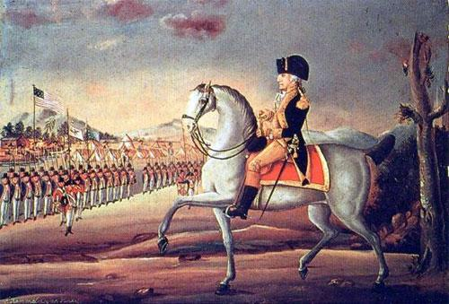
Historical Context
Intended Audience
Purpose of Author
Point of View of Author
Other Context
IMAGE - “Washington Leads Army to Put Down Whiskey Rebellion” John Trumball? 1792?

Slide 49
“Slavery hung over the Philadelphia Convention, threatening to divide northern and southern delegates. Even though slavery existed by law in some of the northern states in 1787, most people there favored its end. Southerners were more unsure about whether to end slavery, both because they had significantly greater numbers of slaves to deal with and because an end to [slavery] had important economic implications. The result was compromise. The Founding Fathers were more determined to fashion a new nation than they were to bring an end to slavery.”
- Kermit Hall, historian, The Law of American Slavery, 1987
Historical Context
Intended Audience
Purpose of Author
Point of View of Author
Other Context

Slide 50
I desire you would Remember the Ladies, and be more generous and favorable to them than your ancestors. Do not put such unlimited power into the hands of the Husbands. Remember all Men would be tyrants if they could. If particular care and attention is not paid to the Ladies we are determined to foment a Rebellion, and will not hold ourselves bound by any laws in which we have no voice, or Representation.
-Abigail Adams to John Adams, March 31, 1776
Historical Context
Intended Audience
Purpose of Author
Point of View of Author
Other Context

Slide 51
“a national debt, if it is not excessive, will be to us a national blessing”
-Alexander Hamilton, 1781
Historical Context
Intended Audience
Purpose of Author
Point of View of Author
Other Context

Slide 52
“A firm union will be of the utmost moment to the peace and liberty of the states, as a barrier against domestic faction and insurrection.”
-Alexander Hamilton
“I am not a friend to a very energetic government. It is always oppressive. It places the governors indeed more at their ease, at the expense of the people.”
-Thomas Jefferson
Historical Context
Intended Audience
Purpose of Author
Point of View of Author
Other Context

Slide 53
“Be it enacted by the General Assembly, that no man shall be compelled to frequent or support any religious worship, place, or ministry whatsoever, nor shall be enforced, restrained, molested, or burthened in his body or goods, nor shall otherwise suffer on account of his religious opinions or belief; but that all men shall be free to profess, and by argument to maintain, their opinion in matters of religion, and that the same shall in no wise diminish, enlarge, or affect their civil capacities.”
-Thomas Jefferson, Virginia Statute on Religious Freedom, 1786
Historical Context
Intended Audience
Purpose of Author
Point of View of Author
Other Context

Slide 54
Congress shall make no law respecting an establishment of religion, or prohibiting the free exercise thereof; or abridging the freedom of speech, or of the press; or the right of the people peaceably to assemble, and to petition the Government for a redress of grievances.
-Amendment I, United States Bill of Rights
Historical Context
Intended Audience
Purpose of Author
Point of View of Author
Other Context

Slide 55
The Constitution Needs a BOR | The Constitution does NOT need a BOR

Slide 56
“If any citizen of the United States, or any other white person or persons, shall presume to settle upon the lands now relinquished by the United States, such citizen or other person shall be out of the protection of the United States; and the Indian tribe, on whose land the settlement shall be made, may drive off the settler, or punish him in such manner as they shall think fit; and because such settlements, made without the consent of the United States, will be injurious to them as well as to the Indians, the United States shall be at liberty to break them up, and remove and punish the settlers as they shall think proper, and so effect that protection of the Indian lands herein before stipulated…”
-Excerpt from the Treaty of Greenville, 1795
Historical Context
Intended Audience
Purpose of Author
Point of View of Author
Other Context

Slide 57
In 1783, Nancy Shippen wrote a journal entry, outlining goals for her daughter’s education.
1st Study well her constitution and genius
2nd Follow nature and proceed patiently
3rd Suffer not servants to terrify her with stories of ghosts and goblins
4th Give her a fine pleasing idea of good, and an ugly frightful one of evil
5th Keep her to a good and natural regimen of diet
6th Observe strictly the little seeds of reason in her, and cultivate the first appearance of it diligently.
-Excerpts from the journal of Nancy Shippen (1783)
Historical Context
Intended Audience
Purpose of Author
Point of View of Author
Other Context

Slide 58
"[H]istory and experience prove that foreign influence is one of the most baneful foes of republican government.... Excessive partiality for one foreign nation and excessive dislike of another cause those whom they actuate to see danger only on one side and serve to veil…the arts of influence on the other.... The great rule of conduct for us, in regard to foreign nations, is in extending our commercial relations to have with them as little political connection as possible. So far as we have already formed engagements, let them be fulfilled with perfect good faith. Here let us stop, Europe has a set of primary interests which to us have none or a very remote relation. Hence she must be engaged in frequent controversies, the causes of which are essentially foreign to our concerns."
-George Washington, Farewell Address, 1796
Historical Context
Intended Audience
Purpose of Author
Point of View of Author
Other Context

Slide 59
Period 4: 1800-1848

Slide 60
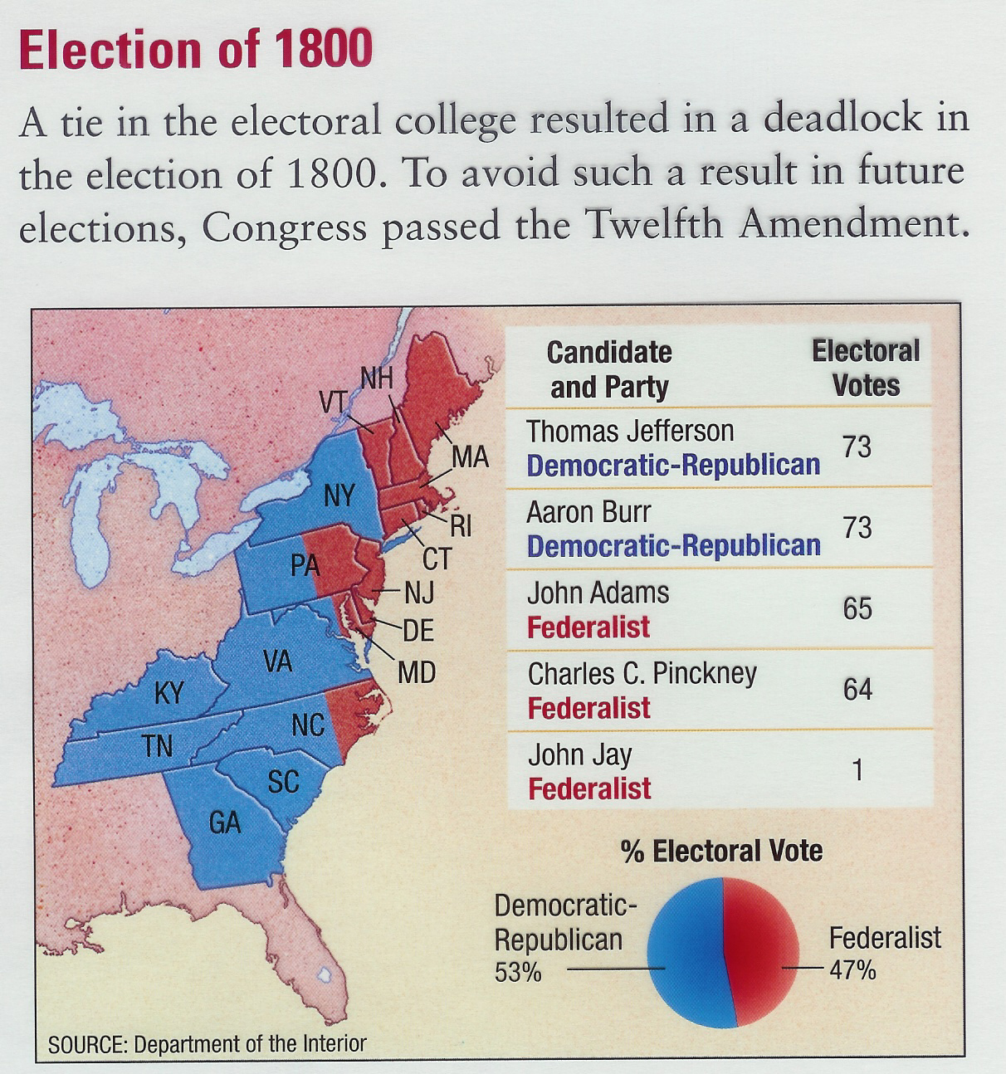
Historical Context
Intended Audience
Purpose of Author
Point of View of Author
Other Context

Slide 61
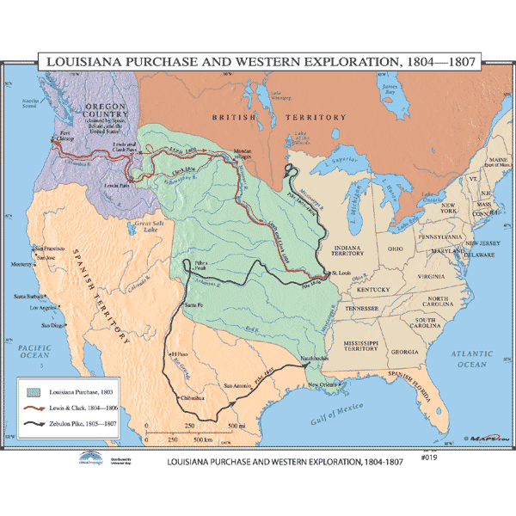
Historical Context
Intended Audience
Purpose of Author
Point of View of Author
Other Context

Slide 62
“…in declaring that shall be the supreme law of the land, the Constitution itself is first mentioned; and not the laws of the United States generally, but those only which shall he made in pursuance of the Constitution, have that rank. Thus, the particular phraseology of the repugnant to the Constitution is void; and that courts, as well as other departments, are bound by that instrument…
Marbury v Madison 1803
Historical Context
Intended Audience
Purpose of Author
Point of View of Author
Other Context

Slide 63
“The history of mankind is a history of repeated injuries and usurpation on the part of man toward woman, having in direct object the establishment of an absolute tyranny over her...”
-From The Declaration of Rights and Sentiments, 1848
Historical Context
Intended Audience
Purpose of Author
Point of View of Author
Other Context

Slide 64
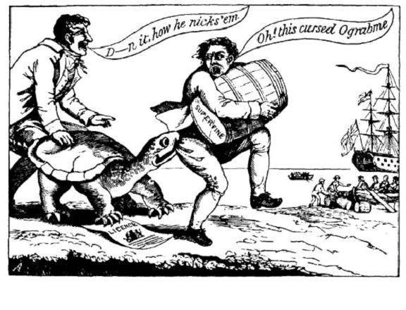
Historical Context
Intended Audience
Purpose of Author
Point of View of Author
Other Context

Slide 65
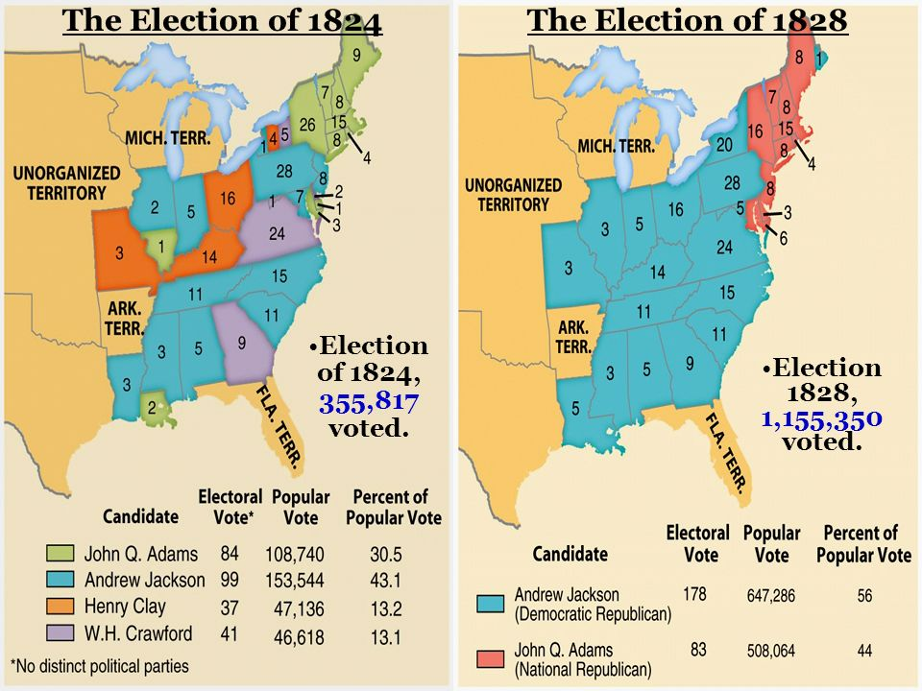
Historical Context
Intended Audience
Purpose of Author
Point of View of Author
Other Context

Slide 66
I thank you, Dear Sir, for the copy you have been so kind as to send me of the letter to your constituents on the Missouri question... this momentous question, like a fire bell in the night, awakened and filled me with terror. I considered it at once as the knell of the Union. it is hushed indeed for the moment. but this is a reprieve only, not a final sentence. a geographical line, coinciding with a marked principle, moral and political, once conceived and held up to the angry passions of men, will never be obliterated; and every new irritation will mark it deeper and deeper. I can say with conscious truth that there is not a man on earth who would sacrifice more than I would, to relieve us from this heavy reproach, in any practicable way. ...but, as it is, we have the wolf by the ear, and we can neither hold him, nor safely let him go. justice is in one scale, and self-preservation in the other....this certainly is the exclusive right of every state, which nothing in the constitution has taken from them and given to the general government.
-Thomas Jefferson 1820
Historical Context
Audience
Purpose
Point of View
“Y” is this important?

Slide 67
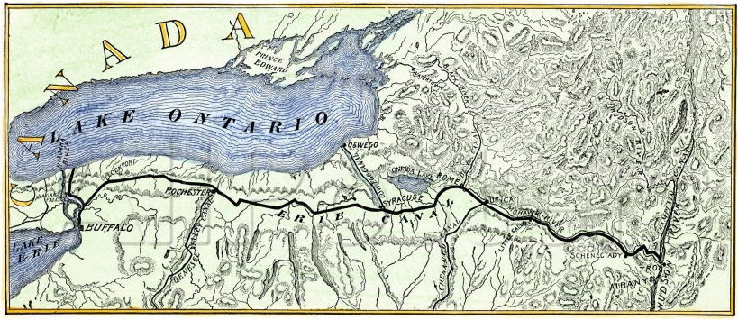
Historical Context
Intended Audience
Purpose of Author
Point of View of Author
Other Context

Slide 68
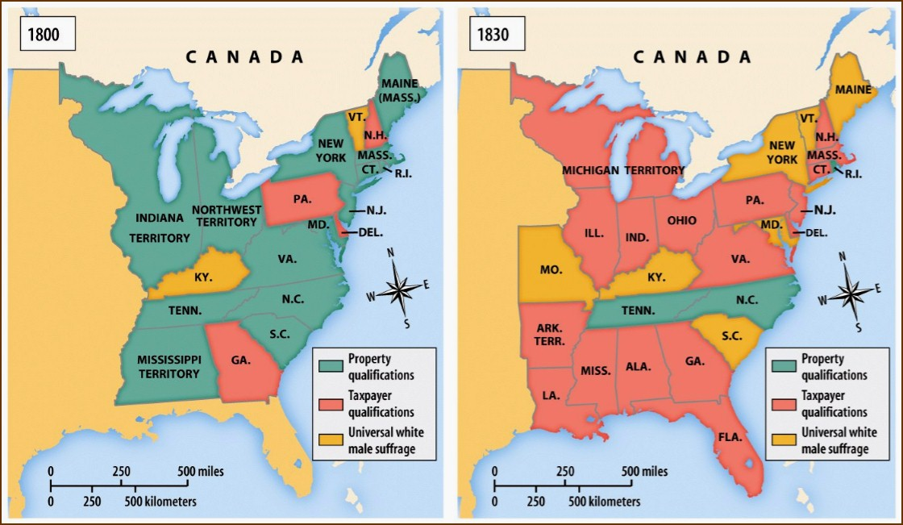
Historical Context
Intended Audience
Purpose of Author
Point of View of Author
Other Context

Slide 69
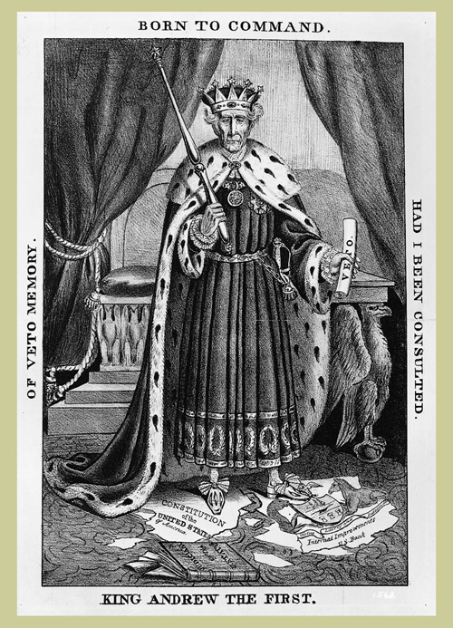
Historical Context
Intended Audience
Purpose of Author
Point of View of Author
Other Context

Slide 70
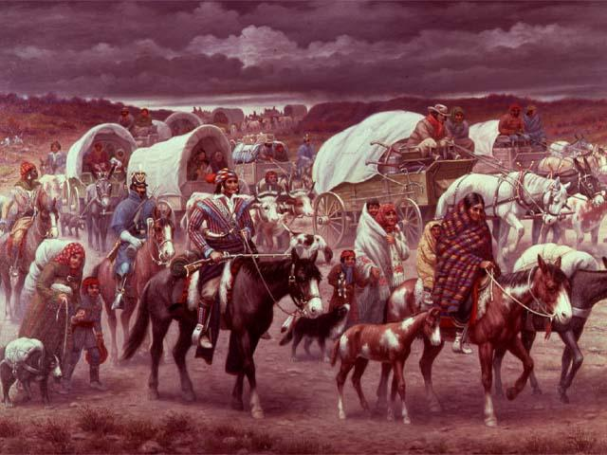
Historical Context
Intended Audience
Purpose of Author
Point of View of Author
Other Context

Slide 71
In the 1840 presidential election, the Whigs ran William Henry Harrison on a pro-business platform against the hapless scapegoat of the 1837 panic, Martin Van Buren, and won crushing victories in the state, congressional, and presidential contests (Harrison carried nineteen of the twenty-six states). Whigs captured three-fifths of the new voters and triumphed, not only across the nation, but across all class, religious, and ethnic divisions. On the other hand, when the Whigs were unable to keep focused on these strategies, they generally lost, and lost big. The Whigs were always a minority party. Without clear partisan policy distinctions that made clear how awful an opposition victory would be, they discouraged their existing voter base and failed to recruit new voters… They prided themselves on being a coalition of independent thinkers, unlike (in their imagination) the disciplined faithful of the Democrats, and they did not hesitate to turn on each other with divisive and disheartening abandon.
-The Rise and Fall of the American Whig Party: Jacksonian
Politics and the Onset of the Civil War, Michael Holt. Summer 2001
Historical Context
Intended Audience
Purpose of Author
Point of View of Author
Other Context

Slide 72
“I cannot but remark, sir, to what lengths arguments might be carried, predicated upon the supposition of the existence of the power, on the part of congress, to impose conditions and restrictions.
If you have the authority to impose the one now sought to be imposed, may you not impose any other? If you have the right to inhibit the introduction of slaves into the new state, you have a right to inhibit the introduction of any other species of property. And you may go a step further, and prescribe the manner in which the soil shall be cultivated. In fine, there is no restriction or condition whatever, which may not, with equal propriety, be imposed.”
-Senator Freeman Walker (Georgia) 1819
Historical Context
Intended Audience
Purpose of Author
Point of View of Author
Other Context

Slide 73
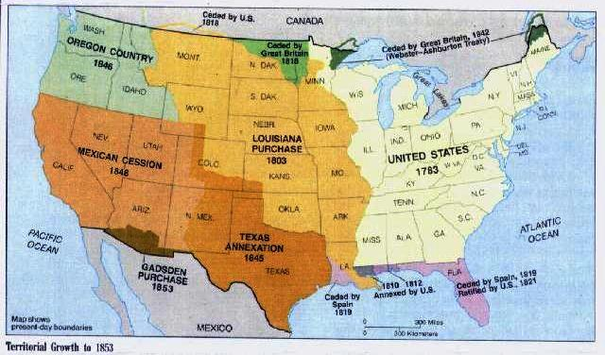
Historical Context
Intended Audience
Purpose of Author
Point of View of Author
Other Context

Slide 74
“It is impossible that the allied powers should extend their political system to any portion of either continent without endangering our peace and happiness; nor can anyone believe that our southern brethren, if left to themselves, would adopt it of their own accord. It is equally impossible, therefore, that we should behold such interposition in any form with indifference. If we look to the comparative strength and resources of Spain and those new Governments, and their distance from each other, it must be obvious that she can never subdue them. It is still the true policy of the United States to leave the parties to themselves, in hope that other powers will pursue the same course. . . .”
- Monroe Doctrine, 1823
Historical Context
Intended Audience
Purpose of Author
Point of View of Author
Other Context

Slide 75
To be sure, the meeting at Hartford put an end to the already waning national fortunes of the Federalist Party while giving a legitimacy to the notion of nullification which would haunt the nation later. Yet the Convention preserved the centrist course of New England federalism. Indeed, as the most notable instance since the Second Continental Congress of men organizing to satisfy, direct, and control an aroused populace, it was a monument to the growth of electoral democracy. It was a victory for political management, for the 'system'.
-JamesM. Banner, historian, A Shadow of Secession? The Hartford Convention, 1814, 1988
Historical Context
Intended Audience
Purpose of Author
Point of View of Author
Other Context

Slide 76
I believe in the existence of a great, immortal, immutable principle of natural law...which proves the absolute right to an education of every human being that comes into the world; and which, of course, proves the correlative duty of every government to see that the means of that education are provided for all.... Massachusetts is parental in her government. More and more, as year after year rolls by, she seeks to substitute prevention for remedy, and rewards for penalties. She strives to make industry the antidote to poverty, and to counterwork the progress of vice and crime by the diffusion of knowledge and the culture of virtuous principles. -Horace Mann to the Massachusetts Legislature, 1846
Historical Context
Intended Audience
Purpose of Author
Point of View of Author
Other Context

Slide 77
“The existence of chattel slavery in a nation that claimed to be Christian, and the use of Christianity to justify enslavement, confronted black Evangelicals [Protestants] with a basic dilemma, which may be most clearly formulated in two questions: What meaning did Christianity, if it were a white man’s religion, as it seemed, have for blacks; and, why did the Christian God, if he were just as claimed, permit blacks to suffer so? In struggling to answer these questions, a significant number of Afro-Americans developed a distinctive evangelical tradition in which they established meaning and identity for themselves as individuals and as people. Simultaneously, they made an indispensable contribution to the development of American Evangelicalism.”
-Albert J. Raboteau, historian, African American Religion, 1997
Historical Context
Intended Audience
Purpose of Author
Point of View of Author
Other Context

Slide 78
Well, children, where there is so much racket there must be something out of kilter. I think that ‘twixt the negroes of the South and the women at the North, all talking about rights, the white men will be in a fix pretty soon. But what’s all this here talking about? That man over there says that women need to be helped into carriages, and lifted over ditches, and to have the best place everywhere. Nobody ever helps me into carriages, or over mudpuddles, or gives me any best place! And ain’t I a woman? Look at me! Look at my arm! I have ploughed and planted, and gathered into barns, and no man could head me! And ain’t I a woman? I could work as much and eat as much as a man —when I could get it —and bear the lash as well! And ain’t I a woman? I have borne thirteen children, and seen most all sold off to slavery, and when I cried out with my mother’s grief, none but Jesus heard me! And ain’t I a woman? -Frances Gage of Sojourner Truth’s speech, 1851, to Akron Women’s Convention
Historical Context
Intended Audience
Purpose of Author
Point of View of Author
Other Context

Slide 79
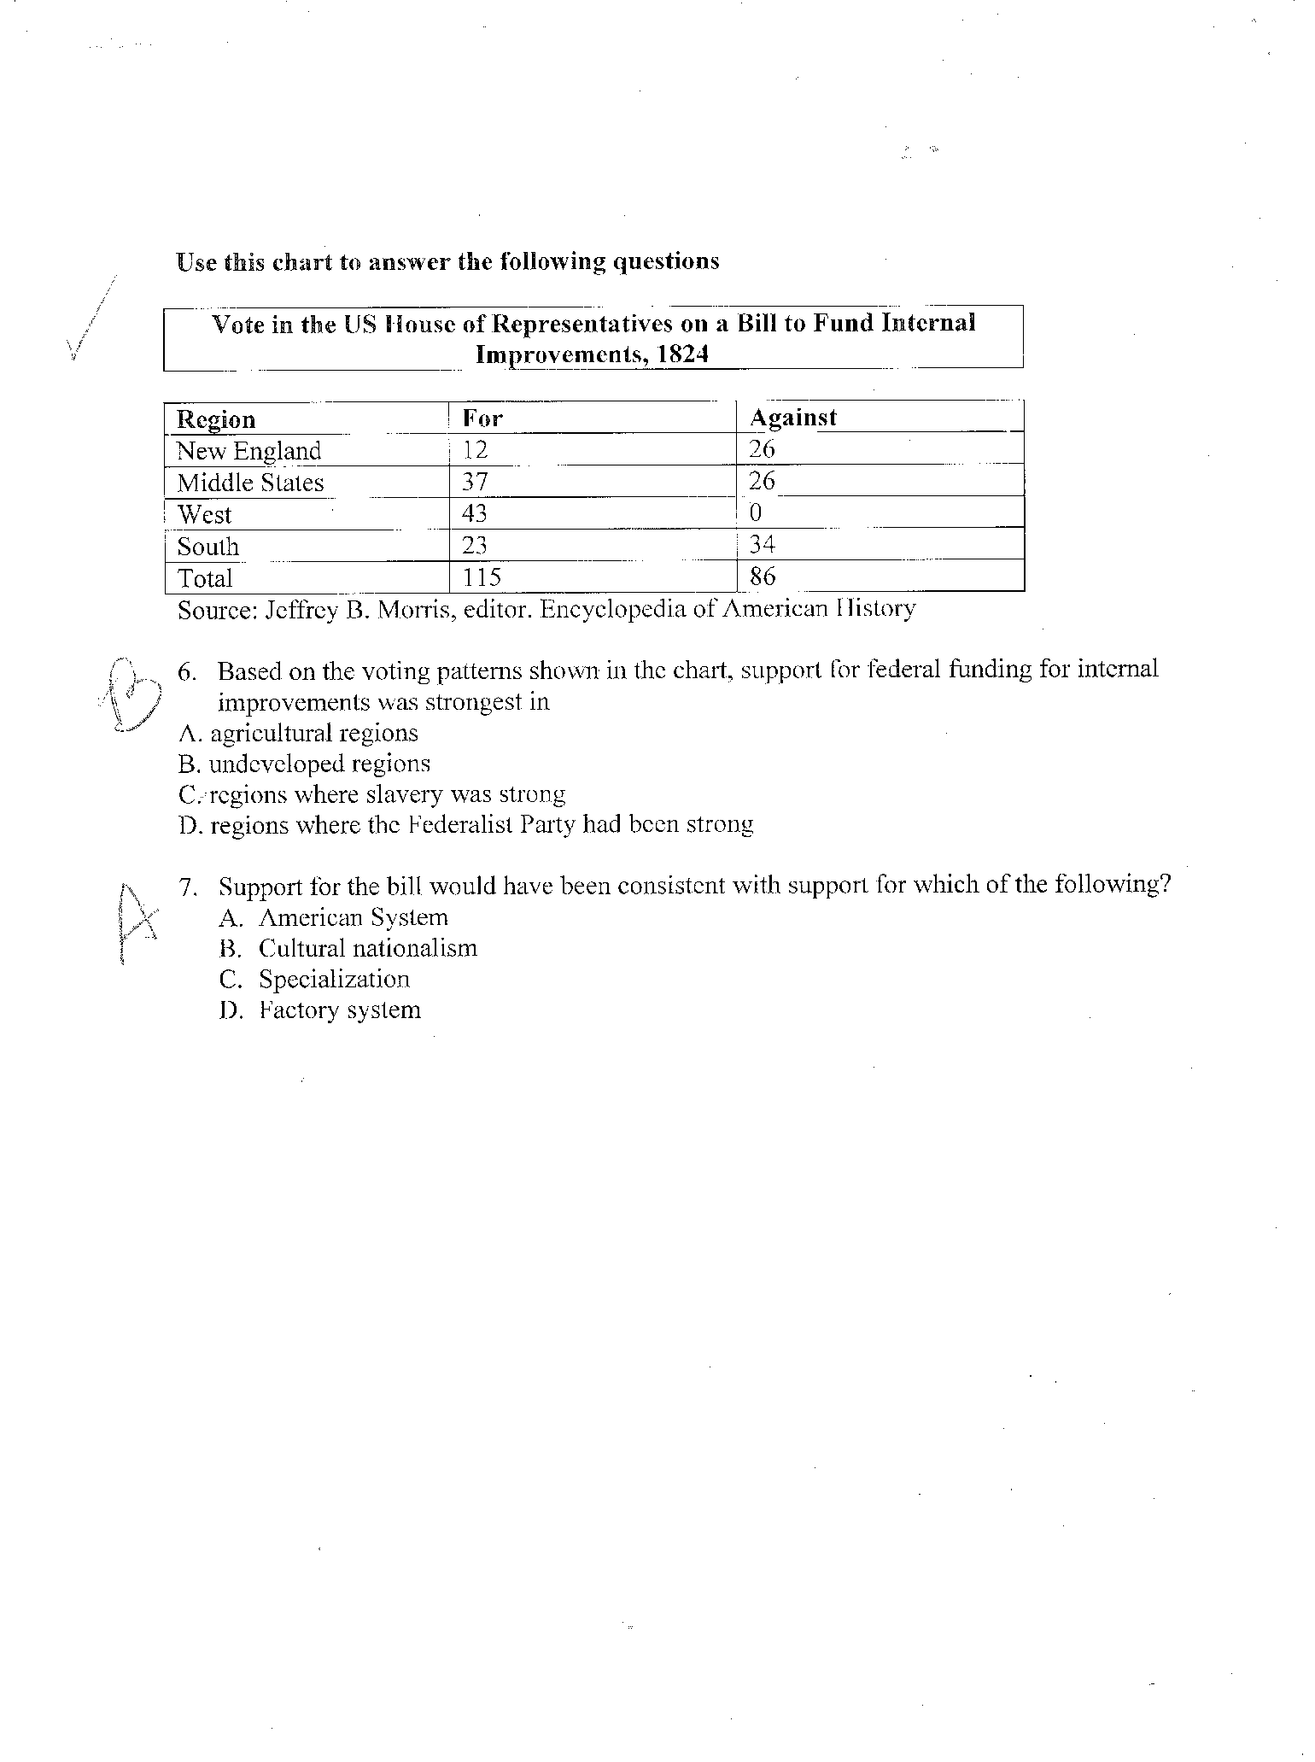
Historical Context
Intended Audience
Purpose of Author
Point of View of Author
Other Context

Slide 80
But those, for whose emancipation we are striving, —constituting at the present time at least one-sixth part of our countrymen, —are recognised by the laws, and treated by their fellow beings, as marketable commodities—as goods and chattels—as brute beasts; —are plundered daily of the fruits of their toil without redress; —really enjoy no constitutional nor legal protection from licentious and murderous outrages upon their persons; —are ruthlessly torn asunder-the tender babe from the arms of its frantic mother—the heart-broken wife from her weeping husband—at the caprice or pleasure of irresponsible tyrants; —and, for the crime of having a dark complexion, suffer the pangs of hunger, the infliction of stripes, and the ignominy of brutal servitude. They are kept in heathenish darkness by laws expressly enacted to make their instruction a criminal offence. These are the prominent circumstances in the condition of more than TWO MILLIONS of our people, the proof of which may be found in thousands of indisputable facts, and in the laws of the slaveholding States. -William Lloyd Garrison, Declaration of the National Anti-Slavery Convention, December 14, 1833
Historical Context
Intended Audience
Purpose of Author
Point of View of Author
Other Context

Slide 81
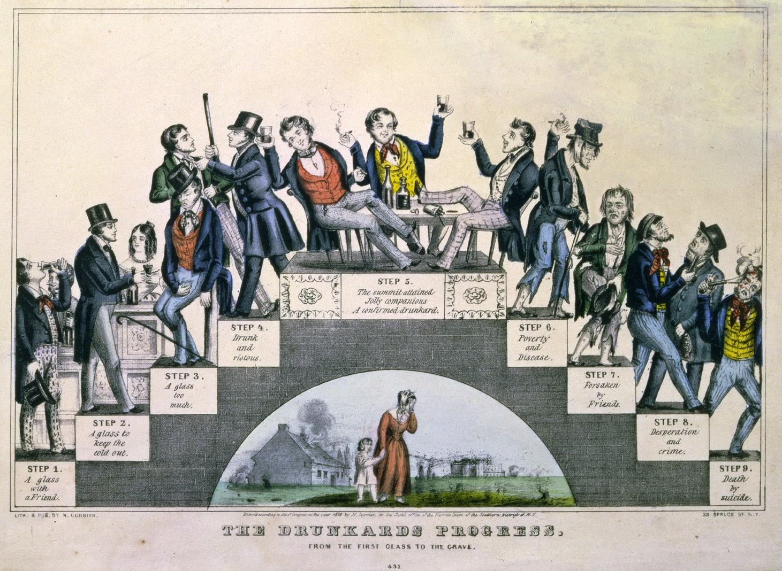
Historical Context
Intended Audience
Purpose of Author
Point of View of Author
Other Context

Slide 82
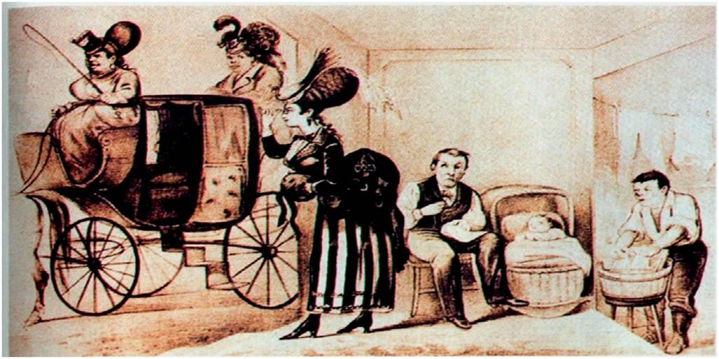
Historical Context
Intended Audience
Purpose of Author
Point of View of Author
Other Context

Slide 83
“Much has been written and spoken in woman’s behalf, especially in America; and yet a large class of females are, and have been, destined to a state of servitude as degrading as unceasing toil can make it. I refer to the female operatives of New England--the free states of our union--the states where no colored slave can breathe the balmy air, and exist as such;--but yet there are those, a host of them, too, who are in fact nothing more nor less than slaves in every sense of the word! Slaves to a system of labor which requires them to toil from five until seven o’clock, with only one hour to attend to the wants of nature…”
-Lowell Factory Worker (1845)
Historical Context
Intended Audience
Purpose of Author
Point of View of Author
Other Context

Slide 84
Period 5: 1844-1877

Slide 85
. . . We think [people of African ancestry] are . . . not included, and were not intended to be included, under the word "citizens" in the Constitution, and can therefore claim none of the rights and privileges which that instrument provides for and secures to citizens of the United States. . . .
-Majority Opinion written by Roger B. Taney, Chief Justice of the United
States Supreme Court, Dred Scott v. Sandford, (1857)
Historical Context
Intended Audience
Purpose of Author
Point of View of Author
Other Context

Slide 86
“There has long been a supposed conflict between the interests of free labor and of slave labor… But let us admit Texas, and we shall place the balance of power in the hand of the Texans themselves… Are our friends of the North prepared to deliver over this great national policy to the people of Texas… in order to purchase a slave market for their neighbors, who, in the words of Thomas Jefferson Randolph, ‘bred men for the market like oxen for the shambles’?”
-Representative Joshua Giddings, “Upon the Annexation of Texas,” 1844
Historical Context
Intended Audience
Purpose of Author
Point of View of Author
Other Context

Slide 87
In illustration of the blessing and benefit of Hospital care in cases long and most cruelly neglected, I adduce the following examples recorded by Dr. Hill, and corresponding with many cases under my own immediate observation since 1840. “Two patients,” writes the Dr. “were brought to me in 1836, who had been confined in a poor-house between eighteen and twenty years. During this period they had not known liberty. They had been chained day and night to their bedsteads, and kept in a state so filthy that it was sickening to go near them. —They were usually restrained by the strait-waistcoat, and with collars round their necks, the collars being fastened with chains or straps to the upper part of the bedstead, to prevent, it was said their tearing their clothes. The feet were fastened with iron leglocks and chains. One poor creature was so wholly disabled by this confinement, that it was necessary for the attendants to bear her in their arms from place to place after she was brought to the Hospital; she shortly acquired good habits, and was long usefully employed in the sewing-room. The other was more difficult of management but soon gained cleanly habits, and now occupies herself in knitting and sewing, and that, after having been treated for years like the lowest brute.
-Dorothea Lynde Dix, Memorial Soliciting a State Hospital for the Protection and Cure of the Insane,
Submitted to the General Assembly of North Carolina, November, 1848
Historical Context
Intended Audience
Purpose of Author
Point of View of Author
Other Context

Slide 88
When in the course of human events, it becomes necessary for one portion of the family of man to assume among the people of the earth a position different from that which they have hitherto occupied, but one to which the laws of nature and of nature’s God entitle them, a decent respect to the opinions of mankind requires that they should declare the causes that impel them to such a course. We hold these truths to be self-evident: that all men and women are created equal… The history of mankind is a history of repeated injuries and seizures of power on the part of man toward woman, seeking to establish an absolute tyranny over her. To prove this, let facts be submitted to a candid world. He has never permitted her to exercise her inalienable right to the elective franchise. He has compelled her to submit to laws in the formation of which she had no voice. He has withheld from her rights which are given to the most ignorant and degraded men —both natives and foreigners. -Elizabeth Cady Stanton, Declaration of Rights and Sentiments, 1848
Historical Context
Intended Audience
Purpose of Author
Point of View of Author
Other Context

Slide 89
SECTION 1. No negro shall be allowed to come within the limits of the town of St. Landry without special permission from his employers.
SECTION 3. Every freedman, free negro and mulatto shall, on the second Monday of January, one thousand eight hundred and sixty-six, and annually thereafter, have a lawful home or employment.
SECTION 4. Every Negro is required to be in the regular service of some white person, or former owner, who shall be held responsible for the conduct of said negro.
SECTION 5. No Negro shall be permitted to preach, exhort, or otherwise declaim to congregations of colored people, without a special permission in writing from the president of the police jury.
SECTION 7. No freedman who is not in the military service shall be allowed to carry firearms, or any kind of weapons, within the limits of the town of St. Landry without the special permission of his employer, in writing, and approved by the mayor or president of the board of police.
SECTION 11. All the foregoing provisions apply to freedmen and freedwomen.
-Black Code from St. Landry, Mississippi. July 3, 1865
Historical Context
Intended Audience
Purpose of Author
Point of View of Author
Other Context

Slide 90
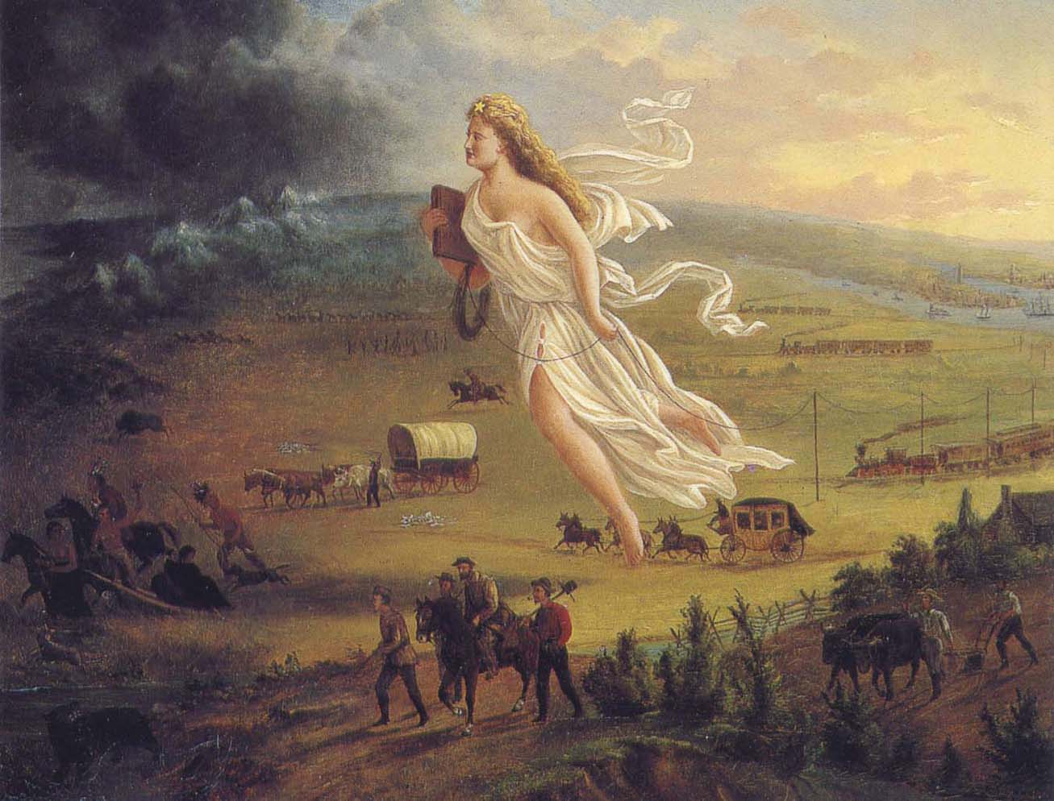
John Gast, American Progress, 1872
Historical Context
Intended Audience
Purpose of Author
Point of View of Author
Other Context

Slide 91
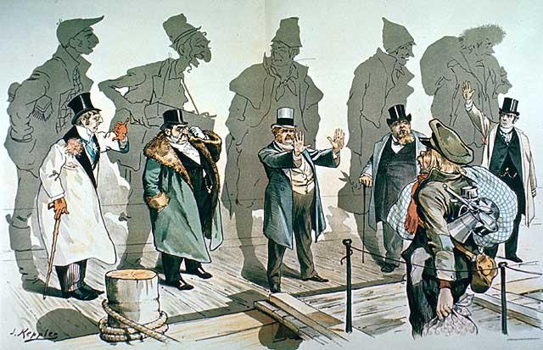
Historical Context
Intended Audience
Purpose of Author
Point of View of Author
Other Context

Slide 92
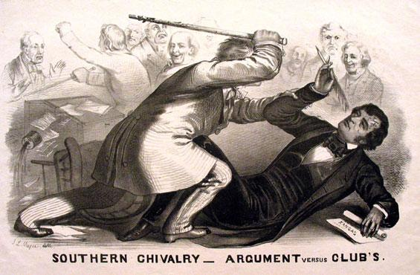
Historical Context
Intended Audience
Purpose of Author
Point of View of Author
Other Context
The caning of Charles Sumner

Slide 93
“It being desirable for the peace, concord, and harmony of the Union of these states to settle and adjust amicably all existing questions of controversy between them arising out of the institution of slavery upon a fair, equitable, and just basis…
“We are told now… that the Union is threatened with subversion and destruction… If the Union is to be dissolved for any existing causes, it will be dissolved because slavery is interdicted or not allowed to be introduced into the ceded territories, because slavery is threatened to be abolished in the District of Columbia, and because fugitive slaves are not returned… to their masters…
“I am for staying within the Union and fighting for my rights.”
-Henry Clay, Resolution on the Compromise of 1850, 1850
Historical Context
Intended Audience
Purpose of Author
Point of View of Author
Other Context

Slide 94
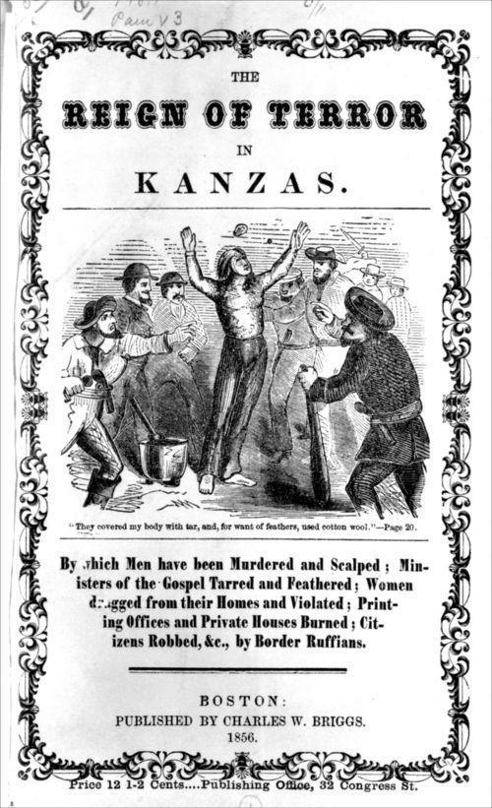
Historical Context
Intended Audience
Purpose of Author
Point of View of Author
Other Context

Slide 95
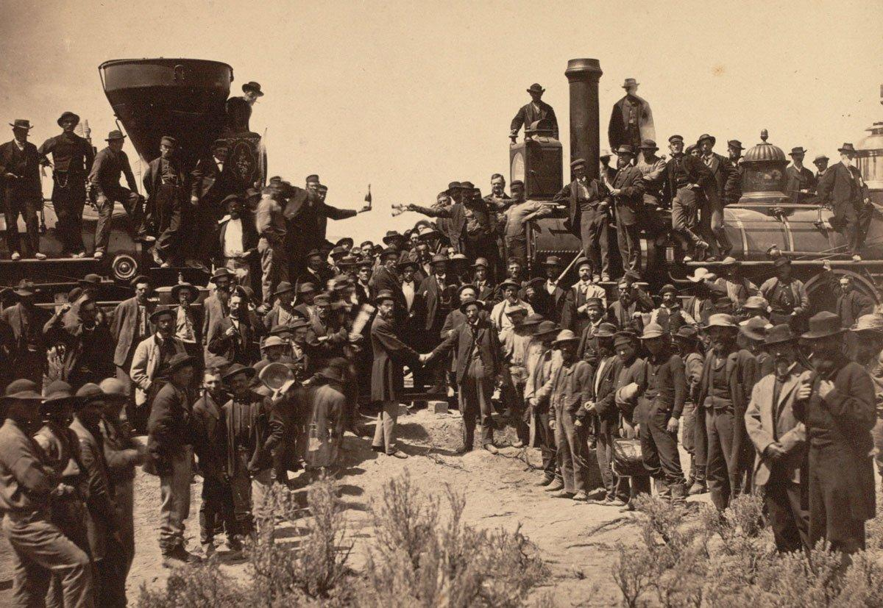
Historical Context
Intended Audience
Purpose of Author
Point of View of Author
Other Context

Slide 96
“Section 6: when a person held to labor in any State, has escaped into another State, the person to whom such labor may be due ... may pursue and reclaim such fugitive person, either by warrant, ... or by seizing and arresting such fugitive; and ... to use such reasonable force and restraint as may be necessary
Section 7: any person who shall willingly hinder from arresting such a fugitive, or shall rescue, or attempt to rescue, such fugitive from labor, from the custody of such claimant ...; or shall aid, abet, or assist such person ... to escape from such claimant ...; or shall harbor or conceal such fugitive, shall, be subject to a fine not exceeding one thousand dollars, and imprisonment not exceeding six months ...; and shall pay the sum of one thousand dollars for each fugitive so lost”
-Fugitive Slave Act, 1850
Historical Context
Intended Audience
Purpose of Author
Point of View of Author
Other Context

Slide 97
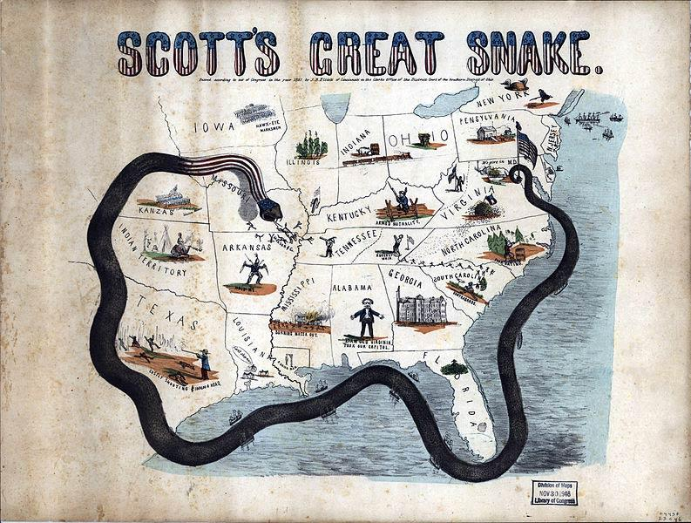
Historical Context
Intended Audience
Purpose of Author
Point of View of Author
Other Context

Slide 98
“Sometime during the summer of 1862, Lincoln concluded that emancipation had become a political and military necessity…Lincoln delayed his announcement until after a Union victory. On September 22, 1862 Lincoln issued the preliminary Emancipation Proclamation. The initial Northern reaction was not encouraging. Not only did the Emancipation Proclamation alter the nature of the Civil War and American History, it also represented a turning point in Lincoln’s own thinking. For the first time it committed the government to enlisting Black soldiers in the Union Army. Lincoln now became in his own mind the Great Emancipator. He assumed the role that history had thrust upon him, and he tried to live up to it. He would later refuse suggestions that he rescind or modify the Proclamation in the interest of peace.”
-Eric Foner, historian, Give Me Liberty! An American History, 2014
Historical Context
Intended Audience
Purpose of Author
Point of View of Author
Other Context

Slide 99
“Should we consecrate a war that killed and maimed over a million Americans? Or should we question… whether this was really a war of necessity that justified its appalling costs…
“Very few Northerners went to war seeking or anticipating the destruction of slavery. They fought for the Union, and the Emancipation Proclamation was a means to that end: a desperate measure to undermine the South and save a democratic nation that Lincoln called ‘the last best, hope of earth.’…
“From the distance of 150 years, Lincoln’s transcendent vision at Gettysburg of a ‘new birth of freedom’ seems premature… Rather than simply consecrate the dead with words, he said, it is for ‘us the living’ to rededicate ourselves to the unfinished work of the Civil War.”
-Tony Horwitz, journalist and writer, “150 Years of Misunderstanding the Civil War,”
The Atlantic, June 2013
Historical Context
Intended Audience
Purpose of Author
Point of View of Author
Other Context

Slide 100
Neither slavery nor involuntary servitude, except as a punishment for crime whereof the party shall have been duly convicted, shall exist within the United States, or any place subject to their jurisdiction. - 13th amendment
All persons born or naturalized in the United States, and subject to the jurisdiction thereof, are citizens of the United States and of the State wherein they reside. No State shall make or enforce any law which shall abridge the privileges or immunities of citizens of the United States; nor shall any State deprive any person of life, liberty, or property, without due process of law; nor deny to any person within its jurisdiction the equal protection of the laws. - 14th amendment, section 1
The right of citizens of the United States to vote shall not be denied or abridged by the United States or by any State on account of race, color, or previous condition of servitude. - 15th amendment
Historical Context
Intended Audience
Purpose of Author
Point of View of Author
Other Context

Slide 101
“dear Sir:
So many people ask me what they shall do; so few tell me what they can do. Yet this is the pivot wherein all must turn.
I believe that each of us who has his place to make should go where men are wanted, and where employment is not bestowed as alms. Of course, I say to all who are in want of work, Go West!
But what can you do? and how can your family help you? Your mother, I infer, is to be counted out as an effective worker. But what of the rest? And you – can you chop? Can you plow? Can you mow? Can you cut up Indian corn? I reckon not. And in the west it is hard to find such work as you have been accustomed to. The conditions of living are very rude there.
On the whole I say, stay where you are; do as well as you can; and devote every spare hour to making yourself familiar with the conditions and dexterity required for the efficient conservation of out-door industry in a new country. Having mastered these, gather up your family and Go West!”
-Horace Greeley, editor of the New York Tribune, Letter to R.L. Sanderson, 1871
Historical Context
Intended Audience
Purpose of Author
Point of View of Author
Other Context

Slide 102
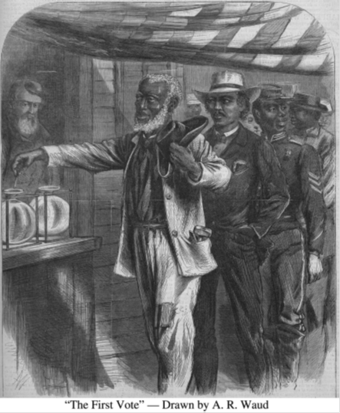
Historical Context
Intended Audience
Purpose of Author
Point of View of Author
Other Context

Slide 103
“It is apparent to my mind that the President thoroughly believed the tenure-of-office act to be unconstitutional and void. He was advised by every member of his cabinet…
“This was a punitive statute. It was directed against the President alone. It interfered with the prerogatives of his department as recognized from the foundation of the Government… This Government can only be preserved and the liberty of the people maintained by preserving intact the coordinate branches of it – legislative, executive, judicial – alike. I am no convert to any doctrine of the omnipotence of Congress.
“I cannot agree to destroy the… Constitution for the sake of getting rid of an Unacceptable President.”
-Senator James W. Grimes, Iowa, statement on the trial of Andrew Johnson, 1868
Historical Context
Intended Audience
Purpose of Author
Point of View of Author
Other Context

Slide 104
A Sharecropping Contract: 1882 (Modified)
To everyone renting land, the following conditions must be agreed to: Forevery 30 acres of land (rented by
sharecroppers), I will provide a mule team, plow,
and farming tools. The sharecroppers can have half of the cotton, corn, peas, pumpkins, and potatoes they grow if the following conditions are followed, but--if not--they are to have only two-fifths. For every mule or horse furnished by me there must be 1000 good sized rails (logs) hauled, and the fence repaired if I so direct. All sharecroppers must haul rails (logs) and work on the fence whenever I may order. The wood must be split and the fence repaired before corn is planted. No cotton must be planted by sharecroppers on their home patches of land. No sharecropper is to work off the plantation when there is any work for them to do for me. Every sharecropper must be responsible for all farming gear placed in his hands, and if not returned must be paid for unless it is worn out by use.
The sale of every sharecropper's part of the cotton to be made by me when and where I choose to sell, and after taking all they owe me.
-Grimes Family Papers (#3357), 1882; Held in the Southern Historical Collection, University of North Carolina, Chapel Hill.
Historical Context
Intended Audience
Purpose of Author
Point of View of Author
Other Context

Slide 105
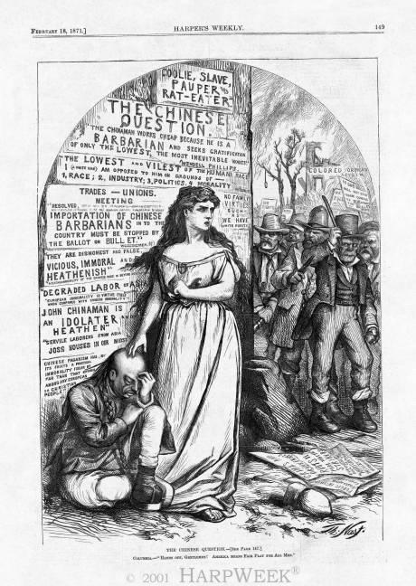
Historical Context
Intended Audience
Purpose of Author
Point of View of Author
Other Context

Slide 106
“Do not believe those who call us savages, rioters, incendiaries, and outlaws. We seek our ends calmly, rationally, at the ballot box. So far good order has marked all our proceedings. But, we know how false, how inhuman, our adversaries are. We know that if gold, if fraud, if force can defeat us, they will all be used. And we have resolved that they will not defeat us. We shall arm. We shall meet fraud and falsehood with defiance, and force with force, if need be.
We are men, and propose to live like men in this free land, without the contamination of slave labor, or die like men, if need be, in asserting the rights of our race, our country, and our families.
California must be all American or all Chinese. We are resolved that it shall be American, and are prepared to make it so. May we not rely upon your sympathy and assistance?
With great respect for the Workingman’s Party of California.
-Dennis Kearney, President
Historical Context
Intended Audience
Purpose of Author
Point of View of Author
Other Context

Slide 107
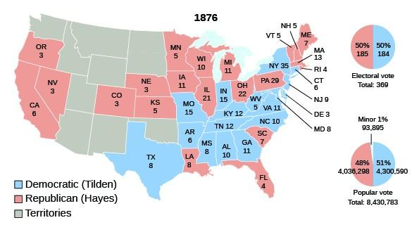
Historical Context
Intended Audience
Purpose of Author
Point of View of Author
Other Context

Slide 108
Period 6: 1865-1898

Slide 109
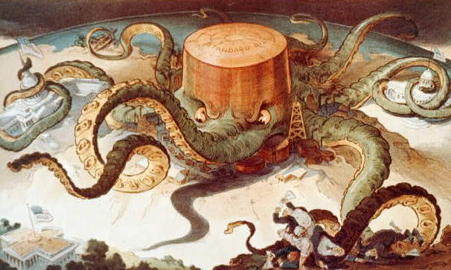
Historical Context
Intended Audience
Purpose of Author
Point of View of Author
Other Context

Slide 110
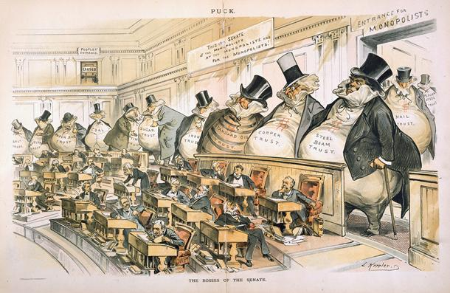
Historical Context
Intended Audience
Purpose of Author
Point of View of Author
Other Context

Slide 111
“To everyone applying to rent land upon shares, the following conditions must be read, and agreed to. To every 30 and 35 acres, I agree to furnish the team, plow, and farming implements, except cotton planters, and I do not agree to furnish a cart to every cropper. The croppers are to have half of the cotton, corn, and fodder if the following conditions are complied with, but-if not-they are to have only two-fifths (2/5). All must work under my direction. No cropper is to work off the plantation when there is any work to be done on the land he has rented, or when his work is needed by me or other croppers.”
-Sharecropping Contract, Grimes Family Papers (#3357), 1882
Historical Context
Intended Audience
Purpose of Author
Point of View of Author
Other Context

Slide 112
“Booming industries offered jobs to unskilled workers, like the Irish, Italian, Polish, and Hungarian peasants who poured into the cities in the late 1800s.These new immigrants also worked on the ever-expanding rail system, sometimes replacing Irish and Chinese laborers. American railroad companies advertised throughout Europe. They offered glowing descriptions of the Great Plains, hoping to sell land they received as government grants.”
-History Alive! Pursuing American Ideals
Historical Context
Intended Audience
Purpose of Author
Point of View of Author
Other Context

Slide 113
“But today we are raising more than we can consume. Today we are making more than we can use. Today our industrial society is congested; there are more workers than there is work; there is more capital than there is investment. We do not need more money—we need more circulation, more employment. Therefore, we must find new markets for our produce, new occupation for our capital, new work for our labor. . . .”
— Senator Albert J. Beveridge, 1898
Historical Context
Intended Audience
Purpose of Author
Point of View of Author
Other Context

Slide 114
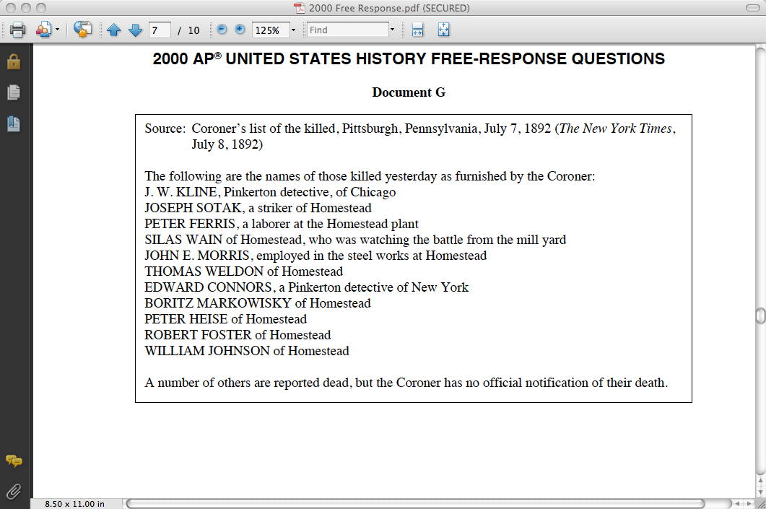
Historical Context
Intended Audience
Purpose of Author
Point of View of Author
Other Context

Slide 115
“We will answer their demands for a gold standard by saying to them: ‘You shall not press down upon the brow of labor this crown of thorns, you shall not crucify mankind upon a cross of gold.’”
--William Jennings Bryan, 1896
Historical Context
Intended Audience
Purpose of Author
Point of View of Author
Other Context

Slide 116
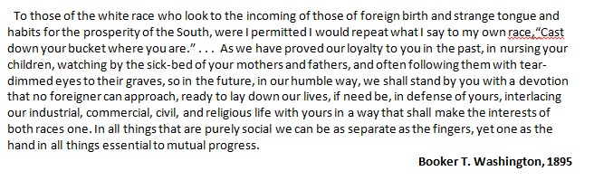
Historical Context
Intended Audience
Purpose of Author
Point of View of Author
Other Context

Slide 117
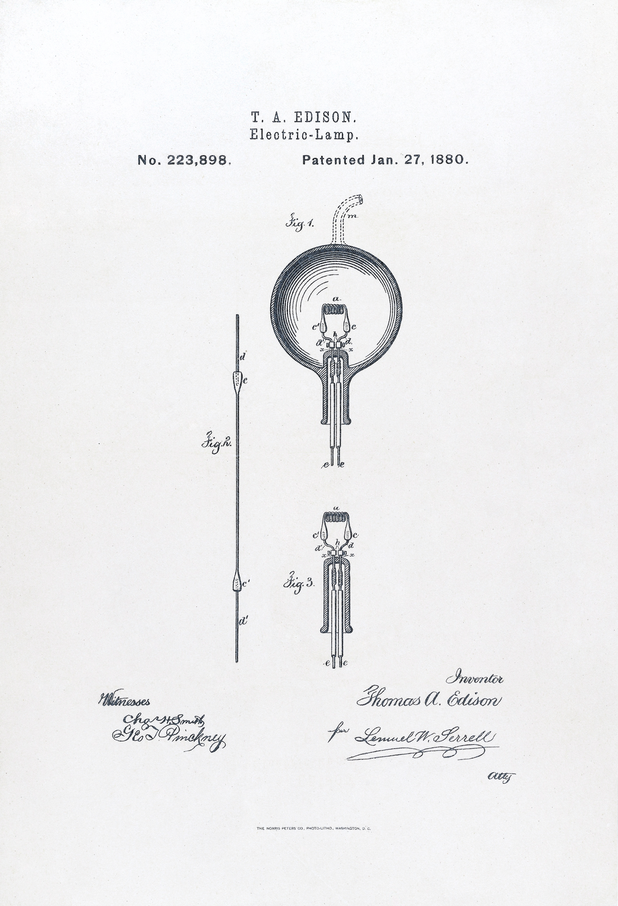
Historical Context
Intended Audience
Purpose of Author
Point of View of Author
Other Context

Slide 118
“The President of the United States…hereby is authorized, whenever in his opinion any reservation or any part thereof…is advantageous for agricultural and grazing purposes…to allot the lands in said reservation in severalty to any Indian located thereon in quantities as follows:
To each head of family, one-quarter of a section;
To each single person over eighteen years of age, one eighth of a section;
To each single orphan child under eighteen years of age, one eighth of a section…
Every Indian born within the territorial limits of the United States to whom allotments shall have been made…who has voluntarily taken up, within said limits his residence separate and apart from any tribe of Indians therein, and has adopted that habits of civilized life, is hereby declared a citizen of the United States.”
-The Dawes Severalty Act, 1887
Historical Context
Intended Audience
Purpose of Author
Point of View of Author
Other Context

Slide 119
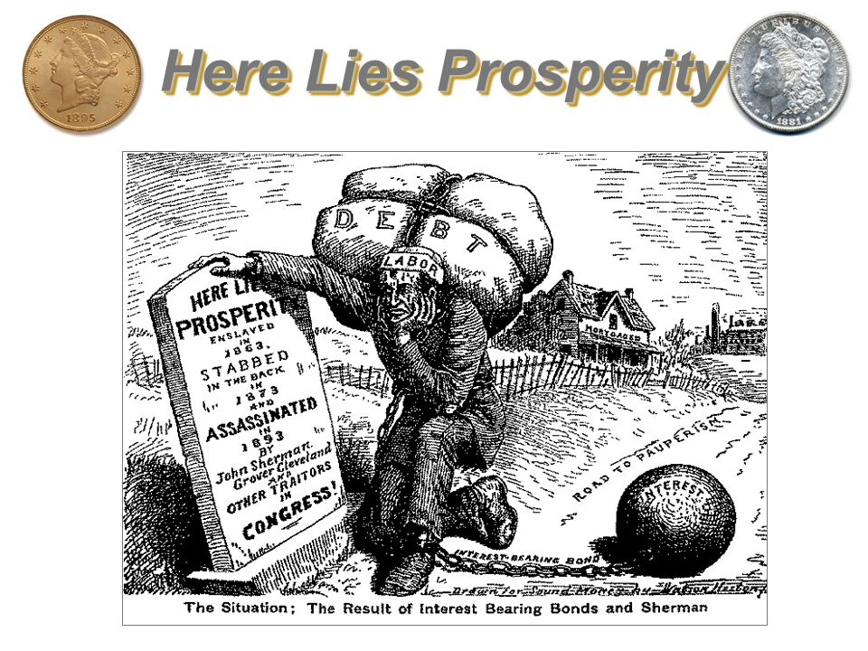
Historical Context
Intended Audience
Purpose of Author
Point of View of Author
Other Context

Slide 120
[8] This, then, is held to be the duty of the man of wealth: To set an example of modest, unostentatious living, shunning display or extravagance; to provide moderately for the legitimate wants of those dependent upon him; and, after doing so…
[9] In bestowing charity, the main consideration should be to help those who will help themselves. Neither the individual nor the race is improved by alms giving.
[10] The best means of benefiting the community is to place within its reach the ladders upon which the aspiring can rise-free libraries, parks, and means of recreation, by which men are helped in body and mind; works of art, certain to give pleasure and improve the general condition of the people; in this manner returning their surplus wealth to the mass of their fellows in the forms best calculated to do them lasting good.
– Excerpts from Andrew Carnegie’s Gospel of Wealth, 1889
Historical Context
Intended Audience
Purpose of Author
Point of View of Author
Other Context

Slide 121
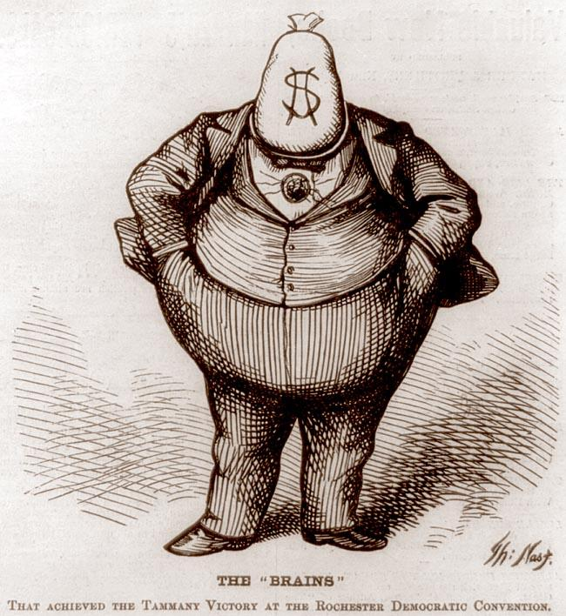
Historical Context
Intended Audience
Purpose of Author
Point of View of Author
Other Context

Slide 122
“The growth of a large business is merely survival of the fittest…The American Beauty Rose can be produced in the splendor and fragrance which bring cheer to its beholder only by sacrificing the early buds which grow up around it. This is not an evil tendency in business. It is merely the working-out of a law of nature and a law of God.”
-John D. Rockefeller, 1903
Historical Context
Intended Audience
Purpose of Author
Point of View of Author
Other Context

Slide 123
“What really lifted the giants above the rest was the ability to envision where the world, or their part of it, was going, and to act on that vision in a creative way.... From the days of Adam Smith, self-interest has been the acknowledged driving force of capitalism; the secret of the market system is that one person’s self-interest can simultaneously serve the interests of others. Buyers and sellers, producers and consumers, investors and entrepreneurs take reciprocal advantage of each other. Success rewards those who can discover or create areas of reciprocity; the larger the area, the greater the success.... They were captains of industry; but like officers of volunteer regiments, they held their posts at the sufferance of those they led.”
-H. W. Brands, historian, 1999
Historical Context
Intended Audience
Purpose of Author
Point of View of Author
Other Context

Slide 124
To the PRESIDENT: Washington, July 8, 1876
The present military operations are not against the Sioux Nation at all, but against certain hostile parts of it that defy the Government. No part of these operations are on or near the Sioux reservation. The accidental discovery of gold on the western border of the Sioux reservation, and the settlement of our people there, have not caused this war.
The young Indian warriors love war, and frequently leave the reservation to go on the hunt, or warpath. The object of these military operations was in the interest of the peaceful people of the Sioux Nation, and not one of these peaceful Indians have been bothered by the military authorities.
Very respectfully,
J. D. CAMERON, Secretary of War
Historical Context
Intended Audience
Purpose of Author
Point of View of Author
Other Context

Slide 125
“ As the early years at Hull House show, female participation in that area of reform grew out of a set of needs and values peculiar to middle class women in the late 19th century and early 20 century. Settlement workers did not set out to become reformers. They were rather women trying to fulfill existing social expectations for self-sacrificing female service while at the same time satisfying their need for public recognition, authority, and independence. In the process of attempting to weave together a life of service and professional accomplishment, they became reformers as the wider world defined them.”
-Robyn Muncy , historian, Creating a Female Dominion in American Reform, 1890-1935, published in 1991
Historical Context
Intended Audience
Purpose of Author
Point of View of Author
Other Context

Slide 126
Period 7: 1890-1945

Slide 127
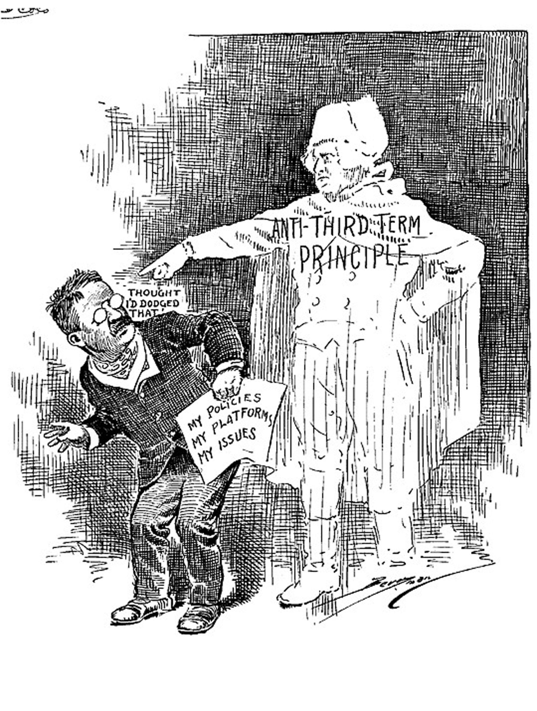
Historical Context
Intended Audience
Purpose of Author
Point of View of Author
Other Context

Slide 128
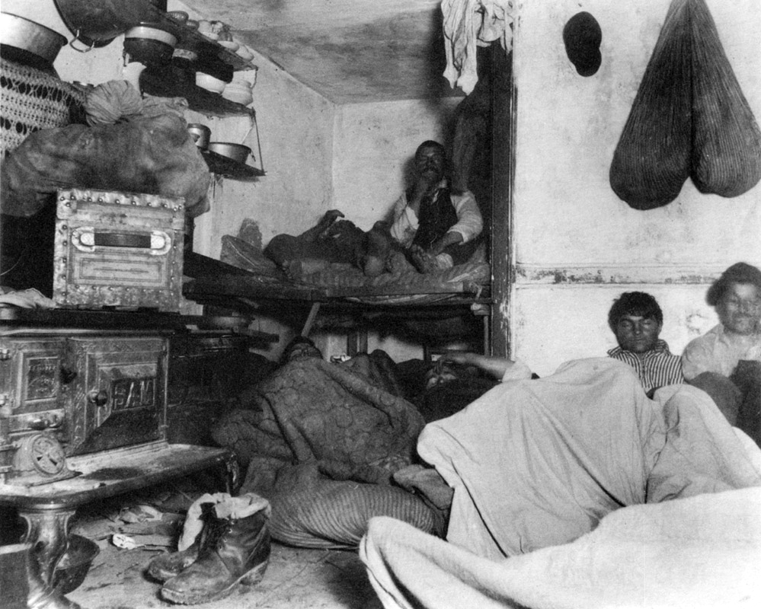
Historical Context
Intended Audience
Purpose of Author
Point of View of Author
Other Context
Jacob Riis

Slide 129
Let us know the modern city in its weakness and wickedness, and then seek to rectify and purify it until it shall be free at least from the grosser temptations which now beset the young people who are living in its tenement houses and working in its factories.”
-Jane Addams, The Spirit of Youth and the City Streets, 1909.
Historical Context
Intended Audience
Purpose of Author
Point of View of Author
Other Context

Slide 130
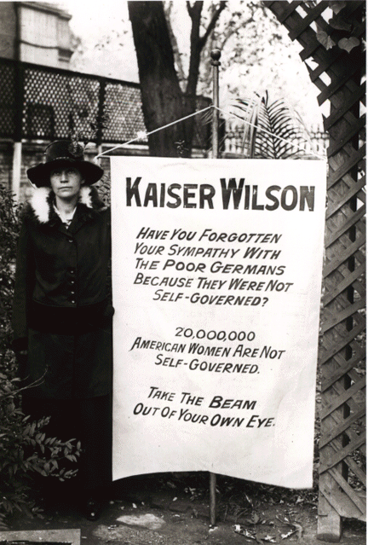
Historical Context
Intended Audience
Purpose of Author
Point of View of Author
Other Context

Slide 131

Historical Context
Intended Audience
Purpose of Author
Point of View of Author
Other Context

Slide 132
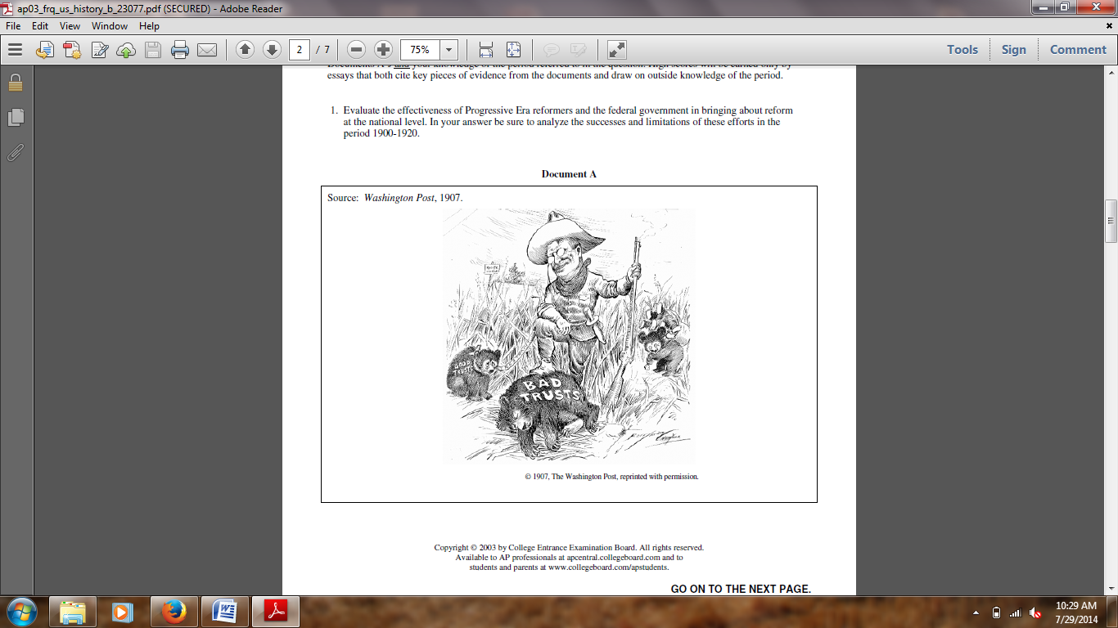
Historical Context
Intended Audience
Purpose of Author
Point of View of Author
Other Context

Slide 133
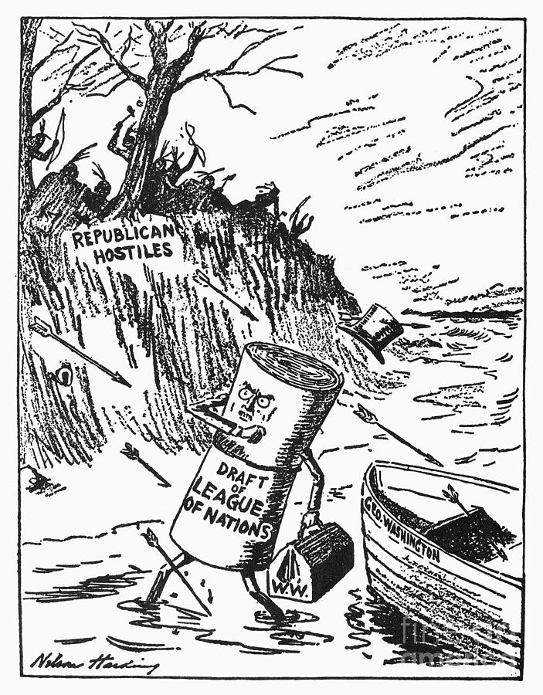
Historical Context
Intended Audience
Purpose of Author
Point of View of Author
Other Context

Slide 134
“We admit that in many places and in ordinary times the defendants in saying all that was said in the circular would have been within their constitutional rights. But the character of every act depends upon the circumstances in which it is done...The question in every case is whether the words used are used in such circumstances and are of such a nature as to create a clear and present danger that they will bring about the substantive evils that Congress has a right to prevent.”
-The majority opinion in Schenck v. U.S., 1917
Historical Context
Intended Audience
Purpose of Author
Point of View of Author
Other Context

Slide 135
“The association of poverty with progress is the great enigma of our times. So long as all the increased wealth which modern progress brings goes but to build up great fortunes, to increase luxury and make sharper the contrast between the house of have and the house of want, progress is not real and cannot be permanent.”
-Henry George, Late 1800’s
Historical Context
Intended Audience
Purpose of Author
Point of View of Author
Other Context

Slide 136
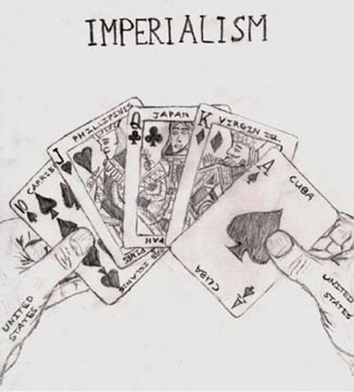
Historical Context
Intended Audience
Purpose of Author
Point of View of Author
Other Context

Slide 137
“Let a man so much as scrape his finger pushing a truck in the pickle-rooms, and he might have a sore that would put him out of the world; all of the joints in his fingers might be eaten by the acid, one by one.”
“…and as for other men, who worked in the tank rooms full of steam…their peculiar trouble was that they fell into the vats…sometimes they would be overcooked for a day, till all but the bones of them had gone out to the world as Durham’s Pure Beef Lard!...”
-except from Upton Sinclair’s The Jungle
Historical Context
Intended Audience
Purpose of Author
Point of View of Author
Other Context

Slide 138
“ As the early years at Hull House show, female participation in that area of reform grew out of a set of needs and values peculiar to middle class women in the late 19th century and early 20 century. Settlement workers did not set out to become reformers. They were rather women trying to fulfill existing social expectations for self-sacrificing female service while at the same time satisfying their need for public recognition, authority, and independence. In the process of attempting to weave together a life of service and professional accomplishment, they became reformers as the wider world defined them.”
-Robyn Muncy, historian, Creating a Female Dominion in American Reform, 1890-1935, published in 1991
Historical Context
Audience
Purpose
Point of View
“Y” is this important?

Slide 139
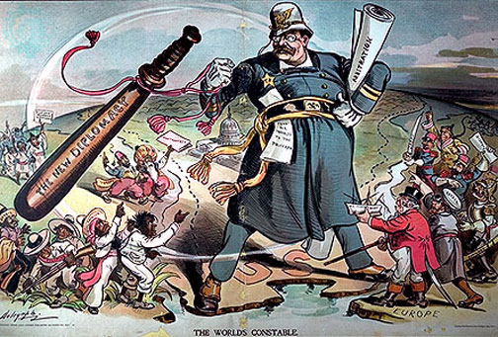
Historical Context
Intended Audience
Purpose of Author
Point of View of Author
Other Context

Slide 140
For the recognition of the independence of the people of Cuba, demanding that the Government of Spain relinquish its authority and government in the island of Cuba, and withdraw its land and naval forces from Cuba and Cuban waters...that the government of Cuba shall never enter into any treaty or other compact with any foreign power or powers which will impair or tend to impair the independence of Cuba...That the government of Cuba consents that the United States may exercise the right to intervene for the preservation of Cuban independence...That to enable the United States to maintain the independence of Cuba, and to protect the people thereof, as well as for its own defense, the government of Cuba will sell or lease to the United States lands necessary for coaling or naval stations at certain specified points to be agreed upon with the President of the United States.
-Platt Amendment, 1903
Historical Context
Intended Audience
Purpose of Author
Point of View of Author
Other Context

Slide 141

Life Magazine 1926
Historical Context
Intended Audience
Purpose of Author
Point of View of Author
Other Context

Slide 142

“The Only Way to Handle It,” May 19, 1921
Historical Context
Intended Audience
Purpose of Author
Point of View of Author
Other Context

Slide 143
Be a little careful, please! The hall is dark and you might stumble over the children pitching pennies back there. Not that it would hurt them; kicks and cuffs are their daily diet. They have little else. Here where the hall turns and dives into utter darkness is a step, and another, another. A flight of stairs. You can feel your way, if you cannot see it. Close? Yes! What would you have? All the fresh air that ever enters these stairs comes from the hall-door that is forever slamming, and from the windows of dark bedrooms that in turn receive from the stairs their sole supply of the elements God meant to be free, but man deals out with such niggardly hand. That was a woman filling her pail by the hydrant you just bumped against. The sinks are in the hallway, that all the tenants may have access--and all be poisoned alike by their summer stenches. Hear the pump squeak! It is the lullaby of tenement-house babes. In summer, when a thousand thirsty throats pant for a cooling drink in this block, it is worked in vain. But the saloon, whose open door you passed in the hall, is always there. The smell of it has followed you up. Here is a door. Listen! That short hacking cough, that tiny, helpless wail--what do they mean? They mean that the soiled bow of white you saw on the door downstairs will have another story to tell--Oh! a sadly familiar story--before the day is at an end. The child is dying with measles. With half a chance it might have lived; but it had none. That dark bedroom killed it.
Jacob Riis “How the Other Half Lives”
Historical Context
Intended Audience
Purpose of Author
Point of View of Author
Other Context

Slide 144
“In 1925 a trial in Tennessee threw into sharp relief the division between traditional values and modern secular culture. John Scopes, a teacher in a Tennessee public school was arrested for violating a state law that prohibited the teaching of Charles Darwin’s Theory of Evolution. HIs trial became a national sensation. The proceedings were even carried live on the radio.”
- From “Give me Liberty; an American History”
Historical Context
Intended Audience
Purpose of Author
Point of View of Author
Other Context

Slide 145

Historical Context
Intended Audience
Purpose of Author
Point of View of Author
Other Context

Slide 146
Chairman Walsh, my friends of the Democratic National Convention of 1932:
...As we enter this new battle, let us keep always present with us some of the ideals of the Party: The fact that the Democratic Party by tradition and by the continuing logic of history, past and present, is the bearer of liberalism and of progress and at the same time of safety to our institutions. And if this appeal fails, remember well, my friends, that a resentment against the failure of Republican leadership--and note well that in this campaign I shall not use the word "Republican Party," but I shall use, day in and day out, the words, "Republican leadership"--the failure of Republican leaders to solve our troubles may degenerate into unreasoning radicalism.
There are two ways of viewing the Government's duty in matters affecting economic and social life. The first sees to it that a favored few are helped and hopes that some of their prosperity will leak through, sift through, to labor, to the farmer, to the small business man. That theory belongs to the party of Toryism, and I had hoped that most of the Tories left this country in 1776.
Historical Context
Intended Audience
Purpose of Author
Point of View of Author
Other Context

Slide 147

Historical Context
Intended Audience
Purpose of Author
Point of View of Author
Other Context

Slide 148
“... by virtue of the authority vested in me as President of the United States, and Commander in Chief of the Army and Navy, I hereby authorize and direct the Secretary of War, and the Military Commanders whom he may from time to time designate, whenever he or any designated Commander deems such action necessary or desirable, to prescribe military areas in such places and of such extent as he or the appropriate Military Commander may determine, from which any or all persons may be excluded, and with respect to which, the right of any person to enter, remain in, or leave shall be subject to whatever restrictions the Secretary of War or the appropriate Military Commander may impose in his discretion. The Secretary of War is hereby authorized to provide for residents of any such area who are excluded therefrom, such transportation, food, shelter, and other accommodations as may be necessary, in the judgment of the Secretary of War or the said Military Commander, and until other arrangements are made, to accomplish the purpose of this order. The designation of military areas in any region or locality shall supersede designations of prohibited and restricted areas by the Attorney General under the Proclamations of December 7 and 8, 1941, and shall supersede the responsibility and authority of the Attorney General under the said Proclamations in respect of such prohibited and restricted areas.”
-Franklin Roosevelt, Executive Order 9066, 1942
Historical Context
Intended Audience
Purpose of Author
Point of View of Author
Other Context

Slide 149
President Harry S. Truman’s Press Release Announcing the Atomic Bombing of Hiroshima on August 6, 1945 and Statement Defending the Use of Atomic Weapons
“...The Japanese began the war from the air at Pearl Harbor. They have been repaid many fold. And the end is not yet. With this bomb we have now added a new and revolutionary increase in destruction to supplement the growing power of our armed forces. In their present form these bombs are now in production and even more powerful forms are in development. We are now prepared to obliterate more rapidly and completely every productive enterprise the Japanese have above ground in any city. We shall destroy their docks, their factories, and their communications. Let there be no mistake; we shall completely destroy Japan's power to make war... It was to spare the Japanese people from utter destruction that the ultimatum of July 26... Their leaders promptly rejected that ultimatum. If they do not now accept our terms they may expect a rain of ruin from the air, the like of which has never been seen on this earth.”
Historical Context
Audience
Purpose
Point of View
“Y” is this important?

Slide 150
Period 8: 1945-1980

Slide 151

Historical Context
Audience
Purpose
Point of View
“Y” is this important?

Slide 152
“Soviet power...bears within itself the seeds of its own decay, and the sprouting of these seeds is well advanced...[If] anything were ever to disrupt the unity and efficacy of the Party as a political instrument, Soviet Russia might be changed overnight from one of the strongest to one of the weakest and most pitiable of national societies....This would...warrant the United States entering with reasonable confidence upon a policy of firm containment, designed to confront the Russians with unalterable counter-force at every point where they show signs of encroaching upon the interests of a peaceful and stable world.”
-George Kennan, U.S. State Department, “The Long Telegram”, February 22, 1946
Historical Context
Intended Audience
Purpose of Author
Point of View of Author
Other Context

Slide 153

Historical Context
Intended Audience
Purpose of Author
Point of View of Author
Other Context

Slide 154
“The reason why we find ourselves in a position of impotency is… because of the traitorous actions of those who have been treated so well by this Nation. It has not been the less fortunate or members of minority groups who have been selling this Nation out, but rather those who have had all the benefits that the wealthiest nation on earth has to offer – the finest homes, the finest college education, and the finest jobs in Government.
“This is glaringly true in the State Department. There the bright young men who are born with silver spoons in their mouths are the ones who have been the worst… In my opinion, the State Department… is thoroughly infested with Communists.
“I have in my hand 57 cases of individuals who would appear to be either card-carrying members or certainly loyal to the Communist Party, but who nevertheless are still helping to shape our foreign policy.”
Joseph R. McCarthy, Speech to the Women’s Club of Wheeling, West Virginia, February 1950
Historical Context
Intended Audience
Purpose of Author
Point of View of Author
Other Context

Slide 155
"....I believe that it must be the policy of the United States to support free peoples who are resisting attempted subjugation by armed minorities or by outside pressures. I believe that we must assist free peoples to work out their own destinies in their own way. I believe that our help should be primarily through economic and financial aid which is essential to economic stability and orderly political processes...”
-President Harry S. Truman – March 12, 1947 – Truman Doctrine speech to Congress
Historical Context
Intended Audience
Purpose of Author
Point of View of Author
Other Context

Slide 156

Historical Context
Intended Audience
Purpose of Author
Point of View of Author
Other Context

Slide 157
“Does segregation of children in public schools solely on the basis of race even though the physical facilities and other ‘tangible’ factors may be equal, deprive the children of the minority group of equal education opportunities? We find that it does.
“In finding that a segregated law school for Negroes could not provide them equal education opportunities, this court relied in large part on ‘those qualities which are incapable of objective measure but which make for greatness in a law school.’
“We conclude that in the field of public education the doctrine of ‘separate but equal’ has no place. Separate educational facilities are inherently unequal. Therefore, we hold that the plaintiffs… [are] deprived of the equal protection of the laws guaranteed by the 14th Amendment.”
-Supreme Court, Brown v. Board of Education of Topeka, May 17, 1954
Historical Context
Intended Audience
Purpose of Author
Point of View of Author
Other Context

Slide 158

Historical Context
Intended Audience
Purpose of Author
Point of View of Author
Other Context

Slide 159

Historical Context
Intended Audience
Purpose of Author
Point of View of Author
Other Context

Slide 160
“Why is it that in the twelve years that have passed since the end of World War II, the United States which was so far in the lead has been losing its lead to the Russians…
“Our people have been led to believe in the enormous fallacy that the highest purpose of the American social order is to multiply the enjoyment of consumer goods. As a result, our public institutions, particularly those having to do with education and research, have been …. scandalously starved.
“With prosperity acting as a narcotic… our public life has been increasingly doped and without purpose. With the President in a kind of partial retirement… we drift, with no one to state our purposes and to make policy.”
-Walter Lippmann, journalist, essay written six days after Sputnik, October 1957
Historical Context
Intended Audience
Purpose of Author
Point of View of Author
Other Context

Slide 161
“ No man who owns his house and lot can be a Communist. He has too much to do”
William J. Levitt, 1948
Historical Context
Intended Audience
Purpose of Author
Point of View of Author
Other Context

Slide 162
...the fifties appear to be an orderly era, one with a minimum of social dissent. Photographs from the period tend to show people who dressed carefully: men in suits, ties, and—when outdoors—hats; the women with their hair in modified page-boys, pert and upbeat. Young people seemed, more than anything else,"square" and largely accepting of the given social covenants. At the beginning of the decade their music was still slow and saccharine, mirroring the generally bland popular taste… The American Dream was to exercise personal freedom not in social and political terms, but rather in economic ones. Eager to be part of the burgeoning middle class, young men and women opted for material well-being, particularly if it came with some form of guaranteed employment. For the young, eager veteran just out of college… security meant finding a good white-collar job with a large, benevolent company, getting married, having children, and buying a house in the suburbs.
-David Halberstam, The Fifties, 1994
Historical Context
Intended Audience
Purpose of Author
Point of View of Author
Other Context

Slide 163
“Anyway, I keep picturing all these little kids playing some game in this big field of rye and all. Thousands of little kids, and nobody's around - nobody big, I mean - except me. And I'm standing on the edge of some crazy cliff. What I have to do, I have to catch everybody if they start to go over the cliff - I mean if they're running and they don't look where they're going I have to come out from somewhere and catch them. That's all I do all day. I'd just be the catcher in the rye and all. I know it's crazy, but that's the only thing I'd really like to be.”
-J.D. Salinger, The Catcher in the Rye
Historical Context
Audience
Purpose
Point of View
“Y” is this important?

Slide 164
“You have a row of dominoes set up, you knock over the first one, and what will happen to the last one is the certainty that it will go over very quickly. . . . Asia, after all, has already lost 450 million of its peoples to the Communist dictatorship, and we simply can’t afford greater losses.”
—President Dwight Eisenhower
Historical Context
Intended Audience
Purpose of Author
Point of View of Author
Other Context

Slide 165

Historical Context
Intended Audience
Purpose of Author
Point of View of Author
Other Context

Slide 166
The problem . . . was a strange stirring, a sense of dissatisfaction, a yearning that women suffered in the middle of the twentieth century in the United States. Each suburban wife struggled with it alone. As she made the beds, shopped for groceries, matched slipcover material, ate peanut butter sandwiches with her children, . . . lay beside her husband at night--she was afraid to ask even of herself the silent question--"Is this all?" . . .
- The Feminine Mystique by Betty Friedan
Historical Context
Intended Audience
Purpose of Author
Point of View of Author
Other Context

Slide 167
“Hippies … constituted themselves as walking critiques of bureaucratic rationality.… By the late 1960s ‘freakified’ youth were exploring new aspects of self-hood which they had never previously thought existed. Indulgence in drug experiences, sex, communal activities, be-ins, sit-ins, demonstrations, riots, busts, trips with no destination in particular, not only gave subculture members a set of common experiences, but also opened up vast new capacities of self-hood for exploration.
-Daniel A. Foss and Ralph W. Larkin
Historical Context
Audience
Purpose
Point of View
“Y” is this important?

Slide 168
The summer of 1966 was marked by the rupture of the nonviolent integrationist-directed civil rights movement. Although the movement’s strategy proved successful in dismantling the vestiges of dejure segregation, the life chances of African American people nonetheless remained unchanged. Blatant acts of police brutality, inadequate housing, inferior social services, and rampant unemployment still plagued African American communities. By this stage it was clear that the traditional civil rights organizations were unable to alter the systemic forces that adversely impacted the lives of African American people, particularly in northern urban settings.
-Source: The Black Panther Party Reconsidered by Charles E. Jones, 2013
Historical Context
Intended Audience
Purpose of Author
Point of View of Author
Other Context

Slide 169

Historical Context
Intended Audience
Purpose of Author
Point of View of Author
Other Context

Slide 170
“We will stay (in Vietnam) because a just nation cannot leave to the cruelties of its enemies a people who have staked their lives and independence on America’s solemn pledge – a pledge which had grown through the commitment of three American presidents.
“We will stay because in Asia – and around the world – are countries whose independence rests, in large measure, on confidence in America’s word and in American protection. To yield to force in Vietnam would weaken that confidence, would undermine the independence of many lands, and would whet the appetite of aggression. We would have to fight in one land, and then we would have to fight in another – or abandon much of Asia to the domination of Communists.”
-Lyndon B. Johnson, State of the Union Message, January 12, 1966
Historical Context
Intended Audience
Purpose of Author
Point of View of Author
Other Context

Slide 171
“[W]e must also strike down all the barriers which keep many from using those exits. The war on poverty is not a struggle simply to support people, to make them dependent on the generosity of others. It is a struggle to give people a chance. It is an effort to allow them to develop and use their capacities, as we have been allowed to develop and use ours, so that they can share, as others share, in the promise of this nation.”
-President Lyndon B. Johnson War on Poverty Speech, 1964
Historical Context
Intended Audience
Purpose of Author
Point of View of Author
Other Context

Slide 172
Well, come on mothers throughout the land,
Pack your boys off to Vietnam,
Come on fathers don't hesitate,
Send’em off before its too late,
Be the first one on your block,
To have your boy come home in a box
And its 1,2,3 what are we fightin’ for?
Don't ask me, I don't give a damn,
Next stop is Vietnam,
And its 5,6,7
Open up the pearly gates.
Well there ain’t no time to wonder why...
WHOOPEE! We're all gonna die.
-Country Joe and the Fish, “I-Feel-Like-I’m-
Fixin’-to-Die,” -1965
Historical Context
Intended Audience
Purpose of Author
Point of View of Author
Other Context

Slide 173

Historical Context
Intended Audience
Purpose of Author
Point of View of Author
Other Context
October 1962

Slide 174
“The young felt a special sense of deprivation at Kennedy’s death. The slain President had broken through the middle-aged complacency of the 1950s to give a feeling of hopefulness about American society and a free field to the idealism of young people. They had admired, too, the President’s gallantry and the impression he conveyed of being a valorous adventurer.
“Richard Neustadt commented less than a year after the President’s murder, ‘He left a broken promise, that “the torch has been passed to a new generation,” and the youngsters who identified with him felt cheated as the promise, like the glamor, disappeared. What do their feelings matter? We shall have to wait and see.’”
-William E. Leuchtenburg, historian, A Troubled Feast, 1973
Historical Context
Intended Audience
Purpose of Author
Point of View of Author
Other Context

Slide 175

Metro Life Insurance Ad 1947
Historical Context
Intended Audience
Purpose of Author
Point of View of Author
Other Context

Slide 176
“It was in suburbs such as Garden Grove, Orange County [California] . . . that small groups of middle-class men and women met in their new tract homes, seeking to turn the tide of liberal dominance. Recruiting the like-minded, they organized study groups, opened ‘Freedom Forum’ bookstores, filled the rolls of the John Birch Society, entered school board races, and worked within the Republican Party, all in an urgent struggle to safeguard their particular vision of freedom and the American heritage. In doing so, they became the ground forces of a conservative revival—one that transformed conservatism from a marginal force preoccupied with communism in the early 1960s into a viable electoral contender by the decade’s end.”
— Lisa McGirr, historian, Suburban Warriors: The Origins of the New American Right, 2001
Historical Context
Intended Audience
Purpose of Author
Point of View of Author
Other Context

Slide 177

1974
Historical Context
Intended Audience
Purpose of Author
Point of View of Author
Other Context

Slide 178

Historical Context
Intended Audience
Purpose of Author
Point of View of Author
Other Context

Slide 179
“Our people are losing faith, not only in government itself but in their ability as citizens to serve as the ultimate rulers and shapers of our democracy.
“We were sure that ours was a nation on the ballot, not the bullet, until the murders of John Kennedy and Robert Kennedy and Martin Luther King Jr. We were taught that our armies were always invincible and our causes were always just, only to suffer the agony of Vietnam. We respected the Presidency as a place of honor until the shock of Watergate.
“We remember when the phrase ‘sound as a dollar’ was an expression of absolute dependability, until ten years of inflation began to shrink our dollar and our savings. We believed that our Nation’s resources were limitless until 1973, when we had to face a growing dependence on foreign oil.”
-Jimmy Carter, Public Papers of the Presidents of the United States, 1979
Historical Context
Intended Audience
Purpose of Author
Point of View of Author
Other Context

Slide 180
“The implications of the Soviet invasion of Afghanistan could pose the most serious threat to the peace since the Second World War. The vast majority of nations on Earth have condemned this latest Soviet attempt to extend its colonial domination of others and have demanded the immediate withdrawal of Soviet troops. The Moslem world is especially and justifiably outraged by this aggression against an Islamic people.”
Jimmy Carter, State of the Union Speech January 23, 1980
Historical Context
Intended Audience
Purpose of Author
Point of View of Author
Other Context

Slide 181
Period 9: 1980-Present

Slide 182

Historical Context
Intended Audience
Purpose of Author
Point of View of Author
Other Context

Slide 183
REAGAN BLAMES 'GREAT SOCIETY' FOR ECONOMIC WOES
ASHLAND, Ohio, May 9— President Reagan said tonight that food stamps, the minimum wage, Federal urban renewal and the entire array of Great Society programs enacted in the 1960's had destroyed the economy and made Americans poorer than they were 15 years ago. He also likened the rise of government programs in the last 50 years to the ''abuse of power'' by King George III that brought on the Revolution. The President said ''the central political error of our time'' was the Democrats' view that ''government and bureaucracy'' was ''the primary vehicle for social change.''
-Steven R. Weisman, Special to the New York Times Published: May 10, 1983
Historical Context
Intended Audience
Purpose of Author
Point of View of Author
Other Context

Slide 184
“...And now the Soviets themselves may, in a limited way, be coming to understand the importance of freedom. We hear much from Moscow about a new policy of reform and openness. Some political prisoners have been released. Certain foreign news broadcasts are no longer being jammed. Some economic enterprises have been permitted to operate with greater freedom from state control. Are these the beginnings of profound changes in the Soviet state? Or are they token gestures, intended to raise false hopes in the West, or to strengthen the Soviet system without changing it? We welcome change and openness; for we believe that freedom and security go together, that the advance of human liberty can only strengthen the cause of world peace.
There is one sign the Soviets can make that would be unmistakable, that would advance dramatically the cause of freedom and peace. General Secretary Gorbachev, if you seek peace, if you seek prosperity for the Soviet Union and Eastern Europe, if you seek liberalization: Come here to this gate! Mr. Gorbachev, open this gate! Mr. Gorbachev, tear down this wall!...”
-Ronald Reagan, Address from the Brandenburg Gate, June 12, 1987
Historical Context
Intended Audience
Purpose of Author
Point of View of Author
Other Context

Slide 185

Historical Context
Intended Audience
Purpose of Author
Point of View of Author
Other Context

Slide 186
“Make no mistake, the global economy with all of its promise and perils is now the central fact of life for hard-working Americans. It has enriched the lives of millions of Americans. But for too many those same winds of change have worn away at [their] basis of their security. For two decades, most people have worked harder for less. Seemingly secure jobs have been lost. And while America once again is the most productive nation on Earth, this productivity itself holds the seeds of further insecurity. After all, productivity means the same people can produce more or, very often, that fewer people can produce more. This is the world we face.”
-Bill Clinton, Remarks on the Signing of NAFTA, December 8, 1993
Historical Context
Intended Audience
Purpose of Author
Point of View of Author
Other Context

Slide 187

Historical Context
Intended Audience
Purpose of Author
Point of View of Author
Other Context

Slide 188
The Republican Party’s pro-life position is a winning one that has given the party landslides in three of the past four presidential elections. It has served the party well and should not be retreated from, not only as a moral principle, but as a purely political matter because standing down would cost the party the support of millions of pro-family citizens….We will seek by all legal and constitutional means to protect the right to life for the elderly, the infirm, the unborn, and the disabled….
-Ralph Reed, Active Faith: How Christians Are Changing the Soul of American Politics, 1996
Historical Context
Intended Audience
Purpose of Author
Point of View of Author
Other Context

Slide 189

Historical Context
Intended Audience
Purpose of Author
Point of View of Author
Other Context

Slide 190
"These militants are not just the enemies of America or the enemies of Iraq. They are the enemies of Islam, and they're the enemies of humanity.
[I]t is cowardice that seeks to kill children and the elderly with car bombs, and cuts the throat of a bound captive, and targets worshipers leaving a mosque. It is courage that liberated more than 50 million people from tyranny. And it is courage in the cause of freedom that will once again destroy the enemies of freedom!
Islamic radicalism, like the ideology of communism, contains inherent con­tradictions that doom it to failure. By fearing freedom, by distrusting human creativity, and punishing change, and limiting the contributions of half a popu­ lation, this ideology undermines the very qualities that make human progress possible and human societies successful. The only thing modern about the militants' vision is the weapons they want to use against us. The rest of their grim vision is defined by a warped image of the past, a declaration of war on the idea of progress itself."
-George W. Bush, Veterans Day Speech, November 11, 2005
Historical Context
Intended Audience
Purpose of Author
Point of View of Author
Other Context

Slide 191

Historical Context
Intended Audience
Purpose of Author
Point of View of Author
Other Context

