Slide 1
Gravity
6th Grade PBL-Colonizing Space

Slide 2
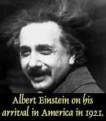

What is Gravity really?
A great scientist, Albert Einstein, who lived in the 20th century, had a new idea about gravity. He thought that gravity is what happens when space itself is curved or warped around a mass, such as a star or a planet. Thus, a star or planet would cause kind of a dip in space so that any other object that came too near would tend to fall into the dip.
Because of gravity, if you drop something, it falls down, instead of up. Well, everybody knows that!
But, what does this really mean? What is gravity?
Gravity has played a big part in making the universe the way it is. Gravity is what makes pieces of matter clump together into planets, moons, and stars. Gravity is what makes the planets orbit the stars--like Earth orbits our star, the Sun. Gravity is what makes the stars clump together in huge, swirling galaxies.
This 2-D animation gives an idea of how gravity works in 3-D.

Slide 3
What does this mean for your colony?
Use the chart on the next page to figure out what the gravity is for your planet.
Fill in the information on your Note-taking Sheet.

Slide 4
Planet | Gravity (1=Earth)
Mercury | 0.387
Venus | 0.907
Mars | 0.377
Jupiter | 2.36
Saturn | 0.916
Uranus | 0.889
Neptune | 1.12
Titan | 0.14
Europa | 0.134
TRAPPIST-1f | 0.623
Proxima Cen b | 1.215
Kepler-22b | 4.4

Slide 6
How would Gravity affect life at your colony?
How does your atmosphere compare to Earth’s atmosphere?
What affect does this have on us if we colonize there?
  What would happen to our muscles and bones?
  What would happen with our heart and blood?
  How would this affect the way we move/travel there?

Slide 7
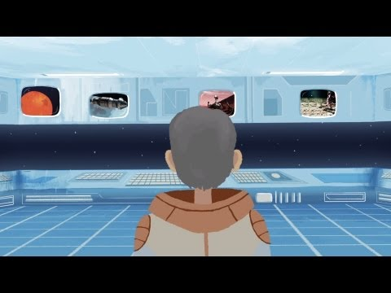
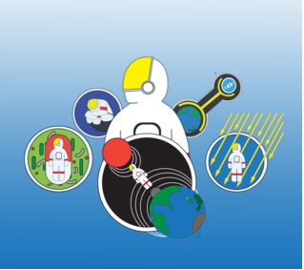
What affect does gravity have on us?

Slide 8
Dealing with Different Gravities
As a team, brainstorm ways to address having more or less gravity and the problems that are created because of it.

