Slide 1
Engaging Students with
Service Learning
Kate Highsmith, Weddington Hills ES
Andy Highsmith, Jay M. Robinson HS
http://bit.ly/HighsmithGlobal

Slide 2
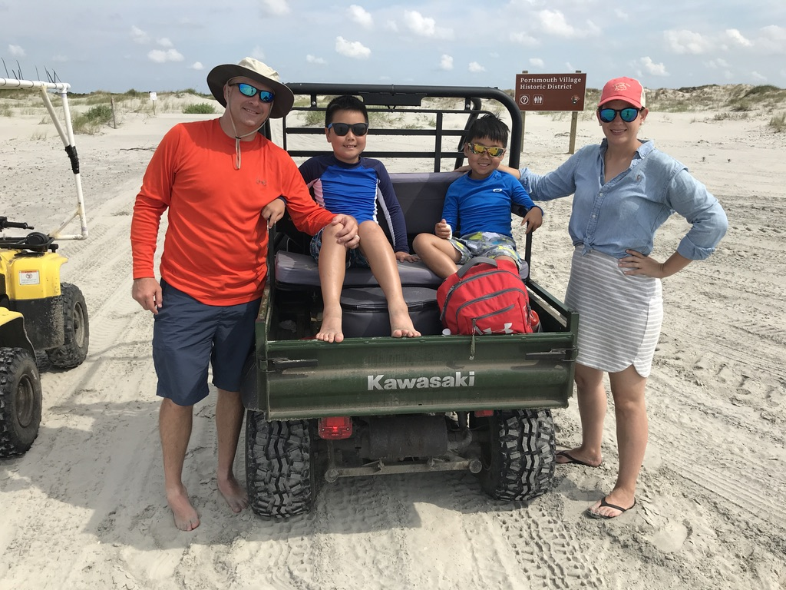
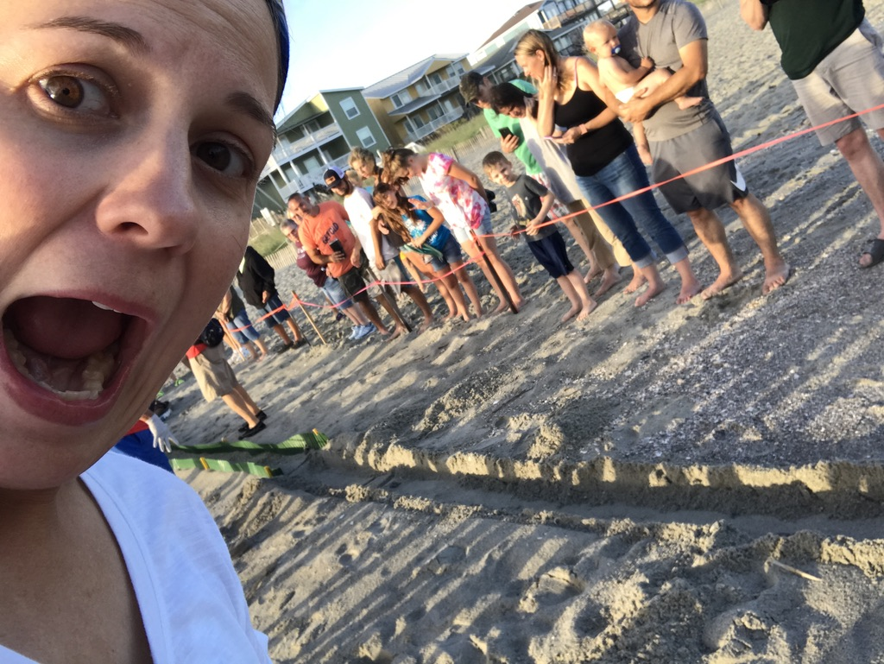
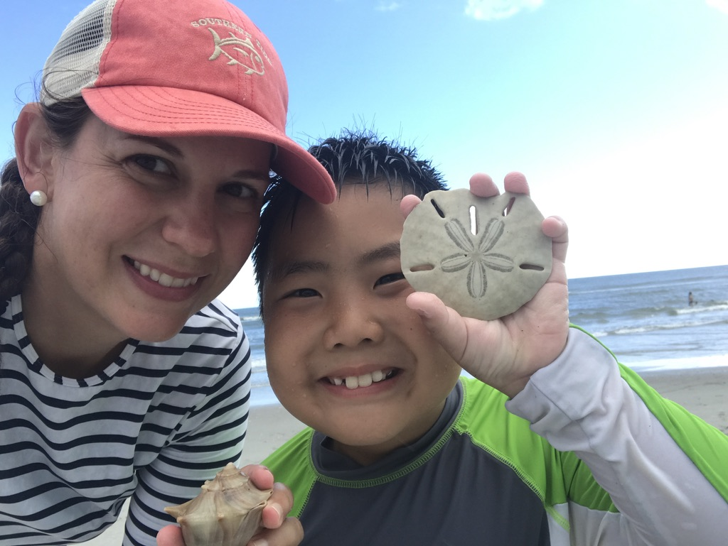
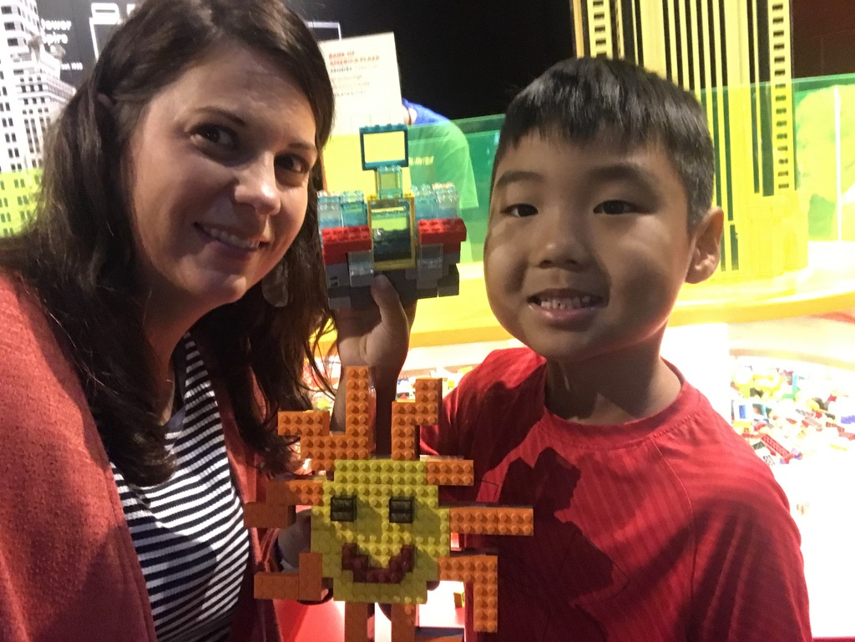
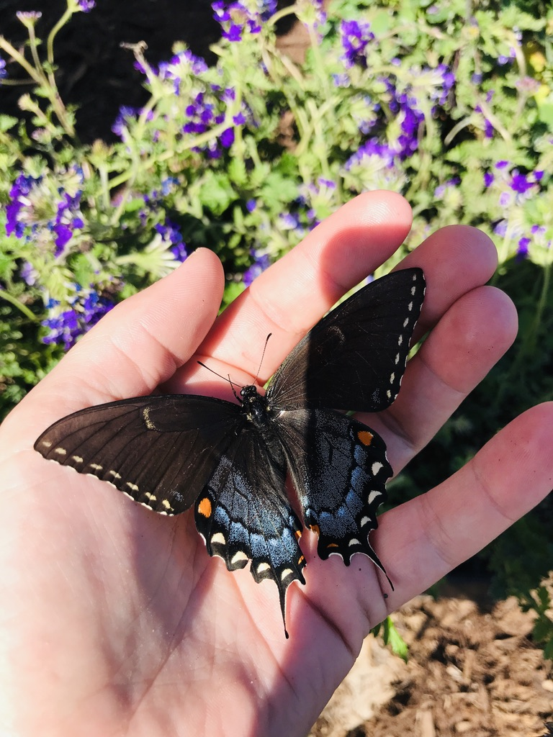
Kate Highsmith
I am a…
  Wife
  Mother
  Teacher
  Nature Lover
  Beach Comber
I am a…
➤Former Pre-K teacher
➤Former high school English teacher
➤Former high school Visual Arts teacher
➤Former middle school homeschool teacher
➤Current elementary Global Inquiry & Design special areas teacher

Slide 3
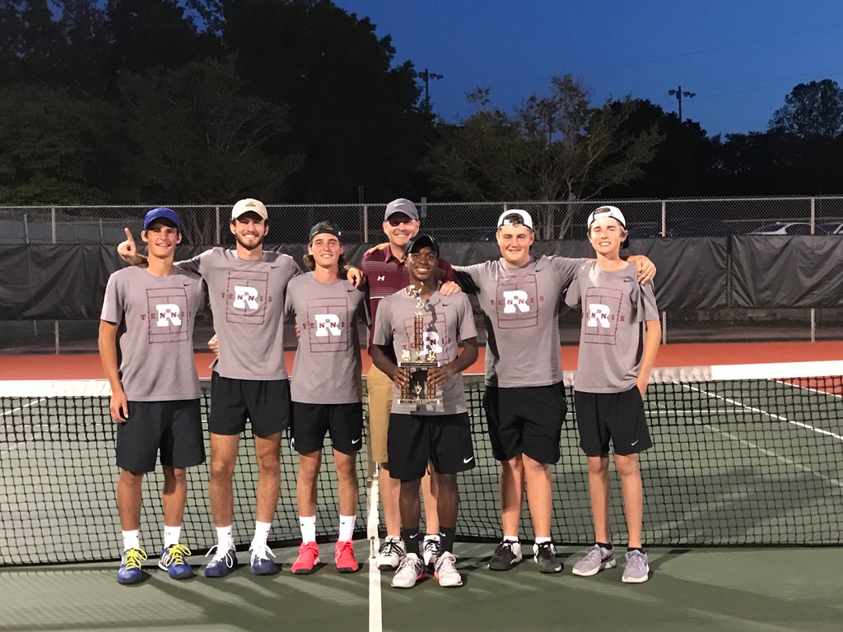
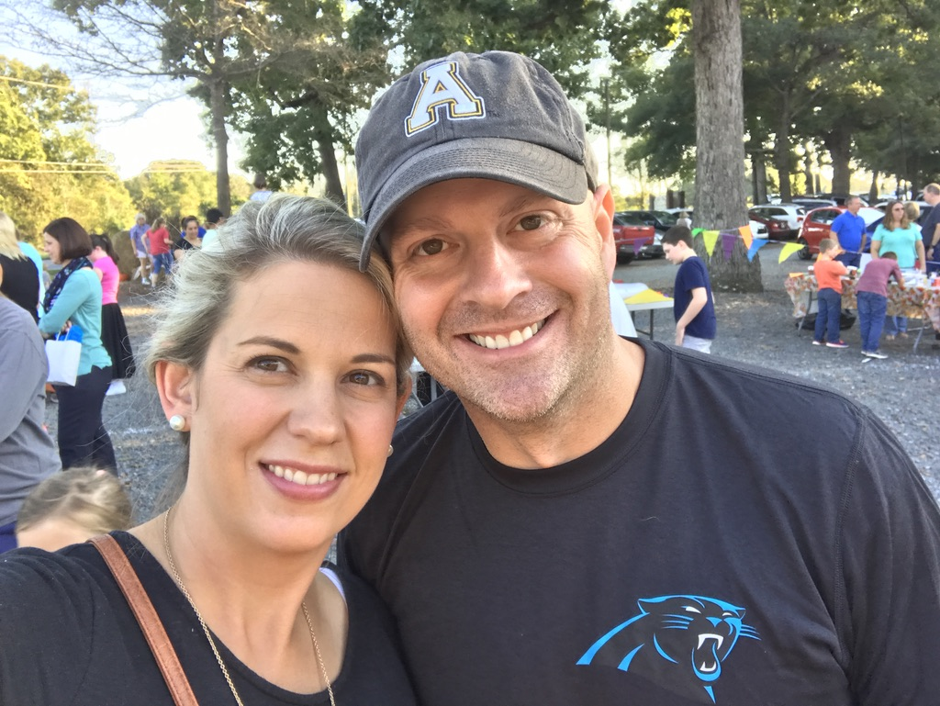
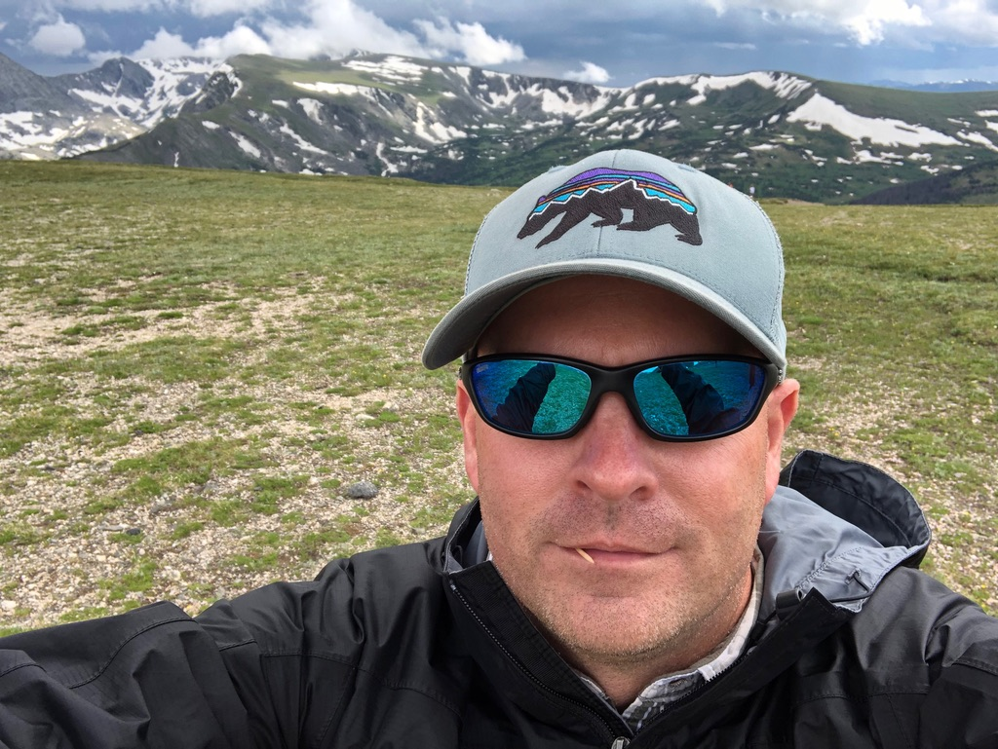
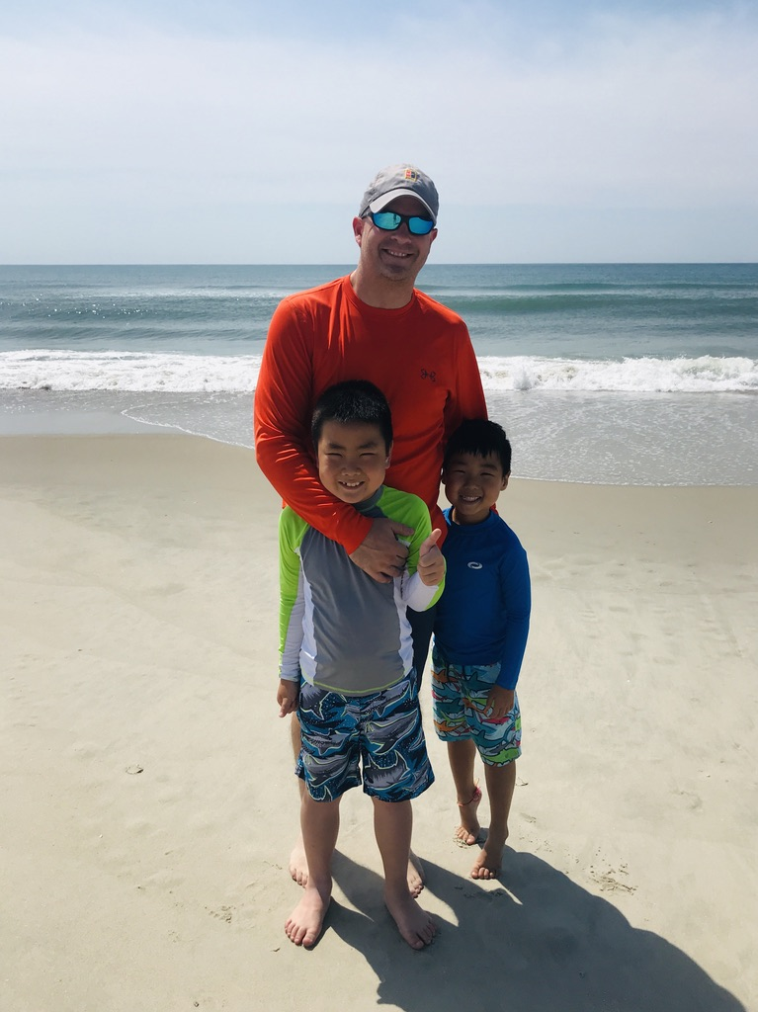
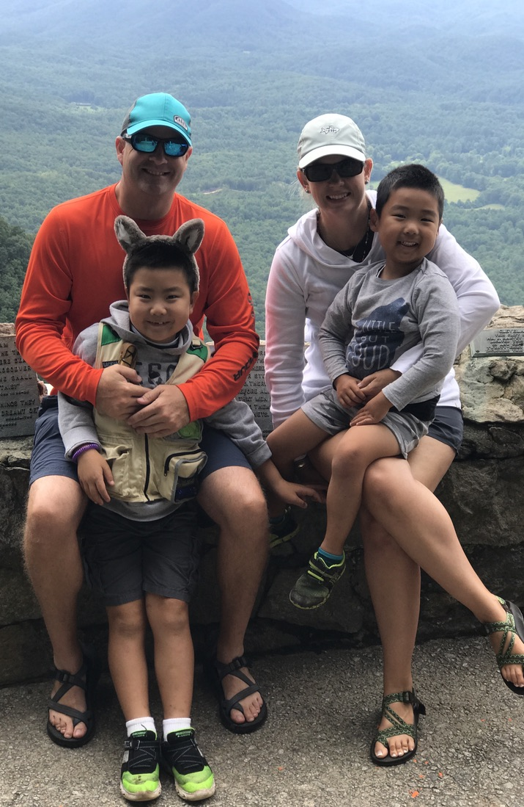
Andy Highsmith
I am a…
  Husband
  Father
  Teacher
  Sports Fan
  Mountain Hiker
I am a…
➤Former Marketing Teacher
➤Former Social Studies Teacher
➤Current Technology Facilitator/Instructional Coach
➤Current Cross Country and Men’s Tennis Coach

Slide 4
What is Service Learning?
How do you define service learning?
How do others define service learning?
According to the National Youth Leadership Council, it’s “a philosophy, pedagogy, and model for community development that is used as an instructional strategy to meet learning goals and/or content standards.”
In simpler terms, service learning is an educational method that combines academic goals with community service projects. Lessons about relevant local, national, or international issues are combined with existing course content to optimize the academic experience.
Service learning is a more student-centered approach than other forms of community service, such as volunteering. The focus is on student experiences, and the entire service project is designed around providing as much education as possible every step of the way.
In your own words, pair-share with a person close to you your definition of service learning.
If there is an odd number of people, Andy has volunteered to be a partner.

Slide 5
Benefits of Service Learning
Helps students make connections between different academic subjects by using an interdisciplinary teaching approach
Encourages students to positively contribute to their communities, while also aligning to class curriculum
Allows for a hands-on learning experience
Improves academic outcomes, attendance rates, and class engagement
Promotes mutual respect and kindness
Boosts levels of self-esteem, empathy, and responsibility
Increases awareness of community needs and local or global issues
Reduces the risk of behavioral problems in the classroom
Strengthens classroom communication

Slide 6
“engages their minds and hearts”
The beauty of service learning is that something real and concrete is occurring. Learning takes on a new dimension. When students are engaged intellectually and emotionally with a topic, they can light up with a revelation or make a connection between two previously separate ideas. What they’ve learned in school suddenly matters and engages their minds and their hearts.
Cathryn Berger Kaye, M.A.
Author of The Complete Guide to Service Learning
Video Clip

Slide 7
Image: https://quotefancy.com/quote/1207952/John-Glenn-By-its-very-definition-civic-responsibility-means-taking-a-healthy-role-in-the

Slide 8
But what does the research say?
Research from the University of South Alabama found that around 80% of students who took part in a service learning project found the experience “highly beneficial.” These students saw improvements in their communication skills, self-awareness and knowledge of community needs.
In another study from the University of Nebraska- Omaha, service learning programs improved the grade-point averages of students 76% of the time. Students in the program were more engaged, punctual and interested in course content.

Slide 9

“The aim of education is not only to prepare students for productive careers, but also to enable them to live lives of dignity and purpose; not only to generate new knowledge, but to channel that knowledge to humane ends; not merely to student government, but to help shape a citizenry that can help promote the public good.”
Ernest L. Boyer, Scholarship Reconsidered
image: https://www.goodfreephotos.com/india/other/mountain-landscapes-in-india.jpg.php

Slide 10
Take 1 minute to brainstorm local, national, or global issues that are important to you.
Take 1 minute to think, doodle, or write about one of those local, national, or international issues that is important to you.
Using the inner/out circle strategy, discuss your selected issue and its importance with a peer.

Slide 11
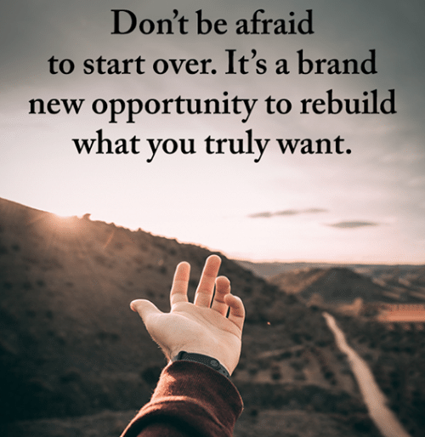
Two years ago I was given a unique opportunity. I was asked to create my own curriculum for a class called Global Inquiry & Design. The class had a title, but that was it. The rest was up to me. This opportunity gave me a chance to think about these two questions.
1. Kate, what are you not teaching about that you wish you were teaching?
2. Kate, what idea do you think our kids need to be learning about?
I finally narrowed the curriculum down to three major units: helping the planet, helping animals, and helping others.
Image: http://www.lovethispic.com/image/337777/don%27t-be-afraid-to-start-over.-it%27s-a-brand-new-opportunity-to-rebuild-what-you-truly-want.

Slide 12
Upon Reflection…
I have realized that I could have incorporated most of my class’s current lessons into the other curriculums that I have taught in my last decade of teaching. But...
I just never stopped to ask myself:
  Should I be teaching Art I differently from how my predecessor was teaching Art I?
  I am really passionate about ____, how can I incorporate that into English I?
  In my English IV class I am required to teach a lesson about ____, but can I expand that lesson to also teach my students about __________?

Slide 13
So I am asking you today…
In addition to what you are required to teach: What topic, idea, or current event do you wish you were teaching in your classroom?
What is happening in our world today that our students need to be exposed to through meaningful learning experiences?

Slide 14
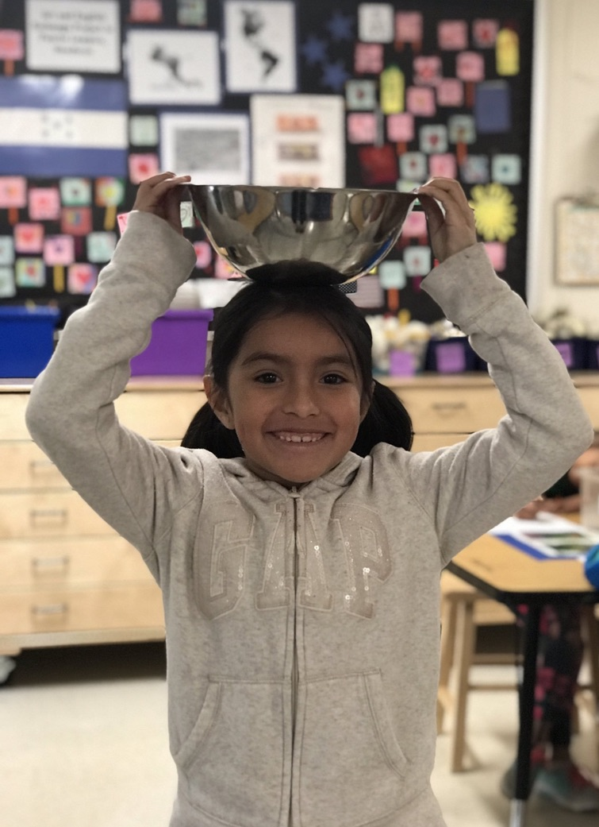
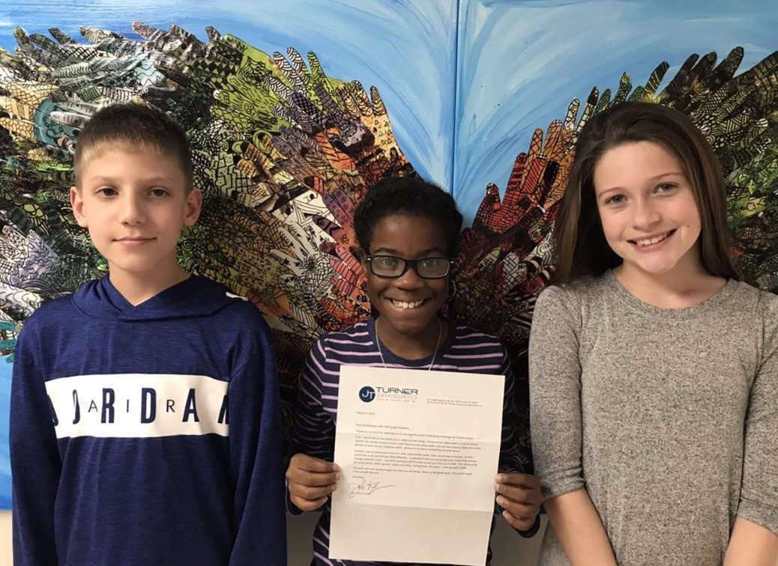
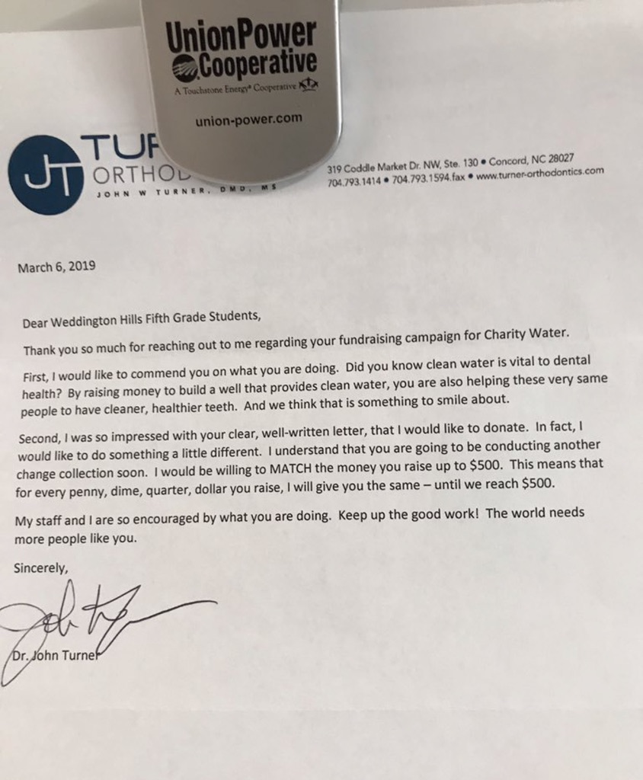
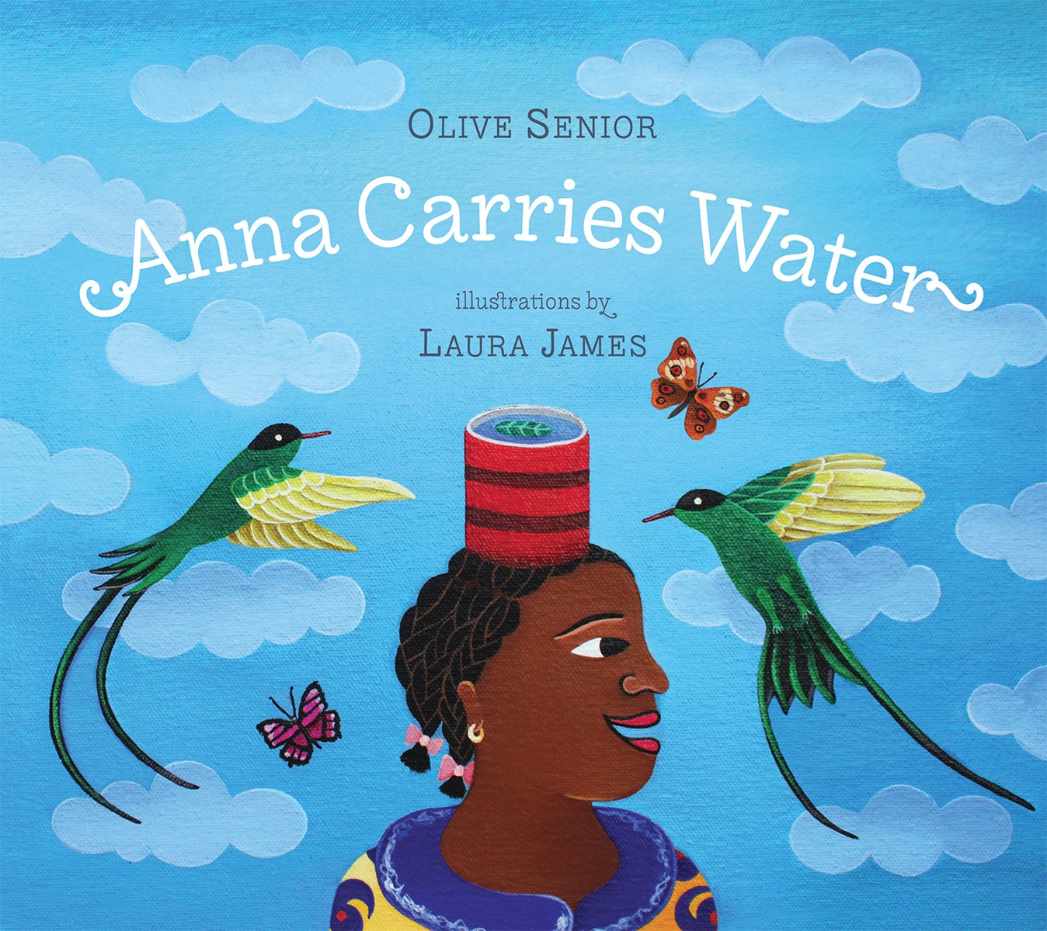
Teach the standard. Add in the service learning. Then apply it to real-life.
Example from my classroom:
Weddington Hills Elementary School is an International Baccalaureate (IB) Primary Years Program school.
One of the six IB units is ”Sharing the Planet”
Using the IB Unit Standards for K-5th grades, my students learned about the global water crisis through picture books, short video clips, and Scholastic Jr. magazine articles.
We set a school-wide goal of raising $10,000 to build a clean drinking well through Charity:Water.
Technology was meaningfully incorporated when 5th grade students wrote, filmed, and tweeted 30 second “infomercials” advocating for help to reach our goal.
Real-world writing experiences were practiced when students wrote letters to local businesses asking them to help us meet our goal by donating money.

Slide 15
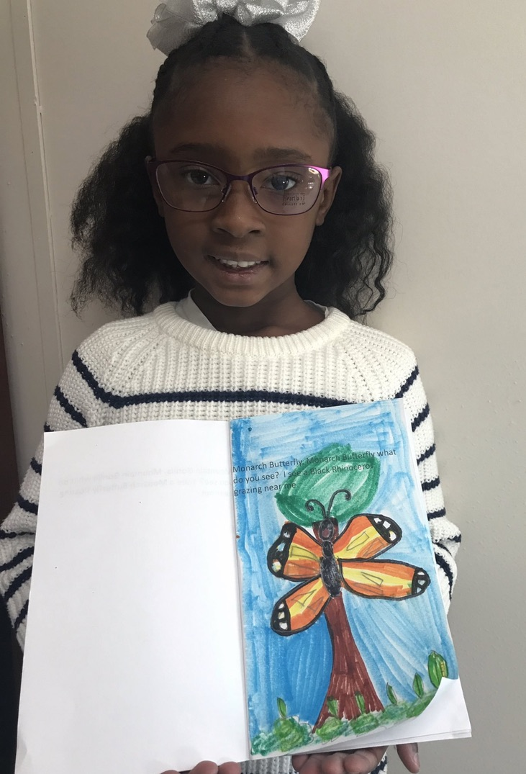
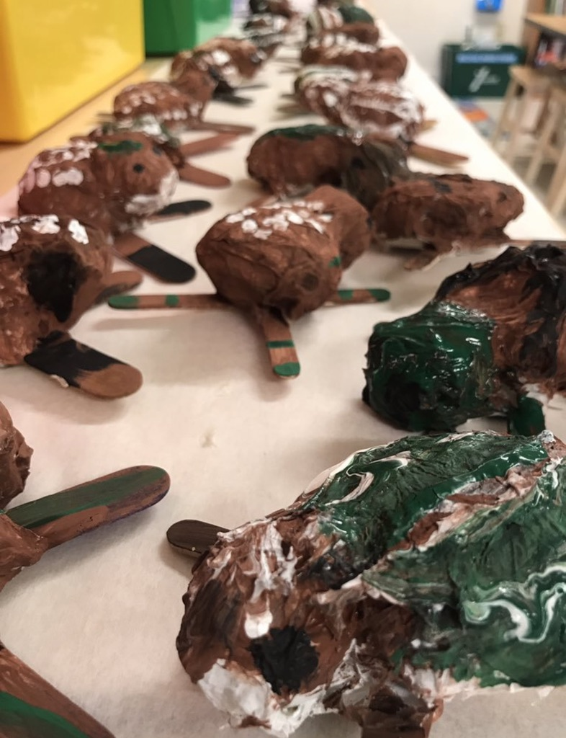
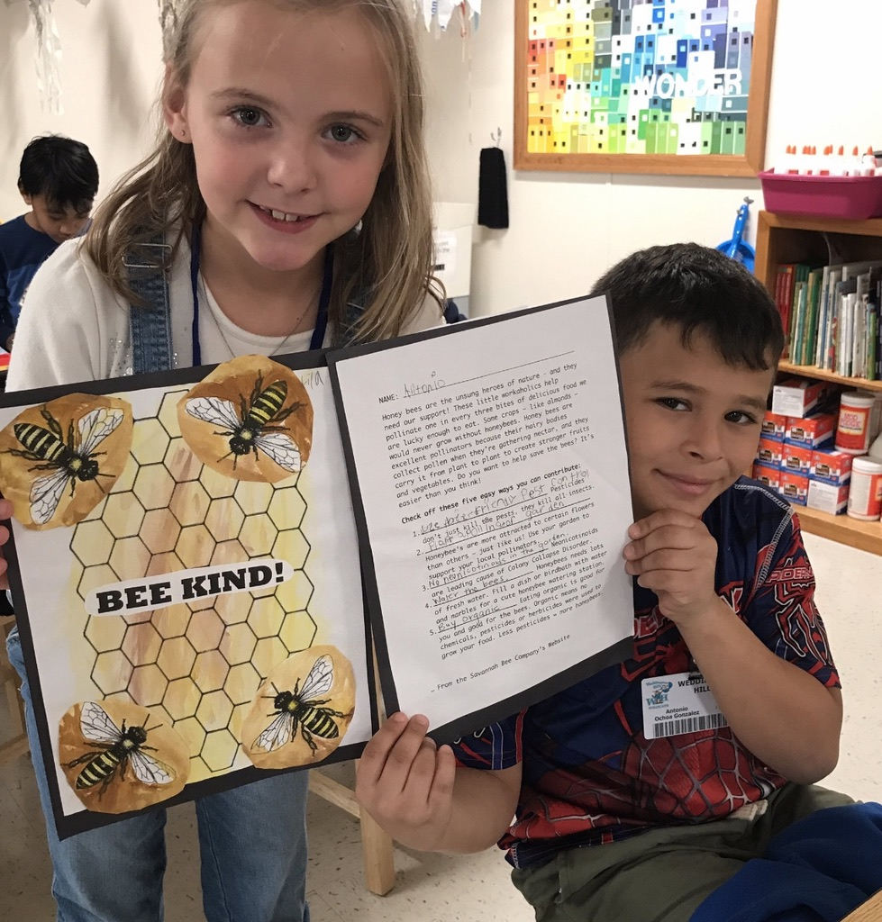
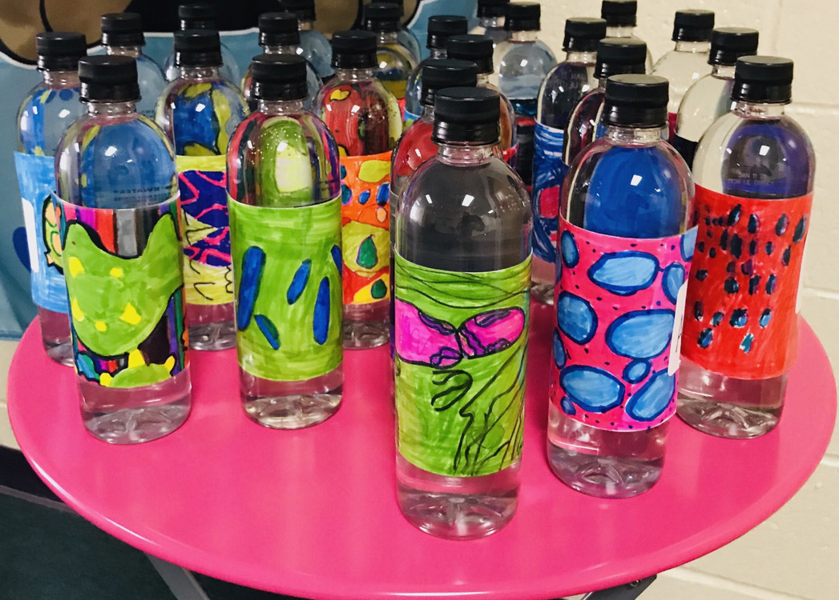
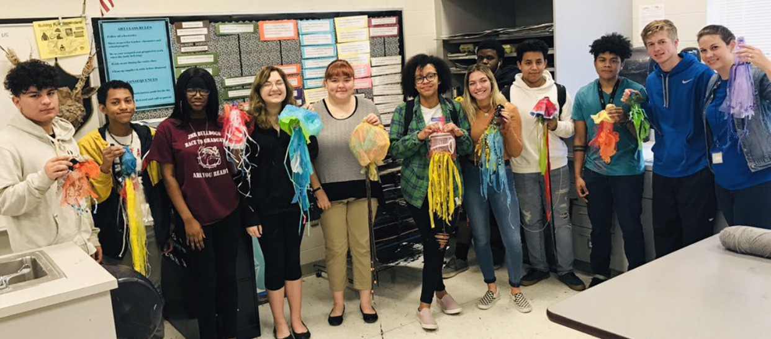
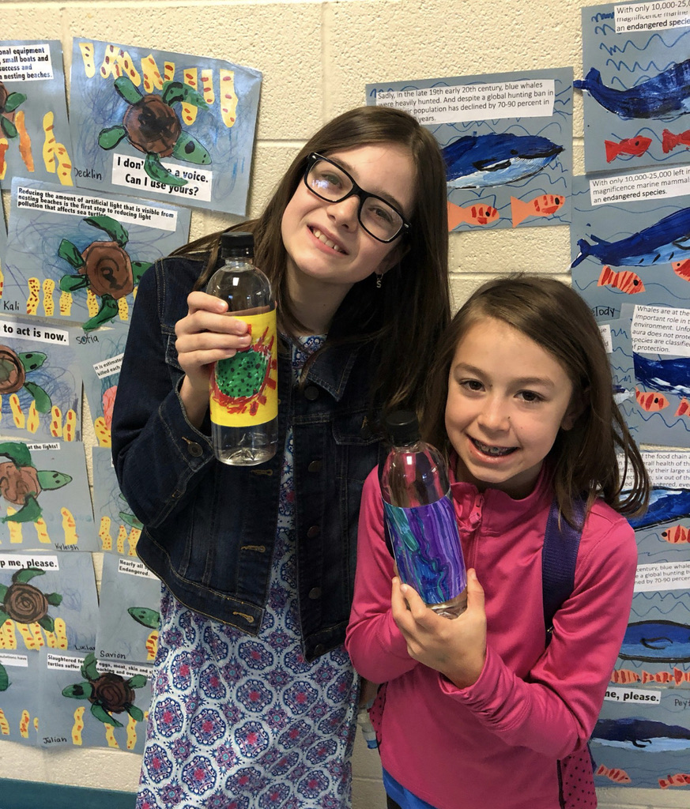
Teach the standard. Add in the service learning. Then apply it to real-life.
Examples of how to apply issues to existing curriculums:
Endangered animals could have been incorporated into my English I lessons when we read the short story “The Most Dangerous Game”. The class could research endangered animals of NC or North America. Then students could raise money to donate money to World Wildlife Foundation.
After looking at the Washed Ashore Project, my art students could have created a 3D projects using recycled plastics to raise awareness of the plastic problem in our world’s oceans, and taken the online National Geographic Pledge to reduce their individual consumption of plastic (for example: plastic straws).
Biology students could create water bottle labels focusing on water-borne germs which kill more people yearly than all forms of violence, including war.

Slide 16
Pause- Think about your own classroom and the curriculum you teach.
What’s a lesson that you are already teaching that would be strengthened with the addition of a service learning component?

Slide 17

“But what if this fails?”
- actual friend/co-worker/amazing teacher
What’s your goal?
  Student growth
  Exposure to a new idea
  Planting a seed of thought
So what would failure actually look like?
Advice:
  Set achievable goals
  Make it as interactive as possible
  Meet them at their level
  And…
It might become your ”jellyfish project”.

Slide 18
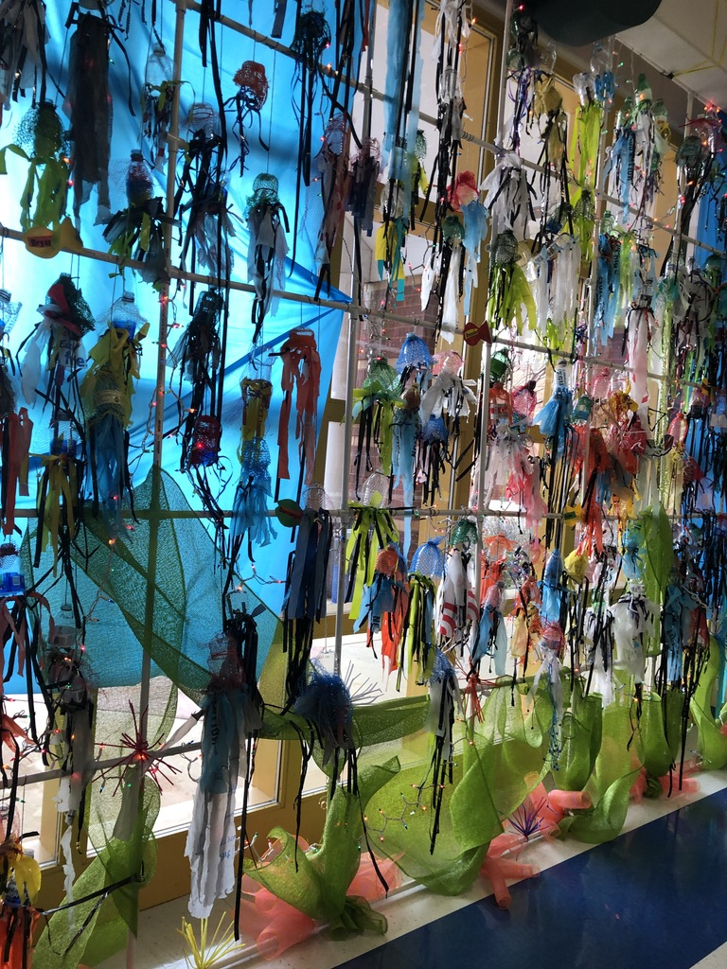
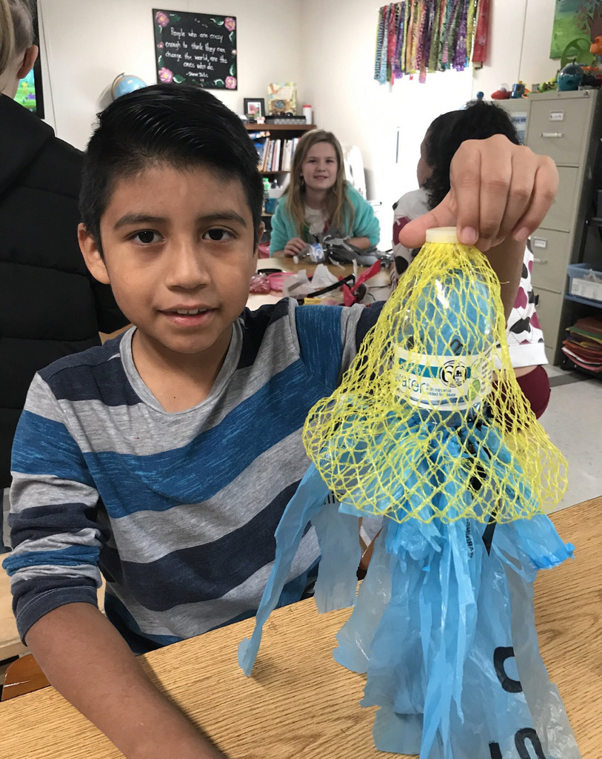
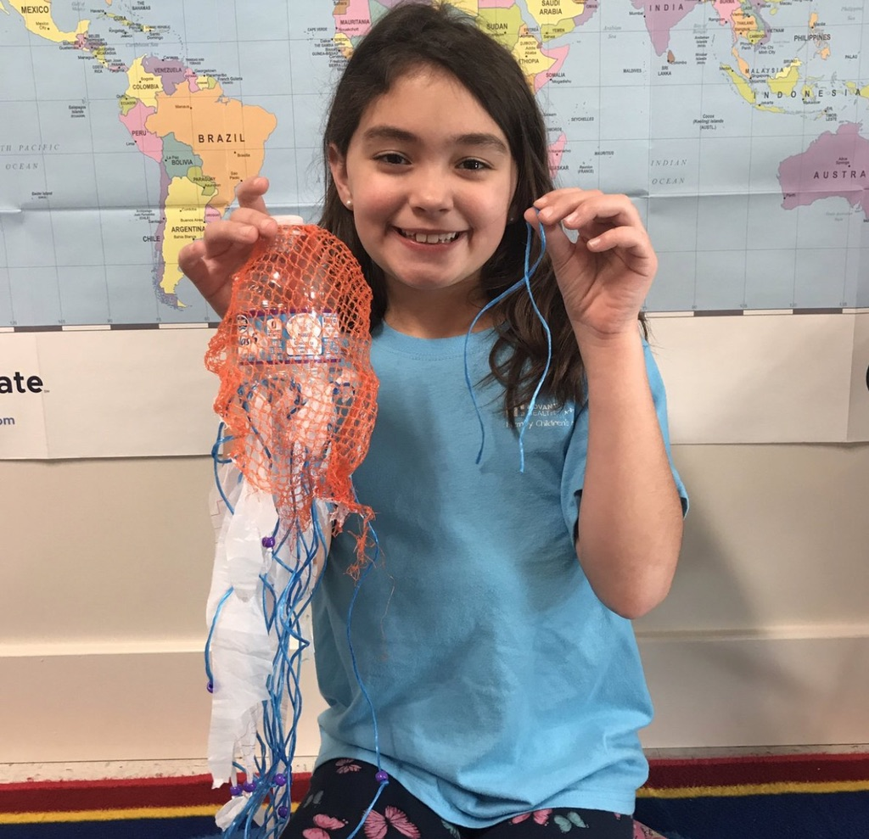
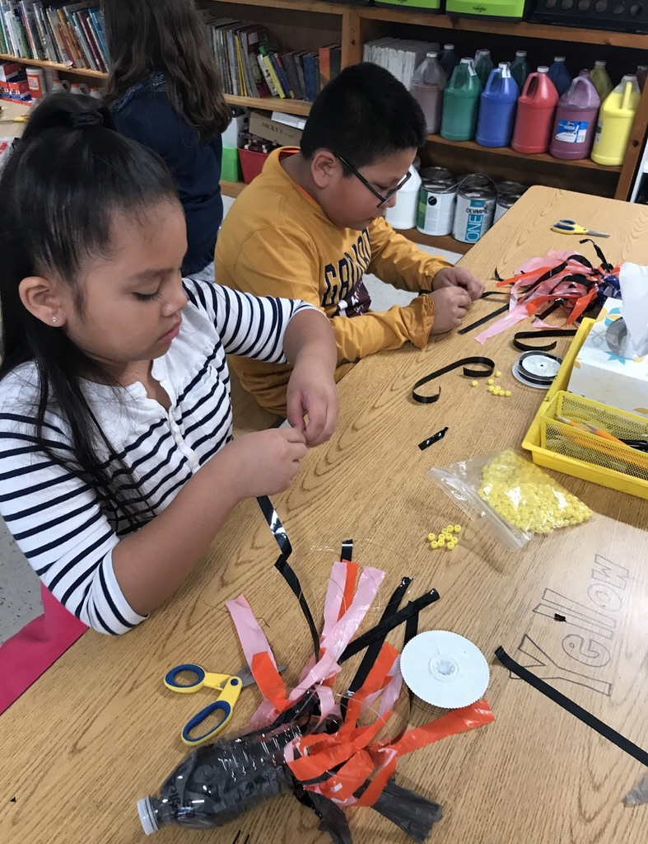

Slide 19
Give students voice and choice!
For 2018-2019,
I selected:
For 2019-2020,
they voted to focus on:
Honduras-supplies drive, friendship project, and art exchange
Global Water Crisis- Raise $10,000 to build a well in partnership with Charity:Water.
Food shortages
Endangered Land Animals
This make sense, right?

Slide 20
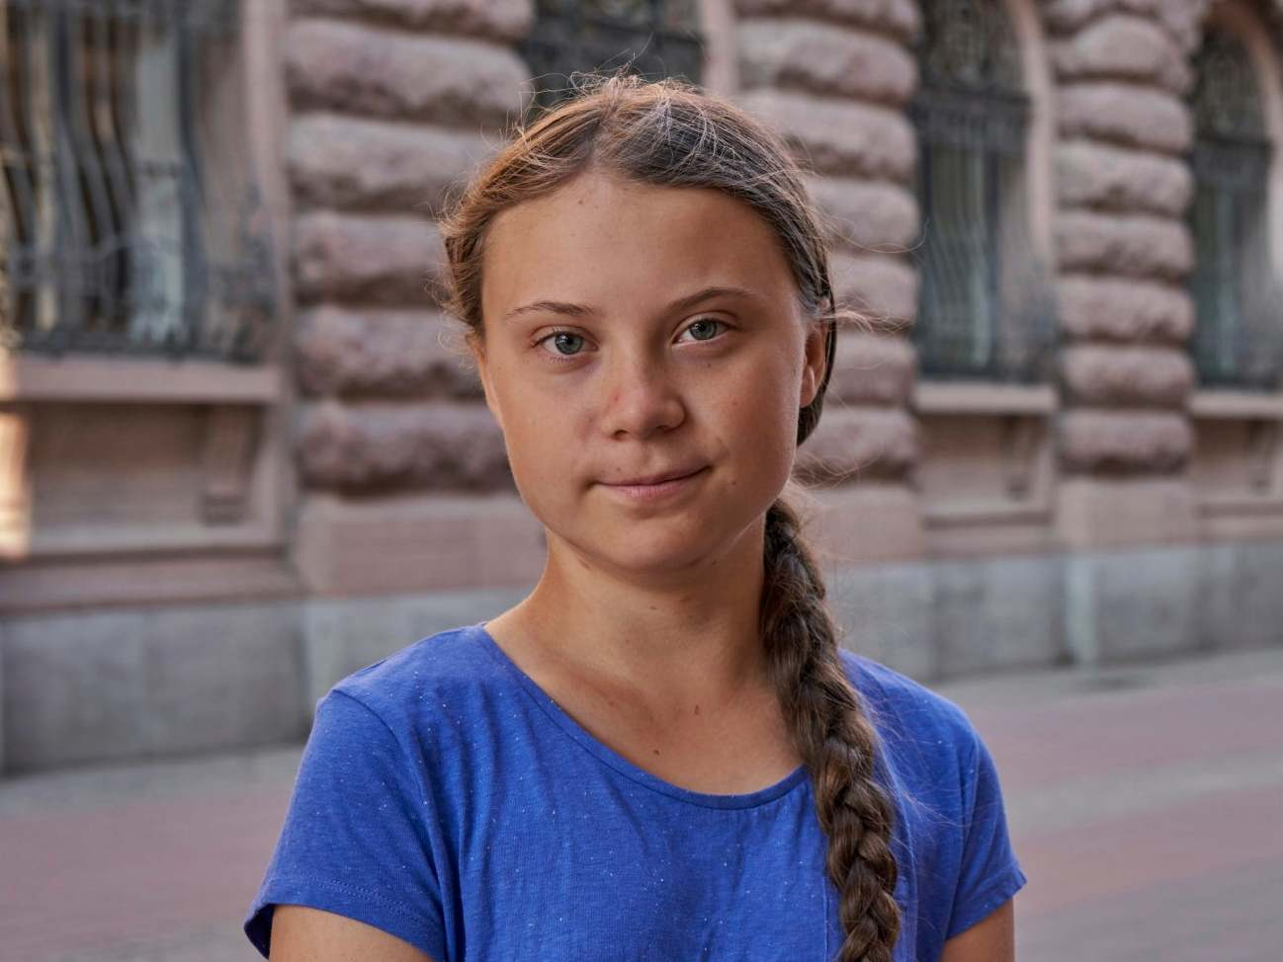
Small learners can understand big concepts-Greta Thunberg
In August 2018, Greta Thunberg started a school strike outside the Swedish Parliament to raise awareness for climate change. This has since spread all over the world and now involves over 100,000 schoolchildren. The movement is now called Fridays For Future.
Thunberg has spoken at climate rallies in Stockholm, Helsinki, Brussels and London. In December she attended the United Nations COP24 in Katowice, Poland, where she addressed the Secretary-General and made a plenary speech that went viral and was shared many million times around the globe. In January 2019 she was invited to the World Economic Forum in Davos where her speeches again made a worldwide impact.
Thunberg tries to live a low-carbon life. Therefore she is vegan, and she doesn't fly. She has been named as one of the worlds most influential teens by TIME magazine.
image: https://www.independent.co.uk/topic/greta-thunberg
Hear Greta’s own words about the need for action.

Slide 21
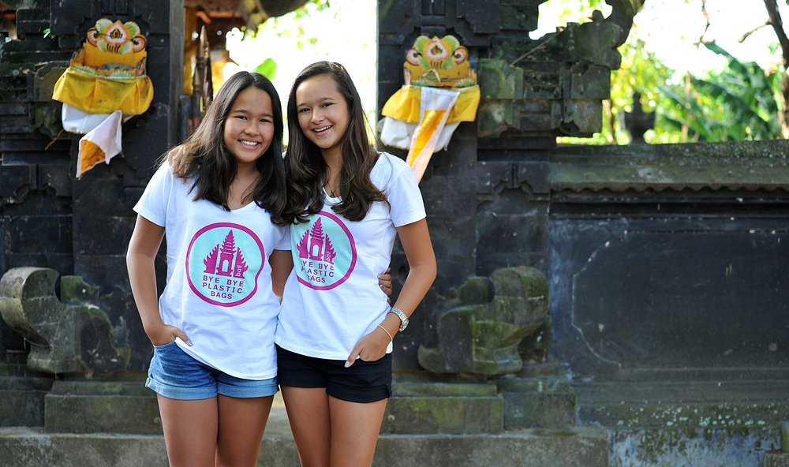
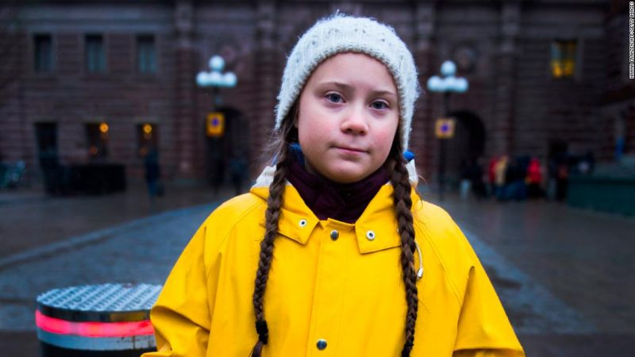
Small learners can understand big concepts-Melati and Isabel Wijsen
In 2013, Melati and Isabel Wijsen launched their flagship non-profit, Bye Bye Plastic Bags, aiming to secure a ban on single-use plastic bags across the Indonesian island. They had to be undaunted by the statistics: 5% of bags are recycled in Bali, while the entire island chain ranks as the world’s second largest producer of ocean-born plastic pollution.
Inspired in school by world leaders like Martin Luther King Jr. and Mahatma Gandhi effecting positive change, the 15- and 17-year-old have made progress towards the goal of eliminating the environmentally destructive bags.
image: https://assembly.malala.org/stories/bali-plastic-bag-free

Slide 22
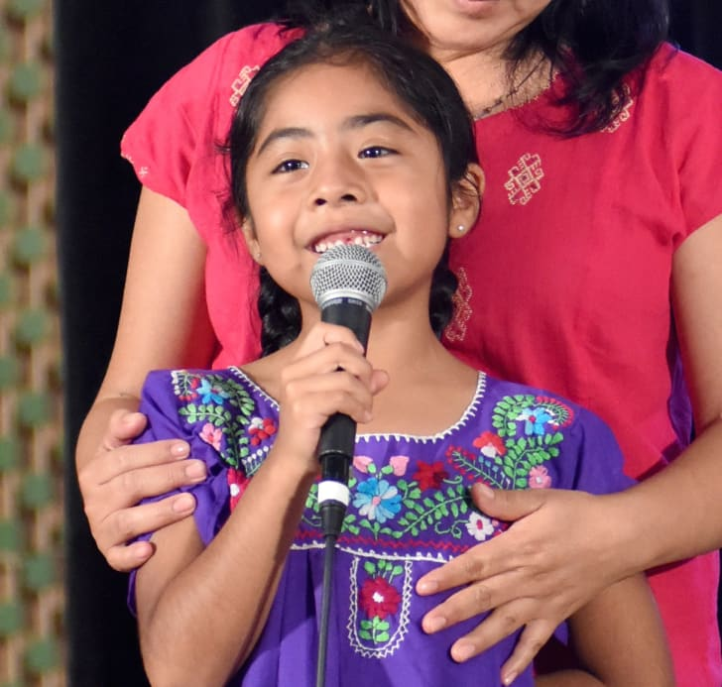
Small learners can understand big concepts-Sophie Cruz
Sophie Cruz has proven that you’re never too young to start caring about national issues, especially when your family’s fate hangs in the balance. Her story got global attention in 2015 when, at just 5 years old, she handed the Pope a letter and a hand-drawn illustration in hopes that he could help change U.S. immigration laws, which threaten to deport her parents, who are both undocumented immigrants. The illustration was of Cruz, her family, and the Pope joining hands, with “My friends and I love each other no matter our skin color,” written in Spanish across it.
Her story continued at the Women’s March in January 2017, where she made a speech to the crowd in both English and Spanish, pleading with them to fight for immigrants around the country. “We are here together making a chain of love to protect our families,” Cruz, who was just 6 at the time, told the massive crowd. “Let us fight with love, faith, and courage so that our families will not be destroyed.” Cruz's story has become a rallying cry for nonprofit organizations like Fighting for Families.
image: https://www.vibe.com/2017/01/sophie-cruz-womens-march-speech

Slide 23

Small learners can understand big concepts-“Miss J” a 1st grader at WHES
WHES students participated in two “change for change” drives. Students were asked to bring spare change Monday-Friday.
Miss J donated money from her own piggy bank.
Next, she asked her uncle and cousins to donate as well.
Then, Miss J collected $21 from her family members.
With Miss J’s help, WHES exceeded its $10,000 goal!

Slide 24
NC Service Year- A Better You. A Greater Us. https://about.serviceyear.org
Service learning does not have stop at graduation. NC Year of Service offers our seniors another opportunity to consider when planning that next step.
What is it?
  https://www.youtube.com/watch?v=3VrPHhTFHGs&feature=youtu.be
Who can participate?
  Individuals ages 18-28.
  GED or High School diploma
Benefits?
  Paid year of service
  Gain Leadership Skills
  Build your resume/application
What can we as educators do?
  Spread the word and start young!
  Present it as a option for graduating seniors.

Slide 25
This school year:
Teach One Lesson
https://www.learningtogive.org/

Slide 26
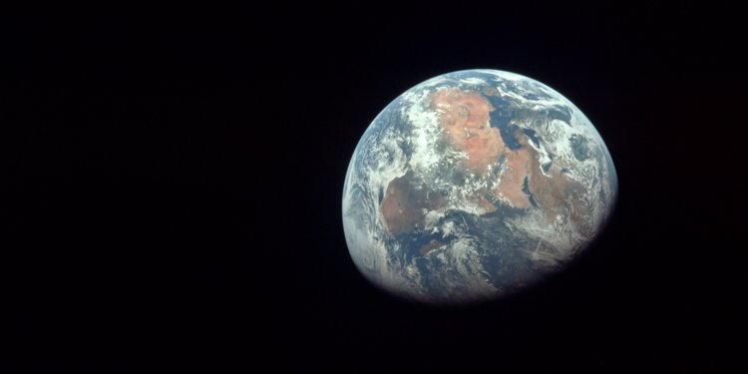
As adults, our future is already in motion. Our students, however, still have the opportunity to take on the world. They will be tasked with the great responsibility and burden of straightening out the global crises that generations before them have contributed to: pollution, climate change, disease, and food shortages. We are relying on our children and the education they receive to ensure that, for generations to come, we live in a world of peace that is driven by people who have the ability to love, communicate, and collaborate. Our students are the opportunity for a better future.
-Hamish Brewer
Relentless
image: https://www.businessinsider.com/best-photos-earth-moon-from-deep-space-2017-3

Slide 27
Thank you for
Your Time!
katherine.highsmith@cabarrus.k12.nc.us--Twitter @WHES_Global
andrew.highsmith@cabarrus.k12.nc.us

