Slide 1
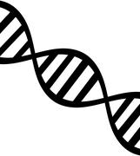
DNA
The genetic information of an organism

Slide 2
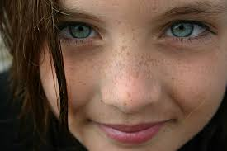
Inherited Trait
Characteristics that are passed from parents to their offspring.

Slide 3
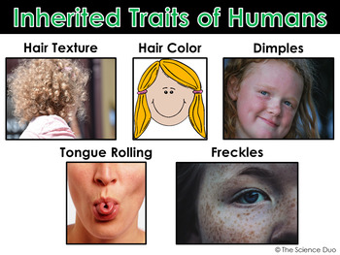
Trait
A characteristic that an organism can pass on to its offspring through its genes.

Slide 4

Organism
A living thing that has (or can develop) the ability to act or function independently.

Slide 5
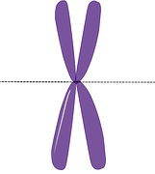
Gene
A factor that controls a trait.

Slide 6
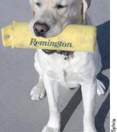
Learned Behavior
Behaviors that are developed by observing other or by being taught.

Slide 7
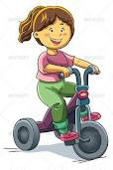
Acquired Trait
Characteristics that an organism develops AFTER it is born. Examples: 1) a very thin bear because there is not enough food 2) a scar on your chin from hitting a table 3) riding a bike 4) playing hopscotch with a friend 5) singing a song you know on the radio

Slide 8
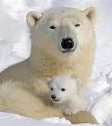
Offspring
New organisms that come from parent organisms

Slide 9

Instinct
A natural, untaught behavior or reaction

Slide 10
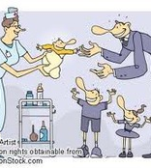
Heredity
The genetic transfer of characteristics from parent to offspring.

