Slide 1
Fundamentals of Biomechanics
IB SEHS- SL

Slide 2
Biomechanics
Biomechanics: Applications of mechanics to the human body and sporting
implements, and studies forces on (and by) the human body and subsequent
results of those forces
Kinematics: study of motion (change in position) of a body or object
Kinetics: forces involved in the movement of an object or body
Linear motion: in a straight line
Angular (rotational) motion: around an axis
General motion: linear and angular motion together
Linear kinetics: force, gravity, mass and weight
Angular kinetics: torque (moments), levers
Curvilinear motion: in a curve

Slide 3
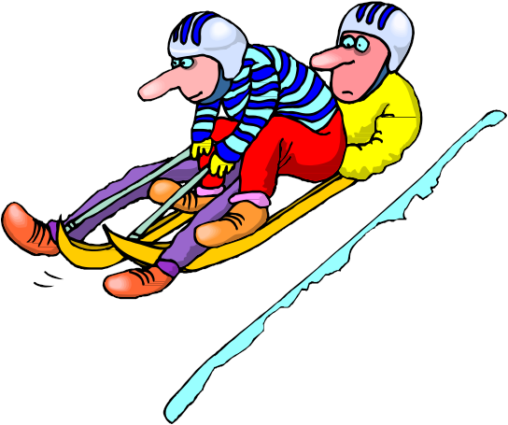
Biomechanics
Motion -Linear
When a body moves in a straight line with all its parts moving the same DISTANCE, DIRECTION, and SPEED
Everything is moving in the same direction and at the same speed
SPORTING EXAMPLE =THE BOB SLEIGH
(TOBOGGAN)

Slide 4
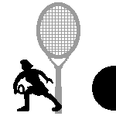


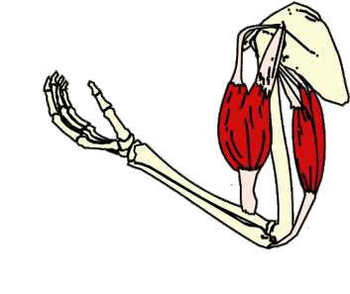
Biomechanics
Motion -Angular
When a body or part of a body moves in a circle or part of a circle about a point (the axis of rotation).
Circular motion about a point. i.e. The elbow being fixed when the forearm moves in a half circle in a tennis serve.

Slide 5
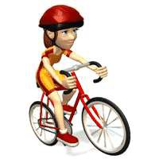
Biomechanics
Motion -General
General motion is a combination of Angular and Linear motion
General = Angular + Linear
SPORTING EXAMPLE = Javelin
Wheel chair athletics
Swimming
Running

Slide 6
Biomechanics
A Scalar quantity has only magnitude
A Vector quantity has both magnitude and direction
PAIRS ACTIVITY:
Sort the following quantities into vector and scalar quantities
• velocity • pressure
• acceleration • length
• lift • drag
• mass • density
• volume • weight
• energy • momentum
• force • power
• work • speed

Slide 7
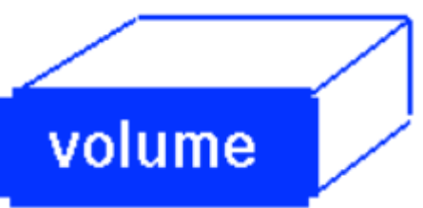

Biomechanics
A Scalar quantity has only magnitude
A Vector quanitity has both magnitude and direction
Scalar Quantities
Length Area
Volume Speed
Mass Density
Pressure Temperature
Work Power
Energy
Vector Quantiites
Displacement Direction
Velocity Acceleration
Momentum Force
Lift Drag
Thrust Weight
NOW COPY THIS INTO YOUR WORKBOOK!

Slide 8
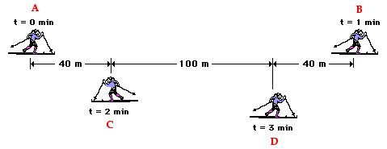
Biomechanics
Distance
Distance (d) – how far an object travels
Does not depend upon direction
In the example below, what is the distance that the skier travels from point A to point B?
d = A to C + C to D + D to B
d = 40 m + 100 m +40 m
d = 180 m

Slide 9
Biomechanics
Distance
Distance (d) – how far an object travels
Does not depend upon direction
In the example below, what is the distance that the skier travels from point B to point C?
d = B to D + D to C
d = 40 m + 100 m
d = 140 m
Does the direction change the answer?

Slide 10
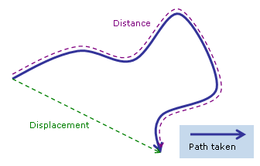
Biomechanics
Displacement
Displacement (s) – the difference between an objects final position (R_{f}) and its initial position (R_{i})
Displacement DOES depend on direction
In order to define displacement, we need direction.
Example of directions:
      + and –
      N, S, E, W
      Angles

Slide 11
Biomechanics
Distance vs Displacement
Now lets look at the displacement of the skier. If we consider that moving to the right is in a positive (+) direction and moving to the left is in a negative (-) direction, lets find the displacement of the skier from point A to point B
d = A to C + C to D + D to B
d = (+40 m) + (+100 m) + (+40 m)
d = +180 m
The positive (+) gives the skier direction

Slide 12
Biomechanics
Distance vs Displacement
Let’s again look at the displacement of the skier. If we consider that moving to the right is in a positive (+) direction and moving to the left is in a negative (-) direction, lets find the displacement of the skier from point B to point C
d = B to D + D to C
d = (-40 m) + (-100 m)
d = (-140 m)
The negative (-) gives the skier direction

Slide 13
Biomechanics
Distance vs Displacement
Examples of distance:
The skier traveled 180 m
Example of displacement:
The skier traveled + 140 m
An object’s distance traveled and its displacement are not always the same

Slide 14
Biomechanics
Distance vs Displacement
Find the displacement of the skier as they travel from point A to point B to point C and finally to point D. What is their final displacement?
d = A to B +180 m
d = B to C -140 m
d = C to D +100 m
180 – 140 + 100 = +140

Slide 15
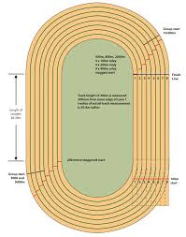
Biomechanics
Distance vs Displacement
An athlete runs around a 400 m track three times, then they stop.
What is the distance traveled?
1200 m
What is the displacement?
0 m
NOW TRY THE ACTIVITY IN YOUR WORKBOOK!

Slide 16
Biomechanics
Homework:
Read pages:
83-84, 86, 88-92
Do page 105 questions:
5, 6, 7, 9

Slide 17


Biomechanics
Starter
Individual Problem
Suppose you run three different paths from a to b. Along which path(s) would your distance travelled be different from your displacement
Path 1 Path 2 Path 3
A B

Slide 18
Biomechanics
Learning Objective
Define velocity and acceleration
Calculate velocity for sporting examples
Analyse velocity-time and distance-time graphs for sporting actions

Slide 19
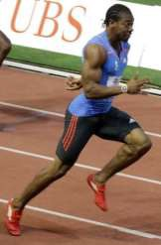
Biomechanics
Speed vs Velocity
Speed is simply how fast you are travelling
Yohan Blake is travelling at a speed of 10 m/s

Slide 20
Biomechanics
Speed vs Velocity
Velocity is speed in a given direction
Yohan Blake is travelling at a speed of 10 m/s East

Slide 21
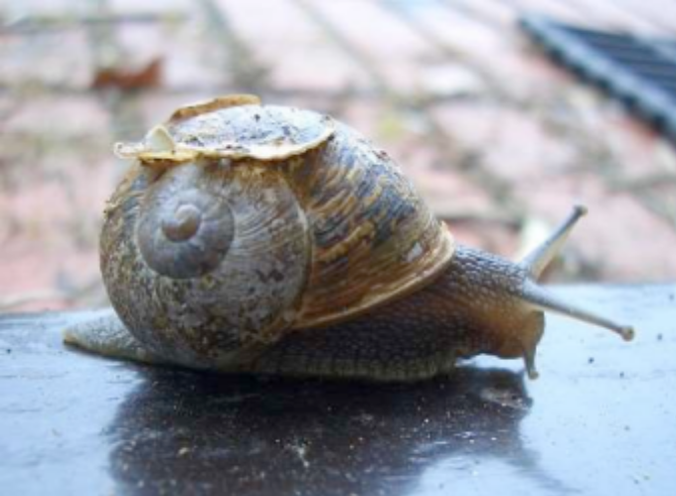
Biomechanics
Speed (Velocity)
Speed = Distance travelled Meters
(Velocity) Time taken Second

Slide 22
Biomechanics
Formula Triangle
D
D = S x t
S (v) x t

Slide 23
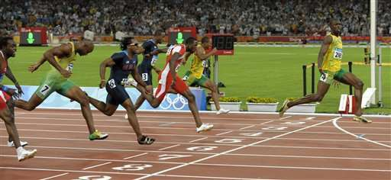
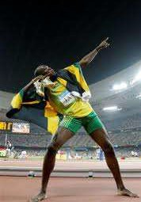
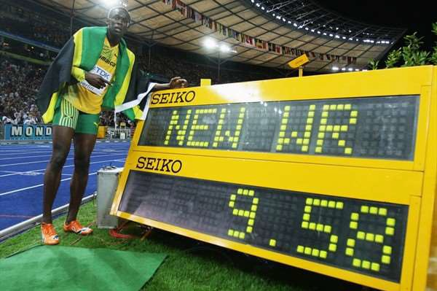
Biomechanics
Group Activity
Usian Bolt ran 100 m in 9.58 seconds, what was his average speed?
10.43 m/s

Slide 24
Biomechanics
Individual activity
• Try the practice questions in your booklet
Lionel Messi kicks a ball 6.5 meters. How much time is needed for the ball to travel this distance if its velocity is 22 meters per second, south?
t= d/s = 6.5m / 22ms-1 = 0.3s

Slide 25
Biomechanics
Individual activity
Andy Murray serves a tennis ball to Rafael Nadal. It travels 9.5 meters south in 2.1 seconds.
a. What is the velocity of the tennis ball?
v= d/t = 9.5m/2.1s = 4.5 ms-1 South

Slide 26
Biomechanics
Individual activity
b. If the tennis ball travels at constant speed, what is its velocity
when Nadal returns Murray’s serve?
4.5 ms-1 north

Slide 27
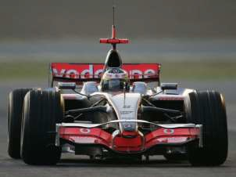
Biomechanics
Acceleration
Acceleration = Change in velocity
Time Taken
Example:
A Formula 1 McLaren can do from 0 – 300,000m in 8.6 seconds. What is the acceleration?
This is ~ 186 m/h
Velocity (v) = 300000 m/h -0 m/h = Δ v = 300000 m/h
8.6 s 8.6 s

Slide 28
Biomechanics
NOW TRY THE ACTIVITY IN YOUR WORKBOOK!
Acceleration
Acceleration = Change in velocity
Time Taken
Example:
A Formula 1 McLaren can do from 0 – 300000 m/h in 8.6 seconds. What is the acceleration?
This is ~ 186 m/h
Acceleration (a) = Δ v = 300000 m/h
t 8.6 s
300000 m/h is 83.3 m/s a = 83.3 m/s = 9.7 m/s²
8.6 s

Slide 29
Biomechanics
1. A skater goes from a standstill to a speed of 6.7 m/s in 12 seconds. What is the acceleration of the skater?
6.7 m/s = 0.56 m/s²
12 s
2. As a shuttle bus comes to a normal stop, it slows from 9.00m/s to 0.00m/s in 5.00s. Find the average acceleration of the bus.
- 9 m/s = - 1.8 m/s²
5 s

Slide 30
Biomechanics
3. During a race, a sprinter increases from 5.0 m/s to 7.5 m/s over a period of 1.25s. What is the sprinter’s average acceleration during this period?
2.5 m/s = 2.0 m/s²
1.25 s
4. A wheel chair athlete starts from rest and accelerates at a constant rate of 1.500 m/s². What is the speed of the athlete after it they have traveled for 4.75 seconds?
4.74 s x 1.5 m/s² = 7.125 m/s

Slide 31
Biomechanics
5. During a 1600 m race, a runner starts their kick to the finish at the 1400 m mark to the finish at 1600 m, it takes them 28 seconds to cover that distance. What is their average speed?
200 m = 7.14 m/s
28 s
6. A cyclist is traveling at an average speed of 12 m/s. After 15 minutes how far will they have traveled?
15 min x 60 s = 900 s
12 m/s x 900 x = 10,800 m or 10.8 km

Slide 32
Biomechanics
7. A cyclist accelerates at 0.89m/s² during a 5.0s interval. What is the change in the speed of the bicyclist and the bicycle?
0.89m/s² x 5.0 s = 4.45 m/s
8. If a rocket undergoes a constant total acceleration of 6.25m/s², so that its speed increases from rest to about 750m/s, how long will it take for the rocket to reach 750m/s?
750 m/s = 120 s
6.25m/s²

Slide 33
Biomechanics
9. A cyclist’s speed changes from 2 m/s to 7 m/s in 4.2 s. What is their acceleration?
5 m/s = 1.19 m/s²
4.2 s

Slide 34
Biomechanics
10. A group of bike riders took a 4.0-hour trip. During the first 3.0 hours, they traveled a total of 50. kilometers, but during the last hour they traveled only 10. kilometers. What was the group's average speed for the entire trip?
50 km = 16.67 km/hr x 3/4 of the total time = 12.5 km/hr
3 hr
10 km = 10 km/hr x 1/4 of the total time = 2.5 km/hr
1 h +
Answer 15 km/hr

Slide 35
Biomechanics
10. A group of bike riders took a 4.0-hour trip. During the first 3.0 hours, they traveled a total of 50. kilometers, but during the last hour they traveled only 10. kilometers. What was the group's average speed for the entire trip?
Speed = Distance
Time
50 miles in 3 hours
10 miles in 1 hour
Total of 60 miles in 4 hours
Average Speed = 60 mi/4 hr = 15 mi/hr

Slide 36
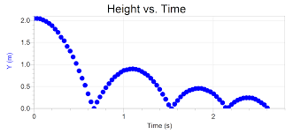
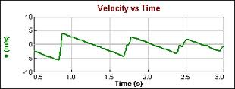
Biomechanics
On a separate piece of paper sketch BOTH a velocity- time graph and a distance-time graph for the following scenarios
• A basketball is dropped on the court and allowed to bounce up and down several times undisturbed.

Slide 37
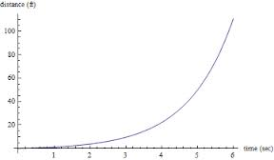
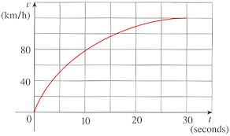
Biomechanics
On a separate piece of paper sketch BOTH a velocity- time graph and a distance-time graph for the following scenarios
• A car on a test track performing a zero-to-sixty acceleration test. (This acceleration will not be uniform.)

Slide 38
Biomechanics
On a separate piece of paper sketch BOTH a velocity- time graph and a distance-time graph for the following scenarios
A race between a tortoise and a hare that unfolds just
like the fable of the same name.

Slide 39
Biomechanics
Now complete the problems in your workbook.

Slide 40
Biomechanics
Groups
Aliani | Quezada
Caroline | Burchfield
Grace | Rotan
Israel | Lopez
Javier | Ortiz
Jordan | DiOrio
JaNajia | Lotharp
Kayla | Spivey
Kevin | Vargas
Kevin | Rogers
Kaitlyn | Kunder
Lauren | DiOrio
Makensie | Alcon
Mary | Ferguson
Marisa | Iacovazzi
Max | McKercher
Olivia | Rotan
Ryan | Clements
Sam | Caron
Tessa | Basinger

Slide 41
Biomechanics
Procedure:
The starter will drop their arm and say go and the timers will all started their watches.
At each 10m interval the timekeepers will stop their watches as the runner passes them.
The runner will then return to the start and record the times from each of the 10m interval stations.
They will then become the timer at the 100 m mark.

Slide 42
Biomechanics
Rotation
Everyone will have a chance at each of the positions. The rotation goes like this:
  The person who runs will end up at the finish line, they will walk back to the start and record your times on your sheet and end up back at the finish line with all of your data collected. You will then take the stop watch from the person who is at the 100m mark.
  The person who was at the 100m mark will move toward the start line to the 90m mark and take watch from that person.
  This will continue until you have reached the 10m mark.
  After you have recorded the 10m time for the runner, you go to the field and warm up.
  The next in the warm up area will be the next subject to run the 100m
  That finishes the rotation.
The instructor will be the starter and makes sure the runners are ready and the timers are all in position and ready with their watches before starting the next subject

Slide 43
Biomechanics
Now, let us head outside and administer the lab.
Everyone will participate at the level they are able, so they can have their own data to calculate from.
Due Thursday November 14

Slide 44
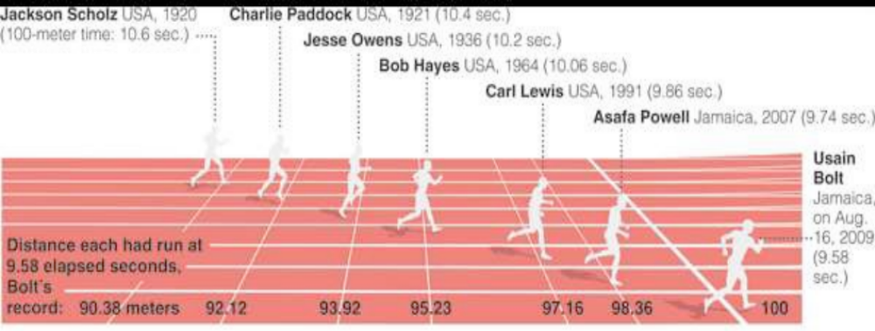
Biomechanics

Slide 45
Biomechanics
Read the article in your workbook
Hero or villain? Ben Johnson and the dirtiest race in history
Make sure you can define all the words in bold.

Slide 46
Biomechanics
Make sure you can define all the words in bold.
Blocks:
a device used in the sport of track and field by sprint athletes to hold their feet at the start of a race so they don't slip as they push out at the sound of the gun.
Feinted:
movement made in order to deceive an adversary; an attack aimed at one place or point merely as a distraction from the real place or point of attack

Slide 47
Biomechanics
Inevitably:
sure to occur, happen, or come true; no alternative
Incredulity:
inability or unwillingness to believe
Eulogized:
to praise of highly
Delegation:
a group of members of an organization chosen to represent the members at a meeting or assembly

Slide 48
Biomechanics
Regime:
a regulated course, as of diet, exercise, or manner of living, intended to preserve or restore health or to attain some result
Pariah:
any person that is generally despised or avoided
Pantheon:
a place of the heroes or idols of any group, individual, etc., or the heroes or idols themselves

Slide 49
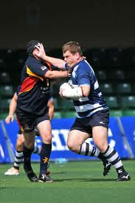
Biomechanics
. Momentum:
is a vector describing a “quantity of motion” and is the product of mass and velocity
*an athlete can increase their momentum by either increasing their mass or velocity.

Slide 50
Biomechanics
Impulse:
the effect of force over time. Calculated as the product of force and time, over which the force acts (I=Ft).
With that being said, when a force is applied to an object, the resulting motion of the body is dependent not only on the magnitude of the force but also on the duration of the force application.
https://www.youtube.com/watch?v=OrLcZNG0N0I

Slide 51
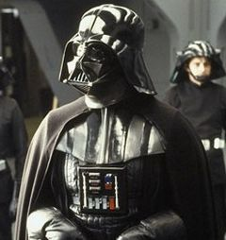
Biomechanics
Learning objectives
Define force
Outline the different types of forces with sporting examples

Slide 52
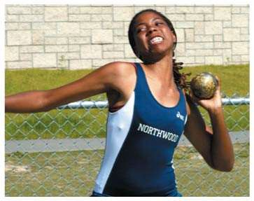
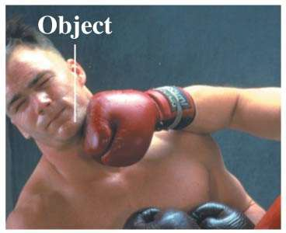
Biomechanics
What is a Force?
A force is a push or a pull.
A force acts on an object.
Pushes and pulls are applied to something.
From the object’s perspective, it has a force exerted on it.

Slide 53
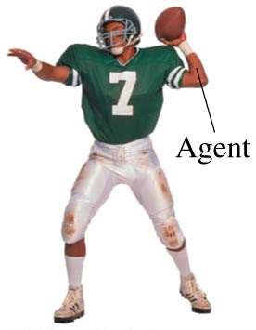
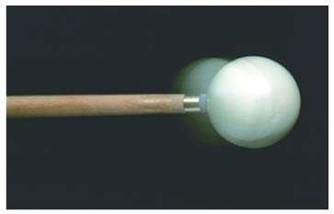
Biomechanics
A force requires an agent, something that acts or exerts power
If you throw a ball, your hand is the agent or cause of the force exerted on the ball.
A force is a vector.
To quantify a push or pull, we need to specify both magnitude and a direction.

Slide 54
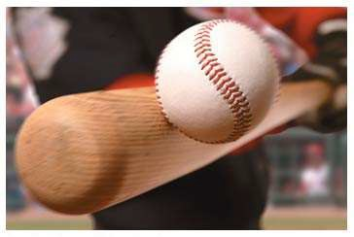
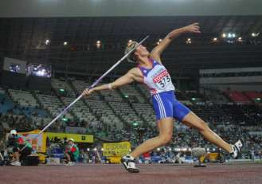
Biomechanics
Contact forces are forces that act on an object by touching it at a point
of contact.
The bat must touch the ball to hit it.
Long-range forces are forces that act on an object without physical contact.
A javelin released from your hand is pulled to the earth by the long- range force of gravity.

Slide 55
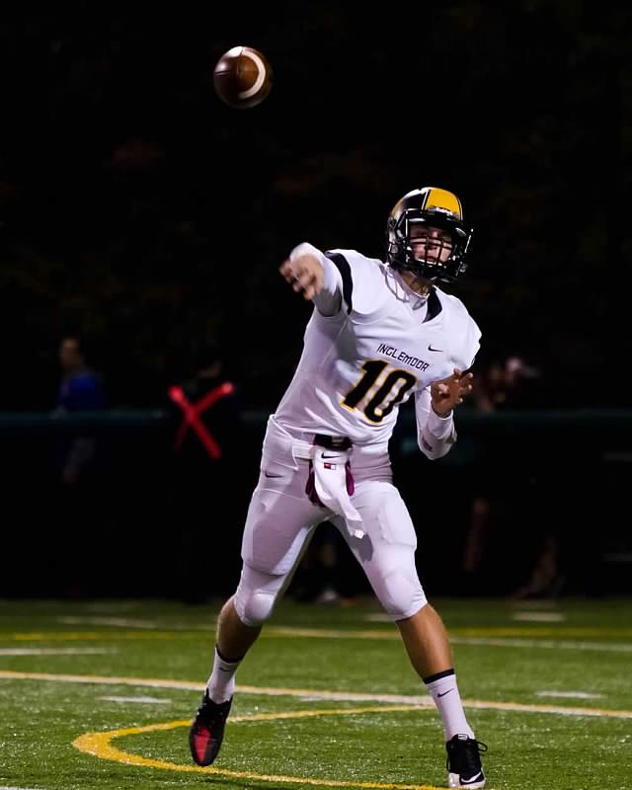
Biomechanics
Force:
Is a push or a pull
Acts on an object
Is a vector
Can be a contact force or a long-range force.

Slide 56
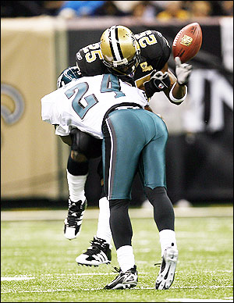
Biomechanics
Force vectors
What are forces?
a pushing or pulling action that causes a change of state (rest/motion) of a body.
How are forces measured?
in units called Newtons (N).

Slide 57
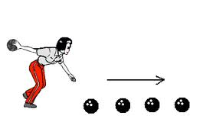
Biomechanics
Forces can produce three types of motion:
Translation: change in position

Slide 58
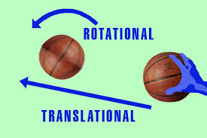
Biomechanics
Forces can produce three types of motion:
Rotation: circular movement of an object around a center of rotation.

Slide 59
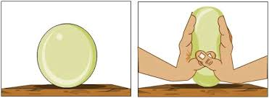
Biomechanics
Forces can produce three types of motion:
Deformation: change in shape/size of an object due to an applied force or a temperature change.

Slide 60
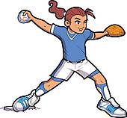
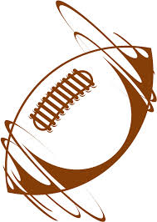
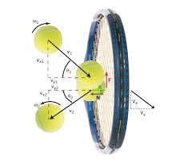
Biomechanics
Forces can cause 3 different types of motion in an object
Name them below
A. Translation
B. Rotation
C. Deformation

Slide 61
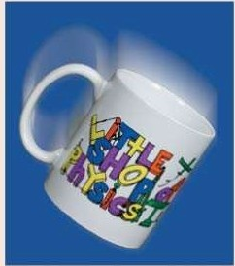
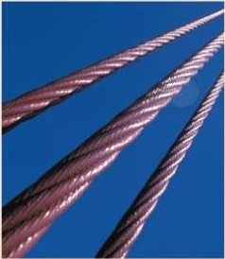
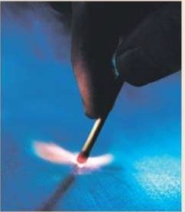
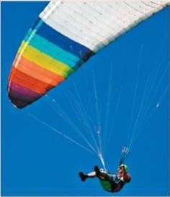
Biomechanics
Types of forces:
Gravity Tension Kinetic Friction Drag

Slide 62
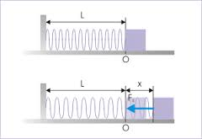
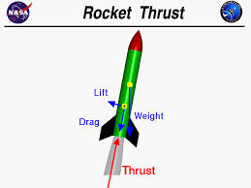
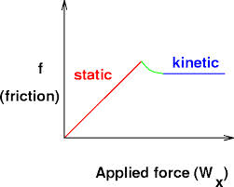
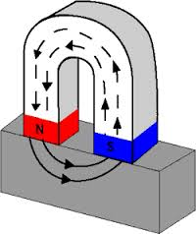
Biomechanics
Types of forces:
Spring Thrust Static Friction Magnetic

Slide 63
Biomechanics
https://www.youtube.com/watch?v=2QOEIQ3_Kuo

Slide 64
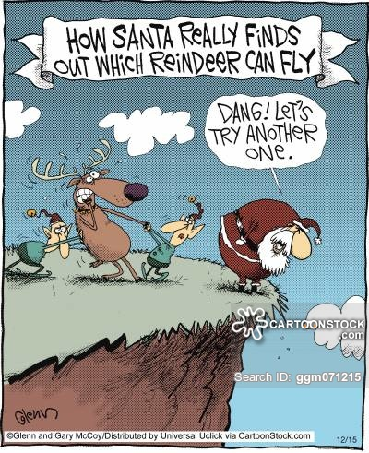
Biomechanics
Try fill in the table in your workbook as we move through the next few slides

Slide 65
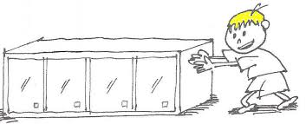
Biomechanics
Types of forces
Applied Force (F_{p})
is a type of contact force that is applied to an object by a person or another object.
A person pushing a table across the room is an example. The applied force is the force exerted on the desk by the person. Or the force exerted on the starting blocks by a sprinter.
https://www.youtube.com/watch?v=h0aoWI2EARM

Slide 66
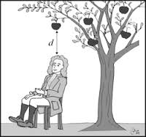
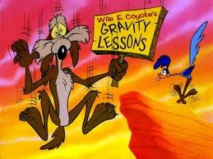
Biomechanics
Types of forces
Gravity force (F_{g})
is the force with which the earth or other massively large objects attracts another object. It is also known as the weight of the object.

Slide 67
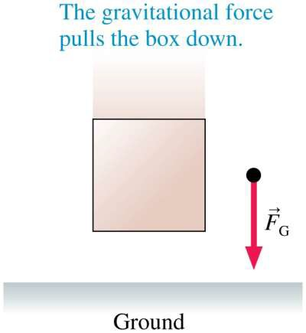
Biomechanics
Types of forces
Gravity force (F_{g})
The gravitational force vector always points vertically downward.

Slide 68
Biomechanics
Curling
https://www.youtube.com/watch?v=miB7HzUvmM0
Golf
https://www.youtube.com/watch?v=MrPWBBptNFI
Types of forces
Friction force (F_{f})
is the force exerted by a surface as an object moves across it. Two types static and friction. Friction force often opposes the motion of an object.
MIT Friction
https://www.youtube.com/watch?v=VUfqjSeeZng

Slide 69
Biomechanics
Types of forces
Drag force (F_{d})
Kinetic friction is a resistive force, which opposes or resists motion. Resistive forces are also experienced by objects moving through fluids.
The resistive force of a fluid is called drag.

Slide 70
Biomechanics
Types of forces
Drag force (F_{d})
Drag points opposite the direction of motion. For heavy and compact objects in air, drag force is
fairly small.
You can neglect air resistance in all problems unless a problem explicitly asks you to include it.

Slide 71
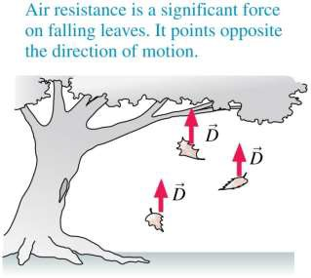
Biomechanics
Types of forces
Drag force (F_{d})
https://www.youtube.com/watch?v=Q6kVxJGsgMA

Slide 72
Biomechanics
Types of forces
Thrust force (F_{thrust})
A jet airplane or a rocket has a thrust force pushing it forward during takeoff. Thrust occurs when an engine expels gas molecules at high speed.

Slide 73
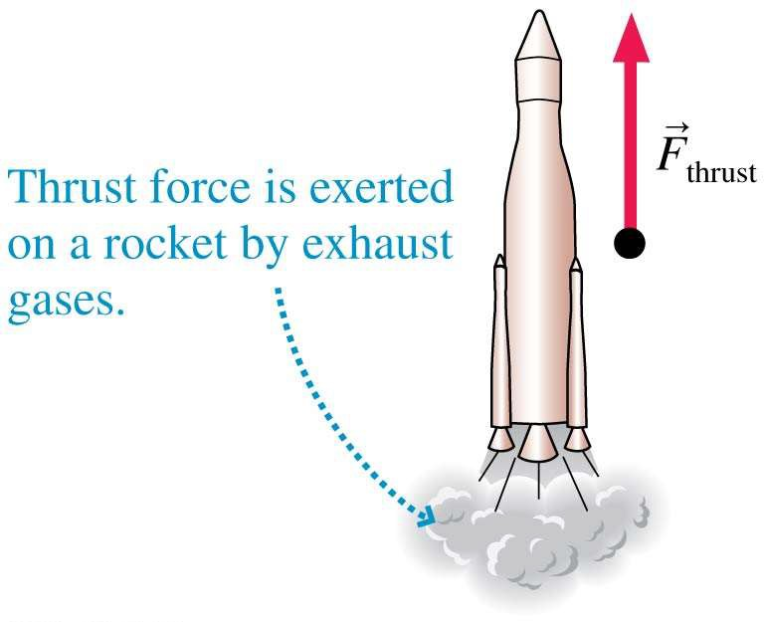
Biomechanics
Types of forces
Thrust force (F_{thrust})
This exhaust gas exerts a contact force on the engine. This exhaust gas exerts a contact force on the engine.

Slide 74

Biomechanics
Types of forces
Spring force (F_{s})
is the force exerted by a compressed or stretched spring upon any object that is attached to it. Not all springs are metal coils
Example, use a bungee to assist in overspeed training.
https://www.youtube.com/watch?v=7I5lXNmOSTM

Slide 75

Biomechanics
Types of forces
Spring force (F_{s})
Whenever an elastic object is flexed or deformed in some way, and then “springs” back to its original shape when you let it go, this is a spring force.

Slide 76
Biomechanics
Types of forces
Tension force (F_{t})
is the force that is transmitted through a string, rope, cable or wire when it is pulled tight by a force acting frome opposite ends.
https://www.youtube.com/watch?v=QjRBvLj5boQ

Slide 77


Biomechanics
Types of forces
Tension force (F_{t})
The tension force is in the direction of the string or rope.
A rope is made of atoms joined together by molecular bonds. These bonds can be modeled as tiny springs holding the atoms together.

Slide 78

Biomechanics
Types of forces
Normal force (F_{n})
is the support force exerted upon an object that is in contact with another stable object.
If a book is resting on a table, the table is exerting an upward force upon the book in order to support the weight of the book. Or like a person leaning against a wall, the wall pushes horizontally on the person

Slide 79

Biomechanics
Types of forces
Normal force (F_{n})
A table is made of atoms joined together by molecular bonds which can be modeled as springs.
Normal force is a result of many molecular springs being compressed ever so slightly.

Slide 80

Biomechanics
Types of forces
Normal force (F_{n})
Suppose you place your hand
on a wall and lean against it. The wall exerts a horizontal normal force on your hand.

Slide 81

Biomechanics
Types of forces
Normal force (F_{n})
Suppose a frog sits on an
inclined surface. The surface exerts a tilted normal force on the frog.

Slide 82

Biomechanics
Types of forces Electric (F_{elect})
and Magnetic (F_{mag}) force
Electricity and magnetism, like gravity, exert long-range forces. Atoms and molecules are made of electrically charged particles. Molecular bonds are due to the electric force between these particles.

Slide 83
Biomechanics
Types of forces Electric (F_{elect})
and Magnetic (F_{mag}) force
Most forces, such as normal force and tension, are actually caused by electric forces between the charged particles in the atoms.

Slide 84
Biomechanics
Learning Objectives
• Define the term center of mass
• Explain that a change in body position during sporting activities can change the position of the center of mass

Slide 85

Biomechanics
Center of mass:
the point at which the body is balanced in all directions.
*a change in body position can change the position of the center of mass within or outside the body

Slide 86


Biomechanics
Center of mass:
Notice how the center of gravity is located outside the jumper’s body.

Slide 87


Biomechanics
Center of mass:
Examples of the center of gravity outside the body.

Slide 88


Biomechanics
Center of Mass
The point at which the mass and weight of an object are balanced in all directions

Slide 89


Biomechanics
Center of Mass
As the mass of the arms move up, so will the center of mass
https://www.youtube.com/watch?v=HSW8gXmOazs

Slide 90

Biomechanics
Base of Support
The Base of Support is the location on a body or object where
most of the weight is supported.
The larger the area of the base of support covers, the more stable an object will be.

Slide 91


Biomechanics
Base of Support
Narrow BOS
Wide BOS
The object on the left
is more stable because of its relatively larger BOS
https://www.youtube.com/watch?v=2WUdHBso3Vk

Slide 92

Biomechanics
Line of Gravity
The line of gravity is an imaginary vertical line passing through the center of gravity down to a point in the base of support.

Slide 93
Biomechanics
Line of Gravity
If the line of gravity falls within the object’s base of support (i.e. its contact with the ground), the object is relatively stable.
If the line of gravity falls outside the object’s base of support (i.e. its contact with the ground), the object is relatively unstable.

Slide 94


Biomechanics
Line of gravity
Line of gravity
Line of Gravity
Center of
gravity
Center of
gravity
Stable
Less Stable

Slide 95


Biomechanics
LOG, BOS and movement
The line of gravity (LOG) must go outside the base of support to initiate or continue movement.

Slide 96
Biomechanics
LOG, BOS and movement
The direction that the line of gravity relative to the BOS will be the direction of the resulting movement.

Slide 97
Biomechanics
LOG, BOS and movement
The further away the LOG is from the BOS, the greater the tendency the body has to move in that direction. E.g. Starting blocks

Slide 98

Line of Gravity
Top of body moves toward the LOG
Leg pushes against the ground

Slide 99


Biomechanics
Stability, what is a definition?
the quality or state of something that is not easily moved

Slide 100
Biomechanics
Factors that affect an athlete’s stability:
Position of the center of mass
Size of the base of support
Mass of the athlete
Where the line of gravity is

Slide 101


Biomechanics
Newton’s Laws of Motion in Sport
First Law
(Law of Inertia)
An object at rest stays at rest and an object in motion stays in motion with the same speed and in the same direction unless acted upon by an unbalanced force.
https://www.youtube.com/watch?v=owOkomofYjU
BMX inertia

Slide 102
Biomechanics
Newton’s Laws of Motion in Sport
First Law
(Law of Inertia)
Consider the two oil drop diagrams below for an acceleration of a car. From the diagram, determine the direction of the net force that is acting upon the car
1
2

Slide 103
Biomechanics
Newton’s Laws of Motion in Sport
The net force is to the right since the acceleration is to the right. An object which moves to the right and speeds up has a rightward acceleration.
1
2
The net force is to the left since the acceleration is to the left. An object which moves to the right and slows down has a leftward acceleration.

Slide 104


Biomechanics
Newton’s Laws of Motion in Sport
Second Law
The acceleration of an object as produced by a net force is directly proportional to the magnitude of the net force, in the same direction as the net force, and inversely proportional to the mass of the object.
Sports sceince -force clip 6 min
https://www.youtube.com/watch?v=dwd6igp7l54
Arrows represent the magnitude (size) of the force

Slide 105

Biomechanics
Momentum is a vector quantity that can be defined as "mass in motion."
Momentum (p) = mass • velocity
Momentum (angular and linear) 2 min

Slide 106
Biomechanics
Check Your Understanding
Express your understanding of the concept and mathematics of momentum by answering the following questions. Click the button to view the answers.
Determine the momentum of a ...
60-kg halfback moving eastward at 9 m/s.
p = m*v =
60 kg*9 m/s
p = 540 kg•m/s, east

Slide 107
Biomechanics
Check Your Understanding
Express your understanding of the concept and mathematics of momentum by answering the following questions. Click the button to view the answers.
Determine the momentum of a ...
b. 1000-kg car moving northward at 20 m/s.
p = m*v =
1000 kg*20 m/s
p = 20 000 kg•m/s, north

Slide 108
Biomechanics
Check Your Understanding
Express your understanding of the concept and mathematics of momentum by answering the following questions. Click the button to view the answers.
Determine the momentum of a ...
c. 40-kg freshman moving southward at 2 m/s.
p = m*v =
40 kg*2 m/s
p = 80 kg•m/s, south

Slide 109


Biomechanics
Impulse change in momentum.
A force produces an acceleration, and the greater the force acting on an object, the greater its change in velocity and, hence, the greater its change in momentum
Bat swing video

Slide 110

Biomechanics
Impulse – Momentum Relationship
momentum (p)= mass • velocity
Force x time = mass x velocity
https://www.youtube.com/watch?v=y2Gb4NIv0Xg
Bat *Ball
*Mass will remain constant

Slide 111


Biomechanics
Force – Time Graphs
Explain the graph to the right using the picture to the left?
The force increases until the ball reaches a point of max compression.
The ball comes in contact with the racket, compresses, decompresses & then contact ends.
Note the time of contact :
40ms (.04 sec)

Slide 112




Biomechanics
Newton’s Laws of Motion in Sport
Third Law
For every action there is an equal and opposite reaction. (every force involves the interaction of two objects)
https://www.youtube.com/watch?v=r9yuR7ezqf4

Slide 113
Biomechanics
Newton’s Laws of Motion in Sport
Check for understanding
For years, space travel was believed to be impossible because there was nothing that rockets could push off of in space in order to provide the propulsion necessary to accelerate. This inability of a rocket to provide propulsion is because …
a. ... space is void of air so the rockets have nothing to push off of.
b. ... gravity is absent in space.
c. ... space is void of air and so there is no air resistance in space.
d. ... nonsense! Rockets do accelerate in space and have been able to do so for a long time.

Slide 114
Biomechanics
Newton’s Laws of Motion in Sport
Check for understanding
For years, space travel was believed to be impossible because there was nothing that rockets could push off of in space in order to provide the propulsion necessary to accelerate. This inability of a rocket to provide propulsion is because …
It is a common misconception that rockets are unable to accelerate in space. The fact is that rockets do accelerate. There is indeed nothing for rockets to push off of in space - at least nothing which is external to the rocket. Rockets are able to accelerate due to the fact that they burn fuel and push the exhaust gases in a direction opposite the direction which they wish to accelerate.

Slide 115

Biomechanics
Newton’s Laws of Motion in Sport
Check for understanding
Baseball pushes glove leftwards.
The glove pushes the baseball rightward.

Slide 116

Biomechanics
Newton’s Laws of Motion in Sport
Check for understanding
Consider the interaction depicted below between foot A, ball B, and foot C. The three objects interact simultaneously (at the same time). Identify the two pairs of action-reaction forces. Use the notation "foot A", "foot C", and "ball B" in your statements.
The first pair of action-reaction force pairs is: foot A pushes ball B to the right; and ball B pushes foot A to the left. The second pair of action-reaction force pairs is: foot C pushes ball B to the left; and ball B pushes foot C to the right.

Slide 117
Biomechanics

Slide 118



Conservation of Momentum
the total momentum of the two objects before the collision is equal to the total momentum of the two objects after the collision.
https://www.youtube.com/watch?v=_w1iEvWsrPI

Slide 119


Conservation of Momentum
A useful analogy for understanding momentum conservation involves a money transaction between two people

Slide 120

Conservation of Momentum

Slide 121


Conservation of Momentum

Slide 122

Conservation of Momentum
When fighting fires, a firefighter must use great caution to hold a hose that emits large amounts of water at high speeds. Why would such a task be difficult?
The hose is pushing lots of water (large mass) forward at a high speed. This means the water has a large forward momentum. In turn, the hose must have an equally large backwards momentum, making it difficult for the firefighters to manage.

Slide 123

Conservation of Momentum
You are traveling in your car at highway speed on a nice spring day when an unlucky bug splatters onto the windshield. You know from class there was no noticeable change in the speed of the car compared to the obvious change in the speed of the bug. Explain why this is true.
The bug and car experience the same force, the same impulse, and the same momentum change (as discussed in this lesson). This is contrary to the popular (though false) belief that the bug experiences more force. The bug has less mass and therefore more acceleration; you and your massive car do not feel the extremely small acceleration

Slide 124
Conservation of Momentum

Slide 125
Biomechanics

Slide 126

Projectile Motion
Motion In Two Dimensions
We restrict ourselves to objects thrown near the Earth’s surface so that gravity
can be considered constant.

Slide 127

Projectile motion refers to the motion of an
object that is thrown, or projected into the air at an angle.
The motion of a projectile is determined only
by the object’s initial velocity and gravity.

Slide 128



Projectile motion applies to sports.

Slide 129

Projectile motion is a combination of horizontal motion and vertical motion.
The horizontal motion of a projectile is constant because no gravitational force acts horizontally

Slide 130

The vertical motion of a projectile is nothing more than free fall
with a constant downward acceleration due to gravity.

Slide 131

The vertical motion of a projected object is independent of its horizontal motion.

Slide 132


Slide 133

A projectile moves horizontally with constant velocity
while being accelerated vertically. The result is a motion
in a curved path.

Slide 134


Slide 135

The path of a projectile is called its trajectory.
The trajectory of a projectile in free fall is a parabola.

Slide 136

A projectile, once projected, continues in
motion by its own inertia and is influenced
only by the downward force of gravity.

Slide 137

An object projected horizontally will reach the ground in the same time as an object dropped vertically.
No matter how large the horizontal velocity is, the downward pull of gravity is always the same.

Slide 138


Slide 139



Slide 140

The cannonball falls the same amount of distance as it did when it was merely dropped from rest

Slide 141


Slide 142

Horizontally launched projectile
Horizontal velocity is constant. Vertical velocity is changing
due to gravitational acceleration..

Slide 143

Vertically launched projectile
The horizontal velocity component remains the same size throughout the entire motion of the cannonball.

Slide 144

Projectiles launched at different angles.

Slide 145

Sports Trivia
Maximum range is achieved if the projectile is fired at an angle of 45 degrees with respect to the horizontal.

Slide 146


Slide 147


Slide 148


Slide 149
In Conclusion
A projectile is any object upon which the only force
is gravity.
Projectiles travel with a parabolic trajectory due to
the influence of gravity.
There are no horizontal forces acting upon projectiles
and thus no horizontal acceleration.
The horizontal velocity of a projectile is constant.
there is a vertical acceleration caused by gravity
(9.8 m/s.
The horizontal motion of a projectile is independent
of its vertical motion.

Slide 150

Test your knowledge
Suppose a snowmobile is equipped with a
flare launcher which is capable of launching
a sphere vertically. If the snowmobile is in
motion and launches the flare and maintains a
constant horizontal velocity after the launch,
then where will the flare land (neglect air
resistance)?

Slide 151


Slide 152
Test your knowledge
Suppose an airplane drops a flare while it
is moving at constant horizontal speed at
an elevated height. Assuming that air
resistance is negligible, where will the flare
land relative to the plane?
A. Directly below the plane.
B. Below the plane and ahead of it.
C. Below plane and behind it.

Slide 153


Slide 154

Why does the horizontal component of a
projectile’s motion remain constant?
Because no force acts on it horizontally.

Slide 155

Why does the vertical component of a projectile’s motion undergo change?
Because gravity is pulling it downward.

Slide 156

How does the vertical distance a projectile
falls below an otherwise straight-line path
compare with the vertical distance it would
fall from rest in the same time?
The vertical and horizontal distances are
equal.

Slide 157

A projectile is launched vertically at 100 m/s. If air resistance can be neglected, at what speed does it return to its initial level?
100 m/s

Slide 158
There is an interesting monkey down at the zoo. The monkey spends most of its day hanging from a limb of a tree.
The zookeeper feeds the monkey by shooting bananas from a banana cannon to the monkey in the tree. This particular monkey has a habit of dropping from the tree the moment that the banana leaves the muzzle of the cannon.
The zookeeper is faced with the dilemma of where to aim the banana cannon in order to hit the monkey. If the monkey lets go of the tree the moment that the banana is fired, then where should she aim the banana cannon?

Slide 159

To ponder this dilemma consider the following:
Shoot at the monkey in a gravity free environment.
In the absence of gravity, the banana moves in a straight line path (and does not experience any downward acceleration) and the monkey does not fall once he lets go of the tree.

Slide 160

Shoot at the monkey
with gravity.
The banana moves in a parabolic path in the presence of gravity. In the presence of gravity, the monkey also accelerates downward once he lets go of the limb. Both banana and monkey experience the same acceleration since gravity causes all objects to accelerate at the same rate regardless of their mass.
Since both banana and monkey experience the same acceleration each will fall equal amounts. The banana misses the monkey, moving over his head as it was originally aimed.

Slide 161
Shoot at the Monkey at a Fast Speed with Gravity On
Since the banana left the muzzle moving very fast, the banana reaches the monkey before the monkey has fallen very far.

Slide 162
Shoot at the Monkey at a Fast Speed with Gravity On
Since the banana left the muzzle moving very slow, the banana reaches the monkey after the monkey has fallen considerably far. In conclusion, the key to the zookeeper's dilemma is to aim directly at the monkey.

Slide 163


FLUID DYNAMICS
Fluid
a substance that continually deforms (flows) under an applied shear stress.
https://www.youtube.com/watch?v=OnYaQgdazEQ

Slide 164


FLUID DYNAMICS
Two major forces involved in fluid dynamic.
Drag
Lift

Slide 165


FLUID DYNAMICS
Drag
refers to forces acting opposite to the relative motion of any object moving with respect to a surrounding fluid

Slide 166


FLUID DYNAMICS
Surface Drag
the part of the drag on a body moving through a fluid that is dependent on the nature of the surface of the body. Also called body friction
https://www.youtube.com/watch?v=FE-xuaAJrIg
Not available

Slide 167

FLUID DYNAMICS
Surface Drag
When swimming, the water must move around your body and limbs. A thin layer of water next to the body actually sticks to it, and moves with it causing up to 30% resistance. The overall effect of this is a considerable drag on the forward progress of the swimmer.
https://www.youtube.com/watch?v=HKV0XISPdWg

Slide 168

FLUID DYNAMICS
Form Drag
the portion of the resisting force encountered by a body moving through a fluid that is due to the irregularity of shape of the body, reducible to a minimum by streamlining.
https://www.youtube.com/watch?v=pHoOvraRfac

Slide 169
FLUID DYNAMICS
Form Drag
Low pressure pocket forms and “holds back” the cyclist. As velocity doubles this resistive force quadruples!!!!
Important factors:
•Shape
•Smoothness
•Orientation (crouch can lower resistance ~30%

Slide 170

FLUID DYNAMICS
Form Drag
Reducing drag:
Frame designs on bikes are often “tear-shaped” to reduce drag
Drafting within 1 m can reduce drag accounting for 6% of energy cost (e.g., ducks flying)

Slide 171


FLUID DYNAMICS
Wave Drag
is a component of the aerodynamic drag on aircraft wings and fuselage, propeller blade tips and projectiles, due to the presence of shock waves.

Slide 172

FLUID DYNAMICS
Lift
Component of air resistance that is directed at right angles to the drag force

Slide 173

FLUID DYNAMICS
Lift
According to Bernoulli's Principle:
faster air has lower air pressure
the high pressure beneath the wing pushes up to cause lift.

Slide 174

FLUID DYNAMICS
Pair Activity
Hold two pieces of thin paper vertically a short distance apart and blow down into the space between them.

Slide 175

FLUID DYNAMICS
Pair Activity
Hold one end of a small sheet of paper in both hands.
Keep the held edge horizontal while the other end sags under its own weight.
Blow steadily over the top of this horizontal edge.

Slide 176

FLUID DYNAMICS
Lift and Formula I
Race car wings operate on exactly the same principle as aircraft wings, only in reverse.
Air flows at different speeds over the two sides of the wing (by having to travel different distances over its contours) and this creates a difference in pressure, a physical rule known as Bernoulli's Principle.

Slide 177
FLUID DYNAMICS
Lift and Formula I
Race car wings operate on exactly the same principle as aircraft wings, only in reverse.
As this pressure tries to balance, the wing tries to move in the direction of the low pressure.
Planes use their wings to create lift, race cars use theirs to create a downward force.
https://www.youtube.com/watch?v=q_Eht0vDoDg
Not available
https://www.youtube.com/watch?v=Hqw0r0kYl0M

Slide 178

FLUID DYNAMICS
Boundary Layer
is the layer of fluid in the immediate vicinity of a bounding surface where the effects of viscosity are significant.

Slide 179
FLUID DYNAMICS
Homework research:
Why do golf balls have dimples?
What is the Magnus effect

Slide 180
Observe the differences in the two swings.
https://www.youtube.com/watch?v=ZXp2u3hMGBk
Additional question
Which sport is it harder to hit the ball?
https://www.youtube.com/watch?v=lGDlwhITEp8

Slide 181


What is a lever?
Rigid structures hinged at one point (fulcrum) to which forces are applied to two other points (effort and load)

Slide 182
Resistance arm- distance between load & fulcrum
Effort arm- distance between effort & fulcrum

Slide 183

What parts of the body are used to create a lever?
Fulcrum
Effort
Load
Joints
Muscles
Resistance, gravity, weight

Slide 184


Levers
1. First Class Lever:
The fulcrum lies between the effort and load.

Slide 185


2. Second Class Lever: the fulcrum lies at one end with the effort at the other and the load in the middle. Ex. Standing heel raise
Levers
mechanical advantage is greater than 1, which means larger loads can be moved with less effort.

Slide 186


3. Third Class Levers: the effort lies between the load and the fulcrum.
Levers
Mechanical advantage is less than 1, which means more effort to move smaller loads.

Slide 187

Human body and Levers
Biceps flexion & triceps extension are antagonistic muscle actions. Each can work as a lever. What type of levers are acting on each side of the humerus? Draw a picture of each lever.

Slide 188
Human body and Levers
Biceps flexion & triceps extension are antagonistic muscle actions. Each can work as a lever. What type of levers are acting on each side of the humerus? Draw a picture of each lever.

Slide 189

Human body and Levers
What type of lever is at the neck when you flex and extend?

Slide 190

Human body and Levers

Slide 191

Human body and Levers
What type of lever is at the toes joints when you go up on your toes?

Slide 192

Human body and Levers
What type of lever is at the toes joints when you go up on your toes?

Slide 193

Types of Levers
Levers
https://www.youtube.com/watch?v=ny8k7LUUIEk

Slide 194

Long levers result in greater speed at the end of a limb. This in beneficial for throwing or striking an object.
Short lever can be moved with less force and at a greater speed. This is beneficial for moving body parts quickly and applying strength for pushing, pulling and lifting.
How can the length of a limb change the how a lever functions?

Slide 195

In the human body, levers are made of joints (fulcrum) and the bones that connect them to the objects being moved.
Levers in the human body can be manipulated to improve speed & apply large forces at the same time
Can you think of any situation in the human body where this occurs? (hint: think about changing the length of a limb)
.
Running – lifting your foot and knee will create a shorter lever arm and increase speed.
Boxing- flexing elbow creates a shorter lever arm and increase speed of a punch.

Slide 196



Compare the throwing of a ball by hand and with the throwing of a ball with a jai alai basket, lax stick… Which is faster?
About 95-100mph
About 170mph
Fastest shot 111mph
Lincecum clip
Jai Alai clip
lacrosse shot clip

Slide 197

How can a 5’10” pitcher be such a powerful pitcher?
An excessively large stride increases the speed the arm can move as a 3rd class lever. See picture on next page.
The normal stride length for a pitcher is 77% to 87% of his height. Lincecum's stride is 129%, some 7 1/2 feet

Slide 198

Load
Effort
Fulcrum

Slide 199
Is there a faster ball than that of the jai alai ball (Pelota)?
https://www.youtube.com/watch?v=Ito3BSO-St8

