Slide 1


Functions of Eggs
All graphics in this resource have been attributed CC0 1.0 Universal
(CC0 1.0) Public Domain Dedication, waiving all of his/her rights to the work worldwide under copyright law.

Slide 2
Eggs as Ingredients:
Eggs can be used:
As an emulsifier
To incorporate air (foams)
As a thickener
As a binding agent
As an interfering agent
To give structure, flavor, and color
To add nutritive value

Slide 3
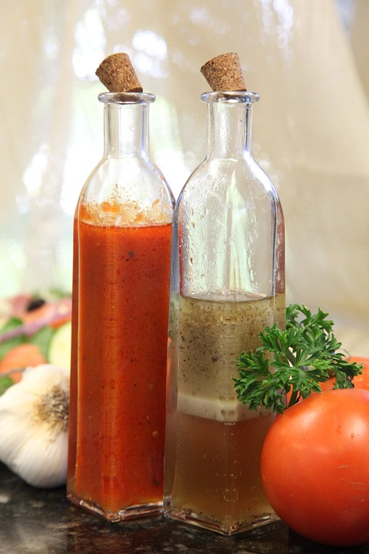
As an Emulsifier
Emulsifier: the mixture that forms when combining liquids that ordinarily do not mix; can be temporary or permanent

Slide 4
Types of Emulsions
Temporary emulsion:
  Ex. French dressing is made of oil, water, vinegar, and seasonings. When shaken, an emulsion is formed. Once you stop shaking it, the oil and water separate again.
Permanent emulsion: an emulsion that will not separate upon standing
By adding a third ingredient (egg) to oil and a liquid, the following takes place:
  Egg yolk surrounds the oil droplets and keeps them suspended in the liquid thus eliminating the need to shake the product once the product is formed
    Example: mayonnaise

Slide 5
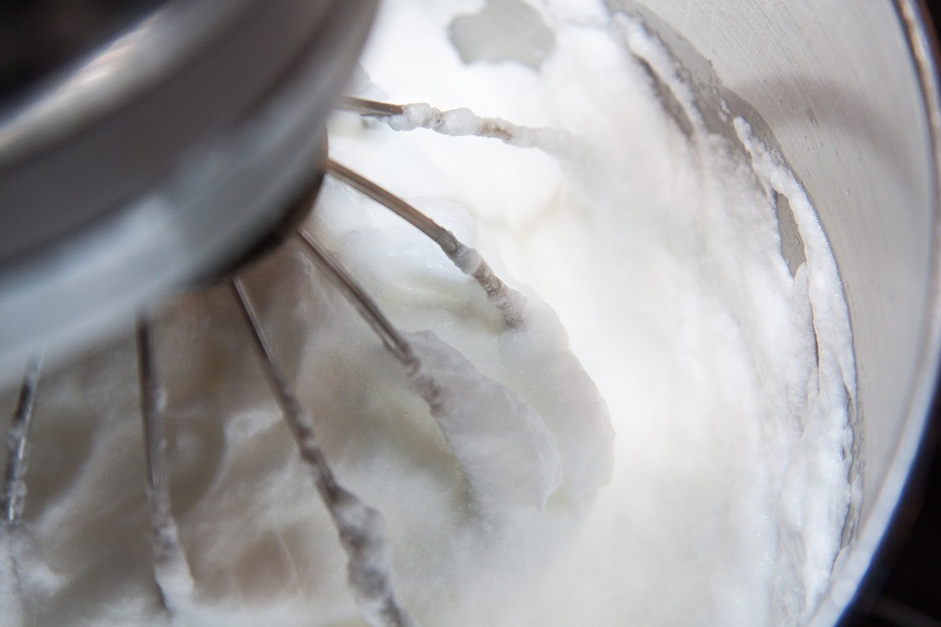
To Incorporate Air
Foam: used to add air to food (volume)
  Beat air into egg whites
  Egg white proteins surround each air cell
  The more they are beaten, the more air pockets= more foam

Slide 6
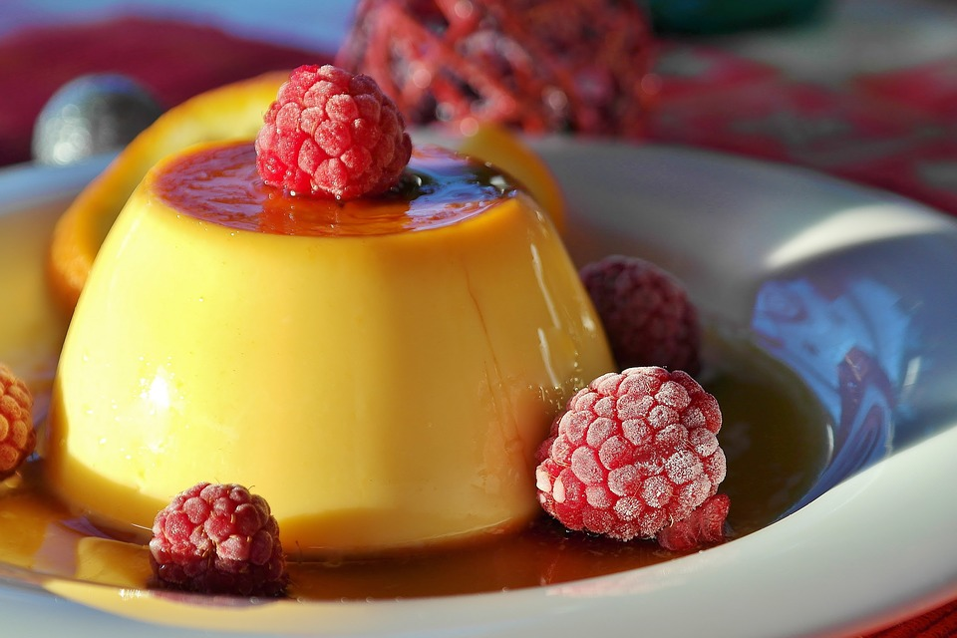
As a Thickening Agent
Heat causes egg proteins to coagulate
    Used to thicken puddings, custards, and sauces
Egg-starch mixtures (eggs can be added two ways)
  Add egg with ingredients then cook with low heat slowly
    OR
  Add egg after starch paste is thickened (tempering)

Slide 7
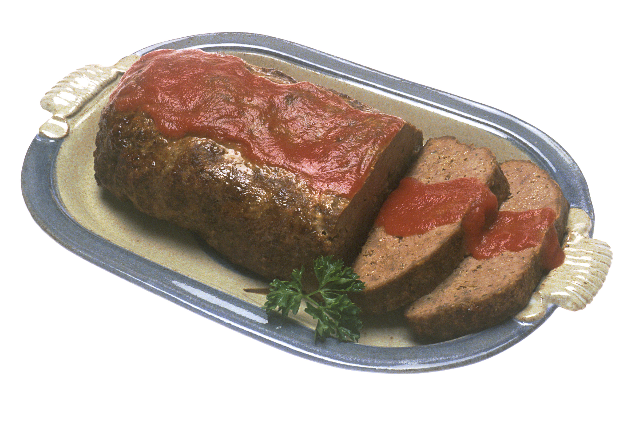
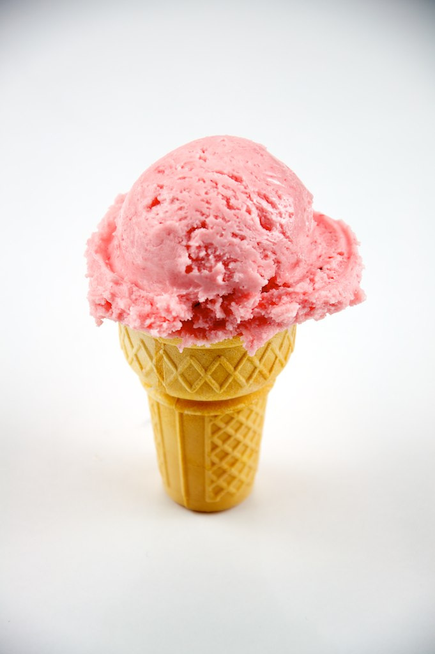
As a Binding Agent & Interfering Agent
Eggs serve as a binding agent when they hold other ingredients together as in a meat loaf
Eggs serve as an interfering agent when they inhibit the formation of ice crystals as in ice cream (helps keep it creamy)

Slide 8

To Give Structure, Flavor and Color
Structure: Eggs add structure to baked products such as muffins and cakes
Flavor: Eggs add flavor to foods such as custards and puddings
Color: Egg yolks can add color to baked products (yellow cake)

Slide 9
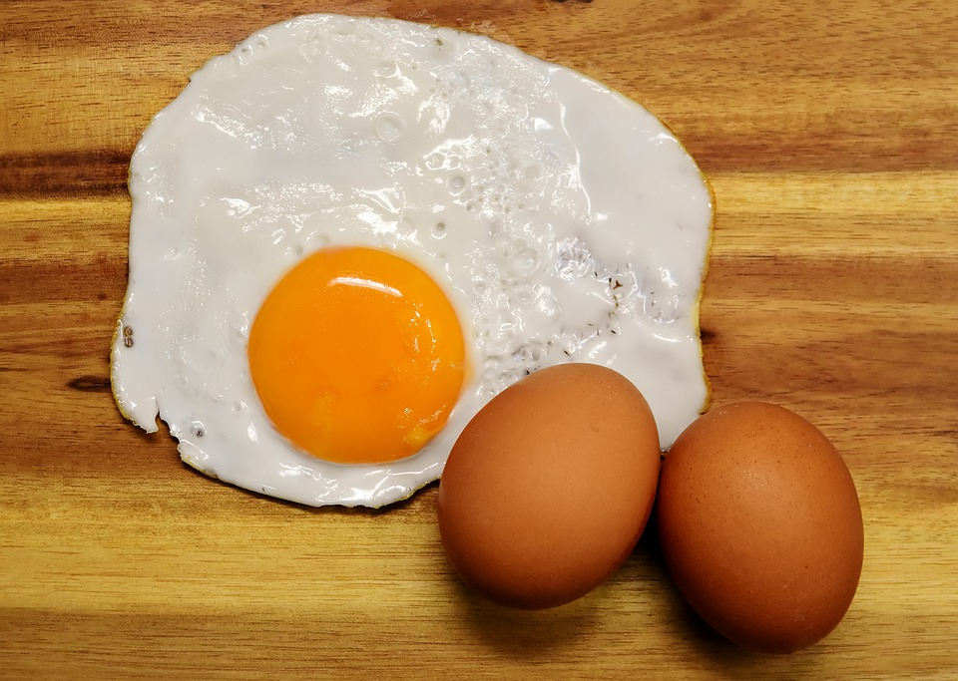
To Add Nutritive Value
Eggs add nutritional value to foods by providing protein, vitamins, minerals, and antioxidants. If the whole egg is used the yolk also adds fat.

