Slide 1
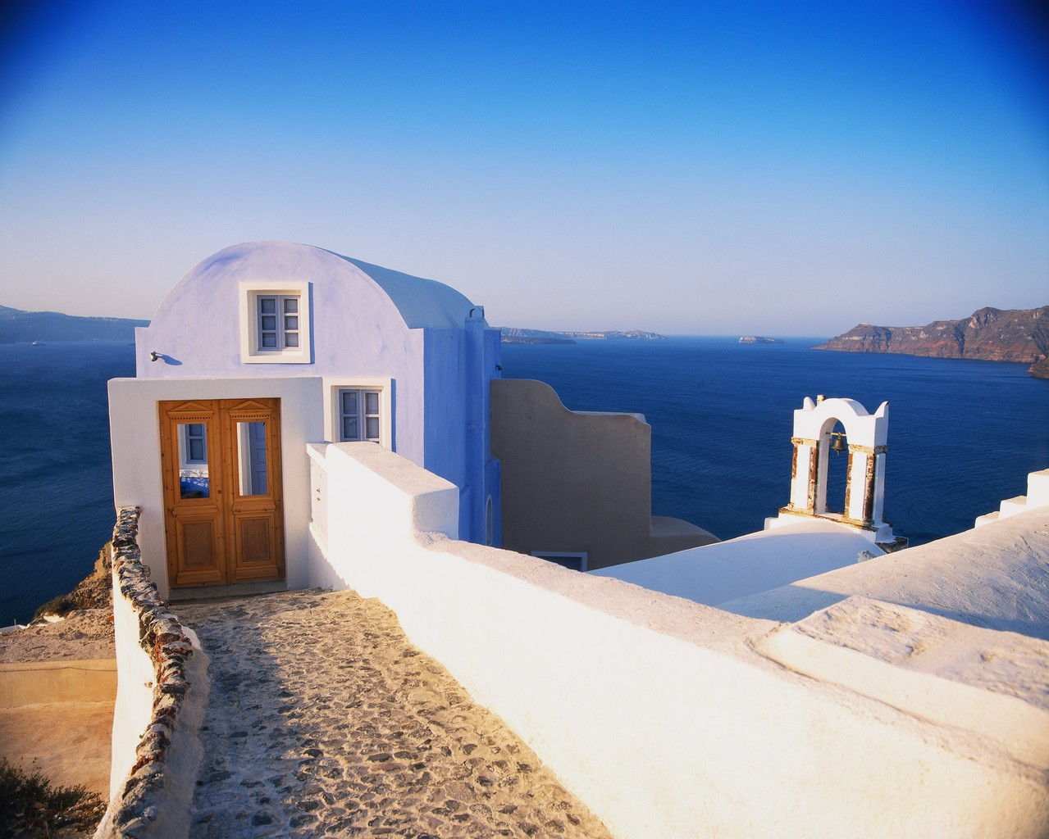
Get to Know
Greece:
Geography

Slide 2
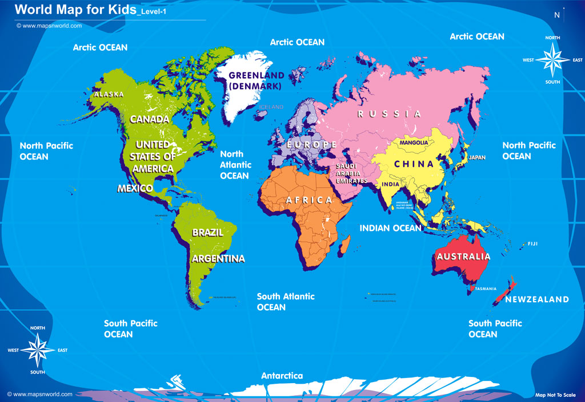
Greece is located on the continent of Europe. It is in the South Eastern corner of the continent.

Slide 3
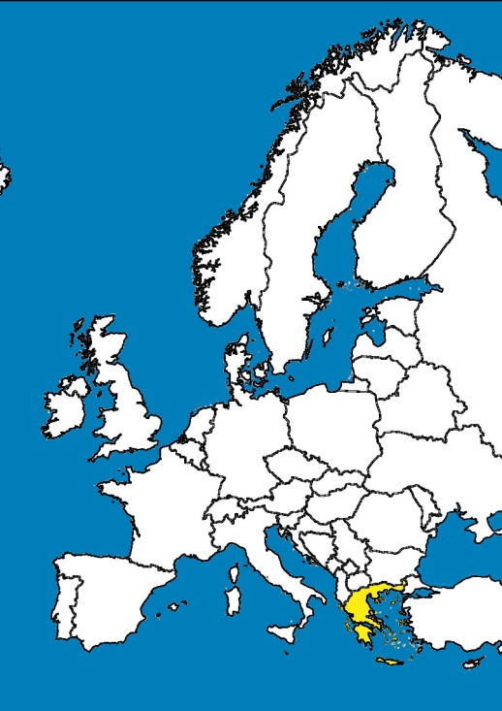
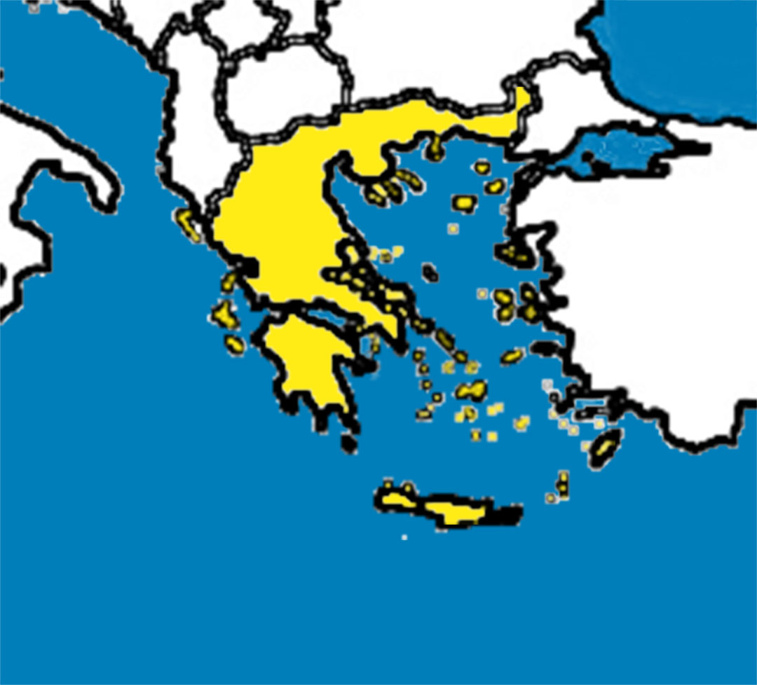
Surrounding Water
Europe
Ionian Sea
Aegean Sea
Greece is a peninsula
which means it is surrounded on three sides by water. Those three seas are the Mediterranean Sea, the Ionian Sea, and the Aegean Sea.
Mediterranean Sea

Slide 4
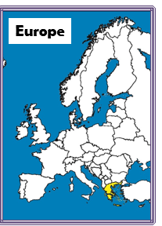

Slide 5
Greece has four neighbors. They are Albania, Macedonia, Bulgaria, and Turkey. Italy is also very close to Greece. It is just across the Ionian Sea.
Bulgaria
Macedonia
Turkey
Italy
Albania
Neighboring Countries

Slide 6
Islands
Greece is made up of thousands of islands. Although numbers vary, it is often said that there are 3000 islands in Greece, but that people only live on 227 of them.
Corfu
Lesbos
Chios
Zante
Peloponnesus
Rhodes
Crete

Slide 7
Eighty percent (80%) of Greece is mountainous, but there were two mountains that were more important than any others during ancient times.
3
1
Mt. Olympus was considered the home of the Gods.
Mt. Parnassus was located outside of Delphi where the Oracle of Delphi resided. It was also sacred to the God, Apollo.
1
2
2
Fun fact: The Vikos Gorge is the third deepest gorge in the world.
3
Mountains

Slide 8
Climate
Most of Greece has a Mediterranean climate.
  Hot, dry summers
  Cool, wet winters
Northern Greece has an Alpine climate, also called a mountainous climate.
  Temperatures are always cool or cold
  There is often rain or snow

Slide 9
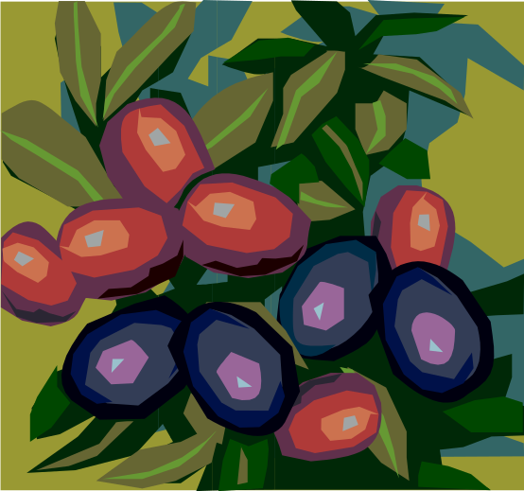
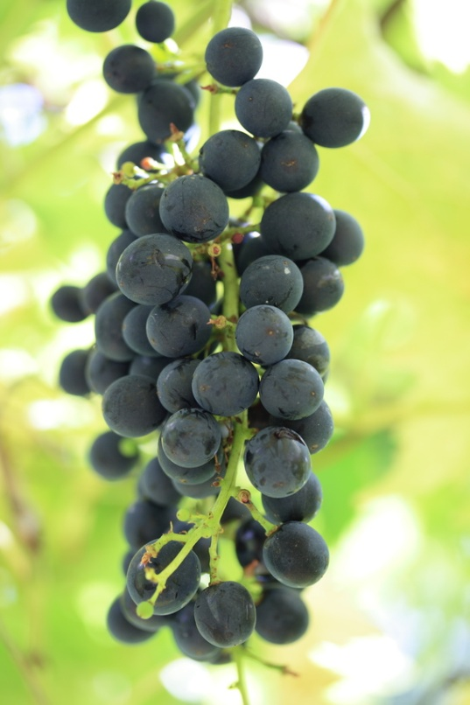

Between Mt. Olympus and Mt. Parnassus there is a large central plain in Greece that is good for growing crops.
Grains, vegetables, herbs, and orchards all exist in this area, but Greece is most known for their olives and grapes.
1
2
Agriculture

Slide 10
City-States of Ancient Greece
Athens:
This was the wealthiest and most powerful city-state. It was the birthplace of democracy and was home to over 250,000 people. Athenians valued theater, philosophy, art, & education.
Delphi
Sparta:
Sparta was the main competitor to Athens. They valued bravery, toughness, and conquest. Boys began military training at the age of seven, men lived in military barracks even when married, and women were the farmers back at home.
Athens
Olympia
Corinth
Sparta
Knossus

Slide 11
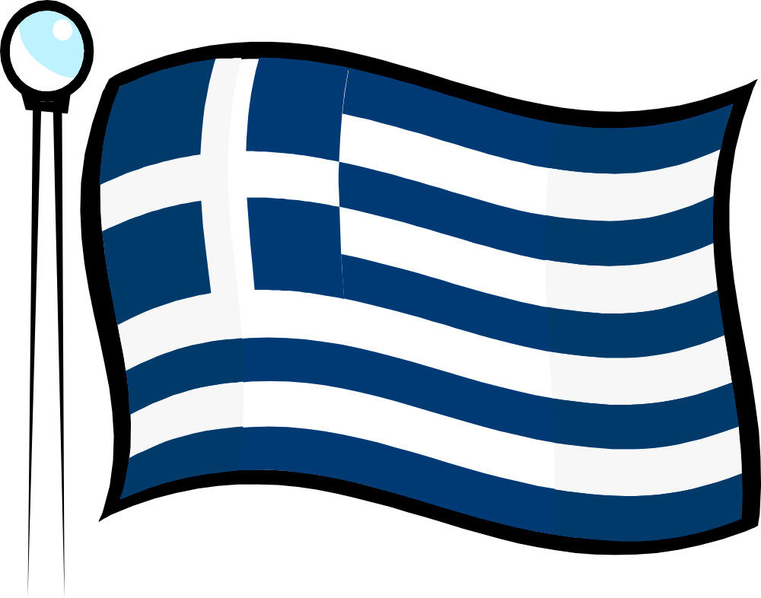
The Flag of Greece
The cross represents Eastern Orthodox Christianity, the official religion of the nation.
Although some say the blue and white represent the sea and sky, the nine horizontal stripes have been said to stand for the 9 syllables in the Greek phrase “Freedom or Death”, the 9 letters in the Greek word “Freedom”, or the 9 Muses from Greek mythology.

