Slide 1
Digital Frayer Model
Template
Once you’ve opened this document,
click “save as” and save under a new name
to your drive.

Slide 2
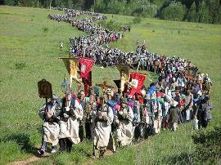
Example Word: Procession
Definition | Sentence using the word
A number of people or vehicles moving forward in an orderly fashion, esp. as part of a ceremony or festival. | “In our parade we had a procession of many people.” Page 52
Pictures | one antonym and one synonym
Grandmont, Jean-Pol. Petit Doudou actors in the procession of the Golden Car. 2006. Web. 17 October 2013. | antonym: chaotic crowd synonym: parade
Notes:
Grandmont, Jean-Pol. Petit Doudou actors in the procession of the Golden Car. 2006. Web. 17 October 2013.

Slide 3
Word:
Definition | A sentence using the word
Examples and/or Pictures | One synonym and one antonym

Slide 4
Word:
Definition | A sentence using the word
Examples and/or Pictures | One synonym and one antonym

Slide 5
Word:
Definition | A sentence using the word
Examples and/or Pictures | One synonym and one antonym

Slide 6
Word:
Definition | A sentence using the word
Examples and/or Pictures | One synonym and one antonym

Slide 7
Word:
Definition | A sentence using the word
Examples and/or Pictures | One synonym and one antonym

Slide 8
Word:
Definition | A sentence using the word
Examples and/or Pictures | One synonym and one antonym

