Slide 1
Force and Motion
Unit 4 – 5th Grade Science

Slide 2
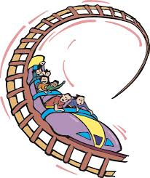
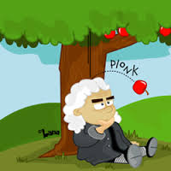
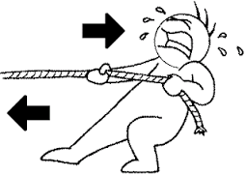
Setting up your journal
Title Page
  “Force and Motion” should be written on the page and you should include illustrations (which will need to be colored in)

Slide 3
Table of Contents and Essential Questions
  Page 3 – Essential Questions
  Pages 4-6 – Vocabulary
Essential Questions
  Where does motion begin?
  Is it possible to explain ALL motion using only Newton’s 3 Laws?

Slide 4
Vocabulary
Force- is any push or pull on an object
Friction- is a force that opposes, or acts against, motion when two surfaces rub against each other.
Magnetism- is the force or repulsion (pushing) or attraction (pulling) between poles of magnets.
Magnetic field- area around a magnet where the force of magnetism can be felt
Gravitation- is the force that pulls all objects in the universe towards one another.

Slide 5


What is a force?
A force is a push or pull that causes an object to move faster or slower, stop, change direction, or change size or shape.
Without force, nothing would ever move.

Slide 6
What is a force?
http://studyjams.scholastic.com/studyjams/jams/science/forces-and-motion/force-and-motion.htm
https://www.brainpop.com/science/motionsforcesandtime/forces/

Slide 7
Friction

Slide 8
Friction
Friction is a force between two objects rubbing against each other.
Friction works against motion.
Rough surfaces produce more friction than smooth surfaces do.
Without friction, it would be very hard to slow or stop the motion of objects.
Example- when a baseball player slides into second base, the friction of his or her legs rubbing on the dirt provides enough force to stop the slide.
Example- a sled on ice keeps on moving because there is little friction from the ice.

Slide 9
Friction
The rougher the surface, the greater the friction.
Smooth surfaces reduce friction.
So, carpets have more friction than tile floors.
Soles of shoes have rough textures to increase friction between the shoes and the floor so that it is possible to walk without slipping

Slide 10
Surface Area
The greater the surface area, the greater the friction.
If more surface of an object touches another object, the friction will be greater. If tires of a car or truck are larger, more surface area of the tire will touch the road making friction greater. Trucks have larger tires to make it easier for them to stop or slow down.

Slide 11
Magnetism

Slide 12

Magnetism
Magnetism is the force of pushing or pulling between magnetic poles. It acts at a distance and cannot be seen.
Materials that create this force are said to be magnetic and are called magnets.
Brain Pop - Magnetism

Slide 13
Magnetism
When like poles of magnets are near each other, a repulsive force exists, and the magnets move away from each other if the force is great enough.
When opposite poles of magnets are near each other, an attractive force exists and the magnets move toward each other if the force is great enough.
The closer the objects, the greater the magnetic force. The magnetic force is greatest at the poles of magnets.

Slide 14
Gravity

Slide 15
Gravity
Gravity is a force that pulls all objects toward each other.
The force of gravity causes two objects of different weights to fall to the ground at the same time.
The force of gravity is a pull that attracts objects to each other. This attraction is not noticeable unless one of the objects is very large (like a planet, moon, or the Sun). The force of gravity between Earth and anything on it is extremely noticeable because the mass of Earth is so large.
The pull of Earth’s gravity makes any object fall to the ground. As The Moon goes around Earth, its gravity pulls on Earth causing water in the oceans to move toward the Moon.

Slide 16
Gravity
Earth’s gravity also pulls on the Moon. This force of gravity keeps the Moon moving around Earth. Similarly, the pull of the Sun’s gravity keeps Earth moving around the Sun.
Brain Pop – Gravity

Slide 17
Balanced and
Unbalanced Forces

Slide 18
Vocabulary
Balanced forces – are equal in size and opposite in direction.
Unbalanced force- occur when one force is greater than its opposite force.
Buoyant force- is the upward push of a liquid or gas on an object.

Slide 19


Balanced and Unbalanced Forces
Forces occur in pairs and they can be either balanced or unbalanced

Slide 20
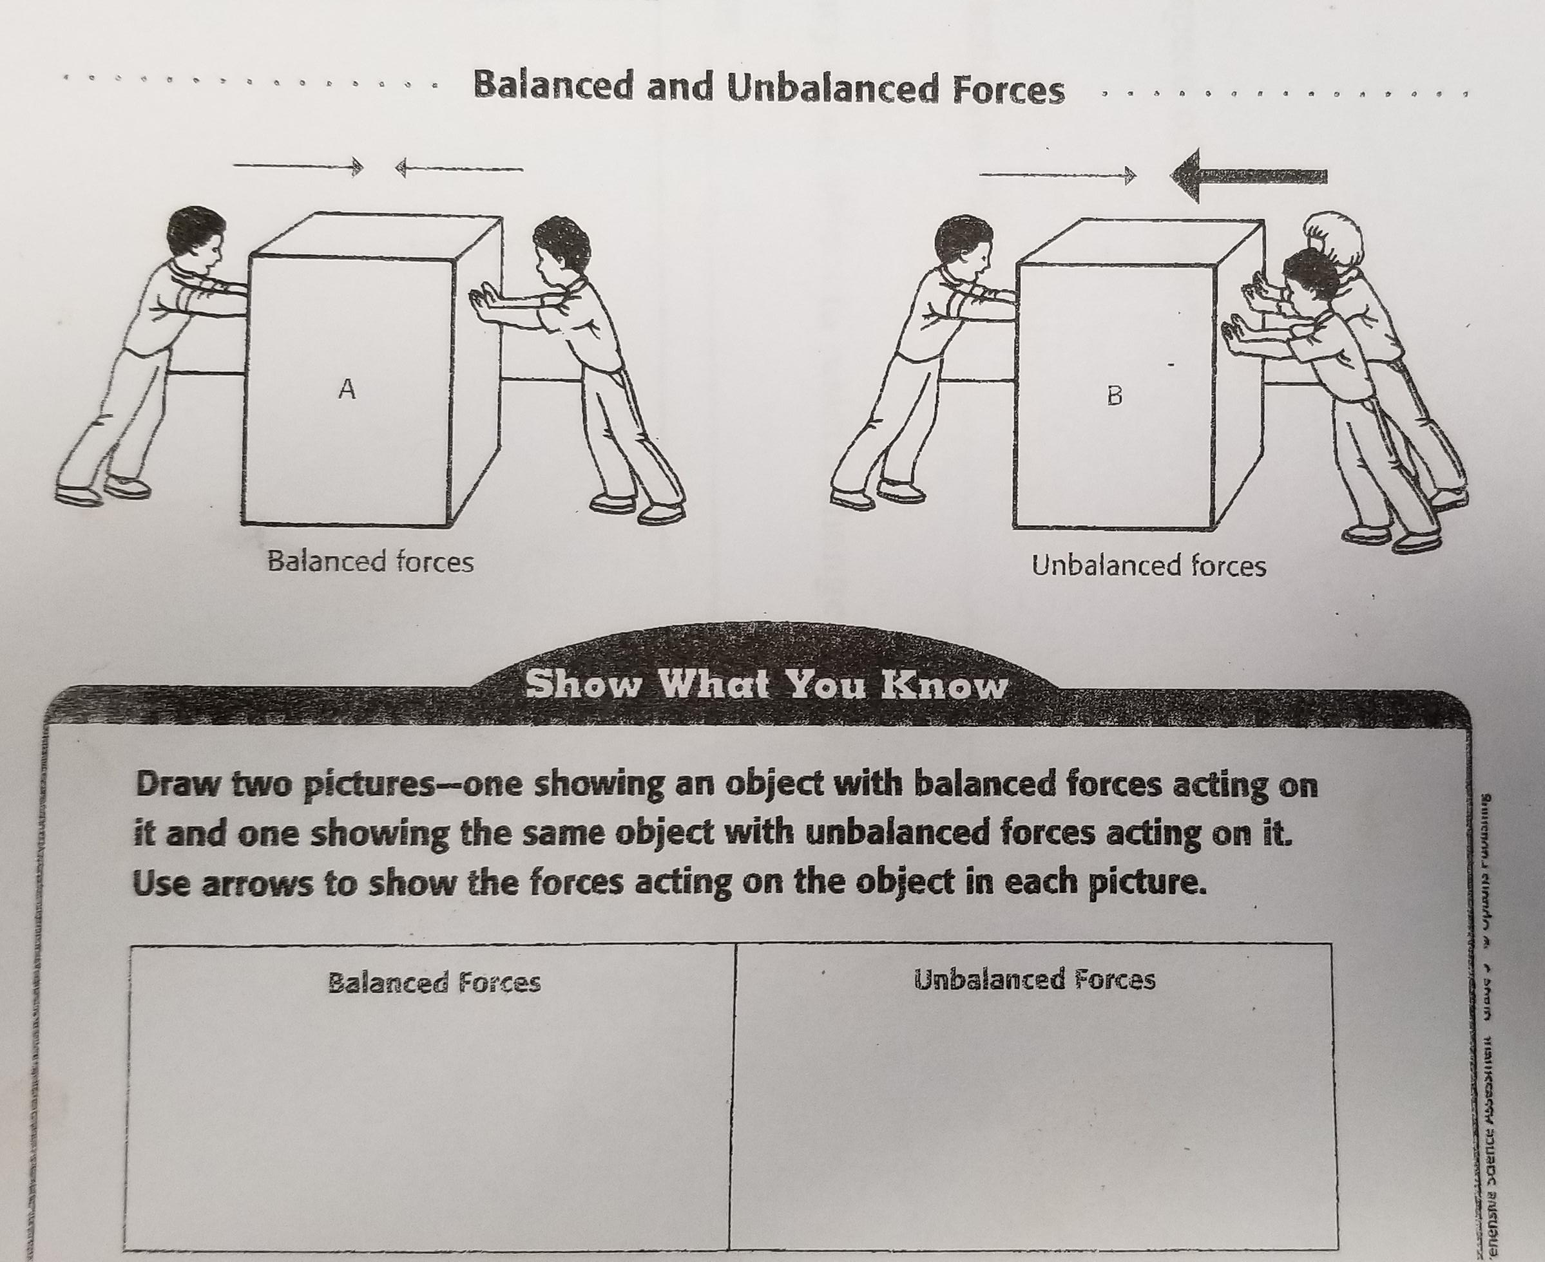
Balanced and Unbalanced Forces

Slide 21
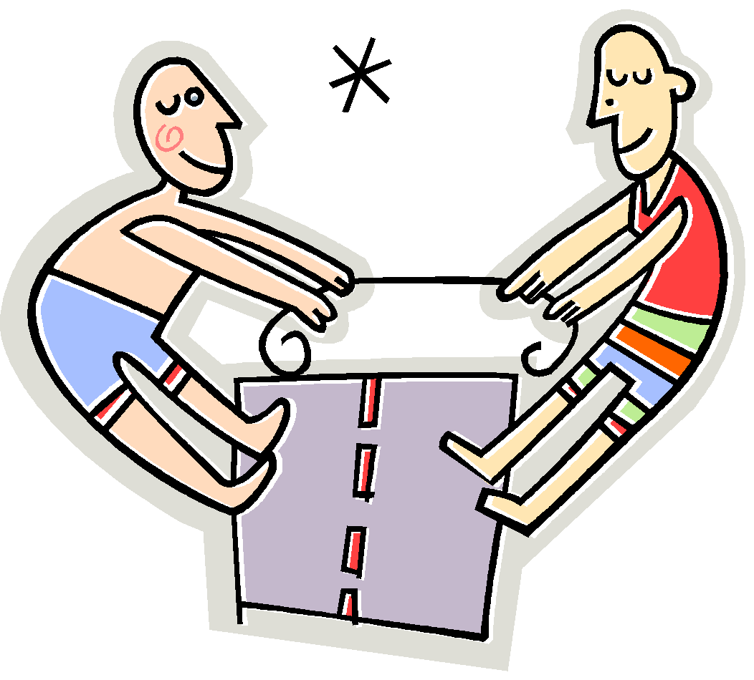
Balanced Forces
Balanced forces are forces equal in size and opposite in direction.
Neither object moves because it is equal in both directions.

Slide 22
Unbalanced Forces
Unbalanced forces occur when one force is greater than its opposite force. They cause the object’s motion to speed up, slow down, or stop. The object moves in the direction applied by the greater force.
Unbalanced forces cause a non-moving object to start moving. They affect the rate and direction of motion in objects.

Slide 23
Unbalanced Forces
Think of the game tug-of-war:
If you are the only one pulling on your side, and on the other side there are three people pulling, the forces are unbalanced because it is three pulling against one.
However, if three people were on each side, the forces would be more balanced, making the rope move less quickly.
The Jeep pulling the car is another example of an unbalanced force because the Jeep has a bigger and more powerful force.
If the Jeep was pulling another Jeep, the forces would be balanced and neither would move very far because the force being used is the same amount.

Slide 24
Isaac Newton and
3 Laws of Motion

Slide 25
Isaac Newton
Brain Pop - Isaac Newton
Isaac Newton introduced new ideas about forces and motion.
Isaac Newton developed the three laws of motion that describe the movement of objects on Earth.

Slide 26
1st law of motion
An object at rest will remain at rest, an object in motion will continue moving in a straight line at a constant speed until an outside force acts on it.
Inertia- The property of matter that keeps it moving in a straight line or keeps it at rest.
An objects inertia resists any change in motion.
Newton's first law

Slide 27
2nd Law of Motion
An object’s acceleration depends on the size and direction of the force acting on it and on the mass of the object.
A large force acting on an object will cause more acceleration than a small force.
A force that acts on an object may cause it to speed up, slow down, stop, or change direction.
A force has more effect on an object with less mass than it has on an object with more mass.
Newton's second law

Slide 28
3rd Law of Motion
For every action, there is an equal and opposite reaction.
Forces always occur in pairs.
Action force- first force
Reaction force- force that pushes or pulls back.
Newton's third law
Bill Nye the Science Guy

Slide 29
NFL 3 Laws of Motion
https://www.nbclearn.com/science-of-nfl-football
(Watch Law 1- Then do quarter on elbow flip)
(Watch Law 2- Paper Football Flick)
(Watch Law 3- Newton’s Cradle- See Plummer)
How to make a real paper football (OLD SCHOOL)
https://www.youtube.com/watch?v=a4hd1jigqLs&disable_polymer=true

Slide 30
Motion

Slide 31
Vocabulary
Motion- change in position
Position- object’s place or location
Speed- measure of the distance an object moves in a given amount of time.
Velocity- an object’s speed in a particular direction.
Momentum- is a measure of how hard it is to slow down or stop an object.

Slide 32
Position
In order to observe motion, you must first determine an object’s position.
Position= an object’s place, or location.
If the object’s position changes, the object is in motion.
Frame of Reference- observing motion against a background that is not moving.
Roller Coaster- when a roller coaster is moving, the frame of reference is the track and background that aren’t moving.

Slide 33
Speed and Velocity
You can describe the motion of an object by describing its speed.
Speed- is a measure of the distance an object moves in a given amount of time.
Average Speed – total distance an object moves divided by the total amount of time.
In order for two objects to have the same motion, they must be moving at the same speed and in the same direction.
Velocity is an object’s speed in a particular direction.

Slide 34
Acceleration
*Speed in a certain direction
*Formula: Final Speed-Initial Speed divided by time
*In a graph- speed will be on one axis and time will be on the other axis

Slide 35
Momentum
When a car crashes, it almost stops instantly. Without seatbelts, the passengers would be hurt.
Momentum- is a measure of how hard it is to slow down or stop an object.
It is the product of an object’s velocity and its mass.
Two objects with the same velocity, the one with the greater mass will have more momentum.
If two objects have the same mass, the one with the greater velocity has more momentum.

