Slide 1


KITCHEN EQUIPMENT
USES AND CARE
All pictures are original works by Reno Palombit, NC Department of Public Instruction, Career & Technical Education.
Teacher may add, substitute or delete pictures as needed.

Slide 2
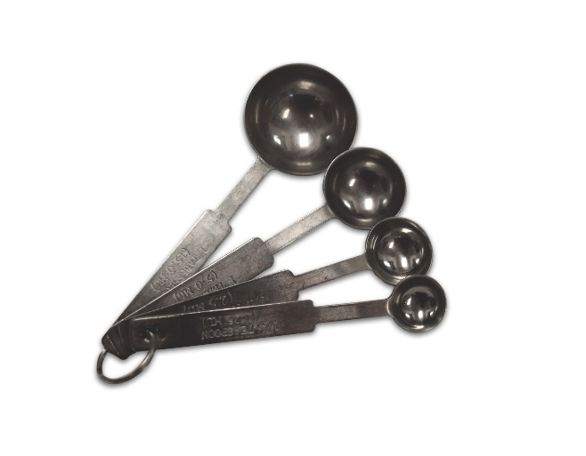
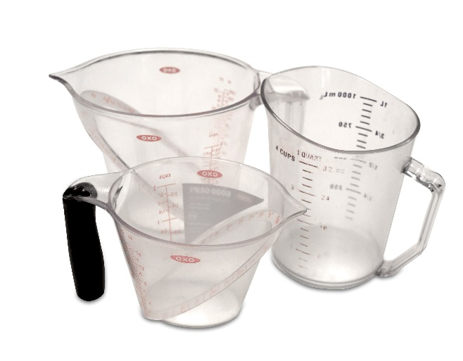
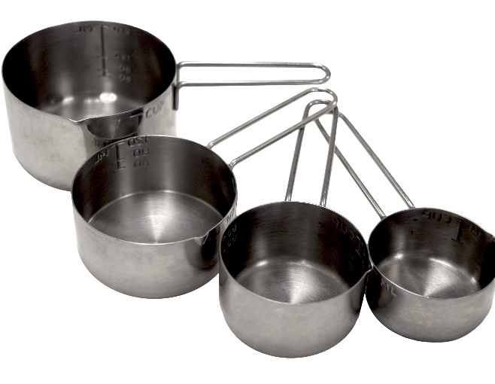
Measuring Equipment- Volume
Measuring spoons
Dry measuring cups
Liquid measuring cups
Notes:
Measuring spoons – usually made of metal or plastic; basic set contains 1 tablespoon, 1 teaspoon, ½ teaspoon, and ¼ teaspoon. Used to measure small ingredients, usually less than ¼ cup. Hand or machine wash.
Dry measuring cups (nested measuring cups) – usually made of metal or plastic; basic set contains 1 cup, ½ cup, 1/3 cup, and ¼ cup. Used to measure dry and solid ingredients. Hand or machine wash.
Liquid Measuring Cups – usually made of clear glass or plastic; contains measurements for portions of a cup and fluid ounces. Used to measure liquid ingredients. Hand or machine wash.

Slide 3
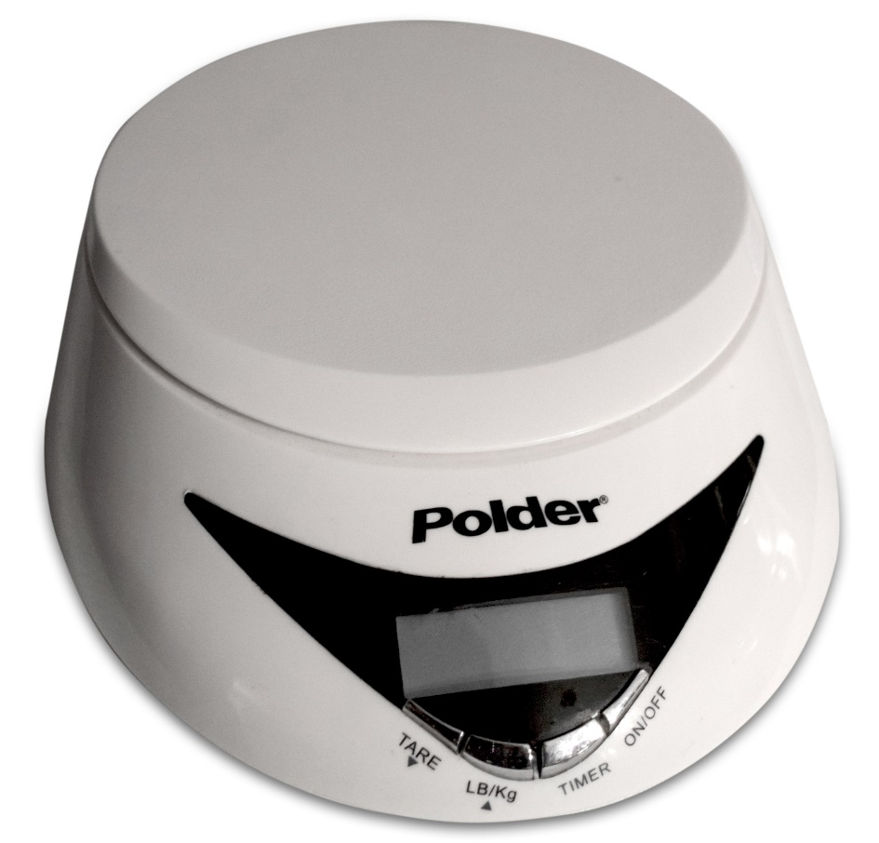
Measuring Equipment- Weight
  Scale
Notes:
Scale – may be a spring or balance scale. Used to weigh dry ingredients, usually larger amounts. Wipe with a damp cloth.

Slide 4
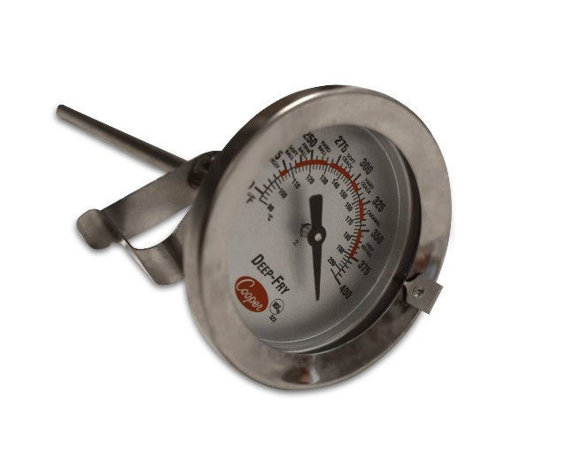
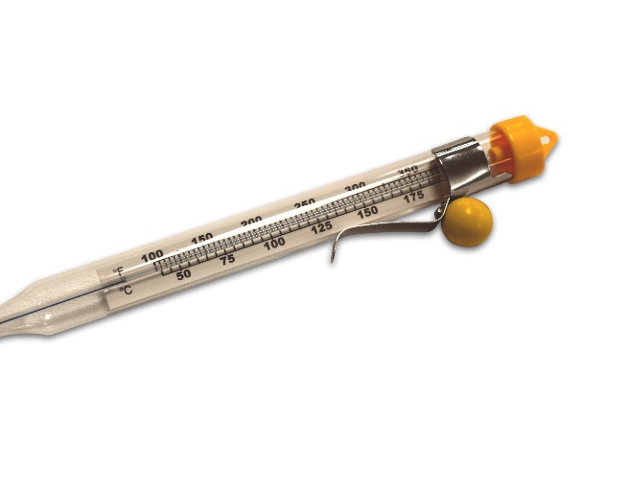
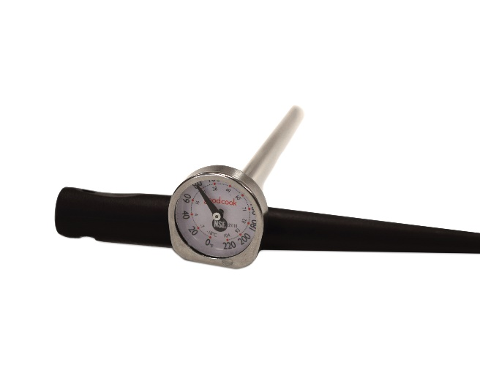
Measuring Equipment- Temperature
Deep-fry/Candy
Instant-Read
Meat (not pictured)
Notes:
Thermometers – may have a dial or digital display. Used to take the internal temperature of foods to ensure the safety and sanitation of foods. Hand wash and calibrate daily and/or after dropping.
Deep-fry/Candy thermometer – A thermometer that measures the temperature of oil in which foods such as French fries and doughnuts are immersed ometer that for frying. Will clip to the side of the pot. Hand wash.
Instant-read/bimetallic – A probe thermometer with a dial or digital display is thermometer inserted into food at the end of cooking time. Gives an accurate internal temperature reading within a matter of seconds. Calibrate daily and/or after dropping. Hand wash.
Meat thermometer – Also known as an oven-safe thermometer, it is designed to be placed in food while cooking. A probe thermometer with a large dial used to accurately measure the internal temperature of a large piece of meat, poultry, etc. as it cooks. Hand wash.

Slide 5
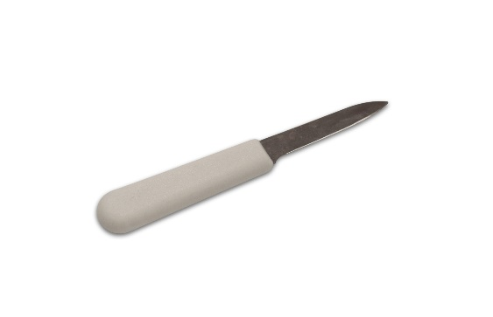
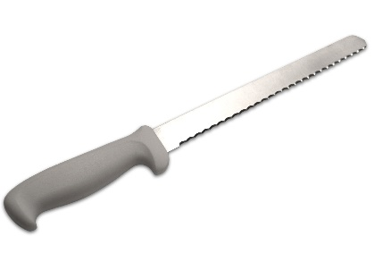
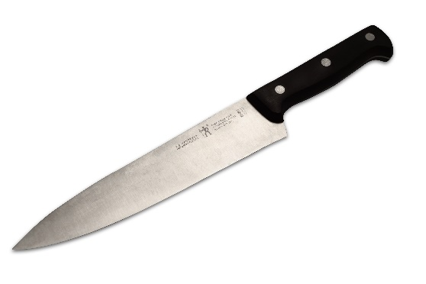
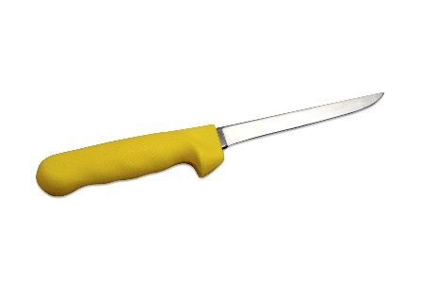
Cutting and Preparing Equipment
Chef’s/French knife
Bread knife
Slicing knife
Paring knife
Notes:
Chef’s/French knife – large, triangular blade. Used to slice, chop, and dice fruits and vegetables. Hand wash.
Bread knife – serrated or saw-tooth blade. Used to slice breads and other soft foods. Hand wash.
Slicing knife – long, thin blade. Used to cut large cuts of meat or for slicing meat. Hand wash.
Paring knife – smallest kitchen knife. Used to remove a thin peel from fruits and vegetables. Hand wash.

Slide 6
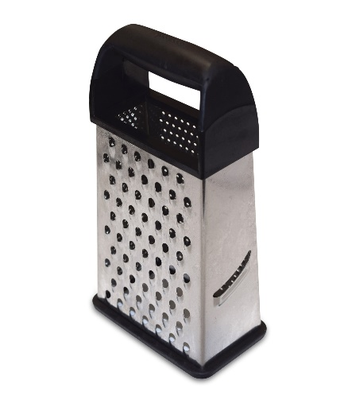
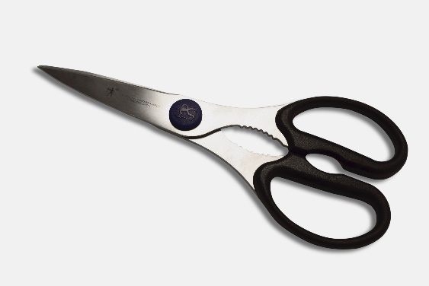
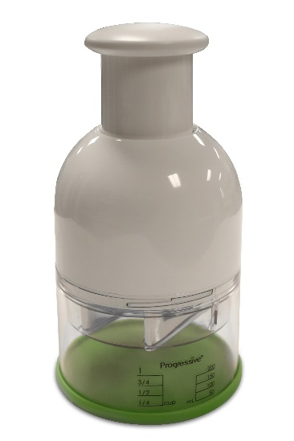
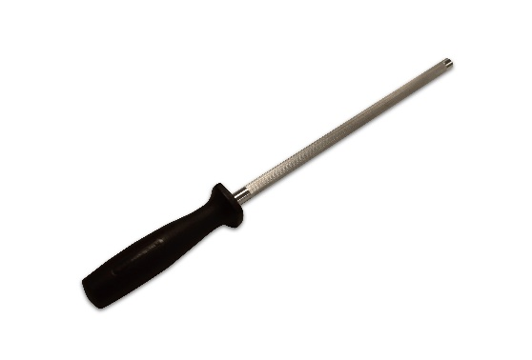
Cutting and Preparing Equipment
Straightening steel
Kitchen shears
Food chopper
Grater/shredder
Notes:
Straightening steel – long steel rod. Used to straighten knife edges between sharpening. Hand wash.
Kitchen shears – scissors. Used to snip, trim, or cut fresh herbs, dried fruit, vegetables, meat, and pastry. Hand or machine wash.
Food chopper – small hand-held to multi-bladed size. Used to chop foods, such as nuts, eggs, meats, and some fruits and vegetables. Hand or machine wash.
Grater/shredder – two-or four-sided metal cutting tool with openings of different sizes. Used to grate/shred foods, such as cheese and cabbage. Hand or machine wash.

Slide 7
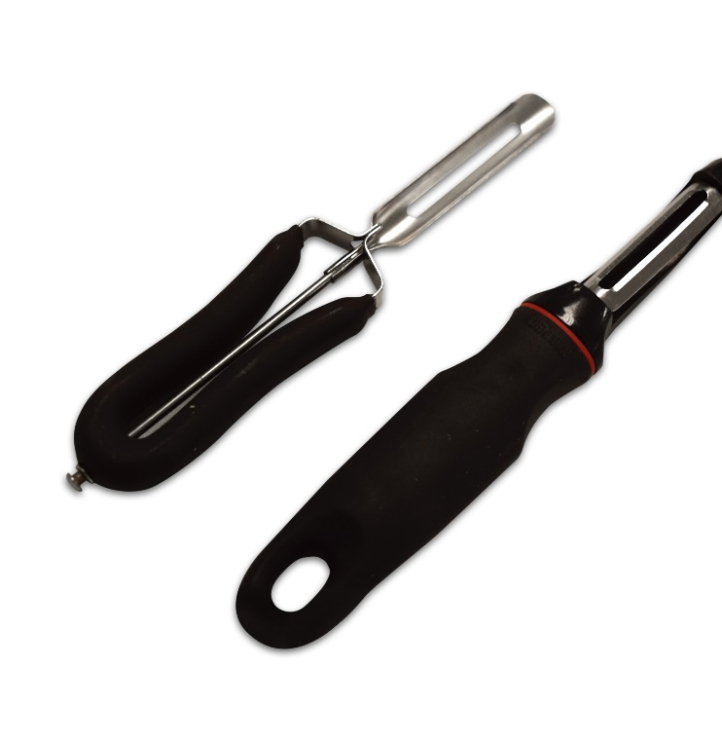
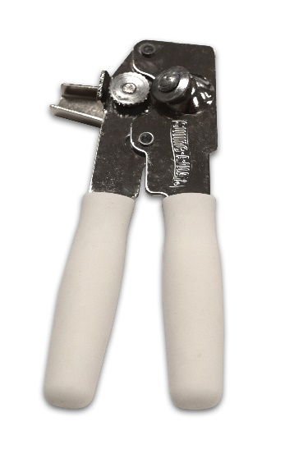
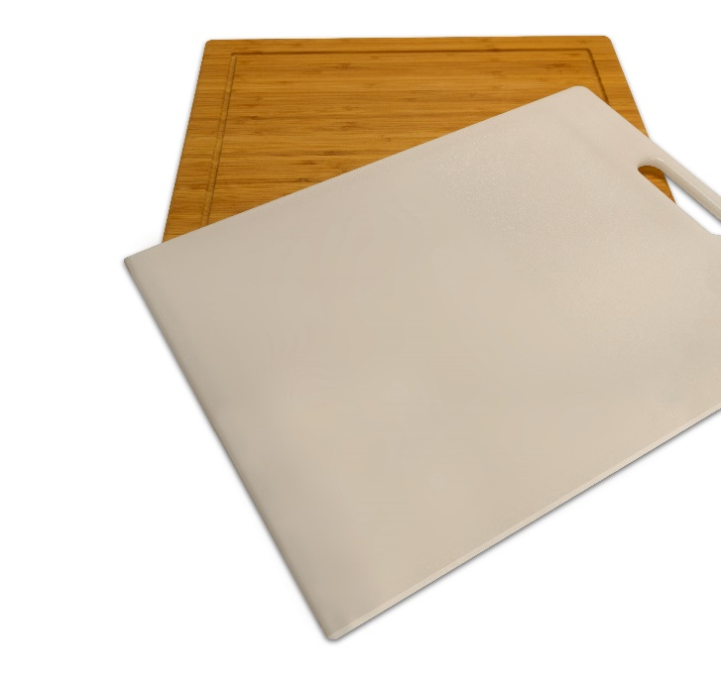
Cutting and Preparing Equipment
Vegetable peeler
Can opener
Cutting board
Notes:
Vegetable peeler – a swivel blade. Used to pare/peel fruits and vegetables; making decorative carrot, chocolate, or cheese curls for garnishing. Hand or machine wash.
Can opener – hand and electric varieties. Used to cut lids off of metal cans. Small hand openers may be hand or machine washed. Electric models should be wiped with a damp cloth. The blade should be removed and cleaned with soap and water.
Cutting board – made from a variety of materials (plastic resists bacteria better than soft woods). Used to protect counter and table tops when cutting and chopping. Wooden cutting boards should be hand washed. Plastic boards may be either hand or machine washed.

Slide 8
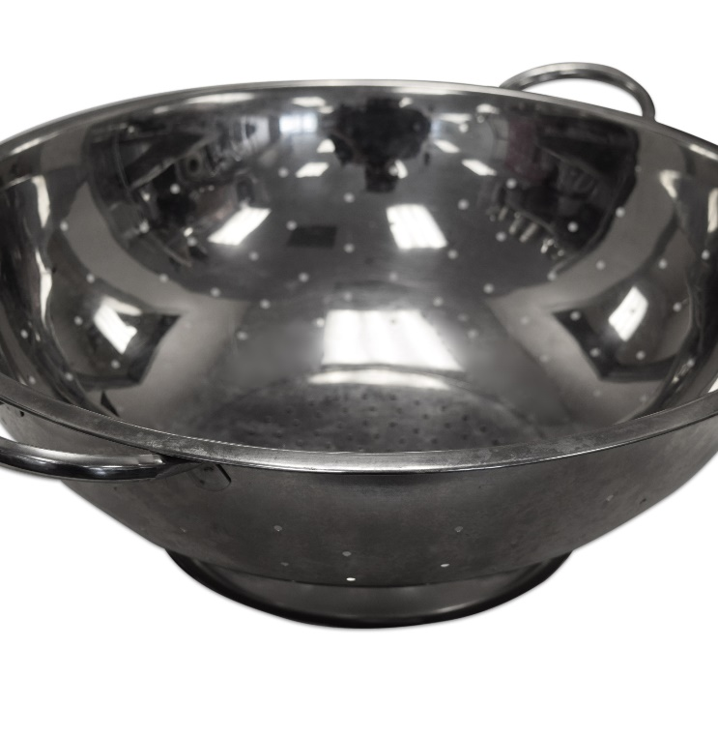
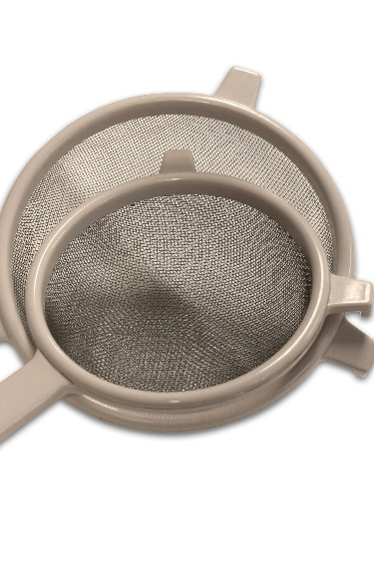
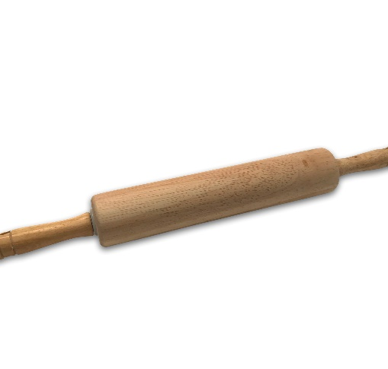
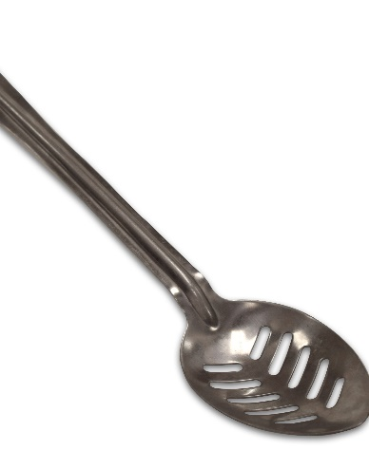
Cutting and Preparing Equipment
Colander
Slotted spoon
Rolling pin
Strainer
Notes:
Colander – perforated bowl made of metal or plastic available in a variety of sizes. Used to drain liquids from foods. Hand or machine wash.
Slotted spoon – usually made from metal, plastic, or wood in various sizes. Used to remove solid food from and draining away liquids. Hand or machine wash.
Rolling pin – heavy roller made of wood, marble, or metal. Used to flatten dough; crush bread, cookies, or crackers into crumbs. Hand wash.
Strainer – bowl made of wire mesh available in a variety of sizes. Used to remove solid pieces from liquid foods. Hand or machine wash.

Slide 9
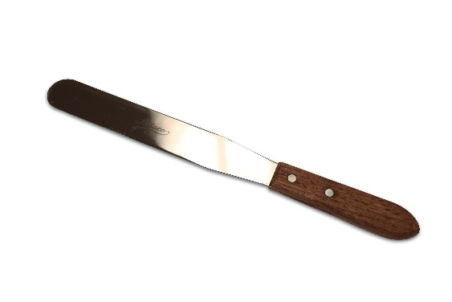
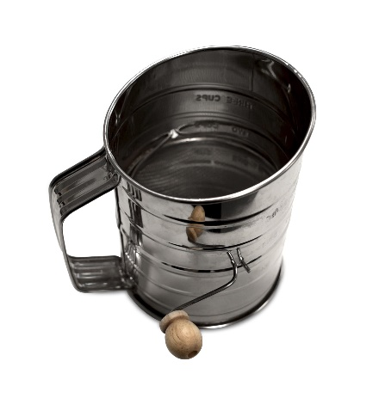
Cutting and Preparing Equipment
Sifter
Straight-edge spatula
Notes:
Sifter – a metal or plastic canister with a wire-screened bottom, available in various sizes with a blade or wheel inside. Used to remove lumps from and incorporating air into dry ingredients before measuring. To clean, tap over garbage can to remove dry ingredients; if necessary, wipe with a damp cloth, but dry immediately to prevent rusting.
Straight-edge spatula – Used to level dry or solid ingredients and apply fillings and frostings. Hand or machine wash.

Slide 10
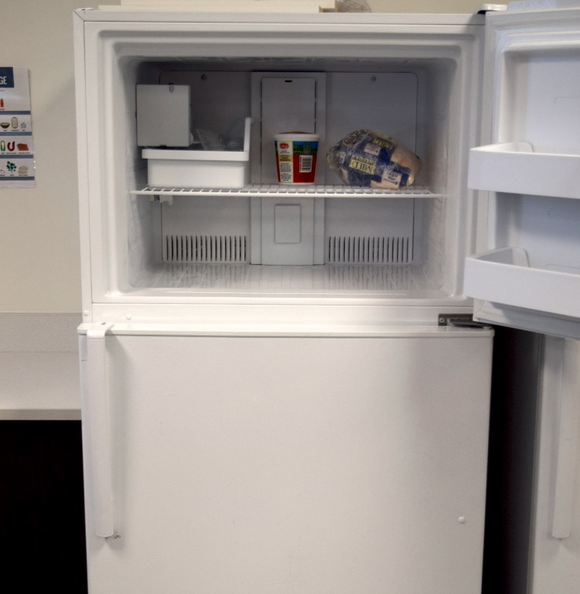
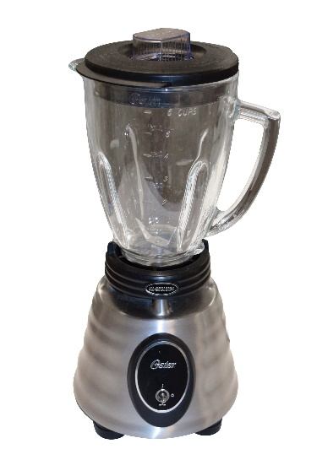
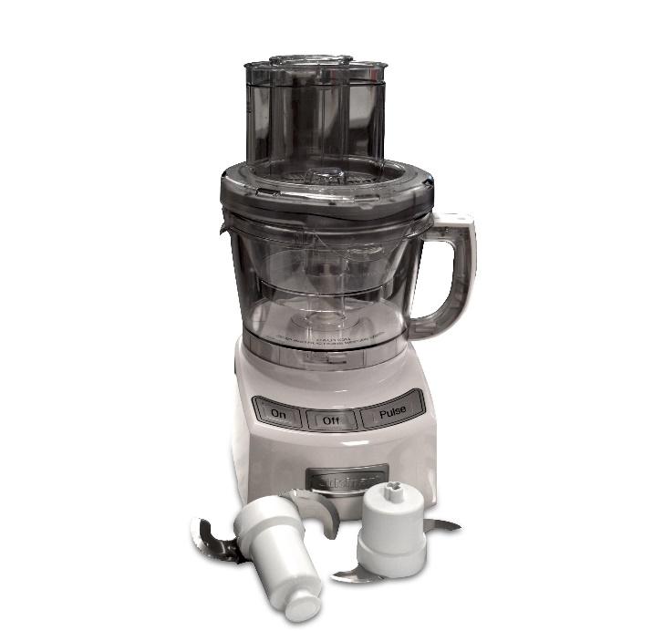
Cutting and Preparing Equipment- Appliances
Blender
Food processor
Refrigerator/Freezer
Notes:
Blender – removable container with a wide opening, handle, pouring spout, and measurement markings on side. Used to chop, blend, and liquefy. See the use and care booklet for parts that must be hand washed and can be machine wash.
Food processor – more powerful and versatile than a blender; assorted disks/blades for special jobs. Used to blend, chop, grate/shred, grind, knead, and slice. See the use and care booklet for parts that must be hand washed and can be machine wash.
Refrigerator/freezer – a major kitchen appliance; comes in a variety of sizes and colors with a wide range of options, such as ice maker, in-door dispensers, etc. Used to refrigerator/freeze perishable foods. Refrigerator should be kept at 40˚, and freezer at 0 ˚ for home consumer use. Wipe spills as they occur. Clean interior of refrigerator with baking soda solution a minimum of once a month. Clean exterior of refrigerator with appliance cleaner or damp cloth. Check gaskets around door monthly. Vacuum under and behind refrigerator/freezer a minimum of twice a year. Change water filters as recommended.

Slide 11
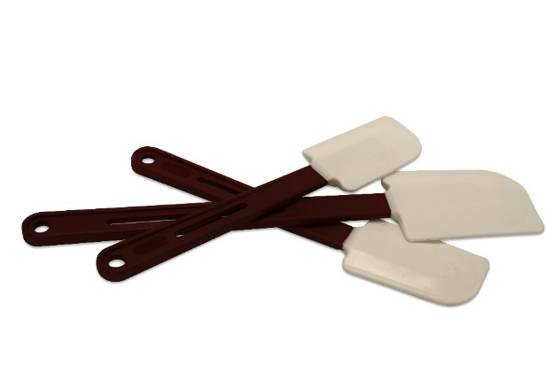
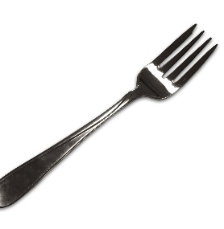
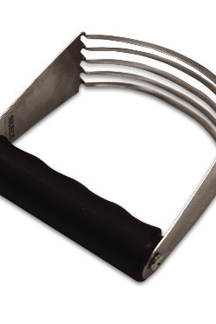
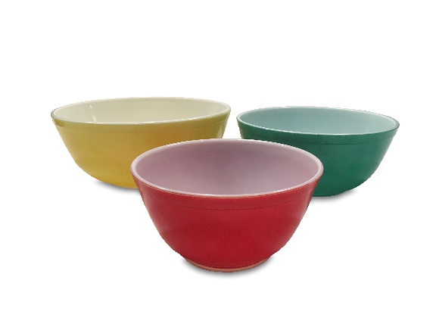
Mixing Equipment
Fork
Pastry blender
Rubber spatula
Mixing bowls
Notes:
Fork – Used to beat eggs and other ingredients and/or to mix together ingredients. Hand or machine wash.
Pastry blender – several pieces of curved metal attached to a handle. Used to blend flour and solid fat when making pastry; blending butter and cheese mixtures. Hand or machine wash.
Rubber spatula – Used to gently mix together ingredients, scrape down the sides of mixing bowls, and remove solid ingredients from measuring cups. Hand or machine wash.
Mixing bowls (nested mixing bowls) – usually made from plastic, glass, or metal in a variety of sizes; some have lids for storage. Used to prepare and combine ingredients for recipes. Hand or machine wash.

Slide 12
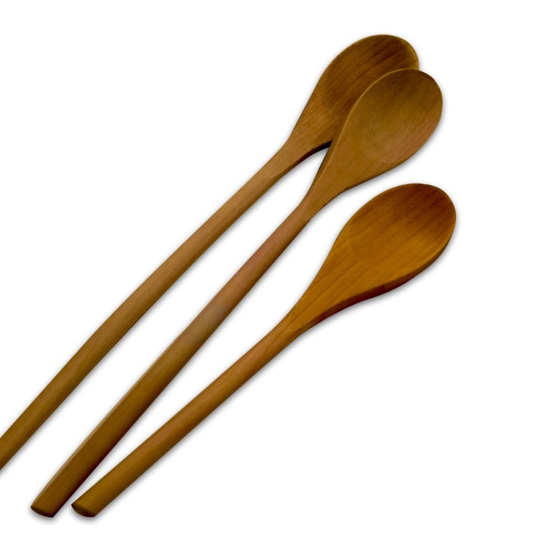
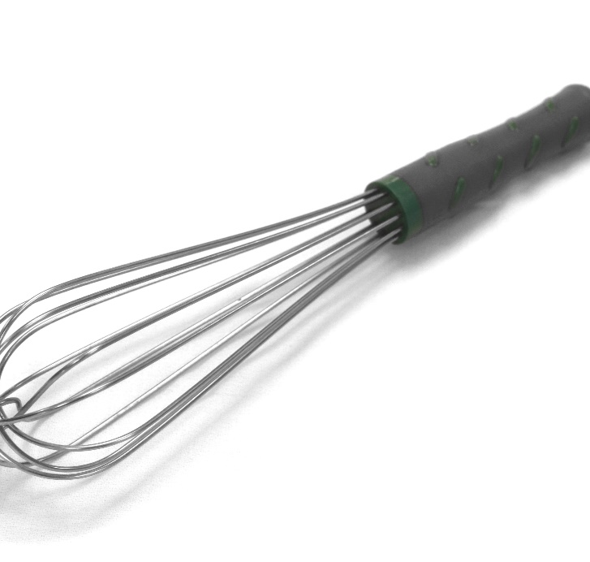
Mixing Equipment
Wooden spoons
Wire whisk
Notes:
Wooden spoons – available in many sizes and may be slotted or solid; will not scratch pan surfaces. Used to mix and stir ingredients. Hand wash.
Wire whisk – usually made of balloon-shaped wire loops that are held together by a handle. Used to stir, beat, and whip foods; incorporates air into foods; helps to prevent/remove lumps. Hand or machine wash.

Slide 13
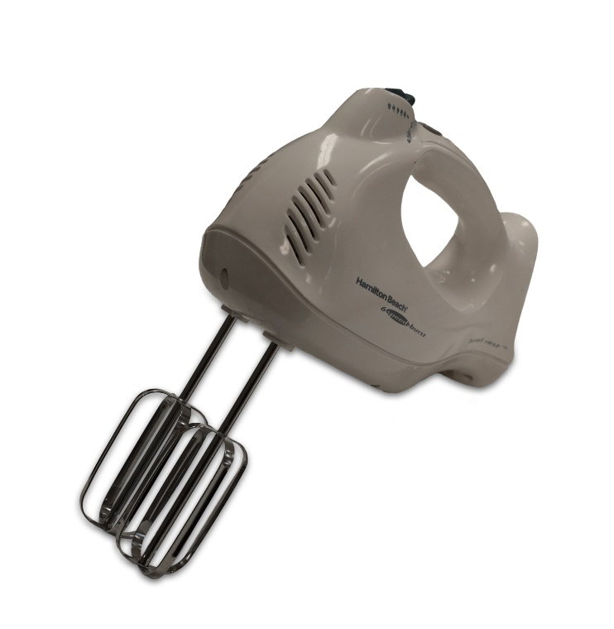
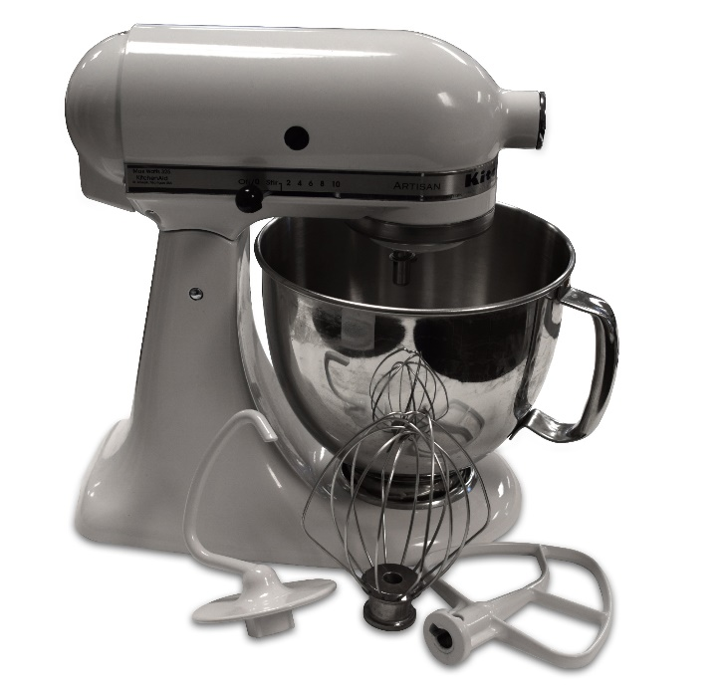
Mixing Appliances
Hand mixer
Stand mixer
Notes:
Hand mixer – a hand-held electric appliance; lighter and less expensive than a stand mixer, but less versatile. Used to blend, beat, and whip ingredients. Hand or machine wash removable beaters; wipe mixer body with a damp cloth.
Stand mixer – electric mixer that leaves hands free; suited for heavy-duty work; often has attachments. Used to blend, beat, whip ingredients, and to knead dough. Hand or machine wash removable attachments; wipe mixer body with a damp cloth.

Slide 14
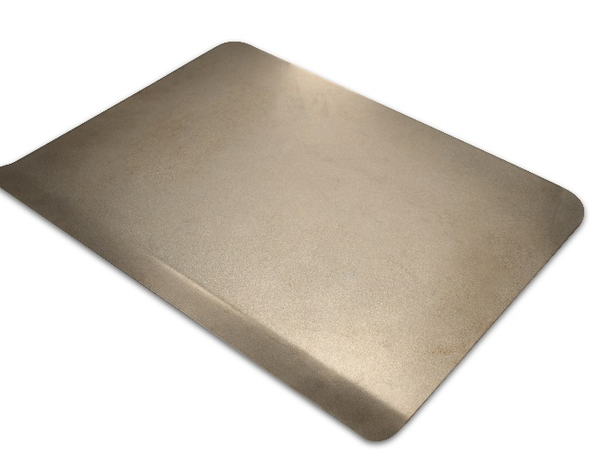
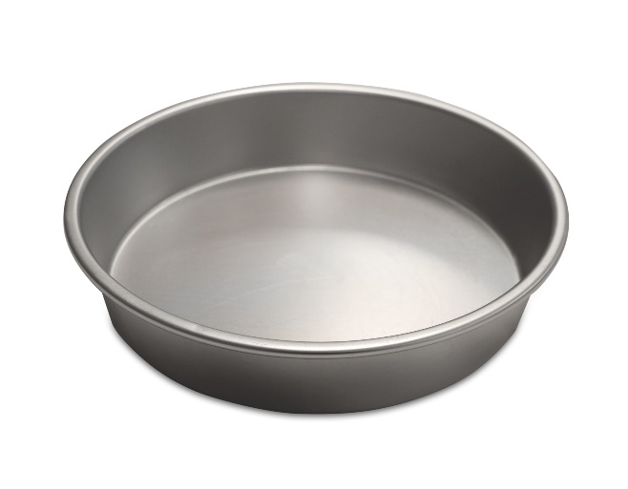
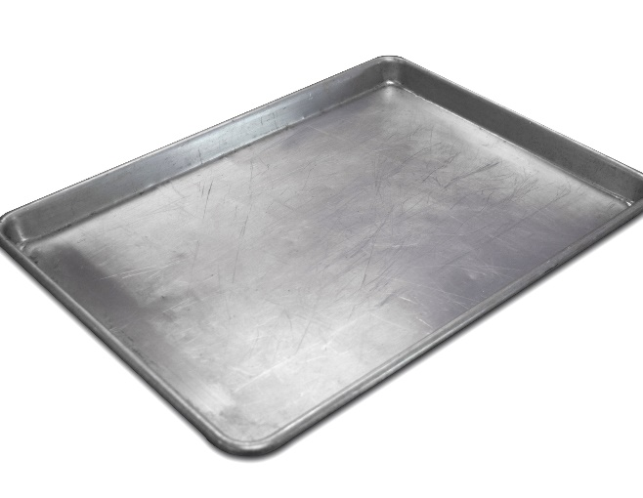
Cooking Equipment- Bakeware
Cake pan
Baking sheet
Cookie sheet
Notes:
Bakeware – used to cook foods in the oven.
Cake pan – usually made of aluminum in a range of sizes. Used to bake layer cakes and other baked goods. Hand or machine wash.
Baking sheet – metal rectangular pan, similar to a cookie sheet, but with four sides about 1 inch deep. Used to bake sheet cakes, pizza, chicken pieces, and fish. Hand or machine wash.
Cookie sheet – flat, metal rectangular pan with two or three open sides. Used to bake cookies, biscuits, and pizza; also used to toast bread. Hand or machine wash.

Slide 15
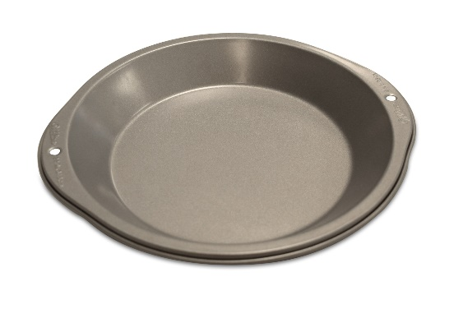
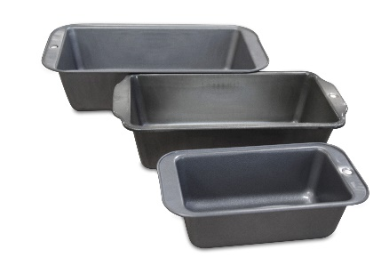
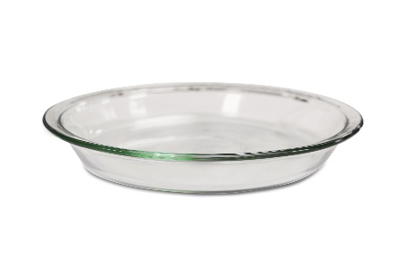
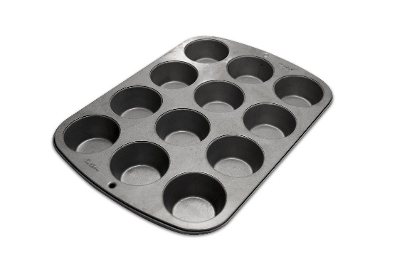
Cooking
Equipment- Bakeware
Muffin pan
Loaf pan
Pie pan, glass
Pie pan, metal
Notes:
Muffin pan – rectangular baking pan that comes in a variety of sizes, such as with six to twelve round depressions; usually made of metal. Used to bake muffins, cupcakes, and rolls. Hand or machine wash.
Loaf pan – a deep, narrow, oblong pan that may be made of glass, glass-ceramic, or aluminum. Used to bake loaves of bread, pound cake, and meat loaf. Hand or machine wash.
Pie pan – shallow, round baking dish with sloping sides; usually made of glass or metal in a variety of sizes. Used to bake dessert and main-dish pies and quiches. Hand or machine wash.

Slide 16
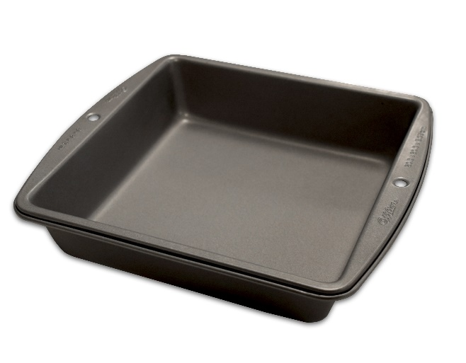
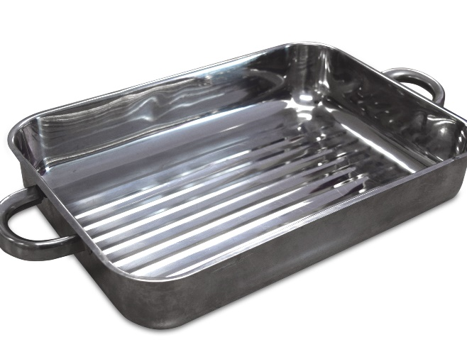
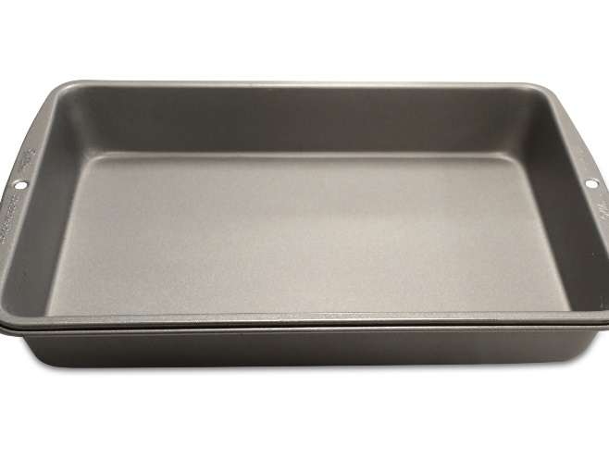
Cooking Equipment- Bakeware
Rectangular pan
Square pan
Roasting pan
Notes:
Square/rectangular pan – usually made of aluminum in a variety of sizes. Used to bake a variety of cakes, cookies, and other baked goods. Hand or machine wash.
Roasting pan – heavy oval or rectangular pan; usually made of metal with a lid. Used to roast meats and poultry. Hand or machine wash.

Slide 17
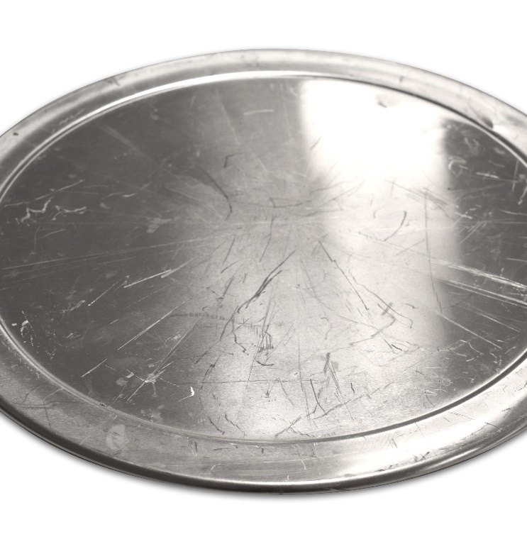
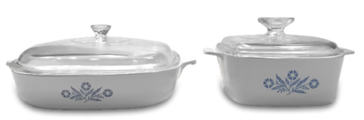
Cooking Equipment- Bakeware
Pizza Pan
Casserole
Notes:
Pizza pan – large, round baking pan with a narrow rim around the edge; may be perforated for crispier crust. Used to bake pizza. Hand or machine wash.
Casserole – dishes with high sides that may be made of glass, glass-ceramic, or earthenware; available in a variety of sizes, with or without lids; may go from freezer-to-oven. Used to bake and serve main dishes and desserts. Hand or machine wash.

Slide 18
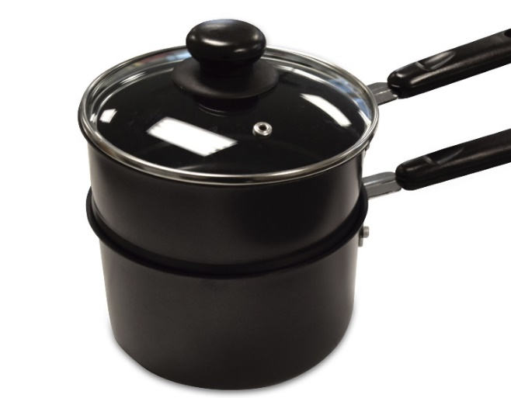
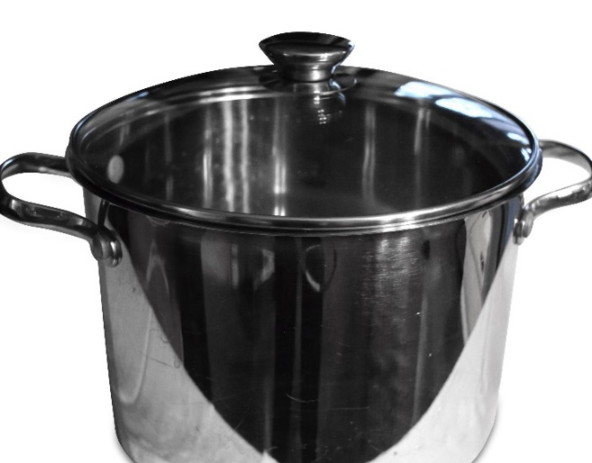
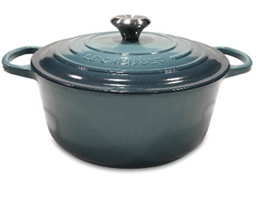
Cooking Equipment- Cookware
Double boiler
Dutch oven
Pot
Notes:
Cookware – used to cook foods on the range.
Double boiler – a small pan that fits into a larger pan with a lid; usually made of glass or metal. Used to cook and melt foods that scorch easily, such as sauces, chocolate, custard, butter, etc. Hand or machine wash.
Dutch oven – a heavy pot with close-fitting lid; may have a rack to keep foods from sticking to the bottom. Used to cook large amounts or sizes of foods on the range or in the oven. Hand or machine wash.
Pot – usually made from metal; larger and heavier than saucepans; small handles on each side with a lid; vary in size from 3 – 20 quarts. Used to cook large amounts or sizes of foods in liquid on a range.

Slide 19




Cooking Equipment- Cookware
Sauté pan
Covered skillet
Steamer
Saucepan
Notes:
Sauté pan/skillet – skillets (fry pans) have wide bottoms and low sides; vary in size and often have lids. Sauté pans are uncovered skillets with narrow bottoms and sloping sides. Used to brown and fry foods. Hand or machine wash. ** Cast iron must be hand washed and dried completely to prevent rusting; may need to rub with vegetable oil to preserve “seasoning.”
Steamer – Perforated metal or bamboo insert that fits into a saucepan or pot that holds food above boiling water. Used to steam vegetables to retain nutrients. Hand or machine wash, depending on material from which it is made.
Saucepan – usually made of metal or heatproof glass; one long handle and a lid; range in size from ½ - 4 quarts. Used to cook foods in liquid on a range. Hand or machine wash.

Slide 20



Cooking Equipment- Cookware
Ladle
Cooling rack
Wok
Notes:
Ladle – round cup attached to a long handle; usually in a variety of sizes and made from glass, metal, or plastic. Used to lift and serve sauces, soups, stews, gravies, salad dressings, and punches. Hand or machine wash.
Cooling rack – wire rack with legs; usually square or rectangular, made of metal, in a variety of sizes. Used to hold baked goods and hot pans off of counter/table tops, preventing scorching; allows air to circulate around foods so it cools quickly. Hand or machine wash.
Wok – Bowl-shaped pan often used in Chinese cooking; may be used on range or electric. Used to quickly fry foods in a very small amount of fat. Hand or machine wash – if electric, follow operating manual’s instructions for care.

Slide 21


Cooking Equipment- Cookware
Pastry brush
Oven mitt and pot holder
Notes:
Pastry brush – usually found in a variety of sizes and materials. Used to brush pastry and other foods with butter or sauces; removing crumbs from cakes before frosting. Hand or machine wash.
Oven mitt/pot holder – Cloth pads in various sizes and shapes. Used to protect hands while handling hot bakeware and cookware. Cleaning depends on the type material.

Slide 22


Cooking Equipment- Cookware
Tongs
Turner
Notes:
Tongs – Usually made of metal or plastic; variety of sizes. Used to turn meats and fried foods; griping and lifting bulky foods. Hand or machine wash.
Turner – Made of metal or plastic; may be slotted or solid. Used to lift and turn foods, such as cookies, meat, fish, pancakes, and eggs. Hand or machine wash.

Slide 23




Cooking Equipment- Small Appliances
Slow cooker
Electric griddle
Toaster
Electric skillet
Toaster Oven (not pictured)
Notes:
Slow cooker – (crock pot) a heating base, cooking vessel that may be removable, and a lid; usually have at least two settings. Used to cook slowly for several hours; convenient for one-dish meals. Exterior: Wipe with damp cloth. Interior: If removable, cooking vessel may be hand or machine washed.
Electric skillet/griddle – fry pan whose temperature is controlled by a thermostat; high dome cover with vent; clearly visible heat indicator light. Skillets are used to fry, bake, roast, panbroil, stew or simmer food.
Griddles are similar to skillets, but have no sides or lids. Griddles are used to fry foods, such as eggs and pancakes. Immersible: Hand or machine wash, as instructed by operating manual. Thermostat to be wiped clean with damp cloth. Non immersible: Wash by hand, following operating manual’s instructions.
Toaster – comes in two- and four-slice models; may have extra wide openings for bagels and thick-sliced bread. Used to brown/toast breads and pastries on both sides at one time. Wipe exterior with damp cloth; clean crumbs from bottom regularly.
Toaster oven – available in variety of sizes; uses less energy and creates less heat than a full-size oven. Used to bake and broil small amounts of foods in addition to toasting. Wipe exterior with damp cloth; clean crumbs from bottom regularly.

Slide 24


Cooking Equipment- Large Appliances
Microwave oven
Range/oven
Notes:
Microwave oven —Available in a variety of sizes; may be built into a range hood or may be a counter top model. Used to cook foods; defrosts foods; foods. Exterior - Wipe with a damp cloth. Interior – Wipe with mild detergent or baking soda solution.
Range/oven – a major kitchen appliance available in free-standing, drop-in, or built-in models; number and types of cooking surfaces vary; oven types vary; may be electric or gas. Used for frying or cooking in liquid, on top of the range; baking, broiling, or roasting in the oven. Wipe with damp cloth any spills as they occur when appliance cools; follow operating manual’s instructions for specific use and care.

Slide 25

Cleaning Appliance
Dishwasher
Notes:
Dishwasher – a major kitchen appliance available in portable or built-in models; various options available. Used to clean/sanitize kitchen equipment and tableware. Follow operating manual’s instructions for loading details and recommended detergent and drying agents; use ONLY dishwasher detergent; scrape dishes before loading; and ensure that all items are dishwasher safe.

