Slide 1
Safe Plates for Home Food Handlers
Module 5: Cleaning and Sanitizing

Slide 2
Case Study

Slide 3
What Happened
Oregon and Washington, 2010
Nine members of an Oregon soccer team became ill with Norovirus
All who got sick ate prepacked cookies and chips, as well as grapes stored in a reusable grocery bag
After investigation, health inspectors found out the bag had been stored in the bathroom used by the first person who got sick
Notes:
https://www.cbsnews.com/news/report-2010-oregon-norovirus-outbreak-tied-to-reusable-grocery-bag/

Slide 4
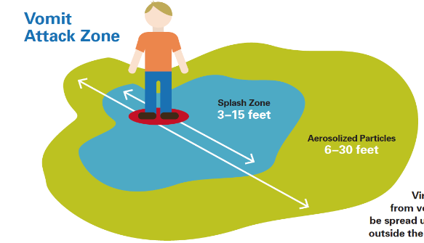
What They Found
Vomit can mist up to 30 feet
The bag and snacks were contaminated just by being in the same room
Notes:
“This story had nothing to do with disposable bags, reusable bags, or anything similar. It is about how when norovirus-infected people vomit, they shower their surroundings with an invisible fog of viruses—viruses that can later infect people who have contact with those surroundings…it could just have easily been a disposable plastic bag, a paper bag, a cardboard box, the flush handle on the toilet, the sink, the floor, or the nearby countertops.”

Slide 5
Learning Objectives
Understand the difference between cleaning and sanitizing
Define food contact surfaces and know when and how to clean and sanitize them
Identify how to clean and sanitize utensils and equipment properly using mechanical and manual washing
Use and store wiping cloths appropriately
Use chemicals according to manufacturer instructions and store in properly labeled containers in designated areas

Slide 6
Key Terms
Clean – removal of dirt or food residue
Food-contact surface – a surface of equipment or a utensil with which food normally comes into contact or from which food may drain, drip or splash
Hand-contact surface – any surface touched by clean or dirty hands

Slide 7
Key Terms
Contact time – period of time sanitizer must be in contact with a surface to work properly
Sanitize – reduces the number of disease-causing microorganisms on equipment and utensils to acceptable public health levels
Sanitizer – heat or chemical that destroys pathogenic microorganisms to safe levels

Slide 8
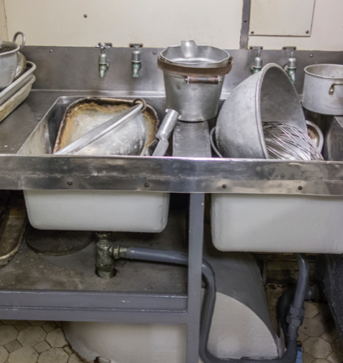
Cleaning and Sanitizing

Slide 9
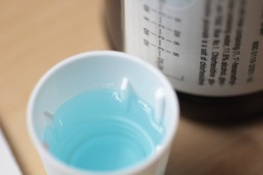
Cleaning and Sanitizing
Cleaning – the removal of soil and food residue from surfaces of equipment and utensils
Sanitizing – reduce number of pathogens to safe levels
Cleaning is like brushing teeth while sanitizing is like using mouthwash
Notes:
If you use mouthwash before you brush your teeth your breath doesn’t stay fresh for long, does it?
You must get rid of the fuzzy bunny slippers before you can use mouthwash

Slide 10
Cleaning and Sanitizing Methods
Manual Process
  Done in steps or with multiple compartment sink
  Make sure sanitizer is mixed at the correct concentration
  Use five step process
Mechanical Process
  Use a dishwashing machine according to manufacturer instruction
Cleaning Fixed Equipment
  Use a combination of manual and in-place cleaning procedures

Slide 11
Five-Step Process
Pre-flush, pre-scrape or scrub to remove food residue
Wash at a water temperature of 110°F or follow manufacturer instructions
Rinse well to remove all remaining food and detergent residue
Sanitize at contact time, concentration and temperature as shown in manufacturer instructions
Air dry, never towel dry

Slide 12
Cleaning and Sanitizing
Clean and Rinse
Clean, Rinse and Sanitize
Hand Contact Surfaces
Handles
Faucets, soap, paper towel dispensers
Switches
Wiping cloths, brushes, scrubbers, mops
Trash containers and lids
Food contact surfaces
Prep boards
Multi-use utensils
Tables and work surfaces
Machinery and equipment
Utensils
Containers and service items
Notes:
Some establishments are required to sanitize handles and other hand-contact surfaces

Slide 13
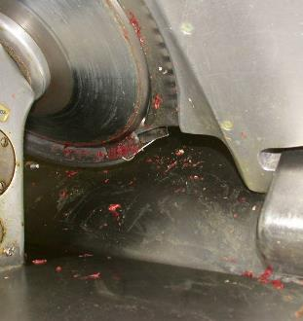
When to Clean and Sanitize
At least every 4 hours when equipment and utensils are used at room temperature
Before and after using equipment or utensils
When switching to a different food
Anytime there is a risk of contamination

Slide 14
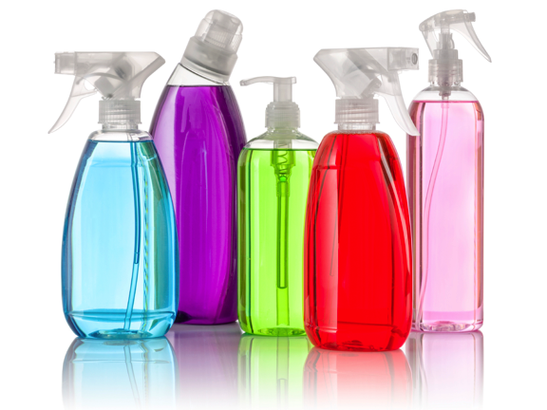
Sanitizers
Notes:
Introduce that in home settings, usually chemicals come pre mixed or you’re using a mechanical dishwasher. For community or retail settings these things become a little more complicated.

Slide 15
Using Chemical Sanitizers
Chemical cleaners and sanitizers must be used in a way that they don’t contaminate food
Food should be moved or covered before chemicals are used
Always follow directions carefully to make sure chemicals don’t become a hazard

Slide 16
Test Strips
Test strips – paper strips used to monitor concentration of chemical sanitizer and pH
Use the test strips specific to the chemical
Throw away after expiration date
Keep away from water and sunlight

Slide 17
Wiping Cloths
Cloths for wiping food spills during service must be kept clean and dry
Cloths for wiping surfaces in contact with raw animal foods must be kept separate
Wiping cloths and solution should not be stored on the floor or near food

Slide 18
Sanitizer Buckets
Cloths in-use for wiping counters and equipment must be stored in a chemical sanitizer solution
Make sure solution is at the appropriate concentration
Launder or replace cloths daily
Replace solution if there is visible soil or residue in the buckets

Slide 19
Storing Chemicals
Keep chemicals in original containers if possible
If chemicals must be transferred to a new container, label the side with common name
Store chemicals away from food
Know where to find Safety Data Sheets

Slide 20
Heat to Sanitize
Surface temperature must reach at least 160ºF
When sanitizing manually, hot water must be maintained at 171ºF or above with item in water for minimum of 30 seconds
When sanitizing mechanically, hot water temperature is maintained by the dishwasher
Notes:
Water must be above 160F, since items being placed into the water will lower the temperature

Slide 21
Safety Precautions

Slide 22
Safety Precautions
Dry hands before cleaning electrical equipment
Turn off power/safety/breaker switch
Do not use chemical unless trained
Never mix chemicals together
Notes:
Some of this is common sense, but important to make sure employees understand
Even common household chemicals can be dangerous when combined: bleach + ammonia (glass cleaner) = chloramine, bleach + acid (vinegar) = chlorine gas (mustard gas), bleach + rubbing alcohol = chloroform

Slide 23
Safety Precautions
Use personal protective equipment such as gloves, aprons and goggles
Use rack or basket to immerse items in hot water for sanitizing
Follow manufacturer’s instructions for dishwashers
Wash hands after using chemicals

Slide 24
Discussion
How does cleaning and sanitizing help prevent cross-contamination?

Slide 25
Review
Difference between cleaning and sanitizing
How and when to properly clean and sanitize food contact surfaces, utensils and equipment
Using and storing wiping cloths appropriately
Properly using and storing chemicals

