Slide 1
FITNESS
Let’s get it started in here!

Slide 2
Dean Ornish, M.D. is the founder and president of Preventive Medicine
Research Institute and a clinical professor of medicine and the University of California in San Francisco.
In his Epic study patients who never smoked, were not overweight, had at least 30 minutes/day of physical activity, and adhered to healthy dietary principles (high intake of fruits, vegetables, and whole-grain bread and low meat consumption) had a 78% lower overall risk of developing a chronic disease. These included a 93% reduced risk of diabetes, an 81% lower risk of a heart attack, a 50% reduction in risk of stroke, and a 36% overall reduction in risk of cancer than participants without these healthy factors.
Lifestyle changes can slow, stop, or even reverse the progression of early-stage prostate cancer. We also found that these lifestyle changes beneficially altered the expression of over 500 genes in only three months, “turning on” protective genes that prevent disease and “turning off” oncogenes associated with breast cancer and prostate cancer as well as genes that cause heart disease, oxidative stress, and inflammation.
type 2 diabetes, high blood pressure, and elevated cholesterol levels may be reversed by making these same lifestyle changes. More than half of Americans will have diabetes or be pre-diabetic by 2020 at a cost to the U.S. health care system of $3.35 trillion if current trends go on unabated, according to health insurer UnitedHealth Group Inc. The ravages of diabetes - heart disease, blindness, amputations, impotence, kidney damage - are completely preventable for most people by changing diet and lifestyle.
http://www.ncbi.nlm.nih.gov/pubmed/19667296

Slide 3
What does all this mean???
You need to know your history
Participate in your health care
Monitor your eating habits
Realize your stressors and learn how to cope
Determine what your body mass index or body composition is
And above all else
EXERCISE
So how do you do all this?

Slide 4
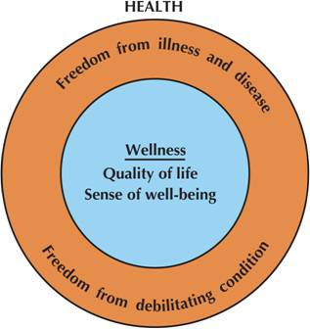
Health - state of being associated with freedom from disease and illness.
Wellness - the positive component of health; sense of well-being; a product; multidimensional
Notes:
The model of wellness is important for students to understand, as it sets the stage for the entire course (similar to Figure 2, pg. 4 in text). It illustrates the modern concept of health, and how wellness is the positive component as evidenced by a sense of well-being reflected in optimal functioning, health-related quality of life, meaningful work, and a contribution to society. It is multi-dimensional, which includes those listed on the next slide. They are all closely related to each other. Some examples are provided below:
1. Exercising with a friend: (physical and social)
2. Getting together with friends (social and emotional)
3. Going to church: (spiritual, intellectual, and emotional)
Refer to Figure 2, pg. 4 in book. Physical Health/Wellness is the emphasis of this course (definitions below), although all dimensions will be discussed. In fact, you have a Wellness Activity project which requires performing an activity in each dimension and reflecting on each experience.
Physical Health: Free from illnesses that affect the physiological systems of the body such as the heart and nervous system. A person with physical health possesses an adequate level of physical fitness and wellness.
Physical Wellness: A person’s ability to function effectively in meeting the demands of the day’s work and to use free time effectively. It includes good physical fitness and the possession of useful motor skills.

Slide 5
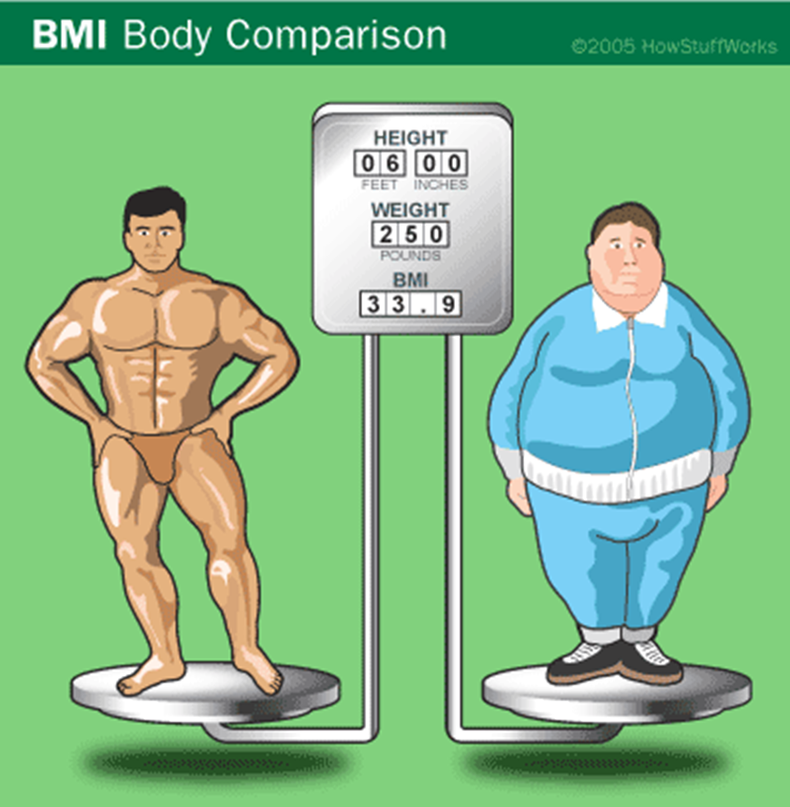
Body Mass Index http://static.howstuffworks.com/gif/bmi-comparison.gif

Slide 6
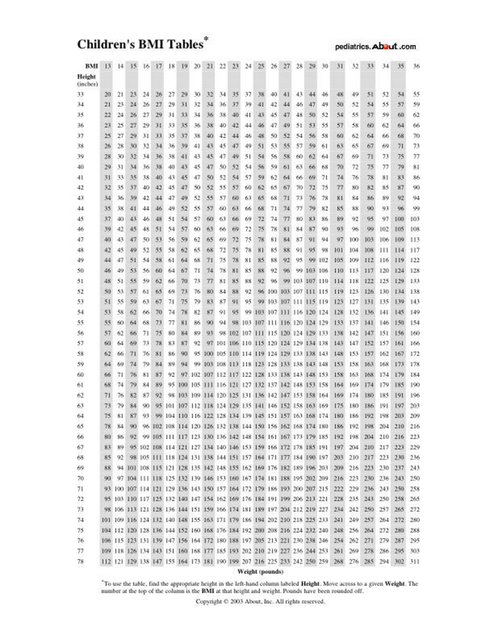
BMI (BODY MASS INDEX)
Body Mass Index is a measurement that accounts for weight and height and provides an estimate for the effects of weight on one’s health.
The greater the BMI the greater the risk for health issues like diabetes, CVD, hypertension, etc.
It should only be used by a physician as a screening tool
Not everyone over a BMI of 30 is obese. Athletes may have a BMI over 30 and not be obese!
http://pediatrics.about.com/library/growth_charts/n_bmi_tables.htm

Slide 7
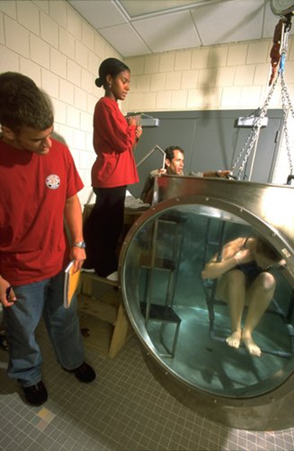
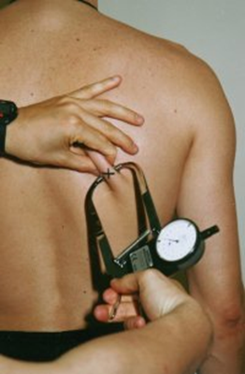
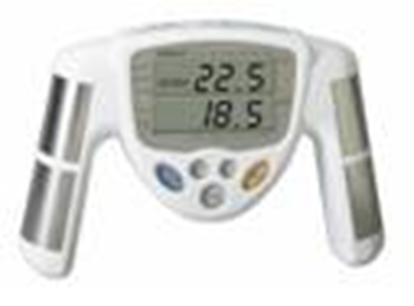
Best Way to determine body fat verses lean muscle is………
Skin fold measurement
Bioelectrical impedance
Under water weighing (hydrostatic)
http://www.ithaca.edu/depts/gallery_img/5290_full.jpg
http://www.fitnesszone.com/Merchant2/graphics/00000001/man_back.jpg
http://www.youtube.com/watch?v=GliffGz-8Gg
http://www.youtube.com/watch?v=mYv6J8-KrSU
Bod pod
Body composition is the ratio of body fat and lean muscle mass

Slide 8
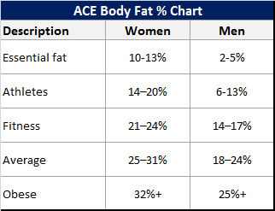
Percent Body Fat
Obesity is abnormal accumulation of body fat, 20% or more over ideal weight
Overweight is abnormal accumulation of body fat, 10-15% over ideal weight
Underweight is very small amount of body fat 10-15% under ideal weight.
These numbers are based off your ideal weights decided on by your measurements.
Why is there a difference between men and women?

Slide 9
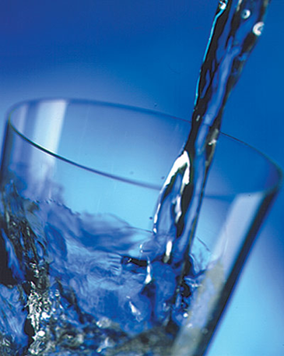
The importance of water
It transports usable materials and carries away waste
It can be derived from liquids or solids
It absorbs heat
It regulates temperature
It acts as a cushion
It serves as a joint lubrication
It can be lost and not noticed
It helps prevent kidney stones
It helps prevent cavities, gum problems and other oral health issues
**Pick 5

Slide 10
Hydration
Recommendation: 6-8, 8 ounces glasses of H2O. With exercise increase by 16 ounces.
Differences in consumption and loss of water triggers______.
Thirst is the first symptom of _______ and serves to signal the replenishment of body water. What is the problem with feeling thirsty?
Sweat – releases water from your blood and the blood becomes more concentrated. This can trigger thirst and make you drink.
As little as 2% to 5% of loss of body weight can result in symptoms of Dehydration.

Slide 11
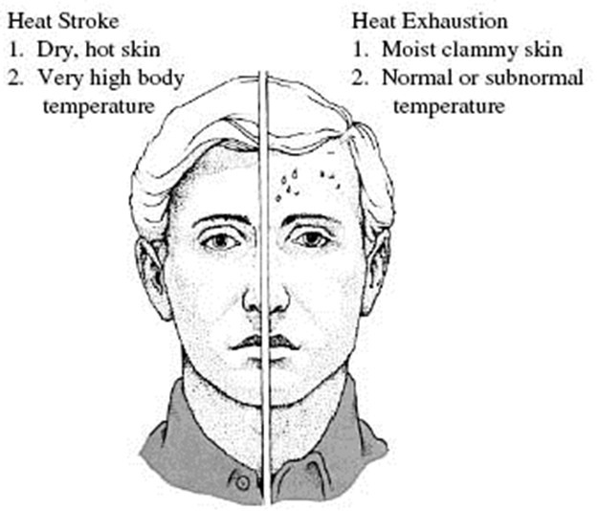
Dehydration
Heat Illness
Heat cramps
Heat Exhaustion
Heat Stroke
Symptoms
Headache
Fatigue
Flushed skin
Rapid weak pulse
Rapid breathing
Excessive thirst
Body Core temperature rises to 106 degrees
How do you treat someone that is suffering from heat illness?

Slide 12
Dehydration
2% loss become thirsty and weak
4% loss strength & endurance greatly hindered
10% loss heat intolerance and weakness
20% loss susceptible coma and death
Ways to Quench thirst:
Always drink enough to quench it
Water, sports drinks, juice, milk, smoothies, fruit, & soups are food sources for replenishing losses.
**** Avoid caffeine in sodas, tea, and coffee due to the diuretic nature of these fluids.

Slide 13
Rest
Rest is extremely important for your body to give it time to repair itself.
How many hours of sleep should you get?
What prevents you from getting that sleep?
What should you do to get more rest?
http://news.health.com/2011/10/25/sleepy-teens-more-prone-to-weight-gain-study/

Slide 14
Physical Fitness cont’d
Consists of:
  5 health-related fitness components
  6 skill-related components (aka sports fitness or motor fitness)
  2 non-performance components
Specific, but interrelated components
Notes:
Health-Related Fitness Components (on Next Slide): Cardiovascular Fitness, Muscular Strength & Endurance, Body Composition, & Flexibility
Skill-Related Fitness Components (also referred to as sports fitness or motor fitness) (on Future Slide): Power, Speed, Reaction Time, Coordination, Balance, Agility
Non-Performance Components: Metabolic Fitness & Bone Integrity
Physical fitness is a combination of several aspects, rather than a single characteristic. A fit person possesses at least adequate levels of each of the health-related, skill-related, and metabolic fitness components. Some relationships exist among various fitness characteristics, but each of the components of physical fitness is separate and different from the others. For example, people who possess exceptional strength may not have good cardiovascular fitness, and those who have good
coordination do not necessarily possess good flexibility.

Slide 15
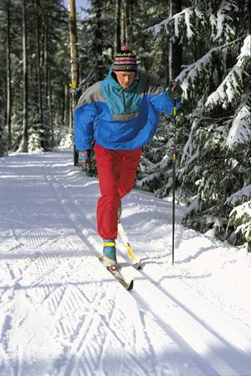
Health Related Fitness
Cardiovascular endurance
Muscular endurance
Muscular strength
Flexibility
Body composition
Notes:
7
There are 5 dimensions of health related fitness
Go over each of the dimensions. Relate briefly how each of the dimensions may relate to health:
Cardiovascular: decrease CHD risk
MS and ME: decrease risk of osteoporosis, back pain
Flex: reduced risk of musculoskeletal injuries, back pain
Body Comp: reduced risk of diabetes, hypertension, CHD

Slide 16
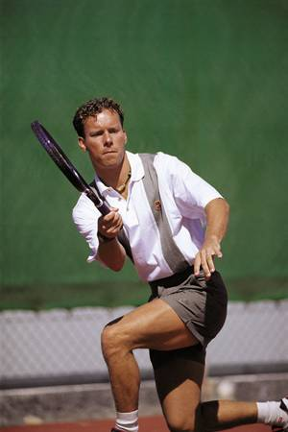
Skill Related Fitness
Agility
Balance
Coordination
Speed
Power
Reaction time
Notes:
8
There are 6 dimensions of Skill Related Fitness
Ask the students what types of fitness testing they remember doing in grade school. Most likely it included primarily SRF tests (shuttle run, softball throw, 50 yard dash etc....)
Discuss why we have shifted to a focus on health related fitness.
1. less genetically determined (all people can improve))
2. more related to health and wellness rather than performance

Slide 17
Need for Fitness
Effective work
Good health
Face emergencies
Enjoyable leisure
Value of fitness
  Look good
  Feel good
  Enjoy life
  Be healthy
Notes:
3
This slide summarize why fitness is needed. It improves our work ability, improves our health, helps us to meet emergencies and increases our potential for rewarding leisure activities. All of these contribute to improving our quality of life. The value of fitness is also described.

Slide 18
Before you start an exercise program
Consult a physician (why)
Get a pre-participation physical
Wear proper clothes and shoes
Set goals that can be to gain, maintain or lose weight; gain self-esteem; or for health benefits.
** Remember everyone responds differently to
exercise, so don’t compare your routine with
others or their results.
Plan your workout start out slow and add or increase as you see improvement.

Slide 19
FIT Principle
What does cardiovascular training involve?
Frequency- How often you work out. 3-4 days per week.
Intensity- How hard you are working out. Measured by Max heart
rate and Target heart rate
Max HR is 220-age
Target HR is Max HR * multiplied by either 85% (strenuous exercise) and 50% (moderate exercise)
Example 220-14=206 Max HR
206*.85= 175.1 206*.50= 103
Time- How long you work out. American College of Sports Medicine
recommends you work out for 60-90 minutes per day of aerobic
exercise at moderate intensity level.

Slide 20
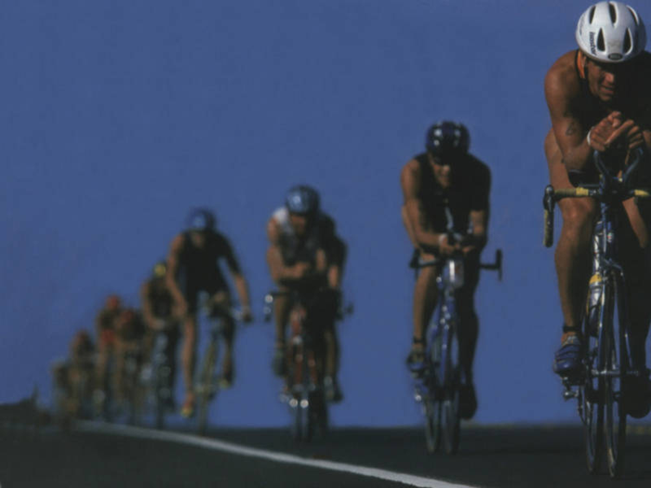
Conditioning
Always begin with a proper warm-up to get the pulse/heart rate up slowly and get the muscles ready for stretching.
There can be significant improvement of fitness levels if one exercises 3 – 4 times a week at target heart rate for at least 3 weeks.
Exercise improves: resting heart rate, blood pressure, blood sugar levels, cholesterol, and sleep.
Cool down to clear lactic acid and stretch again to prevent injury
http://www.senmcycling.org/default_files/cycling.jpg

Slide 21
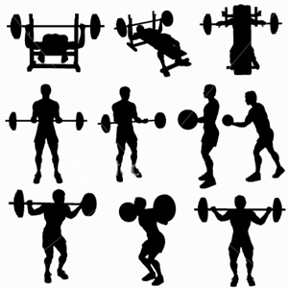
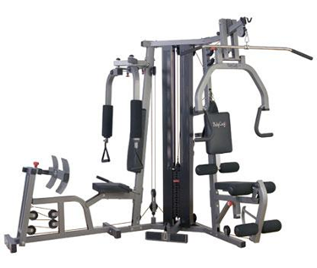
Strength
Strength- the maximal force generated by a muscle.
Strength training- is increasing the amount of strength a muscle can generate.
Why do weight training?
Maintaining or increasing strength enable one to perform tasks with minimal physical stress and reduces the risk of injury.
Maintaining or increasing strength also increases bone density and the reduction of muscle loss over time.

Slide 22
Strength training
Load- refers to the highest load you can lift in one repetition. It’s expressed
in pounds or kilograms or 1RM
Repetition- How many times you lift the weight in a set
Lifting for the first time:
Warm-up and cool down properly, include stretching.
Start with low weights and gradually add on more weight until your max is determined. Max is determined when you can only lift the weight one time.
Once you have your max figure out the percentage of the load you need to lift.
Example: Load of 100% = 1 repetition
Load of 75% = 12 repetitions
Load of 50% = 25 repetitions
Decide are you trying to “bulk up” or “tone up” this will change your load.
Aim for 2-3 sets of each exercise and rest in between each set.
And always remember to lift with a partner when using free weights.

Slide 23
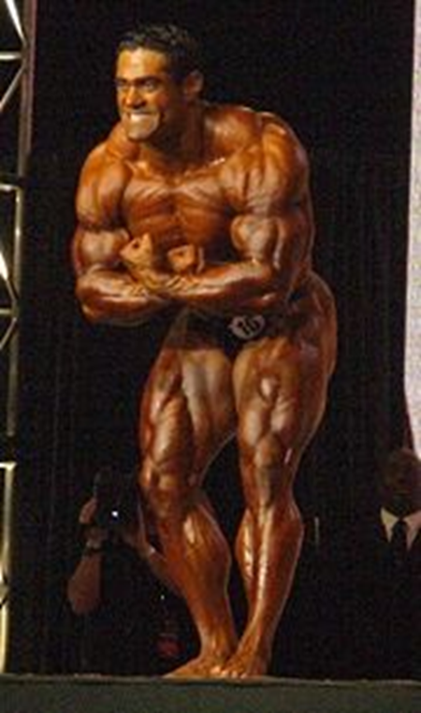
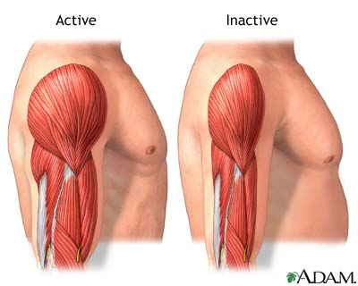
Muscle strength
Hypertrophy- is when you increase muscle mass.
Atrophy- is when you decrease or lose muscle mass. (due to injury or illness)
http://karnalasportsacademy.com/A-FILES/180px-Badell3.jpg
What can cause both
of these?

Slide 24
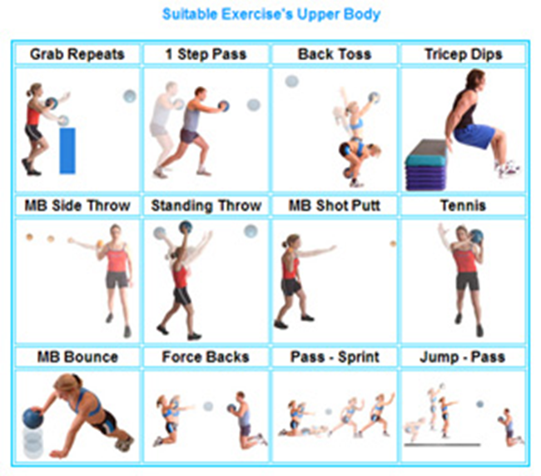
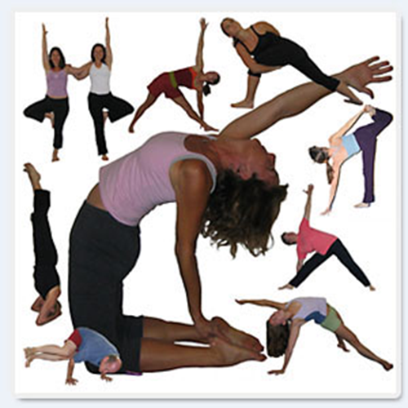
Strength training
You can develop strength without using weights or fancy resistance equipment. You can use your own body.
Pilates, yoga and any core or plyometric workout is an example.
Activities build muscle and using your own body against it self can build tone as well.
http://www.netfit.co.uk/assets/plyo6.jpg
http://www.springdaletown.com/images/yoga_collage.jpg

Slide 25
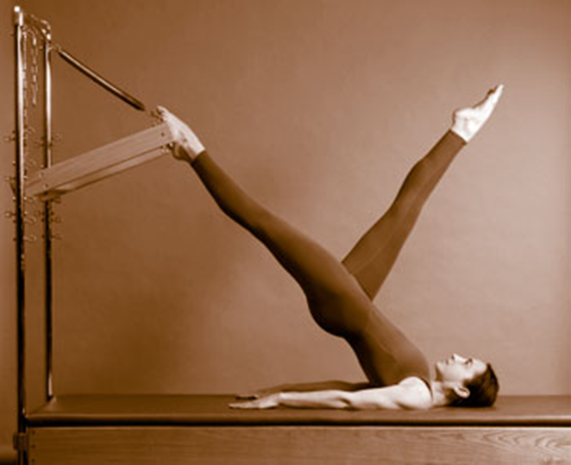
Flexibility
Flexibility is an important component of strength training as well as regular CV exercise.
It helps improve balance and can prevent some injuries.
Body’s Core- This is an essential area to concentrate on, as well as, the arms and legs.
The “core” is your abdominal muscles and back muscles. They must work equally or injuries can occur.
DO NOT over extend the joints either because this can result in a weakening of the joint and injury.
http://www.fyvie.net/images/pilates-zurich.jpg

Slide 26
Work out videos

Slide 27
Develop your own workout plan
Warm-up
Cardio
Weights
Cool down
Stretching
Must take 90 minutes to complete
Mix it up
Example
Warm-up: jump rope 5-10 min at easy pace. Stretch legs and arms 5-10 min
Cardio: Moderate 50% of Max heart rate
Jump rope 30 sec./ dips 30 sec.
Jump rope 1 min/crunches 1 min
Jump rope 1:30/ push-ups 1:30
Jump rope 2 min/crunches 2 min
(Repeat)
Weights: 20-30 min.
Bench # / 3 sets of 25
Squats #/ 3 sets of 25
Reverse fly #/ 3 sets of 25
Lung # / 3 sets of 25
Shoulder shurg #/ 3 sets of 25
Cool down: Walk 5-10 min.
Stretch 10-15 min.

Slide 28
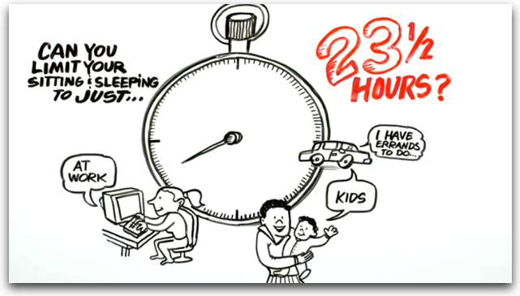
http://www.youtube.com/watch?v=2xKfAuJbClU
Ticket out the door. List two ways 231/2 hours can help you (benefits).

Slide 29
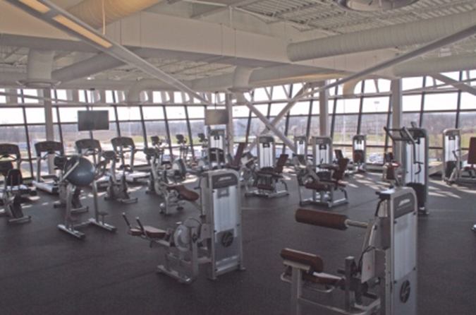
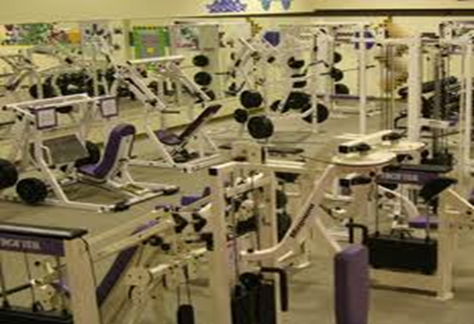
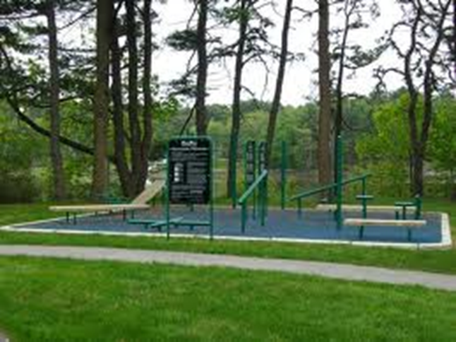
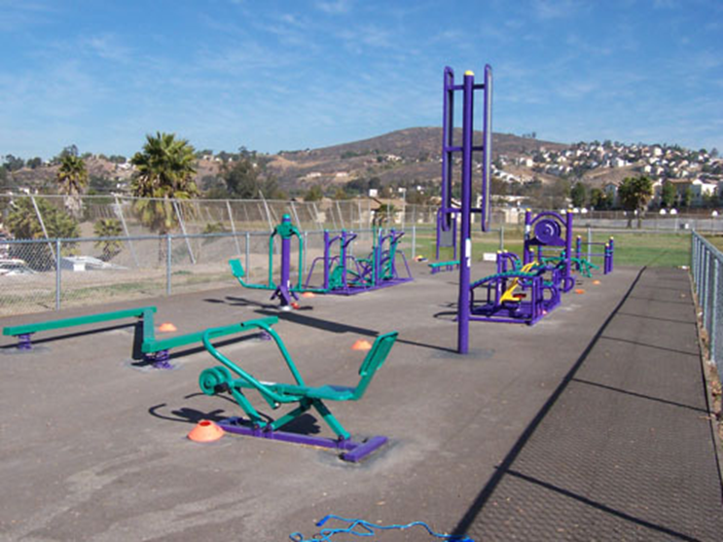
Develop a workout center/gym/outdoor center

Slide 30
Develop a workout center/gym/outdoor center
Design a space either indoor/outdoor.
List all of the equipment needed and price how much it will cost.
Decide if you will charge for it and how much.
Who will cover the cost and maintenance of it.
Make sure it is handicap acceptable.

