Slide 1
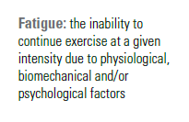
FATIGUE & RECOVERY
Chapter6

Slide 2
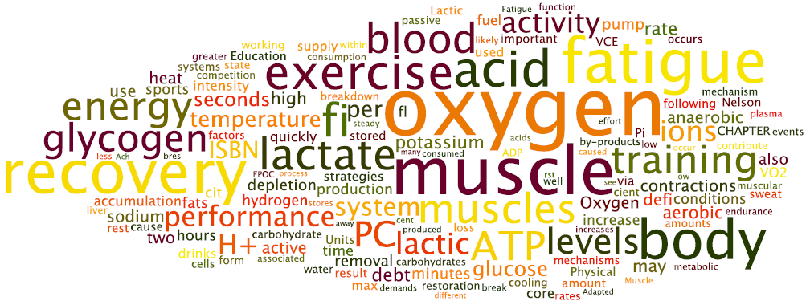

Slide 3
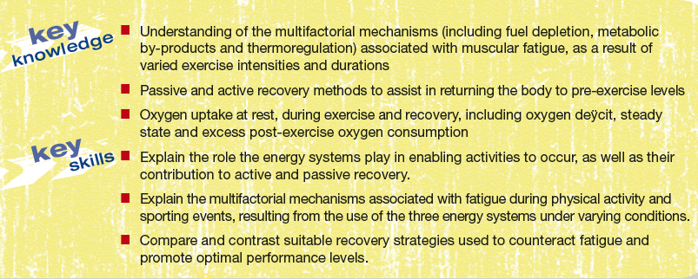
Key Knowledge & Skills

Slide 4
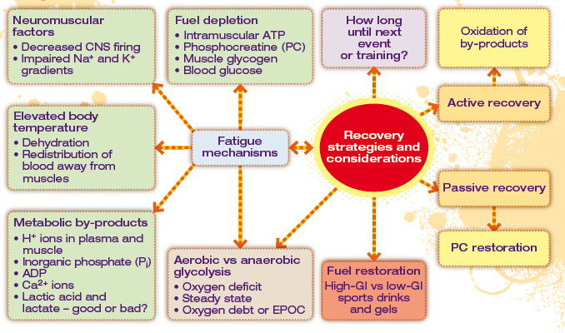
Chapter preview

Slide 5
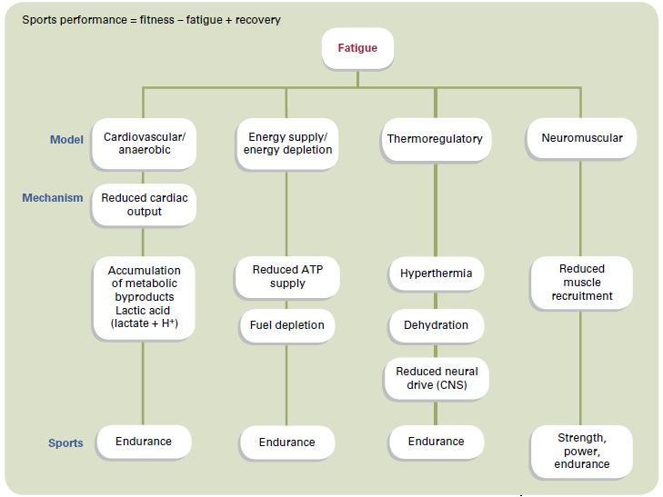
Chapter preview

Slide 6
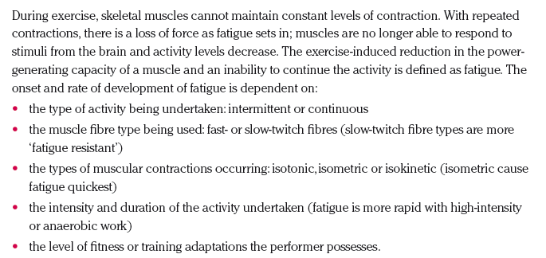
Fatigue

Slide 7
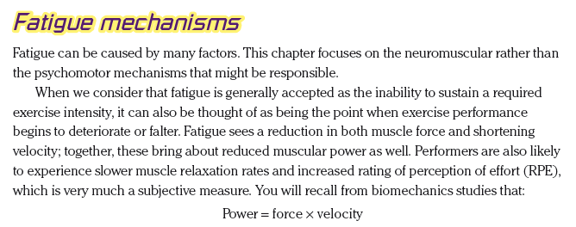
Fatigue Mechanisms

Slide 8
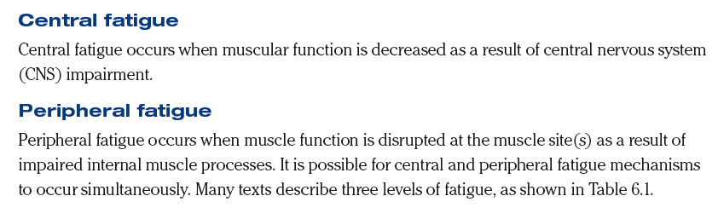
Central & Peripheral Fatigue

Slide 9
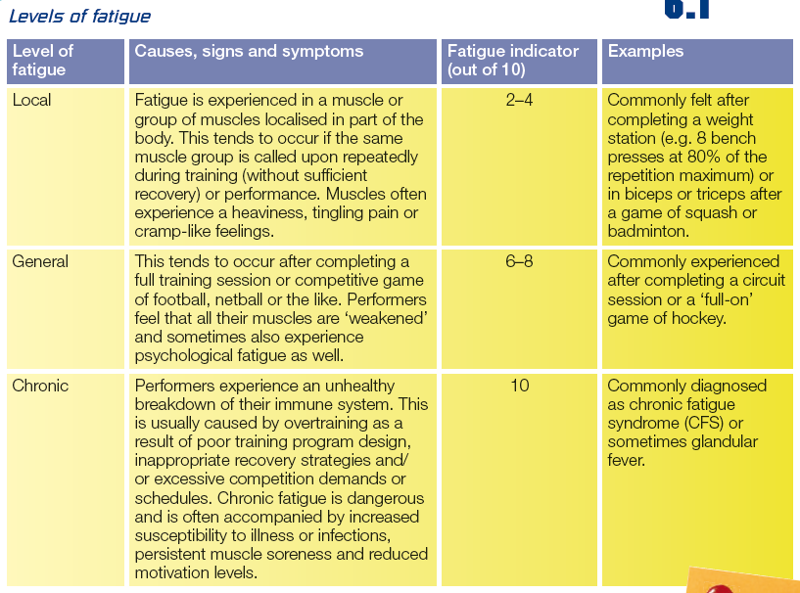
Levels of Fatigue

Slide 10
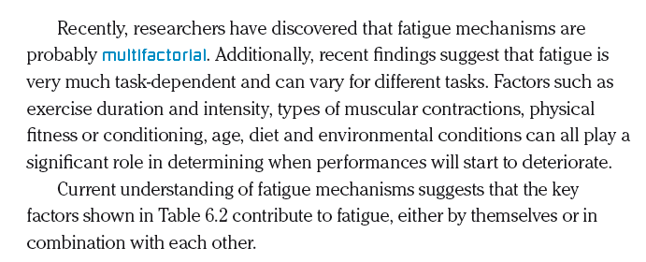
Multifactorial Mechanisms

Slide 11
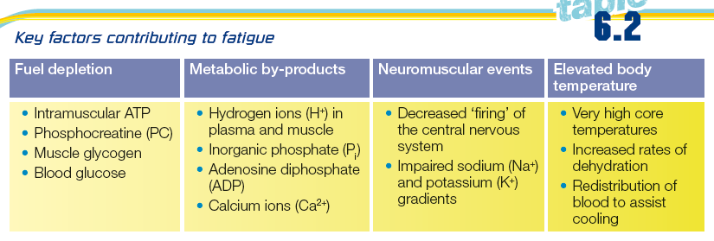
Fatigue Mechanisms

Slide 12
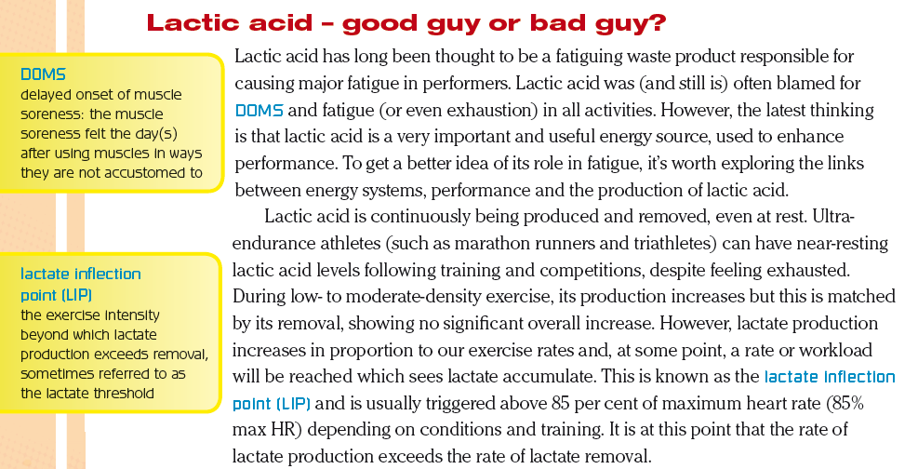
Lactic Acid

Slide 13
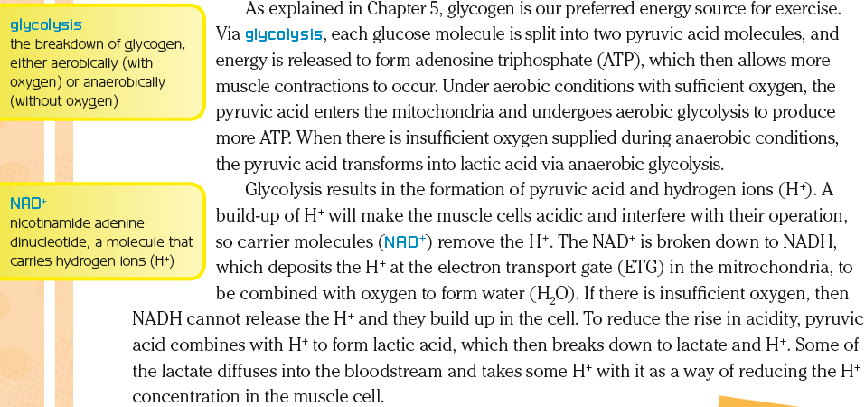
Lactic Acid

Slide 14
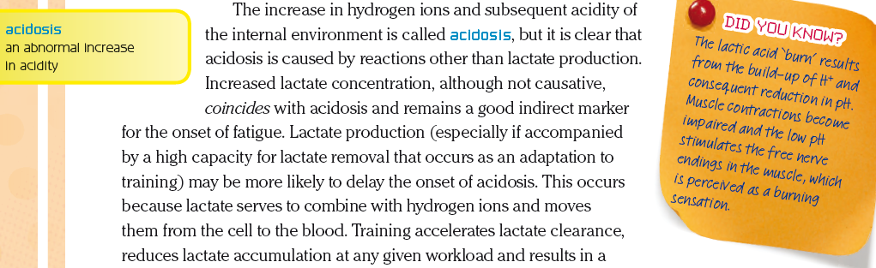
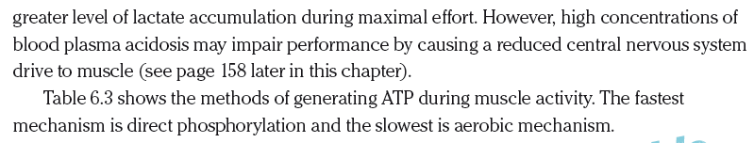
Lactic Acid

Slide 15
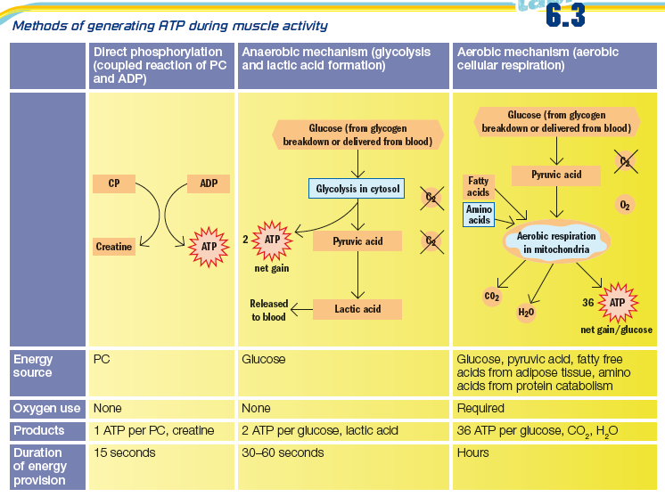
ATP resynthesis

Slide 16
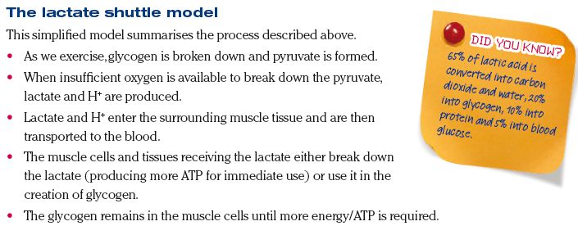
LA Shuttle

Slide 17
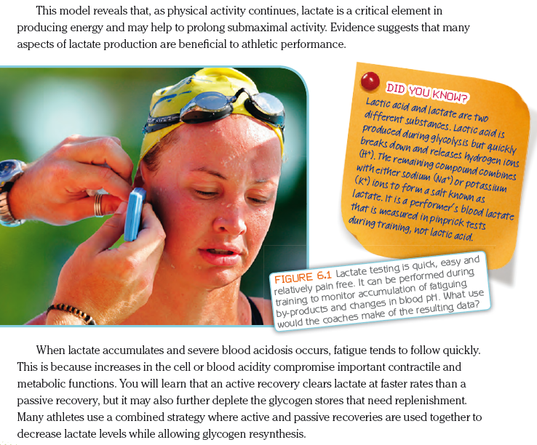
LA Shuttle

Slide 18
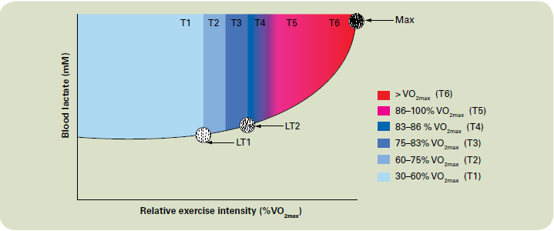
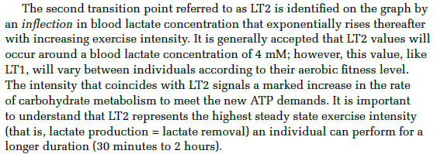
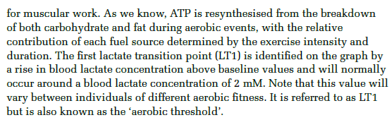
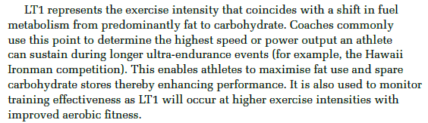

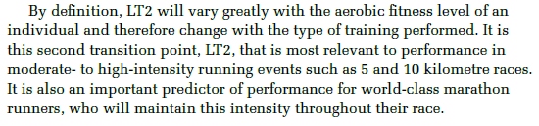
LIP…

Slide 19
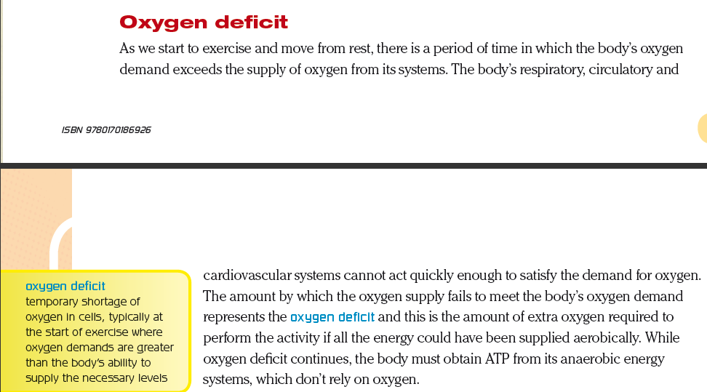
Oxygen Deficit

Slide 20
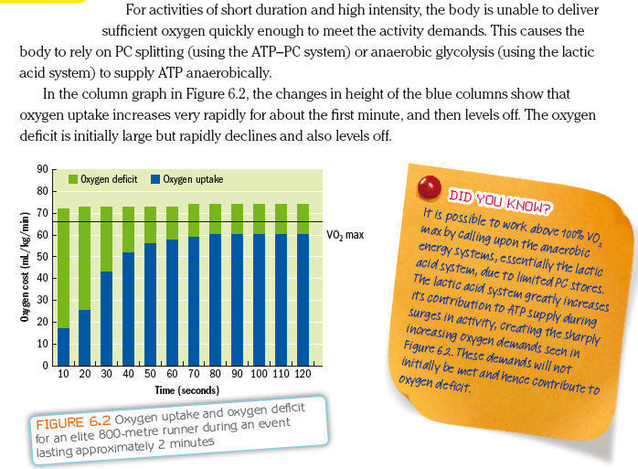
Oxygen Deficit

Slide 21
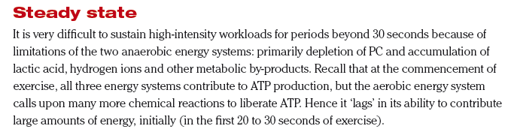
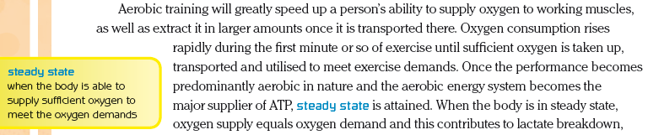
Steady State

Slide 22
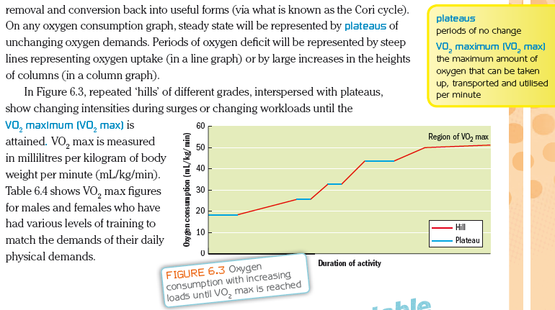
Steady State

Slide 23
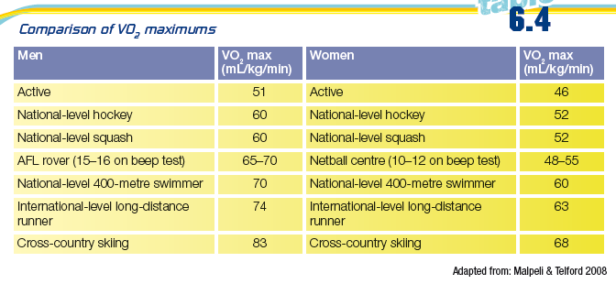
Comparison of Vo₂ max

Slide 24
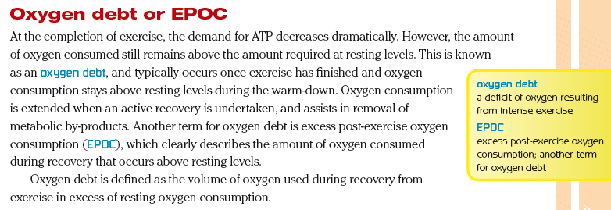
EPOC

Slide 25
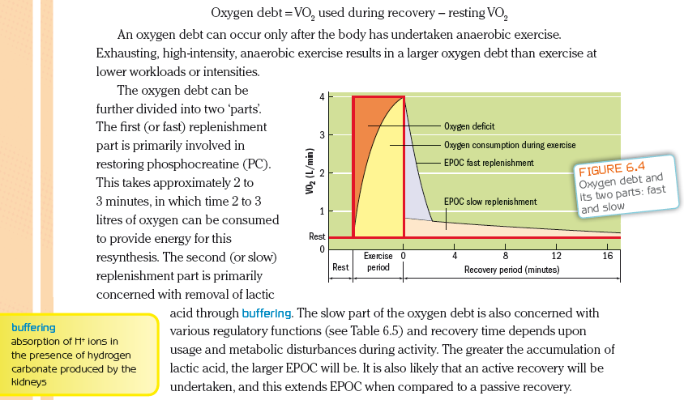
EPOC

Slide 26
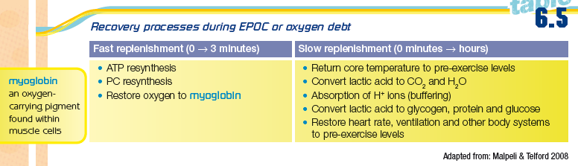
EPOC

Slide 27
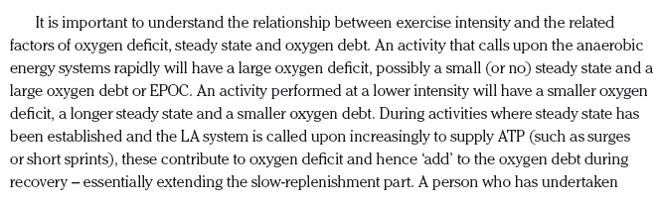

EPOC

Slide 28
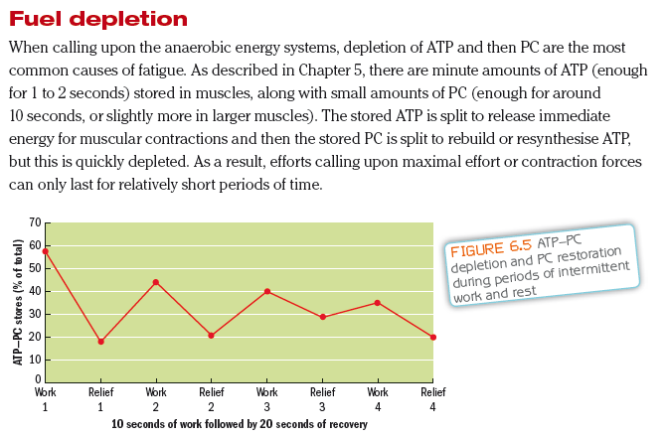
Fuel Depletion

Slide 29
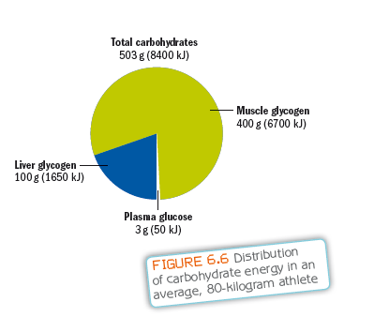
Distribution of CHOs

Slide 30
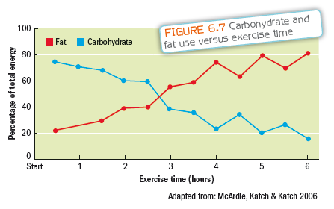
CHO vs Fat use

Slide 31
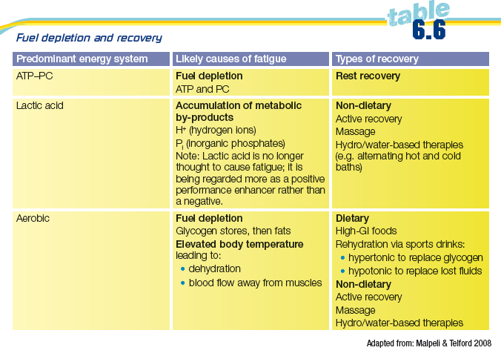
Fuel Depletion & Recovery

Slide 32
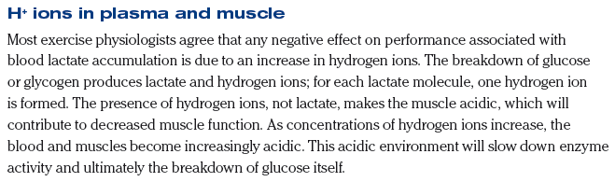
H+ ions

Slide 33
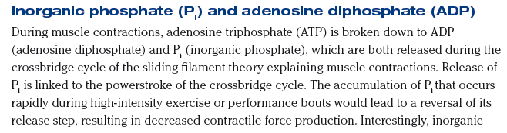
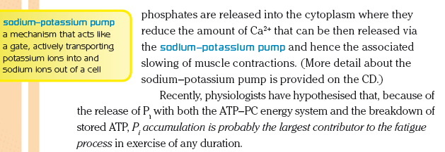
Pi & ADP

Slide 34

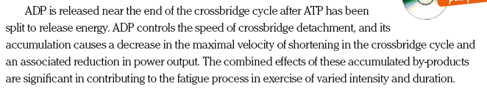
ADP

Slide 35
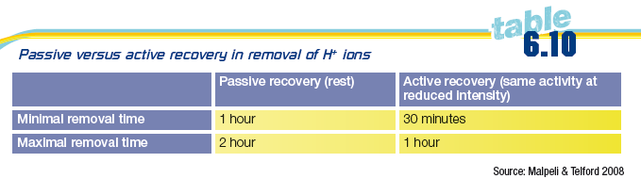
Pi & ADP vs H+

Slide 36
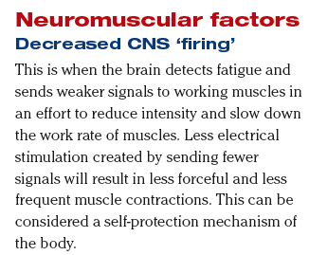
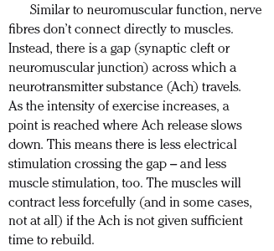
CNS

Slide 37
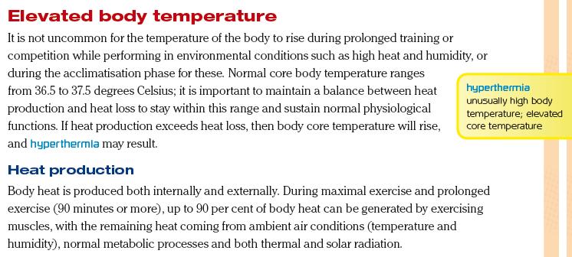
Body Temperature

Slide 38
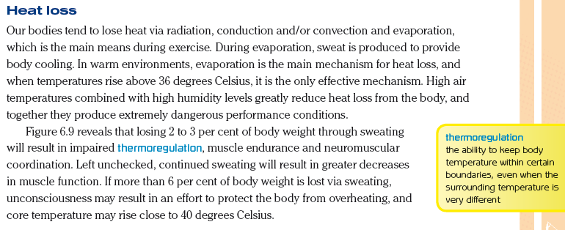
Body Temperature

Slide 39
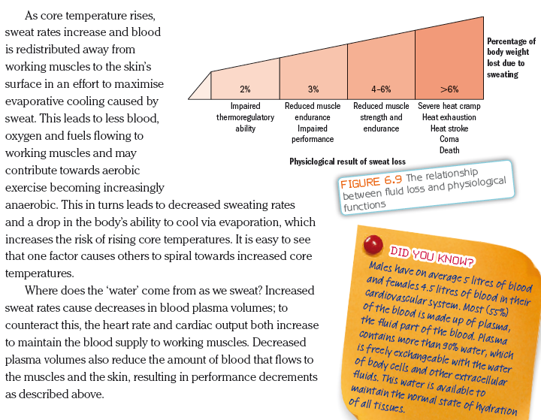
Body Temperature

Slide 40
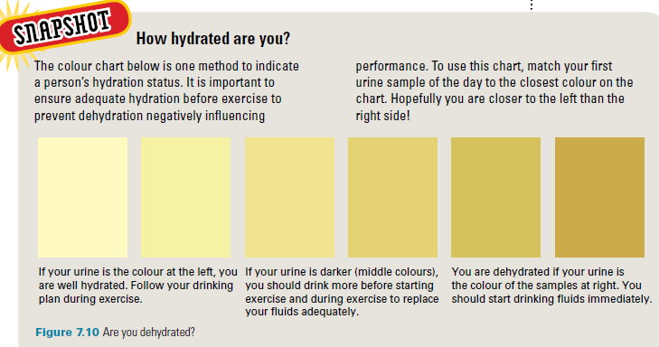
Body Temperature

Slide 41
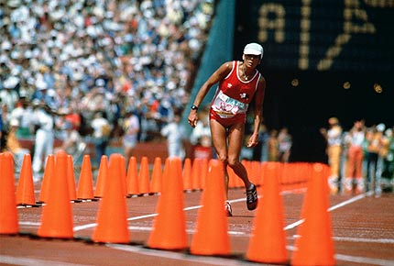
Multifactorial Mechanisms

Slide 42
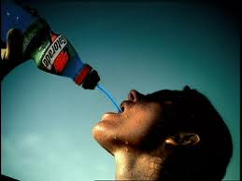

Recovery

Slide 43





Recovery

Slide 44




Recovery

Slide 45

Recovery

Slide 46

Recovery

Slide 47




Refuelling

Slide 48

Refuelling

Slide 49

PC restoration

Slide 50

Glucose / Glycogen

Slide 51

Glucose / Glycogen

Slide 52

CHO intake

Slide 53

CHO intake

Slide 54

CHO intake

Slide 55


CHO intake

Slide 56

CHO & protein intake

Slide 57

Na+ & K+

Slide 58

Lowering Body Temperature

Slide 59

Lowering Body Temperature

Slide 60

Lowering Body Temperature

