Slide 1
Extra Resources

Slide 2
Day 1 Resources
Chapters 1 and 2

Slide 3
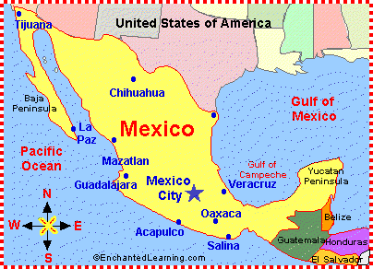
Author Angela Dominguez was born in Mexico City, Mexico. Later, her family moved to the United States, living in the state of Texas.
While there are a many languages spoken in Mexico, the official language of Mexico is Spanish. Spanish is also spoken by many people living in the state of Texas, either as the primary language or as a second language.

Slide 4

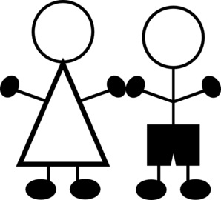


How do you say that?
Author Angela Dominguez has sprinkled many Spanish words throughout the story starting right in Chapter 1. For those not familiar with this language, consider using this great website!
The website provides the audio pronunciation, along with the definition and usually an image associated with the word.
TEACHERS: Check out some ideas on the next slide.
This symbol is a direct link to the Spanish Dictionary website.

Slide 5
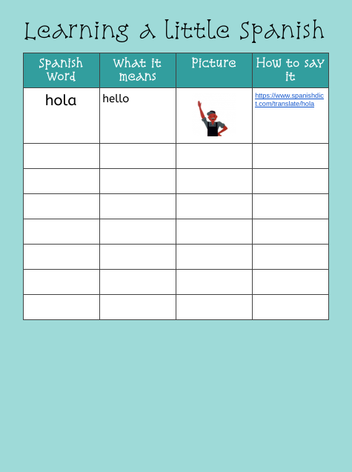
Ideas for Working With Spanish Words
Consider using a separate document like the one shown below to track the Spanish words used in the story. The way you use this document will vary, depending upon the age of your students and/or your students’ familiarity with G-Suite tools.
TEACHER OPTIONS:
Do this as a class. This would allow teacher modeling of working in a Google Doc.
Give each student a copy of their own by embedding this link onto a slide within the hyperdoc. Their “copy” will be saved within their Google Drive.
The first column could be filled in ahead of time.
You can modify the columns as you see fit.
To MAKE A COPY, click here.
NOTE: You or students will need to add ROWS to the table as you go but to keep the HEADINGS, you would have to duplicate (CTRL-D) a blank TABLE onto each new page.

Slide 6
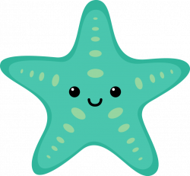
Build a Spanish Word Resource
As you read Stella Diaz Has Something to Say, gather up the Spanish words the author sprinkles throughout the story.
Spanish word | Meaning/Translation

Slide 7
Spanish word | Meaning/Translation
TEACHERS: Teach students how to duplicate this slide as is (no words filled in). Select the slide by tapping on it at the left, and then use CTRL-D. They should always keep one slide like this (blank) so they can add more slides as they go.

Slide 8

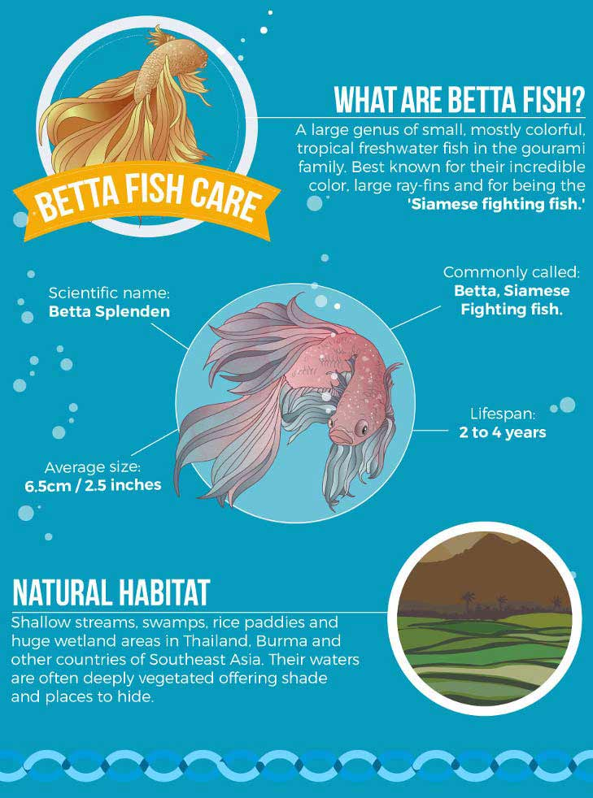
Story Connection: In chapter 1, we find out that Stella has a blue betta fish named Pancho.
Male betta fish cannot live together. This is because they are “territorial” and will attack other males. This is why they’re called Siamese fighting fish.
Most pet bettas are male bettas. This is because male bettas are larger and are much more colorful than females. The also have more ornate (fancier) fins.
Male bettas build bubble nests. After the female releases the eggs the male gathers them in his mouth and "spits" them into the nest!
Betta fish can learn to recognize their owners and will often “show off” by performing tricks. They might follow your finger as you move it outside the bowl or swim through hoops or even push a ball into a goal!

Slide 9
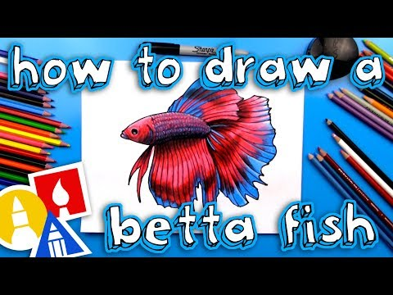
Draw Poncho!
Share your betta fish picture with others! Add it into your class Seesaw or your teacher may post an assignment in Google Classroom. Maybe your teacher has set up a Padlet or Flipgrid topic.
You can also add a slide to this presentation using the + sign at the far left end of the toolbar and put your drawing there!

Slide 10
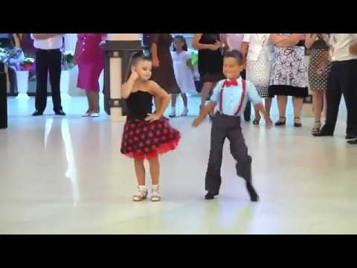

Story Connection: In chapter 2, we find out that Stella, Nick and Mom enjoy listening to salsa music and doing salsa dancing at home for fun.
Rapid movement of arms, shoulder, feet, hips
Includes turns and lifts
Partners will go in circles trading places with each other
Done to salsa music which has Cuban origins
Different types of salsa dances
TO LISTEN TO SALSA MUSIC,
click on the music notes (haga clic en la notas musical)

Slide 11
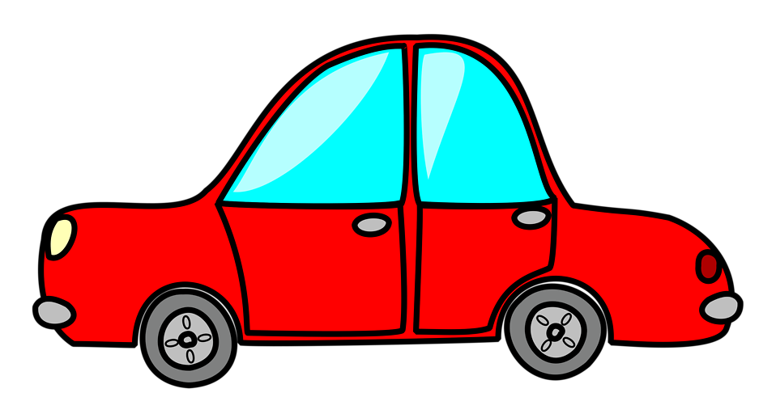
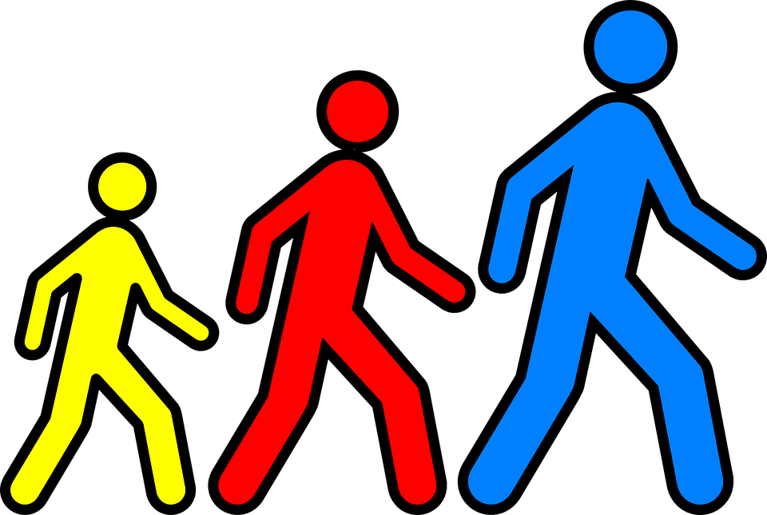
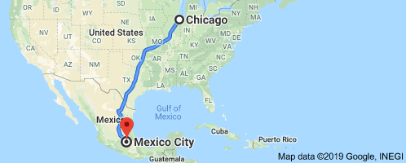

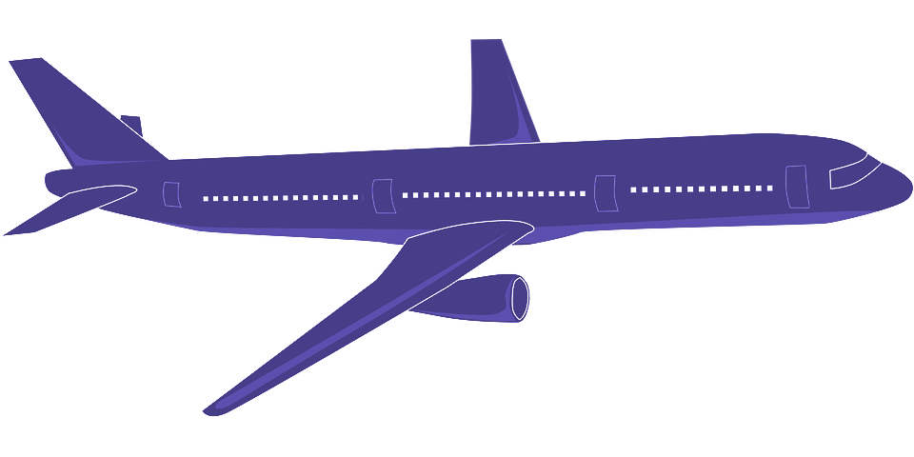
33+ hours
27+ days
7-10 days
About 4 hours
Story Connection: In chapter 2, we find out that Stella’s family used to live in Mexico City, Mexico but now live in Chicago, Illinois.
What is the farthest you’ve ever traveled?

Slide 12
Day 2 Resources
Chapters 3 and 4

Slide 13
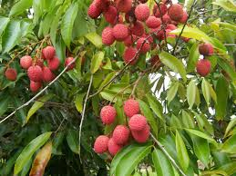
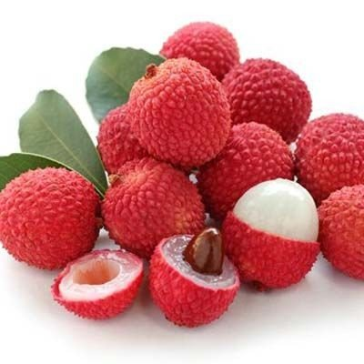
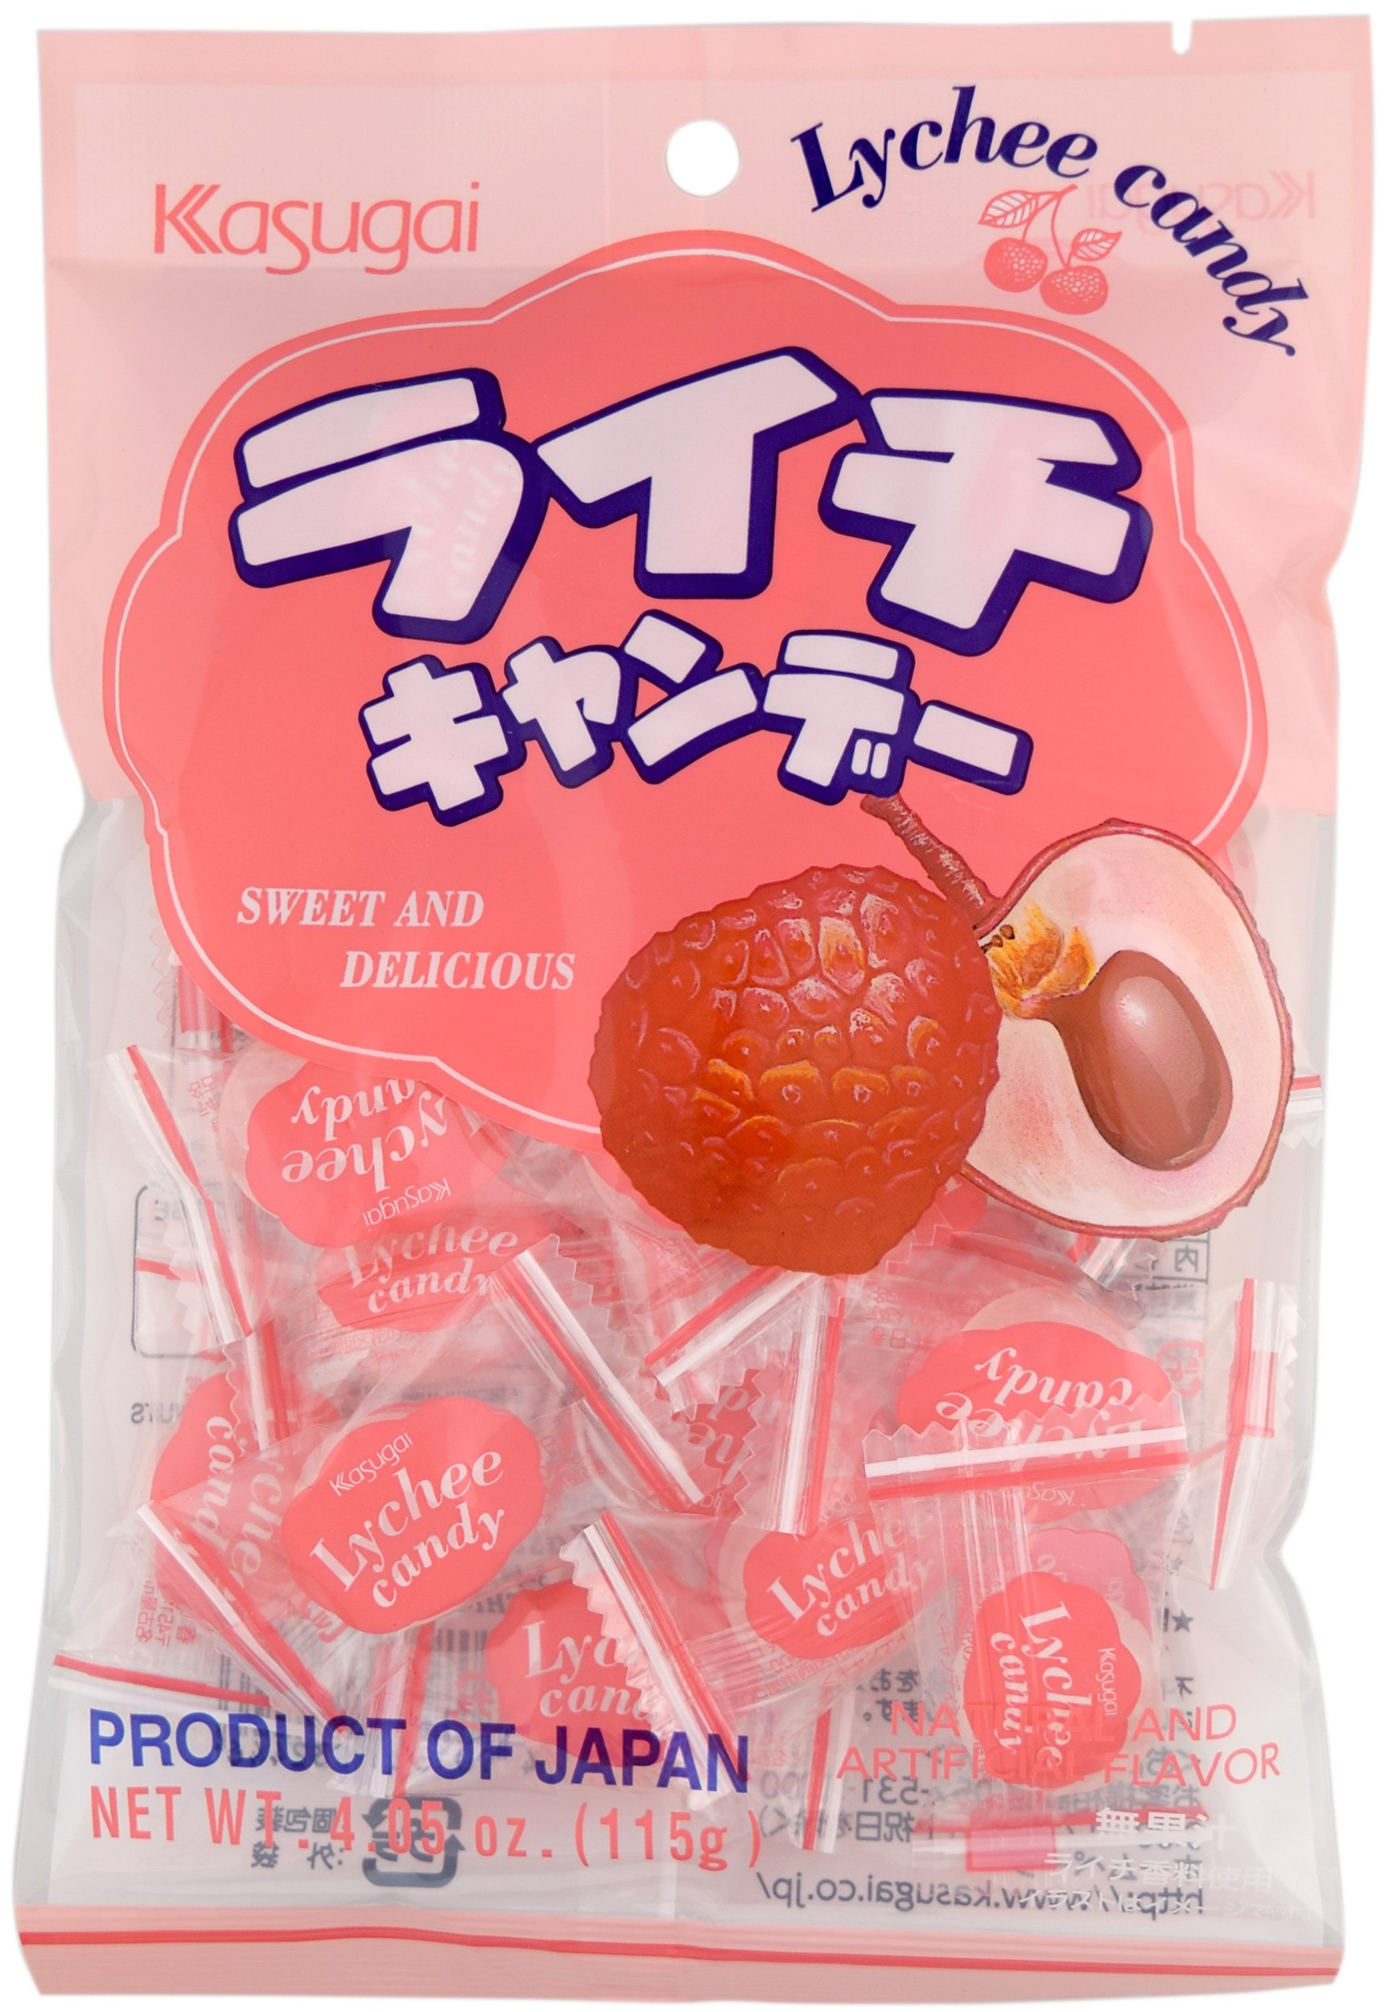
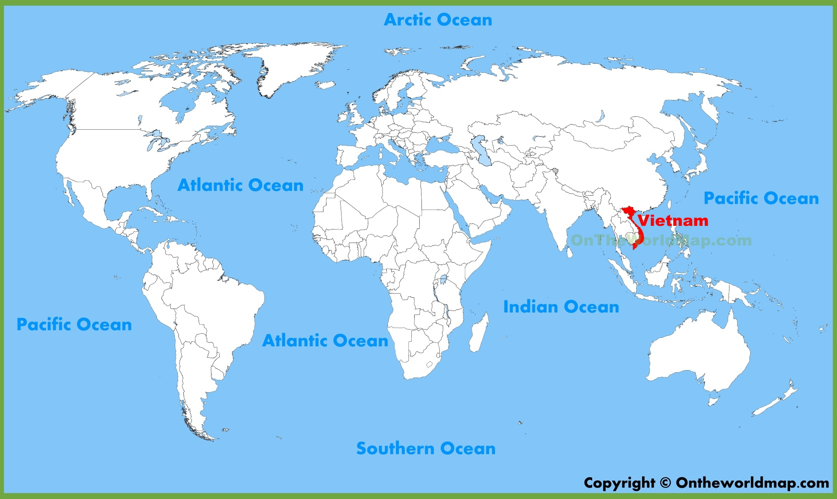
Story Connection: In chapter 3, we are introduced to Jenny, Stella’s best friend. Jenny’s family is from Vietnam. Jenny gives Stella a piece of Vietnamese candy called lychee.
Lychee is a type of plant that has fruit.
The lychee plant mainly grows in China and Vietnam.
Lychee fruit is canned and used in certain recipes.
Lychee candy is popular at Vietnamese markets.

Slide 14
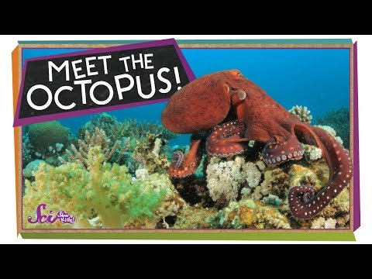


Learning from digital media!
Stella has a keen interest in marine animals. She loves to read and most of the books she reads are about different marine animals. She enjoys sharing what she learns with friends and family.
In chapter 4, Stella shares some octopus facts with Ms. Bell, the school librarian.
Has no bones
Has three hearts
Known to be escape artists
Can release a cloud of ink
Can paralyze their prey
In today’s digital world, it’s important for students to learn how to learn from consuming digital media!

Slide 15
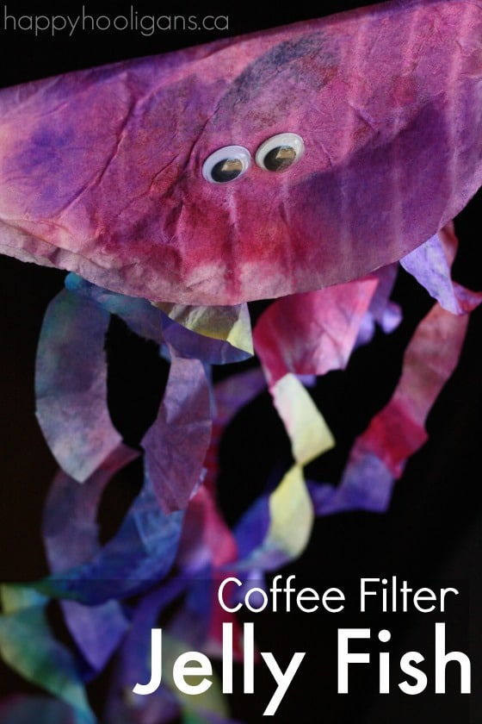
Coffee Filter Octopus or Jellyfish Craft!
Students can celebrate their octopus learning by making this colorful craft. Each student could create their own or students could partner in order to practice working in a collaborative way. Here is a link to the activity which describes it as a jellyfish but with one additional coffee filter, this could easily be an octopus!
TOOLS NEEDED:
Pipettes (medicine droppers)
Paint brush
Scissors
Glue
Small bowls or ice cube tray (to hold watercolors)
CONSUMABLES:
4 coffee filters for jellyfish or 5 for octopus
2 googly eyes
Piece of cardboard or styrofoam tray cut into semi-circle slightly smaller than coffee filter folded in half

Slide 16

Booksnaps
Chapters 1-4
Insert screenshots from your booksnaps for Chapters 1-4 here on this page. Insert additional slide(s) if necessary.
Click here to link back to Booksnap Resources
Notes:
Student response page. Duplicate this slide and add it for each section of the novel you'd like for students to create a booksnaps

Slide 17
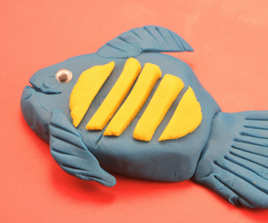

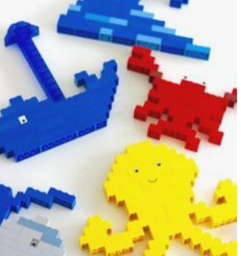
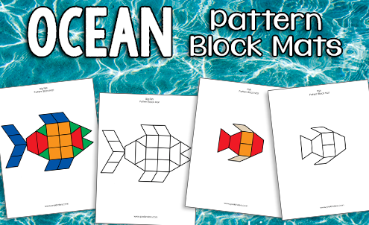
Week 1 STEM Challenge
Create a Marine Animal or Ocean Scene
Use any of the following to design or re-create a 3D model of a marine animal or underwater habitat scene.
Unifix cubes, Legos, pattern blocks, clay or Play-doh.

Slide 18
Reflect...Share your Results!
In this space describe your creation.
Add a photo of your creation.

Slide 19
Day 3 Resources
Chapter 5

Slide 20
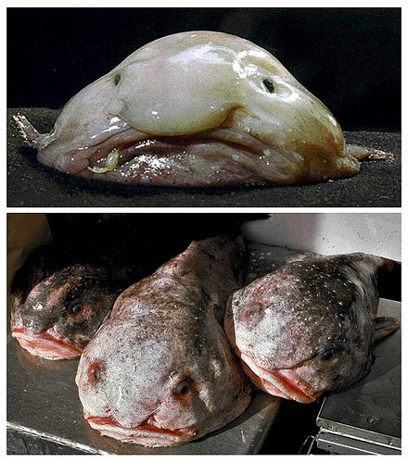
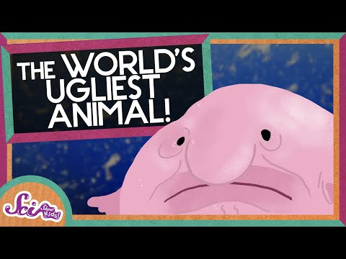
Story Connection: We know that Stella enjoys drawing the marine animals she reads about. In chapter 5, Stella is working on drawing a blobfish when Stanley Mason stops at her desk to share a birthday cookie.
A deep sea dweller (lives 3,000 feet down)
Named “World’s Ugliest Animal” in 2013
Native to Australia and New Zealand
Eat crabs, sea urchins, and crustaceans
No bones or teeth (they suck food into their mouth)
Up to 12 inches long
Female lays thousands of eggs

Slide 21

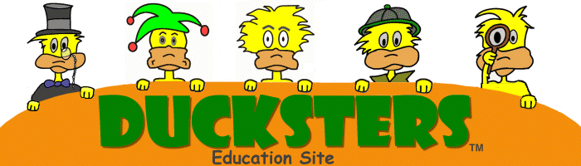
Becoming a U.S. Citizen
In chapter 5, there is a school-wide surprise celebration for Don, the school custodian. Don has recently become a citizen of the United States of America. He was born in the Philippines and says he came to the U.S. “for a better life.”
a.
b.
Use the Ducksters website to learn about some of the steps Don had to take to become a U.S. citizen. Fill in two facts in the chart at the right.

Slide 22
Day 4 Resources
Chapter 6

Slide 23
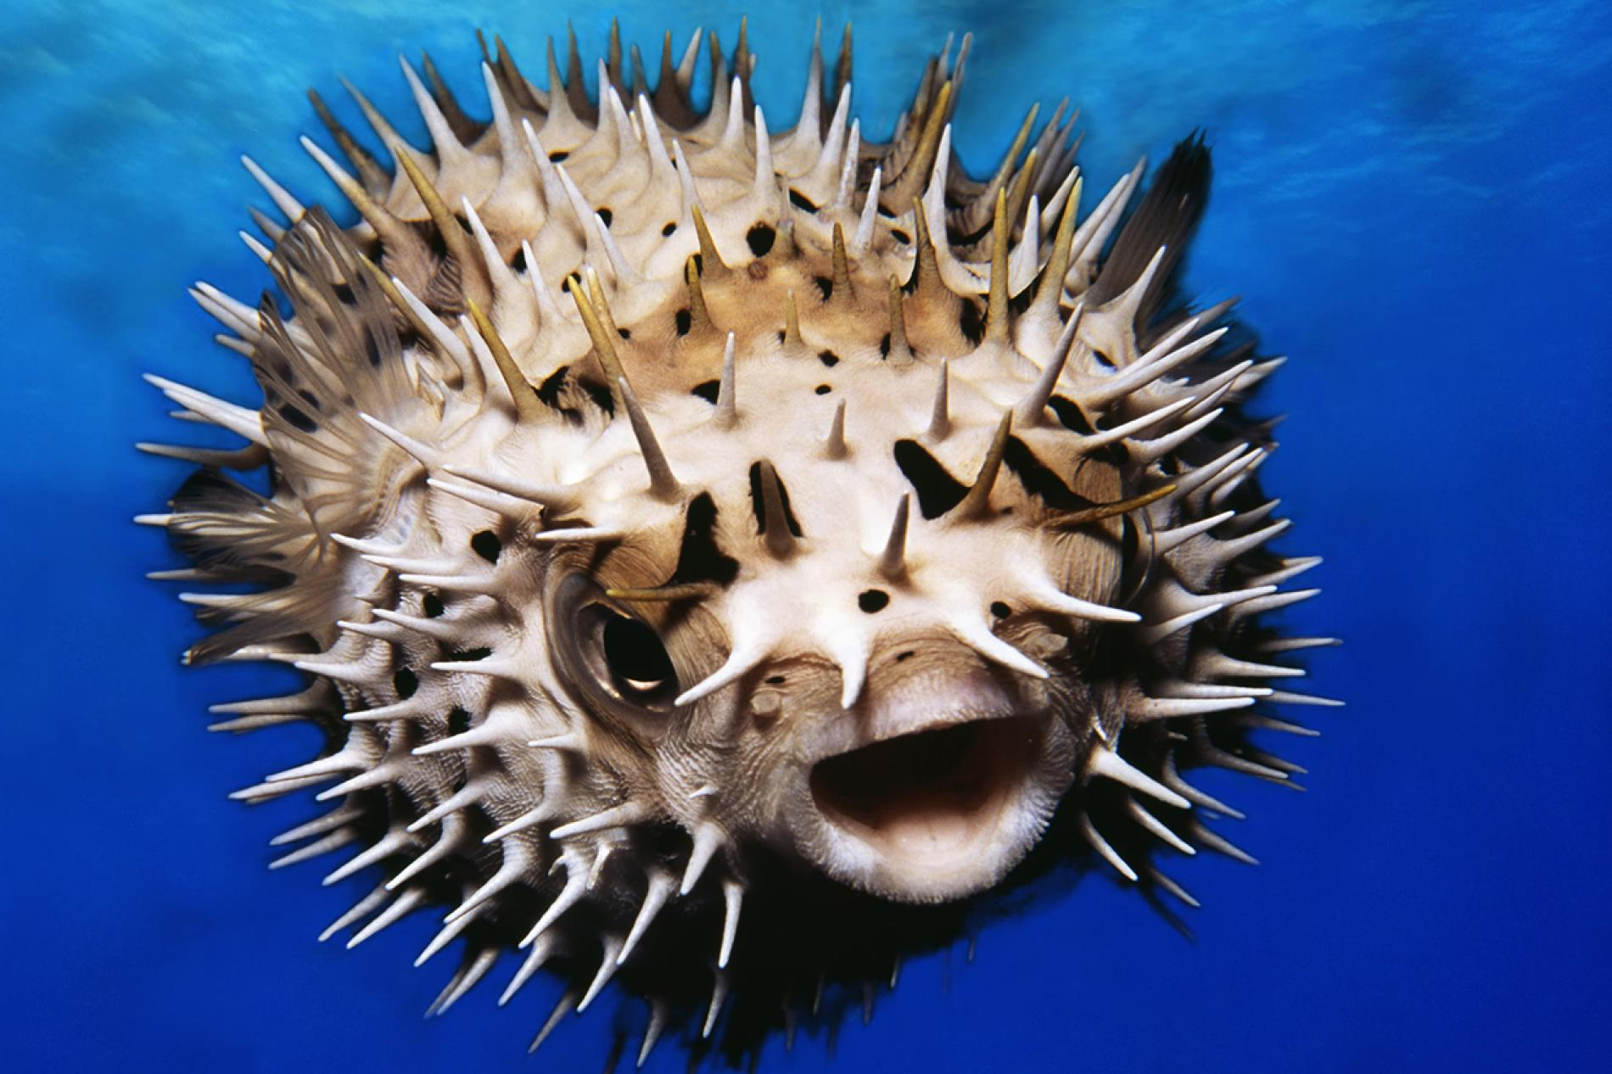
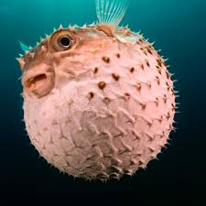
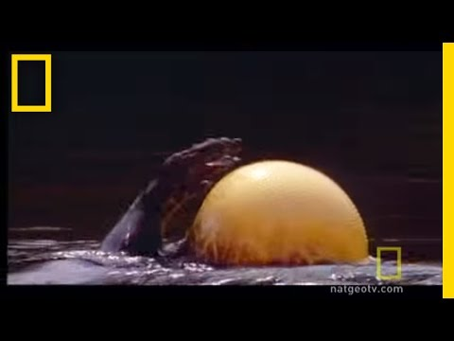
Story Connection: It’s no surprise that Stella often relates events and conversations to one marine animal or another, In chapter 6, Stella thinks about puffer fish when she and her Speech teacher Ms. Thompson do their mouth exercises.
Learn about puffer fish!

Slide 24
Day 5 Resources
Chapter 7

Slide 25
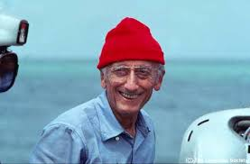
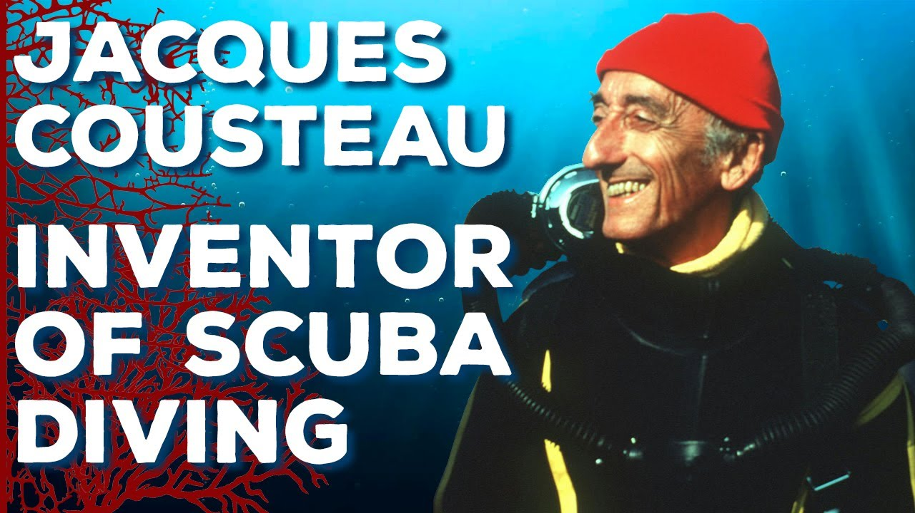
Story Connection: Back in chapter 4, we find out that Stella loves reading about famous ocean explorer Jacques Cousteau. In chapter 5, she is reading about Jacques Cousteau again in a biography about him. She mentions how he invented the “aqua-lung,” a portable breathing machine scuba divers use.
Born in 1910 in France
Had a special ocean research ship called the Calypso
Had a TV show and made special movies called documentaries to teach people about undersea life and ecosystems
Worked hard to try to protect the world’s oceans
Read together in Wonderopolis to learn more about this world famous man. Make sure to watch the short animated video on Jacques Cousteau!

Slide 26
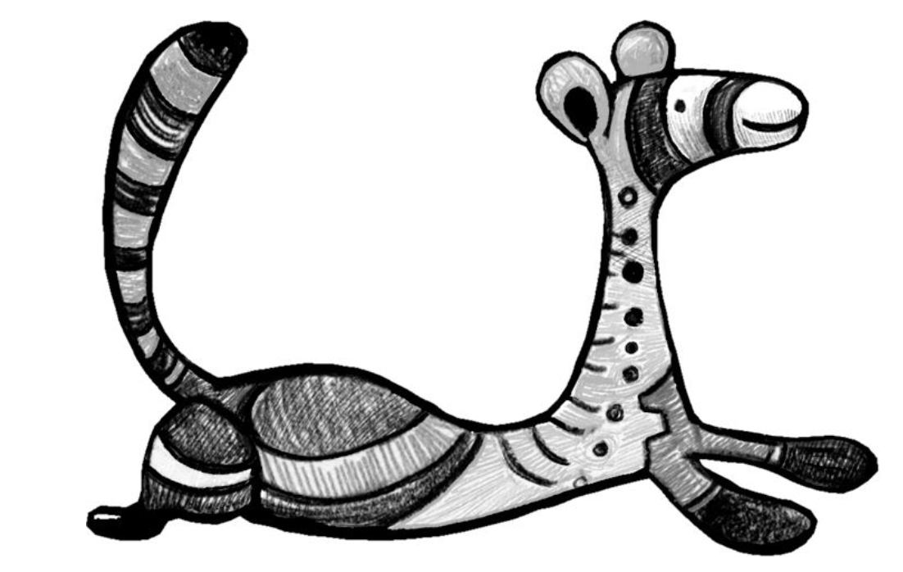
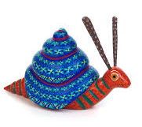
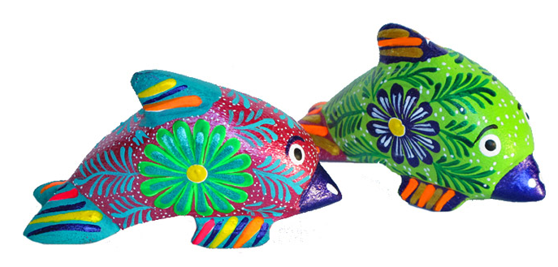
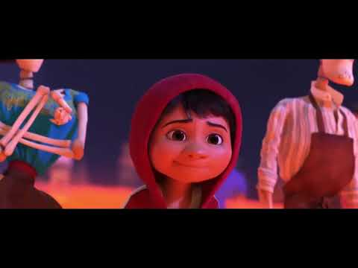
Alebrijes
Stella and Jenny share things about their heritage with each other. Sometimes it’s about foods they eat or sometimes it’s about their customs. They even give each other gifts or tokens from Mexico or Vietnam. In chapter 7, Stella mentions she’s promised to bring Jenny an alebrije from Mexico on her next trip there. Let’s learn about alebrijes!
Just for fun...
Read together in Wonderopolis to learn more about the Mexican folk art creations called alebrijes. Make sure to check out the short video on the page.!

Slide 27
Booksnaps
Chapters 5-7
Insert screenshots from your booksnaps for Chapters 5-7 here on this page. Insert additional slide(s) if necessary.
Click here to link back to Booksnap Resources
Notes:
Student response page. Duplicate this slide and add it for each section of the novel you'd like for students to create a booksnaps

Slide 28
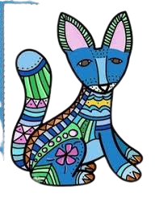
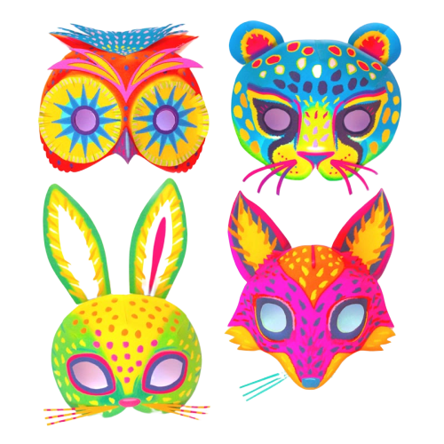
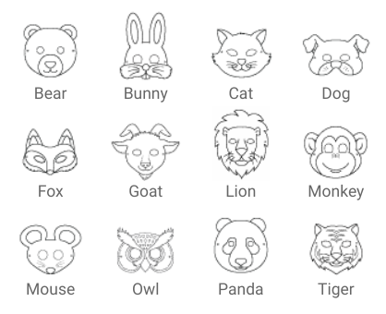
Week 2 STEM Challenge A
Alebrije Mask
Use one of the templates to create an alebrije mask. But DON’T color traditionally! Create an interesting design and then use a variety of vivid bright colors. Do it alebrije style!
Letter size cardstock
Crayons, paint, or any coloring material
Scissors
Hole punch
Elastic string
Transparent tape
Craft stick (optional)

Slide 29
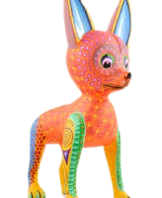
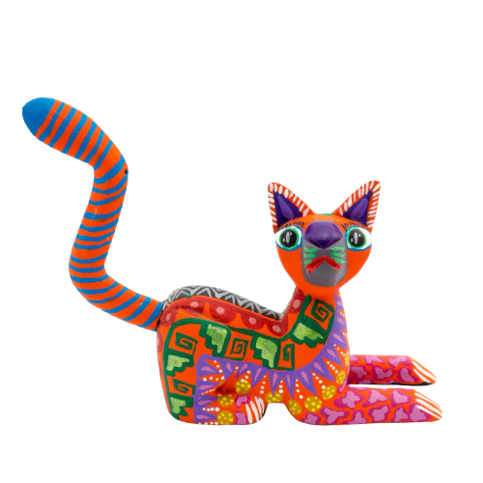
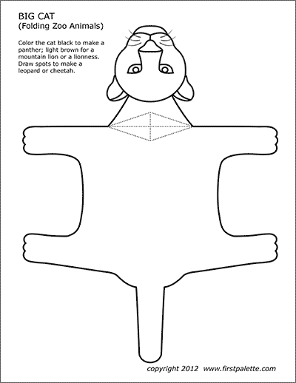
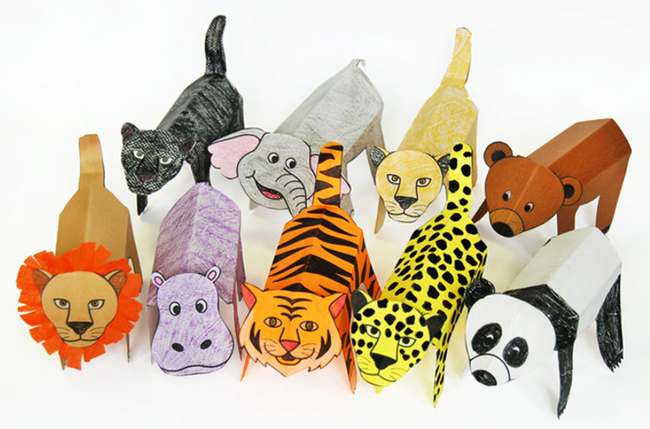
Week 2 STEM Challenge B
3D Alebrije
Use one of the templates to create a 3D alebrije. But DON’T color traditionally! Create an interesting design and then use a variety of vivid bright colors. Do it alebrije style!
Letter size cardstock
Crayons, paint, or any coloring material
Scissors
Elastic string
Transparent tape
Craft stick (optional)

Slide 30
Reflect...Share your Results!
Add a photo of your alebrije creation.
In this space describe your alebrije creation.

