Slide 1
Examples of Drawing/Shading Techniques
Blending
Hatching
Cross-Hatching
Stippling
Micrography
Scribble
Variety

Slide 2
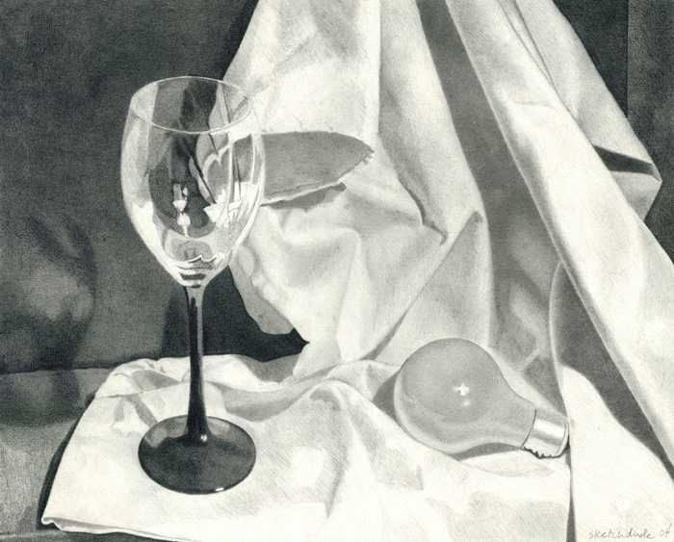
Blending
(Mezcla)

Slide 3
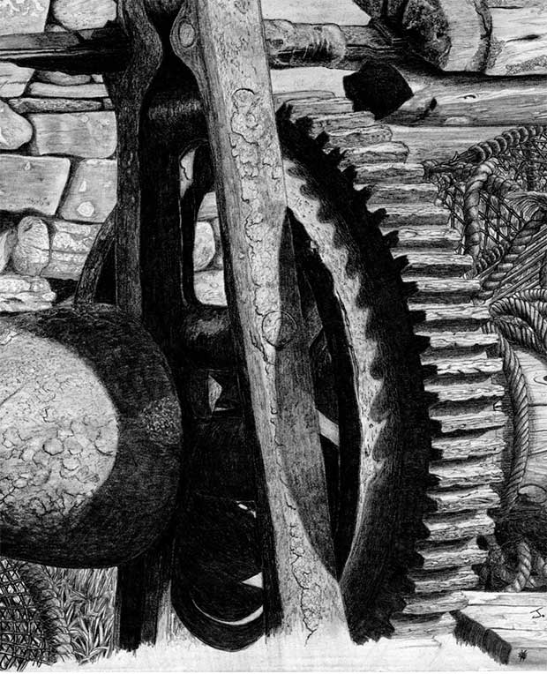
Blending

Slide 4
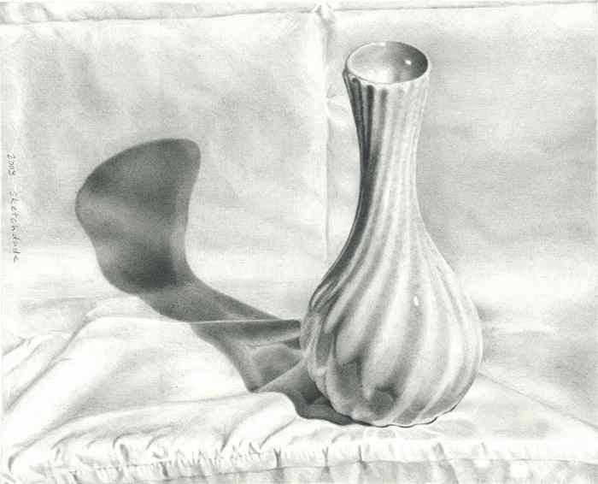
Blending

Slide 5
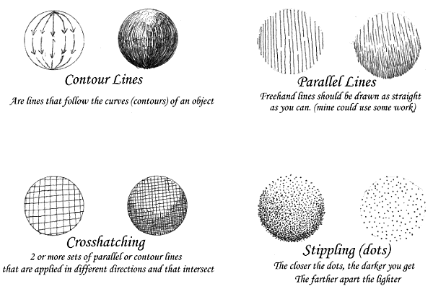
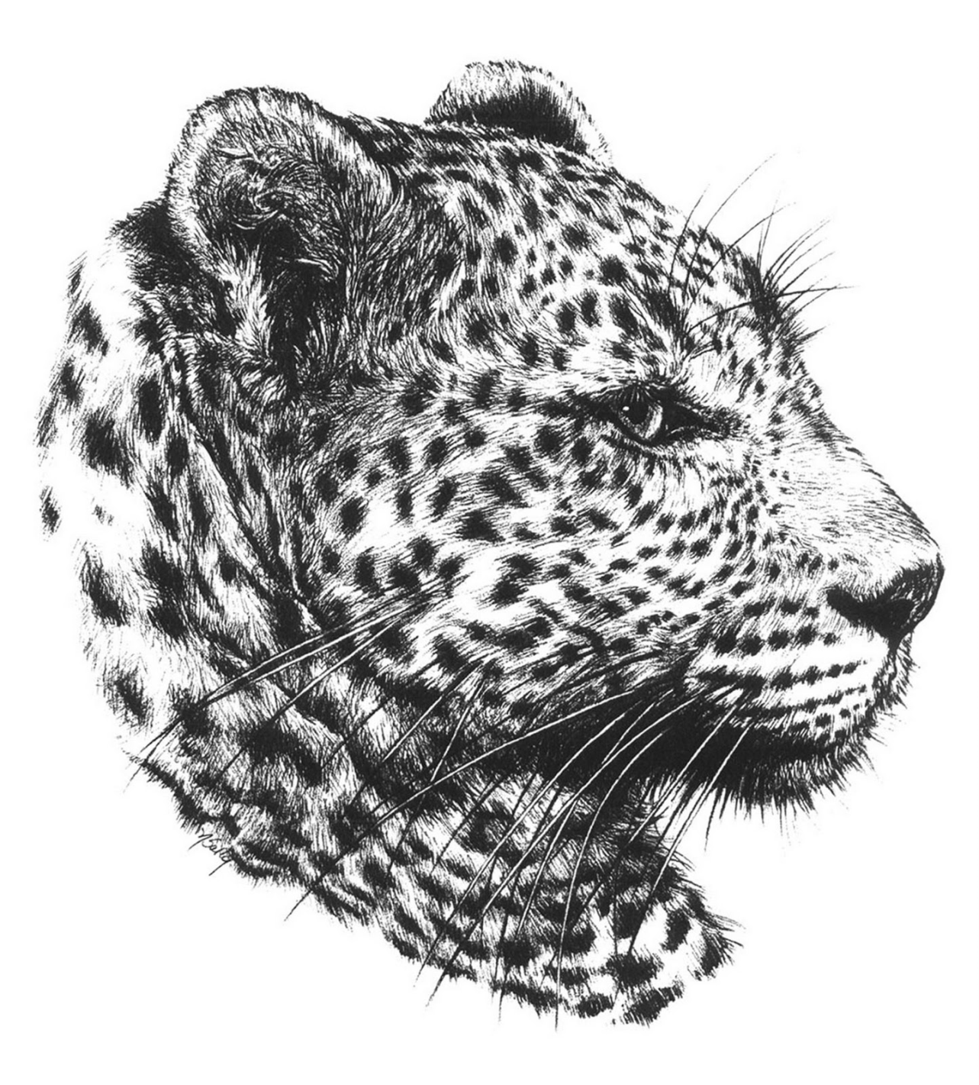
Hatching
(Incubar)

Slide 6
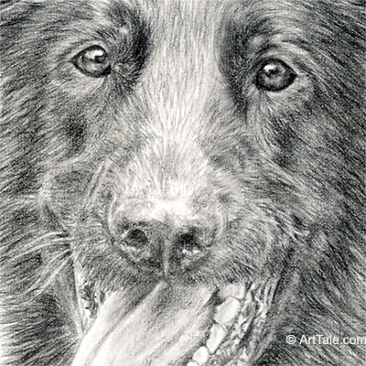
Hatching

Slide 7
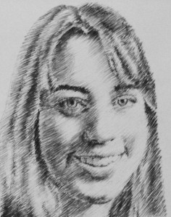
Hatching

Slide 8
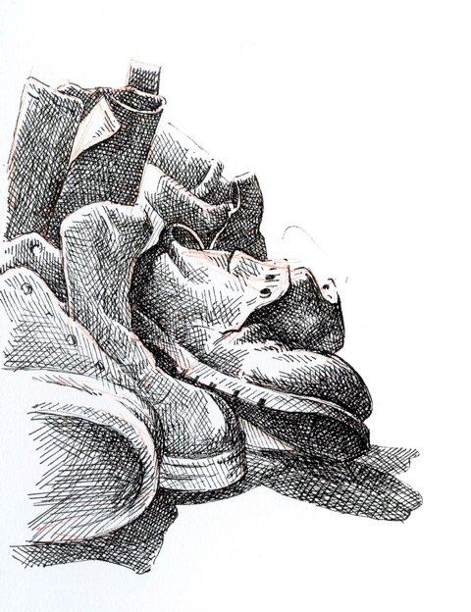
Cross-Hatching
(Línea cruzada)

Slide 9
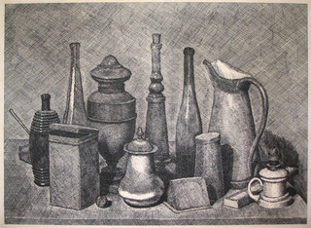
Cross-Hatching

Slide 10
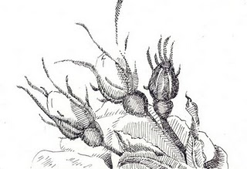
Cross-Hatching

Slide 11
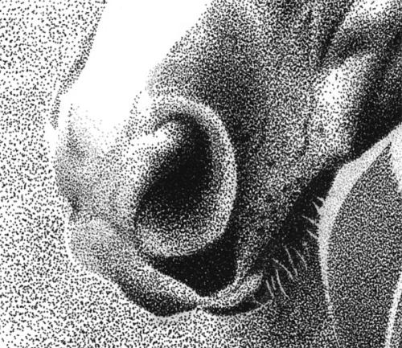
Stippling
(Puntos repetidos)

Slide 12
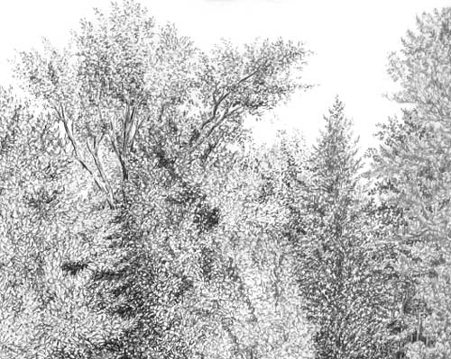
Stippling

Slide 13
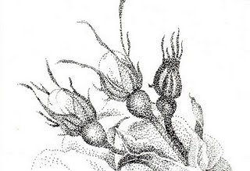
Stippling

Slide 14
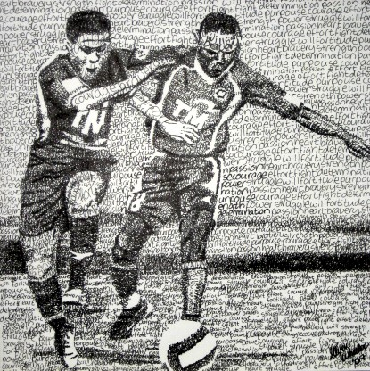
Micrography
(Micrografía)

Slide 15
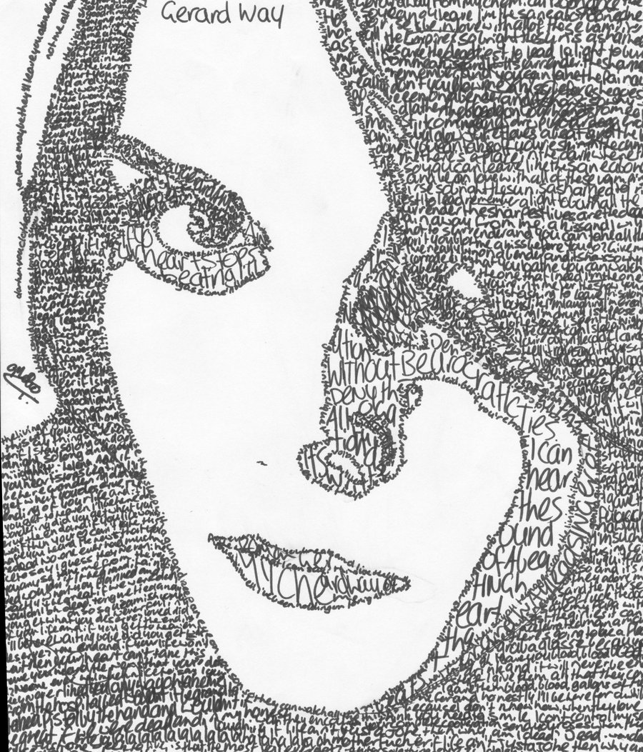
Micrography

Slide 16
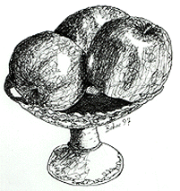
Scribble
(Garabatos)

Slide 17
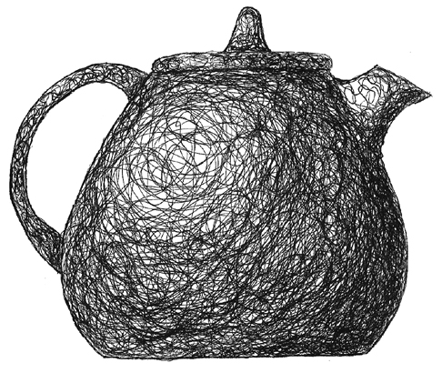
Scribble

Slide 18
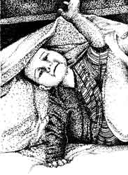
Variety

Slide 19
In Your Sketchbooks
Create 7, 3-step value scales. One for each drawing technique.
Draw 7 forms (all the same or different) 3” or bigger.
Each form needs to have one of the drawing techniques
Label each type of technique used

Slide 20
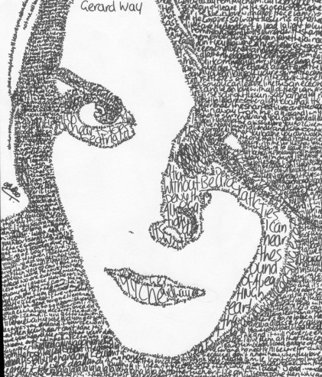
Hatching
Cross-hatching
Scribble
Micrography
Variety
Blending
stippling

